Slide 1

1st Touch Enterprise Mobile Working and Customer Self Service Solution
Winner of the 2013
NICE Best Application of Technology Award

Slide 2
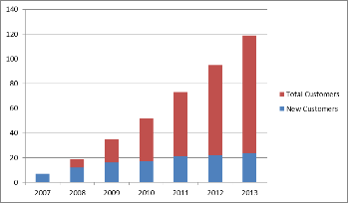
1st Touch Overview
Social Housing Pedigree:
  100 + customers
  Over 15,000 operatives
  Over 1.9 million properties managed
  50% of new contracts replace existing mobile products
  55% Market share
  Opti-Time users – 30+

Slide 3





















Sample Customers
Notes:
3

Slide 4
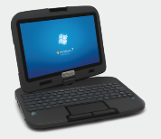
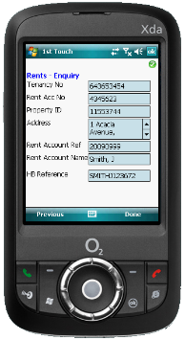
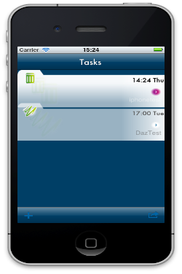
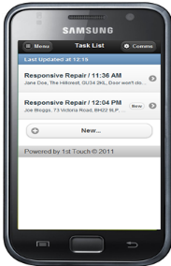
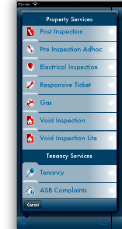



Platform / Device Agnostic
Design once, deploy to many
Collect fly-tipped rubbish from Greenfield estate,
SO16 7NP
Remove graffiti from garage block wall at Redlands, SO20 1LP

Slide 5
No Signal Working
1st Touch mobile working solutions are not web based – true offline capability
No Application Rendering – 1st Touch only pulls data
Unique “PUSH” technology - 1st Touch configured to push data at intervals (e.g. x minutes prior to a scheduled appointment).
‘Store and Forward’, facility ensures that data is transmitted as soon as connectivity is established. Data transmission is a background task without interrupting or requiring any input from the user.
Advanced algorithms to determine the largest amount of data that can be sent in one network session. Guaranteed data delivery

Slide 6
1st Touch Application Modules
Property Services
  Responsive repairs
  Voids
  Gas Servicing
  Electrical Servicing
  Pre/Post Inspections
  EPCs
  Stores & Van management
  Public buildings
  Risk Assessments
  Stock Condition Surveys
Estate Management
  Inspections
  Fly tipping
  Graffiti
  Abandoned cars
  Untidy Gardens
  Communal Repairs
  Cleaning
Tenancy Services
  Rents and arrears
  ASB
  Tenancy agreements
  Annual visits
  Resident Profiling
  Chip & Pin
Tenant Self-Service Apps
  MyTenancy
  MyProperty
  MyCommunity
Platform wide modules
  Data warehouse
  Job Point
  Timesheets
  H&S assessments
  Customer satisfaction
  Lone Worker Safety
Supporting People
  Initial assessments
  Floating care visits
  Support Care Plans
  & Reviews
Others
  Lettings
  Caretaking

Slide 7
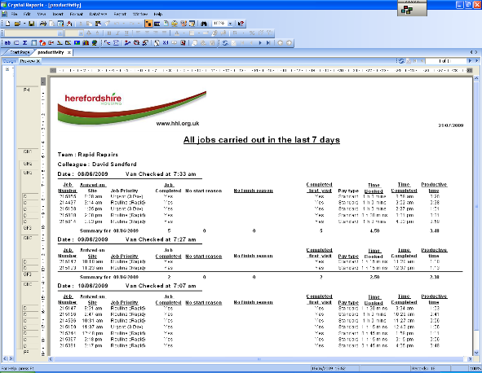
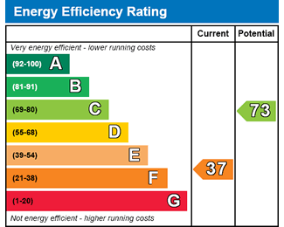

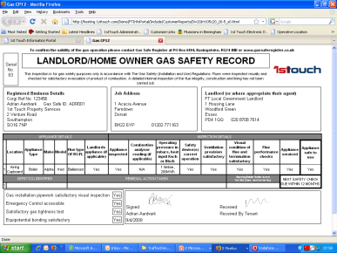
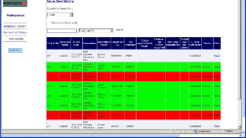
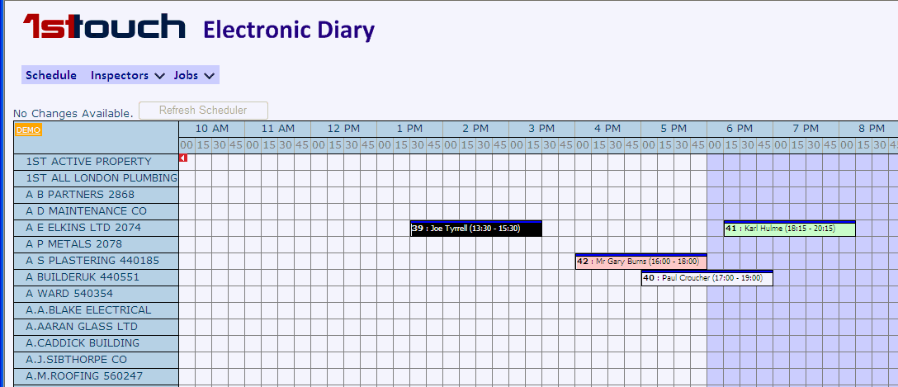







1st Touch – Solution overview
Gas
Inspection
Electrical
Certs
Pre & Post
Rents
Responsive
Repairs
Voids
EPC
Fly Tip
Supporting
people
……….
Gardens
ASB
Data
Warehouse
Diary system
Integration to
Multiple
Back office
systems
1st Touch
Mobile
Guaranteed
Secure data delivery

Slide 8
Forms and Workflow Designer - You are in control
Skills Transfer – Aldwyck can develop / modify forms and processes
Designer tool aimed at Business Analysts / super-users
No hard-coding / programming skills required
Existing forms for rapid deployment coupled with rapid customisation

Slide 9

Proven, Flexible Integration options
Scheduling Systems
Opti-time
Service Power
360
Housing Management
CRM / ERP
Aareon
Orchard
Civica
Northgate
Capita/IBS
Microsoft CRM
Navision
Sage
SAP
Oracle
^{1st Touch}
^{Integrator}
Third Party Systems
1st Touch Mobile Applications
Ready to use applications
Self generated forms & apps
ROCC
Asset Management
Outsourced Stores
Security

Slide 10
Integration Methodology Summary
1st Touch are totally flexible with regards to the solution and available integration methods.
1st Touch integration methods:
  Web Services
  APIs
  Direct database updates
  Flat file transfer e.g. XML or CSV.
  Interface tables
Enables most appropriate methodology to be selected (Aldwyck in-house capability)
Notes:
Aldwyck has the in-house capability to extract data from systems and to update information. Aldwyck are able to run SSIS packages and can script stored procedures in SQL where required, to facilitate this. Data can also be output to CSV, Excel or text files. We understand that Aldwyck can also upload (and export) files sent to as CSV, Excel or text files, for Aldwyck to then upload into their system.

Slide 11
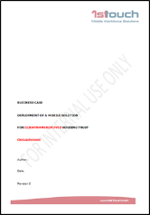
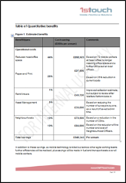
Implementation – Business Review
Business Review:
  Project Nomad
  Business drivers
  Benchmark current practises and costs
    Input from customer
    Industry standards
    Other 1st Touch customer experiences
  Identify quantitative and qualitative benefits
    Productivity improvements
    Efficiency Improvements
    Customer Service Improvements
    Cashable savings
  Point of reference
Typical outcomes:
  Reduced requirement for office space
  Reduced visits to office and time in office
  Increased productivity per field based worker
  Reduced travel resulting in fuel / mileage costs
  Potential for reduced headcount
  Reduced cost of paper, paper storage and requirement for printing

Slide 12
Increased Efficiency examples
Herefordshire Housing
  Reduced visits to HQ from 5 to 2 per week
  No of tasks / jobs per day increased by 2
  Savings in unnecessary travel of 3,500 hours (30mins per worker per day)
  Annual cashable savings of £80-90,000 per annum
Rotherham
  1.5 Million sheets of paper taken out of the process, which in turn delivered identified savings of £300,000
Across a range of customers
  Reduced fuel costs from between 15% - 25%
  Reduced admin requirements for manual input -100%
  Reduced the workload for planners - 75%
  One system “for all” reduces IT resource costs (Mobile Platform)

Slide 13
Increased Productivity examples
Powys County Council
  “Always available” technology increased operative efficiency in rural areas
  Immediate risk assessment alerts to back office reduces management response times to initiate further action
Stevenage Homes
  Personnel complete, record and notify office where additional jobs required via mobile device as part of standard process
Across a range of customers
  Operative productivity up 20 – 30%
  Clearance of jobs backlog
  Automated production of timesheets/letters/statements……..

Slide 14
Improved Customer Service examples
Coast and Country
  Right First Time Service - successful appointments increased from 14% to 75%
Northwards / Manchester Working
  Tenants more aware of job progression, feel more involved
Morrison
  SLA’s exceeded and in some areas hitting aspirational levels
  Improved communication improves tenant experience and reduces “No access” calls dramatically
Thames Valley Homes
  Information to customer service centre reduced by 3-5 days
  Contractors are then notified on Properties/Grounds/Estates
  Mobile contractor scorecards has meant a higher standard of work is delivered first time

Slide 15
Tenant Self-Service Apps - Business Value
Alternative channel & not web based
Tenant engagement
Reduce calls / contact
Reduce costs
Key is integration …
  Unique to 1st Touch solution
  Automates process

Slide 16
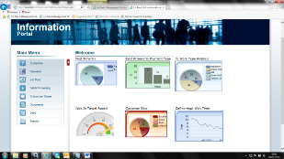
Scalability, expanding and changing with the business
Highly scalable and robust architecture:
  1,000s of users (e.g. HomeServe)
  Internally or externally hosted options
  Full resilience and DR options
Changing / Expanding:
  Implement new modules created by 1st Touch
  Form and Workflow Designer
  Development Roadmap, User Group
  Productivity Reporting, driving efficiency
  and improving customer service, “right first
  time”
Notes:
This data is collated and passed to the 1st Touch data warehouse. Aldwyck can utilise a variety reporting options and tools to integrate with the data warehouse to perform analysis to manage improvements.
Regarding increasing service improvements, the 1st Touch solution enables Social Housing to “get it right first time”. Having the right information available to Housing Officers, Repairs teams, Income managers and other employees out in the field means that more informed discussions can take place.

Slide 17
Key Functional Drivers
“Overall, the solution will be considered ‘fit for purpose’ if the following criteria is satisfied:”
Can meet the solution and security requirements specified
  Platform / device agnostic, no signal working
Has a Library of Forms capable of covering requirements specified
Provides flexibility and ease of use to enable our own staff to make changes.
Is capable of being delivered using rapid development techniques.
Can be integrated with our workflow processes and systems
Can assist in increasing service performance and reducing operational costs
Is capable of expanding and changing with the business and provides a development roadmap

Slide 18


Deployment Options
On-premise / internally hosted / Private Cloud, SAAS
1st Touch Hosting Partner –
  Founded 1999, 6,000 clients, £20 million turnover
  UK data centre providing comprehensive services
  100% network uptime guarantee
  Intelligent backup – secure, effortless full state system backups
  Proactive uptime monitoring – continuous monitoring with engineer & client alerts
  Accreditations – ISO9001, ISO14001, ISO27001, PAS2060, PCI Compliance
  Awards Internet Services Providers’ Association Best Hosting Provider 4 consecutive years and ISPA Best Business Customer Service winner

Slide 19
1st Touch Support
2nd/3rd line Support
1st Touch Diagnostics Tool
Remote Access/Device Management Tools
Investigation & Root Cause Analysis
Trend & Pattern Analysis
Skilled with 3rd Party Solutions
Multi Back Office Integration Expertise

Slide 20
Summary - Unique features
Smart client technology
  On or offline - no signal support
Device agnostic
Comprehensive integration, multiple systems
Flexible platform and existing modules
  Simple user interface
  Form Builder - no programming skills required
  Build applications in hours

Slide 21
Thank you

