Slide 1
Take on the Future Business Transformation Smarter, Better, Greater
26 February 2014
Nick Horne, CEO - Mandy Garrett, Head of IT – Chris Mocock, IT Services Manager

Slide 2
To cover…
Introductions
Take on the Future – why and how we did what we did
Critical role of IT in enabling
smarter ways of working
better tenant services
greater efficiencies
Lessons learned & key takeaways
Q&A

Slide 3
Introductions
Nick Horne: Chief Executive since 1998; Business member West of England LEP Infrastructure & Place Group, Chair Bristol Homes Commission, Committee member Social Housing Pension Scheme
Mandy Garrett: Head of IT since June 2008
Chris Mocock: IT Services Manager since January 2008
Knightstone: South West housing association covering West of England & Somerset 12,000 homes managing all tenure types. £60m turnover, 450 staff

Slide 4
Take on the future - Why?
Five drivers for change?
Old business model – 11,000 homes, 37 LAs, 7 offices
Too expensive, resources spread too thinly
Not local or large enough in too many places – Lead & Influence?
Invest more in developing new homes + individual & community empowerment
Strengthen Group financial capacity, resilience & reduce risk

Slide 5
Take on the future – What & How?
Define vision & business model
Minimum 10,000 homes – connected geography – lead or influence everywhere – more development – more community investment – great service from any location – better resident experience – single office hub & field working – 25% operating margins (up from 18%)
Deliver through workstreams – the three R’s
Refocus our heartland - Reshape our services - Refresh our ways of working
Launched June 2011

Slide 6
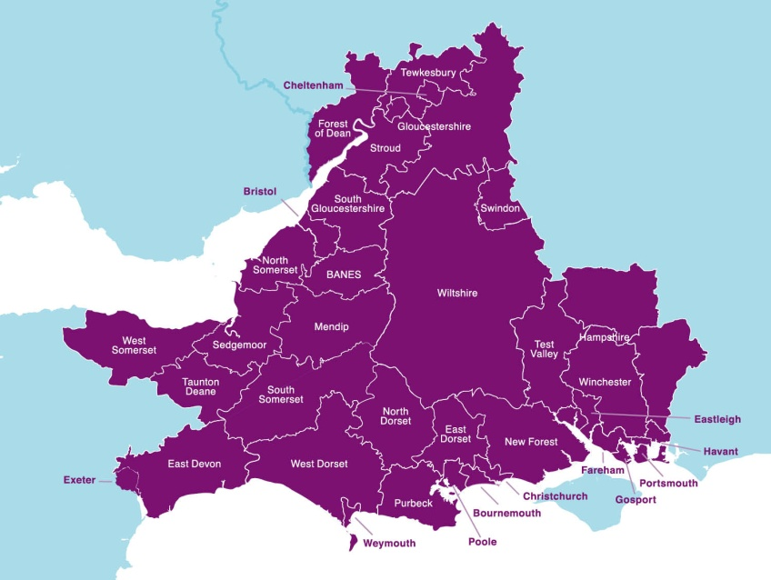
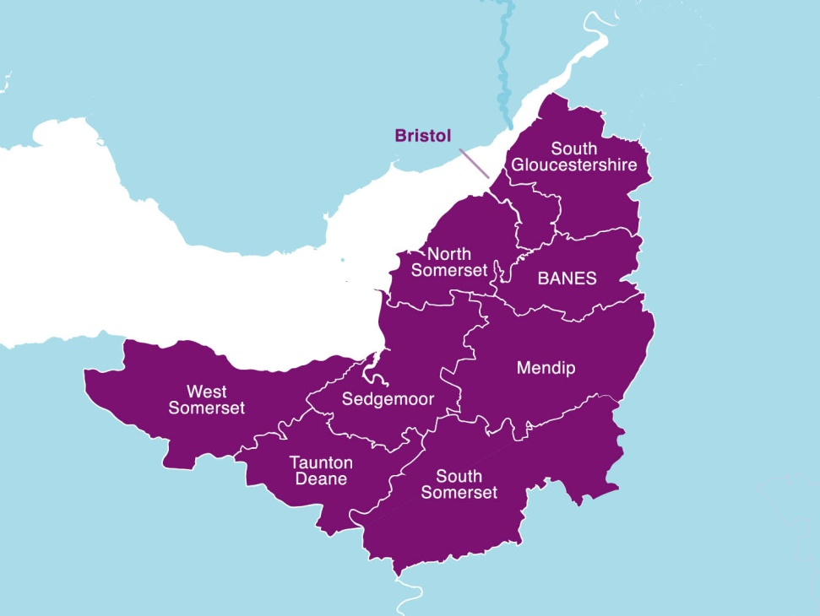
Take on the future – outcomes
Refocus - From 37 LAs to 9 in West of England & Somerset
So far 16 stock swap transactions
2,200 new homes into heartland
2,600 non heartland homes to other RPs
1,500 heartland development programme 2011-2015
Key partners - Home – Sovereign – Spectrum – BCHA – others TBA
Huge change in property portfolio, residents, staff

Slide 7
Take on the future – outcomes
Reshape – Individual & Community Empowerment Service – £2m p.a. people & places complementing landlord & property services – Customer Contact Team
Refresh – New build single office (c280)– Close six offices – Network of field based staff (c100+) and touchdown points (plus scheme based staff & DLO c80) – Invest in smart technology – new ways of working cultural changes – new branding
Four big things – communication – culture – people - technology

Slide 8
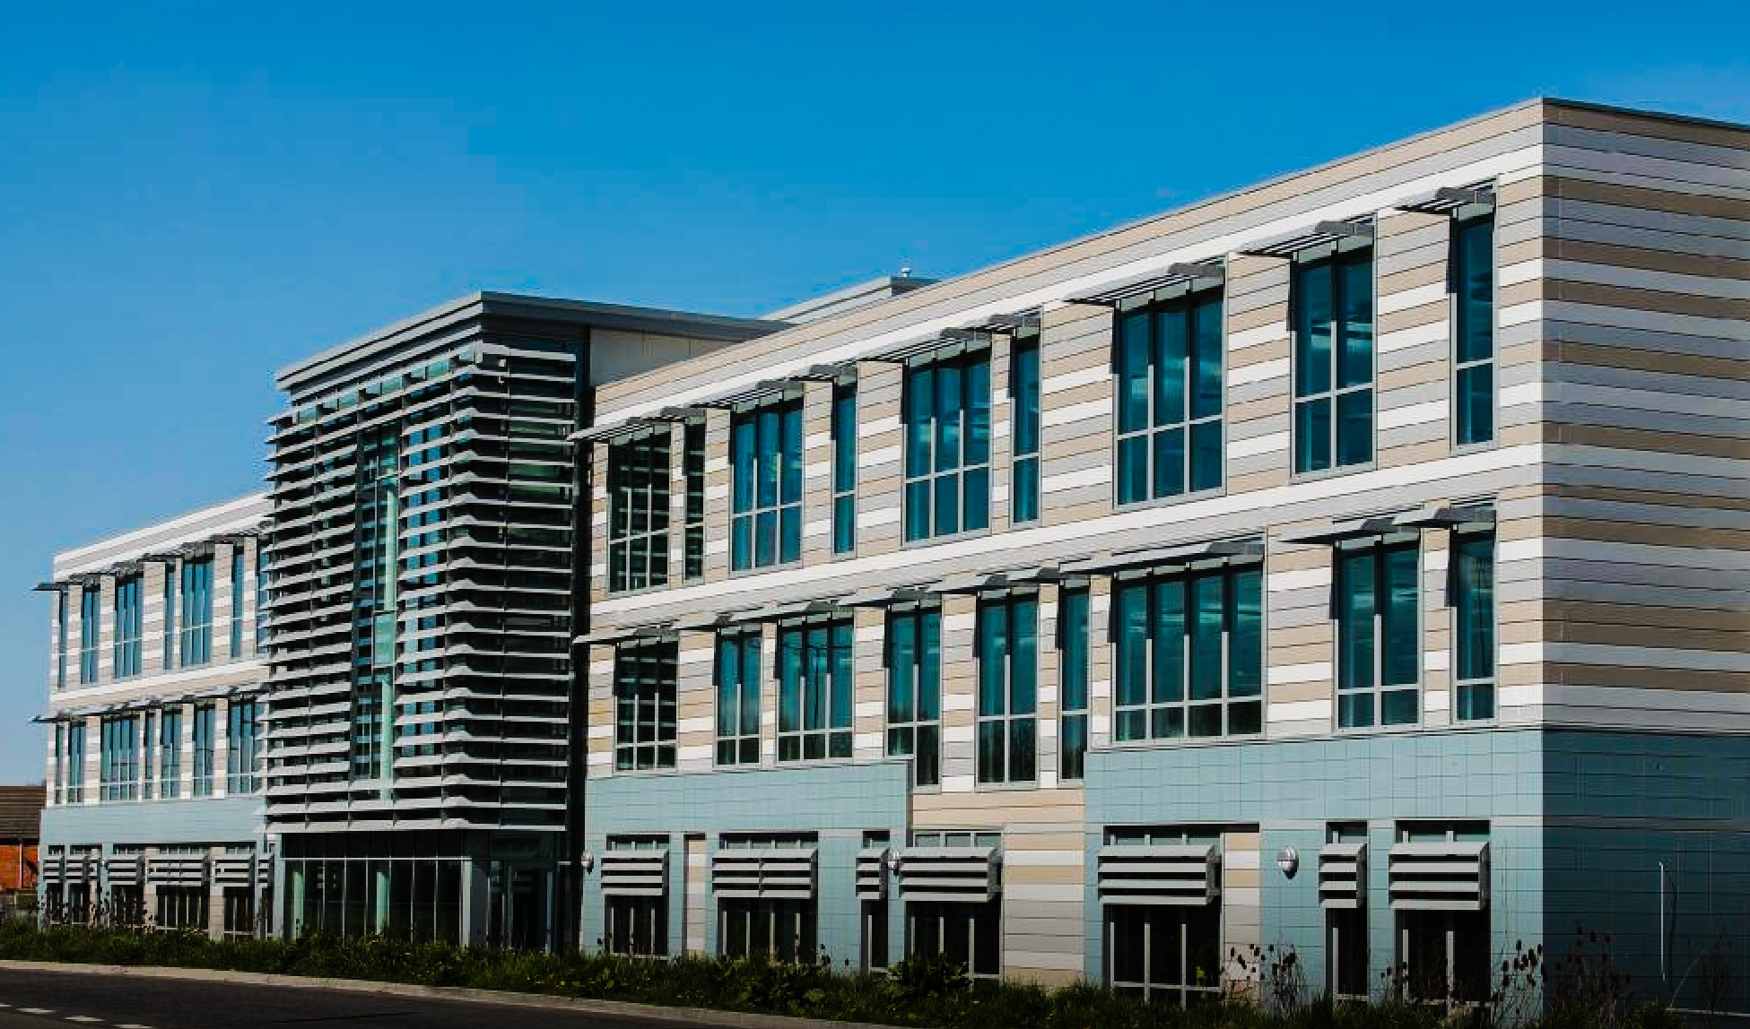
Take on the future – the single office hub

Slide 9
Setting the IT Scene
4 IT Programmes comprising over 30 projects
Built >400 laptops
Closed 7 offices
Built one new office (25 miles of cabling, 1 mile of fibre optic)
Digitalized > 200,000 paper records
Worked with > 20 suppliers
Relocated > 100 servers
£2.5m budget

Slide 10
Technology Vision
4 main programmes of work
Infrastructure
Modernise an ageing infrastructure to improve the user experience as well as increasing our capacity and resilience
2. New Office
Implement the technology to support the business vision and culture
3. Mobile Working
Giving staff the devices and connectivity for rapid access to our corporate IT resources
4. Unified Communications
Providing our staff with the means to communicate and collaborate effectively regardless of their location

Slide 11
1. Infrastructure – top 3 change enablers
Decentralised to centralised
MS Exchange
File Servers
Active Directory
Phone system and voicemail
Increase core capacity
Switches
Virtual hardware infrastructure
MPLS
Server consolidation
Hybrid cloud
Private - VMWare, Systems centre
Public - Symantec
Server footprint – physical to virtual

Slide 12
2. New Office - top 3 change enablers
Office fit-out and move
Telecomms infrastructure, cabling, Internet
Meeting room technology, staff desk prototypes, media systems, print management
Staff training – ‘moving in experience’
Wifi
Cloud based solution
Ease of provisioning
Usability
Data centre
Options appraisal for location
New kit provision into new office and business continuity implications
Relocation existing data centre

Slide 13
3. Mobile working - top 3 change enablers
Windows 8 and Direct Access
Rationale
Devices and smartphones
Pilots with staff
Coverage
Print management
Follow you printing, integrated with ID cards
3 tier billing with Xerox ColorQube
Fieldworking
Touchdown points
Places I Like to Work
CRM and SharePoint for our Business Records Centre

Slide 14
4. Unified Comms - top 3 change enablers
Providing our staff with the means to communicate and collaborate effectively regardless of their location
So we use:
Lync
Yammer
Exchange

Slide 15
Lync 2013
Lync capabilities
Presence with Outlook integration
Instant messaging
Audio and video conferencing
Desktop sharing
Lync app on smartphone
Some stats…over the last 3 months
56,000 instant messages sent and received
392 video sessions
146 desktop sharing sessions

Slide 16
Yammer
Yammer is an enterprise social network for businesses to get work done smarter and faster
Interactive
Real time
Break downs barriers
Information sharing
Flattens the corporate hierarchy
#yammerstats
381 out of 490 members are ‘engaged’
Over 11,000 messages posted since it was launched in June 2013
Over 50% of our groups are ‘active’

Slide 17
Exchange 2010
Allowed our calendar and contacts information to be integrated into Lync
Provided staff a full address lookup from our Windows 8 smartphones
Remote access to voicemail through your laptop, mobile phone or public computer
Voice recognition that reads out your calendar appointments, email messages etc.

Slide 18
Successes
Smarter ways of working
Greater productivity
More flexibility
Better work/life balance
Reliance on paper dramatically reduced
Better tenant services
Less handoffs
Better informed staff
We go to the tenants – tenants don’t come to us
Interactive website in development

Slide 19
Successes
Greater efficiencies
Saved over £0.75m in server hardware costs over 5 years
26kw per hour before virtualisation to 6kw per hour saving £16000 per year on electricity cost
Other examples
Microsoft Case Study
Shortlisted for UKHA – business transformation award

Slide 20
Lessons learned
Things take longer and cost more
Things outside of our control – accept it and work with it
Don’t assume contractors know what we want
Involve your main vendors as early as possible
Time is always in short supply, so plan where you can!
Implemented new technology but still old ways of working – caused issues
Business as usual will suffer – manage as best you can

Slide 21
Key takeaways
Align technology changes to strategic outcomes so people ‘get it’
Know your vision – everyone has an opinion
Build really good relationships with your partners and suppliers
Make sure your technology supports your culture – indeed it can shape it too!
If you give people the kit they will use it

Slide 22
A picture paints a 1000 words…
But a video is even better… ☺
Our Journey

