Slide 1
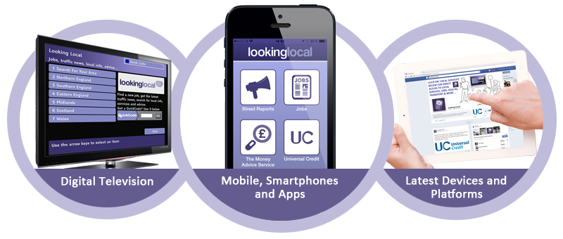
It is…
Guy Giles, Programme Director
26th February 2014

Slide 2
QUICK INTRODUCTION
It is…
One of the original e-Government National Projects – over 10 years old
Owned by Kirklees Council, not-for-profit & only available for public sector bodies
Original remit to investigate TV as a channel of digital inclusion - now publish partner content & transactional services across Sky, Virgin, mobile web, a range of Apps, games consoles
120+ local authority, health & housing partners
Collective approach to technical development
Developed by the Public Sector for the Public Sector

Slide 3
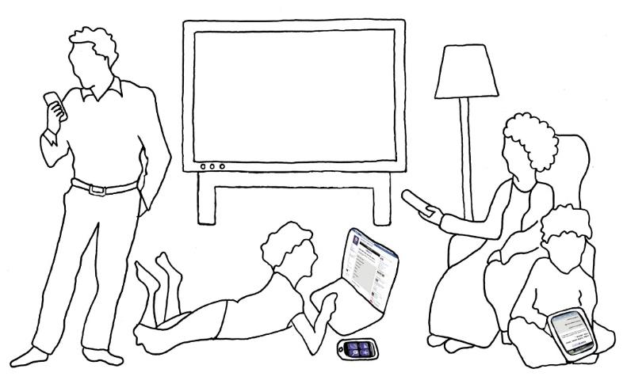
MULTI-CHANNEL BRITAIN
It is…
91% of the population
has a mobile phone
Still 7.4 million
People offline
SMART TV:
12% of homes
INTERACTIVE TV:
57% of homes
38% of homes have a games console
59% of UK adults own a smartphone
55% of adults accessing web
via mobile
30% of homes have a tablet
50% of adults used Facebook in last 3 months
Average household in UK has three devices that can connect to the Internet
72% of homes have broadband
FROM IPSOS MORI – Q4 - 2013

Slide 4
WELFARE REFORM
It is…
National Housing Federation Survey (Feb 2014)
Two thirds of housing association tenants affected by benefit cuts
Equivalent of 72,000 housing association tenants in rent arrears because of the ‘bedroom tax’ policy; 1 in 7 at risk of eviction
Housing associations with affected tenants have each spent an average of an extra £109,000 on measures such as welfare and financial advice services to mitigate the effect of the changes
National Landlords Association (Feb 2014)
50% of tenants surveyed say they’re aware existing benefits will be replaced with Universal Credit, but they don’t fully understand what it means
21% say they are completely unaware of the Universal Credit changes

Slide 5
SUPPORTING PARTNERS & TENANTS
It is…
WE CAN’T ALTER WELFARE REFORM POLICY…
…BUT WE CAN HELP PARTNERS SUPPORT TENANTS IN THIS TIME OF CHANGE
Working with the DWP and The Money Advice Service to deliver a national, multi-channel solution for Universal Credit claimants on their preferred digital device or channel
Helping partners use welfare reform to change tenant behaviour and push digital channels; TV, apps, social networks, mobile & even games consoles

Slide 6
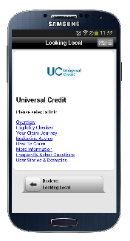
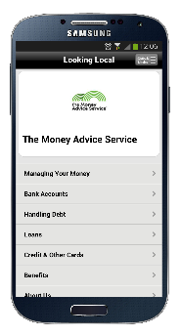
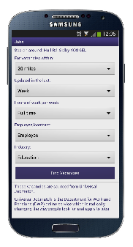
TAKE-UP
It is…
UNIVERSAL CREDIT
Access to Universal Credit information and eligibility checking, reassuring claimants as to when and how they will be affected
Oct 2013 -Jan 2014
Over 1,000 eligibility checks
50,000+ hits
JOBS
Real-time access to Universal Jobmatch: 105,000 jobs viewed via Looking Local channels in January alone
FINANCIAL ADVICE
The latest financial and consumer advice from The Money Advice Service
Information & guides covering bank accounts, handling debt, types of borrowing, benefits & entitlements, credit cards/store cards, budgeting, overdrafts & more

Slide 7
IMPROVING TENANT ACCESS & SERVICES
MY LANDLORD APP
Smartphones are the major tool in driving change in tenant access behaviour; most popular device
In-built housing repairs
Management portal & push messaging
Integration capabilities
National partners: UC, UJ, MAS, NHS Choices, Transport Direct, CBL, Timebanking, Credit Unions etc
Proven savings
Reduction of up to 80% in transaction costs
Improved tenant communication
Reduced time for housing repairs
No capital investment, no running costs
Notes:
7
7

Slide 8
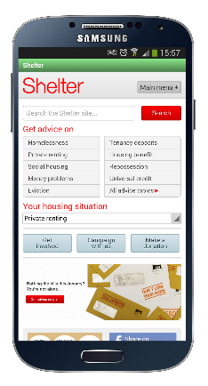
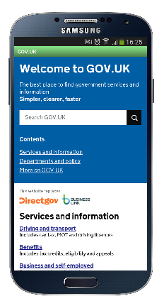
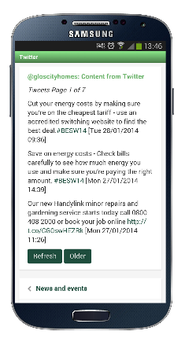
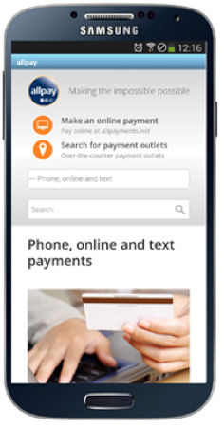
LINKING TO MOBILE & APPS
Linking to mobile optmised content/services from trusted third-party websites, allowing a wider set of services to be delivered by the app:
Services offered by suppliers: e.g.: Payments
National housing services: e.g. Shelter, advice from .GOV.UK or your local authority partner
Facebook & Twitter: keeping your tenants up to date with your news & information
Notes:
8
8

Slide 9
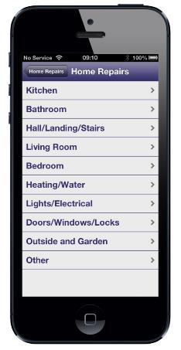
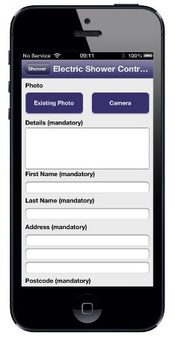
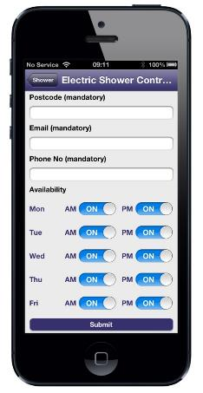
HOUSING REPAIRS
HOUSING REPAIRS
Housing repairs feature allows reports to be sent in with an image, detail, the tenants availability as well as any comments. Communication is then undertaken within the app – no other channel required
All reports can be handled within the management portal
Integration opportunities with existing repairs systems
Notes:
9
9

Slide 10
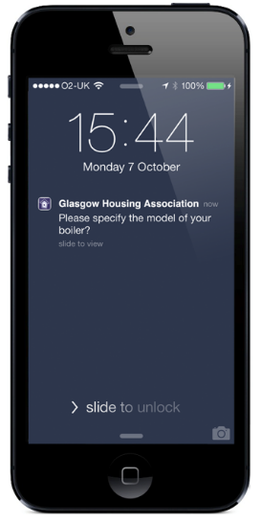
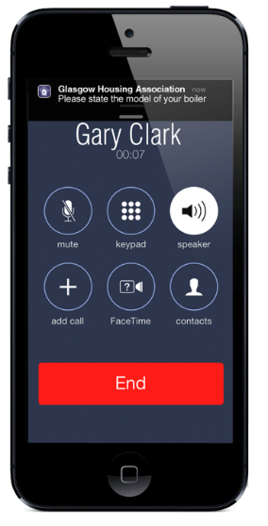
PUSH MESSAGING
Push messaging is managed via the My Landlord management portal
Every message appear in full on the home screen – or as a received message which needs to be viewed /cleared if the phone is in use
Valuable for questions, appointment reminders, updates
Gives feedback and rating capability following the repair
By ensuring availability & having a quicker conversation, repair scheduling can be better managed
Push Message when
phone off
Push Message when
phone in use
Notes:
10
10

Slide 11
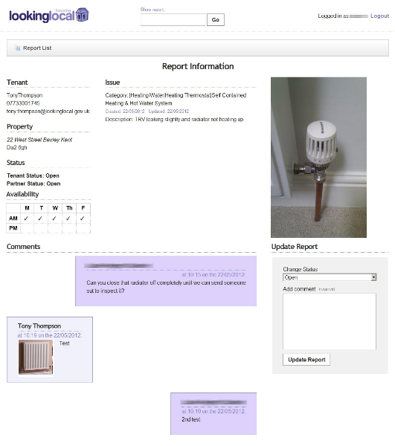
MANAGEMENT PORTAL
My Landlord Management Portal
A simple intuitive web portal allowing repairs management and communication
Email notification when reports are submitted
Individual report tracking capabilities
When a report is received it shows images, detail of the issue, availability, tenant details and comments
Communication is enabled within the portal and can be seen in one view
Export and integration capabilities
Notes:
11
11

Slide 12
INTEGRATION
MEARS – first to complete full end-to-end integration
Will go live at Epping Forest in March 2014
Real time bookings
Push messaging integration
No additional costs
Notes:
12
12

Slide 13
MEET JOE B. LOGGS
21 years old
Good tenant
In arrears
Recently unemployed
Impacted by Welfare Reforms
Needs help & support
What can you do?
Notes:
13
13

Slide 14
CURRENT STATUS QUO
Maintain your own database of information, services, and support groups.
This carries extensive ongoing resource efforts and historically stagnates as the data within it becomes out of date and lacks the richness and personalization that people now expect from an online experience.
Nor does it tap into the smaller community run support groups who choose to engage with social media as a means to communicate and support each other.
Top down, ‘build and they will come’ mentality
Notes:
14
14

Slide 15
CURRENT STATUS QUO
Notes:
15
15

Slide 16
CURRENT STATUS QUO
Notes:
16
16

Slide 17
AGORA
Local &
National
Local & National databases of support services e.g. LA, CCG, UC, UJ
Separately managed listings for voluntary sector services, schools, centres, groups etc
Local & national groups who can support different needs with physical meetings
Access to Facebook groups with special interest in relevant issues and virtual support
Your website
Video content – can include local videos
Information on issues, careers, law, support & more

Slide 18
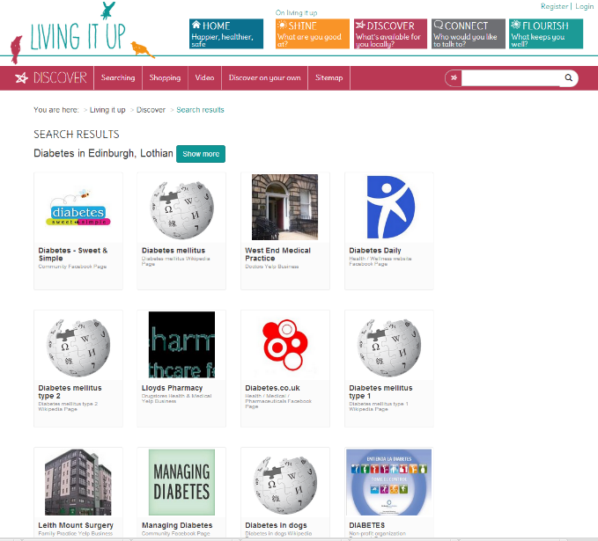
AGORA IN ACTION - DIABETES
Notes:
18
18

Slide 19
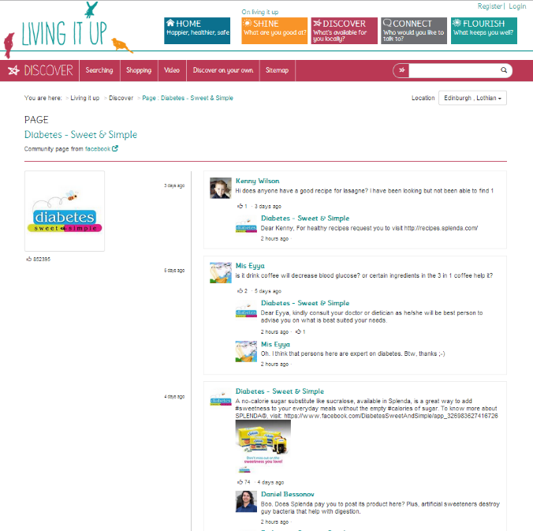
AGORA IN ACTION - DIABETES
Notes:
19
19

Slide 20
BENEFITS
It removes the need for the resource intensive content management effort that many organisations are struggling with.
Taps into the small community run support groups who choose to engage in social media as a means to communicate and support each other.
It gives everyone access to information that currently is only available to those that have an identity on social media.
The solution highlights the areas where the target audiences’ needs are not being met to allow those gaps to be filled. Helps ensure internal resources are better focused on areas of need.
Notes:
20
20

Slide 21
Guy Giles
Programme Director
email: guy.giles@lookinglocal.gov.uk
tel: 07973 909663
web: www.lookinglocal.gov.uk

