Slide 1


Slide 2
Insight & Demand Led Housing Management

Slide 3
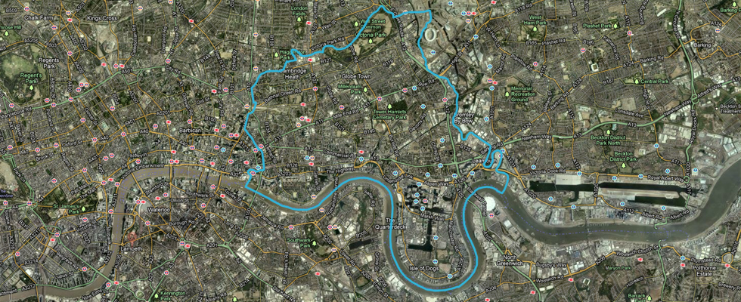
TOWER HAMLETS: CONTEXT

Slide 4


Slide 5
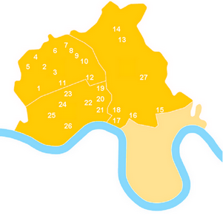
22,000 Properties
45% Leasehold
27 Neighbourhoods
77% Satisfaction

Slide 6
The THH Context
1
if Tower Hamlets Homes was 100 residents
⓪①⓪①⓪①⓪①⓪①⓪①⓪①⓪①⓪①⓪①
⓪①⓪①⓪①⓪①⓪①⓪①⓪①⓪①⓪①⓪①
⓪①⓪①⓪①⓪①⓪①⓪①⓪①⓪①⓪①⓪①
⓪①⓪①⓪①⓪①⓪①⓪①⓪①⓪①⓪①⓪①
⓪①⓪①⓪①⓪①⓪①⓪①⓪①⓪①⓪①⓪①
41 would be Bangladeshi
39 would be other Black and Minority ethnic groups
20 would be White British

Slide 7



ICT in THH
1
SLA with parent Council
Working with an Outsourced Provider
Shared systems requiring PSN compliance
In-House Development Methodology following ITIL Best-Practice
Initiate
Build & Test
Deploy & Review
Design

Slide 8




ICT in THH
1
Core Housing Management System
EDRMS, Contact Management
Asset Management
Self-Service Portal

Slide 9

Systems Thinking Review: Rents

Slide 10

Rents
2
Introduction to Systems Thinking – Vanguard
Resourced in-house
Pre-welfare reform
Service improvement driven
Approach:
  Customer satisfaction survey
  Demand analysis
  Data analysis and insight
10

Slide 11
Demand Analysis
2
Inbound demand
Based on 956 inbound calls over a ten day period
11

Slide 12
Demand Analysis
2
Breakdown of
Value Demand
12

Slide 13
New rent accounts balances
2
13

Slide 14
Response
2
Rent account sign-up as close to tenancy sign-up
Benefits and repayment calculator (Excel)
Promotion of enrolments to SeeMyData
Migration of general rent enquiries to call centre
Changes to Northgate Sx3 arrears escalation policies
Understanding of customer payment patterns and not just arrears level
Big Lottery Fund: Getting on with Money - Project
14

Slide 15
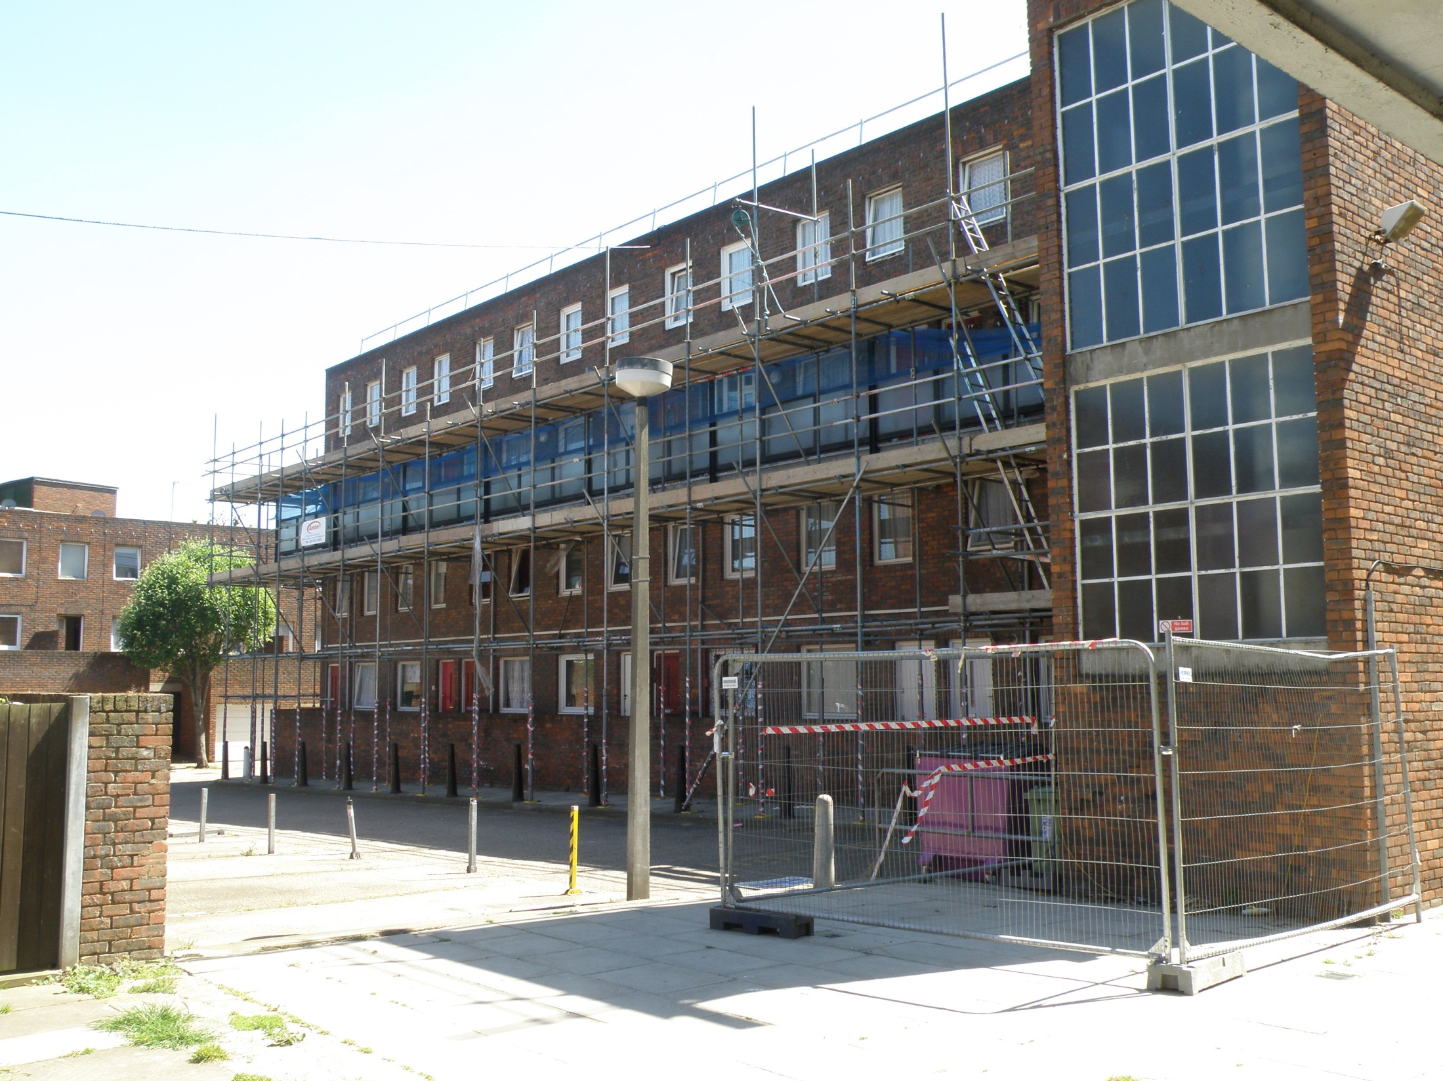
Improving Asset Management

Slide 16
Asset Management
3
Old, bespoke IT systems
Heavy reliance on manual processing
2013-16: Decent Homes Programme
Organisation Wide Approach
Approach:
  Requirements Capture
  Procurement
  Business-led Implementation

Slide 17
Asset Management
3
First major system procurement and implementation with Agilisys
Keystone selected as preferred supplier:
  Asset Management (KAM)
  Planned Maintenance (KPM)
  Asbestos Register (KAR)
  Servicing & Inspection (KSI)
Agile implementation:
  KPM live within two months to support Decent Homes
  KAM & KAR took longer – data!
  Service-led review of servicing and inspection

Slide 18
Asset Management
3
Efficiency and accuracy gains in Decent Homes delivery
Improved Customer Communications
  Kiosk Deployed to All Staff
  Integrated with Public Interactive Map
Flexible working opportunities
Savings opportunities:
Type of Benefit | Estimated Saving
Cost Avoidance | £580,000
Reduced Wastage | £300,000
Revenue Management | £100,000
Productivity Gains | £10,000
Total | £990,000
Notes:
Comms – Kiosk Deployment – integration with DH Map

Slide 19
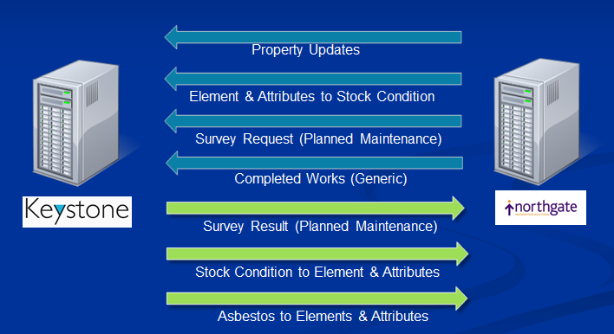
Asset Management
3
Ensuring integration with existing infrastructure

Slide 20
Asset Management
3
Improved management of Planned Maintenance, including Decent Homes
Clearer and more widely-accessible asbestos survey information
Further opportunities:
  Rollout of mobile surveying solutions
  Increasing assurance of servicing and inspection compliance to Board
  More accurate long-term investment planning

Slide 21
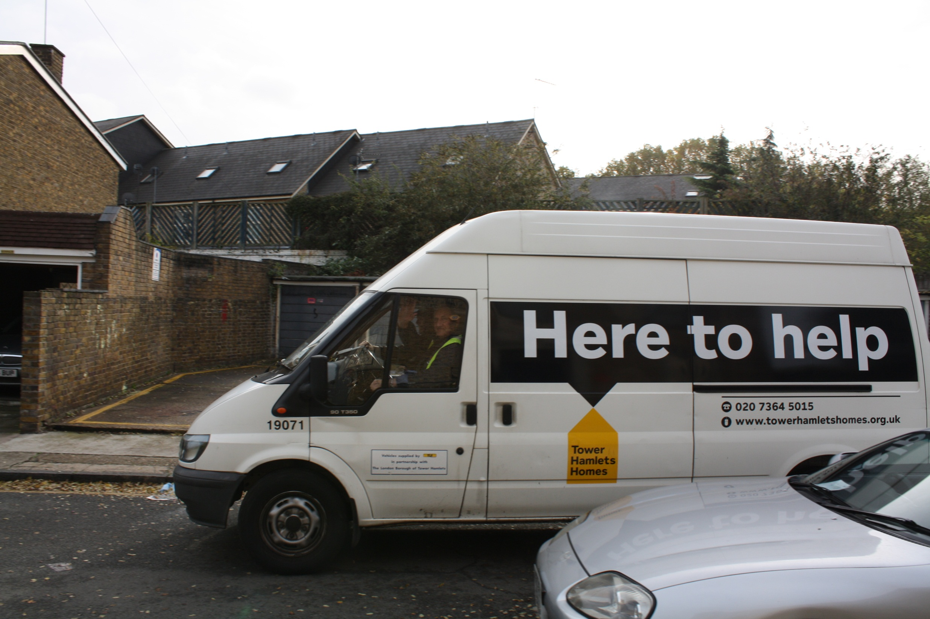
Improved Ways of Working

Slide 22
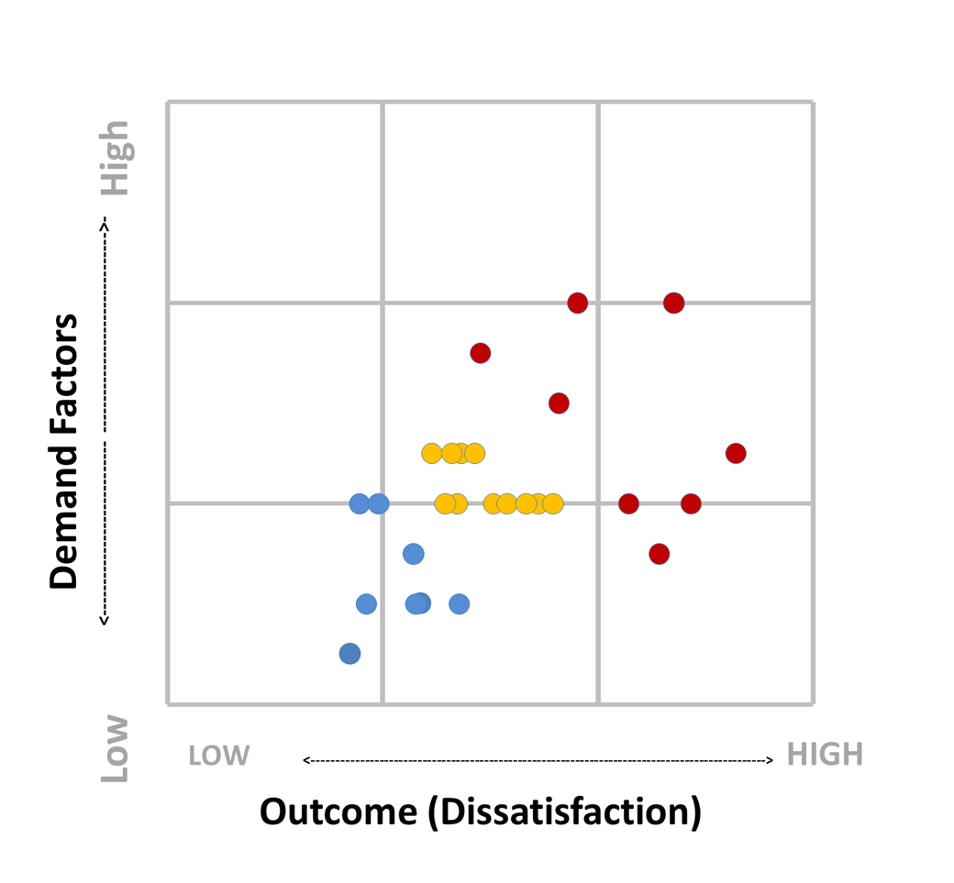
Insight-led
4
There are different levels of risk in each neighbourhood and these affect satisfaction

Slide 23
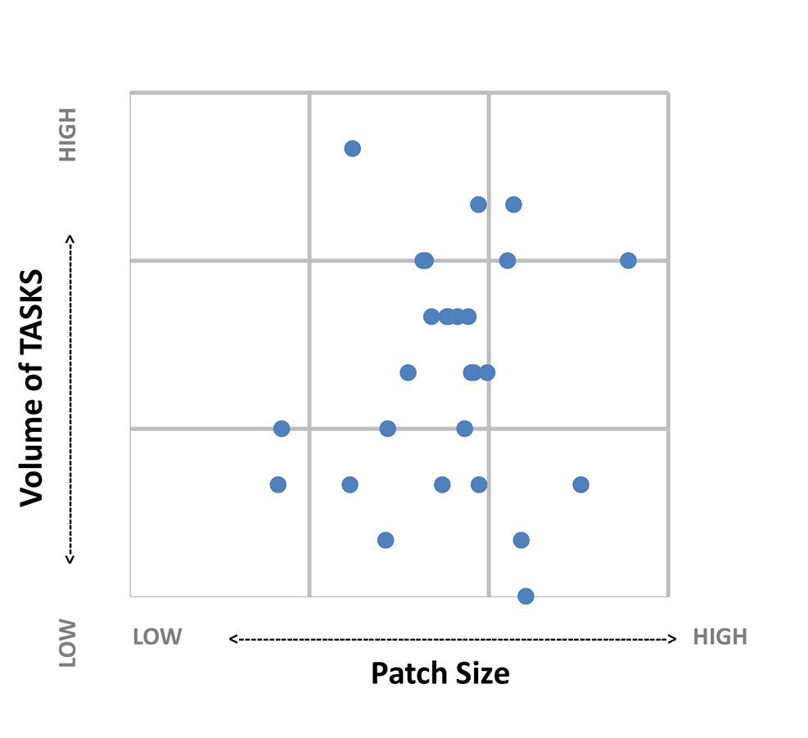
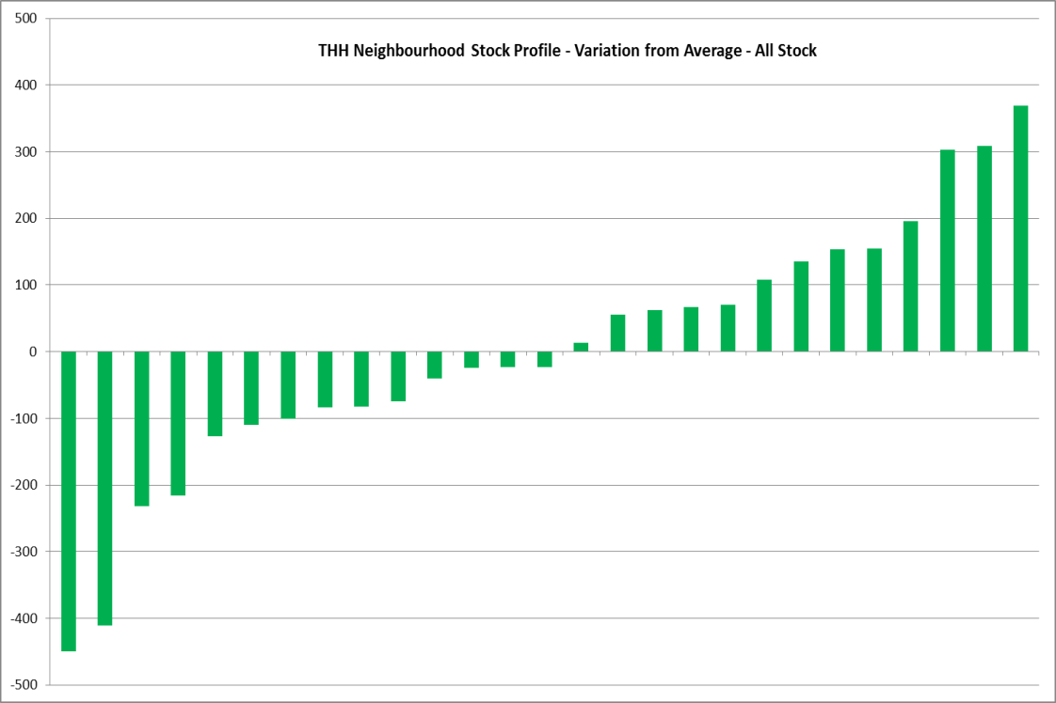
Insight-led
4
Variation in patch size but no correlation between patch size and activity

Slide 24
Insight-led
4
Large variation in satisfaction with caretaking service across our Neighbourhoods

Slide 25
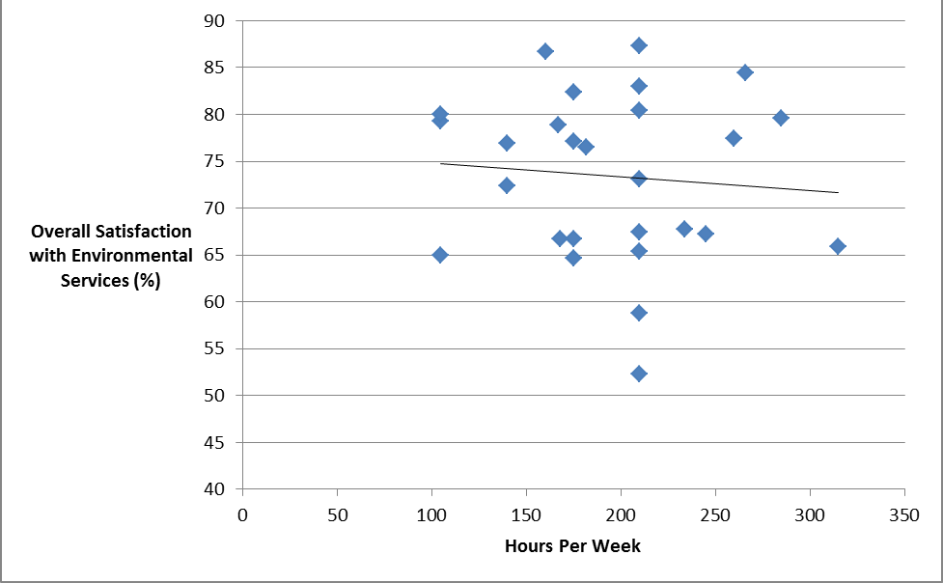
Insight-led
4
There is no correlation between hours spent on a block and the rate of satisfaction

Slide 26

Insight-led
4
Different levels of risk in each neighbourhood affect satisfaction
Low risk
Low demand
High Satisfaction
Low risk
High demand
Medium Satisfaction
High risk
High demand
Low Satisfaction

Slide 27
Demand-led
4
Allocation of resources will depend on need, not geography
From generic roles to specialist teams
Removing ‘Single Points of Failure’
Continuous service improvement
  Insight-led
  Performance driven
  Planned, not reactive

Slide 28
I ♥ MY
HOUSING
OFFICER
Notes:
Insight takes you so far, but…
Data vs Emotion

Slide 29

Summary

Slide 30
Summary
5
Continuous improvement rather than transformation led
  Focus on leveraging existing applications rather than new applications
There are limits and constraints to Insight-Led Housing Management
Best results where ICT development and some business process change introduced concurrently
Notes:
However, what got us here won’t get us there…

Slide 31
Questions?

