Slide 1
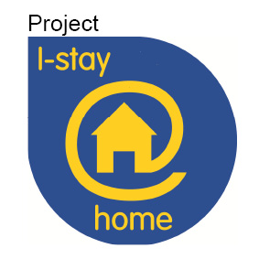
I-stay@home:
ICT Solutions for an ageing society

Slide 2
I-stay@home Project
3 Year European Project to investigate how ICT can help support elderly and disabled with challenges:-
Isolation
Security
Health
Financial
Disability
Independent Living
Notes:
We have massive financial and corporate backing.

Slide 3
What is I- Stay at Home about ?
Josephine Lambert, 76 years old:
“Even though all these technical devices scare me a bit, I will try to test some of the solutions in my home. Life is getting harder for me since I am not becoming any younger, but I do not want to leave my home, I have lived there for almost 30 years now. I hope there will be ways for me to avoid the retirement home in future. Leaving my home scares me more than the technical equipment.”

Slide 4
Ageing Populations
According to EU’s 2012 Ageing Report, by 2060:-
Small population rise to 517m (from 502 in 2010)
15 – 64 yr olds decline from 67% to 56%
65 and over increase from 17% to 30%
Significant impact on economies & welfare across Europe
Notes:
We have been around a very long time.
We have established a very strong pedigree.

Slide 5
I-stay@home project
I-stay@home project (2012-2015) is being part funded by the EU via the European Regional Development Fund Interreg IVB programme.
INTERREG IVB North West Europe (NWE) Programme is a financial instrument of the European Union’s Cohesion Policy.
Over seven years the programme is investing €355 million from the European Regional Development Fund (ERDF) into the economic, environmental, social and territorial future of North West Europe (NWE). The fund is used to co-finance projects that maximize the diversity of NWE’s territorial assets by tackling common challenges through transnational cooperation.

Slide 6
The Partners
Lead Partner: Joseph-Stiftung, Bamberg, Germany
De ideale Woning c.v., Antwerp-Berchem, Belgium
EBZ Business School, Bochum, Germany
Foundation Smart Homes, Eindhoven, The Netherlands
Habinteg Housing Association Ltd, London, United Kingdom
Le Foyer Rémois, Reims, France
Rheinwohnungsbau GmbH, Düsseldorf, Germany
Staedion, The Hague, The Netherlands
SOPHIA living network GmbH, Bamberg, Germany
Vilogia, Villeneuve d'Ascq, France
Volkshaard cvba, Ghent, Belgium
De Woonplaats, Enschede, The Netherlands

Slide 7
The IT Partners
Aareon France SAS, Meudon la Forêt, France
Subpartners of Aareon France:
Intent Technologies, Paris, France
Isen Ecole d‘Ingenieurs, Lille, France

Slide 8
Europe's Largest Systems Provider to the Property Sector

Slide 9
Benefit from Best Practice Shared Across European Housing Sector
Proven
Resourced
Financially Secure
Over 2,800 Customers / 110 in UK
Over 9 Million Units of Rental Stock / 600,000 in UK
Over 1,100 Employees / 97 in UK
20 European Offices / 3 in UK
2013 Revenue of €173.4m / £11.6m in UK
2013 Ebit of €27.11m / £2.4m in UK

Slide 10
Products to be tested / incorporated in ISAH
WITHINGS Smart Body Analyzer WS-50
Vivago Watch
SOPHITAL®
MiBida
iRobot Roomba®
WITHINGS Pulse (O2)
ComﬁCare
Lightwave RF
Ucam247 Outdoor WiFi IP Camera

Slide 11
Products to be tested / incorporated in ISAH
Stove Guards - SAFERA Siro R Stove Guard
Innohome Stove Guard Kit SGK500-3CC
WITHINGS - Wireless Blood Pressure Monitor
Salveo
Tabtime Med-E-Lert
GEOCARE®
Sybility Voice Control –PilotOne
En:key

Slide 12
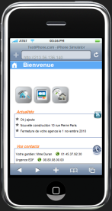
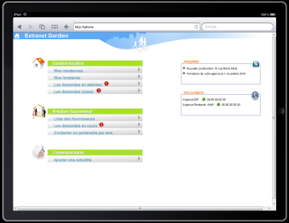
- ISAH ICT PLATFORM
ISAH ICT Platform
Claims and demands
Health and care services
Multimedia sharing : documents, videos, pictures…
Safety and privacy
Service provider
N°1
Household and provision
Social Market place : Elderly people submit demands and other tenants offers their services or help
Energy efficiency
Service provider
N°n
Text and Video chatting
Communication
Housing ICT SYSTEM

Slide 13
Timetable : The project will run from 2012 till 2015.
During this time, the partners will together deliver four phases of work:
1. Identify and consider the core concerns of older and disabled people in terms of their ongoing independence at home (2012).
2. Make a pre-selection of affordable ICT based products and services that are currently available (2013).
3. Live test the selected solutions in about 200 homes of tenants from the participating housing organizations (2014).
4. Publish details of the products and services via a database platform to make them better available for the elderly tenants and housing providers (2015).

Slide 14
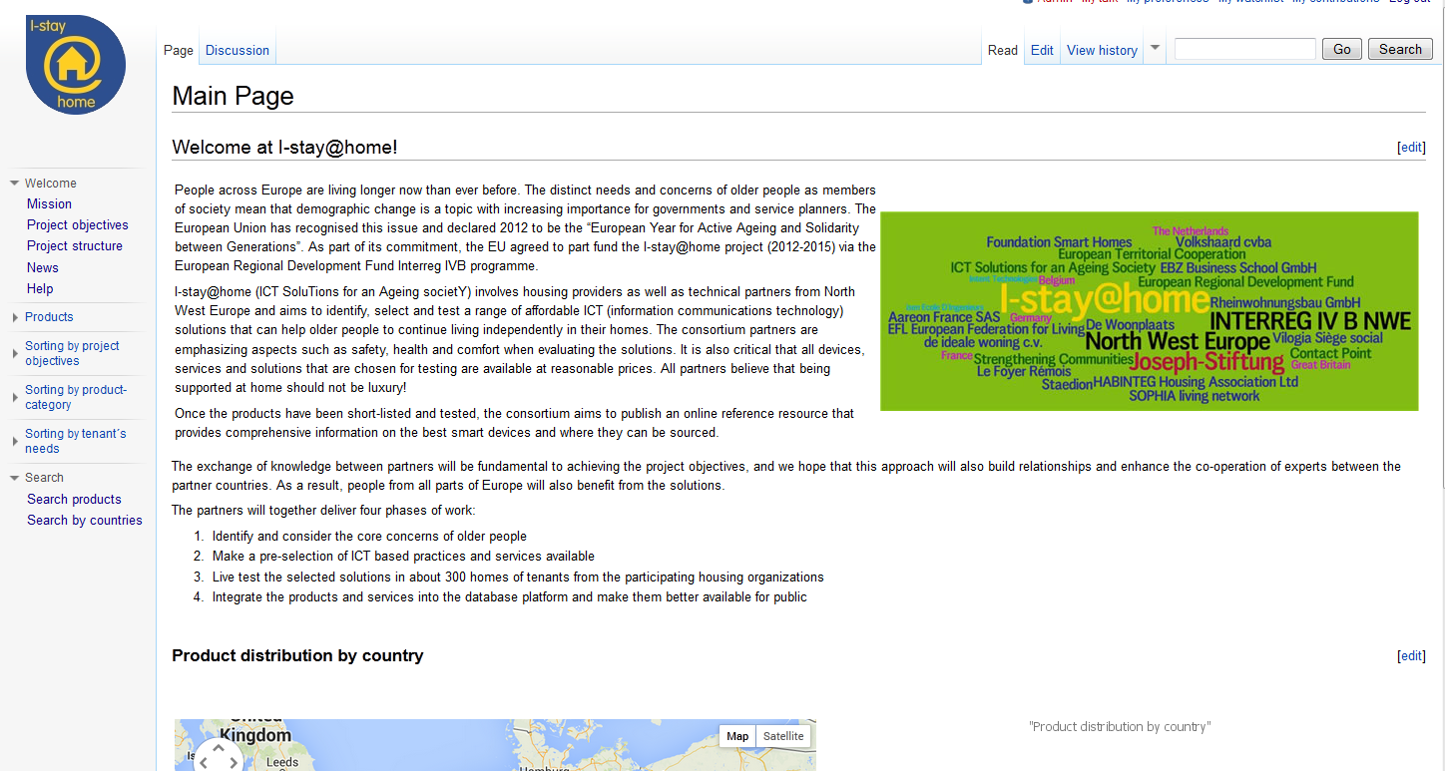

Slide 15
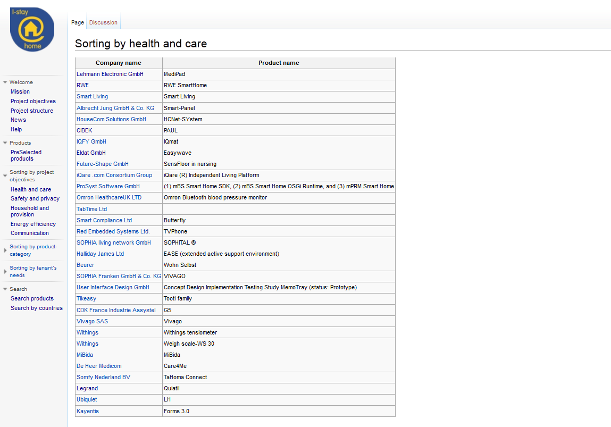

Slide 16
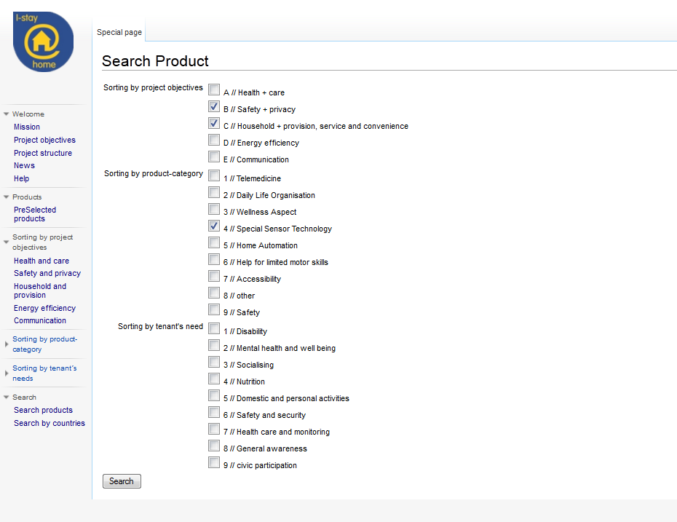

Slide 17
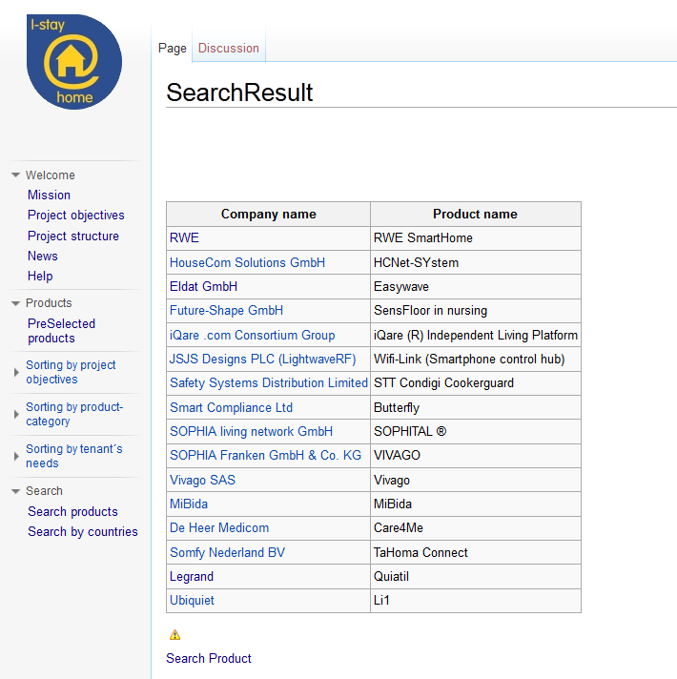

Slide 18
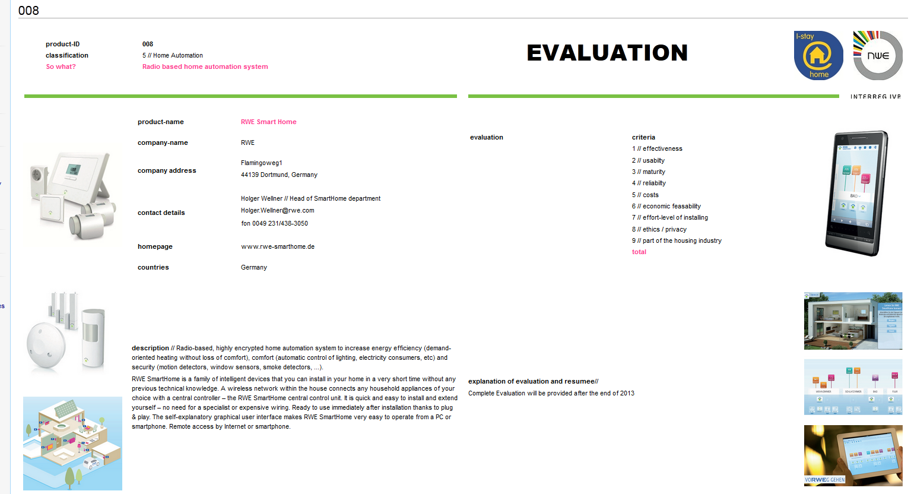

Slide 19
I-stay@home Project
3 Year European Project to investigate how ICT can help support elderly and disabled with challenges:-
Isolation
Security
Health
Financial
Disability
Independent Living
Notes:
We have massive financial and corporate backing.

Slide 20
I-stay@home Project
Four Phases
Research into challenges faced and attitude to technology
Evaluation of available technologies to assist
12 Month Pan-European test of solutions in tenant’s homes
Project Evaluation
Notes:
We have massive financial and corporate backing.

