Slide 1

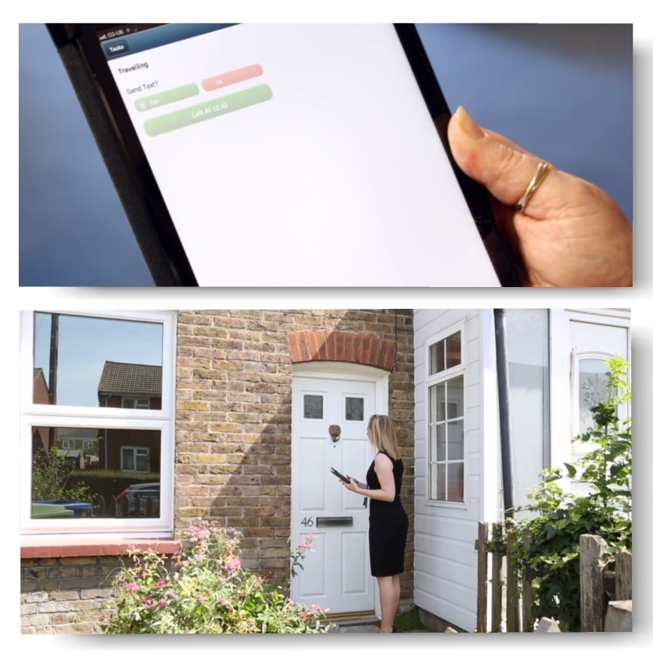
Making homes, helping people
How to design mobile solutions
to improve customer service and efficiency
Robert Stewart
Business Systems Manager
www.amicushorizon.org.uk

Slide 2

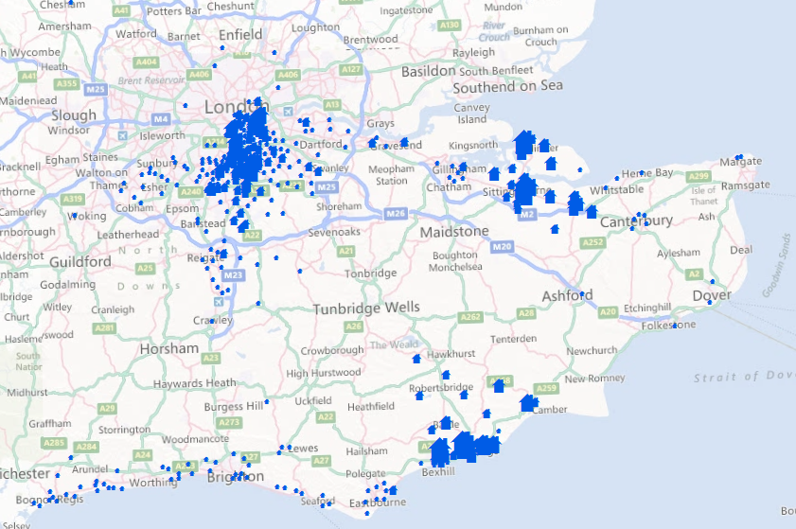
Our 28,000 homes
Making homes, helping people

Slide 3
What we wanted from going mobile
Making homes, helping people
Increase satisfaction
  Get things right first time
  Provide greater levels of service
Improve consistency and efficiency
  Give people the best information
  Familiar look and feel
Return more value
  Greater value from each visit
  Allow us do more visits (less trips to the office)
  Have less aborted visits
Continuously improve
  Learn from feedback
  Learn from other projects or services

Slide 4
Building Apps for Mobile Working
Making homes, helping people
Demo
www.amicushorizon.org.uk

Slide 5
Building Apps for Mobile Working
Making homes, helping people
How we do it
www.amicushorizon.org.uk

Slide 6
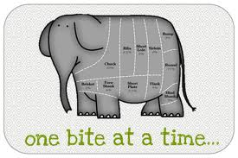
Our process
Making homes, helping people
Discovery
  Go and see for yourself – shadowing
  Evaluate core system usage
  Workshop
  Process Maps
  Scope
Agile like development
  Prototyping
  Release management
  Feedback collection
  Iterative improvement

Slide 7
When we visit a home
Making homes, helping people
We need to know or say:
Where when why
Contact warnings
Visit needs
We are on our way
We have arrived
Got access
Visit summary
Contact details
Background menu
These are…
INFO
Form Design
Components
INFO
INFO
TRAVEL
TRAVEL
ACTION
INFO
INFO
NAVIG

Slide 8
Form Design Components
Making homes, helping people
They can be:
  Functional (Travelling)
  Navigational (Menus)
  Information (Background)
  Purpose driven (Actions)
  Confirmation seeking (Signature)
Components are: Read only; Write Only; Both

Slide 9
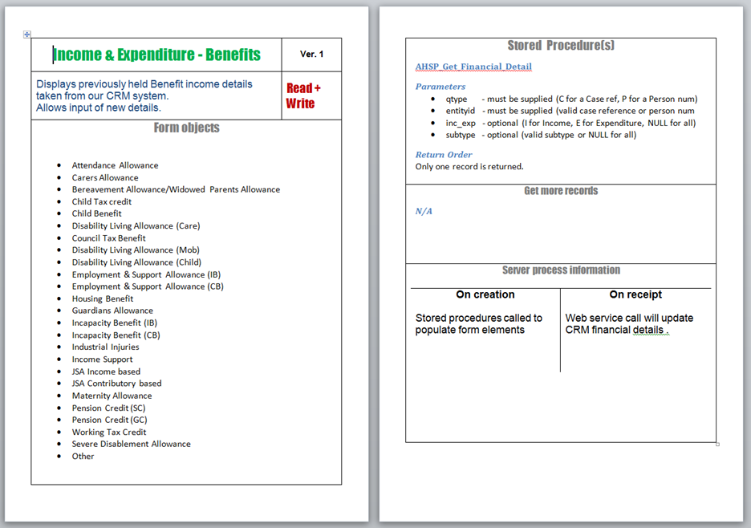
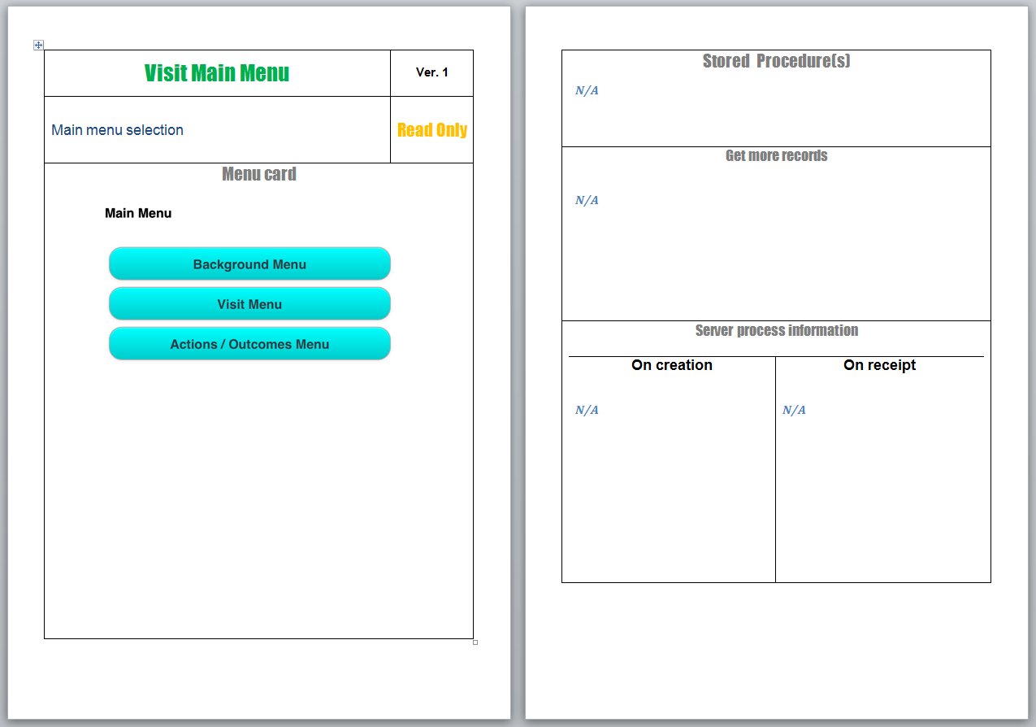
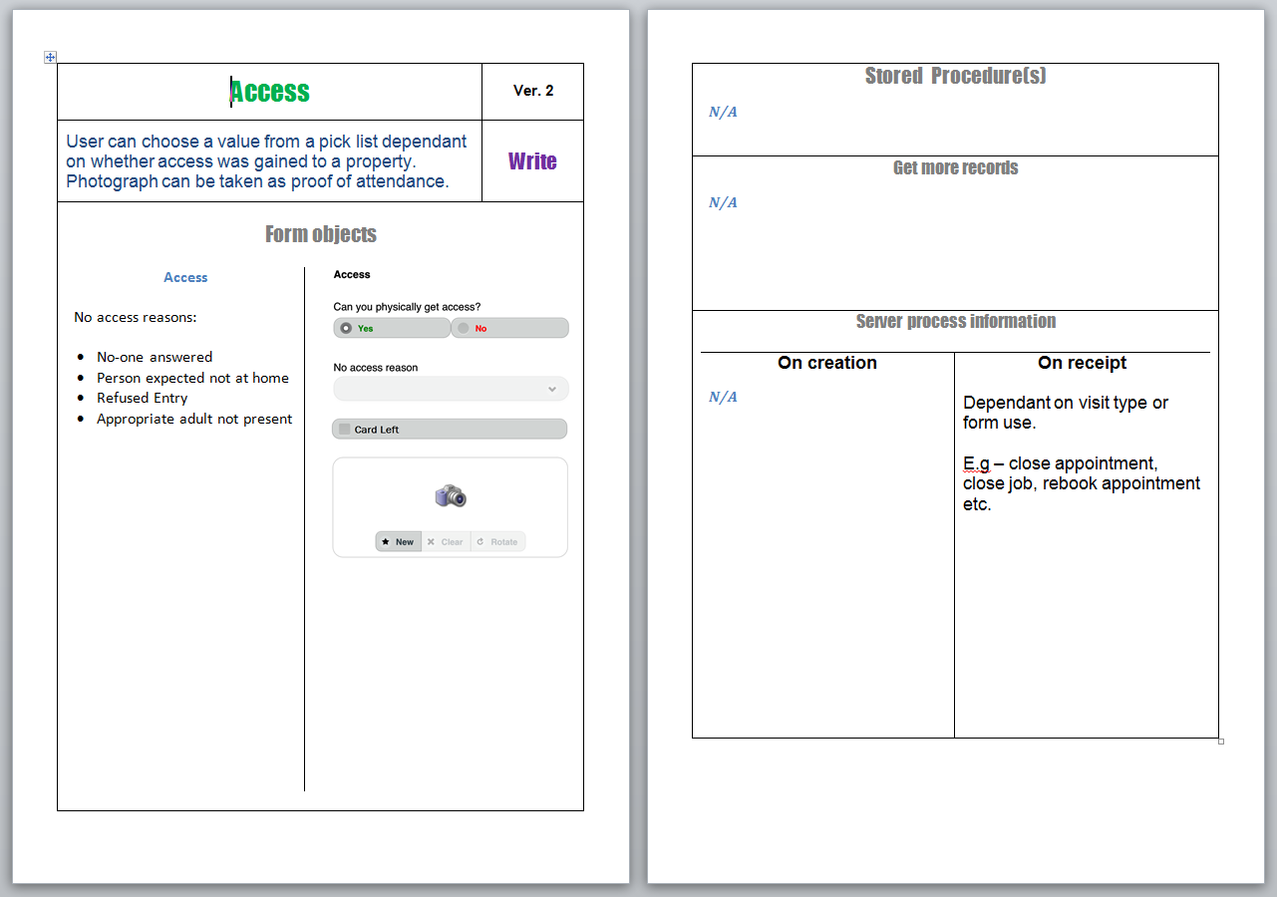
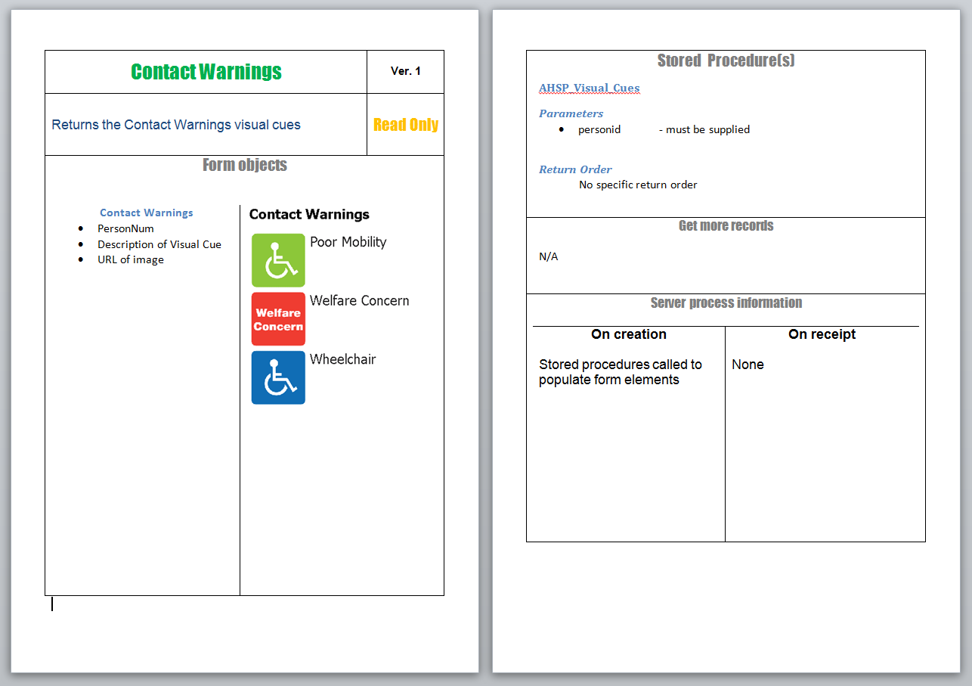
Form Design Components Cards
Making homes, helping people
An Information card
An Action Card
A Menu Card
Data Collection Card

Slide 10
“How to play”
Making homes, helping people
You lay out the cards to build a structure, e.g.
  Task summary
  Pre visit info and activities
  Background menu and form components
  Visit menu and form components
  Actions or Outcomes
You adapt cards for stuff you can tweak
You create new cards for totally new stuff
You need some scenarios to design for

Slide 11
What happens next?
Making homes, helping people
We analyse the development needs
We scope in to releases by focusing on what:
  We can easily do now
  Is essentially to do
  Adds value but is not essential
We produce a:
  1st release prototype
  Spec to sign off and test against
  An agreed 1st release

Slide 12
The Technique’s Benefits
Making homes, helping people
It’s rapid, visual and easy to do
Improves future releases of existing forms too
Helps consistency of service and familiarity
The cards detail:
  What you will see
  Where information comes from
  What will happen to any changes you make
The technique works!

Slide 13
Integrated approach
Making homes, helping people
Taking an enterprise approach
How we:
Make things happen faster
Provide an integrated service
Keep things consistent and efficient
www.amicushorizon.org.uk

Slide 14
Taking an enterprise approach
Making homes, helping people
Using the best information
Using the best system
Using the best integration methods
  Single views of data
  Web services
To achieve consistency and efficiency

Slide 15
Integrated approach
Making homes, helping people
Single Views of Data
Different applications using the data
Information derived from the best sources
Reliable and consistent approach
www.amicushorizon.org.uk

Slide 16




“Single Views” Stored Procedures Model
Making homes, helping people
Applications
My Account
CRM
HMS Info-tabs
Consistent data!
24x7 Data Service Need
Resilience:
Tables
Views
INCREMENTAL
REFRESHES ON
SUCCESS
Customer Experience Views
Single
Views
Stored Procs
SERVER ALIASES
FOR DB ADMIN & PORTABILITY
Data
Warehouse
Housing Data Warehouse
SERVER ALIAS
Danger!
Truncates or Drops tables
Replica Databases
ASB
Replica
CRM Replica
Live Systems
Orchard Housing Management
Apex Asset
Management
ReAct Anti-Social Behaviour
MS Dynamics
CRM

Slide 17
Integrated approach
Making homes, helping people
Web-services
Supported confirmed real-time transactions
Best systems used for servicing or processing
Used to send tasks and actions, distribute, manage the immediate case or jobs
www.amicushorizon.org.uk

Slide 18
Future
Read and Write Integration
Today
Making homes, helping people
Web Services and Integration Management
WS
WS
WS
WS
WS
WS
WS
WS
Exchange
SMS
Text
Apex
Orch
ReAct
CRM
Web
1st T
Single Views Stored Procedure Library
See the previous slide’s diagram. It is for:
Parameterised stored procedures
Data Warehousing and reporting
Real-time data via replication

Slide 19
Integrated approach
Making homes, helping people
The benefits
www.amicushorizon.org.uk

Slide 20
10 Benefits of Our Approach
Making homes, helping people
Visual and easy to do
Allows mobile working team to innovate
We get fantastic ownership and feedback
Gives us consistency and efficiency
We have single views of information
Resilience and flexibility aid 24x7 service
An enterprise solution (teams and systems)
Re-useable or adaptable components
Business is now able to confidently innovate
Been a successful return on investment

Slide 21

Closing messages from our FI team
Making homes, helping people
www.amicushorizon.org.uk

