Slide 1


BancTec and New Charter Housing
Supporting the Contact Centre
Pete Dinham, BancTec
Stuart Clover, NCH

Slide 2
Some Aspects of the Subject
BancTec ?
The Challenge
What is CRM anyway?
Managing Journeys
Making Contact
Supporting the Approach
Looking to the Future

Slide 3
About BancTec
Over 40 years of delivering innovative solutions in the UK
500 people in UK, engaged in business solutions and technology led services
Strategic commitment to the Housing vertical
Our core IPR and skills are relevant to the future of Customer Service in Social Housing, but come from many industry experiences
Integrated, single platform, multi channel customer servicing
  R and D in Big Data, Adaptive Case Management

Slide 4
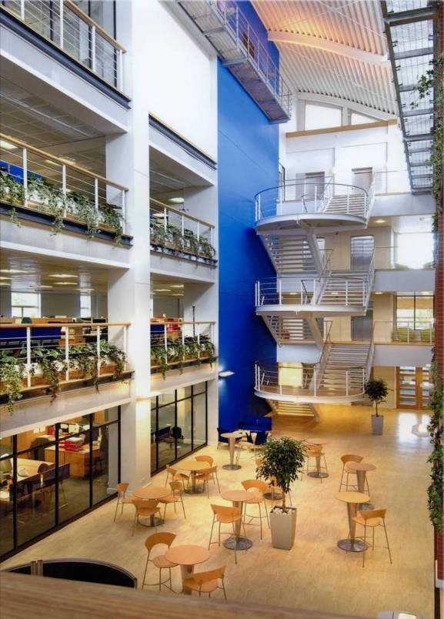
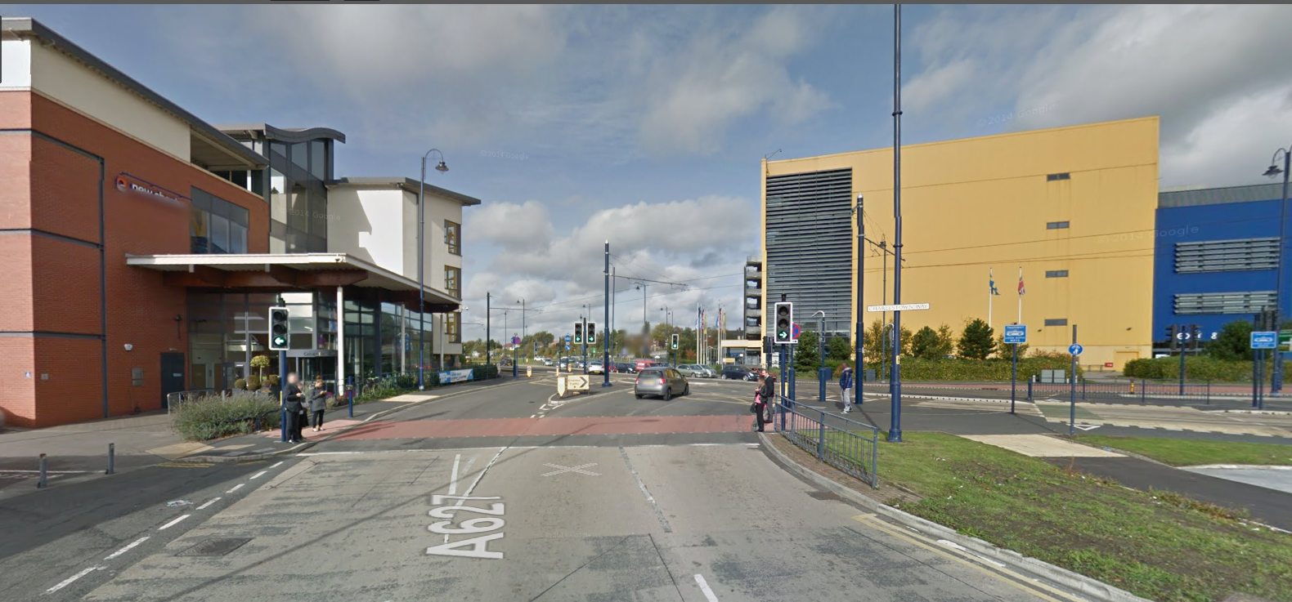
About New Charter
15 years as New Charter – experience from many years previous as part of Tameside Council
19,000 homes managed through 3 major brands
Turnover greater than £100m
Around 1,000 directly employed staff

Slide 5
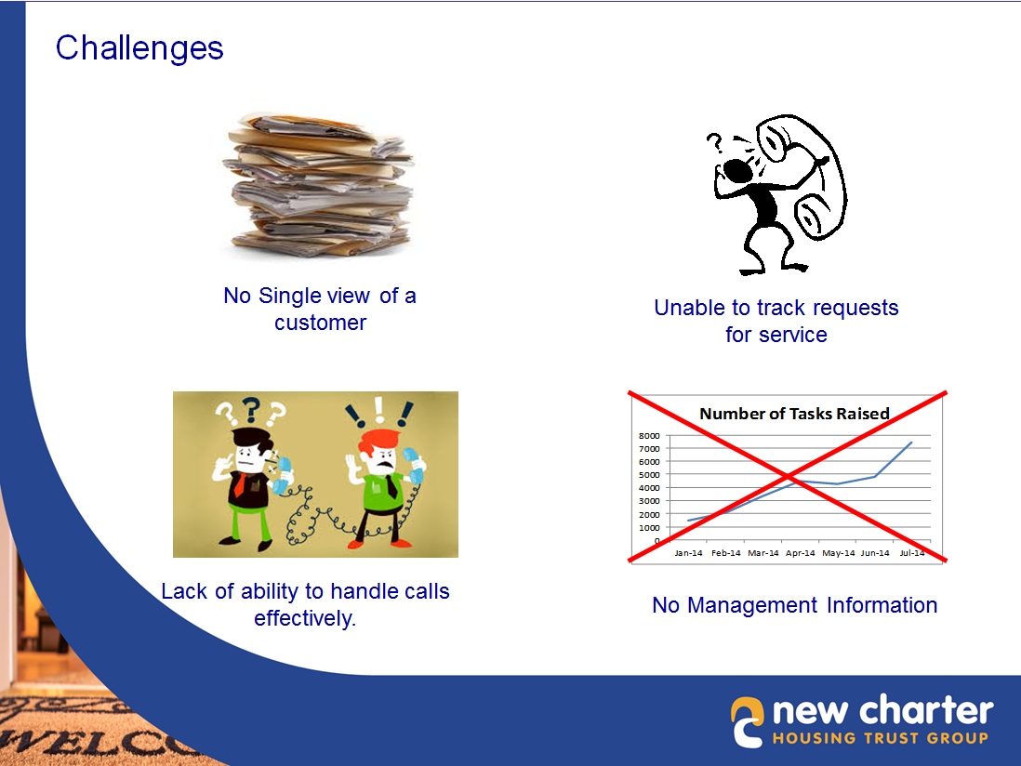
The Challenge

Slide 6


When is “CRM” not CRM?
Most CRM systems are concerned with the enterprise’s outward relationship with its potential customers – and with selling
  What if you’re dealing with Citizen–RM?
  What if the C-Relationship-M is lifelong?
  What if they want help, not CR-Managing?
Or isn’t “this” the problem at all ?
Is this your CRM?
Or is THIS your CRM?
Notes:
Relationship based on selling and marketing
Ideal relationship as short as possible given the job to be done

Slide 7
The Challenges
WORKFLOW AND INTEGRATION
INTEGRATION
WORK
MANAGEMENT
DATA COLLECTION
Notes:
Just as much a challenge in the back office or in the repair depot or in the legal department as it is in the call centre.

Slide 8



What’s in a “customer” journey?
Customer Journey
Customer Journey
Touchpoints
Disconnects
but hopefully not
Breakdowns
Customer
Enterprise
Notes:
So we’ve undertaken mapping our customer journey. That tells us an awful lot about how to improve interactions with the customer but this can’t be looked at in isolation.
Most businesses are complex entities and changing interactions with the customer may ripple back a long way in the business. So how do customer journeys relate to processes
<CLICK> For an initial analysis we can treat the organisation as a single entity but
<CLICK> it’s sometimes rewarding to break this down to a lower level and switch back to the enterprise view – yes, the most important thing is the customer’s view of the company but the company’s view of the customer can be just as revealing.
<CLICK>
Identifying different stakeholders and actors in the organisation who play a part in the customer journey and their touchpoints with the customer and with each other is illuminating (there’s no formal difference between stakeholders and actors, they’re terms we’ve adopted for people directly in touch with the customer versus people who have knock on engagements but no direct contact)
And our contention is that the aggregate of these facets is another perspective on the business process.
<CLICK>
In looking at the wider implications it’s important to maintain the customer’s view at the centre of the network just as some versions of value stream mapping maintain the value flow at the centre of the chain.

Slide 9

But what’s really happening?
Customer Journey
Actor 1
Customer
Actor 2
Stakeholder 3
Actor 4
Customer
Enterprise
Notes:
So we’ve undertaken mapping our customer journey. That tells us an awful lot about how to improve interactions with the customer but this can’t be looked at in isolation.
Most businesses are complex entities and changing interactions with the customer may ripple back a long way in the business. So how do customer journeys relate to processes
<CLICK> For an initial analysis we can treat the organisation as a single entity but
<CLICK> it’s sometimes rewarding to break this down to a lower level and switch back to the enterprise view – yes, the most important thing is the customer’s view of the company but the company’s view of the customer can be just as revealing.
<CLICK>
Identifying different stakeholders and actors in the organisation who play a part in the customer journey and their touchpoints with the customer and with each other is illuminating (there’s no formal difference between stakeholders and actors, they’re terms we’ve adopted for people directly in touch with the customer versus people who have knock on engagements but no direct contact)
And our contention is that the aggregate of these facets is another perspective on the business process.
<CLICK>
In looking at the wider implications it’s important to maintain the customer’s view at the centre of the network just as some versions of value stream mapping maintain the value flow at the centre of the chain.

Slide 10
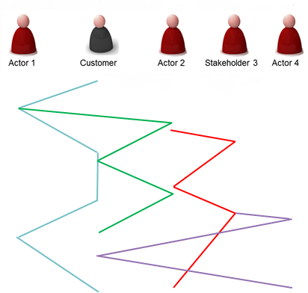
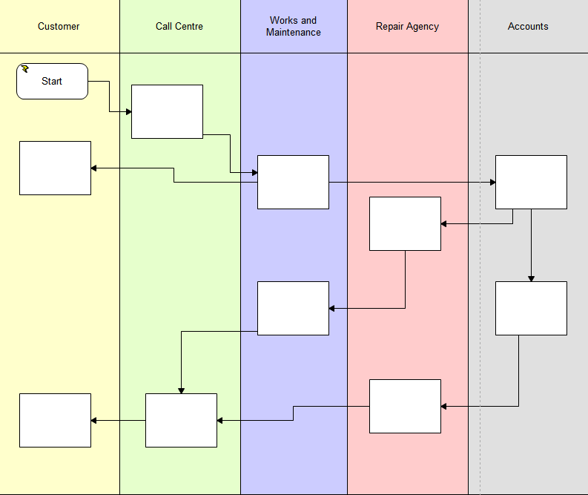
The key to “CRM” is helping all role journeys
Focus on flow of data, messages or physical items
  Incidental communications may be implicit in activity boxes
Focus on interactions, interfaces and disconnections
Sequential flow of value objects may not be clear
Notes:
Our view is that the two different models are largely equivalent but useful in different ways as they draw focus onto different things and both approaches have value in our mission of understanding, improving, guiding and explaining.

Slide 11
Must my business participate in all Journeys?
It’s sometimes scary to let go but there are many successful examples of community based journeys being a better alternative to enterprise mediated ones:
  Sky TV, TomTom, GiffGaff: Community based Customer support; costs reduced by 60-70% with a small rise in the perceived quality of information and speed of response
  Barclaycard Ring: Crowdsourced credit card – far higher customer satisfaction ratings and customer retention compared to conventionally created product offerings
Sometimes the best customer journeys are the ones they make themselves
Notes:
It’s also becoming increasingly clear that new channels as well as bringing more problems may also bring solutions. The rise of on-line communities can be used as a force multiplier by enterprises who still need to stay in-touch but may not require to be engaged.
If you are hosting the community it’s one very good way to minimise that time and distance disengagement problem as long as you’re ready to re-engage when the time is right.
<CLICK> An associate of ours has done some fascinating work recently at a major broadcast organisation and even allowing for the cost of the IT platform and staff to monitor and mediate exchanges, community based support has been shown to be up to 70% cheaper and no less effective.
And they may not be limited to “how do I use this product or service” – think about “I am a person of this age and gender with these life-goals – what financial service products are the best for me” – you can get a theoretical answer from the enterprise but more likely there will be someone with those same problems who can respond with more practical advice.
Barclaycard in the US removed a lot of their financial product development costs from the Ring card and allowed the target community to set a lot of the parameters of the offering with consequentially less churn and less complaints
<CLICK> Having someone at least partly inside the enterprise turns attack into defence. Customers with a buy-in will literally defend the organisation.

Slide 12

Community mediated journeys
Customer Journey
Customer
Community
Enterprise
Notes:
A community mediated customer journey looks much more like this

Slide 13
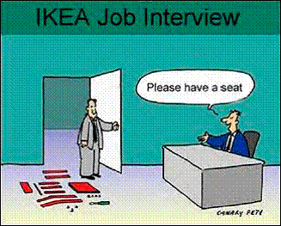

Slide 14
A platform for Tenant Services Support
Integration
Work Management
Case Handling
History and Context to every Touchpoint
Signposting and Guiding Tenant Journeys
Managing the delivery of service to people in a way that makes sense to them

Slide 15




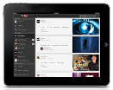







Not too much integration!
Customers and partners must be able to
  Interact when it’s convenient
  In an environment in which they feel comfortable
But integrating too many layers introduces fragility and complexity
Try to ensure that your core solution has a facet for all channels you handle..
… and mediation for pathways through your IT
And be very careful about social media!
Tenant
Comms
Corporate Website Portal
Mobile
Workplace
Advanced Web Workplace
Accounts
Repairs
Planning
Inspections

Slide 16
Approach to implementation
Business Led
Pragmatic and Cost-benefit evidenced
Iterative / Agile
  Current trend but not always evidenced in implementations in housing – or elsewhere!
  Supplier / Buyer relationship key here
Remember the concept of the Minimum Viable Product
  Emphasis on having a platform which is capable of iterative, incremental delivery

Slide 17
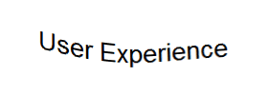
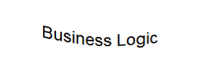
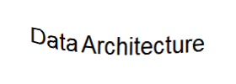
Development Processes
Waterfall methodologies often build in layers as there is no specific pressure on short-cycle deliveries
But this may mean there is “nothing to see” until a long way into the project

Slide 18
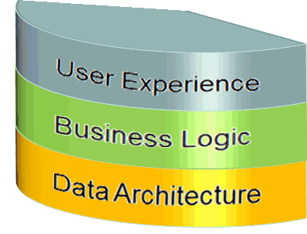
Development Processes
But Agile wants to deliver potentially shippable business features from the first, very short, development cycle
This is like building a cake from slices not layers
User Story #1
User Story #2
User Story #3

Slide 19
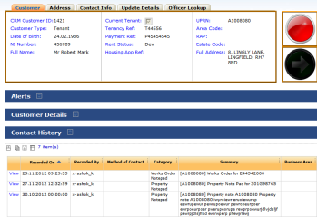


CaseVision helps to build in Business Slices
The UX is generated as functions are added to the business logic. The UI directly inherits the datamodel and workflow
Forms, Menus
Searches
Business logic is maintained through workflows business rules and decision tables. These cen be extended organically and iteratively
Workflows and Rules
The Data Architecture is configured. It can be created independently in small functional areas
Case model and Integrations
Street
House 1
History
House 2

Slide 20
So why did New Charter Win Their Award?
They’re good at what they do!
Single View of Customer / Single view of Service
  Multi-channel
  Integration
  Workflow
Customer Satisfaction
  Callbacks down, tasks up, first resolutions increased
Scripting
  Service oriented, iteratively adapted
  Heavily used
MIS
  Visibility across the organisation

Slide 21
Background
New Director of Customer Experience
Repairs, Relets, Neighbourhood = Connect
Business case for CRM already agreed at board
New Service Improvement Team
BUY IN essential
User Workshops
User requirement document
Working group to select CRM provider
BancTec selected

Slide 22
Approach to Implementation
Phased approach
Requirements prioritised by users
Spec > Go live phase 1 12 months
Spec > Go live phase 2 16 months
Training
Phase 3 – Facebook, Twitter

Slide 23
The facts….

Slide 24
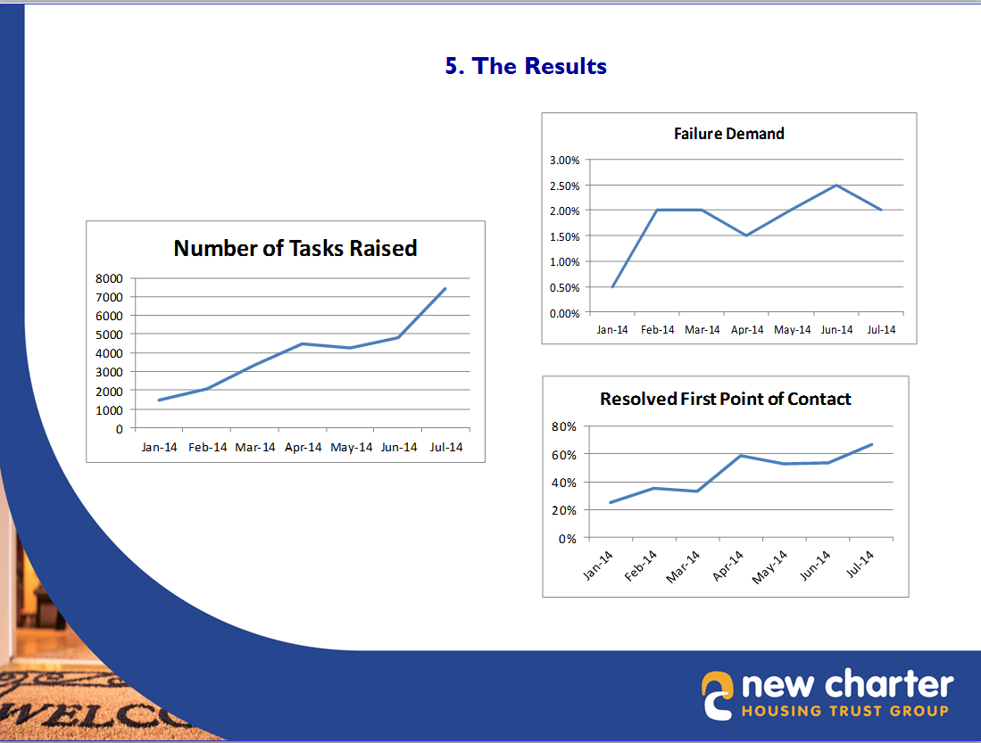
The facts….

Slide 25
What’s Next

Slide 26
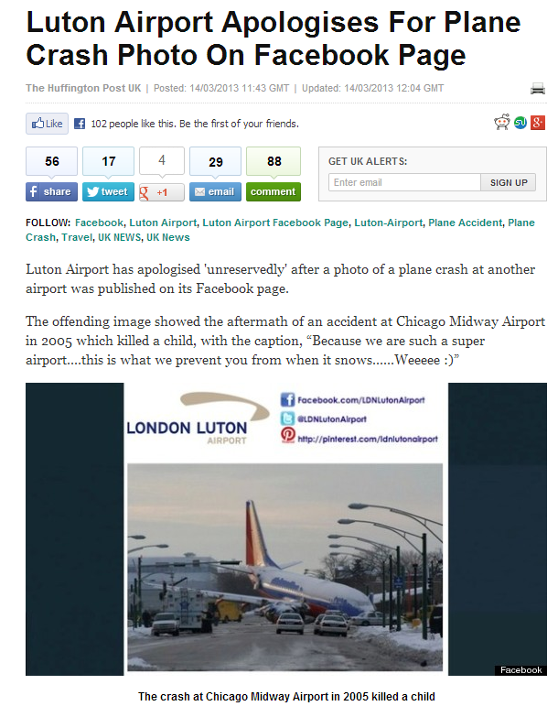
Social media and Natural Language Processing
Regulators very sensitive to outbound “errors”
Checking outbound messages with NLP can trap non-compliant responses
Checking inbound messages can help routing & prioritisation

Slide 27
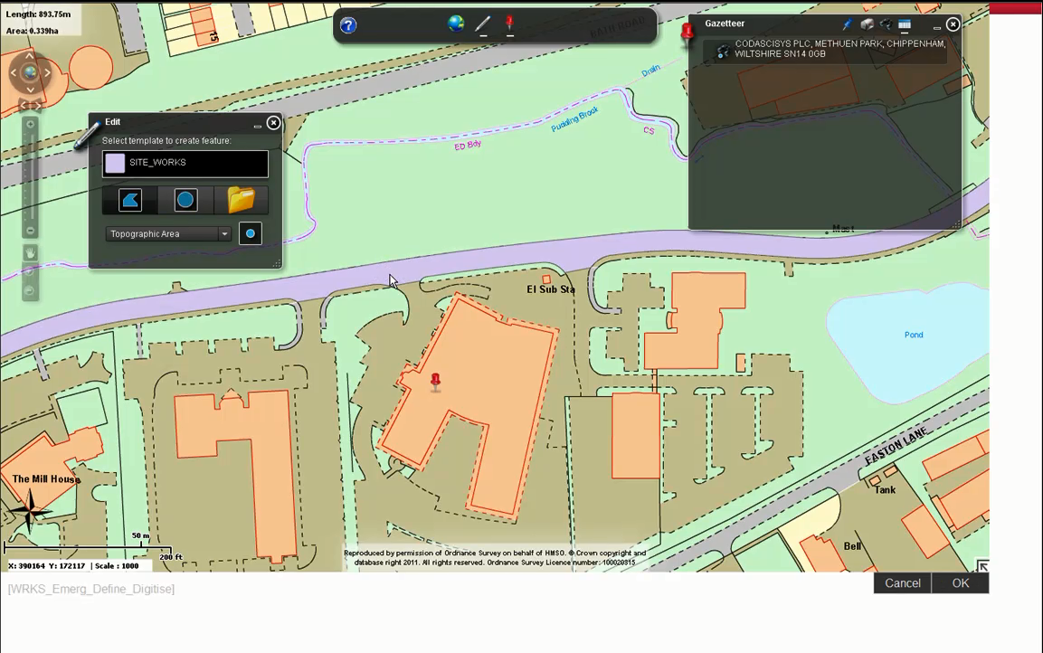
Increased Support for GIS

Slide 28
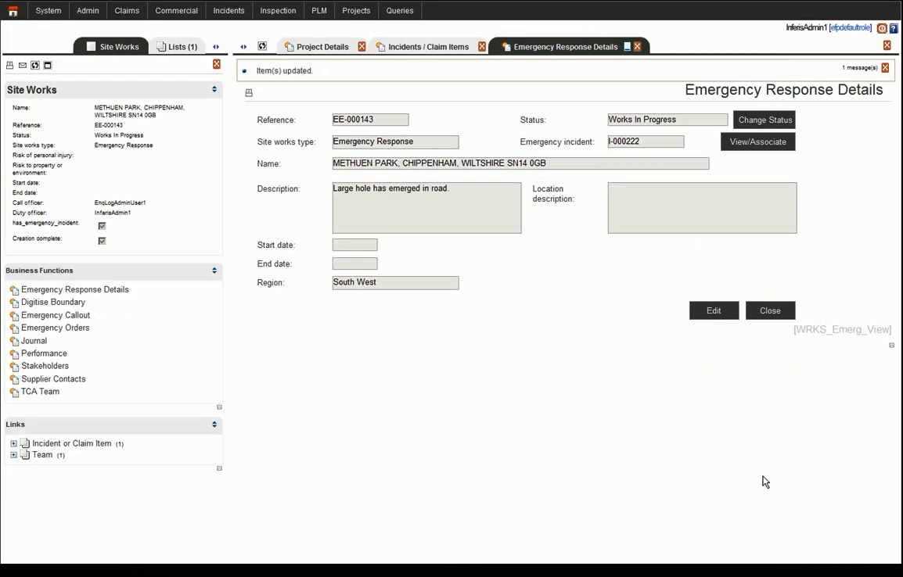
Increased Support for GIS

Slide 29
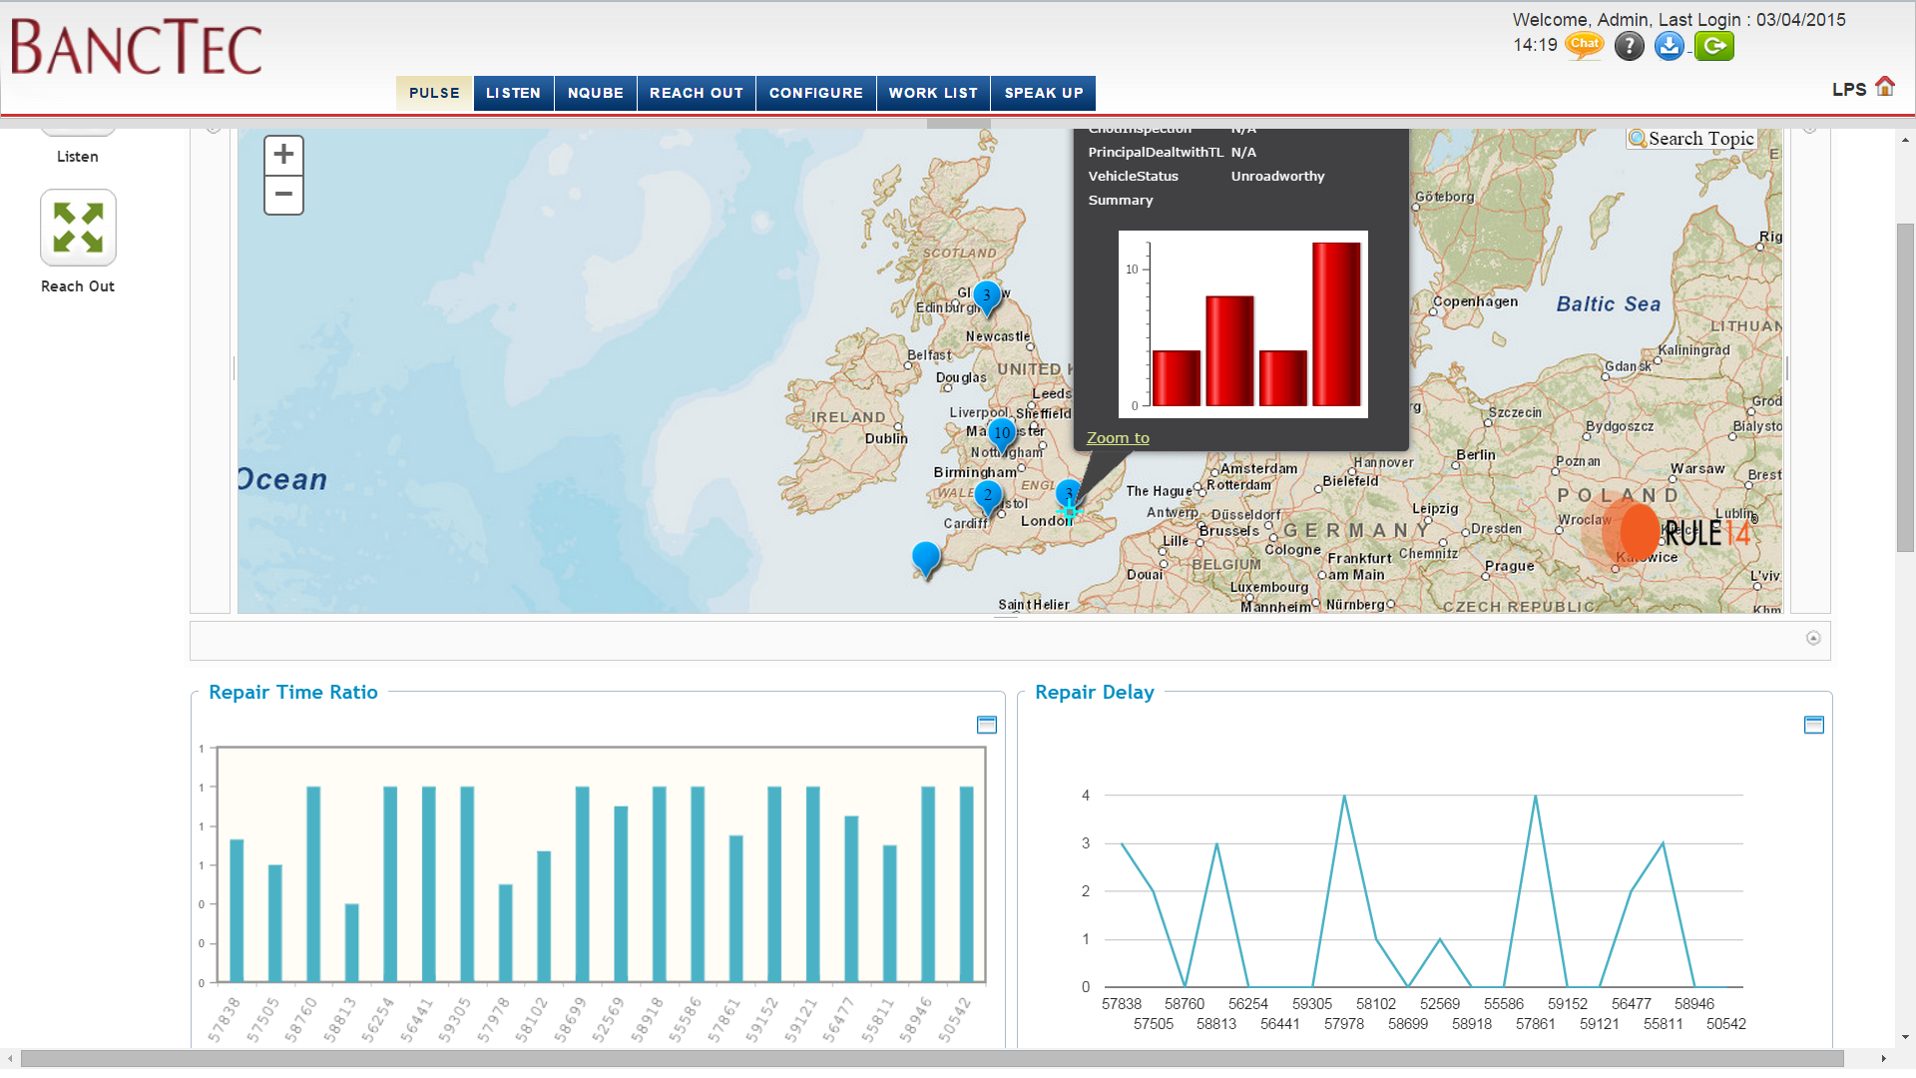
Big Data Analysis (and GIS)

Slide 30
Thank You

