Slide 1
Systems Of Execution: How Cairn Delivers Results Through e-accountability
Fin Smith – Housing Technology 2015

Slide 2
Introduction and Overview
Pictured: Cradlehall Football Club, Inverness, sponsored by Cairn

Slide 3
Introduction
Speaker
Organisation
Fin Smith
Cairn Housing Association
Head of Business Improvement
National (Scotland)
3500 units
350 staff
23 LA Areas
3 Main Offices

Slide 4
Content Overview
Challenges and Context
Executing on our Plans
Executing for our Customers
Accountable to our Customers
Accountable to each other
Summary
Questions and Close

Slide 5
Challenges and Context
Pictured: Cairn HomeWorks Team, Highlands

Slide 6
Challenges and Context
Strategies and Plans
Number and diversity
Geographical spread
366 miles – 6h 49min
Business transformation
Performance Improvement
The need to execute
How to deliver on our ambitions and plans

Slide 7
Why e-accountability?
Accountable to….
Embedded Accountability….
Regulators
Funders & Lenders
Partners
Board
Management
“Beware the 3 disciplines of execution….”

Slide 8
Need more? e-accountability because…
Accountability is cultural
“Culture eats strategy for breakfast”
Strategy dies as its leaves the boardroom
So….technology that drives process and process that is driven through technology can embed behaviours of accountability
Needs to become “How we do things around here”

Slide 9
Valuing Accountability
Bring strategy together
Bring people together
Focus on what’s important
Share the outputs and outcomes
Ensure that we know whether we are delivering on our strategy or not

Slide 10
Executing on our plans
Pictured: Community Fund Project – Herb Garden, Devlin Court, Stirling

Slide 11
Executing on our plans
Breaking strategy down to deliverables
Allocating responsibility
Monitoring performance

Slide 13
Breaking it down
The Strategic Cascade

Slide 14
Breaking it down
Goal
Project
Project
Task
Board
Management
All Staff
Project
Task
Task
Task

Slide 15
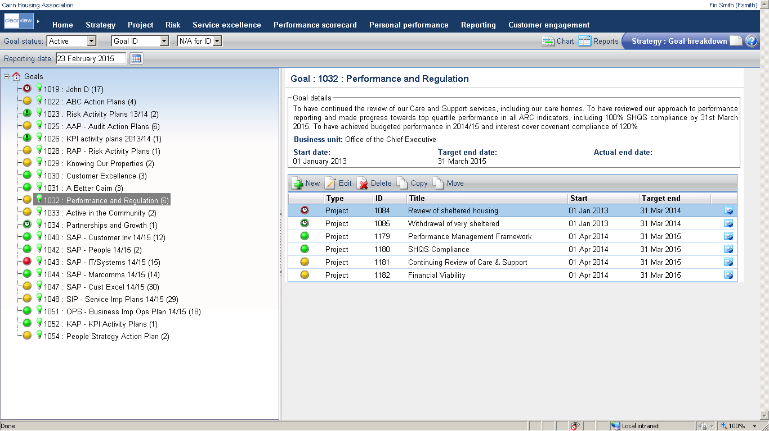

Slide 16
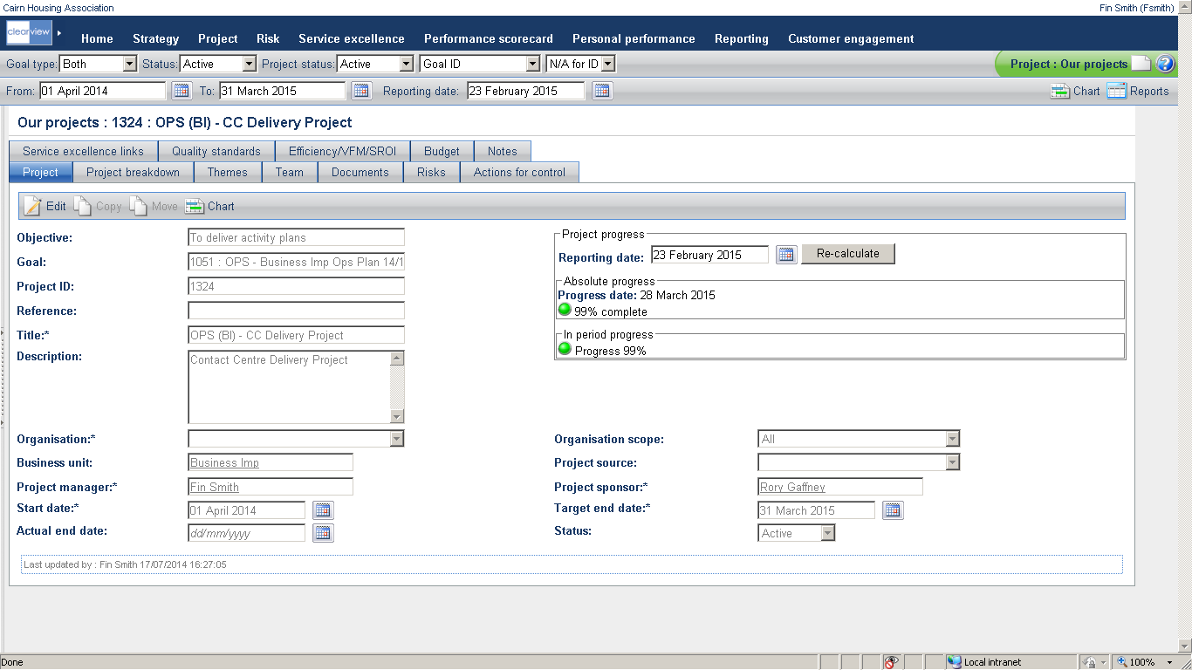

Slide 17
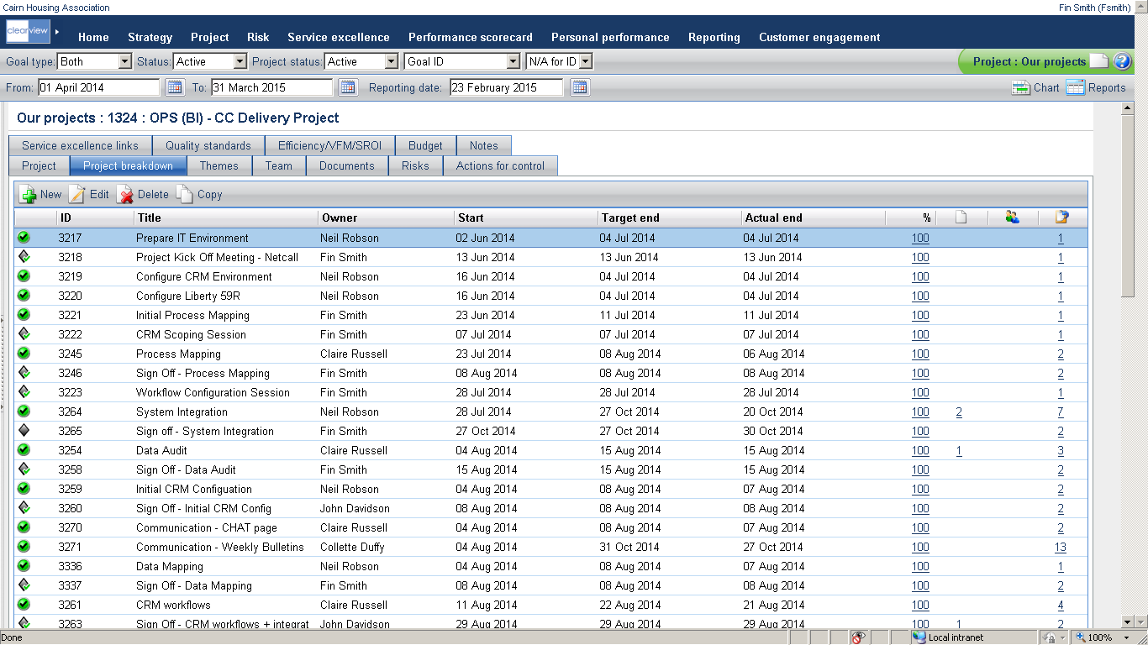

Slide 18
Allocating Responsibility
Personal Accountability

Slide 19
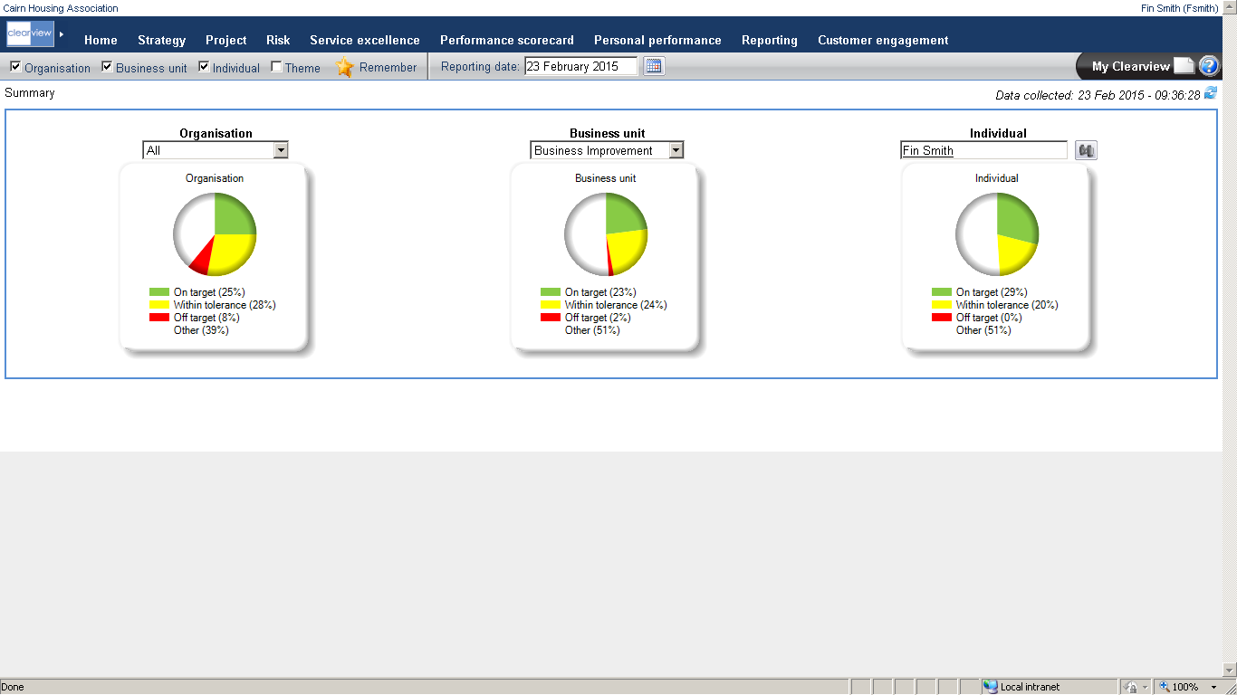

Slide 20
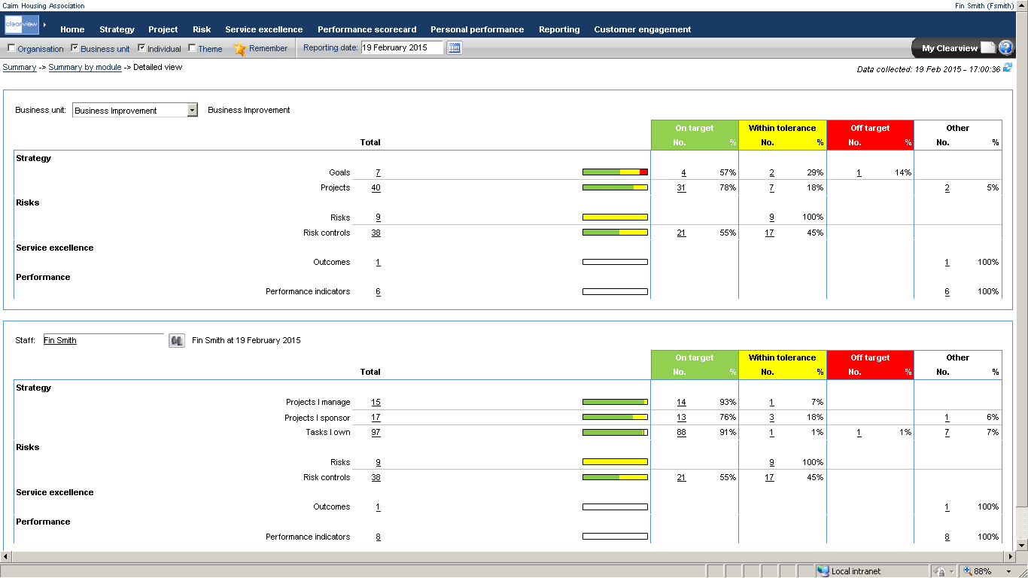

Slide 21
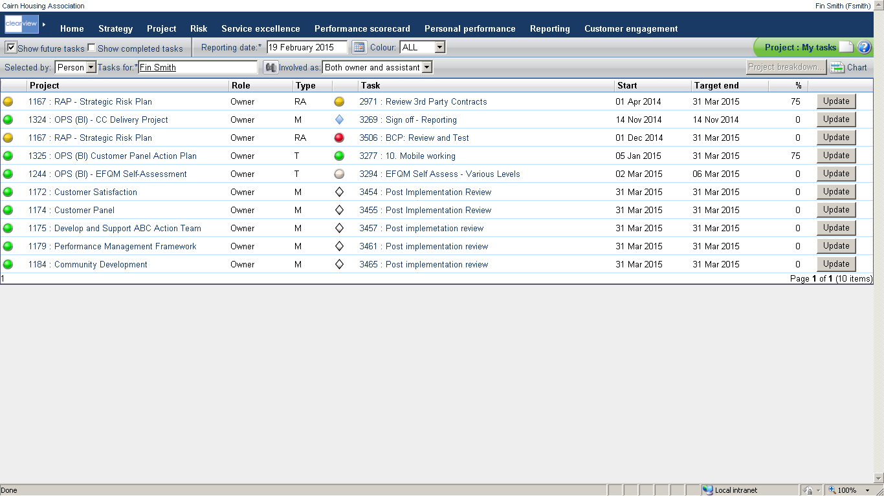

Slide 22
Monitoring Performance

Slide 23
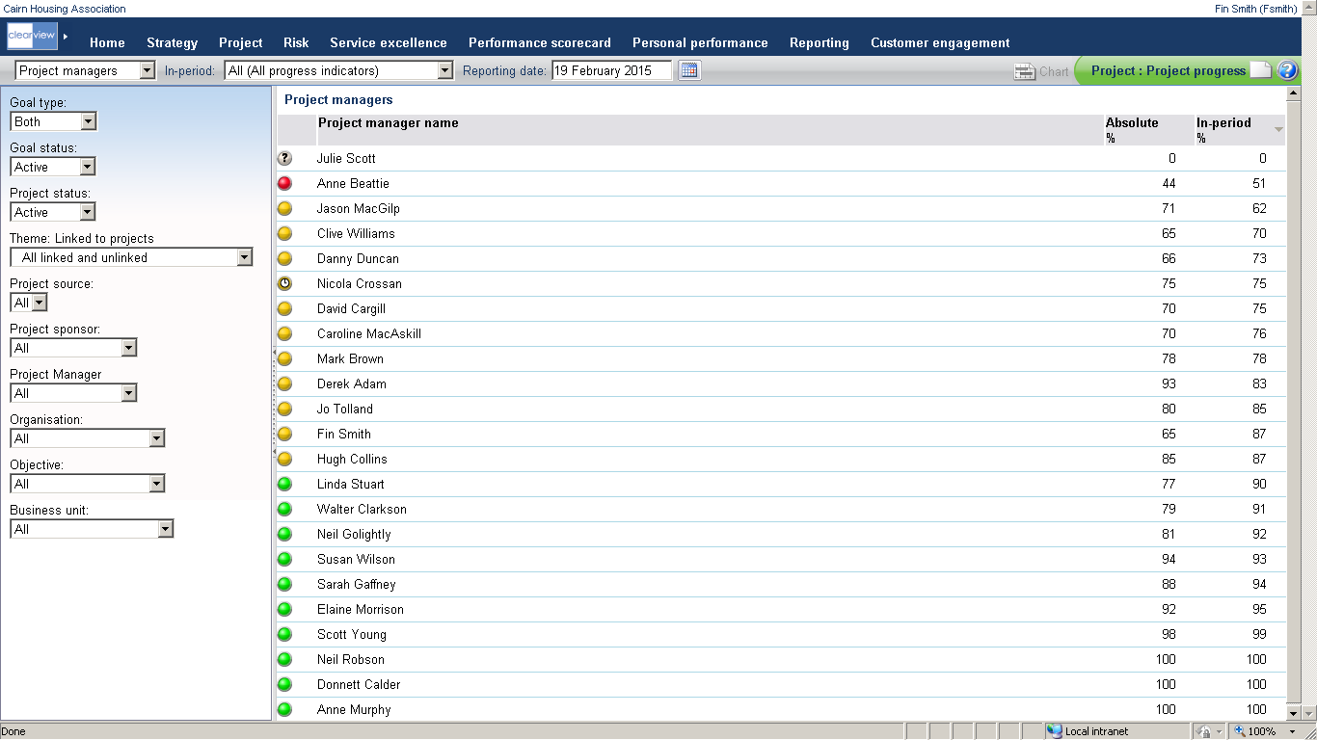

Slide 24
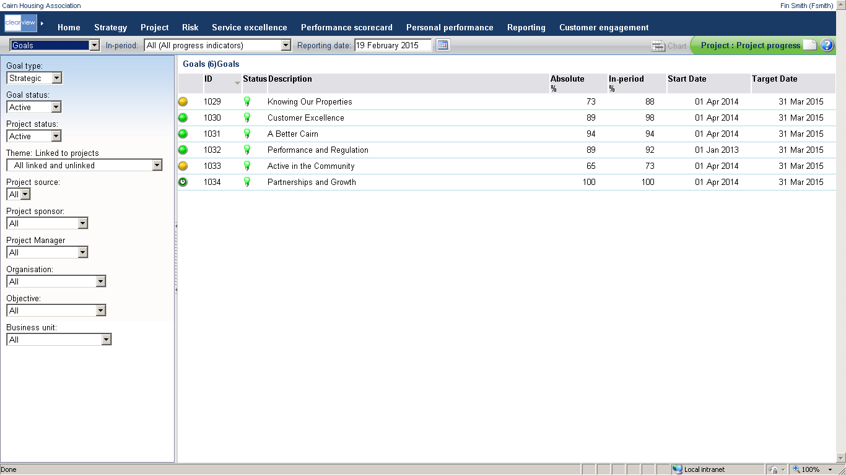

Slide 25
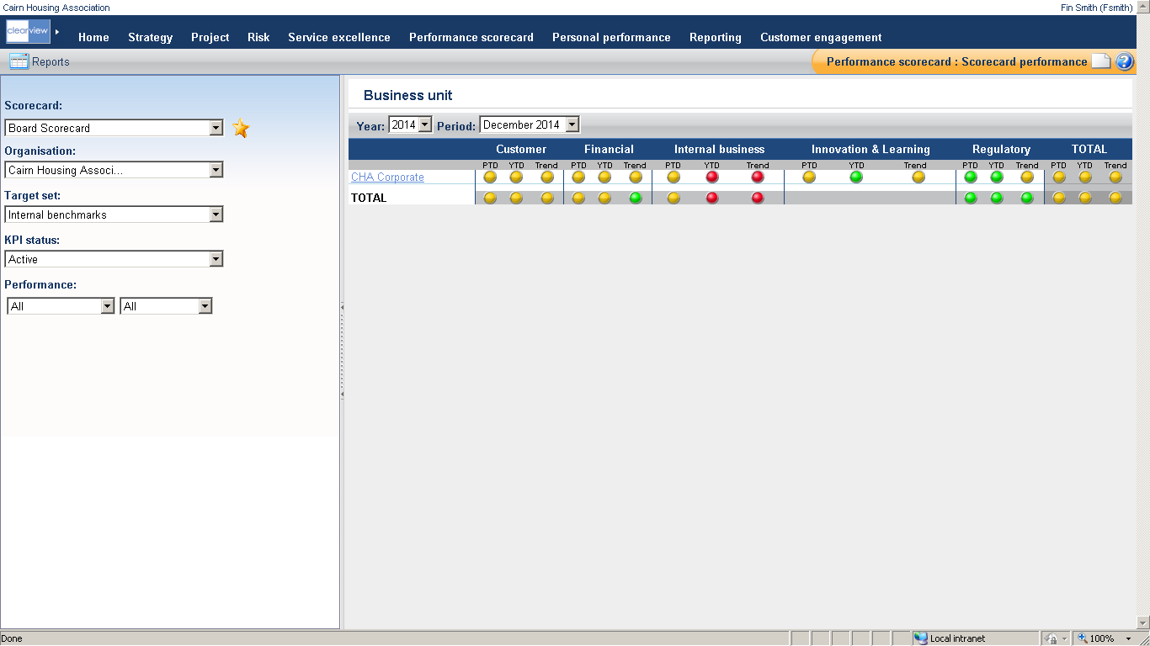

Slide 26
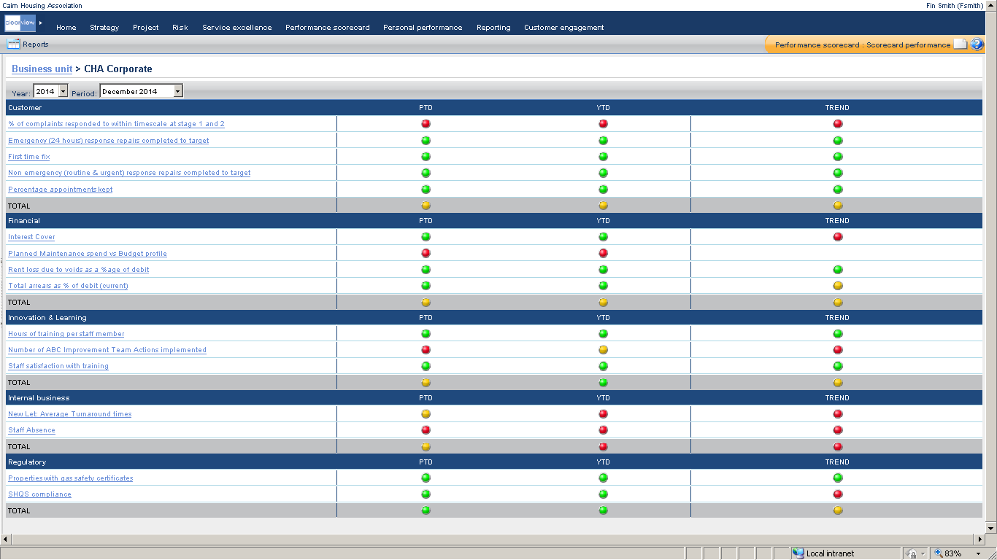

Slide 27
Essentially
We have a Business Plan
We break this down into deliverables
We allocate responsibility to deliver
We monitor progress against delivery
We monitor key performance information related to delivery
We know if we are delivering on our Business Plan or not

Slide 28
Executing for our Customers
Pictured: Cairn Contact Centre Team Members

Slide 29
Executing for our Customers
But what about the day to day – isn’t that more important to customers?
Centralised call handling
Automated workflows – creating visibility and accountability
Mobile

Slide 30
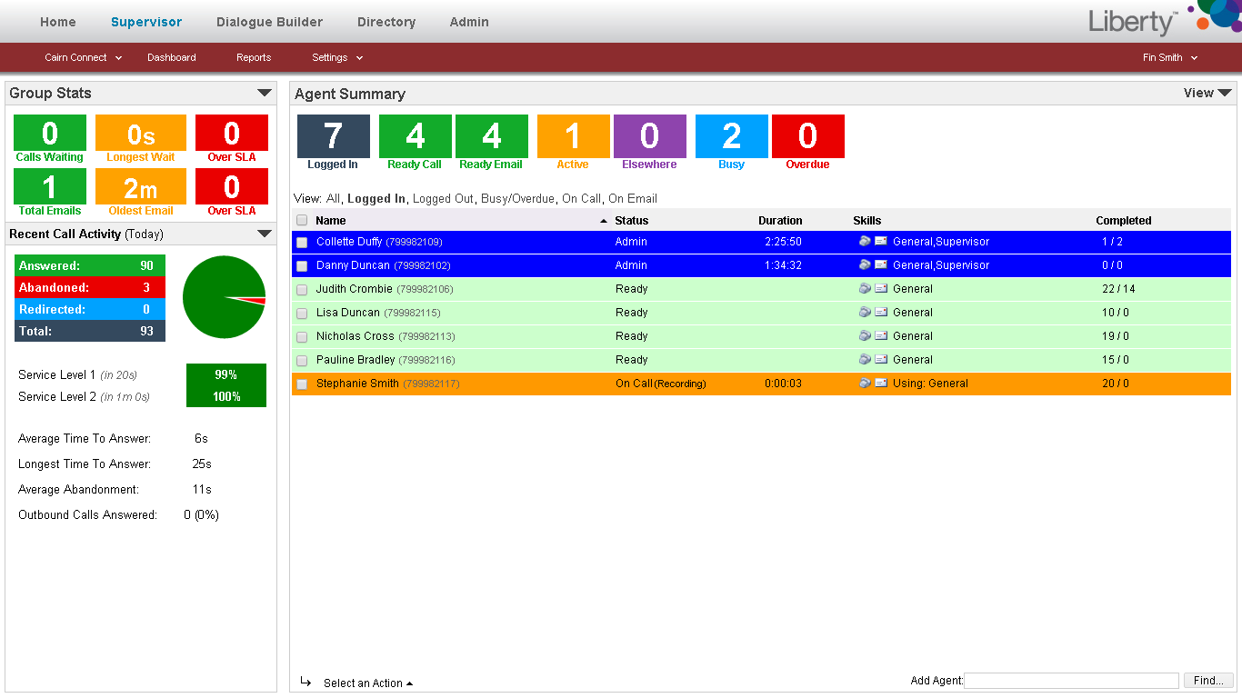

Slide 31
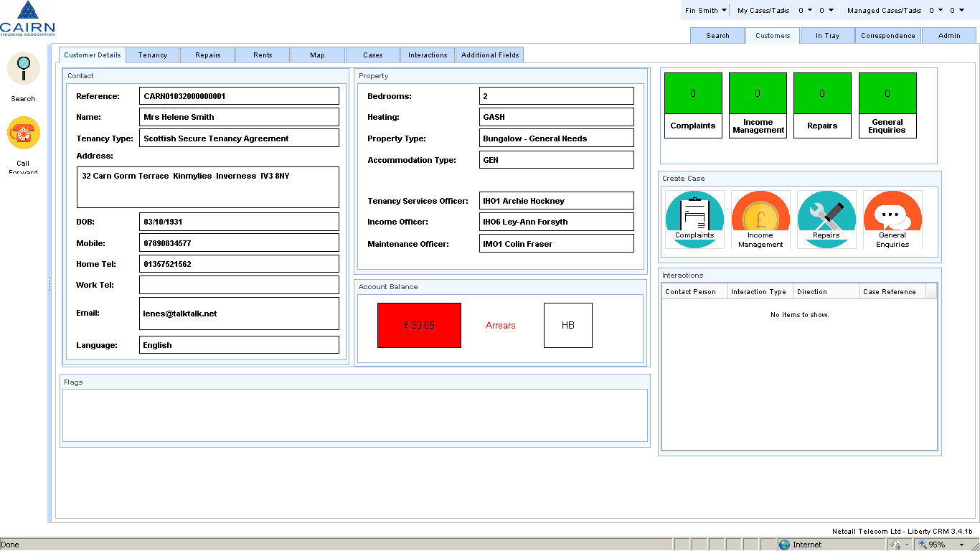

Slide 32
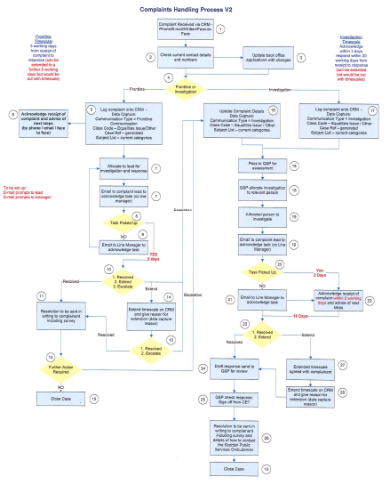
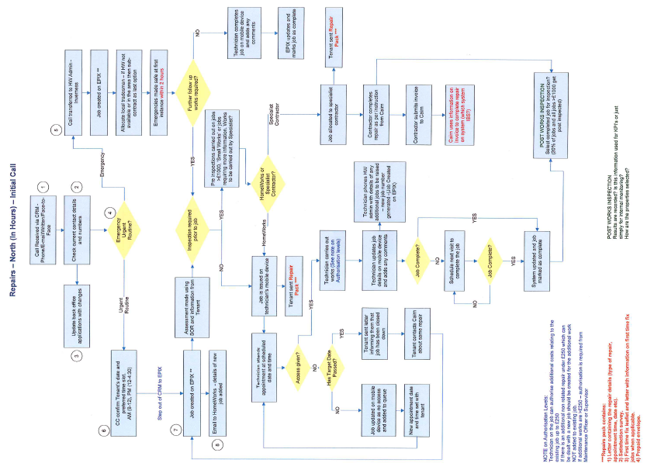

Slide 33
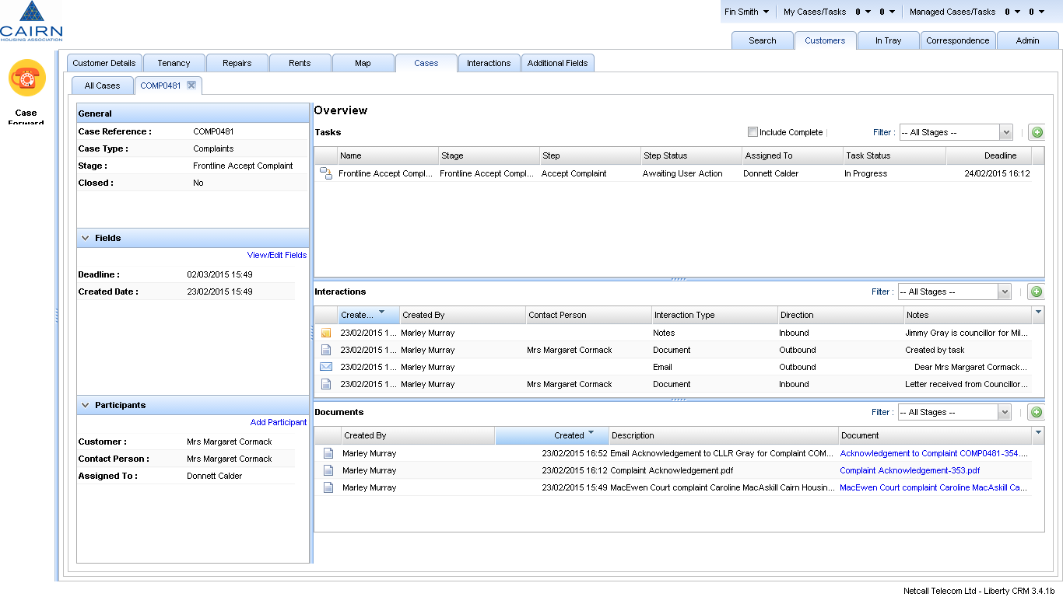

Slide 34
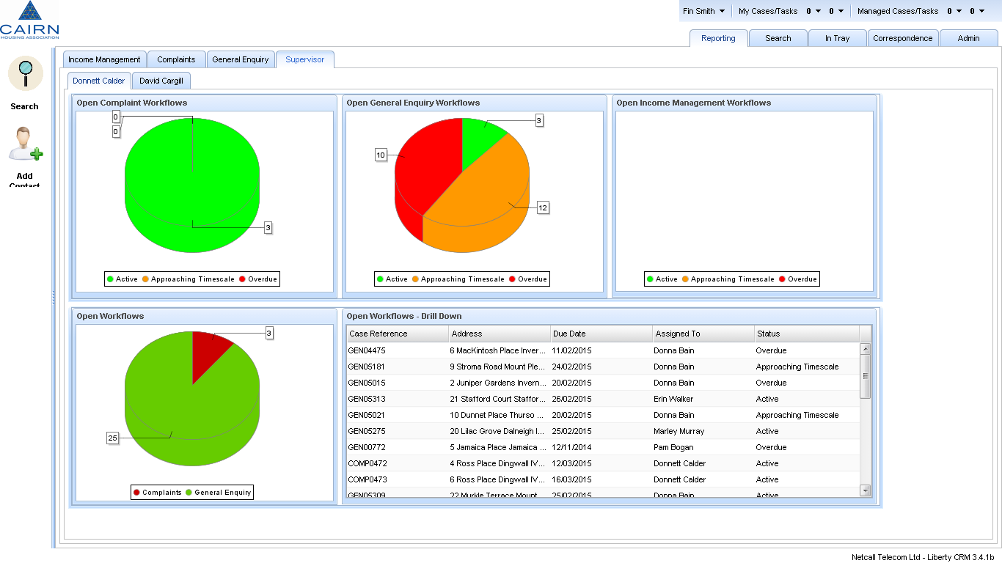

Slide 35
Next Stage – Mobile
Accountability on the move!
Adding value for staff and customers

Slide 36
Accountable to our Customers
Pictured: Cairn’s Customer Panel

Slide 37
Accountable to our Customers
How do we know that we’re any good?
Customer Engagement and Satisfaction

Slide 38
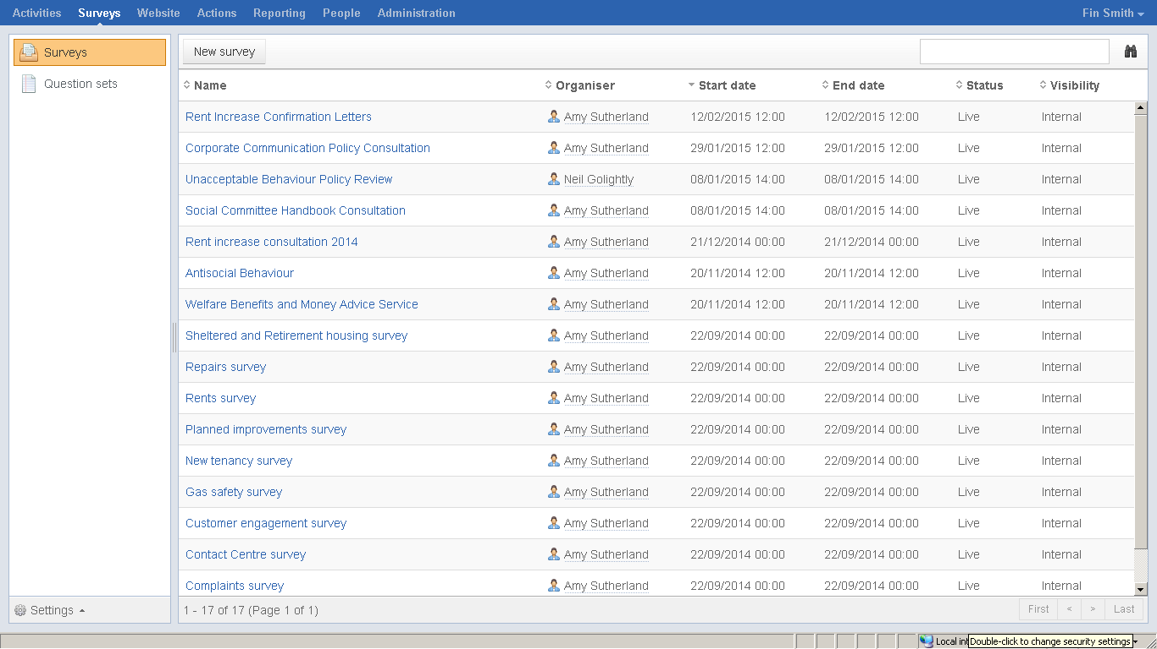

Slide 39
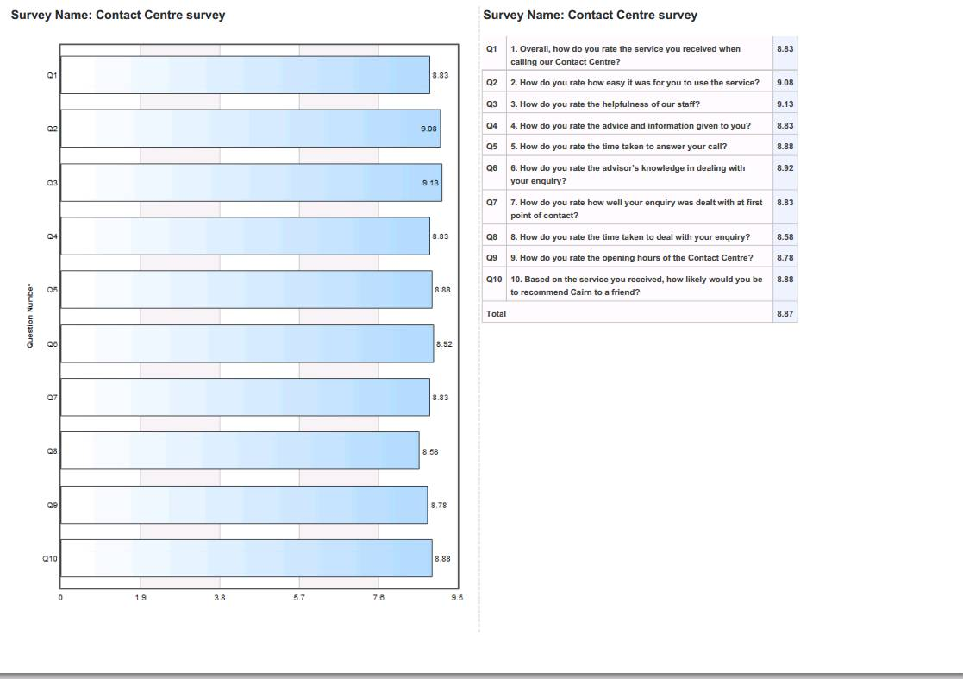

Slide 40
Accountable to our Customers
Improvement notices are issued
Individual question scores below 6
Survey averages score below 6
Assigned to a named officer
Next Steps
Integration to the CRM

Slide 41
Accountable to each other
Pictured: Cairn HomeWorks, Highlands

Slide 42
Accountable to each other
The next stage in our journey
How do we drive improvement in delivery through our most important asset – our people
New People Strategy – Focus on Organisational Development

Slide 43
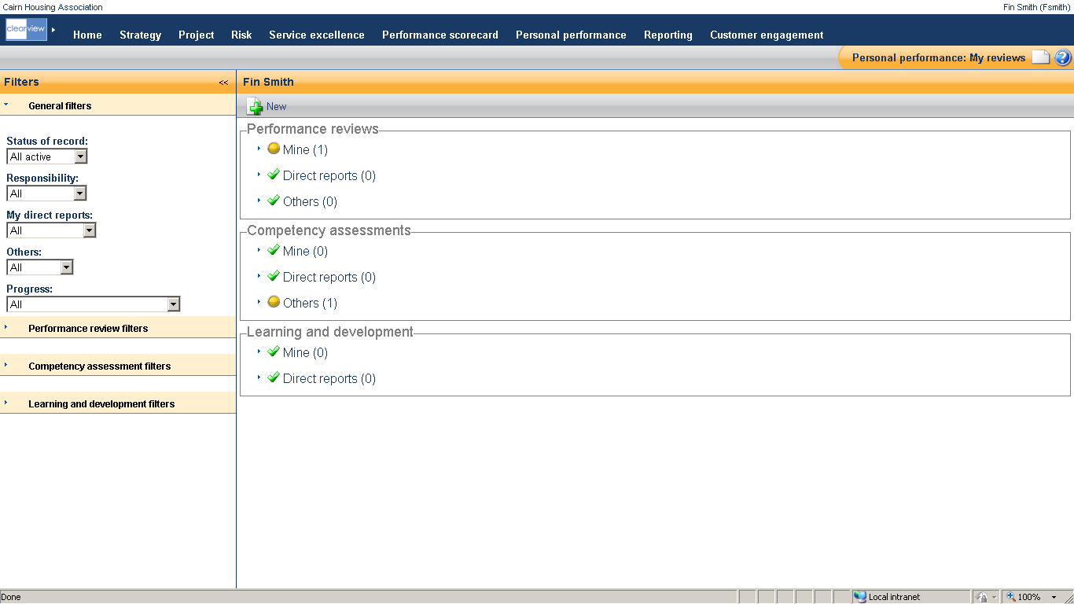

Slide 44
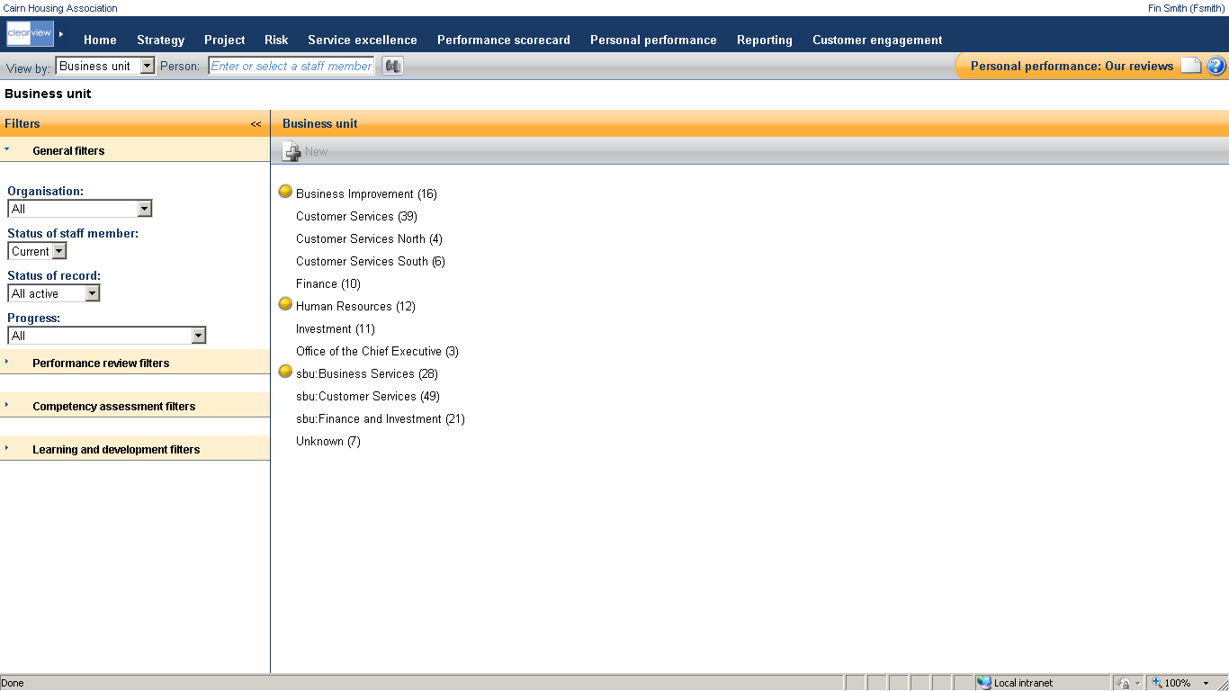

Slide 45
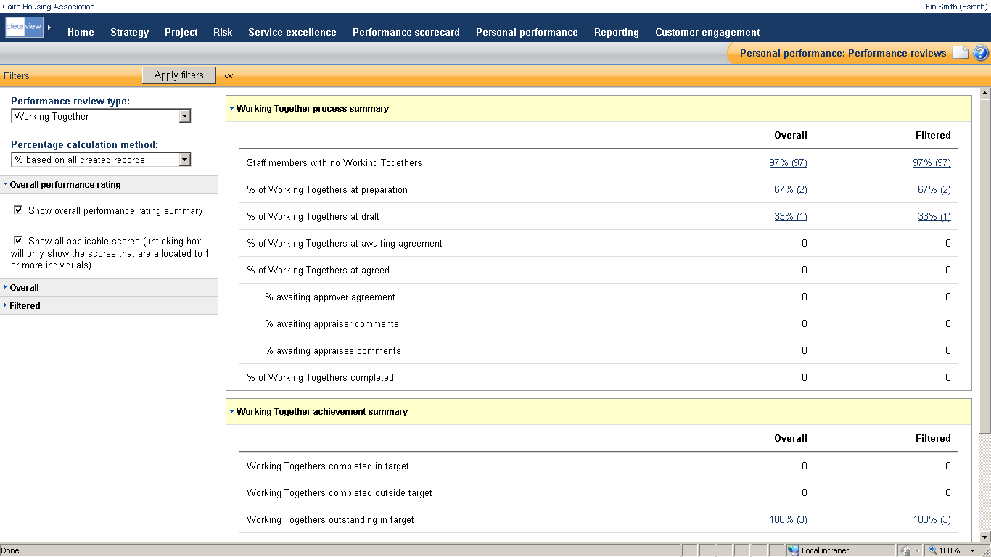

Slide 46
Accountable to each other
Project for 2015/16
Clarity on expectations and priorities
Linked to strategy delivery
Pulls through projects and tasks
Delivers
121 meetings
Appraisals
Covers values and behaviours – including accountability

Slide 47
Summary
Pictured: Cairn’s South Office, Bellshill

Slide 48
Summary
Challenges and Context
Executing on our Plans
Executing for our Customers
Accountable to our Customers
Accountable to each other
Summary
Questions and Close

Slide 49
Drives Outcomes for Customers
Drives Delivery of Strategy
e-accountability

Slide 50
Questions and Close
Pictured: Cairn Headquarters, Edinburgh

Slide 51
Questions and Close
Fin Smith
fin.smith@cairnha.com
0800 990 3405
www.cairnha.com

