Slide 1
Getting tenants online in Wales;
overcoming skills, motivation and affordability barriers
Hayley MacNamara
Regeneration Officer, Community Housing Cymru

Slide 2
This workshop
Policy level
Interventions
Housing associations role
Overcoming the key barriers: skills, motivation and access
Our work at CHC with the sector to look at overcoming affordability barrier

Slide 3
Who are we?
Membership body for housing associations in Wales
Group structure with Care and Repair Cymru and CREW Regeneration Wales
Policy, lobbying, networking & events
@chcymru www.chcymru.org.uk
Notes:
Community Housing Cymru Group (CHC Group) is made up of Community Housing Cymru, Care & Repair Cymru and Crew Regeneration Wales, who came together to form a Group in 2010 to jointly champion not-for-profit housing, care and regeneration, effectively collaborating for communities.

Slide 4
Drivers for digital Inclusion in Wales
Changing digital world
Welfare reform and universal credit
Williams Commission- reform of Local Authorities in Wales
Change in public services
Communicating in a rural country
Tackling poverty agenda
Notes:
We are in a changing world
Reforms and public service changes- welfare reform and universal credit
Williams Commission
Public service reform
Communication across largely rural country
Tackling poverty agenda- skills gap and poverty in Wales- disparity across wales- get some key stats. Developing digital skill seen as an economic opportunity

Slide 5
Welsh Government
Digital Inclusion Unit
Tackling poverty and digital inclusion are closely linked
2010- Strategic Framework for Wales
2011- Digital Inclusion Delivery Plan and 2014 update
Communities 2.0
Notes:
Dedicated digital inclusion unit
Tackling poverty is seen as an overarching priority for WG. Digital inclusion features as a priority within the tackling poverty action plan
2010- In December 2010 we launched the "Delivering Digital Inclusion: A Strategic Framework for Wales" which offered a shared vision of how to get increasing numbers of people to use the internet. It analysed who were excluded, described the barriers that they faced, and identified steps that could be taken to start addressing the issues.
It set out our commitment to providing strategic leadership to tackling digital exclusion.
The "Digital Inclusion Delivery Plan" was first published in 2011. The Plan set out the key objectives, tasks to be undertaken and the expected outputs and outcomes from 2011-2015. Find out the targets
Used ERDF funding to create a programme called Communities 2.0 which has run since 2009. It prioritises support to the most digitally excluded groups in society by helping them overcome barriers, building their confidence and creating opportunities for them to use new skills. It also helps support social enterprises and new micro enterprises to improve their operations and competitiveness through ICT.
Communities 2.0 videos

Slide 6
Case study- Norman, RCT Homes
Notes:
Norman from RCT Homes sheltered accommodation

Slide 7
Beyond Communities 2.0
Future of Communities 2.0…Digital Communities Wales
Scaled back strategic service
Focus on maintaining delivery with existing resource
Volunteering, digital champions, best practice and network

Slide 8
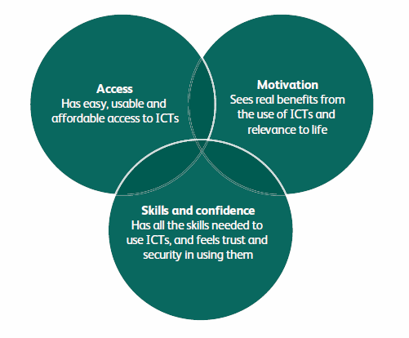
Housing Associations and Digital Inclusion
46% of social housing tenants do not have access to the internet within their own home- 214,000 tenants across Wales
Barriers to Digital
Inclusion:
Motivation 34%
Skills 20%
Access (cost) 46%
Notes:
We frequently hear of statistics stating the rise in the number of people using the internet, but these figures often overshadow those most deprived in society who still do not have access to the internet- and these people are becoming increasingly marginalised and socially deprived as a society moves to a digital movement
In Wales, 46% of social housing tenants do not have access the internet in their own home. This figure is from welsh government internet access use figures and is supported by our own survey results.
These social housing tenants lack access due to any of these three barriers- motivation, skills or cost of access. Either they don't see the benefits of using the internet, they don't have the skills, or they cannot afford to purchase a home internet package.
Those not online cite
46% cost barrier
Motivation- 34%
Skills- 20%

Slide 9
Motivation
Case study:
Monmouthshire Housing Association: Computers in the community
Notes:
Will it inadvertently be addressed with the introduction of universal credit?
MHA- recognised that skills, employment and digital inclusion go hand in hand. Made sense to team them together- easier to engage and motivate if shown benefits of getting online.
Computers in the Community’ is a scheme that forms part of the ‘Work & Skills Wise Service’. The ‘Work & Skills Wise Service’ is the name given to our training, education and employment programme. ‘Computers in the Community’ is a computer loan scheme that allows MHA tenants to borrow laptop computers from MHA for a certain period of time. The laptops are provided in order to help you complete educational courses and learn computer related skills.
If you are successful with your application, the laptop will be loaned to you free of charge. Any other fees such as the cost of an internet connection and other equipment are your responsibility.
Upon approval for the scheme and signing the user agreement, MHA will deliver the laptop computer to you ready for use. MHA will take care of any fault that develops during the loan of the laptop. However, any wilful damage will be the responsibility of the user. The laptop will be ‘Wi-Fi’ (wireless internet) enabled and you will be able to immediately access the internet if you have a wireless connection. Note: MHA will not provide or pay for an Internet connection. It will be up to you, the user, to provide this.
1. The applicant must be a tenant of MHA - as part of the family named on the Tenancy Agreement. 2. The applicant must be on a course. 3. He/she must have completed two courses already, adding up to a total of 12 weeks. 4. He/she must be willing to enrol on further courses. If the participant is only willing to take one course, the participant will have the laptop for the duration of the course plus six further weeks. 5. He/she must be willing to engage with MHA and other providers who offer support for employment. 6. The recipient must not normally have access to a computer in the home. 7. Only one laptop can be issued per household. 8. MHA reserves the right to use discretion in the loan of laptops by the waiver of certain conditions, or the refusal of a loan.

Slide 10
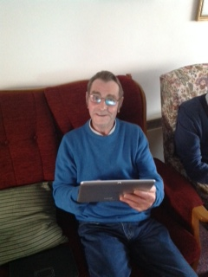
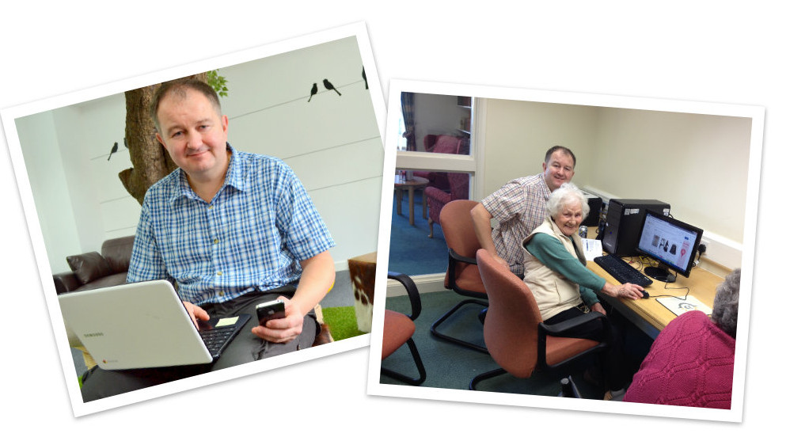
Skills
Case study:
Coastal Housing: Digital Training Sessions
Notes:
Coastal received funding from Communities 2.0 which helped employ a tutor to help run the course as well. Nigel also provided additional one to one support in their homes to help them set up and connect to Wi-Fi, download Apps, and any support they required.

Slide 11
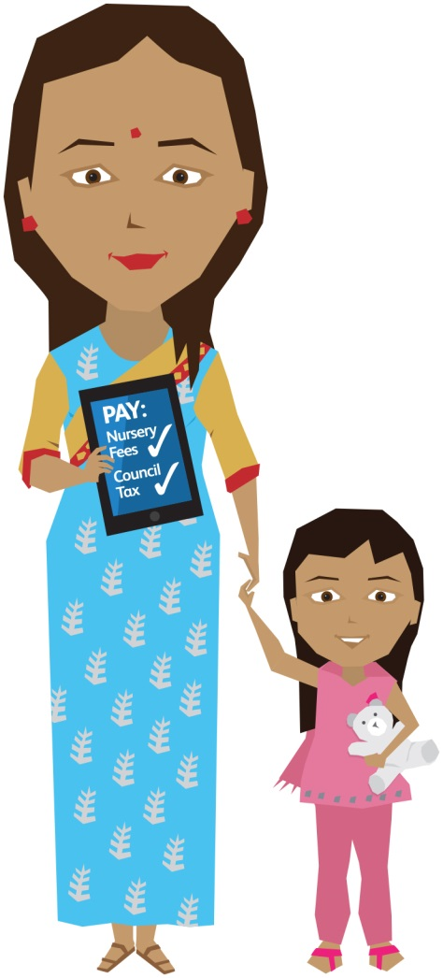
Access: going mobile
Case study:
United Welsh: Going Mobile
Notes:
United Welsh has developed a new app for tenants on mobile phones and tablets. Louise Taggart explains the thinking… The decision to create an app for our tenants was the next logical step for United Welsh. When we looked at how our main website was accessed, we found that only 33 per cent of visits were from traditional desktops or laptops; the other 67 per cent were from tablets or smart phones. Our tenants clearly want to interact with us at a time and place which fits around their lives so we needed a more mobile-friendly solution. The tenant web portal for our website and app allows tenants to do a range of things including: update contact details; view important tenancy documents; see live rent balances and statements; make a payment; report repairs; and see what community events and projects are happening in their area. As part of our digital inclusion strategy we are targeting tenants that are not online and offering free training, affordable equipment schemes and the use of free Wi-Fi which we’ve installed in the shared areas of all of our communal schemes. We have recently started providing mobile IT lessons in the community using our brand new ‘Information Station’ van. With Wi-Fi, comfy seats and the ability to travel to any area, we have been using the van to access communities across our 5,000+ properties to ensure nobody is left behind. We also use this as a chance to let tenants know about the app and show them how to use it. All frontline staff will be trained in how to download and use the app so they can help as many tenants as possible sign up.
Also many examples across wales of laptop and computer loan schemes, working with local credit unions

Slide 12
Access: getting online in the home. Issues for tenants:
What use is it to me? - Motivation
Lack of landlines, mobile use – practical
I don’t know how to use it – Skills
Cost of broadband - regular outlay v “pay as you go”
Cost and choice – of equipment
If I don’t have I might lose my benefits – Consequences
I could save a lot of money and other Benefits

Slide 13
Issues and Challenges for Housing Associations
Why bother? – the business case – the benefits for us and tenants
Threat to income - tenants lose benefits
Lack of technical knowledge – what’s best solution?
Which supplier to go to - Lambs to the slaughter?
Shifting risk – from supplier to RSL
Who bears the cost; Subsidy or not? Tenant or RSL
Who trains and supports them

Slide 14
Issues and Challenges for Suppliers
Untapped potential market
Current delivery models profitable – landlines make the money
New delivery models could undermine mainstream models
Risk of payment defaults
Upfront investment – who pays
Shifting the burden of risk and investment

Slide 15
Work so far
Community Housing Cymru set up a task and finish group with members from RSLs in July 2013.
Communities 2.0 has provided support to CHC and the task group
A preliminary report presented to WG in Dec 2013 and to RSL CEOs in Feb 14
Business case and project proposals put to WG in May 2014
Ongoing work with National Procurement Service, WG Infrastructure, Housing and DIU teams

Slide 16
Examples in action: Glasgow Housing Association
Glasgow HA / BT Affordable Wi-Fi Access
Teamed up with Scottish Govt. and BT
£70,000 from Scottish Govt.
138 homes in multi-storey block offered tablet to connect to free hi-speed access points
Costs GHA around £5 per tenant a month
Notes:
GHA supplied the tablets
Two-thirds of tenants were now actively seeking employment opportunities online, with 4% gaining employment during the first six months of the project. Just over 60% of residents had also saved more than £100 thanks to the scheme, it reported.

Slide 17
Examples in action: sheltered accommodation
Wales & West HA / BT Sheltered Accom
Meraki Wireless access points installed in over 100 sheltered schemes across Wales
Offered free of charge to residents
Communities 2.0 and BT to train tenants
Community UK.net
Offer WiFi Broadband Network for general needs housing

Slide 18
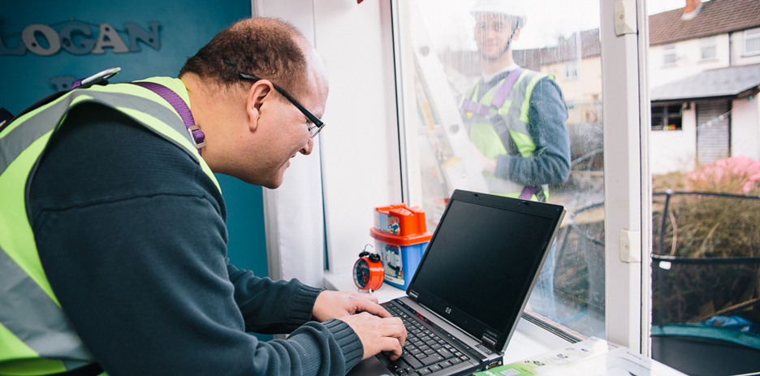
Examples in action: Merthyr Valley Homes
Merthyr Valley Homes/ Guifi Spain
General Housing Stock on Gellideg Estate, Merthyr
Funded by Nominet Trust and MVH. Support from Guifi.net
40 homes piloted community-led network
100% recommended
www.digitalmerthyr.org.uk
Notes:
The picture shows Ian and Tom, volunteers from Digital Merthyr fitting Wi-Fi
Less than a third of the estate was connected to the web. 80% of residents affected by welfare reform- need to be online for UC
£50,000 grant funding from Nominet for design and setting up the prototype
Open- hybrid network from MVH transmitted by series of nodes
Digital Champions received training to help them undertake routine trouble-shooting and maintenance activities.
100% would recommend the network to others on the basis of price, quality of connection
Ian (on computer) holds the estates network phone so that residents can call him if something goes wrong because he is on hand to provide them with advice and support if needed. He reports his computer skills have ‘massively improved’ such that he now has a good understanding of mesh networking and networks in general.
Going forward….
About to start the next phase of the project. This includes installing another 62 homes on the Gellideg estate which will bring our total up to 104 connections in total. Following that MVH are looking at setting up another part of the network in Mandeg, Trelewis. They will install another 50 connections there bringing the total number up to 154 connections. MVH are hoping that all this work will be completed within the next 6 months. As for charging the residents MVH havnt started yet but its something that they are definitely looking into maybe for the next phase of the project. May consider merging with a neighbouring HA and look to make a joint application for funding.

Slide 19
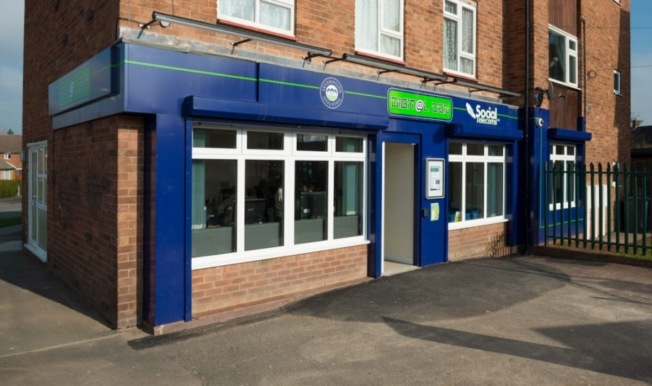
Examples in action: Digital Den
Severnside Housing Association
Digital Den community hub and internet café in Shrewsbury
Wifi to local residents in Meole Brace estate
Training, and refurbished computers

Slide 20
Key findings and conclusions
General market failure – limited alternatives to landlines/fixed contracts
Intervention required – but be wary of state aid issues
Broadband is only part of broader intervention – kit, skills and support
RSLs could use combined purchasing power to influence
Absence of technical knowledge in individual RSLs
Wide variation of technical solutions needed at local level
Decisions to be made by RSLs on whether to subsidise costs
Relationship with suppliers needs to be inverted

Slide 21
What is missing?
Lack of right technical expertise within the housing sector
A list of proven and trusted suppliers
Avoiding legal challenges and state aid issues
Variety of end user packages that minimise risk
Who provides support when things go wrong

Slide 22
Key decisions
To leave it to the market or not
To work collectively or not
To employ missing expertise directly or not
DSW v Procurement Frameworks
How to pump prime
Who pays – RSLs, WG, Market
Should tenants pay full cost?

Slide 23
Digital Solutions Wales
A small team employed within CHC
Project lead
Technical officer
Procurement & contracts officer

Slide 24
My details
Hayley MacNamara
Regeneration Officer
Community Housing Cymru
E-mail: hayley-macnamara@chcymru.org.uk
Twitter: @hayley_CHC

