Slide 1
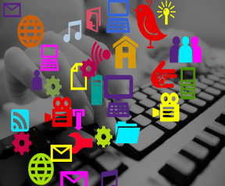
“DIGITAL or DIE….”
The Future of
Tenant
Interaction
Martin Wicks - Cisco
Customer Experience Consultant
March 4th 2015

Slide 2
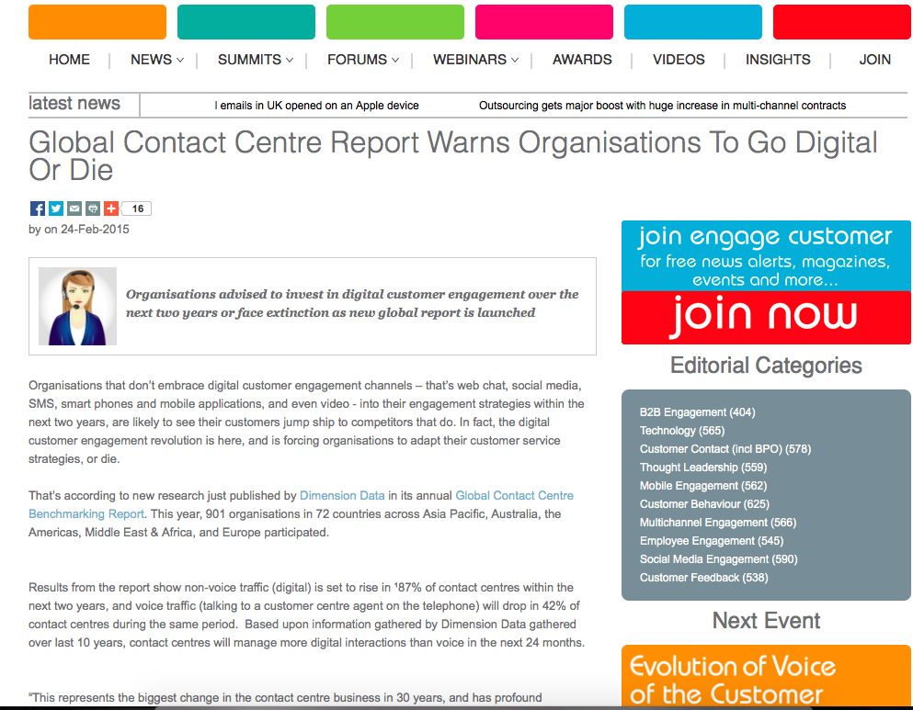
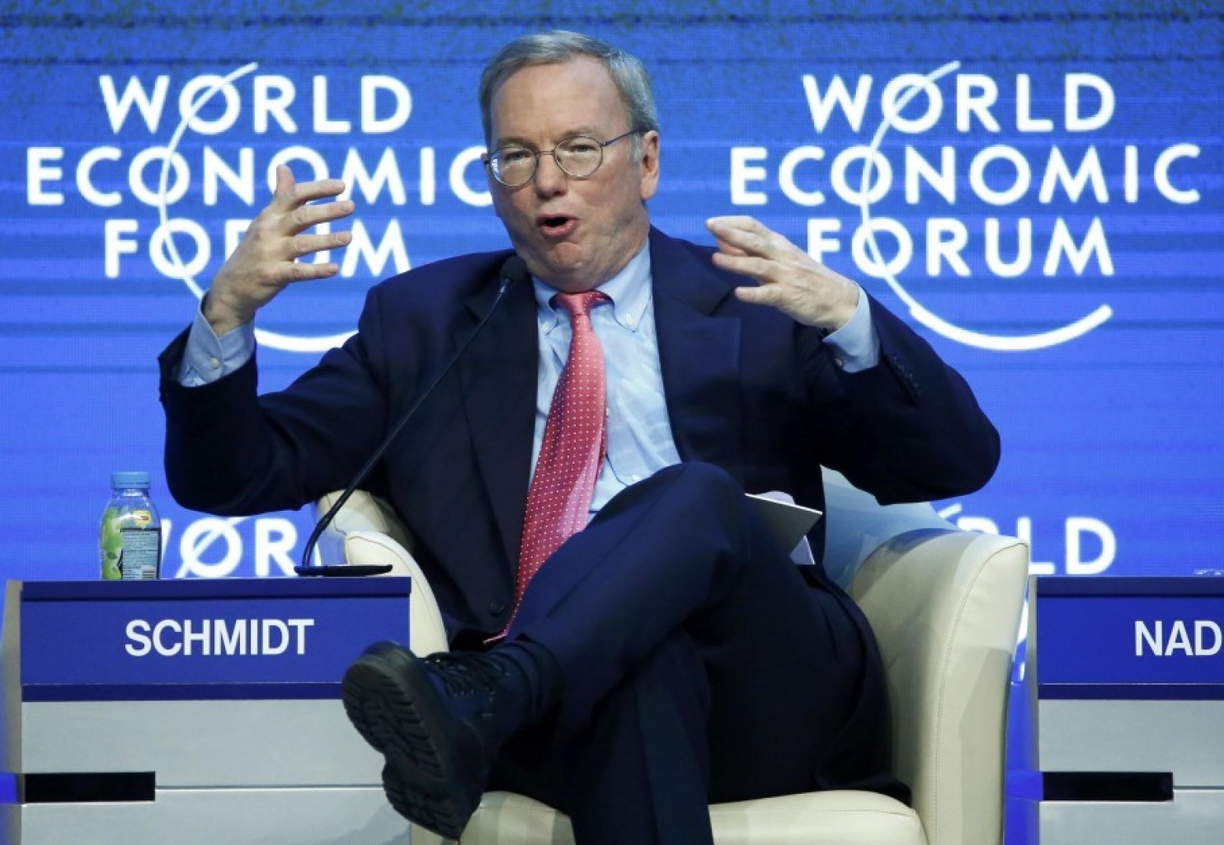
The end of the Internet is drawing near…
While speaking at the World Economic Forum in Davos, Switzerland, Google's executive chairman, Eric Schmidt, said the current Internet will vanish as it becomes a part of everyday objects and services.
"There will be so many IP addresses, so many devices, sensors, things that you are wearing, things that you are interacting with that you won't even sense it," Schmidt said. "It will be part of your presence all the time."

Slide 3
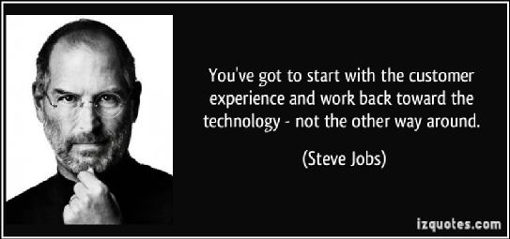

Slide 4
TRENDS AS WE SEE THEM
DIGITAL FIRST
DATA IS THE NEW OIL
RE-HUMANISING CARE
SMART THINGS

Slide 5
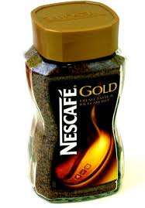
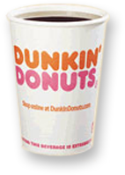
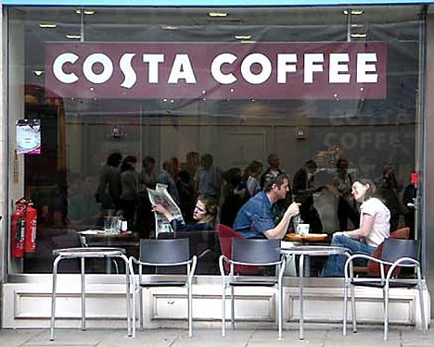
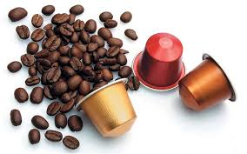
Experience Differentiation Adding Value To Commodity Product
0.05–0.12
Per Cup
0.15–0.25 Per Cup
0.75–1.50 Per Cup
2.00–3.00 Per Cup
Prevailing prices for various coffee offerings
Commodity
Good
Service
Experience
Graphic: BusinessWeek, 2005
Source: Pine and Gilmore, The Experience Economy, 1999
Notes:
Customers are increasingly demanding and expecting experiences, not just products. On top of this, they are willing to pay a premium for those experiences.
A good example of this is a basic commodity product—coffee. According to Pine and Gilmour in their book The Experience Economy, products have evolved from commodities to goods to services to experiences. Companies have figured out ways to add value through this migration from commodities to experiences, and consumers now expect high-quality and differentiated experiences.
Coffee proves a great example. As a commodity, it costs approximately $0.01 to $0.02 per cup. Yet, Starbucks has developed a way to wrap an experience around this commodity, enabling it to charge anywhere from $2 to $5 per cup, depending on the size and the extra items added to the coffee.
Source: Pine and Gilmore, The Experience Economy, 1999

Slide 7
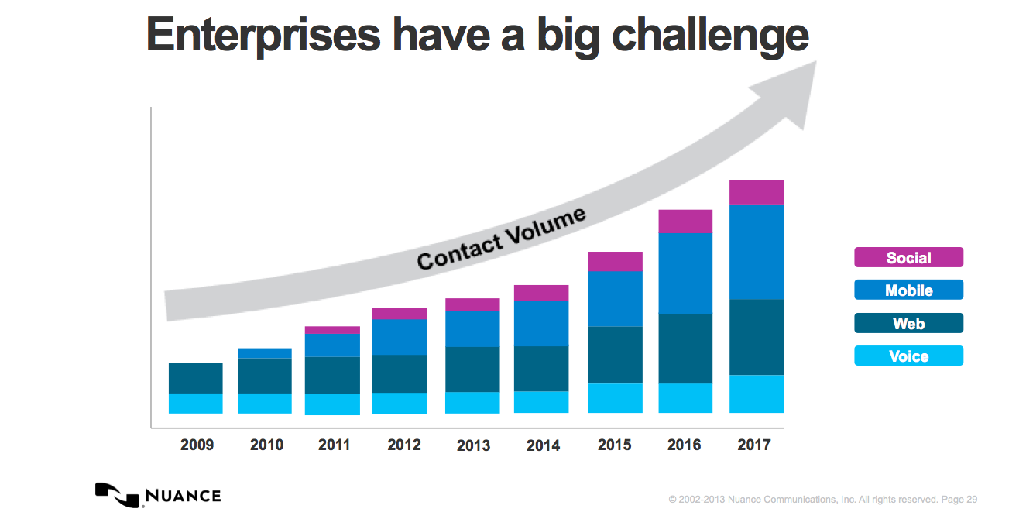

Slide 8
DIGITAL FIRST CUSTOMER EXPERIENCE – TENANT INTERACTION
Consistent experience across all channels
Multiple channels but minimal cross channel consistency
Wave 3:
Omnichannel
Web
Wave 2:
Multichannel
Today
SMS
Mobile
Chat
Contact Center
Wave 1:
Voice Channel
Social Media
Email
Customer
Online
Customer
Care Centre
Branch
Kiosk
Voice
Brick and Mortar
Virtual Customer Care

Slide 9
DIGITAL FIRST Omni-Channel First is a Strategy
“Ensuring a continuous and consistent high-quality experience regardless of how, when, and where a citizen chooses to engage with your organisation and no matter what the purpose”
Web
SMS
Mobile
Chat
Contact Center
Social Media
Email
Customer
Reduce
Customer
Effort
Personal
Customer
Journeys
Persistent
Context
And Data
Kiosk
Voice
Brick and Mortar
Notes:
1. CEO’s Now mention CXP in earnings transcripts
2. Chief Digital Officer and Chief Customer Experience Officer
3. NPS is now a commonly accepted Business Outcome
4. Loyalty is a Global Business Phenomenon
5. George to Push Web Site to Zack (e.g. Satmetrix NPS Community) and co-browses
(Screen Share, Co-Browse, Annotation)

Slide 10
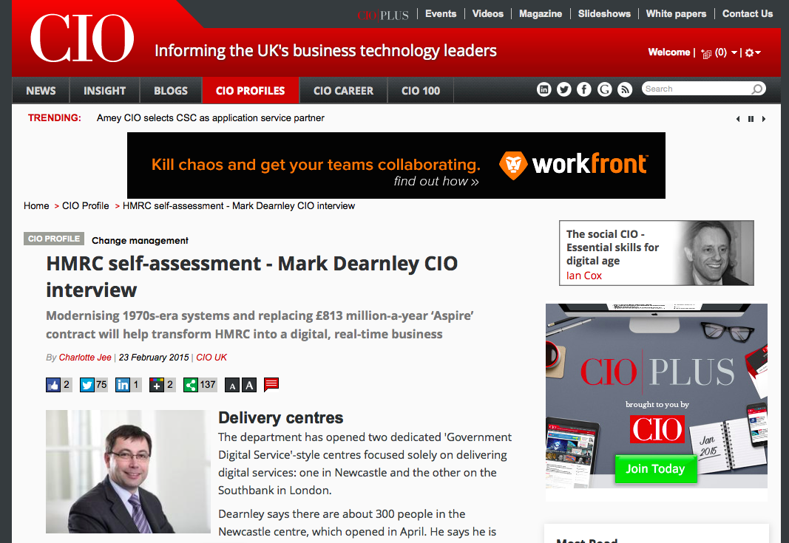
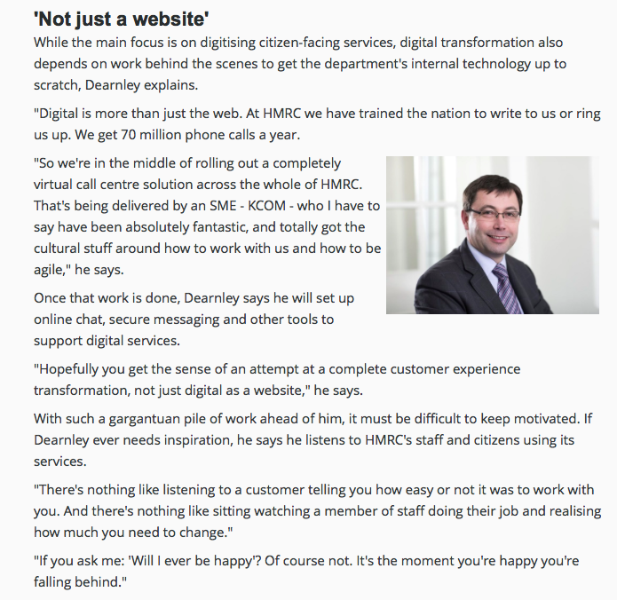

Slide 11
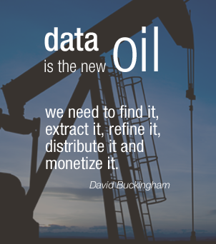
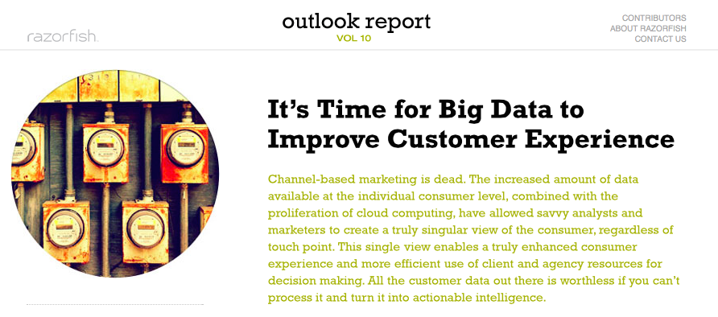
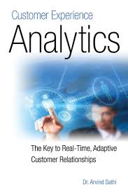
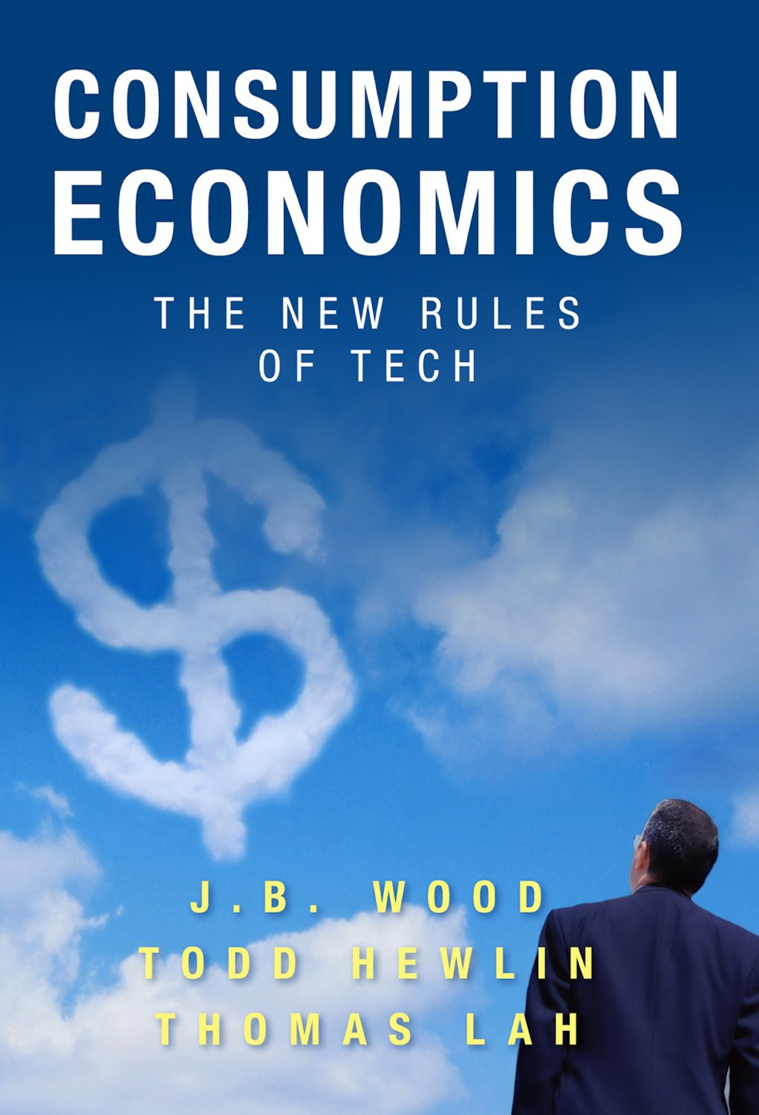
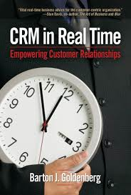

Slide 12
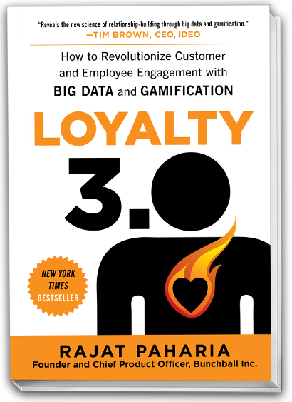
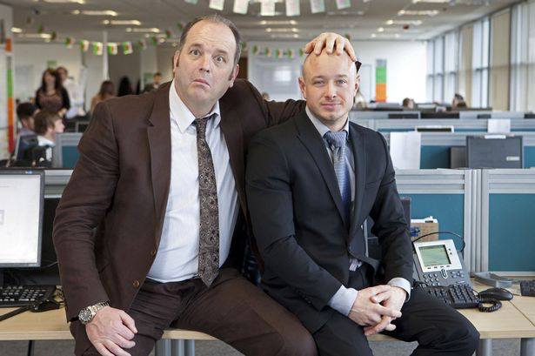
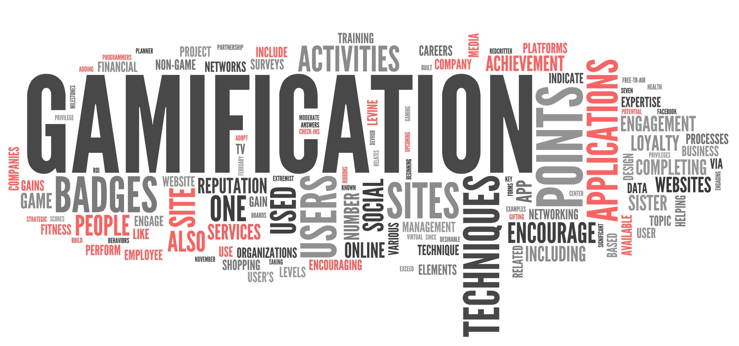
GAMIFICATION
REWARD AND NURTURE
Notes:
But there also some very positive opportunities presented by the empowered consumer.
The upcoming generation is more comfortable with self-service and automation than previous consumers, if these services are well executed. They are also looking to new channels, such as the mobile Internet and SMS messaging, through which to manage their service interactions.
These new expectations and capabilities are beginning to force a redefinition of the contact Centre, which will undoubtedly accelerate over the next three-to-five years.

Slide 13
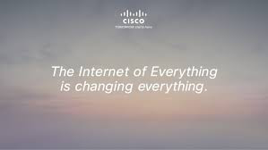
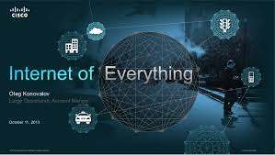
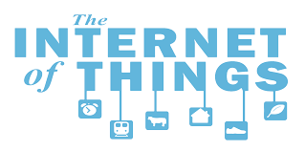
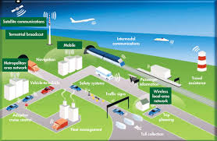
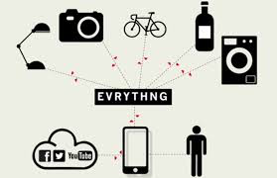
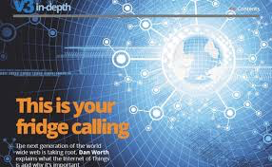
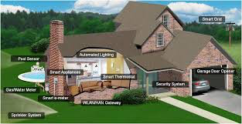
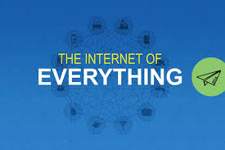
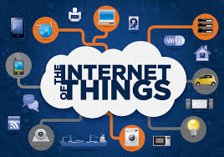
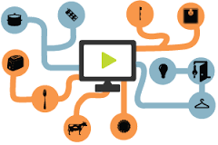
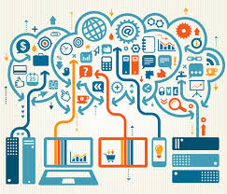
SMART THINGS

Slide 14
IoE Consists of M2M, M2P, and P2P Connections
Connection Type
IoE Value (2013-2022)
Machine-to-Machine (M2M)
Data sent/received from one machine (thing) to another
Often called the “Internet of Things”
$7.4 Trillion
Machine-to-Person (M2P)
Data sent/received from a machine (thing) to a person
Often called “data and analytics”
$4.6 Trillion
Person-to-Person (P2P)
Data sent/received from one person to another
Often called “collaboration”
$7.0 Trillion
Notes:
So let’s look at these connections. The best way to understand the value that the Internet of Everything (IoE) brings is to think in terms of connections. This approach also helps us place the Internet of Things (IoT) in its proper context within IoE.
There are three main types of connections, which we covered in our original thought leadership:
Machine-to-Machine (M2M) Connections: Information transferred from one machine or “thing” to another over a network. Machines include sensors, robots, computers, and mobile devices. Often called the Internet of Things.
Machine-to-People (M2P) Connections: Information transferred from a machine (such as a computer, mobile device, digital sign) to a person, or vice versa. Whether a person gets information from a database, or conducts a complex analysis, this is an M2P connection. Often called Data & Analytics.
People-to-People (P2P) Connections: Information transferred from one person to another. Increasingly, P2P connections happen virtually, through video, mobile devices, and social networks. Often called Collaboration.
This is a good time pause to highlight the difference between IoT and IoE, which is a common source of confusion. Properly understood, the IoT is an important part—but just a part—of IoE. It’s a subset that focuses, more or less, on the connections between machines. Cisco has placed a big bet on this space, but we have much, much more to offer to help customers address the opportunities presented by IoE, as you will see in the course of these Reference Materials.

Slide 15
When Connections Are Combined, We Solve Higher-Order Business Problems
IoE
Highest-Value
IoE Business
Models and
Innovations
Machine-to-Machine (M2M)
Connections (IoT)
Machine-to-Person (M2P) Connections
(Data and Analytics)
Person-to-Person (P2P) Connections
(Collaboration)
Notes:
When we examine the three types of connections graphically, additional insights emerge.
Solutions that exist in the overlapping areas, especially the middle where all three types of connections come together, generate the most value for businesses.
Let’s look at three examples to show how the business value from IoE increases as different types of connections come into play.

Slide 16
What New and Better Connections Mean for the Public Sector
Connections
Value of Combined Connections
Impacts
M2M
Smart buildings and campuses
Smart lighting
Smart payments
Intelligent public transit
Smart grid
Citizen/Employee /Student Experience
Improved Asset Utilization
New Revenue Streams
Energy Optimization
M2P
Video surveillance
Smart parking
Disaster response
In-patient monitoring
Enhanced Security, Safer Communities
Increased Revenue/ Compliance
Smart Public Safety Fleets
Better Health Outcomes
P2P
Telework
BYOD
Connected learning
Travel avoidance
Expertise availability
Work/life balance
Employee Productivity
Lower Costs
Improved Student Outcomes
Increased Efficiency through Remote Testimony
Notes:
As with Retail, creating new and better connections, and lighting up “dark” assets, can pay enormous dividends for governments.

Slide 17
Tenant Services must go DIGITAL
Technologically-Challenged
IVR
Email
Product-focused
patient
Loyal
Branch
Intuition-driven
Low-Expectations
Call Centre
Linear-growth
Face-to-Face Centric
Fax
Mail
Traditional
Tenant
Channels
Businesses
Digitisation
Tech-Savvy
Social Media
Tenant-focused
Knowledgeable
Mobile
Video
Knowledge-Driven
Empowered
Always on
Web Self-Service
Exponential-growth
Impatient
Kiosks
Chat
Innovative
Have Choice
Digital
Tenant
Digital
Channels
Digital
Businesses

