Slide 1

Transforming front-line housing services through mobile technology
Peter Fitzhenry

Slide 2

Thou shall go forth & multiply in a productive manner
Thou shall not forget thy visitors to thy website
for they are good
And lo, thou shall lower thy cost base
Thou shall get close to thy customers
And welcome all my creatures at the doorstep,
in the air and on the phone
Prepare ye for the way of the Duncan Smith,
for he will treat with no shirkers
Thou shalt embrace the world of tablets whilst forsaking the laptop and desktop
And covert not thy neighbour’s ass

Slide 3
A focus on functions
Anti social behaviour
Money advice
Support
Caretaking
Gas servicing
Property viewing
Welfare Reform
Tenancy matters
Rent
arrears
Estates
Furnished tenancy
Sign up
Liaison with contractors
Tenant

Slide 4










Business practice?

Slide 5





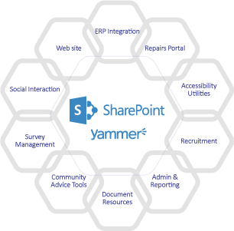



Replaced by a focus on people
Mobile Workforce
Website, Intranet & Portal
Tenant Service
Tenant
Business efficiency
Business efficiency

Slide 6
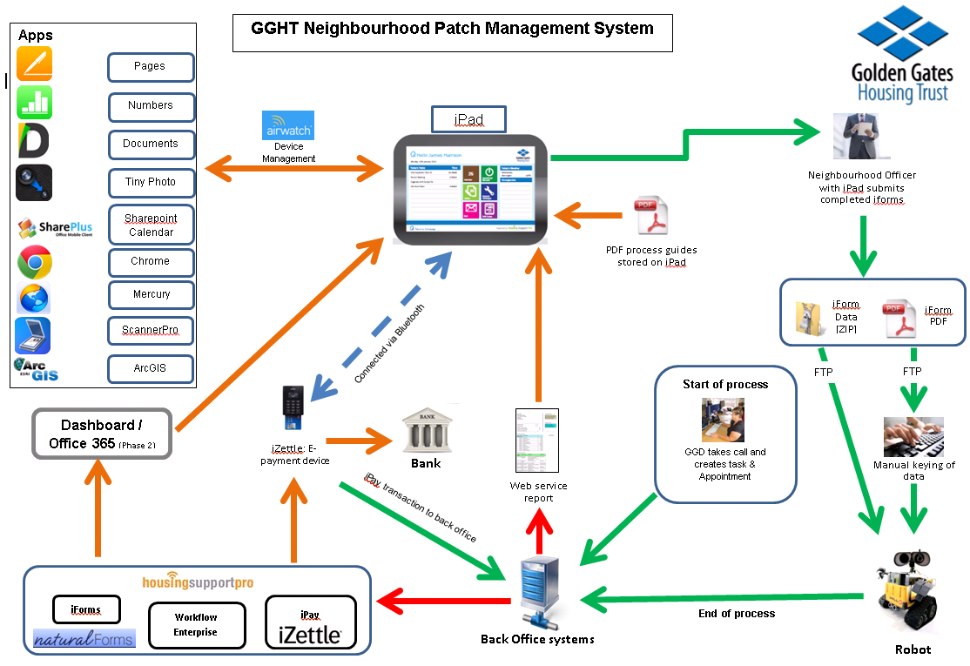

Slide 7












Replaced by a focus on people
Remote working
Home start
Flexibility
Chip & pin Payment
Lone worker
Up-to-date campaigns
Budget tools
Performance
Integration
Right first time
Cut out paper
Detect fraud
Joined up apps and iForms
Bat phone
iPay
But it’s just an iPad !

Slide 8


Lone worker protection
Backed by Guardian24™ and SkyGuard™
  Staff protection on smart phone & tablet
  Integrated panic buttons / alerts on phone and tablet forms
  Compliant with BS8484 and BS5979
  Detailed location info supplied with each alert 24/7, 365 days / year

Slide 9

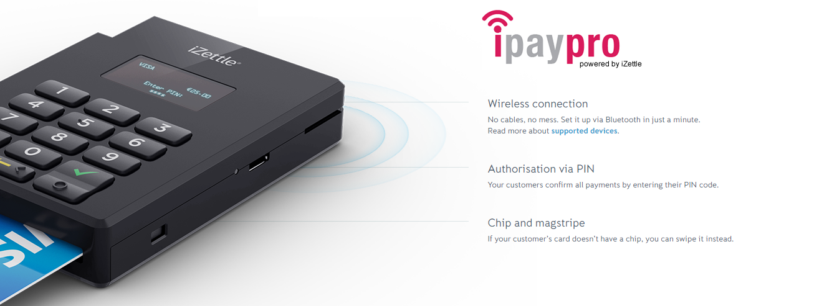
Chip & Pin payments
Chip & Pin payment App
  Accept secure, PCI accredited chip & pin payments
  Smart phones or tablet based
  Immediate receipt generation
  Detailed transaction information & payment in 48 hours

Slide 10

Phase one 93 days
Neighbourhoods first
Front line staff led
Rapid response
Low key launch on time

Slide 11


Slide 12


Slide 13







Building on the foundation

Slide 14

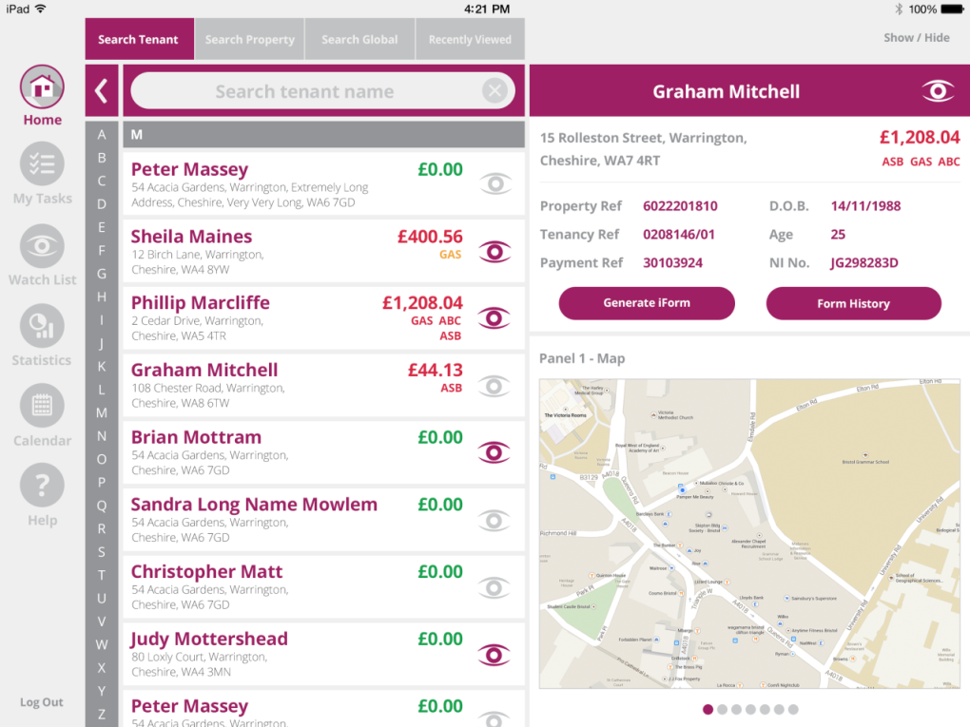
let’s focus on people
Neighbourhood and Tenant Management App
  100% offline working with electronic service forms
  Generate pre-populated forms
  Search for tenant / property offline
  Automated receipts & service alerts to ensure services deliver

Slide 15

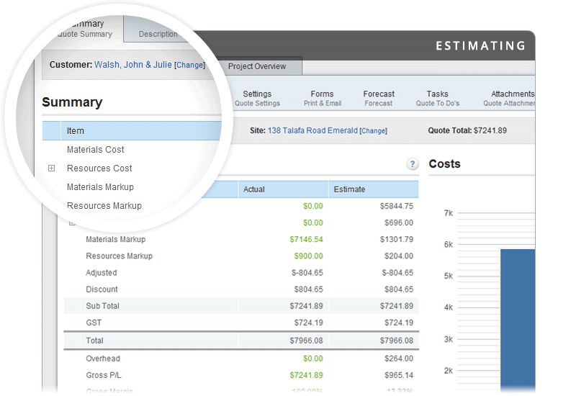
property & repairs
Property, Engineer & Repair Management App
  100% offline working on smart phones & tablets
  Job scheduling & dispatch directly to the phone
  Schedule planned work or responsive repairs in real-time
  Automated alerts for jobs, equipment testing and planned works

Slide 16

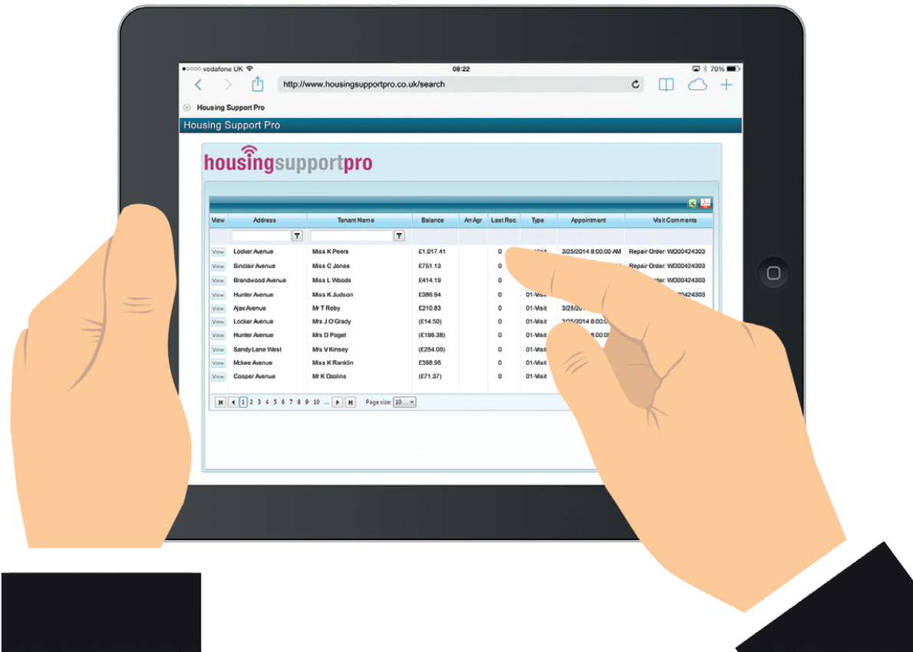
In-built service statistics
Integrated Information warehouse to allow service tracking
  Staff performance
  Service statistics (including trend analysis)
  Understand the services that your tenants require
  Improved service quality

Slide 17


Benefits of the approach
Remote working
Home start
Quality of Tenant & Property Info
Flexibility
Chip & Pin Payments
Lone worker Safety Protection
Up-to-date campaigns
Engineer Management
Real-time information & service receipts
Integration to Housing Systems
But it’s just an iPad !

Slide 18

Business Benefits
£504,000 capital savings
– reduced accommodation needs
£250,000 efficiency savings from back-office and switching to online services
47%
reduction in paperwork and handover work
mmm…this proof is delicious!
i
i
i
29%
productivity
gains
7%
increase in cash collection in 2014-15
£80-100K insurance claims savings
h
h
i

Slide 19
Thank you for listening
Any questions?

