Slide 1
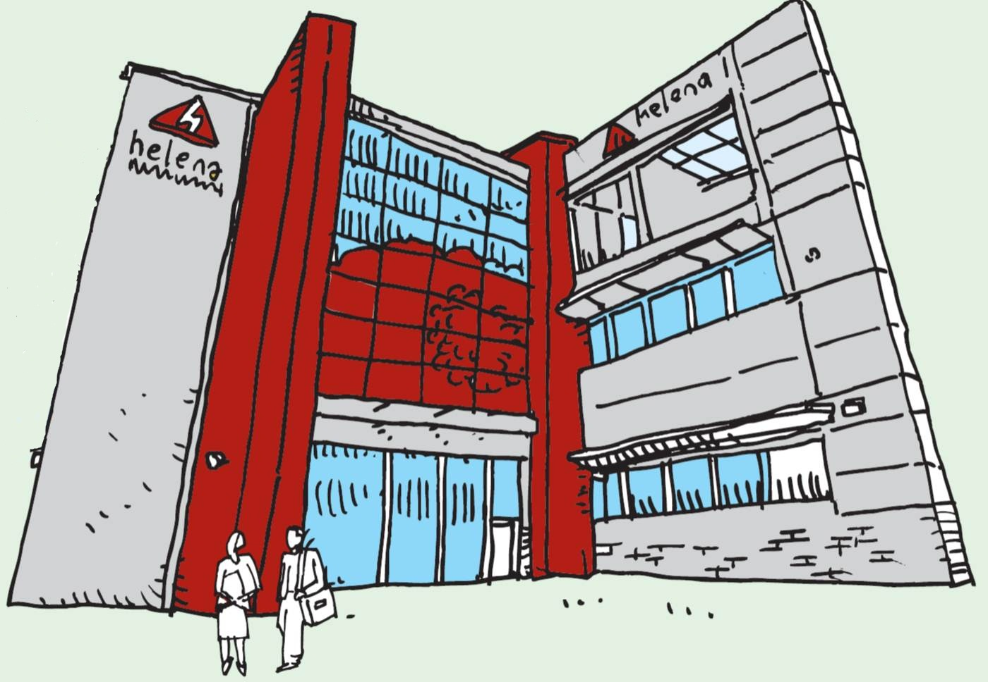
CRM, Mobile Working and Straight Through Processing?
Louise Hodgson Dave Roberts
CRM Strategy Manager Service Development Manager

Slide 2
Why CRM!
Customer Vs Property
Customer Insight
Knowledge Management
Strategy over Technology

Slide 3
Effective CRM
Vision
Strategies
Processes
Information
Skills
Technologies
Organisation

Slide 4
2012 /3
ASB Case Management
Workflow
Process Reviews
2010/ 1
Developed In house
2013/4
Roll out to all business
Indicators
Enhancements
2014/5
Shared Ownership Process
Complaints Process
B2B Customers
Helena Extra
Total Mobile Integration
Data Audit
Experian / CI
Business Change
ICO Audit
Options Appraisal
Target CRM – The Path so Far

Slide 5
Before
Little IT Investment
Silo Teams
Disparate Processes
Numerous Forms
Excel and Paper
No Performance Data

Slide 6
Aims of Sustain Project
Enhanced Customer Journey
CRM
Case management
Big Data
Straight Through Processing
Anyone Anywhere
Cost Effective Solution

Slide 7
Stages of Project
Project Initiation
Sustain and Success?
Jun 2013
Specification
Apr 2014
Business Change
Dec 2013
Jan 2015

Slide 8
Business Changes
Business Draft tool
Process mapping
Clear customer journey
Training /Change Management / Culture
Device Choice

Slide 9
Development
Sustain
Case Management
Security / Visibility
Total Mobile / integrated Forms
CRM Indicators
Suite of Reports
Admin Module
Replace Systems
Wroses
Titan
Customer Insight and Propensity Models
Excel

Slide 10
Sustain Process
Closure
Assessments
Interventions
Referrals
Vulnerabilities

Slide 11
Sustain and CRM
Person Centric Processes
One Picture
Easy to Integrate
Data Rich
Proactive Approach

Slide 12
Case Management in CRM
Flexible
Sub stages and Next Steps
Maps
Audit /Security / Visibility
Document Storage
To-Do-List
Integrated Forms

Slide 13
Total Mobile
Replacement of Open Mobile
Fully integrated Solution
Developed in House
Choice of Devices and PC’s
Integrated into .NET
Generic Processor
Folios
Metadata

Slide 14
Straight through Processing
Customer Touch Point
Total Mobile Form
Generic TM Processor
TM Holding /Reporting Database
Multi System Interfacing
CRM
Device
PC
Automated Reporting
Metadata

Slide 15
The Data
Super Form
DMS
Open Housing
CRM
Form Database
External Agencies
Customer Portals
Keystone
CI

Slide 16
Successes & Future
Live January 2015
Concept Proof
Better Data
Time Saving
Universal Credit
Telephony
Use of Tasks

Slide 17
Terrible CRM’s
“They are terrible when they are not implemented the right way.
They are terrible when companies don’t appreciate that all of these magical applications are nothing but databases and don’t put the right processes in place to ensure that all interactions are entered into this database so that the data can be properly used for further sales, marketing and service interactions.
They are terrible when companies don’t assign strong administrators, or cut corners on training or try to do too much at one time.
They are terrible when senior managers don’t pay the attention needed to make these systems successful and instead cave in to the complaints made by lower level employees who don’t want to do the extra work.
These applications are terrible when managers don’t insist on the reports they should be using, don’t enforce rules for entering new opportunities and don’t commit to long-term, consistent and repetitive drip-marketing and communication campaigns using the information maintained by their CRM system to keep their prospects informed and their customers close.”
Gene Marks, Forbes

