Slide 1
Adopting Agile
Paul Creamer, CTO
Jenny McCulloch, Director of Product Innovation

Slide 2
Outline
Our Challenge
Why is Cloud Technology the way forward
The Agile Manifesto
What we did to implement Agile and move to Cloud technology
How does it benefit the customer
What we’ve learnt

Slide 3
The Challenge - 2014
The development team was not delivering quickly enough
The requirements had changed by the time the software was released
The development team appeared to work in isolation
The development team felt undervalued
The business was not happy

Slide 4
Infrastructure
Requirement
Flexibility to increase capacity quickly
Choice between replacing existing hosted infrastructure or moving to cloud
Wanted greater resilience
Did not want to expand infrastructure team
Solution
Agile approach using the cloud
Iterated available solutions
Used off-the-shelf solutions

Slide 5
1st Solution
Outsource the development to Spain
Cheap labour
Give the problem to someone else
Reduce UK staff

Slide 6
2nd Solution
Recruit a UK development team
Introduce Agile
Read the books
Start stand-ups

Slide 7
Solution 3
Recognise that it is a journey
Train key staff
Reset the business expectation
Start the journey

Slide 8
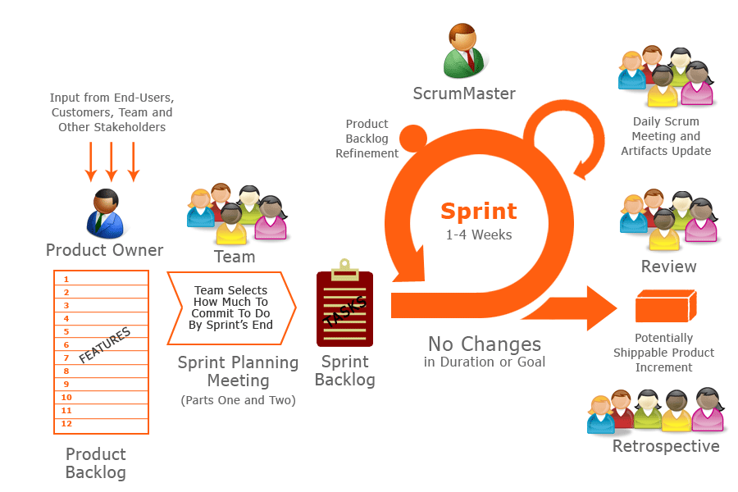
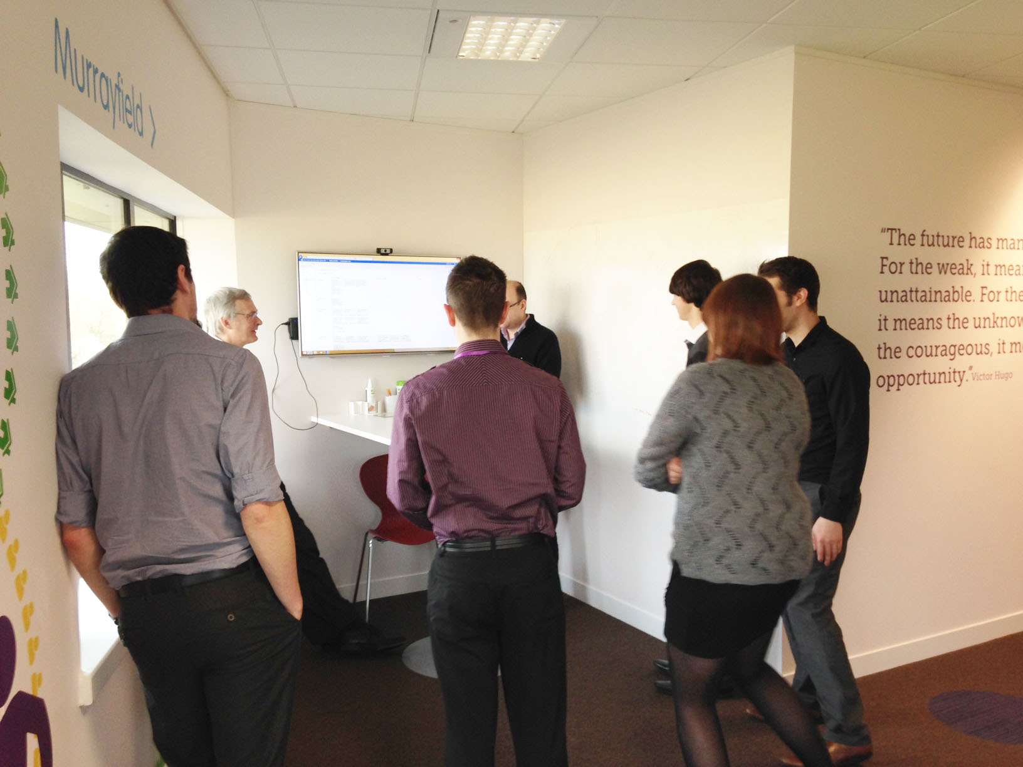
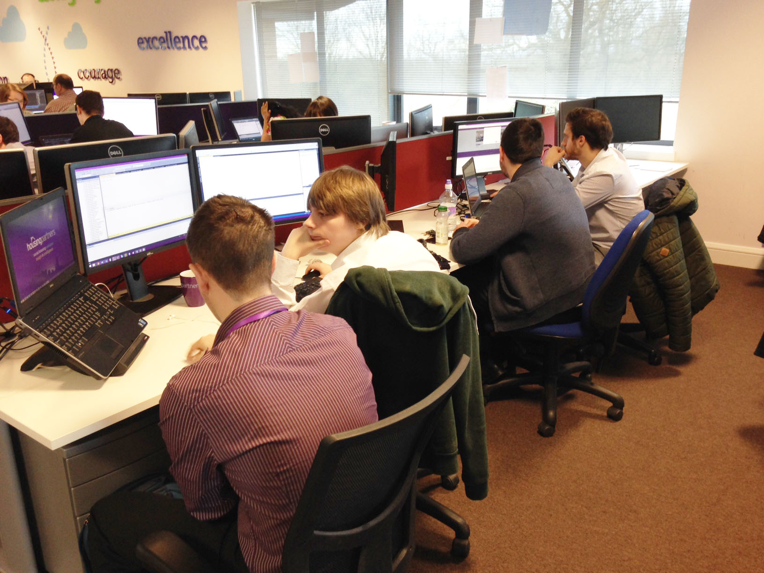
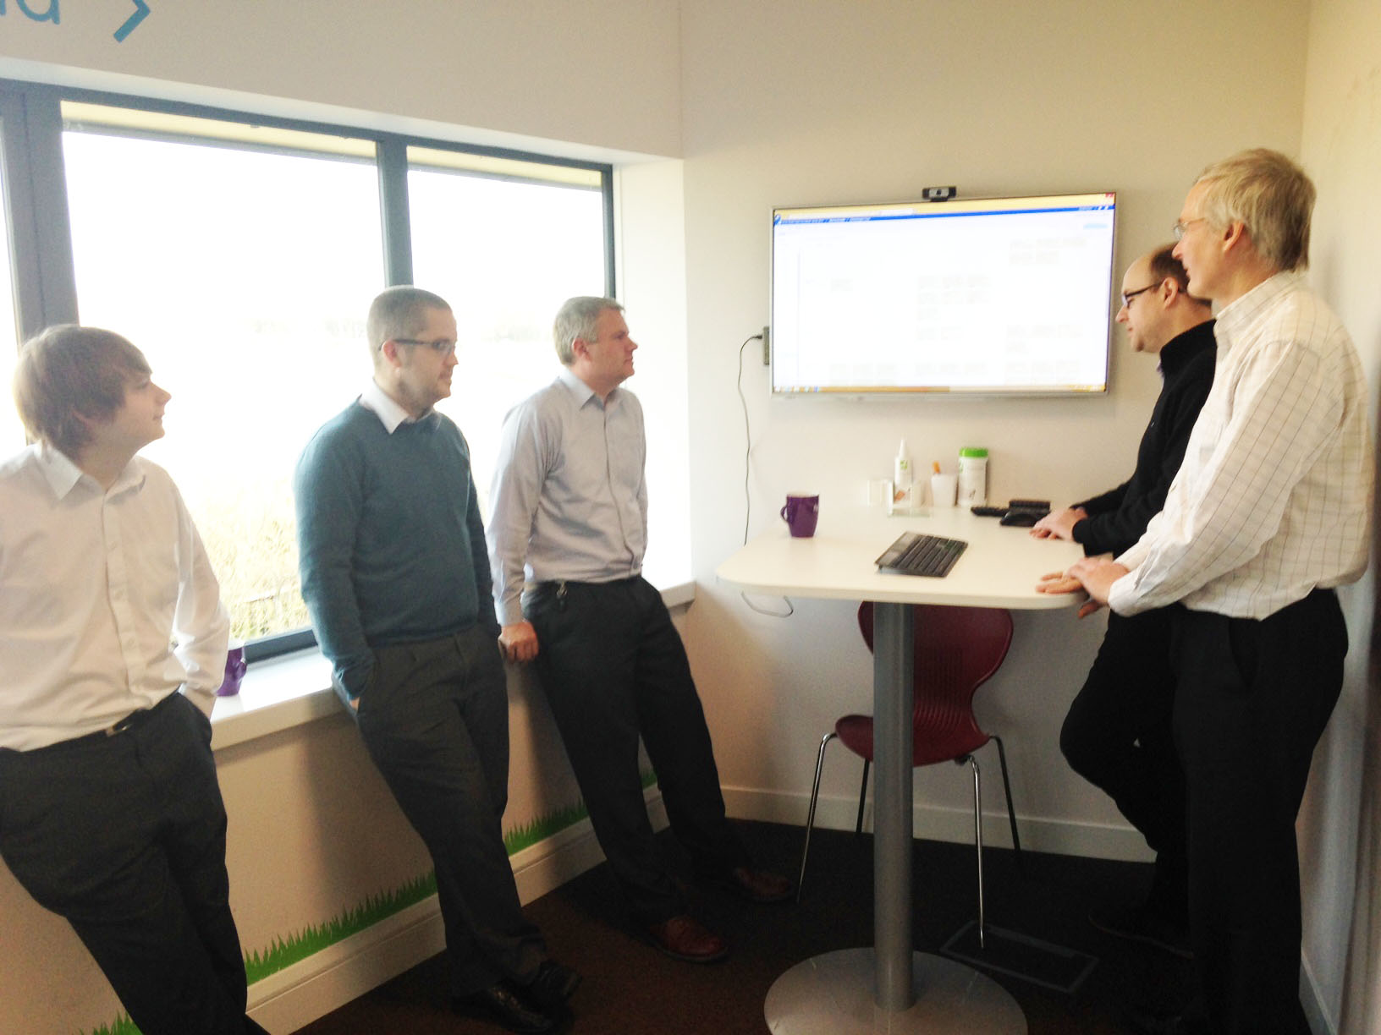
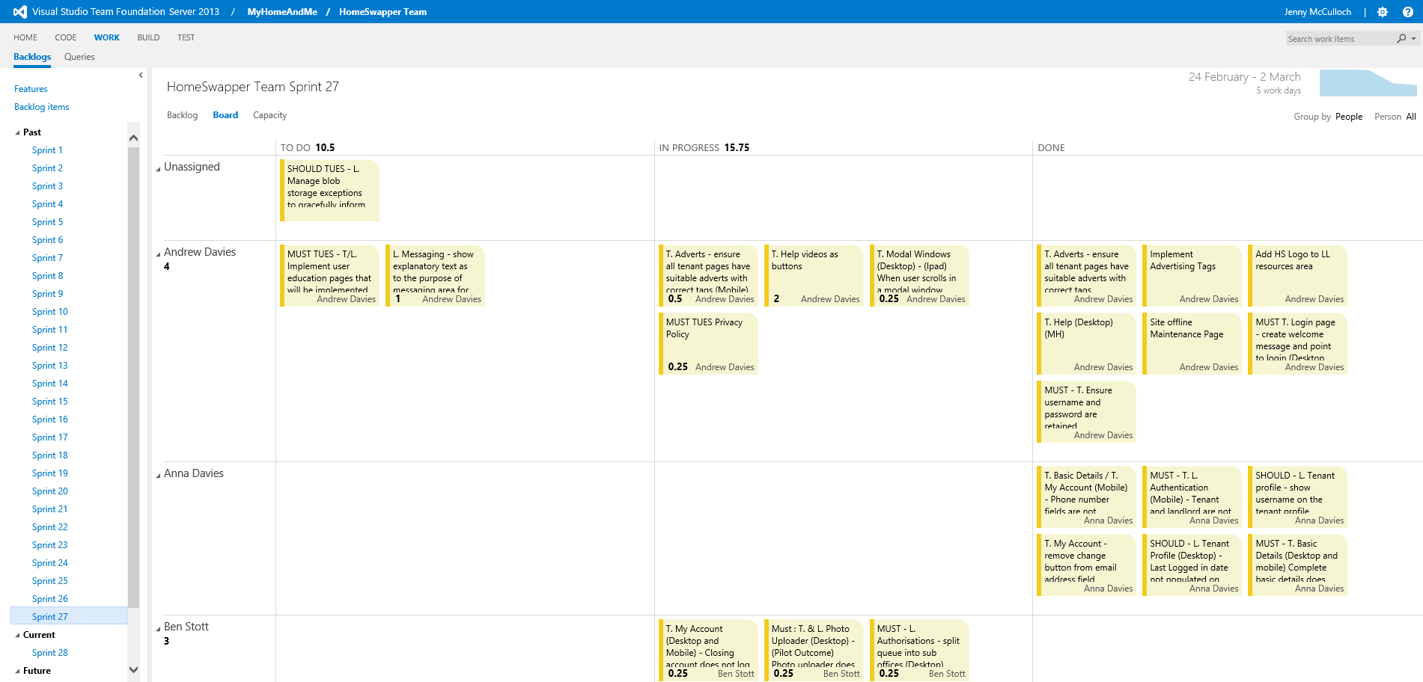
Agile in Practice

Slide 9
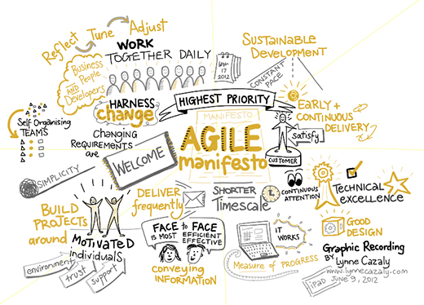

Slide 10
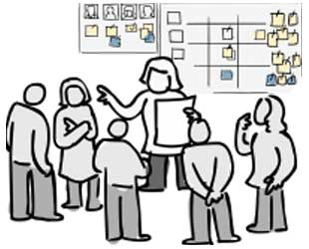
Where are we now
Team working well together
60% along the road
Massive change in productivity
Releasing a new product with monthly updates

Slide 11
THANK YOU
www.housingpartners.co.uk

Slide 12
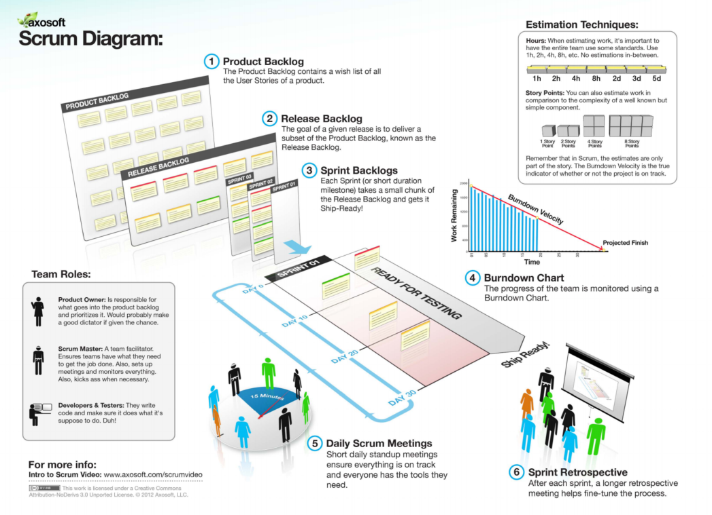

Slide 13
So, what are the benefits of Agile for our customer
Involvement and collaboration
Deliver software frequently on a short timescale
Continual customer engagement and fast feedback loop
Improved product visibility
Happy and Involved Customers!

Slide 15
What we’ve learnt
Barriers
General resistance to change
Lack of understanding that change takes time – not overnight
Lack of understanding of Agile from a management perspective
Availability of personnel with necessary skills
Project complexity (HomeSwapper)
Concerns
Loss of management control
Lack of upfront planning
Lack of documentations
Lack of predictability

Slide 16
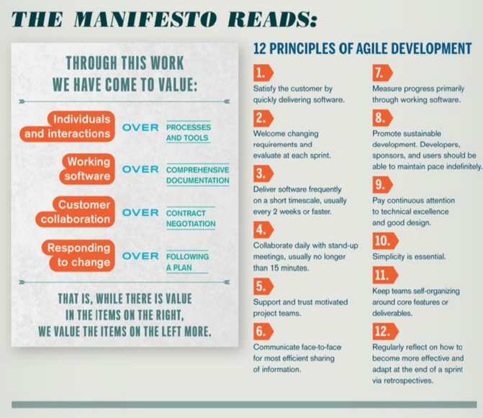
The Agile Manifesto

Slide 17
