Slide 1
What’s next for the key suppliers to the sector?
Aidan Dunphy
Head of Product Strategy
Orchard
March 2015

Slide 2
Who are the “key suppliers”?
Build it yourself
Looks exactly how you want it
...at first
Rapid results
As it grows, becomes harder to maintain and support
Cheaper at the beginning, higher cost of ownership in the long term

Slide 3
Who are the “key suppliers”?
Software Of Unknown Provenance
Usually developed in-house
Poor/no documentation
Knowledge no longer in the organisation
Hard to support, often impossible to maintain
Risky to change/remove

Slide 4
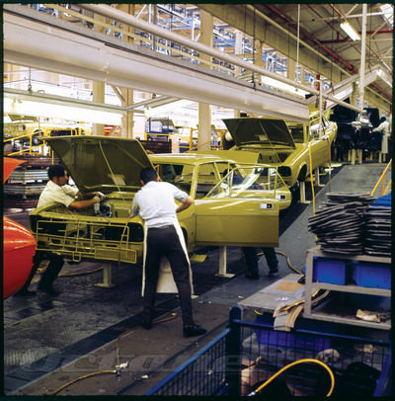
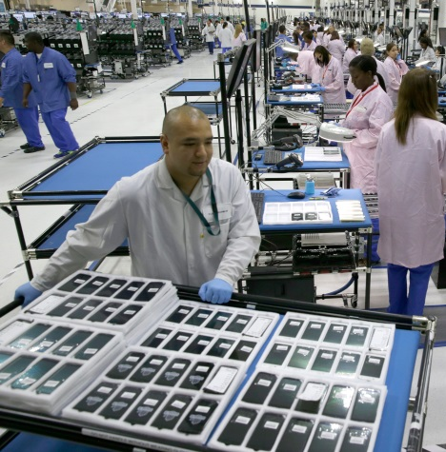
Who are the “key suppliers”?
Commercial Off The Shelf (COTS)
The “C” sometimes taken to stand for “Customisable”
One size mostly fits most (80/20)
Input to design from many clients
Can be slow to develop new features/add-ons due to support burden
High initial cost (traditionally) but very high value for money (no really)
Hard to maintain agility/integration

Slide 5
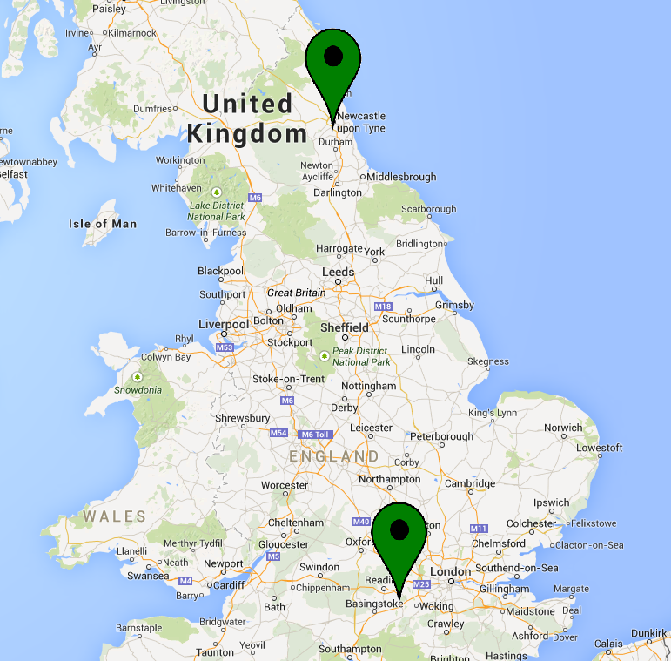
Who is Orchard?
Orchard is a long-standing supplier to the sector. We provide solutions for Housing Management, Finance Management, CRM, Asset Management and Technical Services.
We aim to maintain our position at the forefront of the market by
Maintaining strong client relationships and our market reputation
Continually investing in new technology
Being alive to the changing needs of the market

Slide 6
Sector survey September 2014
Commissioned research to ask “What does the future look like?”
Scope of solutions Delivery Commercials

Slide 7
Which organisations did we target?
30 minute qualitative interview
Targeted by size
IT and Finance
Not targeted at Orchard’s customers
Largest RPs
Target segment
Smallest

Slide 8
What was their level of engagement?
Range of levels of engagement/sophistication with software and IT
Some (mainly IT) highly engaged, able to give technical detail and insight on possible future developments
Others had very little knowledge beyond their current role and product, little awareness of developments in the sector, or beyond
Knowledge & engagement of Finance respondents ranged from detailed to not knowing who the main supplier was (not related to size of organisation)

Slide 9
What solution are they using?
Bespok_

Slide 10
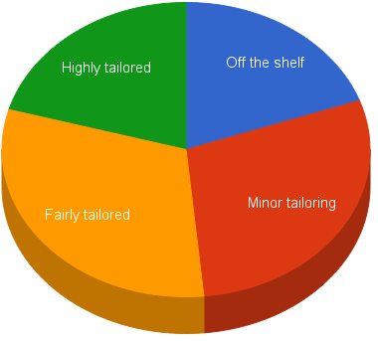
How are these solutions positioned?
Housing, Asset and CRM seen as core functions, yet not all respondents were using all three. Rental and repairs modules are ‘frequent use’
Few feel they have optimal levels of integration with many ‘mix and match’ solutions, particularly with specialist Finance modules and Sage used for payroll
Few feel they have a highly bespoke solution

Slide 11
Strengths
Functionality a hygiene factor
Most common
good customer service experience
positive relationship with the supplier
Also mentioned
Remote or mobile access
Strong integration capabilities
Frequent updates*
* although too many also cited as negative

Slide 12
Ahem… weaknesses...
Many issues with their current software, predominantly:
Integration
Staff skill set
Functionality and complexity
Support
IT and Finance paint a similar picture, however IT Directors gave more detailed feedback
Finance focus on integration / data interrogation capabilities

Slide 13
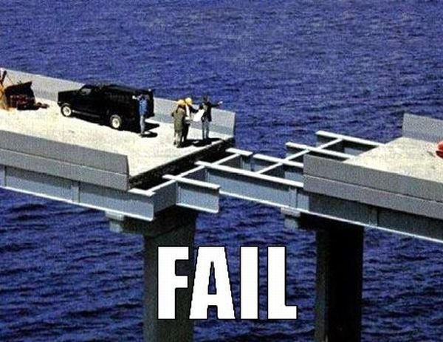
Weakness: Integration
Limited integration of Finance / HR
Want to be able to mix and match different vendors’ solutions
Some feel ‘locked in’ to inferior modules
Customisation inadequate - have to compromise

Slide 14
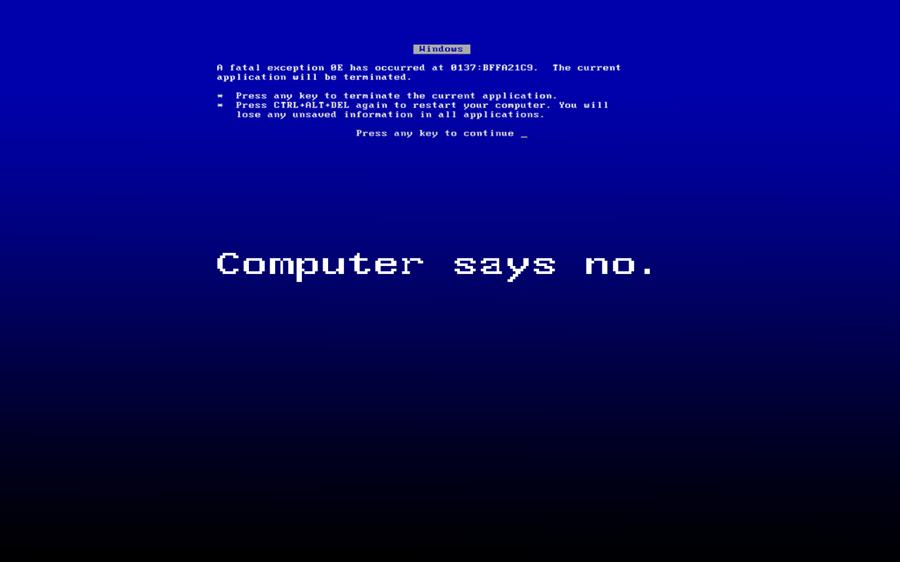
Weakness: Staff skill set
Perceived complexity of software
Challenging to maintain consistent level of staff skill
Ongoing updates to processes
Mainly an IT concern
Some small organisations can not afford to employ software specialists on site

Slide 15
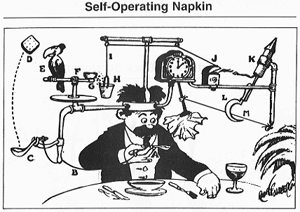
Weakness: Functionality / Complexity
Many feel systems are complex and multi-staged for ‘simple tasks’
“Unfathomable, not logical and not user friendly”
Perceived redundancy in content
Manual rather than automatic updating of accounts / data transfer
Lack of mobile access/solution
Complexity of reporting and data interrogation

Slide 16
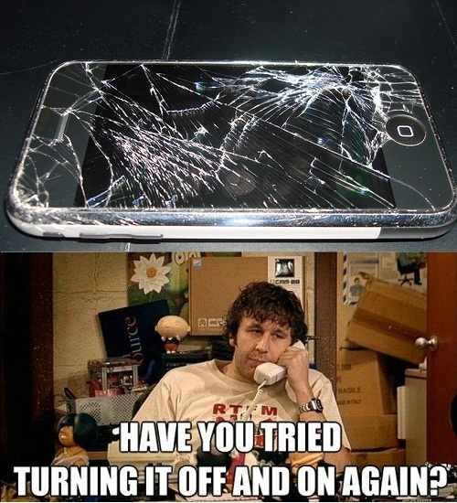
Weakness: Support
Some find support lacking - issues and updates can be slow to resolve
Perception that developments from suppliers are not particularly visible
Some smaller companies feel unable to influence or drive development

Slide 17
Decision making process
Consistent approach amongst respondents:
Review Current Software
Is it delivering value for money and functionality – does it ‘fit’? Any issues? Many departments may contribute
Review alternatives
Specification of needs drafted (many departments may be involved, IT often facilitates). Compare to existing solution
Shortlists and put out to tender
OJEU limits play an important role for some
Shortlists
Based on cost, functionality, fit with current infrastructure and ease of transition – is it future proof?
Interviews / demonstrations
Shortlisted suppliers invited to interview and to give detailed product description / demonstration
Site visits
Some organisations might visit peer organisations to assess solution ‘in situ’
Decision made by senior management
Many stakeholders from across business may be involved depending on level of integration of product

Slide 18
Reviewing solutions
Medium-sized organisations most likely to have a regular review period
For some others reviewing is an ongoing process
Others believe there is no option for them to change
Three respondents review annually
Larger organisations slightly more inclined to use consultants

Slide 19
Drivers for change - suppliers
Ongoing dissatisfaction may lead to review
Reliability is vital, software must “work and work correctly”
Issues with inefficiency and bugs, poor customer service, infrequent updates
Mergers - often the only time they could be in a position to change supplier
Incumbent suppliers often seen as least disruptive way forward

Slide 20
Drivers for change - sector issues
Welfare Reform / legislation changes highly topical
Software must be able to accommodate reform and achieve compliance
Some feel suppliers are not ‘keeping up with the incremental changes’

Slide 21
Barriers to change
The time and expense of changing supplier can be prohibitive, especially for medium-sized organisations.
For many, software was inherited, chosen years ago
Mergers can instigate change, but can be a long, drawn out process
Often trying to find the least painful way forward for all involved
Some will work with their current supplier to develop the existing software, even if an alternative provider has a product that would fit

Slide 22
Developments in software - the sector
Many cited lack of development in the sector
“Stagnant”
“Poor levels of maturity”
“Old fashioned interfaces”
Indication that Welfare Reform has led to changes in business strategy and that software needs to adapt
uptake of new offers - suppliers need an improved take-up strategy to prevent customers feeling they are ‘guinea pigs’
Want a ‘roadmap to change’ to feel more informed / supported regarding developments

Slide 23
Developments in software - awareness
Awareness of developments low
Most were unable to think of any new developments, even outside of the sector
Some said they would only look out for innovations during a review
Some referenced the Cloud, ‘more off site’ or ‘Internet driven processes’ in a very general way, without much detail or sector context
Greater mobile capability and increased tenant access were the most common developments

Slide 24
Developments in software - desires for the future
Most common desire for modernised functionality and interfaces, with simplified, intuitive processes
Customer / tenant driven approach
Some talked about more use of ‘web driven’ software
“Should presume every transaction could be self service”
“Single interface which both staff and customers can use, but it must have a simple design – I think web based is the only way to achieve to this”
Mobile remote access, mobile functionality and apps
Quick installation

Slide 25
Lines of enquiry
Cloud-based software
Software as a service (SaaS)
Available on any device

Slide 26
Cloud / SaaS: First Impressions
Majority find it appealing, only a few rule it out (personal preference/policy)
Everyone acknowledges it is the future
Overwhelmingly concerns and caveats to actual adoption
Appealing
91%
Not at all appealing
9%
Many want factual product knowledge to make a informed decision
Need to “change hearts and minds”
Don’t want to be the ‘guinea pig’

Slide 27
Cloud / SaaS: Concerns about data security
Data protection / security (including physical security) the biggest concern
Questions asked:
Under what jurisdiction will data be held? Housing organisations must know they are achieving compliance with regulations
Will the system be updated regularly with robust security measures?
Will the data be adequately backed up / securely destroyed?
Reassurances needed:
Comprehensive information detailing security and guarantees of safety
ISO accredited (maybe Tier 3) datacentres, compliant with DPA
May want to actually see the datacentre

Slide 28
Cloud / SaaS: Concerns about loss of control
Reluctance to be so heavily reliant on supplier with data in “someone else’s hands” - recurring fear of being ‘held to ransom’ by providers
Questions:
If there is a problem how quickly will it be resolved?
Can they be regularly (even constantly) kept up to date on progress?
What happens if the provider goes into administration?
Reassurances needed:
Thorough Service Level Agreement with guaranteed uptime
The provider must be trusted and the relationship with them excellent
“Workaround or solution to any issue must be available within 24 hours” with immediate and frequent progress updates
Many would like data to be backed up on premise

Slide 29
Cloud / SaaS: Concerns about cost
Lack of conviction on the cost vs. benefit of the Cloud
Questions:
Could there be hidden costs?
Would the cost reflect any loss of flexibility?
Would the cost benefit be enough to outweigh the risk and upheaval?
Reassurances needed:
Cost comparison between the Cloud and their existing offer
Would need to be significant savings

Slide 30
Cloud / SaaS: Concerns about knowledge gap
Lacking of detailed knowledge - more information and facts were wanted
Many are concerned their bandwidth is insufficient or internet may be unreliable
Questions:
How standard is it?
How much data can the Cloud hold?
Integration with other supplier products? What platform is used?
How does the mobile offer work? Can they select their own mobile device?
Is the internet connection itself secure for data protection?
Reassurances needed:
External consultants may be needed - may look to sector leaders for advice or to peers to adopt the solution first
Demonstrations / detailed product information
More information about connectivity requirements

Slide 31
Cloud / SaaS: Doubt about benefits
Lack of certainty of benefits of Cloud, particularly cost savings
Some benefits more apparent:
Reduction in maintenance and management of software
Ability to access software from anywhere using of mobile devices
Reduction in capital expenditure on software and hardware
Space saving through no hardware on site
Other benefits mentioned:
Less infrastructure needed
Greater integration
Regular updates, managed externally
Robust and scalable - ‘future proof’
Less installation time up front (could be up to 50% of a FTE)

Slide 32
Cloud / SaaS: Location is important
UK
UK
or
EU
US
UK only the most commonly desired option desired
No London bias or concern over location within the UK
EU / EEA satisfactory for some as data would fall under DPA (although many preferred UK given the option)
US extremely undesirable due to ‘Patriot Act’ and data ownership issues - Cloud supplier must not be a US registered organisation

Slide 33
Cloud / SaaS: Other practicalities
Platform:
Microsoft SQL Server most desirable platform
...although some against Microsoft due to experience
Some expect Cloud offer to have open source platform
Must be stable, secure, tried & tested - nothing obscure
Support:
24/7 access expected due to mobility / flexibility / customer access
For support only office hours required
Extended hours could be desirable in the future
A small number expect a Cloud-based proposition to have 24/7 support

Slide 34
Cloud / SaaS: The existing market
Most are unaware of anything currently on the market
A few weren’t aware of specific offers, but expressed an assumption that they must exist or they would be surprised if suppliers weren’t considering it
One respondent within the largest group of organisations commented Cloud based offers were to “look after smaller housing organisations”
One commented they were unsure how good the uptake of existing products had been, so questioned the quality and appeal of Cloud based offers in the sector

Slide 35
Cloud / SaaS: The user’s perspective
Only one respondent currently using a Cloud based offer:
Previously hosting data externally so had less concern
External advisors reviewed the information on data security
Went through procurement for hosting provider, also with consultant input
Purchasing / procurement not significantly different or easier
Major significant benefit was cost

Slide 36
Cloud / SaaS: The user’s perspective
Some knew other departments within their organisation were utilising the Cloud - these companies more likely to have set review schedules in place
These respondents were more aware of web based solutions and ‘digital by default’ as developments
Although they were comfortable with the current usage, to consider Cloud for business critical systems brought the same concerns and questions as with other respondents
One was not aware there were Cloud offers available that extended to core modules

Slide 37
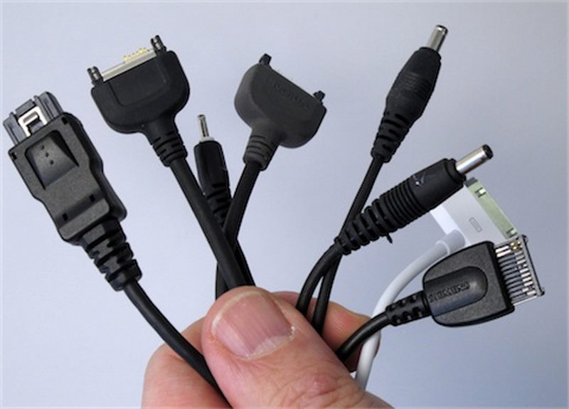
Standardisation
Many perceived benefits of standardisation of configuration (model implementation):
Cost: some happy to compromise on tailoring if saving is attractive
Automatic upgrades: less hassle, staying up to date
Transferability: easy for staff to move between companies
Those most open to the idea feel if the offer is designed well, customisation would not be needed
“People have to adapt to fit standardisation rather than break the system to go back to what they had in the past”
All respondents want to be able to define their own reports; standard reports are only appealing if they can be customised
“Standard reporting so we can compare eggs with eggs when we speak to other HAs – tailored reporting is important for internal processes”

Slide 38
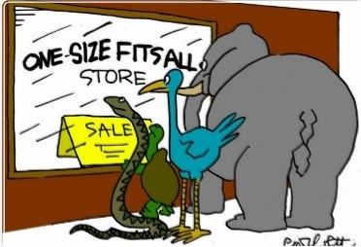
Standardisation - but can it be done?
Most open to standardisation in theory but could not see it working in reality
Too used to tailored functionality
‘Standard’ a subjective concept
A few felt current levels of customisation are unsustainable, and acknowledged perhaps companies are not as different as they might think
However...
Some degree of flexibility as a safety net was desired
Concern standardisation can be replaced by excessive parameterisation
The ability to turn off what is not needed was important

Slide 39
Summary - Strengths
A positive outlook
Recognition and acceptance that Cloud is the future and the way forward
Cloud-based offers fit with the key areas needing development:
Customer access / digital by default
Mobile working

Slide 40
Summary - Weaknesses
Some challenges to overcome
Concerns and doubt within the sector
Security and data protection
Perceived loss of control
Speed and reliability of internet
Lack of knowledge amongst potential clients - magnifies concerns, hinders the perception of benefits
Reluctance to be ‘guinea pigs’
Culture of fixing rather than replacing software
Cloud is not front of mind within the sector

Slide 41
Summary - Opportunities
Key drivers of interest and triggers
Cost savings: purchase, installation, maintenance
Enhancement and modernisation of functionality
Standard review cycles and consultant recommendation
Partnership development creating ambassadors
Mergers and acquisitions
Welfare Reform and other changes to functional needs
Standardisation of configuration and integration can reduce cost & risk and increase flexibility and mobility

Slide 42
Summary - Threats
A number of obstacles
First to market could be seen as leaders in field
Upheaval in the sector due to large scale change
Lack of funding for updates and modernisation
‘Stagnant’ culture of sector regarding IT - many not actively engaging with innovation
Many not ready for standardisation

Slide 43
Final thoughts: Orchard
Housing software delivered through the cloud is a credible proposition
with latent appeal
Challenges are to not only
create a great product
but also to educate and reassure
Standardisation and innovation important; responsiveness to sector change paramount

