Slide 1
Its more than Mobile Working
Resource Management
Improving customer relationships
Self Service
Improving on site visibility
Integration
Proof of Concept Technology
Tailored services
Workflow
Case Management
Notes:
New ways of delivering services to customers required a different approach
Wanted a mobile solution but did not have the appetite for massive infrastructure investment. But our housing management system did not offer the solutions we were looking for.

Slide 2
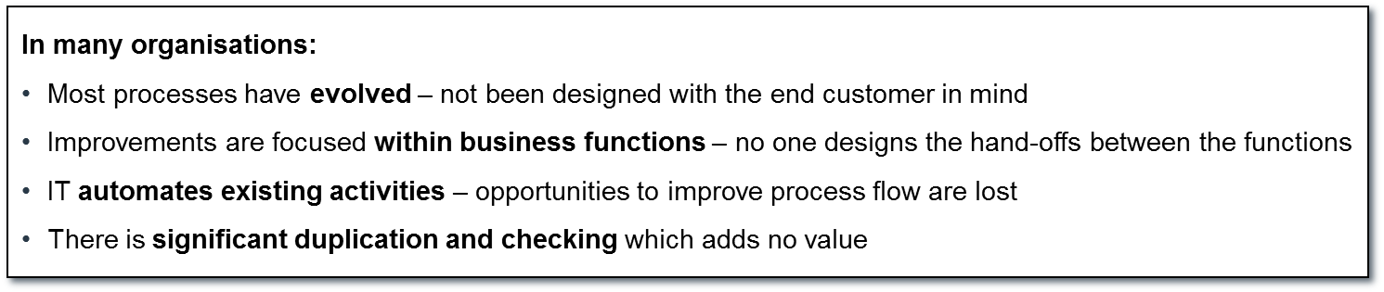
Does this look familiar?
Workflow
We work for our manager!
I work in the service division/ operational division…
I am just a poor customer!
Notes:
Our starting point!

Slide 3


Our starting point – understanding how we deliver services now, and where we want to get to – including the new technology to support us.
We can consider any currently in-scope processes ….
Integrated Design
To Be Process Maps
Acceptance Testing
New Businesses Processes and/or improved systems
Design Principles
Current issues
Options for improvement
Critical Success Factors
Workplace Support
Procedure Manuals (paper and on-line)
Notes:
At each level we can develop a process flow map that shows the logical relationship between processes
Undertook this process for all parts of our case management design process, less so with Panconnect as this about the ‘form’ and information we are able to share with customers out on site.

Slide 4
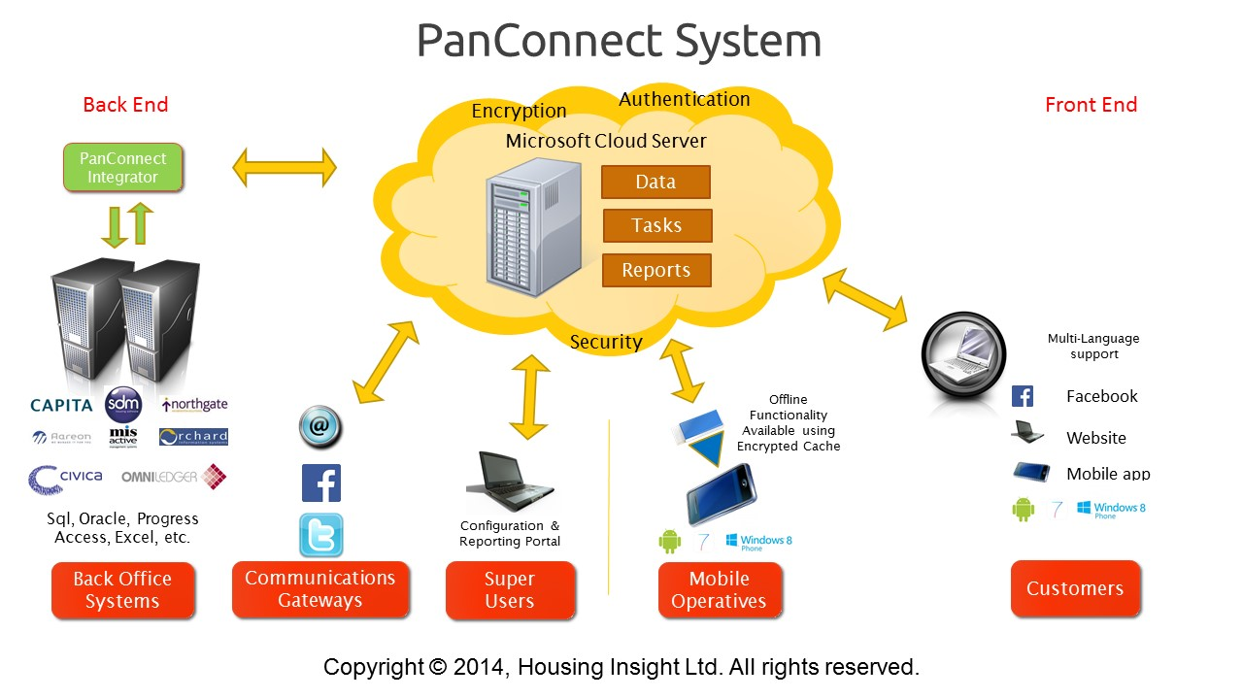
What are we developing/testing?
Notes:
Took a measured approach and risk with small but developing organisations to specify best in class solutions to our technology and business requirements. First project was about getting staff out and about on our estates, creating better visibility and local service delivery – Panconnect

Slide 5
Improving customer relationships
Panconnect a mobile CRM
Demo
Improving on site visibility
Notes:
Real time data from Academy (and other systems going forward
Write back and integration to Academy (and locality going forward)
Off line use of all forms
Tasks and workflow pushed through from academy - locality going forward for business support
Workflow and task management within panconnect forms
Sync to academy when in signal, but completed forms stay in the cloud – last completed forms can be drawn back down.

Slide 6
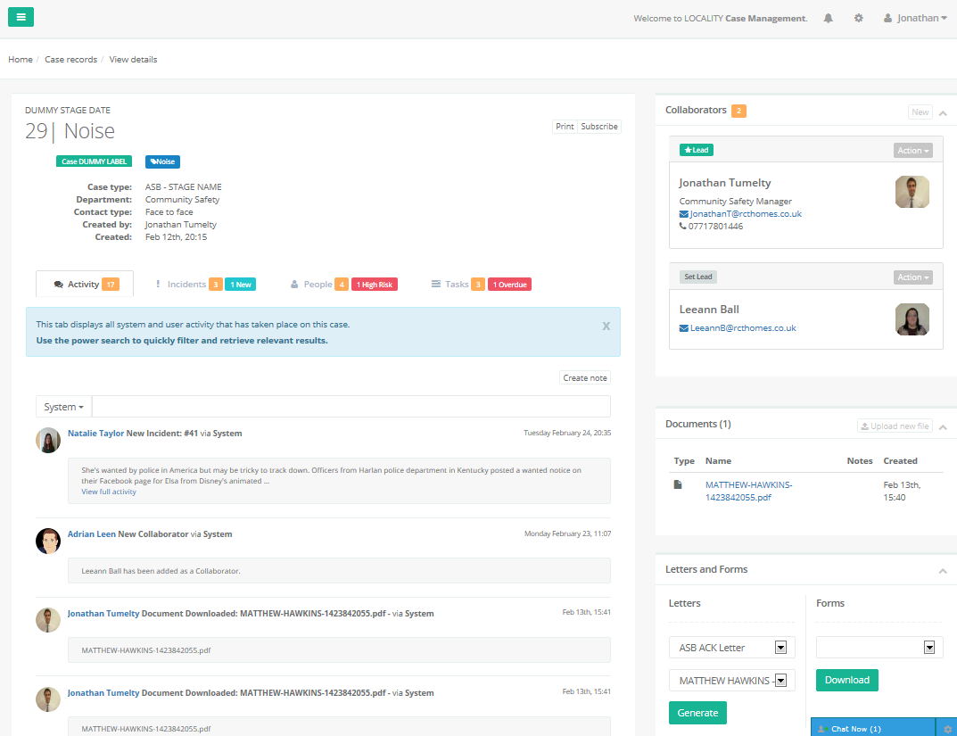
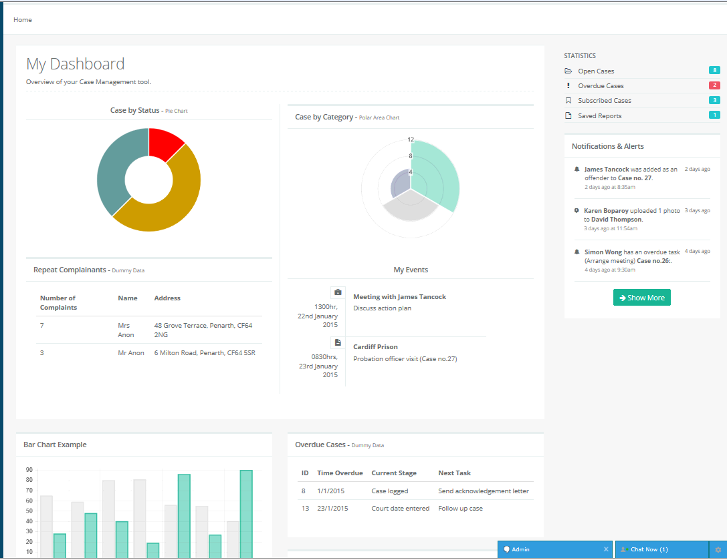
Case Management and Work Flow
Locality Task Management
Notes:
This is our developing approach to case management – Working with locality to develop a new approach to managing cases.
In developing our approach to ASB case management, we can see how this approach might help in the development of workflow and case management systems in other areas such as lettings and business support.
Enable us to track housing management services that we don’t currently track
See performance of tasks - live time resource mgt.
On task management details page officers are able to work collaboratively bringing in colleagues on the fly
Part of our approach to tailoring services, Locality enables us to offer video conferencing and different ways to interface with staff and collect evidence.

Slide 7
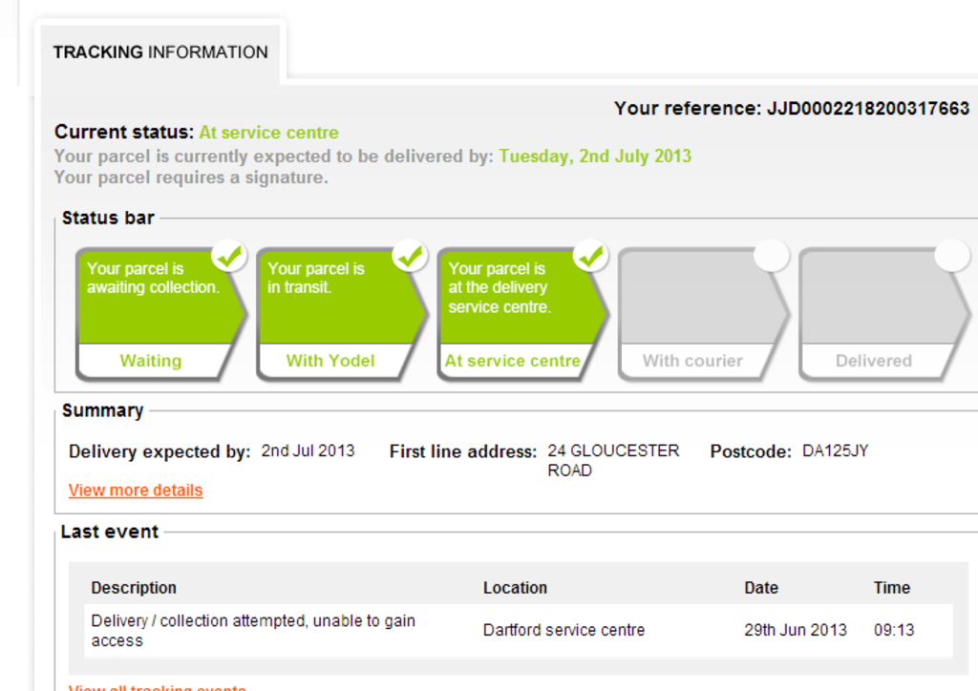
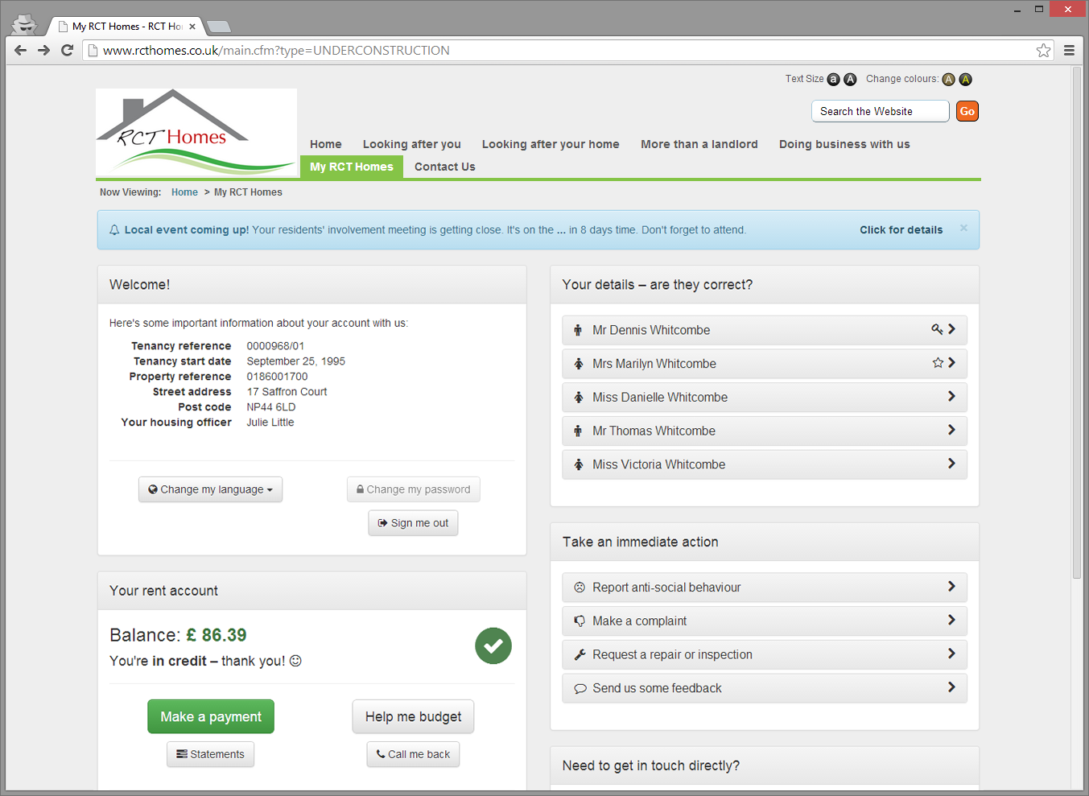
Self Service
Tailored services
Customer Self-Service Portal

Slide 8
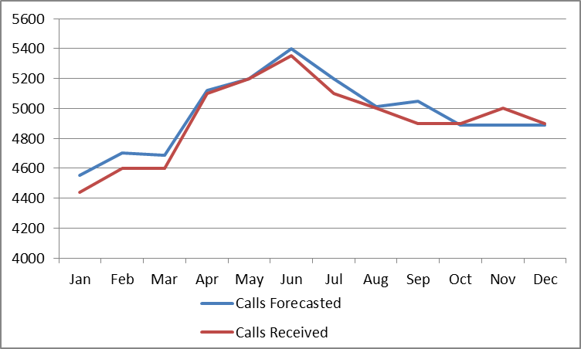
Resource Planning Life Cycle
Based on analysis of the review data forecasts may need to be adjusted and the cycle begins again
Review
Forecasting
Workloads are forecast based on historical trends and feed into the resource planning model
Daily performance is captured and constantly incorporated into the review data
Implementation
Planning
Once high level planning been agreed this then informs the daily plan, which is used to manage workloads through the day and report when things do not go to plan
May need to recruit new staff
Potentially cross train staff to support August’s deficit
Notes:
Are there four stages to the cycle??? Feels like there are three: Forecasting, Implementation, Review???

Slide 9
Outcomes
Live Time Capacity Planning
Real Time Performance (Managers & Staff)
Increased Customer Focus and Satisfaction
First Time Resolution
Increased Efficiency and Productivity
Bespoke Dashboards
Highly Visible, Well Informed Staff

Slide 10
Engagement using different channels
Better customer focus : Management By Fact
Utilisation of Housing management system is changing
Supporting vulnerable customers
Customer and property data - statement
Systems for integration & Performance information
moving towards a data warehouse and canopy products that allow us to get the most out of our databases
Video Conferencing, Social Media, Self service
Leaned processes: Design Against Demand.
Tailored services based on customer insight and the right tools
Risk Based Management and Support
Future Direction

