Slide 1
Pulling the plug on offline services
and how to do it
Barry Cooke, Communications Manager
Rooftop Housing Group

Slide 2
Five things about me
I didn’t sit my O Levels because the night before my first exam I suffered a spontaneous pneumothorax
I once worked as an editorial assistant on Parking Review magazine
I can juggle
I only went abroad for the first time aged 24
I once pulled a man from a burning car

Slide 3
Five things about Rooftop
Formed in 1994 following a large-scale voluntary transfer
Stock grown from 4,020 to 6,150
Operates mainly in Worcestershire and Gloucestershire but in 67 towns and villages covering 17 local authorities
Won Digital Communications Excellence Award from Chartered Institute of Housing
Has 42% or households registered on our website to access online services

Slide 4
Three is the magic number
Some practical things that any organisation can do
If you can’t control these things, you can influence them

Slide 5
But first… what services does Rooftop currently offer online?

Slide 6
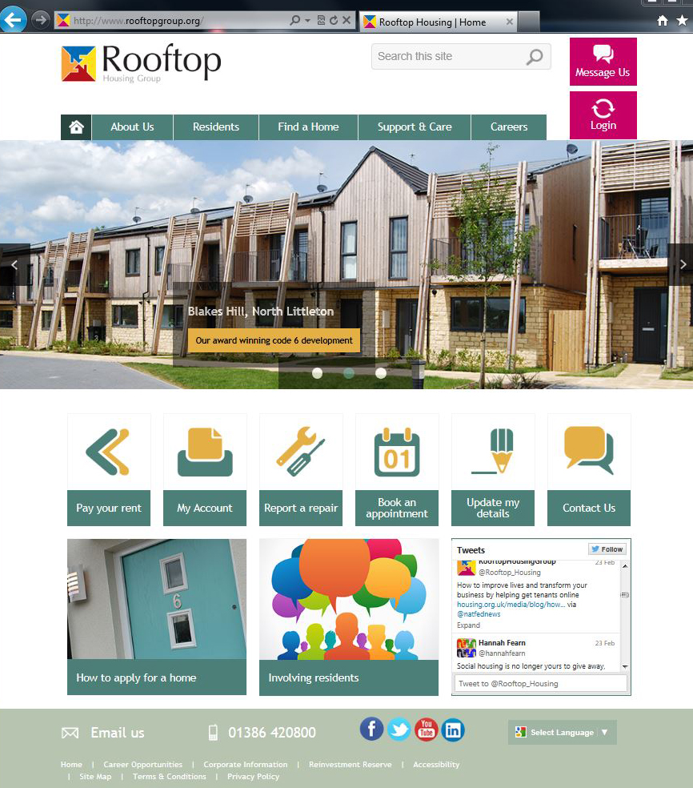

Slide 7
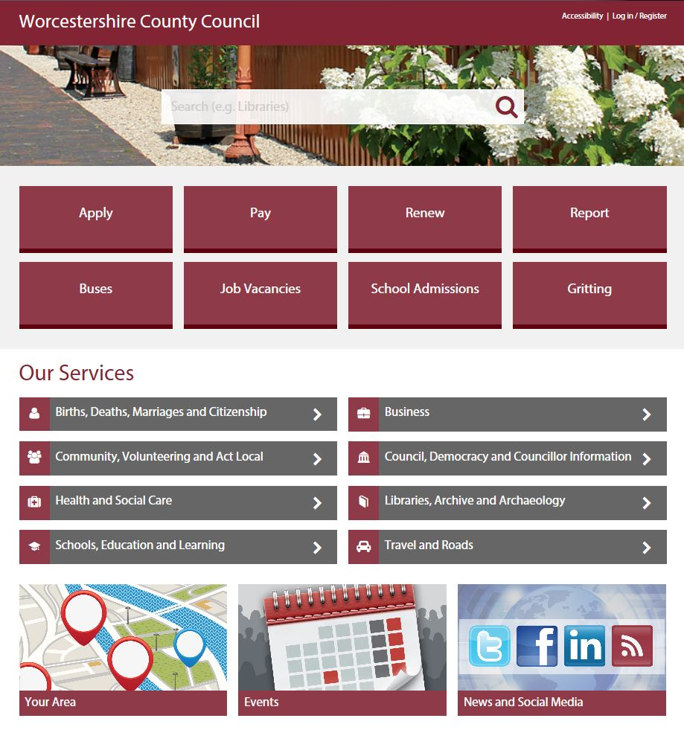

Slide 8
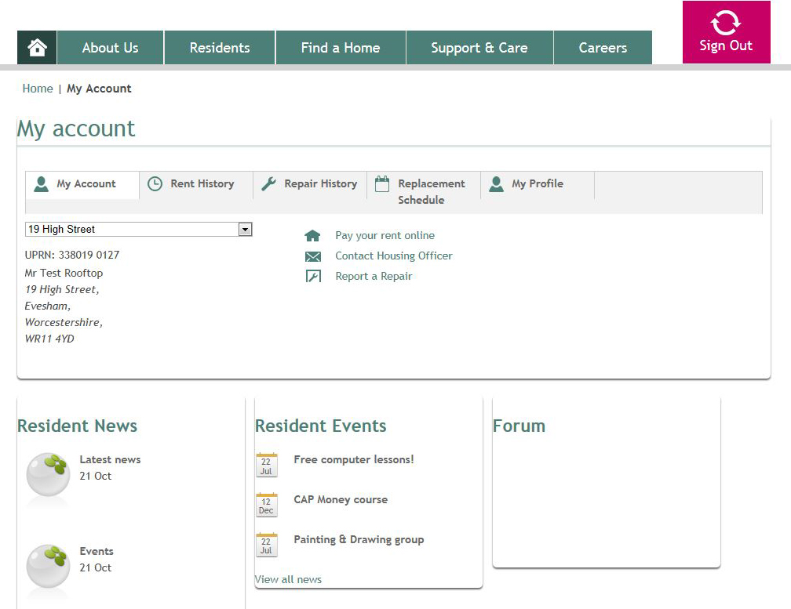

Slide 9
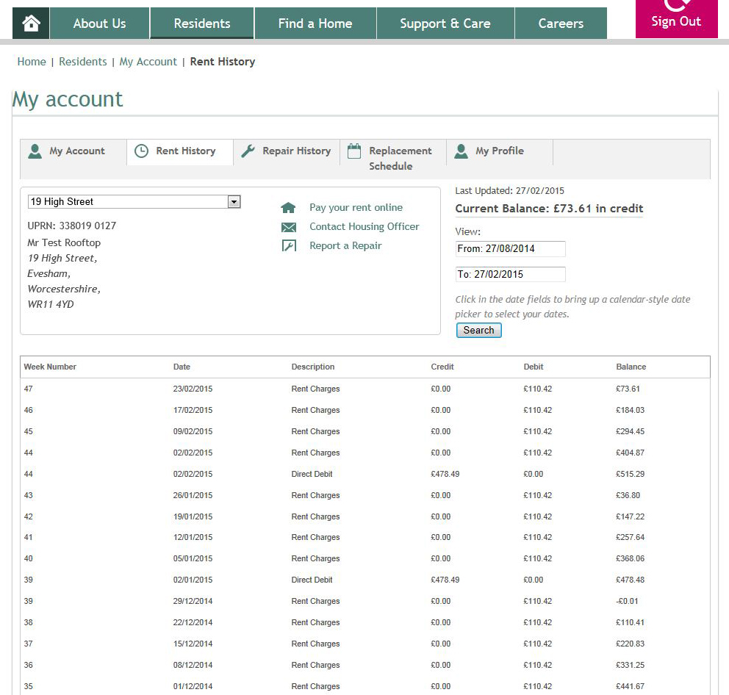

Slide 10
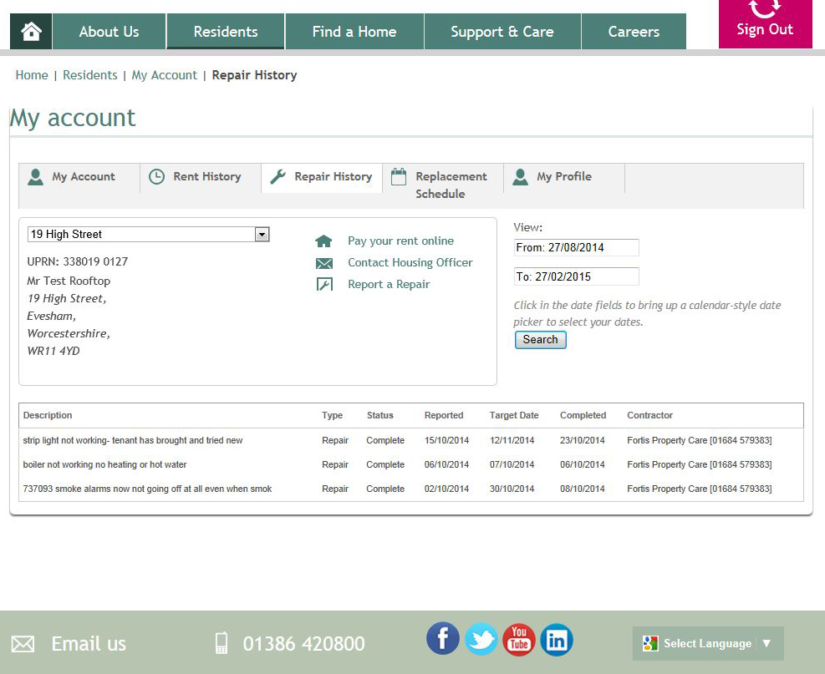

Slide 11
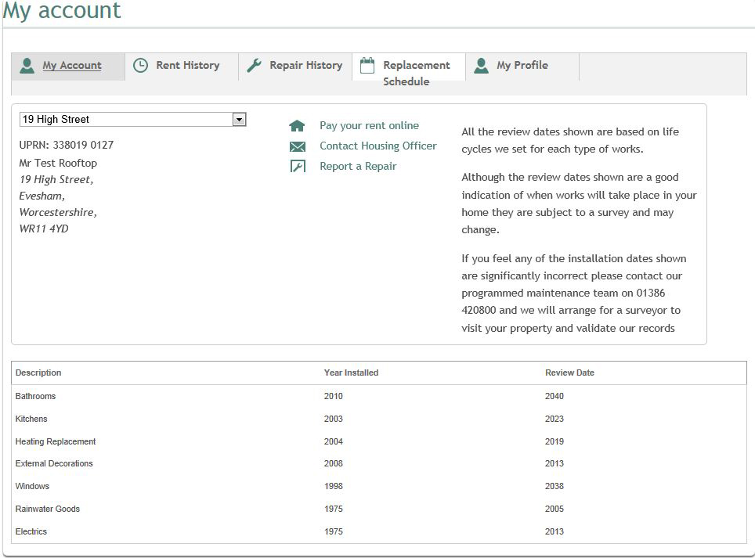

Slide 12
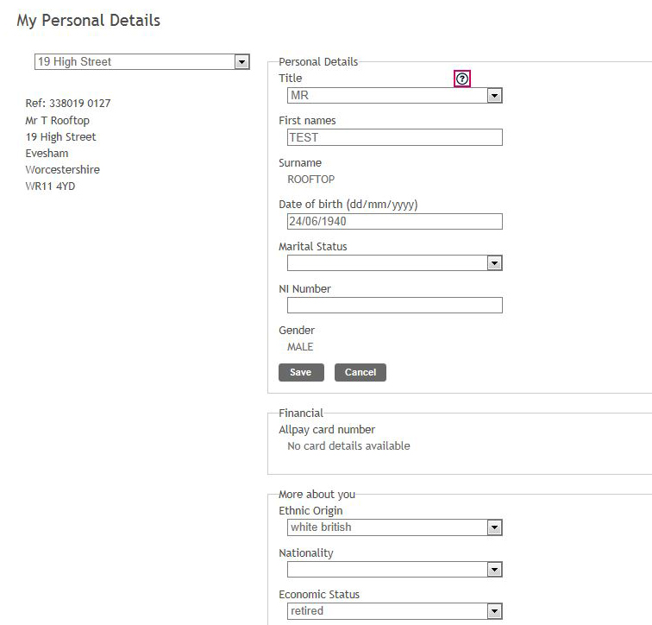
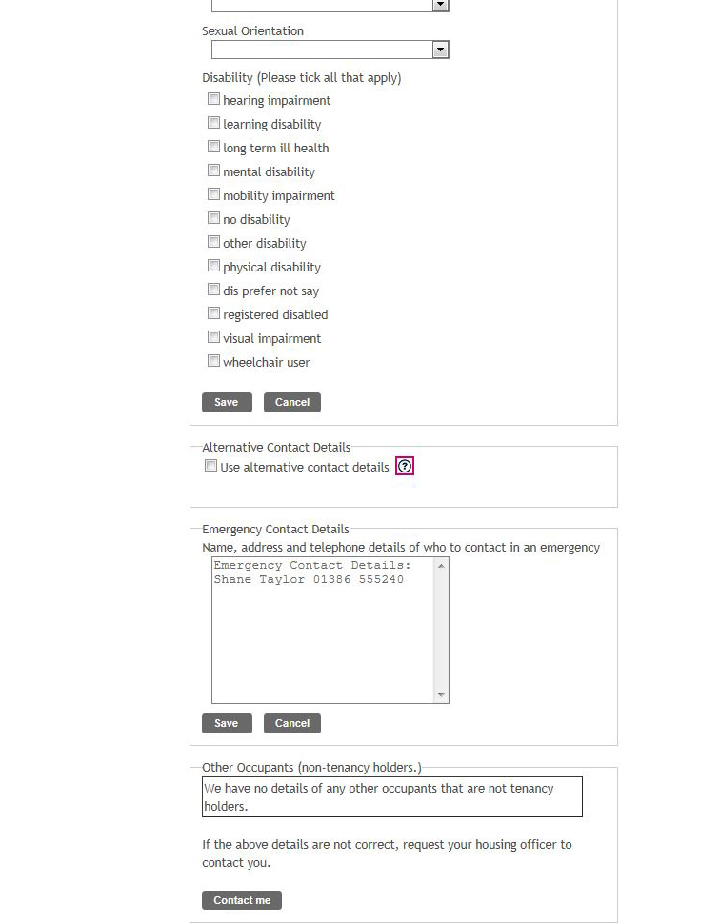

Slide 13
So after all our efforts making everything work, how many residents signed-up to use online services?

Slide 14
200 / 3.5%
signed-up
6,150 households
4,000 / 65%
have internet access
After online services created

Slide 15
Three is the magic number
So what did we do to get more residents signed-up to access online services?

Slide 16
1: Write a letter

Slide 17
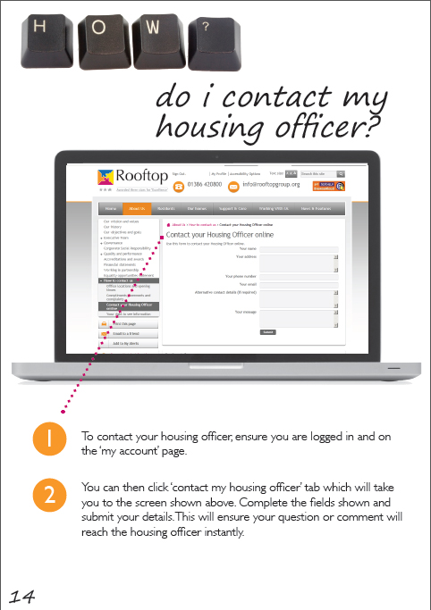
A letter and a booklet was sent to every household

Slide 18
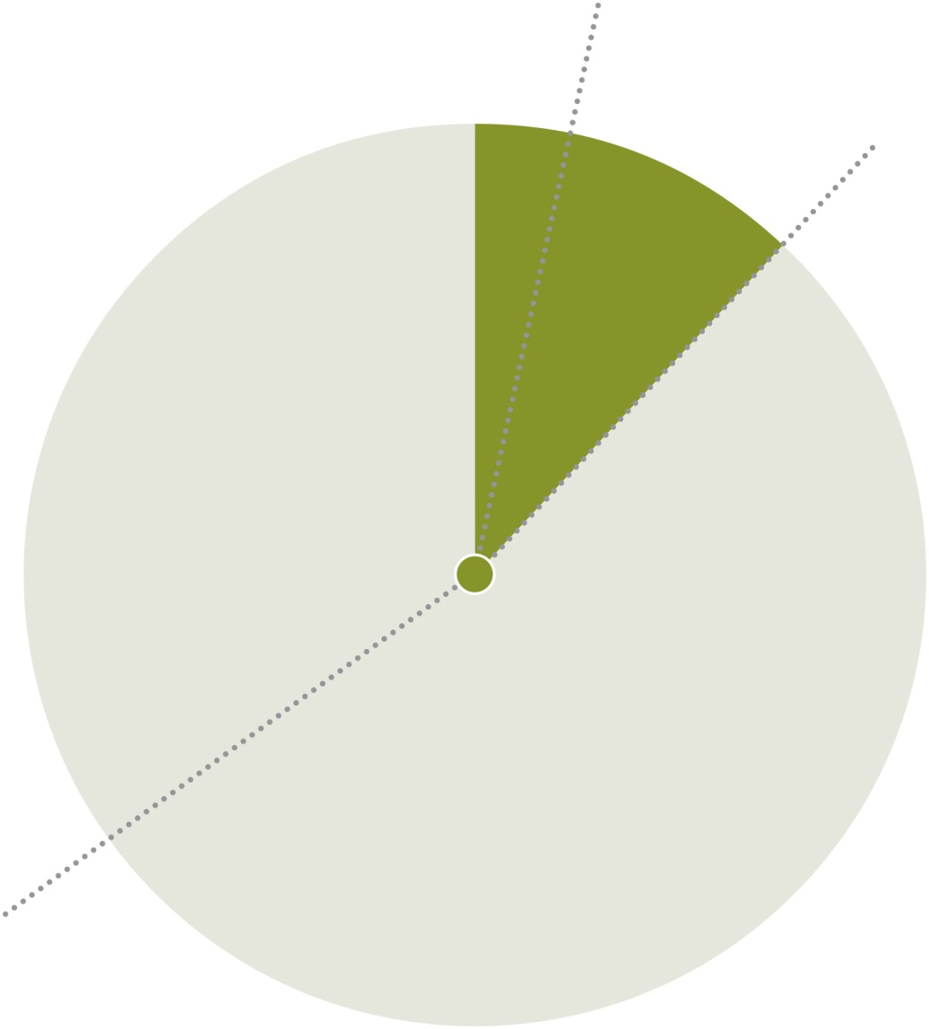
200 / 3.5%
750 / 12%
6,150 households
4,000 / 65%
have internet access
After letter sent to all households

Slide 19
2: Make something online-only
Rent statements
Sent quarterly to all households
Delivered with resident magazine
At time of delivery statements are at least one week out-of-date

Slide 20
Rent statements available online
Told residents that we would no longer send statements to all households
No consultation
Gave residents option to request
Less than 10% of households requested continuation of paper statements
Send a hard-copy statements if we need to contact someone about arrears

Slide 21
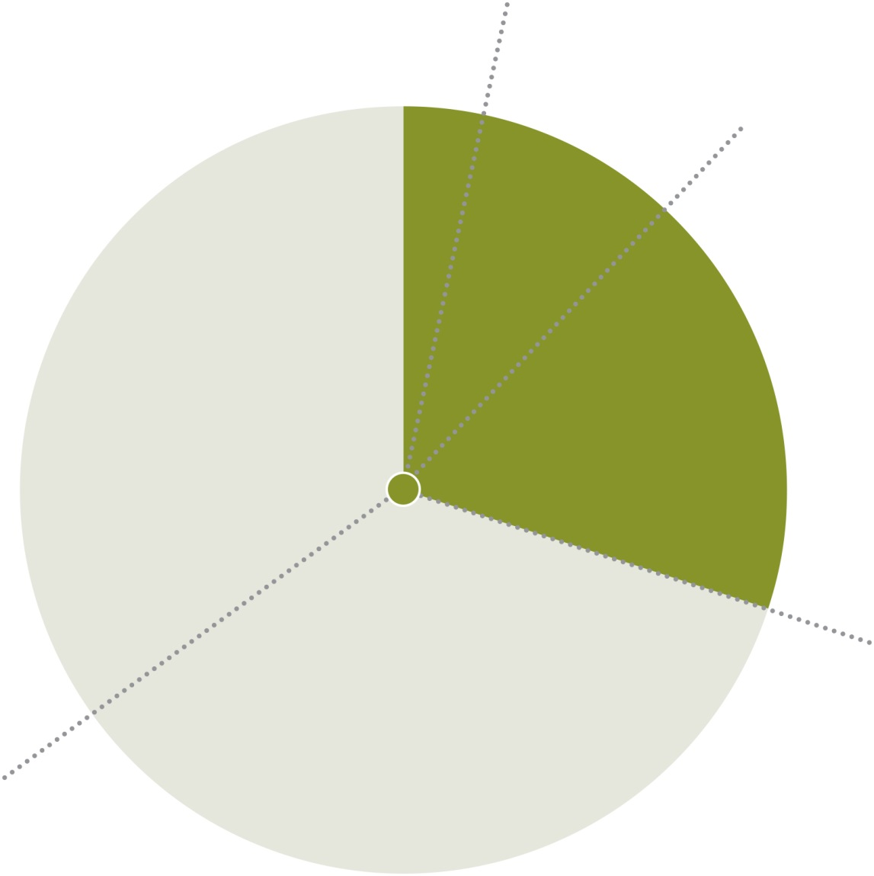
200 / 3.5%
750 / 12%
6,150 households
1,800 / 30%
4,000 / 65%
have internet access
After we stopped sending statements

Slide 22
Extra benefits
Magazine is now mailed in clear polybag – making it more attractive
Process is automated – making it quicker and more accurate
Cost saving of approx £3,000 per annum on postage and mailing

Slide 23
3: Involving other staff
Need buy-in across the organisation
Front line staff may need training
Taking every opportunity to steer people towards online

Slide 24
Customer service teams
Resident: “Hello, this is Mr Smith from 32 Acacia Avenue. Please can you can you tell me what my current rent balance is?
Staff: “Hello Mr Smith, your rent account is currently £50 in credit. Don’t forget, in future you can check your rent statement at any time night or day by signing-up to access online services via our website. I will send you a letter and booklet in the post explaining how you can register online.”

Slide 25
New tenants
As part of the sign-up process, all new tenants are given a ‘tour’ of our website and given a demonstration of all the available online services.
Evidence suggests that when people are introduced to accessing services online at the beginning of their tenancy they tend to stick with that as their primary method of communication.

Slide 26
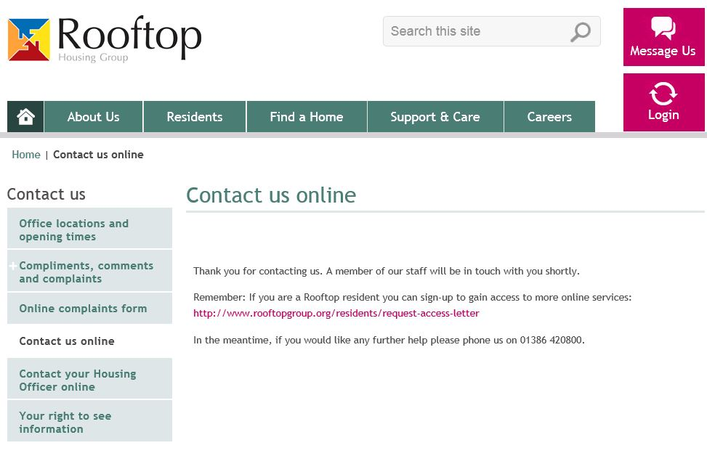
Making the most of every opportunity

Slide 27
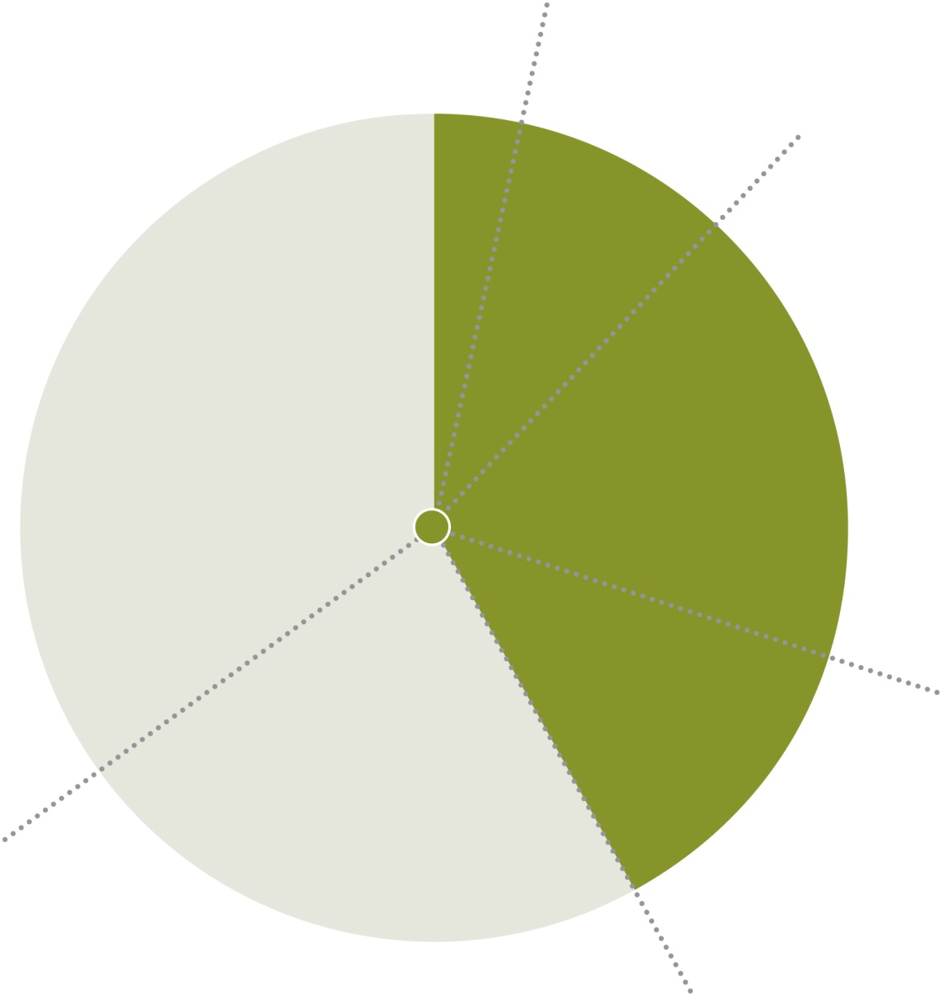
200 / 3.5%
750 / 12%
6,150 households
1,800 / 30%
2,583 / 42%
4,000 / 65%
have internet access
After we involved other staff

Slide 28
Three is the magic number
Make it easy to sign up
Make something important ‘online’ only
Get other staff on board

Slide 29
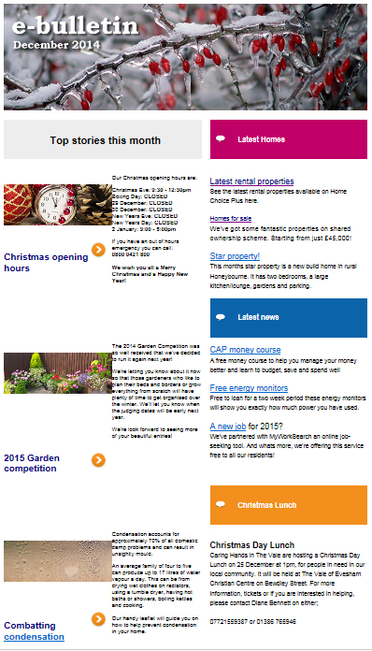
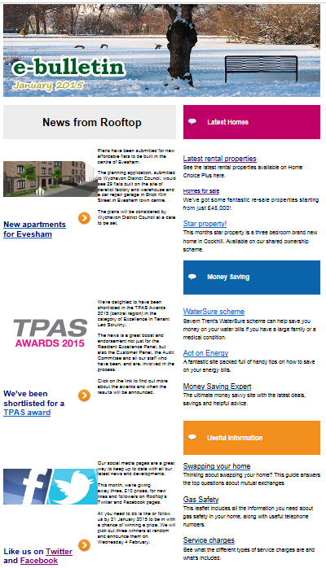
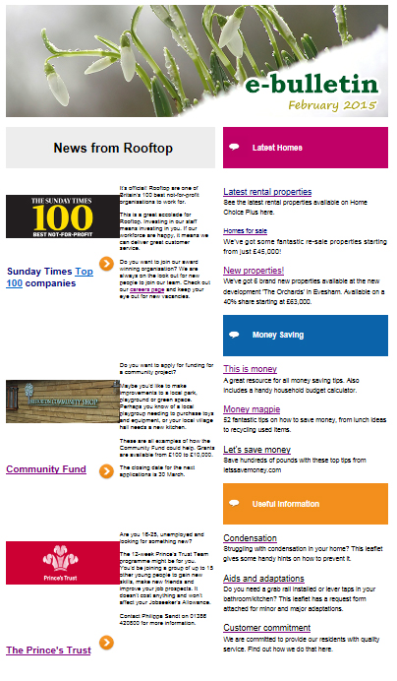
What else you can do

Slide 30
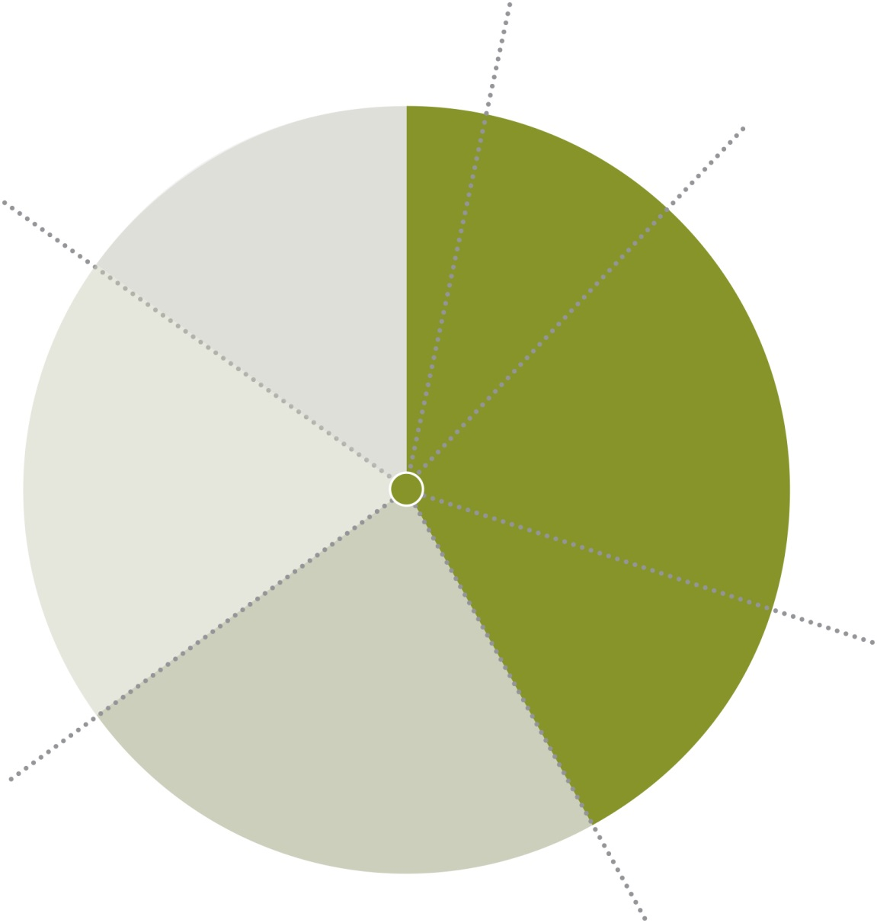
200 / 3.5%
Target
5,230 / 85%
online by 2020
750 / 12%
6,150 households
1,800 / 30%
2,583 / 42%
4,000 / 65%
have internet access
What we are aiming for

Slide 31
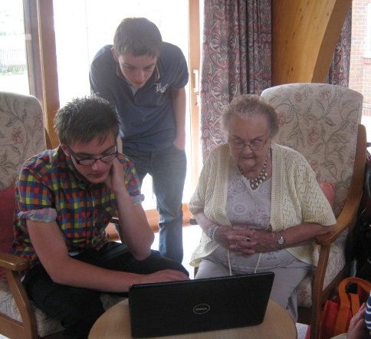
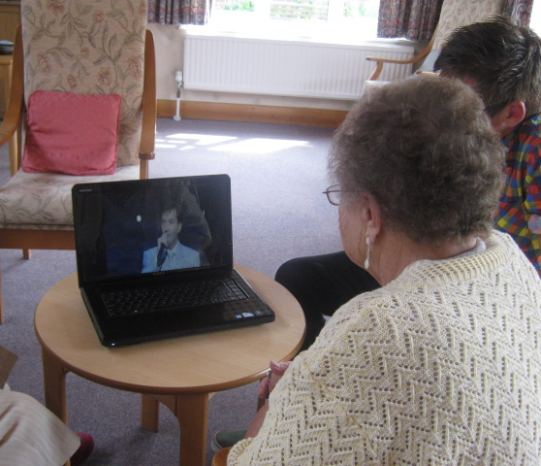
And finally
Getting online should be fun
Discovering your favourite singer
on YouTube can change your life

Slide 32
Thank you
barry.cooke@rooftopgroup.org
www.rooftopgroup.org

