Slide 1

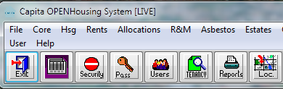



Intelligence Mapping - Data Warehouse
Using tenant insight and externally collected statistics for daily activities and future planning

Slide 2

Content
Business ambition
What do we need
Finding the solution
Engaging the business
Find delivery partner/s
Design and build the product
Delivery
Outcomes
Measuring Success

Slide 3

Severnside
2001 stock transfer Shropshire
5,500 homes - group structure
300+ more homes - 5 years
280 staff – IIP Gold
Community investment
Notes:
Context - getting a feel for our organisation and what is important to it

Slide 4


Business Drivers
Delivering Ambition:
  Excellent homes, thriving communities
Invest in our people
Maximise income
Support communities
Board Assurance / Minimise risk
Engage partners / maximise resources
Notes:
These were our drivers and the thinking behind the direction we have taken

Slide 5


Intelligence Mapping Objectives
To understand residents neighbourhoods and communities
To help create thriving communities and places to live

Slide 6
Understand customers = business success
Partners
Community
Funders
Efficiencies
Notes:
Inter-dependancy and relationships between business case areas. Necta card approach - understand needs / requirements of your customers; Successful communities means income stream assured; funders deals improve; efficiencies mean more resources in areas of need; engaging partners - more effective use of staff

Slide 7

Corporate objectives - assurance
  Encourage and develop greater individual and community responsibility
  Encourage and support customers to influence the customer facing policies and strategies
  Strengthen customer involvement and communication opportunities
Notes:
This is the point where you ask yourselves what you want? This is my choice – what would be yours?
Consider this before you do anything. Where are you starting from and what do you want to achieve. What have you got and what do you want to do with it. This may not be the best choice for lots of motorway work!

Slide 8


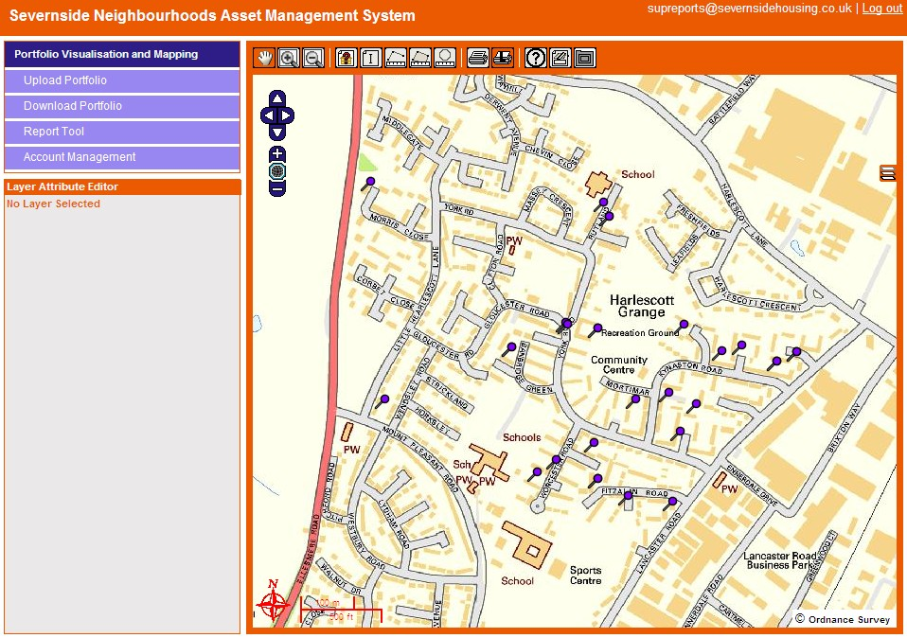
Delivery partners
Concept to reality
Understand
Trust
Ambition
Perseverance
Delivery
Notes:
Find someone to work with who you trust and preferably have an existing relationship with as it will not be easy developing something from scratch

Slide 9

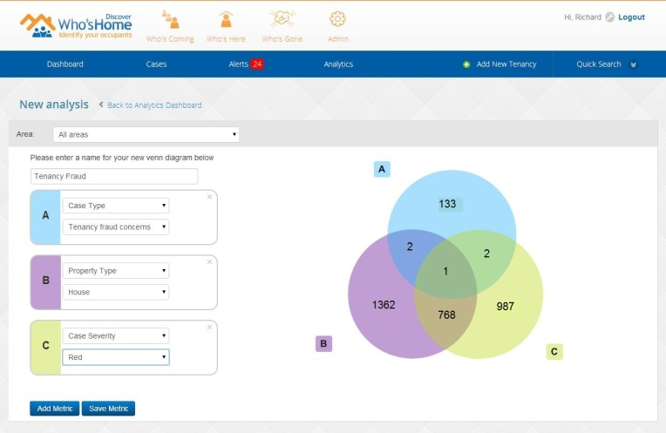



Supporting
Partners

Slide 10

Engaging the business
Board
Senior managers
Involved teams
Rest of business
On-going communication on:
  use of system
  development
Notes:
Get whole business sign up if possible

Slide 11


The Project
Research
Plan
Resources
Project sponsor / lead
Project group – skills / experience
Project plan
Assess existing data – age / accuracy / gaps
Clear direction
Key milestones
Notes:
The process for getting the concept going with relevant people internally

Slide 12

Pitfalls
New system – bugs!
Demonstrating prior to bug removal
Losing partners / others on journey
Show as much as you can at all stages
Keep communicating
Notes:
Be aware of what can go wrong and don’t lose faith!

Slide 13
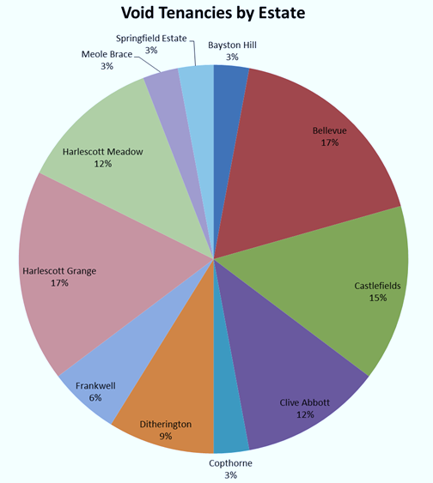

Intelligence Mapping in Neighbourhoods
Targeted information on the issues that matter:
  Customer insight / profiles
  ASB / Crime / Arrears
  Employment / money advice
  Tenancy turnover / voids
  Community involvement
  Repairs and maintenance
  High cost assets
  Customer satisfaction
  Trends / Hot Spots
  Fraud
  High Cost tenancies / assets
  Return on Investment
Notes:
How we are using the data warehouse

Slide 14
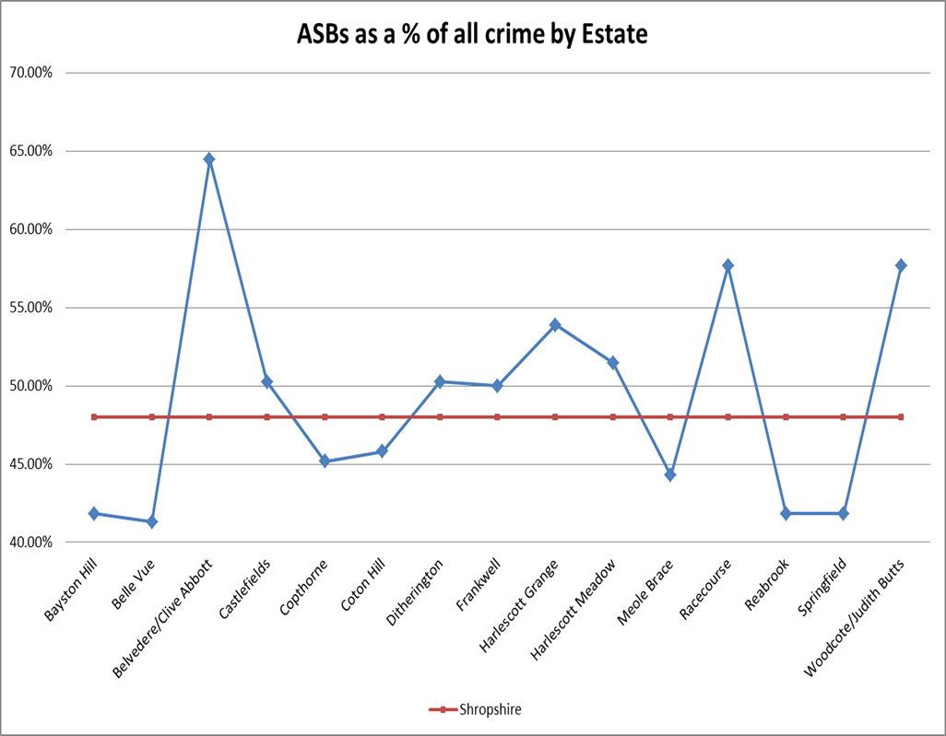

ASBs and Crime

Slide 15

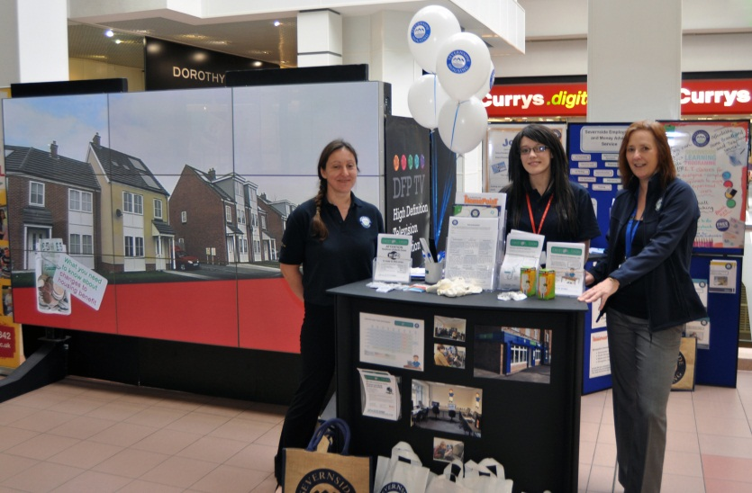
Intelligence Mapping in Neighbourhoods
Sophisticated / targeted services
Partners / Residents engaged
Base position
Delivery model
Respond
Trends
Measure Success
Notes:
These were the drivers for the neighbourhood focus all residents not just our tenants; engage partners as dictated by intelligence. Base data gives starting position and enables organisation to respond, look at trends, monitor the impact and measure success

Slide 16
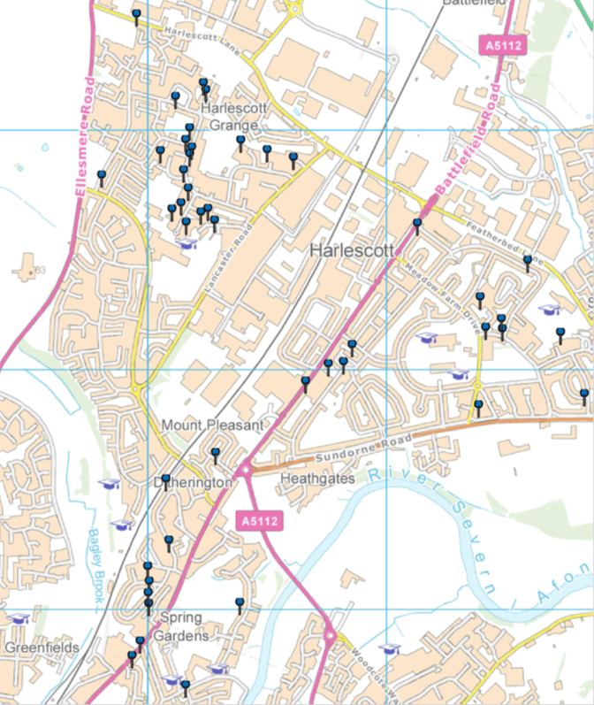
Simple GIS system built in:
Map indicating the location of tenancies with noise related ASBs reported during 2013/2014

Slide 17
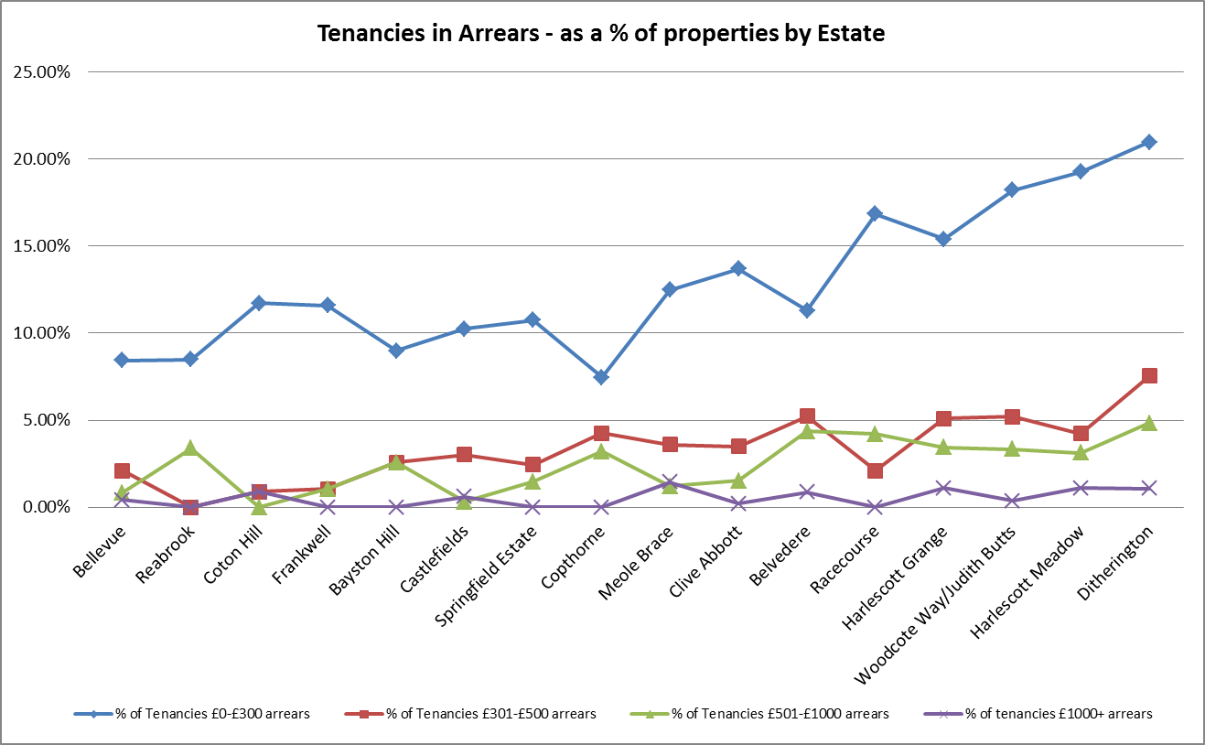

Tenancies in Arrears by Estate

Slide 18

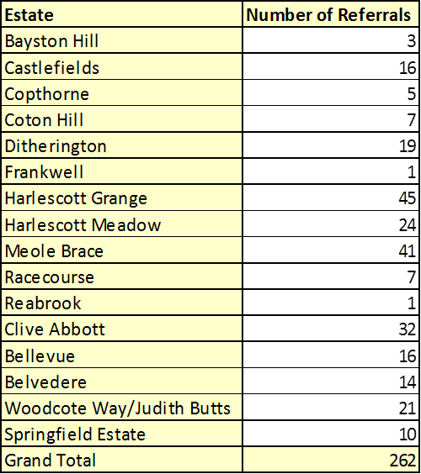
Money advice and support

Slide 19
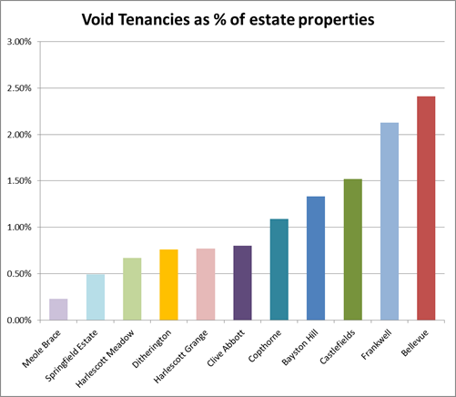
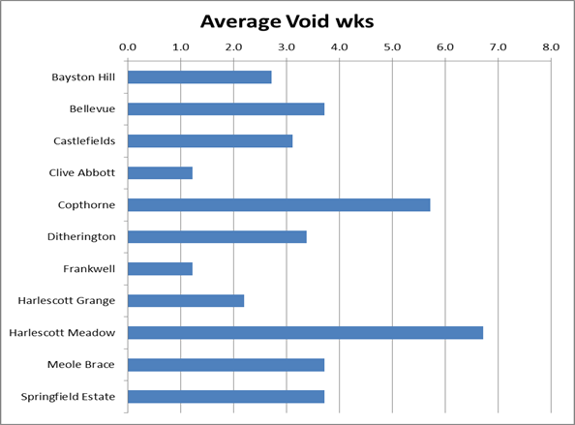

Level of Voids
Weeks Void

Slide 20

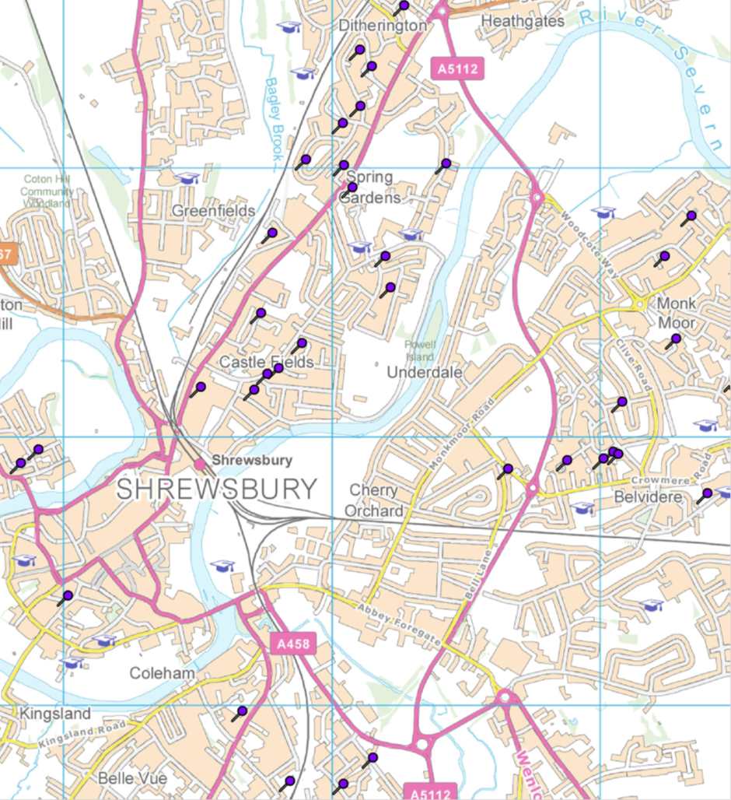
Map indicating the location of void properties

Slide 21

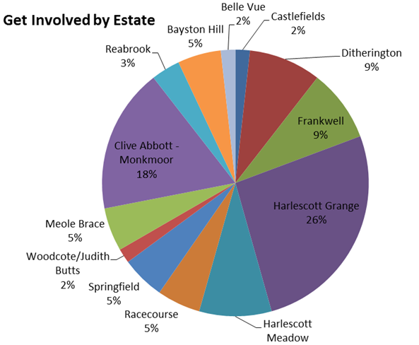
Representative Resident involvement?

Slide 22

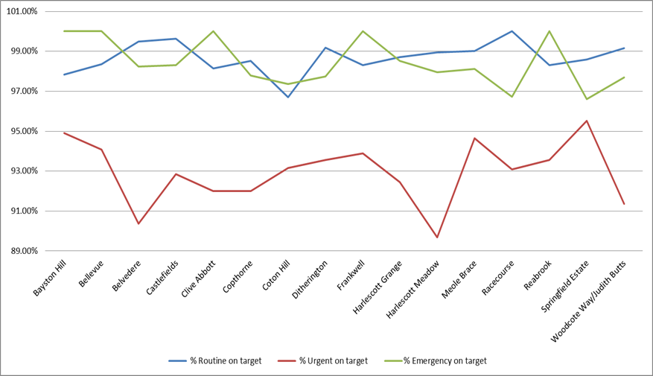
Repairs and maintenance

Slide 23

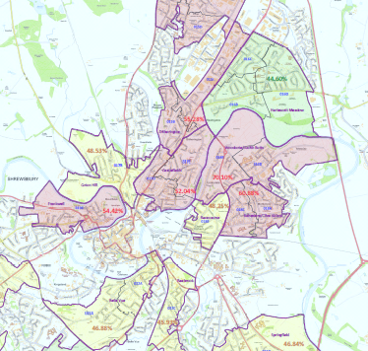
Using the data – Strategically
Informing the Board and Corporate Plan
Demographic data - picture Shrewsbury & rural areas of Shropshire
Data from partners and National Statistics
Representing the data geographically using variable criteria
Our data plus:-
  Levels of crime and ASB
  Levels of school absence and free school meals
  Levels of unemployment and deprivation
Notes:
Using it to prioritise and inform corporate plan

Slide 24
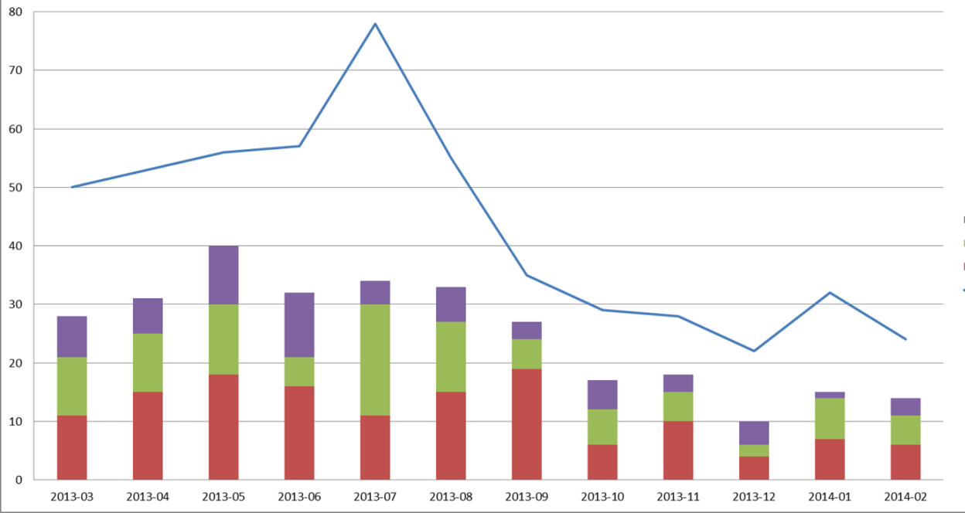

Using the data – operationally
Neighbourhood Standards Agreements (NiSA’s)
Community Development activities
Targeted reduction of arrears
Targeted financial advice and support
Identifying crime and ASB hotspots
Identifying demographic vulnerabilities

Slide 25
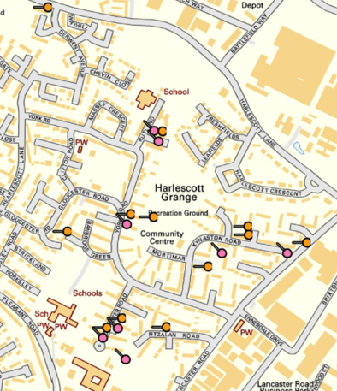
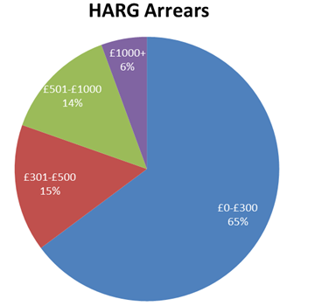

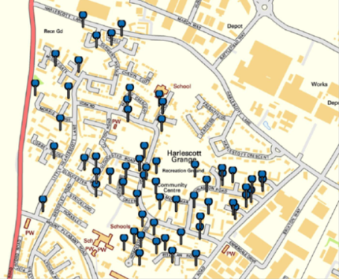
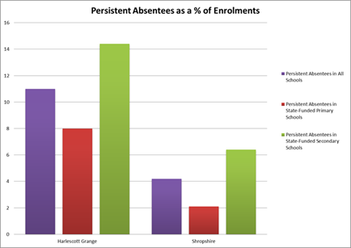
NiSA Monitoring
Review of Statistics for the NiSA
Litter related ASBs
Objectives
An neighbourhood based agreement between residents , Severnside and relevant partners sets standards that all signatories will abide by. Sets KPI’s and reviews these after 6 months Using base data indicating the status of anti-social behaviour and crime, resident involvement, education data, repairs and maintenance; housing management, and financial inclusion etc .
Map of Tenants in arrears

Slide 26
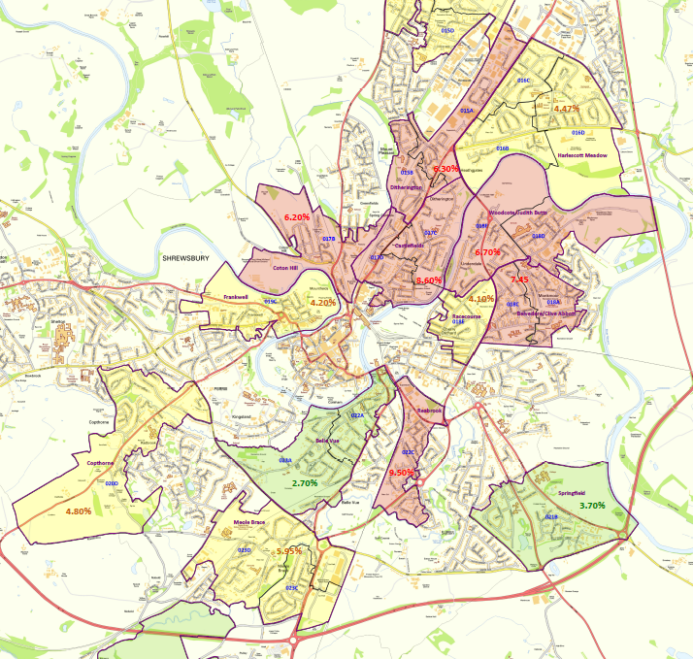

A map of Shrewsbury indicating levels of School Absence against the average for the county

Slide 27
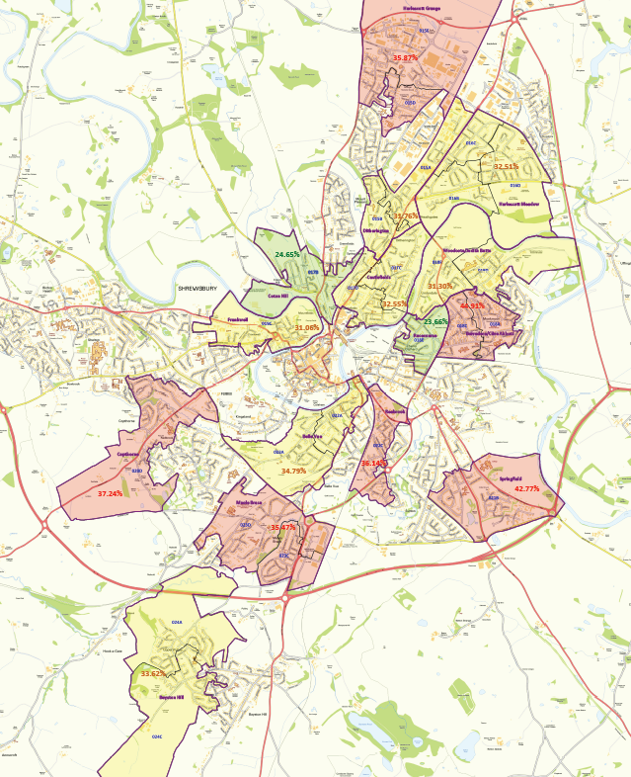

A map of Shrewsbury indicating levels of households without employment against the average for the county

Slide 28
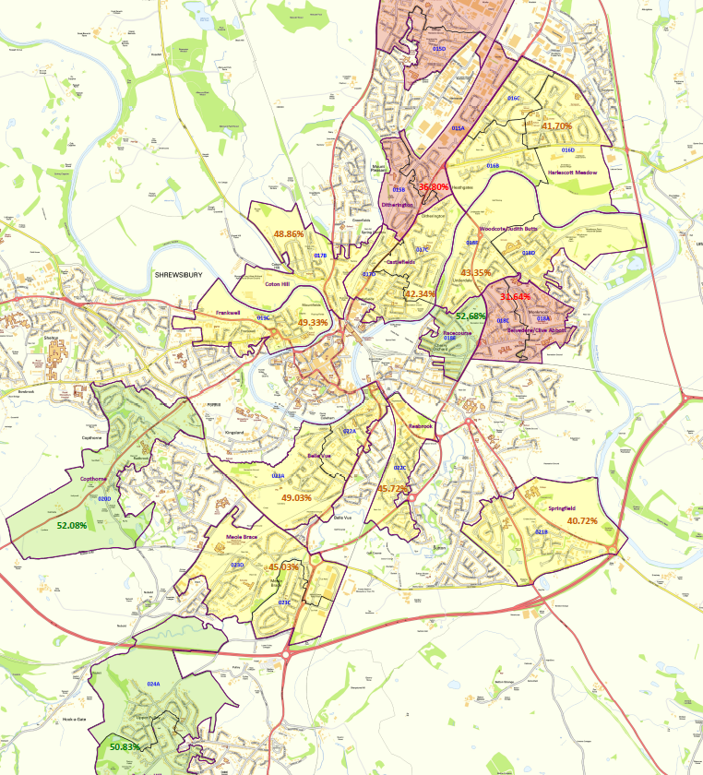

A map of Shrewsbury indicating levels of household deprivation against the average for the county

Slide 29
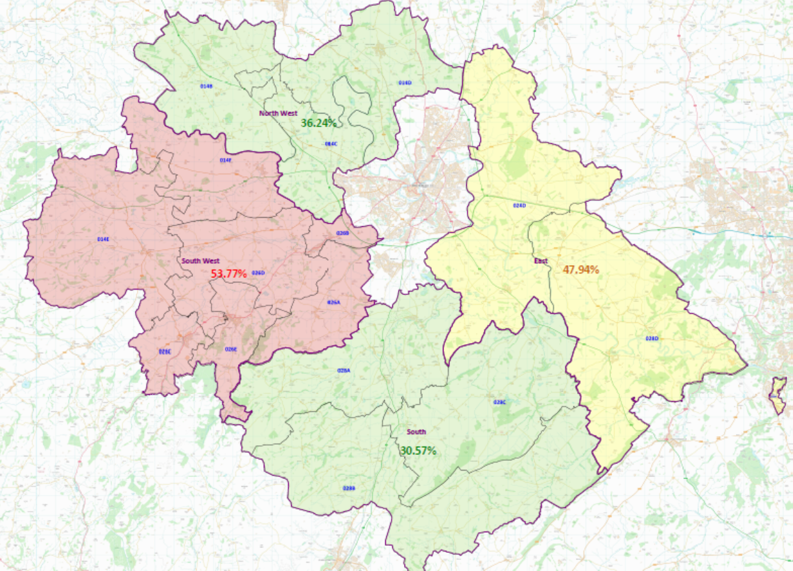

A map of rural areas in Shropshire indicating levels of ASBs against the average for the county

Slide 30
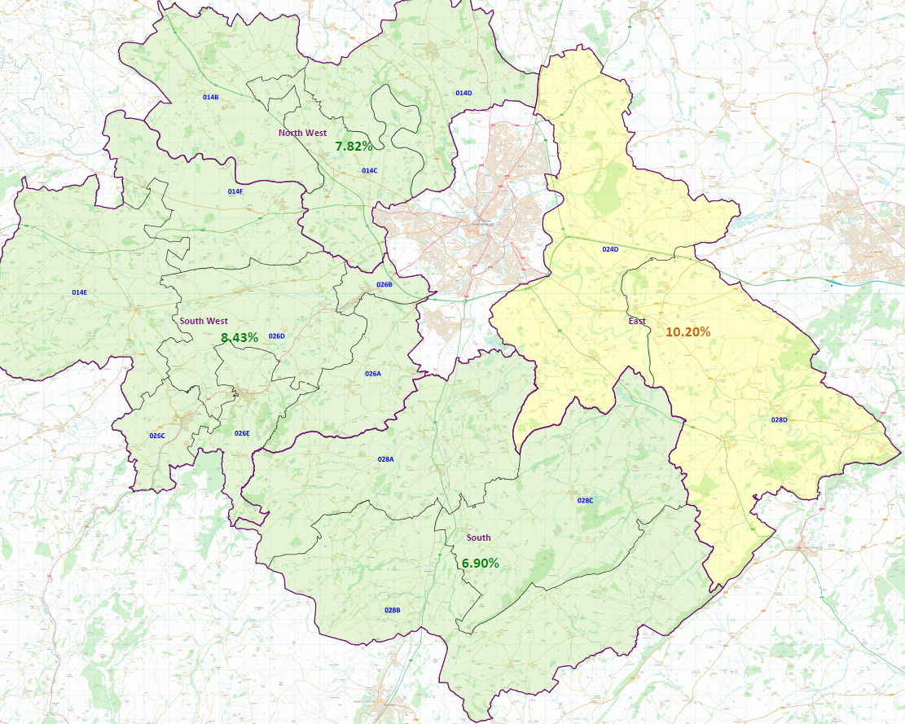
A map of rural areas in Shropshire indicating levels of free school meals against the average for the county

Slide 31
Delivering Business Objectives
Are we are delivering services well?
Are we doing well on key business measures?
Who are the key partners in doing better?
Are tenants more satisfied or better off?
Identify early intervention opportunities
Identify health and wellbeing issues
Mapping households or estates to support strategic decision making
Map voids - identify issues and trends
Map areas and demographics to support new development
Crime and ASB trends
More & less popular areas - inform NiSA work
Mapping customer satisfaction and outcomes

Slide 32

Business Achievements
Targeted / prioritised services
Improved outcomes
Efficiencies – more for the same
Better neighbourhoods - 50% - 70% reduction ASB
Happier customers – 4% up satisfaction
Improved understanding of needs / issues
Surprising results – welfare reform – digital inclusion

