Slide 1
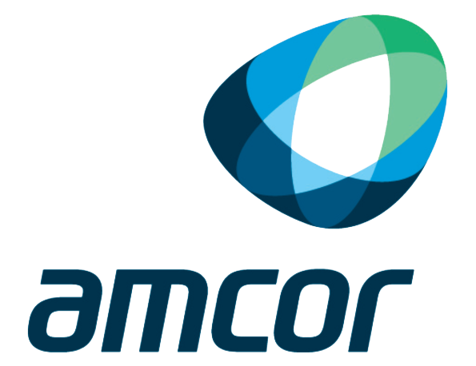
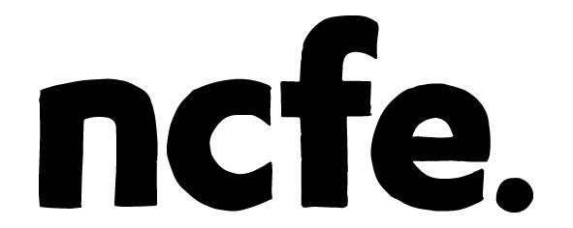
Your journey to the utopian cloud
SITS Group & Trident Social Investment Group.
Pembroke Room 11:00am
Notes:
Welcome to our workshop. I hope you are enjoying the conference so far.

Slide 2
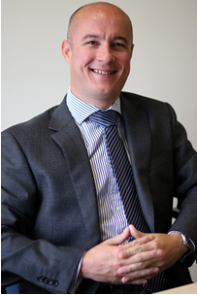
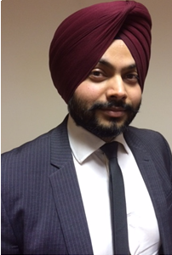
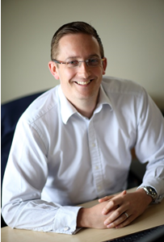
Welcome!
Phil Cambers – Commercial Director,
SITS Group
Manpreet Singh –
ICT Manager,
Trident
Russell Henderson – Technical Director,
SITS Group
Notes:
Aim of the session: is to provoke thought as to what cloud is and challenge current conceptions and whether it is actually Utopia.
We are not here to tell you which one is the best, rather to get you thinking what is right for you.
We hope you find the session refreshing.
Caveat that we are not professional presenters.

Slide 3
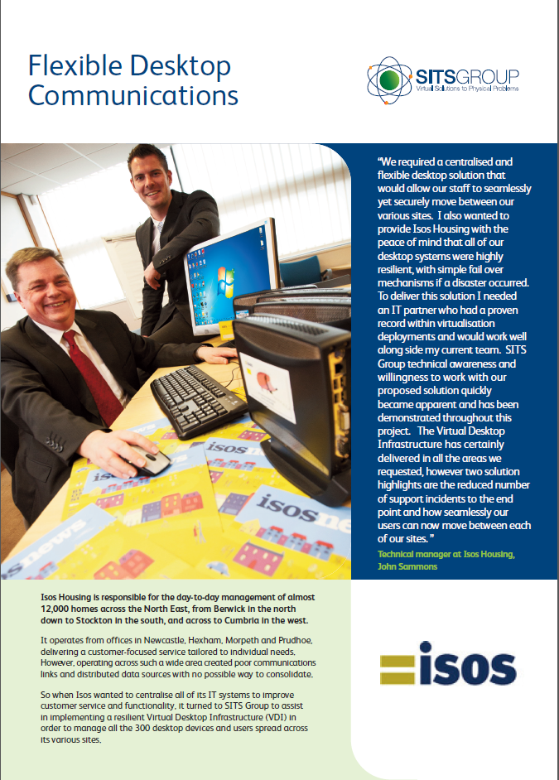
Why are we here?
Notes:
We are here as a result of our clients – two years ago ISOS Housing stood up here and presented what their virtual server and virtual desktop infrastructure had delivered for the business. From this session we were introduced to Trident Housing.
This year we would like to represent ourselves as we now have a growing base of clients in the housing sector and we’d like to share our experiences.

Slide 4
What makes a Specialist
and why Specialise?
Cambridge dictionary meaning
of ‘Specialist’:
“someone who has a lot of experience, knowledge, or skill in a particular subject”
Notes:
So why should you spend the next 40 minutes listening to us? Because we are a cloud specialist.
Cambridge dictionary meaning - someone who has a lot of experience, knowledge, or skill in a particular subject
Examples – The heart Specialist analogy
Experience - We don’t just work in housing we work in the legal, media, public sector, JIT supply chain, Oil & Gas, Housing, list goes on. But for each, all we deliver is virtual infrastructure services.
We are 7 years old and solely operate in the Cloud Infrastructure space – deliver virtual server, desktop & mobility, disaster recovery, networking and solution management services.
Why would you specialise, recognition, reputation, the ability to focus and deliver to a high standard, the question should be who would want to be a generalist?
SITS are a trusted specialist not just for our clients but also our technology partners, VMware, Veeam and others recommend SITS Group frequently to new customers as the job is delivered correctly. And the fact we are here today is proof our customers recommend us to others.
What we’ve seen - Customers Opinions have changed over the last 6-8 years - we have seen business’ choosing to work with multiple specialists rather than a single generalist, it’s easier to manage 3 or 4 key specialists that a single generalist
Ask why the Premier League would work with us.
This is what gives us the credibility to be here an why should you listen.

Slide 5
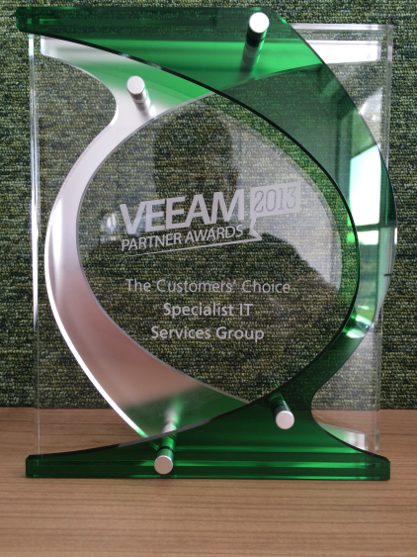
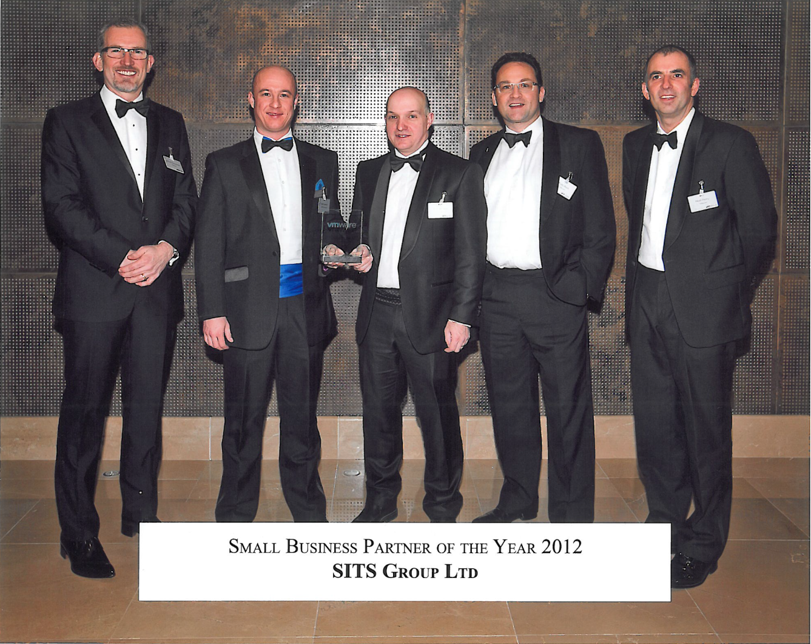
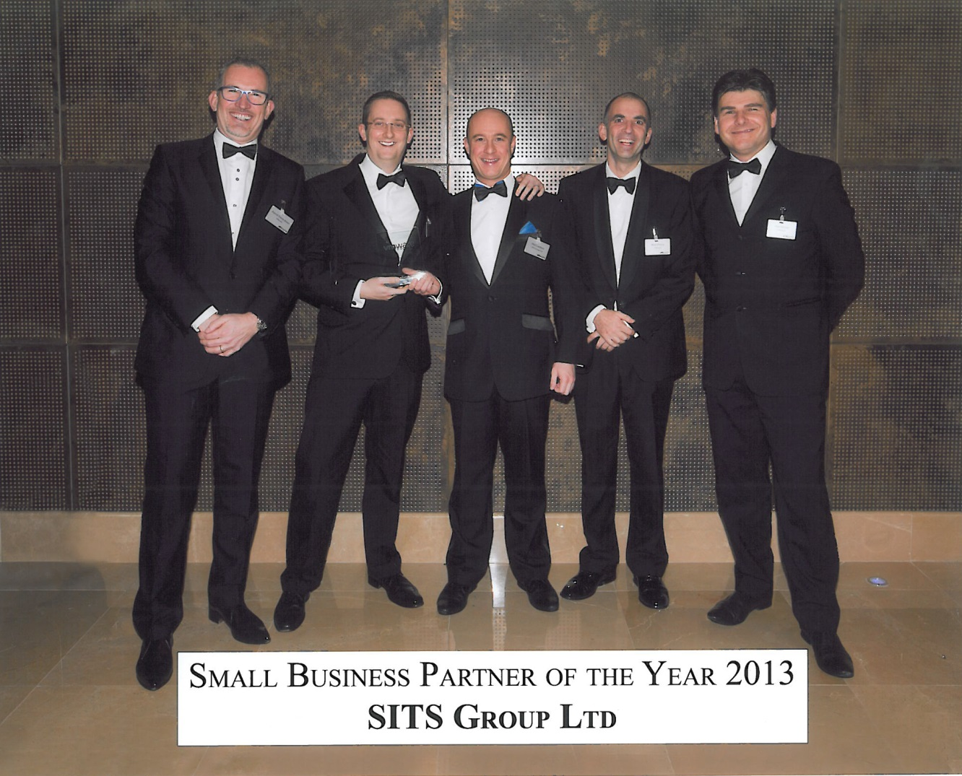
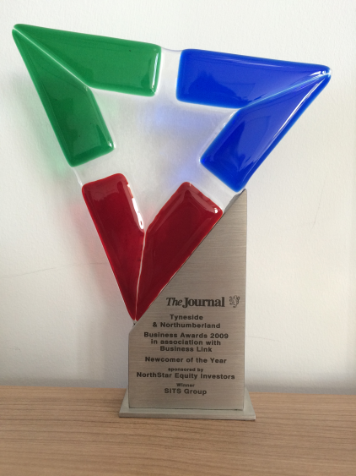
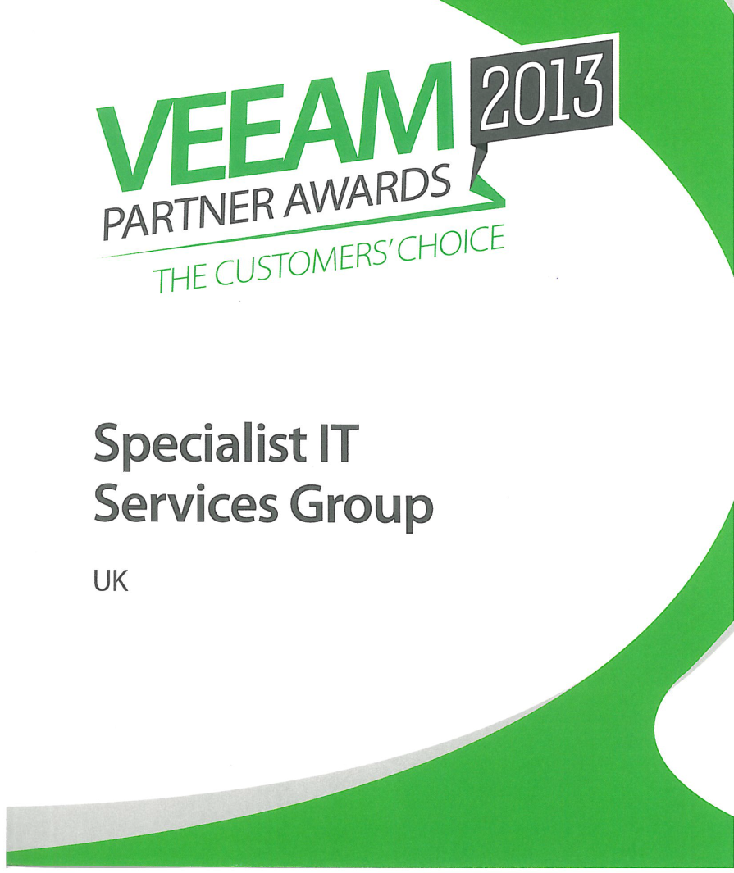
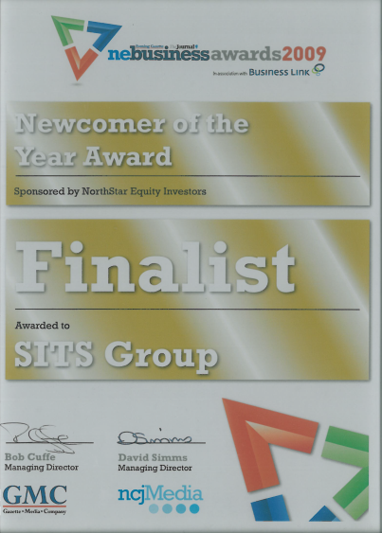
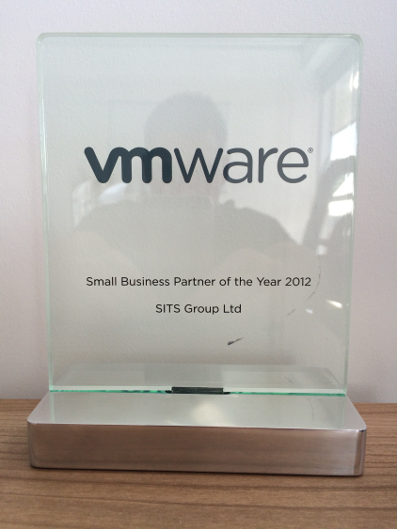
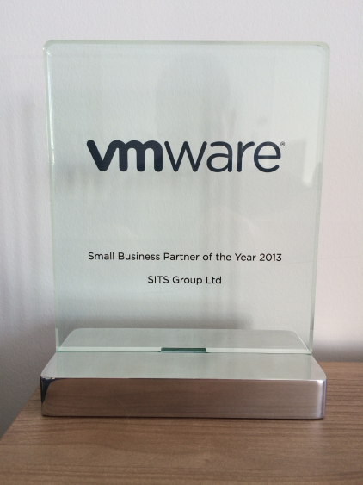
Recognition of specialising
Notes:
Add pictures of the awards ceremony
UK VMware SMB Partner of the Year last 2 years
Runner Up for VMware EUC 2014 Partner
Veeam Customer Choice Award 2014
Only UK LiquidwareLabs Centre of Excellence
– in addition to the awards we have had 100% client retention over 6 years

Slide 6
What is utopia?
Cambridge dictionary meaning
of ‘Utopia’:
“An imagined place or state of things in which everything is perfect.”
Notes:
Can anyone actually think of something which is absolutely uptopian? All cloud vendors promote their solution as being utopia – but is it?

Slide 7
If utopian cloud ‘did’ exist what would it look like?
Notes:
Commercially Viable, Efficient, resilient, accessible, no management requirement, scalable, upgradeable without intervention or cost, 100% up time 100% of the time, performance to match on premise performance – we don’t know we are just surmising

Slide 8
The reality of Cloud today for businesses
Public cloud
Notes:
For businesses is key here, personal cloud use is proven and widely adopted, iTunes, cloud storage offerings, Drop box etc
At SITS we deal with all types of cloud solutions and we have no bias towards any type, it comes down to what is right for the client
SaaS offerings do suit many businesses, but we typically see one or two elements of a business using it, i.e. CRM and service desk for example. It’s rare to fine a full business running from a public hosted cloud due to the complexity of application interaction and speed and reliability of data access.
We can sell you a vCloud-Air solution today, it has HA built in and it’s built on the market leading Hypervisor, but is it right for you?
Off-Premise - Key considerations
Access speed to data, i.e. network communications from all locations
How data is accessed by users, uploads, downloads, print requirements – tolerance for latency or delay
Is this pushed to the public cloud, or rack space procured in a DC with dedicated hardware managed by a 3rd party (out sourcing)
Data protection - backup in a off premise cloud.
Granularity – typically full VM recovery only, no item level
Cost based per GB, length of retention typically quite short and granularity lost as weeks pass, can’t match self controlled
system up time – tolerance to cloud outage, no matter how short, example in 2014
Verizon cloud patching – 40 hours outage for everything 48 hours notice to all customers
Azure – 103 outages, totalling just over 42 hours
Google Cloud Compute and Amazon shared the next spot in terms of number of outages – info taken from CloudHarmony
None of the above may cause too much of an issue depending on the type of data you host in the cloud however
Security – iCloud, Sony Playstation, Sony pictures

Slide 9
The reality of Cloud today for businesses
Private cloud
Notes:
On premise Cloud
LAN based, requires capex investment typically, typically offers high levels of flexibility, data protection is easy to fulfil at a granular level
WAN usually already in place
Can deliver DR to other site or cloud service
Needs maintained – patched, upgraded or replaced over time – can be managed in house or outsourced

Slide 10
The reality of Cloud today for businesses
Hybrid cloud
Notes:
Hybrid Cloud
Some private cloud on site or hosted, some private slice of a public cloud, typically used to facilitate edge services, AV, Mail gateway and protection, FTP and web services etc
Hyper converged – muted to be the future of virtualisation and done correctly it could be.
Aim is to deliver the virtual environment with a webscale mentality, entirely modular and scale as required – just add one or more new devices
Rapid deployment, management and reporting on virtual environment is self contained
IOPS and storage protection is delivered from the use of SSD/Flash and rotational disk in the chassis, data is protected by spreading across disks/chassis in advanced RAID formats, self contained backups, data replication, de-duplication and compression all add to efficiency and protection capabilitiesThe reality of Cloud today for businesses

Slide 11
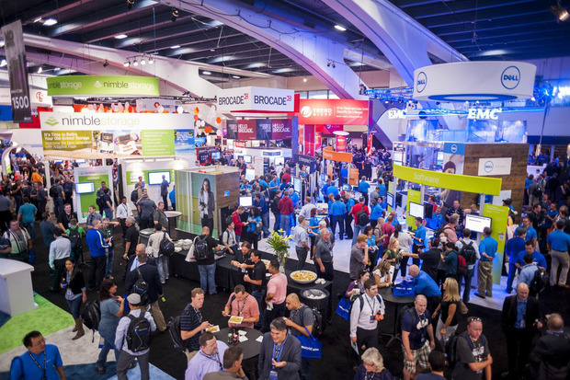
General Market Place Today
Notes:
Market Place
Virtualisation on server is a given largely
DR in a virtual environment is largely straight forwards
Virtual desktop is being adopted at a moderate pace by those for who it suits
How all of this is being delivered is beginning to change
Storage Vendors
All flash, Hybrid Flash, new vendor, long term vendor
How do you choose, pedigree? Can’t for new ones, IOPs key? Capacity key, flexibility, scalability?, Quality support…… all of the above
New wave storage vendors are driving price down and performance and capacity up by using flash with newly written file systems designed to leverage flash to it’s fullist
Hyper converged – muted to be the future of virtualisation and done correctly it could be.
Aim is to deliver the virtual environment with a webscale mentality, entirely modular and scale as required – just add one or more new devices
Rapid deployment, management and reporting on virtual environment is self contained
IOPS and storage protection is delivered from the use of SSD/Flash and rotational disk in the chassis, data is protected by spreading across disks/chassis in advanced RAID formats, self contained backups, data replication, de-duplication and compression all add to efficiency and protection capabilities
Cloud Adoption
General SaaS application uptake is good, Google Mail, 365, Salesforce etc However mid size and larger businesses are not jumping on the bandwagon and pushing full infrastructure to the cloud.
As of Oct 14 according to IDC currently xx% of live business workloads are in the cloud, this is predicted to grow to xx% by 20xx

Slide 12
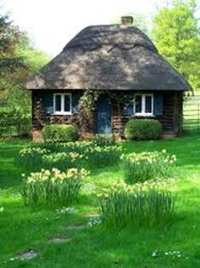
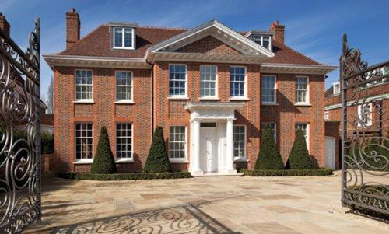
Infrastructure needs are very similar across sectors
Notes:
SITS deal with Housing Sector, legal, Offshore Oil & Gas, Police & other blue light services, JIT supplies for car manufacturing, media – we see a broad base of infrastructure requirements
What’s the difference between a housing sector client and a Oil and Gas client?
Looking for:
Value for money, long term suitability (3-5 years growth), high reliability, scalability, day to day resilience, multi site DR, good system performance, easy of use, day to day data protection etc, etc
At the infrastructure level there is often very little difference between client requirements, each individual company environment can throw up its own challenges but the general requirement list is similar
Example, Police reference 999 system as critical and it is, but is it any more critical than and oxygen and decompression monitoring systems for an offshore company who have 5 – 6 divers on the sea bed, or than a payment system is to a housing company on a busy rent payment day? In isolation to each company all as a critical as each other

Slide 13
Trident’s utopia. The story.
Notes:
Question (PC) –
What is the background of Trident Social Investment Group and yourself Manpreet?
Answer (MS) -
Trident has reinvented itself as a Social Investment Group and is evolving into a new type of organisation incorporating housing organisations, charities and social enterprises, building on the best of the social purpose housing associations created to tackle homelessness and neighbourhood disadvantage.
Trident Social Investment Group is made up of Trident housing Association, Trident Charitable Housing Association, Trident Star, Trident Reach the People Charity, Dorcas Housing and Community Support Association and Community Impact.
Trident delivers services to approximately 6,000 people in 3,500 homes.
Manpreet to talk about his background and Role within TSIG……………………………
Question (PC) –
Why did you choose to work with us?
Answer (MS) -
I came to SITS Group following a presentation I saw at this event by Isos Housing. They had a full virtual solution including desktop virtualisation giving them truly mobile access from any location around the world.
I come to SITS looking for the same solution however it quickly became apparent my under pinning infrastructure for my server environment needed some changes to support my end goal.
Manpreet to cover what he liked about SITS Group……………………………………
Question (PC) – What did your infrastructure look like before SITS were involved?
Answer (MS)
-40 Physical Servers
Full Infrastructure Recovery in 2 weeks
20 hours to complete full backup process
90% of server EOL
EOL Storage Solution
Out of hour maintenance/repair only
High power consumption and CO2 Emission
Power output: 38.4 amps
High capital and operational costs
Question (PC) – What improvements did you want to make to your environment to give you your utopian environment?
Answer (MS)
Reduced capital and operational costs
Enhance Business Continuity and Automated Disaster Recovery
Resilience
High Availability
Distributed Resources Scheduler (DRS)
Efficient Storage
Fast, flexible, and reliable recovery of virtualized applications and data
Reduced CO2 Emission
Reduced Power Consumption
Server Hardware Consolidation
Question (PC) - What benefits were you able to see after the solution went live?
Answer (MS)
6 Physical Servers
Full Infrastructure Recovery in 2 hours
2 hours to complete full backup process
New state of the art servers
Efficient Storage Solution
Maintain/repair during office hours
Low power consumption and CO2 Emission
Power output: 6.5 amps
Low capital and operational costs
Windows Server 2012 Migration
Exchange 2013 Migration
Question (PC) – Did you look at what it would have been to replace like for like? What did the savings look like?
Answer (MS)
Yes of course we had to look at all options available to us. To continue on the same path would have been 57% more expensive in hard cash vs virtualising. However some of the bigger savings which don’t have a hard cash figure are the admin times we have saved being able to pro actively monitor our solution vs manual checks each day.

Slide 14
In Summary
Phil.Cambers@sitsgroup.com Manpreet.Singh@tsig.org.uk
Russell.Henderson@sitsgroup.com
0191 250 04 08
www.SITSgroup.com
@SITSGROUP
Notes:
From experience have we got the Utopian cloud in SITS Group? No downtime since 2008, can upgrade, backups, scalable. Cloud in itself is abstract. Hyperconvernegnce. Mention Temple Heellis. Hope we’ve challeneged perceptions.

