Slide 1
ICT Projects v Business Improvement
Aly Heald, Business Improver
Louise Cope, Head of ICT
Trafford Housing Trust

Slide 2
‘The Problem’
Four Legacy Systems
Expensive Maintenance Contracts
High maintenance interfaces
Old versions
Islands of Data
Poor Management Information

Slide 3
‘The Solution’
The Big One Project
  Replace legacy systems with one integrated solution
  Eliminate interfaces
  Significantly reduce maintenance costs
  Improve Management Information

Slide 4
Project Delivery –
As Planned
Split into 3 phases….
Design
4 months lead by Cultural Architects
Build
3 months led by Process Owners
Test
2 months led by end users.
Training – Senior IT Trainer to deliver guides and facilitate sessions.
Go Live

Slide 5
Work Streams
1. Customer Lifecycle
2. Money
3. Assets
4. Property Maintenance
5. Community
6. Care
Data
Customer Access
Case Management
Workflow
Interfaces
Technical
Mobile

Slide 6
Project Delivery-
As experienced
Design
6 months lead by Cultural Architects
Build
3 months led by Process Owners
Test
IT Trainer – 2 months provision
Training
Go Live
2 months – Led by Process Owners and IT
Train

Slide 7
The Big One Project:
The Successes
Went Live on Time
Went Live within Budget
Reduced annual maintenance costs by £100k
Eliminated Interfaces
Single sign on – significantly reduced Service Desk Calls
No disruption to customers

Slide 8
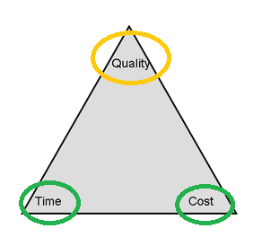
The Big One Project:
Post Implementation Review
The Learning
ICT Led Project
Managed to time & cost
Success factors based around ICT Savings

Slide 9
The Big One Project:
Impact of The Learning
Lack of Business Engagement
Lack of Business Ownership
Lack of System Knowledge & Confidence
System Setup didn’t match Processes
Manual Workarounds Introduced
Culture of ‘putting up’ and ‘making do’
Bad reputation of system
Damaged reputation of ICT Service

Slide 10
Getting it Right
Acknowledged the successes of the Big One alongside its limitations
Being honest about reasons
Business Acknowledgement – changes required
Listening to end users
Green light to Challenge Systems
Review once live
It’s not all about the IT!

Slide 11
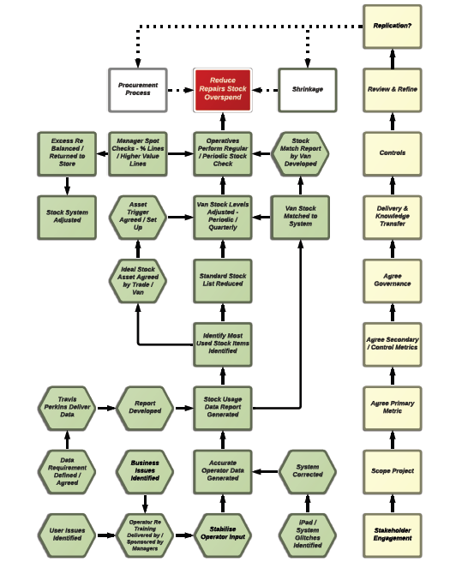
Focus on root causes….
The focus of Front line staff and Managers during initial discussions was at the top end of the value stream e.g. adjust van stock levels
The causes of system and process issues need to be the start point working up the process to impact higher in the road map

Slide 13
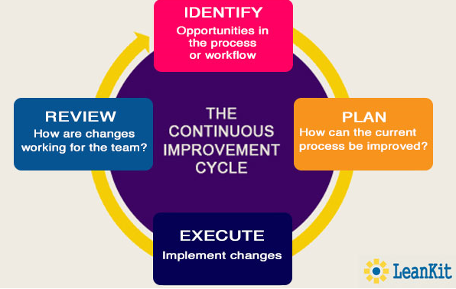
Ongoing process….
Not a standalone event

Slide 14
Service Improvement
Considerations…
Supported by and important to the business
Strategically aligned
Savings to be realised – time, monetary etc.
Adequately resourced – cross business & end user
Route causes not sticking plasters
Focused on long term improvements
Data is key in determining issues and success
Never stops

Slide 15
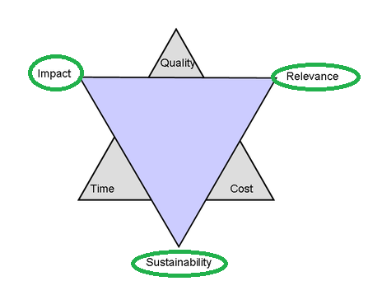
OPENHousing :
The Best it Can Be
Feels completely different
New Business Improvement Project
Priorities determined by the business
One service at a time
Full Customer Journey
Process improvement First
Then introduction of systems

