Slide 2
Creating the ‘Connected Estate’
Geoff Kirk Service Director – Business Systems
delivering promises, improving lives

Slide 3
2020: A Digital Future
New corporate programme aiming to:
Reduce digital exclusion amongst tenants from 51% to 16%.
31,000 WDH homes within the district able to access the internet free of charge.
Maximise the benefits of the WDH wireless network through:
enabling and encouraging channel switch;
smart technologies/Internet of Things (IoT).

Slide 4
Drivers for Change: Technical
High spec corporate network but high cost and inflexible.
Poor quality business broadband links to independent living schemes (ILS).
Highly successful mobile working project (450+ field workers) reliant on intermittent and expensive 3G network.
Discussions with traditional telecoms suppliers not offering any game-changers.

Slide 5
Drivers for Change: Business
Strategic commitment to addressing digital exclusion.
Channel switch to support value for money and meet demands of new/growing customer segments.
Learning from direct payment demonstration project: get the money in.
21st century asset and estate management.

Slide 6
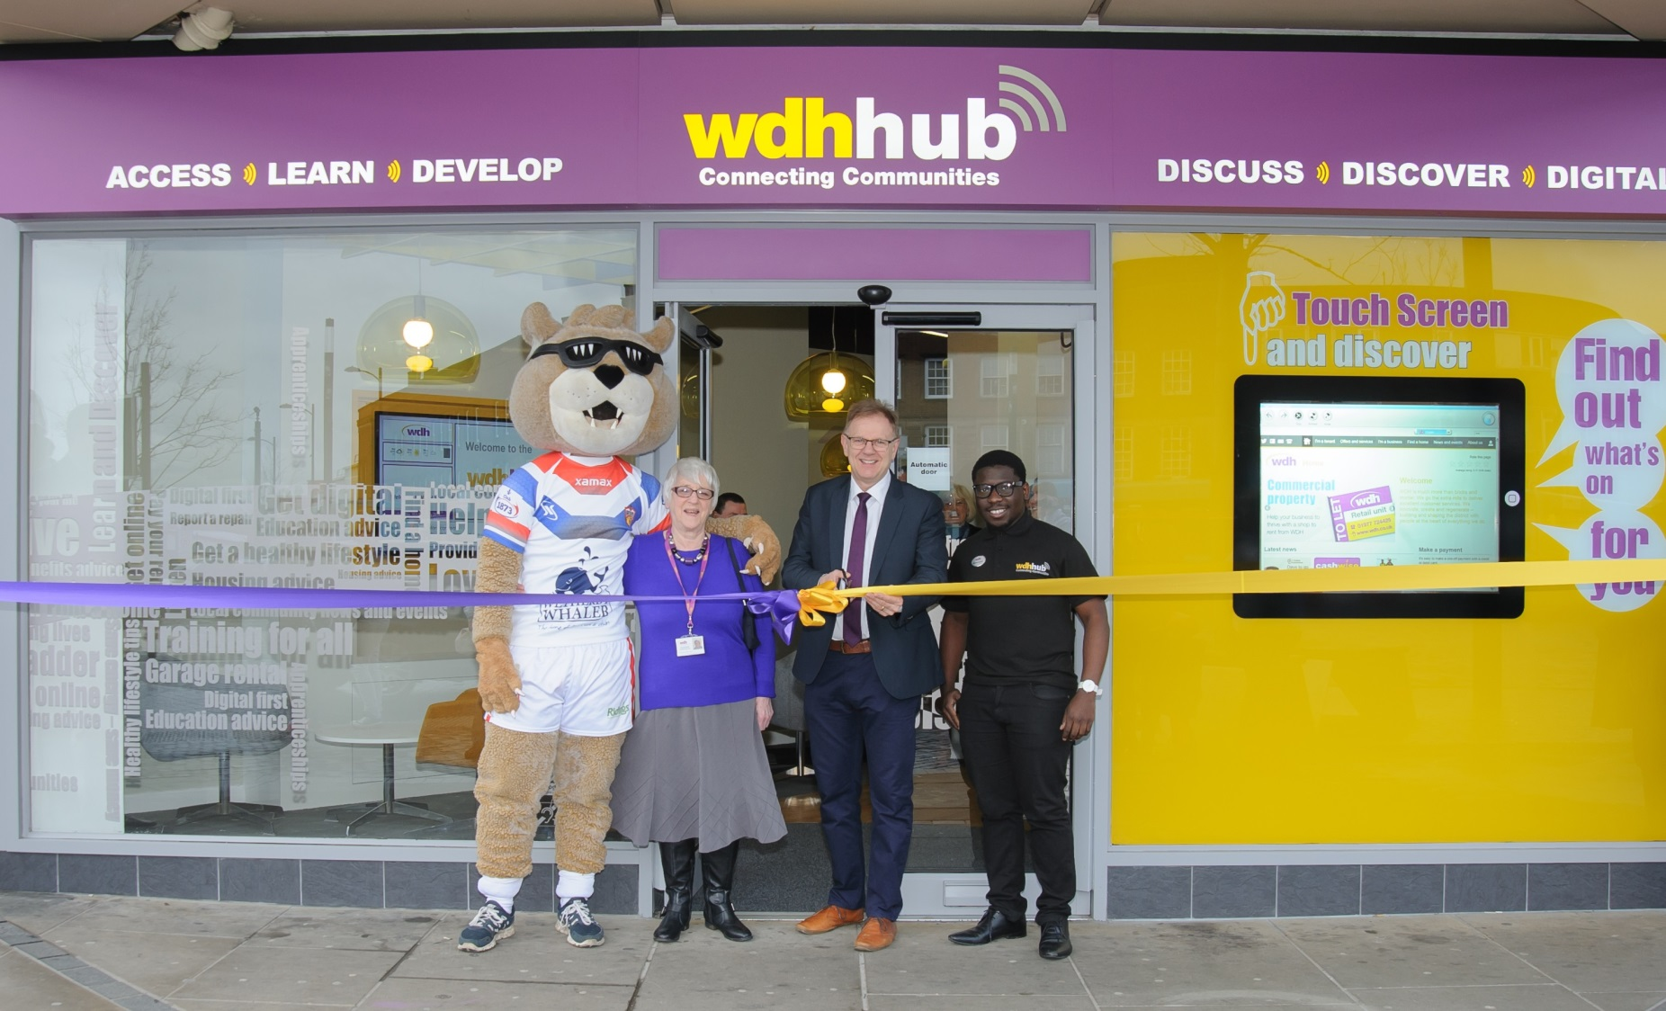
Connecting Communities

Slide 7
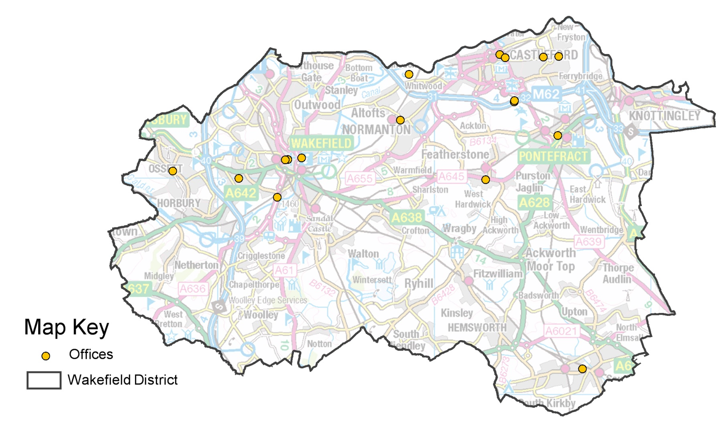
Connecting our Offices

Slide 8
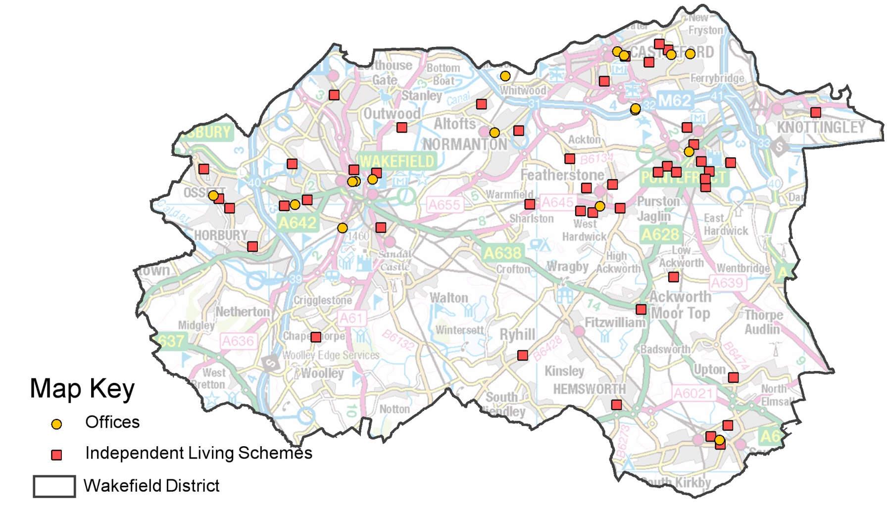
Connecting our ILS

Slide 9
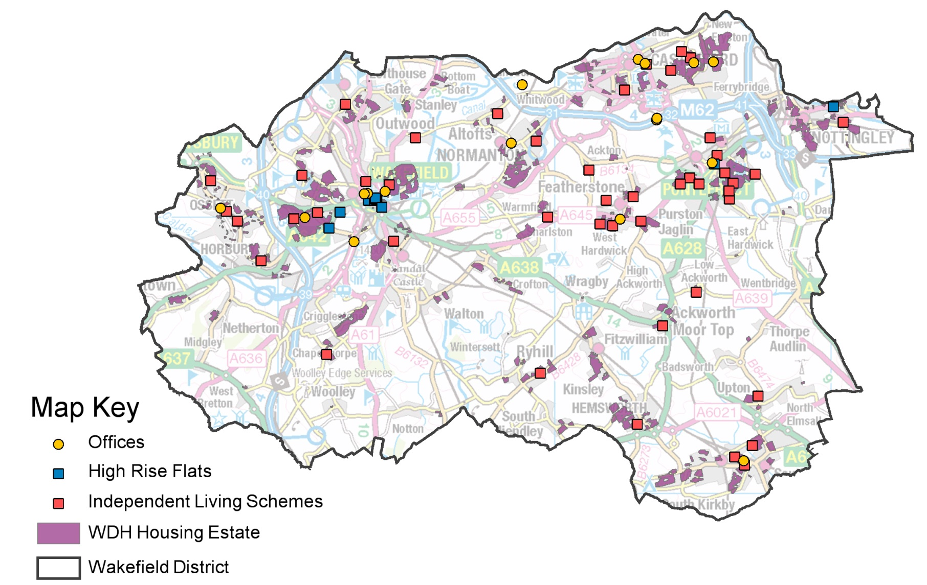
Connecting our Estates

Slide 10
OJEU Procurement Goals
Capital procurement with minimal revenue tail.
Design, supply and build the (WDH owned) network.
Commissionaire agreement for public internet access service at no further cost to WDH.
Commissionaire to offer free internet service for tenants funded through supporting commercial activities.
Profit-sharing agreement in place for longer term.
Comprehensive digital inclusion support programme.

Slide 11
Technical Requirements
Connectivity across corporate WAN c. 300 mbps.
Tenant free internet connectivity minimum 2 mbps.
Up-scalable speeds for paid-for internet connection service.
Future-proofed network design and hardware.
Open-source/standard preferred.

Slide 12
Maximising the Benefits
Cashable savings on wired network and mobile data charges.
Improved connectivity at ILS.
Productivity gains from improved mobile connectivity while working on our estates.
Hardware fund established to fully remove cost as a barrier to digital inclusion.

Slide 13
Digital Inclusion Programme

Slide 14
Where Next?
Transformation potential of IoT is unlimited – but currently uncertain.
PhD being supported to assess true impact of green technologies in social homes.
Key IT suppliers acting as an advisory group on:
smart homes/asset management;
true unified communications with tenants;
encouraging (and incentivising) channel switch.

Slide 15
Any Questions?

