Slide 1
Building a new HMS from scratch
Bite size software delivery
Richard Troote Alex Stephenson
Head of ICT Head of Property Services

Slide 2
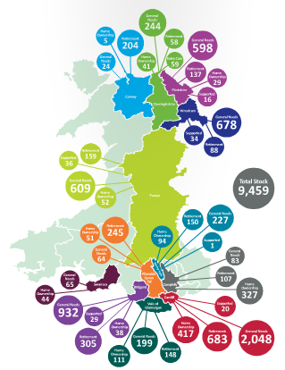
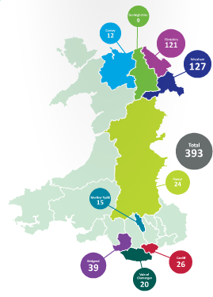
Wales & West Housing founded 1965
Around 10,000 units across Wales – Developing 393 in the coming years
Notes:
Founded in 1965 – 2015 is our 50th Anniversary
Around 10,000 properties (2,000+ North Wales, 6,000+ in South Wales)
Developing around 400 new homes
Your slide from the start about All Wales (with graph)
I will then talk about…..
Give idea of scale
Nature of organisation
Different challenges arising from different bits of Wales

Slide 3
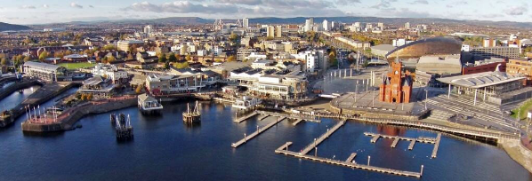
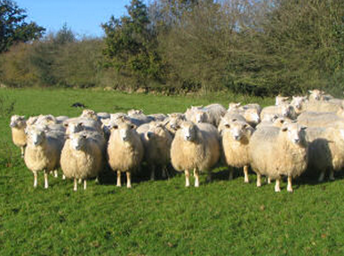
Different needs and environments
Notes:
I will then talk about…..
Give idea of scale
Nature of organisation
Different challenges arising from different bits of Wales

Slide 4
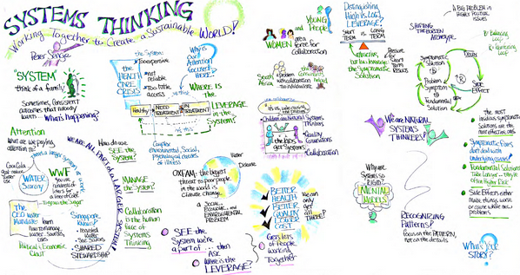
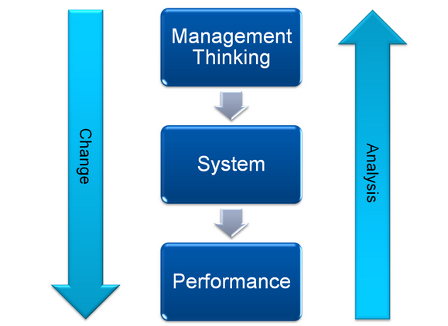
Systems Thinking Organisation story
Notes:
Used to have quite traditional ways of thinking
Moved to a more fluid approach to system design
Thinking about designing systems aligned to what matters to our residents and not our staff

Slide 5
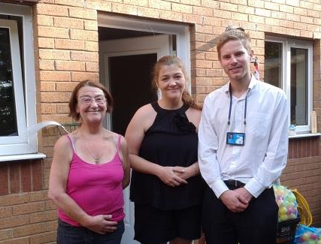
Repairs
What did we hear?
Quickly
Appt
Stays Fixed
Done First Time
Notes:
What Matters to Our Residents about the way we deliver Property Services – with a matrix of key what matters (I will provide this)
Talk about how we establish this
Listening to demand
Designing systems to achieve this

Slide 6
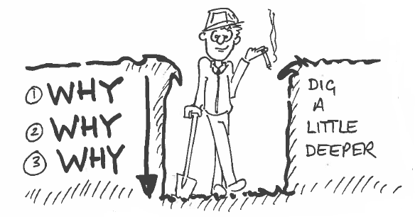
Improving Our System
What Matters
How Well Do We Do It?
Why Is It That Way?
Notes:
How we go about creating systems and improving them
We check with staff all the time
What Matters
How Well Do We Do
Why Is It That Way?

Slide 7
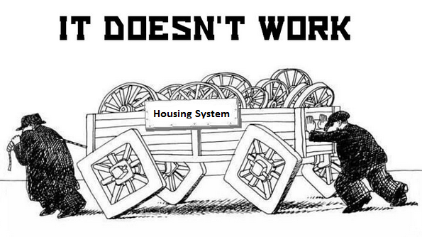
The Challenge !
Housing system has no flexibility
Devices sitting alongside system don’t work well together
Everything has to be on a “certain platform”
All our ICT systems sit in Silo’s
Notes:
Examples – If you can help with this then great.
ICT system has no flexibility
Devices sitting alongside system don’t work well together
Everything has to be on a “certain platform”
All our ICT systems sit in Silo’s

Slide 8
Notes:
Using Capita Open Housing, MS Dynamics, SharePoint and K2 produce an integrated HMS that delivers information both in the office and on the move. Design the system in such a way that its 100% configurable in screen design and process flow. Ensure that it can be changed rapidly to meet changing business requirements and is device agnostic.

Slide 9
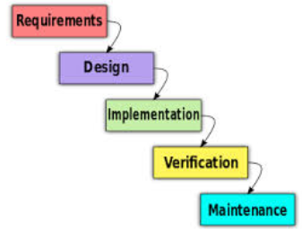
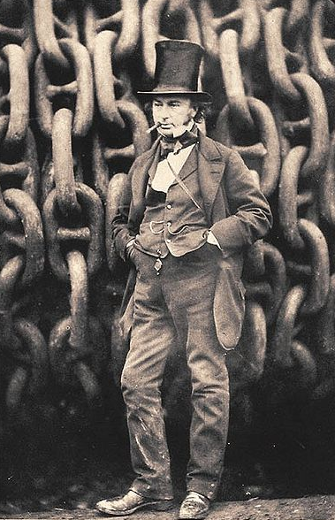
The Traditional way things were done…
Notes:
For decades IT Projects have been run using the Waterfall method. Developed from manufacturing and construction industries it became the main method of IT development in the mid 1070’s.
It’s a familiar story of
Check the requirements with the customer,
Design and Develop the system
Implement the system
Test it with the users
Work with it
Tinker! – make it work for the customer

Slide 10
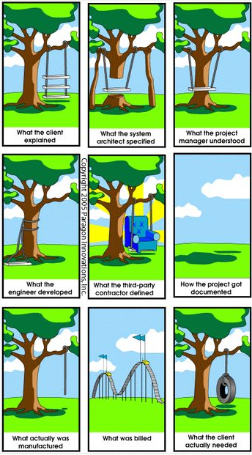
Notes:
Problem was many projects just failed to deliver to expectations

Slide 11
Common Housing Management Systems Issues
Big supplier
Black box solution
Expected to change business processes to match software
Long Lead times
Difficult to amend (inflexible)
Costly
Notes:
Traditionally HMS have been provided by large suppliers
Their systems work to a set method and process, you often need to adjust your method to fit – Their Best Practice
You may have to wait for resources as you are competing with other HA’s for consultancy or development time
Their systems are difficult to change as they have to consider other customers and interdependencies
Most work comes with many zeros attached

Slide 12
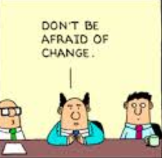
Go – Live is a big bang with all the functionality at once
Big bang –Everything goes live together
parallel running

Slide 13
Agile Project Management options
Adaptive Software Development (ASD)
Agile Modelling
Agile Unified Process (AUP)
Crystal Clear Methods (Crystal Clear)
Dynamic Systems Development Method (DSDM)
Scrum
Disciplined Agile Delivery
Feature Driven Development (FDD)
Kanban (development)
Scrum ban
Lean Software Development
Extreme Programming (XP)
Notes:
Agile PM started in the mid 1990’s and really took off in 2001 its based on 12 founding principles and focuses on removing the issues that Waterfall PM inherently has.
Lots of options with Agile and different methodologies to use, I chose DSDM as it most closely fitted with WWH situation

Slide 14
Agile PRINCIPLES
Customer satisfaction by rapid delivery of useful software
Welcome changing requirements, even late in development
Working software is delivered frequently (weeks rather than months)
Close, daily cooperation between business people and developers
Projects are built around motivated individuals, who should be trusted
Face-to-face conversation is the best form of communication (co-location)
Working software is the principal measure of progress
Sustainable development, able to maintain a constant pace
Continuous attention to technical excellence and good design
Simplicity—the art of maximizing the amount of work done—is essential
Self-organizing teams
Regular adaptation to changing circumstance
Notes:
Agile PM started in the mid 1990’s and really took off in 2001 its based on 12 founding principles and focuses on removing the issues that Waterfall PM inherently has.
Some of the key principles we used are:-
1. Rapid delivery (4 weeks) of agreed functionality
2. Changes to specification are welcomed, even within sprints
3. Sprints are 4 weeks in length
6. Face-to-face communication within the development team and with customers as much as possible
11. Development team are self organised the PM has little contact during the Sprint

Slide 15
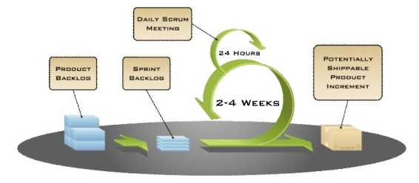
Agile Process – Implementation at WWH
Notes:
DSDM principles have a number of elements that the team
Moved all requirements into a Product Backlog list (more on this later)
In the first week of a month hold a sprint meeting to decide what backlog items will be worked on, the scope of the work and estimate the resources required.
Develop the sprint into a workable plan (Timeboxing)
Alternative days stand up scrum meetings

Slide 16
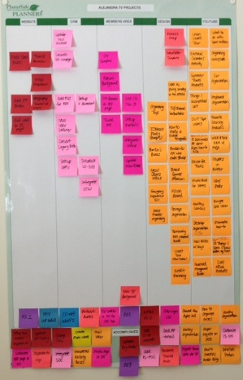
Visual boards in the office show details of the sprint
Notes:
To ensure total visibility each sprint is depicted on a board and displayed in the office

Slide 17
Alternate days stand up meetings discuss progress and issues as they arise.
Face-to-face communication ensures all team members know where the sprint is
Notes:
The boards are used for the alternative days stand up meetings by team members

Slide 18
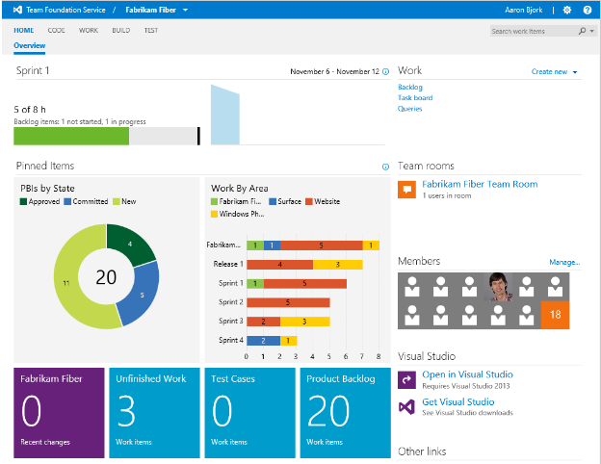
Use to control
sprints and
monitor progress
Notes:
All team members have access to Visual Studio Team Foundation Server to control the sprints and monitor process

Slide 19
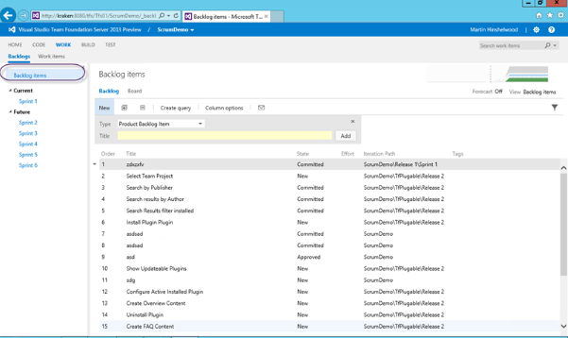
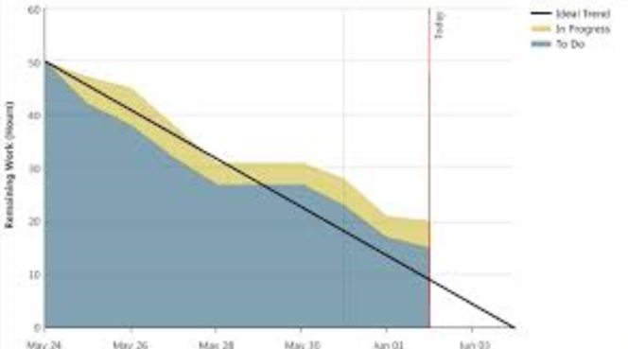
Notes:
Workload is divided into
Features, Backlog and tasks with team members having full control of tasks. The PM controls Features and Backlog. Burn down charts are used to monitor progress.

Slide 20
Does Agile produce
better outcomes?
Notes:
So after 7 months of Agile working what's the verdict?
Before I give you an IT answer to that question.

Slide 21
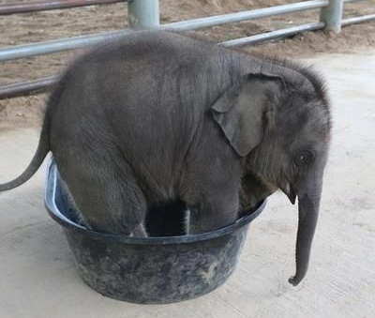
A business Perspective
Key Impact of The New Approach to date
Business drives system design – not ICT acting as a barrier
Agile means business sees impact sooner
ICT feel alongside service delivery in the boat rather than a distant relative
Front Line and Back Office feel more connected to our over arching principles of the “doing what matters”.
Notes:
Key Impact of The New Approach to date
Business drives system design – not ICT acting as a barrier
Agile means business sees impact sooner
ICT feel alongside service delivery in the boat rather than a distant relative
Front Line and Back Office feel more connected to our over arching principles of the “doing what matters”.

Slide 22
A ICT Perspective
MS Dynamics Environment built in first sprint
Mobile working delivered in second sprint (8 weeks after project kick off)
Housing and Property Services functionality delivered
Business fully engaged with process
Notes:
Lets have a view from the customers perspective

Slide 23
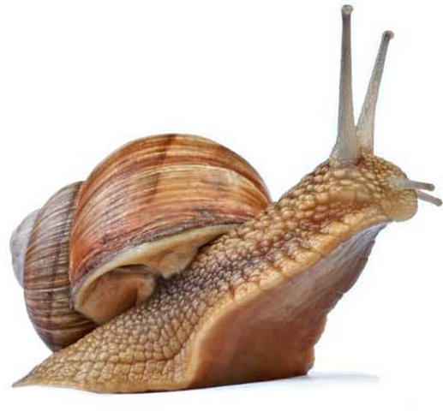
Stand up meetings don’t always happen
Change can BE painful
Estimating for burn down difficult
Size of sprints
Notes:
Stand up meetings are not embedded and I sometimes have to remind teams to have them
Specification change from the business is sometimes meet with a No
Estimating resources and timesacales so that the burndown chart works is not right yet
The amount of backlog tasks attempted in each sprint is not quite right yet

Slide 24
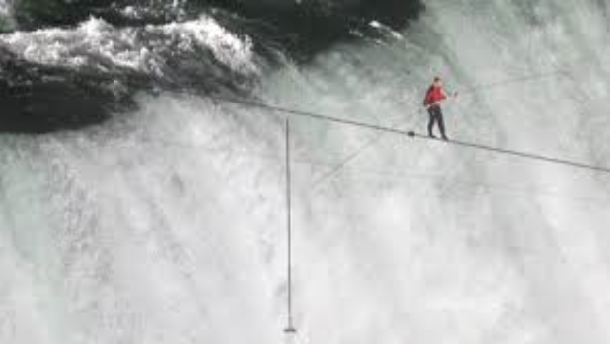
We are learning
Getting better
Need to get the Business involved in kick off meetings at some stage
Notes:
What next for us

Slide 25
Any Questions
Richard Troote
richard.troote@wwha.co.uk
Alex Stephenson
Alex.stephenson@wwha.co.uk
Notes:
Questions

