Slide 1
Winner, 2014 Connect ICT Awards - Connected Citizens
Connecting the Unconnected
Graeme Hamilton Innovation and Online Services Manager
5 March 2015

Slide 2
Wheatley Housing Group Limited
GHA
(£168.6m)
GFL (£1.4m)
Cube
(£13.5m)
West Lothian
(£1.6m)
Loretto HA
(£5.5m)
Lowther Homes
(£1.4m)
GHA Enterprises
Loretto Care
(£11.6m)
YourPlace
(£9.2m)
Private rented
Factoring
Charitable/regulated RSL activities
Other activities

Slide 3
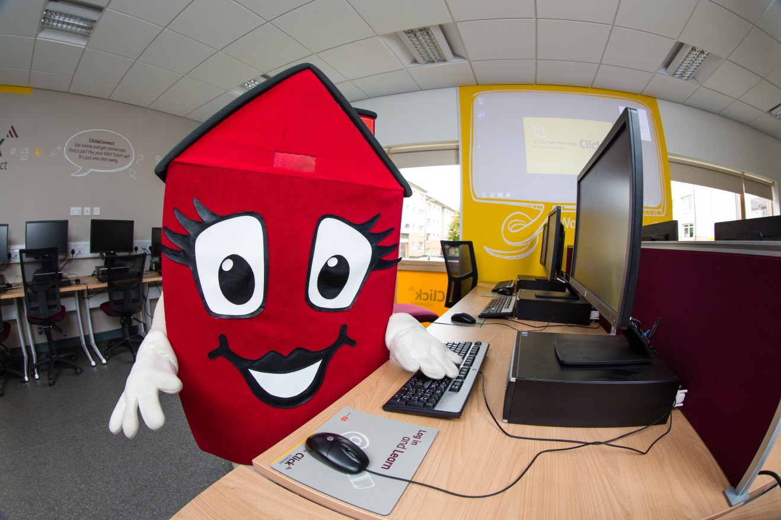
Background- from GHA’s annual tenant survey
Only 43% (2013=37%) of our customers use the internet frequently, compared to Scottish average for social housing tenants of 55%.
Notes:
44,000 customers across Glasgow, 80% dependent on benefits.
High impact of Welfare Reform
Government default position – on-line applications
Usage highest in 16-44 age group and lowest in 75+ age group.
Usage high amongst BME tenants (61%).
Much lower usage in disadvantaged groups.
3

Slide 4
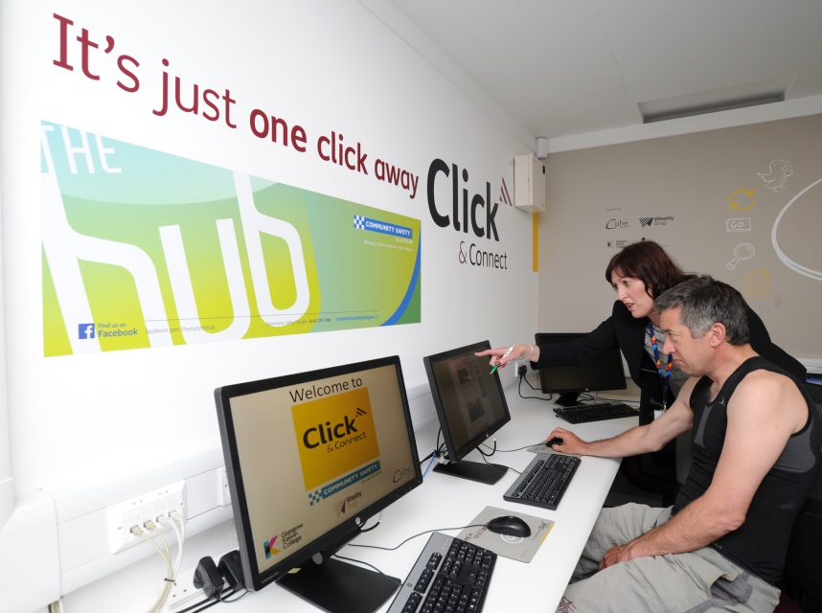
Our trio of connected projects
New Customer Relationship Management (CRM) Platform
- Leading to Online CRM
Hand-held technology for staff
Digital connectivity for customers

Slide 5
Our most successful activities to motivate our customers to get online
Award-winning pilot connectivity study at high-rise block, Kirkton Avenue, Knightswood.
New and refurbished learning centres
Online expressions of interest in our vacant social housing stock (Homefinder)
Increased engagement through facebook and twitter
Outreach initiatives with One Parent Families Scotland
Notes:
5

Slide 6
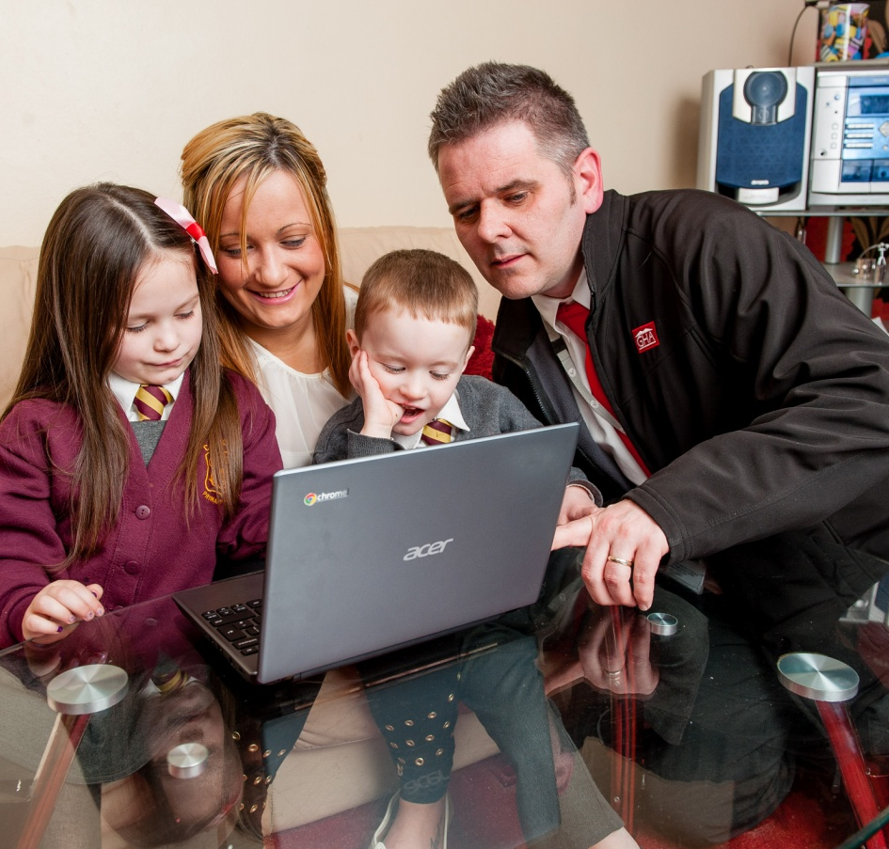
Our Digital vision
Affordable internet access in every rented home
All staff and customers digitally enabled
Digitally accessible services for all - customers, suppliers, partners
Provision of mature, easy to use online services defined and driven by and with our customers
Notes:
6

Slide 7
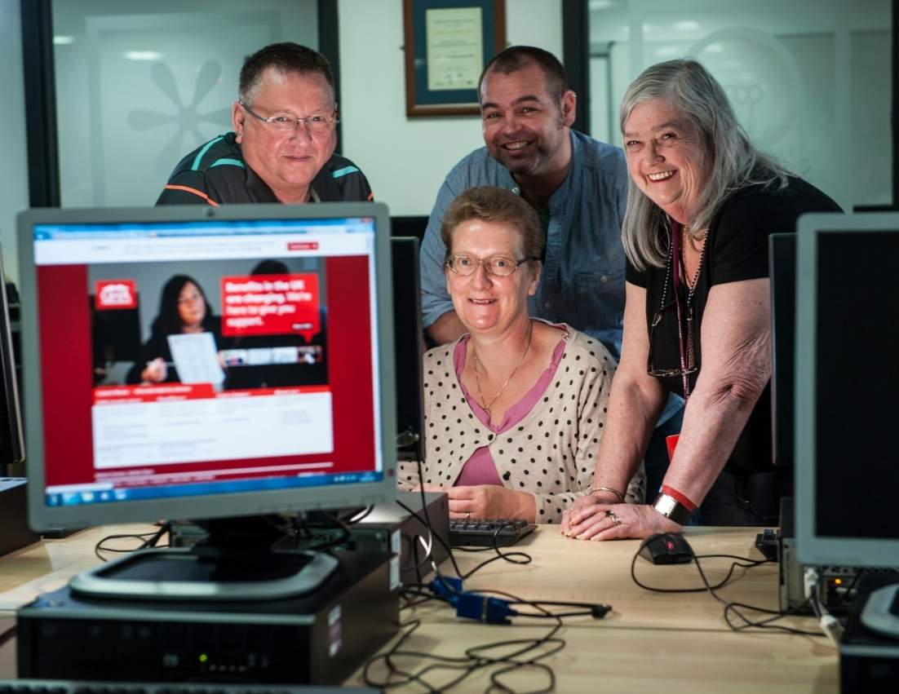
Our digital strategy
Participation
Assisted Digital
Connectivity
Engagement
Notes:
Connectivity
Installing broadband to our homes
Enhancing and extending our learning centres
Participation
Basic digital skills
Better lives – saving money, jobs, health, education
Use on-line services – pay rent, order repairs, enquiries, find a home
Signposting to partners’ services
Engagement
Better communities – local decision making and influencing policy
7

Slide 8
“Demonstrating Digital” study
Joint initiative with Scottish Government
High-rise solution for up to 138 families, including five temp furnished flats
Wi-fi solution
Replicable across portfolio and RSL sector
Measured outcomes
Pre, mid and post surveys
Community flat and learning
Extended for second year to August 2015 with additional agreed outcomes
Notes:
Prove technology
Prove a price point and value for money
Engage customers
Measure benefits
Understand what motivates tenants to go online (and those who still don’t)
Inform the business case
8

Slide 9
2014 Digital Feasibility Study: Interim Interview Results
Glasgow Housing Association

Slide 10
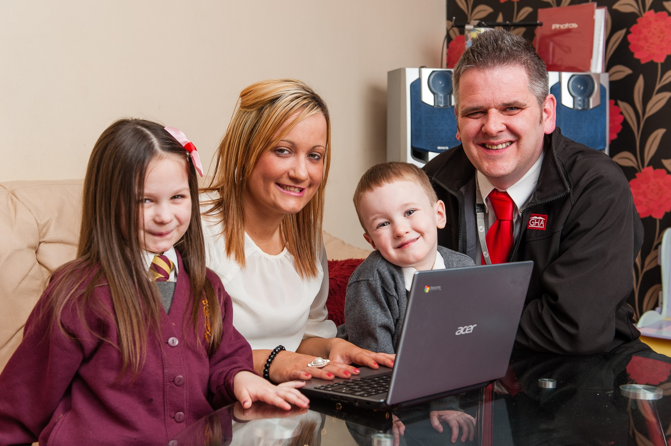

Slide 11
Just under two thirds of residents did not have access to the internet before the study. The advantage of not having to leave the house to gain access being a key difference
Q3b. Could you please explain the difference having access to the internet at home has made to you and your household?
I can talk to my brother and keep in touch with other family members.
Before I had to go to library if I ever needed anything and to print things out. It is a lot easier accessing it in my home, checking things online.
Q3c. What are you able to do now that you could not do before?
Online shopping and I have switched my electricity through it and pay all my bills through it.
Been able to stream some films, but takes ages to load. So not used much.
All respondents (46)
Those that said No (28)

Slide 12
The use of the internet personally or as a household has increased since the baseline study
Q10a. Which of these best describes how often you use the Internet / email?
Personal
Everyday
Male – 81%
At least once per week
At least once per month
At least once every 3 months
Not often (i.e. less than every three months)
Never
Summary: Use
78%
Base: Interim (46), Baseline (61)
All respondents

Slide 13
Nearly three quarters say they feel safer using the internet since taking part in the study
Q8. Since taking part in the study do you feel safer using the internet?
With disability – 78%
All respondents

Slide 14
Just over a third of residents believe they have saved money during the study and 65% of these think they have saved over £100
Q6a. Do you believe that you have saved money by using the internet during the study period?
Q6b. If yes, how much money do you think you have saved since the study started? Please give your best estimate.
Mean savings = £187
All respondents (46)
Where have saved money (17)

Slide 15
Most savings through online discounts or having greater choice were made through food
Q6d. On what type of product(s) did you make savings through online discounts or due to having greater choice?
CAUTION LOW BASE
Those that made online discounts

Slide 16
Half of residents would be willing to pay for an internet connection when the study completes, while 26% would find it difficult to cover the cost
Q48a. To what extent would you be willing to pay for an Internet connection once this study has completed?
Q48c. How difficult, if at all, would you find it to cover the cost of an Internet connection?
Female – 63%
Didn’t have internet access before – 32%
Male – 33%
Didn’t have internet access before – 32%
Where are willing to pay for internet connection (39)
All respondents (46)

Slide 17
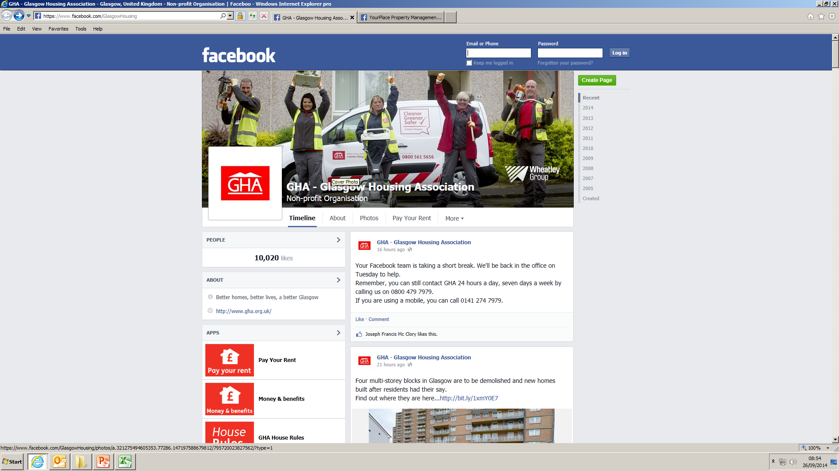
Notes:
GHA has one of the largest following on Facebook of any social landlord in the UK with more than 10,000 followers.
We have created industry-leading Facebook tabs for Pay Your Rent, House Rules and also Money and Benefit Advice.
The Pay Your Rent app, in particular, is a key business driver as it allows tenants to keep up to date with their rent at a time and place which is convenient to them.

Slide 18
Online CRM
Puts customers in control of when, how and where they do business with us.
Notes:
Here are some of the things we are improving:
Report repairs, view the progress and amend appointments
View arranged appointments with your housing officer
Report a compliment or a complaint and track progress
View account payment history and make payments securely
Find a home through Homefinder.

Slide 19
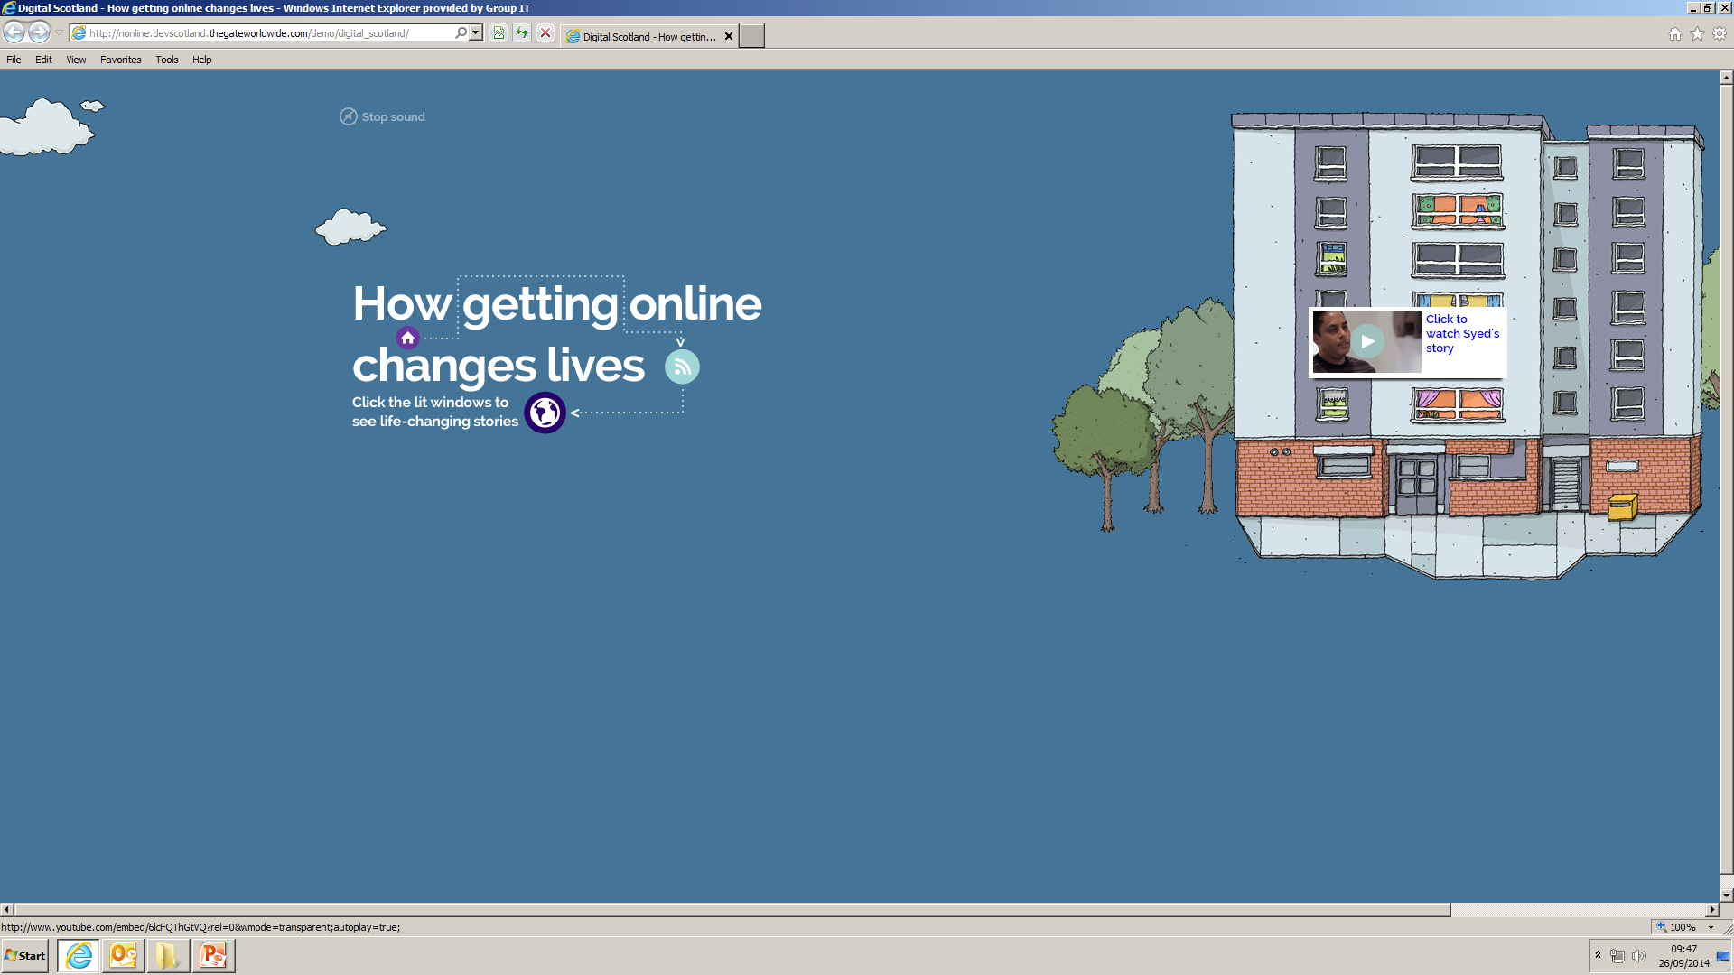
What do our customers say?
Insert Dorothy’s video

Slide 20
Notes:
With you in control, we can do the following:
Our housing officers and other customer facing colleagues would be able to provide personal support to you
Our housing officers would be able to visit their neighbourhoods regularly and ensure they meet the standards you expect
Our housing officers would be able to tackle some of the complex issues that occur within your communities
You would be able to contact us, when you need us most at our Transactional Hub – with minimum waiting times to get through.
We need to make sure our online services are the best, easy to use and you will want to use them every time.

