Slide 1
Our Journey to Excellence Housing Technology Conference
Thursday, 5 March 2015

Slide 2
A journey and not a destination .....
Angus Groom
Ian Hill
Notes:
Welcome
Fire instructions
Carry out the treasure hunt game – five minutes.
On tables is an envelope. In the envelope is a list of items to collect. First table to have a complete list wins. Hands up when you are done.
Hand over to Pat Brandum – Chief Executive

Slide 3
About us
Massive growth
Different cultures and histories
Different delivery
Need to harmonise
Notes:
Quick intro to the three main themes

Slide 4
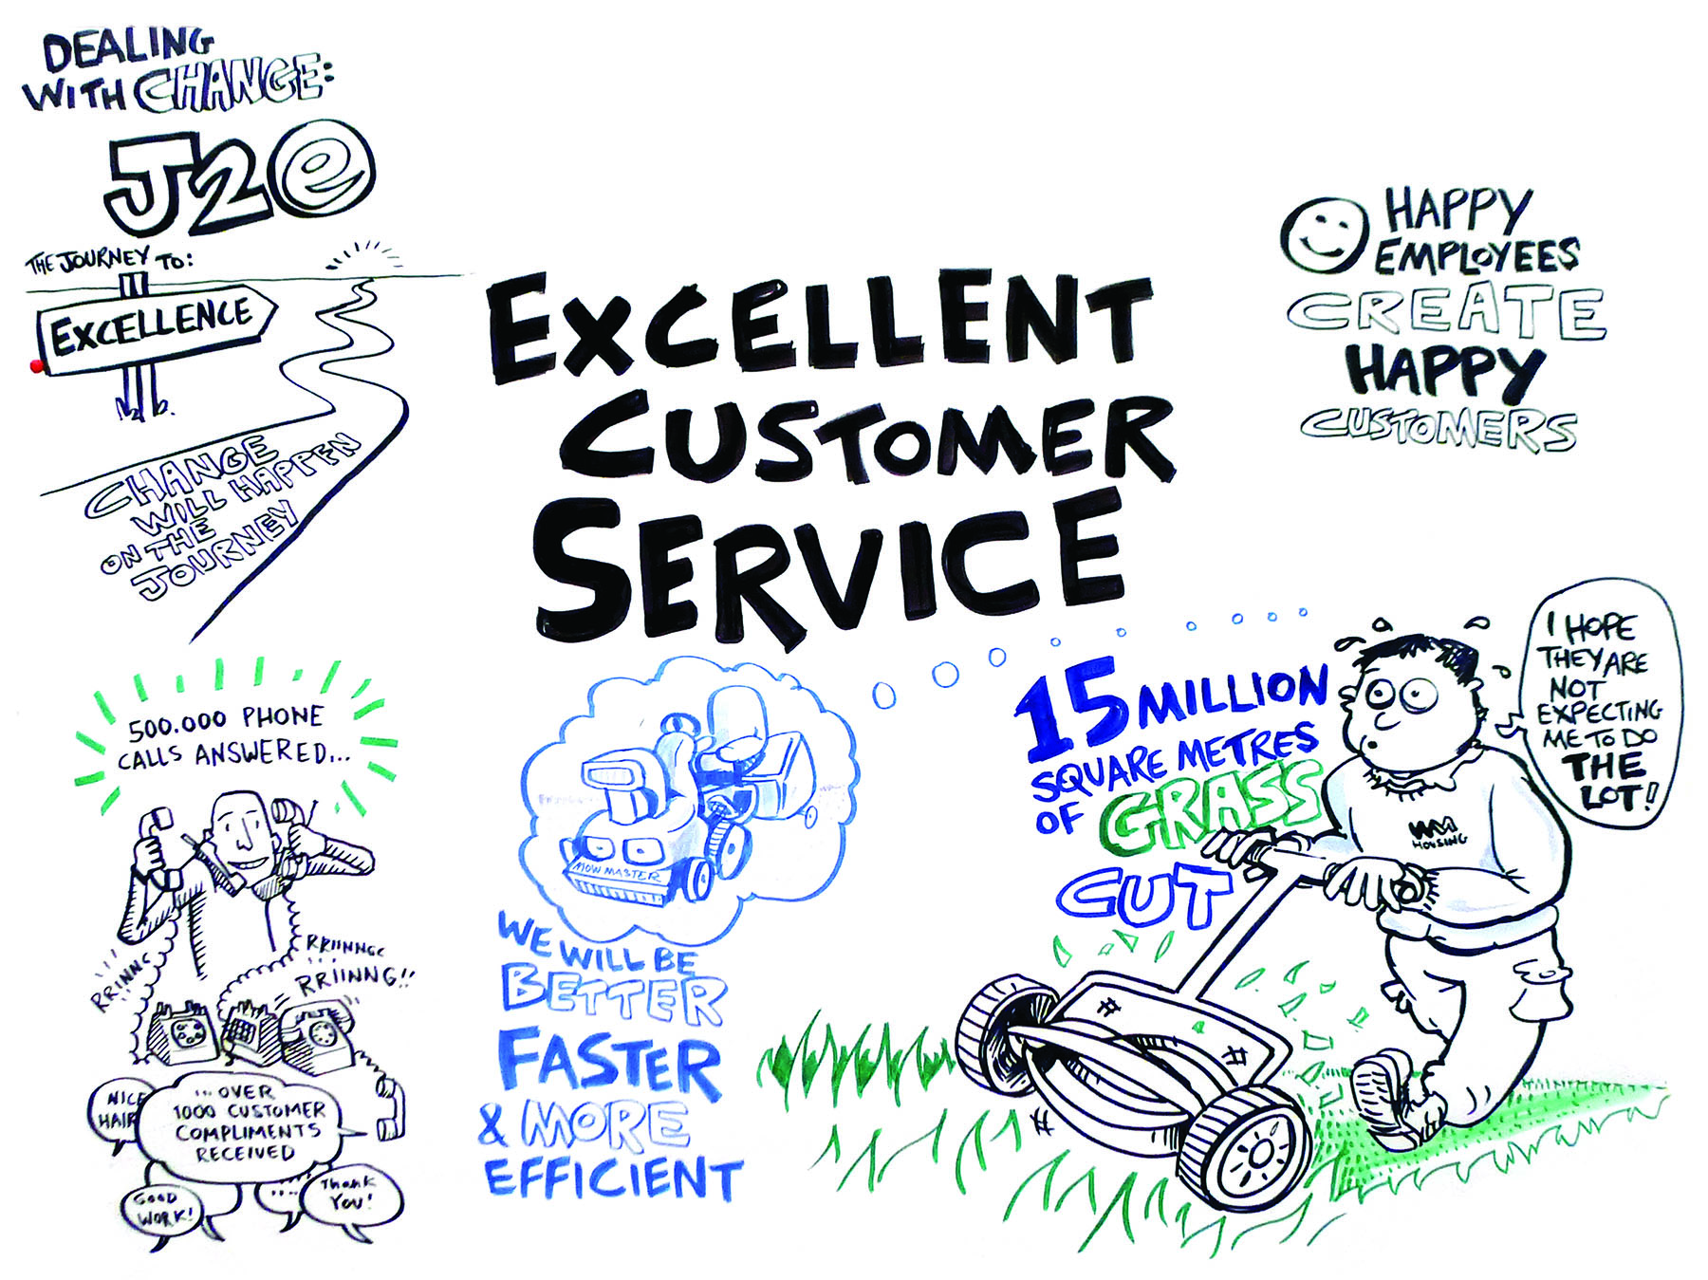
What does excellence mean to us?
Delivering a vision
Inspiring people
Consistency
‘Out of the heavens’
Notes:
Personal reflections:
Growth
Challenging environment – economically, policy, governmental, welfare reform
Positive successes – as general as possible to be inclusive I guess
SHYPP
Development
Finance raising
Community work

Slide 5
Myths of change
People resist change
People are aligned to our aims
Change drives us on
Just say more
Need to change attitudes
Notes:
Unchanged. Important to remember we are not just a landlord we work with 30,000 customers each with different needs. Our emphasis is on creating places – estates, support and tenancies – and a sense of pride in people’s homes in the areas they live and the services we provide.

Slide 6
Starting point
What frustrates customers
What frustrates staff
What would improve things
Notes:
Strengthening our governance and corporate configuration
Why is it important?
In the last few years, the number of top 25 housing groups that operate a federal structure has declined from 16 to five. It is important for our Group that we retain this federal structure as it offers the flexibility to create business efficiencies whilst maintaining local delivery flexibility.
By focusing on our governance arrangements and corporate configuration we can ensure clarity of roles across the Group and ensure decisions are taken at the right level to deliver our corporate aims.
What key projects will we deliver to achieve our objective?
Ensure that we have a single legal entity in Birmingham, bringing together the stock owned by West Mercia Homes, whose focus will be on Worcestershire and Herfordshire, Optima and Family (Birmingham).
To demonstrate clearly the relationships between our parent Group and local member associations to help our customer, partners and staff to understand the way we intend to work into the future.
To establish a mechanism to move our stock between parts of the Group to ensure greater local focus.
How will we measure success?
By March 2017 we will have a single legal entity in Birmingham which manages all group stock within the city and its surrounding areas.
Each year we will receive a G1 and V1, or equivalent, regulatory judgement from our regulators.
Each year we will assess the effectiveness of our intra-group governance arrangements and report to boards on their success.
Delivering excellent customer services
Why is it important?
Our customers are at the heart of all that we do. As our vision sets out we are committed to creating places where people are proud to live and work. To achieve this we need to focus our efforts on achieving performance standards that are important to our customers and ensuring they are delivered in ways which are easy for our customers.
We recognise that our customers’ needs will change over the next few years. Through the use of business intelligence we will be better able to predict, understand and respond to these changes. This will allow us to deliver the right products and services to our customers now and into the future.
What key projects will we deliver to achieve our objective?
We will complete delivery of our Journey to Excellence project ensuring all of our key service information is held and managed through a single computer system.
We will use our geographic information system to provide a system which maps key property and service information to enable us to focus our efforts where they are needed most.
xxxx
How will we measure success?
Achieve top 10 per cent of performance amongst our peers, based upon their 2014/15 performance, for the following performance measures:
The average turnaround time for voids
The level of current rent arrears
The percentage of repairs we deliver right first time.
All of our services will show continual improvements in performance
The percentage of customers who are satisfied with us as a landlord will be at least 87 per cent

Slide 7
Developing a vision
Clear purpose
Clear objectives
Commitment and accountability
Involve people

Slide 8
How do we transform services?
Process mapping
Process design
Share successes
Break down silos

Slide 9
Involvement
Specification
Procurement
Evaluate suppliers
Evaluate developers

Slide 10
Key aspects
Service Centre
Document management
Top to bottom redesign
Mobile working

Slide 11
Programme focus
Management
Governance
Uncertainty
Supplier liaison
Customers

Slide 12
Measuring and monitoring
Change for customer
Improvement
Set-backs
Positive perspectives

Slide 13
Your thoughts?

