Slide 1
A journey of innovation in Social Housing Technology
@JamesRMassey

Slide 2
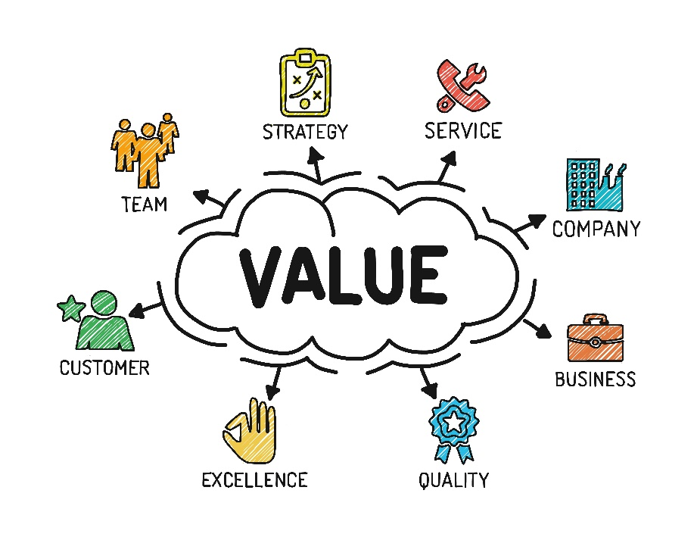
Culture Change
the act of defining, or of making something definite, distinct, or clear

Slide 3
Mobile Working
A method of working that isn’t tied to a physical location
Notes:
Mobile working has been around for over a decade and yet compared to services available on your Smart Phone or tablets almost all systems in use within the sector are very limitied.

Slide 4
Channel Shift
To encourage alternative methods of service delivery

Slide 5
Web Portal
Is a term generally synonymous with ‘gateway’ providing access to services online
Notes:
How many years have people been talking about web portals? In fact only last week did I have a conversation with an organisation who is just going through the process of considering if they should have one.

Slide 6
Integration
Bringing together component systems and data to provide seamless functionality
Notes:
Integration – There’s a definition on the screen for everyone to read however I think those of us who have been in the sector for many years will know there's a mathematical equation to calculate the definition of Integration, it goes something like this “Think of a number between £10k & 20k, double it add a bit more, stand on your left leg on alternate weeks and there you have it”. Seriously… have you ever known a sector so bad at doing this – anyone would think we were trying to put a man on the moon!

Slide 7
Thought Leadership
Delivering value to your stakeholders and customers that is aligned with your organisations values

Slide 8
Are we seriously still talking about this stuff?

Slide 9
Innovation
Only happens when you allow people to think for themselves and do things differently

Slide 10
Challenge
Your suppliers instead of accepting the same old restrictions

Slide 11
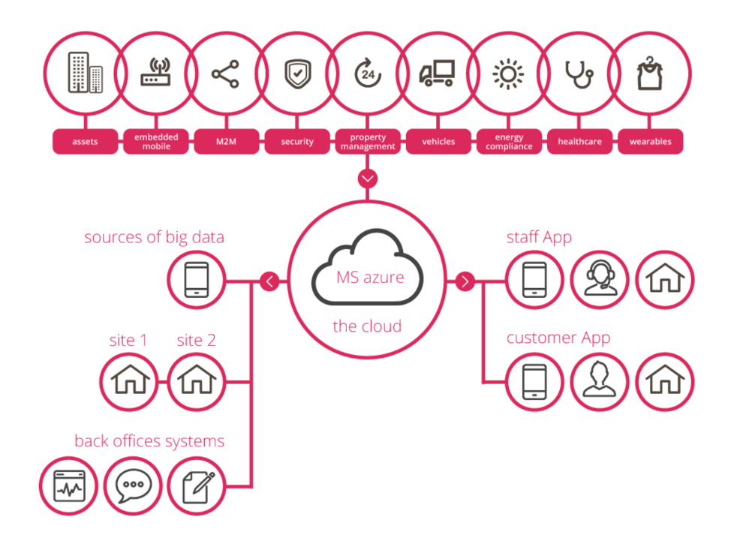
Demand
Better ways of working and integration with other systems as STANDARD
Notes:
The days of a ‘closed shop’ single supplier are dead. All around us in other sectors systems integration is standard. No one system can deliver everything, it is no longer a ‘one-size-fits-all’ world.

Slide 12
Inspire
Your teams to strive for continuous improvement
Notes:
In challenging times we need strong leadership. We need people who are willing to stand up and be counted, to think outside of the box and inspire the people around you to make a positive change.

Slide 13
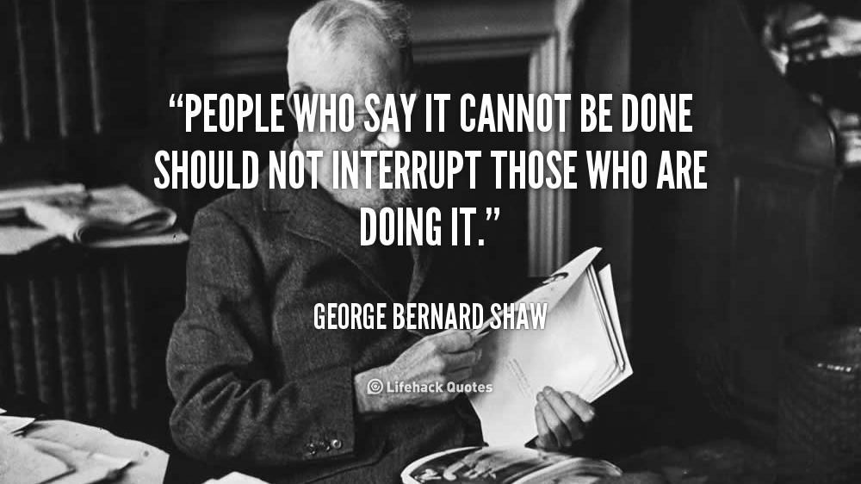

Slide 15
Notes:
Generation X is old news, is now all about Generation Z. These young people have never known not having the internet, have grown up with Tablets and Smart Phones being common place. Can get whatever information they need whenever they want. They have their phones within arms reach 90% of the time and they check them on average 150 times a day! These people are about to become YOUR customers!

Slide 16
We are living…
In the dawn of a post-PC world

Slide 18
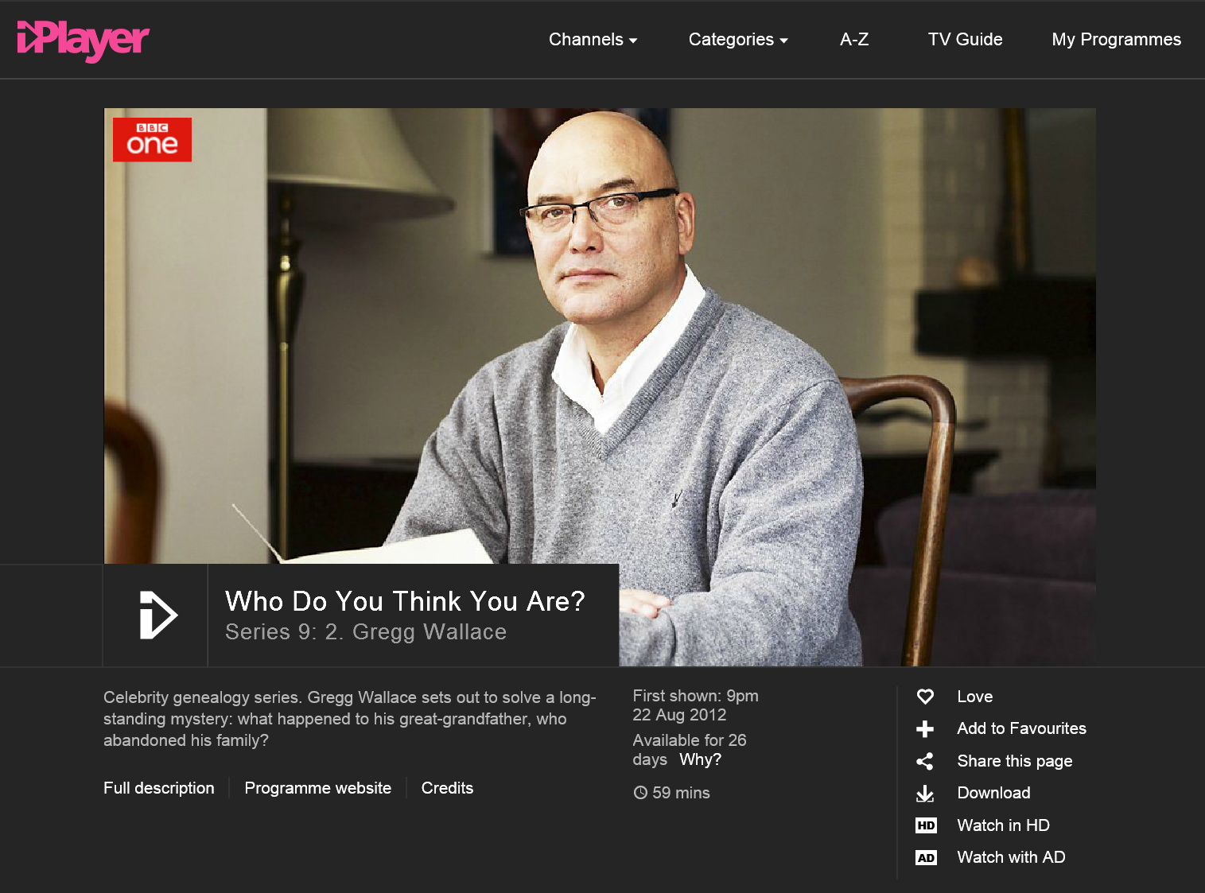

Slide 19
Understanding Current Trends
What are they
How do they work
How can they have a positive impact
@365_Agile

Slide 20
Product Portfolio
Documotive EDRM & Scanning Services
Documotive P2P
Documotive CRM
Documotive BI
Impact Repairs & Scheduling
Opus Service Charges
HousingBrixx Financial Planning
365Agile – Reseller
Kypera Housing
Kypera Financials
Managed Service
hosting, on premise, remote, cloud
DR services
Infrastructure reviews
Consultancy
Notes:
If we are to stand a chance of navigating through these rapidly changing times and technology that is accelerating far quicker than ever before then we must remember these golden rules. Technology will never stop evolving, and I believe it is our mission as IT professionals to help our organisations get the very best solutions that deliver real ROI and help us deliver customer excellence. Thank you for listening.

Slide 21
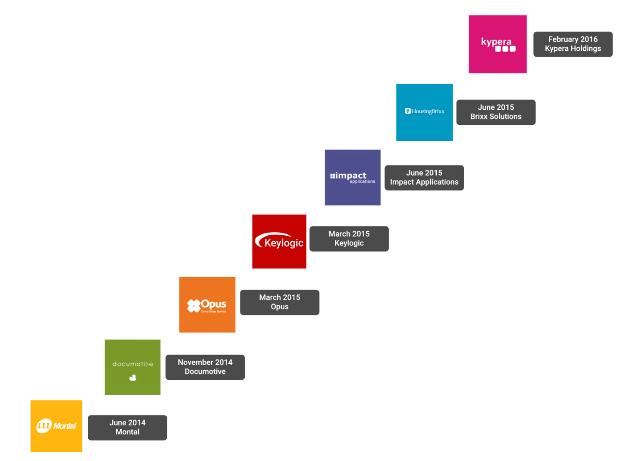
Castleton Overview
AIM Listed c.£60m market cap
Platform of complementary software and infrastructure services
to the public and not-for-profit sectors
A ‘one stop shop’ providing essential tools, services and
products to its chosen markets via 2 divisions
Group’s range of solutions provides its customers with
significant improvements in service, performance and insight
7 acquisitions since June 2014
Supports over 500 of the UK’s
total 1,700 housing associations
Notes:
If we are to stand a chance of navigating through these rapidly changing times and technology that is accelerating far quicker than ever before then we must remember these golden rules. Technology will never stop evolving, and I believe it is our mission as IT professionals to help our organisations get the very best solutions that deliver real ROI and help us deliver customer excellence. Thank you for listening.

