Slide 1
Taking an Innovative Approach to Knowledge Management

Slide 2
What does Knowledge Management mean for Home Group?
“Knowledge Management is the process of capturing, distributing and effectively using knowledge.” (Davenport)
“Knowledge Management is a discipline that promotes an integrated approach to identifying, capturing, evaluating, retrieving and sharing all of an enterprise’s information assets. These assets may include databases, documents, policies, procedures and previously captured expertise and experience in individual workers.” (Duhon, Gartner group)

Slide 3
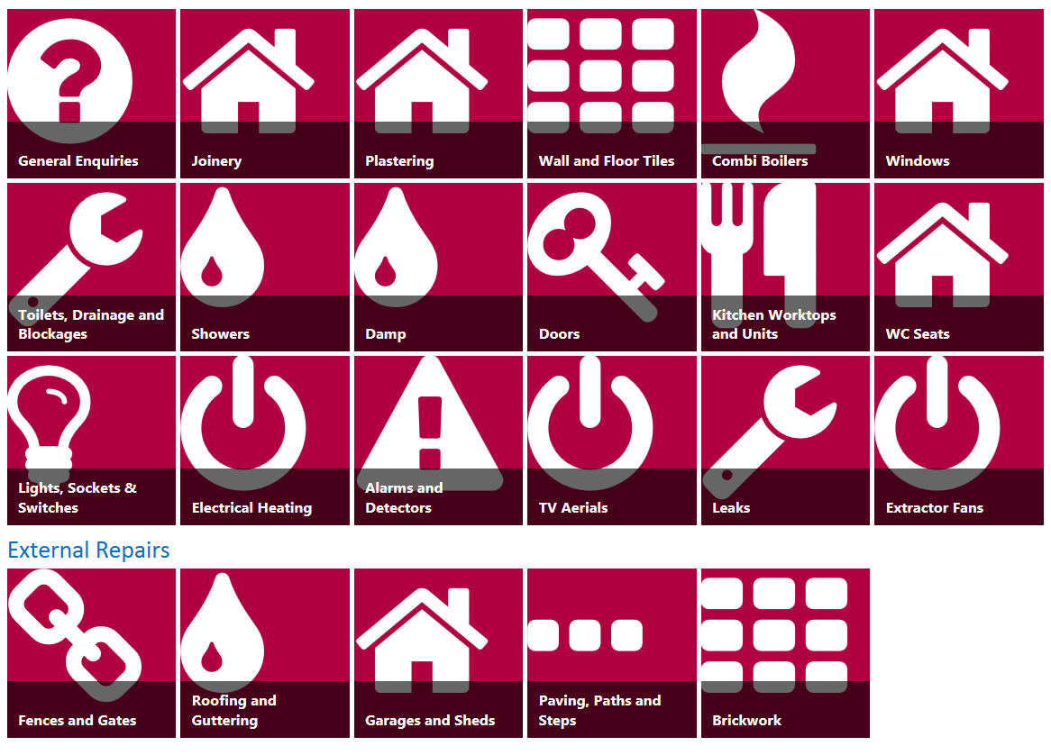
Home Group Introduce Knowledge Management
January 2013
Multi – channel CSC strategy approved
November 2014
Knowledge Management Pilot commences
August 2015
Knowledge Management (KMT) moved on premise
November 2015
Knowledge Management Phase 2

Slide 4
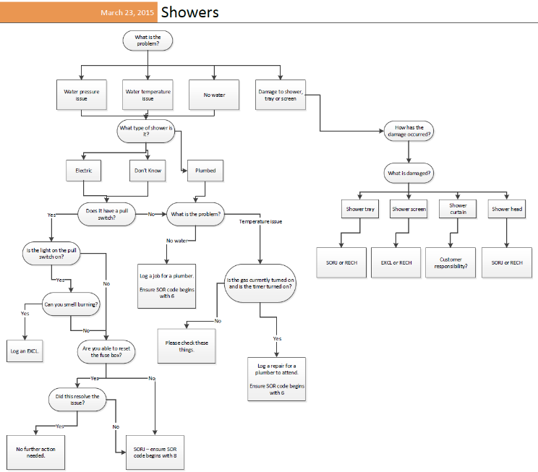
Creation of Guided Helps
End-user input
Benefits and data analysis
Development stage
Specialist expertise
Create Process Maps
Build Guided Helps
Notes:
Case base concept had been tried before on our previous knowledge base KRIB, but rather than replicating what existed, a new approach was taken. A working group was formed to identify how each case base should be structured.
How content creation works
Data analysis – first step. Analysing where there is a need for greater accuracy and consistency of knowledge, to deliver commercial savings. In a nutshell, the answer is ‘across the board’ – but we can look at error rates, costings, customer satisfaction, etc to see where priority lies.
Specialist expertise – gather the people needed to create the knowledge. A working group containing Maintenance Surveyors, Contracts Managers, Senior Client Services Manager, Support Worker, Service Support Advisor and Customer Service Partner. Identify what the topic is, what are the essential questions, what are the different scenarios that might come up in different tenure types or geographical regions?
End user input – involving the staff themselves. Getting their input in developing content, evolving existing content. ‘Make a Suggestion’ button.
All of this is combined into a single flowchart, which is designed to map out the questions that our CSAs need to capture the answers to.

Slide 5
Knowledge Management - Colleague Feedback
The data is accurate and checked on a regular basis. If we identify any errors or changes this is done within a day. I like the news flashes to communicate important information. It looks great.
It helps us identify/diagnose repairs easier and answer queries quicker with confidence that the info we’re providing is accurate
Information is located in once place meaning it is easier to locate information. Advisors are not required to use different systems. Information is up to date and we can take accountability to ensure relevant details are up to date.

Slide 6
Knowledge Management Evolution
Cost effective – saving of £180k in 12 months through advisors getting it right first time
Automation – Workflow improving the customer journey
Roll out to other business areas
Development of Customer KMT
Consultation with Customers to create and design KMT

Slide 7
Knowledge Management demonstration
A one stop shop to enhanced, intuitive frequently asked questions.
Policies and processes brought to life through the use of guided helps
Workflow technology used to enhance the customer experience

Slide 8
Any Questions?

