Slide 1
Our Digital Story
ICT and business partnering
March 2017

Slide 2

Let us introduce ourselves
Steve Dungworth
Head of Corporate Services
Andrew Kidds
Director of Customer Contact

Slide 3
Context
Traditional Housing Association based in north with 12,000 properties – established 1965
Early 2000’s – attract ALMO (Surrey) and another HA (East Midlands) into Group structure (to 21,000 properties)
Multiple governance, procedural complexity and commercial diversity (PFI etc)
Autumn 2012 –CEO makes case for change for One Accent! Year long Fit for the Future change programme launched!
Autumn 2013 – new virtual organisation structure (around 80 redundancies [12%])

Slide 4

One Accent
One vision
One set of values
One service offer
One suite of strategies, policies and procedures
One set of staff terms and conditions
One housing management system based on shared processes
One investment programme
One Accent Board and Executive Team

Slide 5
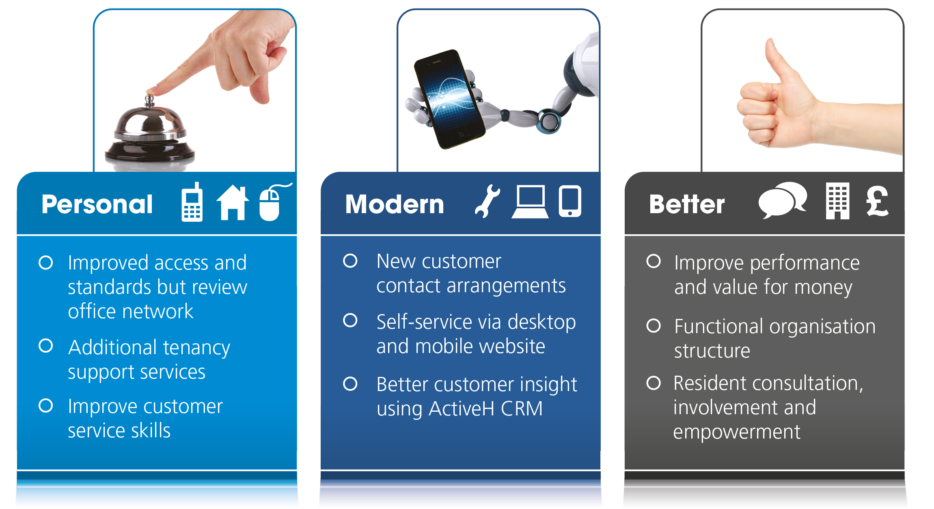
Service proposition
#personal # modern # better

Slide 6
This is our story: 2013:20??
Forming
Storming
Norming
Performing

Slide 7
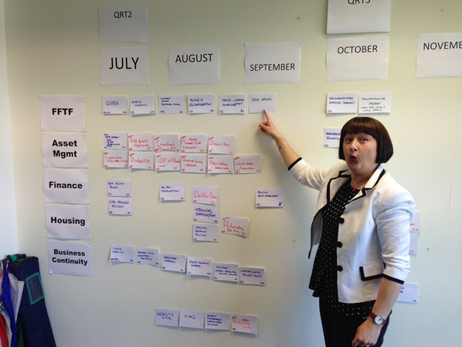
Accent ICT in 2013
ICT strategy not linked to business plan and not a living document
Too many concurrent projects and initiatives
Unreliable equipment and systems supported by reactive service
Seen by managers and users as a service provider
“Thinking” about digital

Slide 8
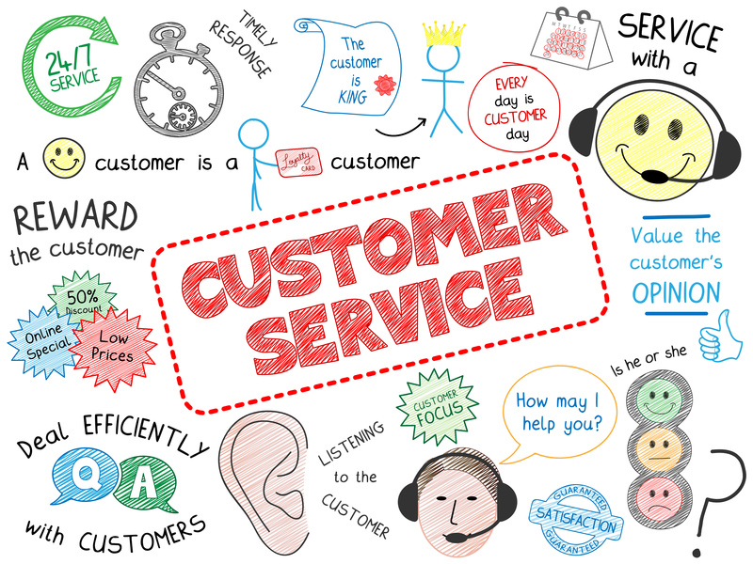
Customer Contact
Notes:
Service is still the differentiator but customer expectations are changing and we needed to respond faster. So do we keep pushing ICT

Slide 9

Customer Contact
We needed to establish a clear route through and head digital
Teams, telephone, housing management and future systems
We knew current systems and approach wouldn’t meet future needs
Customers more demanding, expectations changing
Notes:
Data data data, insight – customer journey -

Slide 10

Storming: great expectations!
“Computer says no!”

Slide 11


Customer Contact in 2014
The voice of the customer
Inconsistent service
Silo channels / service areas
Just give me CTI!
Give me a single view of our customers
Aren’t I the customer?
Ok so I am clear are you Steve?

Slide 12
Accent ICT plays catch-up
Projects
Upgrade housing management system by 6 versions – re-launch and re-train
Integrate leasehold into system (from stand-alone system)
Rebrand and simplify website – add self service options
Mobile working pilot
Replace kit – feels modern to users
People
Communicate, communicate, communicate
Build bridges with managers and users
Change Advisory Board
  Exec Team prioritise
  Critical friend
Formal Project Boards and Innovation Forum
Team restructure – “attitude”

Slide 13

Norming: vision and roadmap
“If we don’t change direction soon, we’ll end up where we’re going.”

Slide 14

One Contact Centre
My vision:
- 6 into 1
- Improved customer service
- Improved staff performance
- Greater resilience
- Responsive and scalable
- Close to those key services, ICT for example!
- Greater insight

Slide 15
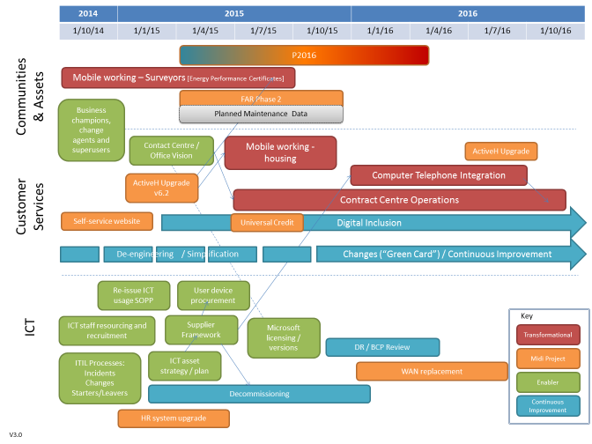
Accent ICT: roadmap 2014-2016

Slide 16

Contact Centre Project
Business case early 2015
Delivery April 2016
Project Management – clarity and a clear plan!
Cant go it alone – get nowhere fast!

Slide 17

Where do we go from here?
“We’re working together. But don’t tell anyone!”

Slide 18
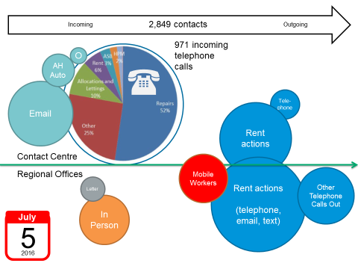
A day in the life of Accent!

Slide 19
Managing customer contact
+600,000 CRM entries 2015/16
We understand how customers interact with us
We understand the nature of each enquiry
Greater insight than ever before
Be true to yourself and work from there

Slide 20
Channel Strategy
Investment in Accent Connect
- Unified Communications
- Easy to do business with (access services)
Investment in our website
- Customer self-service
- Customer Portal
Development in system processes / interfaces and mobile working

Slide 21
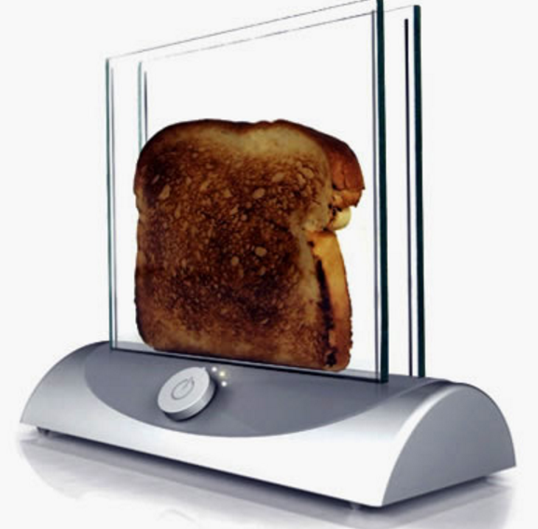
Accent ICT – still lots to do!
Stop! Look! Listen!
Accent Connect
Telephone system
Self-service / channel shift
Electronic Document Management
Contact centre software
Presence management
Printers
#GDPR
Lettings
Repairs diagnostic
Paperless
SharePoint

Slide 22
Where do we go from here?
Business case early
Realistic delivery dates
Clarity of plan!
Cant go it alone – get nowhere fast!

