Slide 1
How Agile delivers more, builds bridges and turns IT critics into IT champions

Slide 2
Draft agenda
Who? Introductions
Why? What were the problems we wanted Agile to solve?
Where? What was the journey – where were we heading?
What? How did we change our working practices?
Well? What happened – did we get the changes we wanted?
When are we there? Continuous evolution

Slide 3
Who? Me, us, them and you

Slide 4
Who? Me: Geof Ellingham
25 years in IT – as programmer, architect, consultant, manager, etc
10 years as Head of IT at Your Homes Newcastle (left 24-Feb-2017)
Director of Agile Business Consortium
About to start the rest of my life

Slide 5
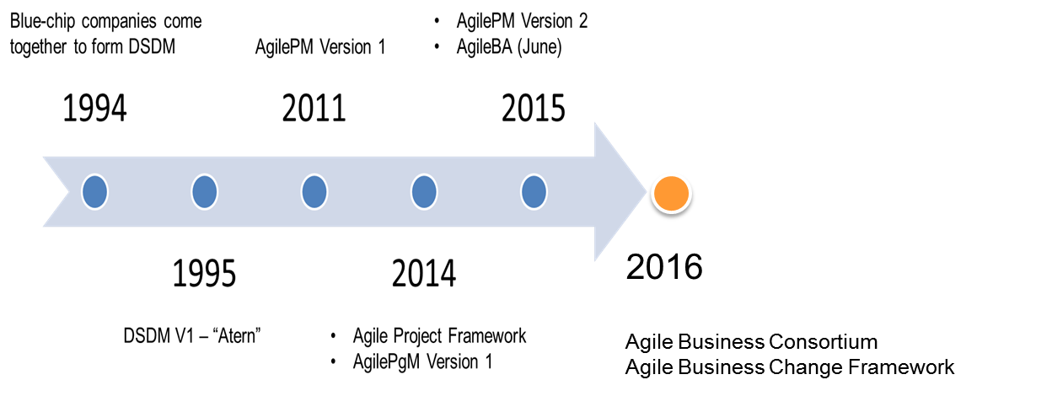
Who? Us: Agile Business Consortium
Agile Business Consortium not for Profit
Created Collaboratively by practitioners for practitioners
Mission: To be the global leader in promoting, supporting and enabling Agile Business
Providing advice, guidance and accredited products and services to C-level executives and their change and project management teams through an international network of partners.
For Business, not just IT
AgilePM for Digital Services will be launched in May 2017, aimed at the public sector & aligned to GDS
2018

Slide 6
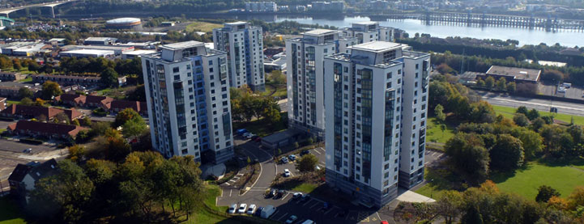
Who? Them: Your Homes Newcastle
ALMO in Newcastle upon Tyne
27,000 homes
General needs, supported housing, furniture service, telecare
ICT infrastructure and desktop support provided by Newcastle City Council
23 FTEs within YHN ICT

Slide 7
Who? You?
What do you want out of this session?
Which of these most closely describes you?
1. I don’t know much about Agile, but I’m interested in finding out more about how it might help my organisation
2. I have a good understanding of what Agile is – but I’d like to know what it’s like implementing it within the housing sector – the benefits and challenges
3. I know all about Agile, and we’re using it in my organisation – but I’m interested in hearing about the experience of others

Slide 8
Why? Articulating the problem
For us
For colleagues in the business
For customers

Slide 9
Why? For us (IT)
Single person dependencies
Management overhead
Shaky reputation for delivery
Too much documentation
Conflicting priorities and demands from business colleagues
Too many projects going on at once
Business colleagues don’t explain their requirements clearly

Slide 10
Why? For colleagues
IT leads the business, instead of the other way around
Decision-making is opaque
Hard to understand current work and priorities
Too much documentation
IT doesn’t understand our requirements properly
Projects often over-run

Slide 11
Why? For customers
Long lead time to deliver new features
Poor usability
No one asks us what we want

Slide 12
Where? Mapping the destination
Agile – in principle
AgilePM – a framework to follow
Service reorganisation
Implementing Agile… in an Agile way

Slide 13
Where? The Agile manifesto
We are uncovering better ways of developing software by doing it and helping others do it.
Through this work we have come to value:
Individuals and interactions over processes and tools
Working software over comprehensive documentation
Customer collaboration over contract negotiation
Responding to change over following a plan
That is, while there is value in the items on the right, we value the items on the left more.

Slide 14
Where? The Agile principles
Our highest priority is to satisfy the customer through early and continuous delivery of valuable software.
Welcome changing requirements, even late in development. Agile processes harness change for the customer's competitive advantage.
Deliver working software frequently, from a couple of weeks to a couple of months, with a preference to the shorter timescale.
Business people and developers must work together daily throughout the project.
Build projects around motivated individuals. Give them the environment and support they need, and trust them to get the job done.
The most efficient and effective method of conveying information to and within a development team is face-to-face conversation.
Working software is the primary measure of progress. Agile processes promote sustainable development. The sponsors, developers, and users should be able to maintain a constant pace indefinitely.
Continuous attention to technical excellence and good design enhances agility.
Simplicity--the art of maximizing the amount of work not done--is essential.
The best architectures, requirements, and designs emerge from self-organizing teams.
At regular intervals, the team reflects on how to become more effective, then tunes and adjusts its behavior accordingly..

Slide 15
Where? The Agile principles
Welcome changing requirements, even late in development
Deliver working software frequently (eg every 2-4 weeks)
Business people and developers must work together daily
The best outcomes emerge from self-organizing teams
Regularly reflect on how to become more effective
The art of maximizing the amount of work not done is essential

Slide 16
Where? AgilePM
Complete project management framework
not simply focused on Agile delivery (eg Scrum)
Governance layer for public/third sector accountability
Formal training course and qualification

Slide 17
Where? Service reorganisation
Self-organised teams are at the heart of agile
Before:
Head of IT
Digital
Projects
Service Management
Business Engagement
Specialist
Manager
Manager
Manager
3 FTE
3 FTE
8 FTE
Service Desk
The business
4 FTE

Slide 18
Where? Service reorganisation
Self-organised teams are at the heart of agile
After:
Mondays & Fridays
Head of IT
Digital
Central
Corporate
Tenancy
Property
Lead
Manager
Lead
Lead
Lead
3 FTE
3 FTE
3 FTE
4 FTE
1 FTE
Service Desk
3 FTE
Enterprise-wide
Corporate Services
Tenancy Services
Property Services

Slide 19
Where? Service reorganisation
Self-organised teams are at the heart of agile
After:
Tuesday-Thursday
Head of IT
Digital Projects
Corporate Projects
Business Projects
Property
Lead
Manager
Lead
Lead
4 FTE
4 FTE
5 FTE
1 FTE
Service Desk
3 FTE
Enterprise-wide
Corporate Services
Tenancy Services
Property Services

Slide 20
Where? Implementation
July-Sep 2015: Agreed new structure, carried out training
October 2015: Agile delivery of “responsive” work (non-project)
December 2015: Agreed new project roadmap (1 project at a time)
April 2016: Agile delivery of new projects

Slide 21
What? Changing our practice
Deliver on time
Fixed project end dates
Delivery sprints
Prioritise and estimate flexibly
MoSCoW (Must, Should, Could, Won’t this time)
Story point estimating (planning poker)
Visualise
Kanban boards
Just enough documentation
Show & Tells
Self-organising, empowered teams
Co-located IT & Business membership
Daily stand-ups
Retrospectives

Slide 22
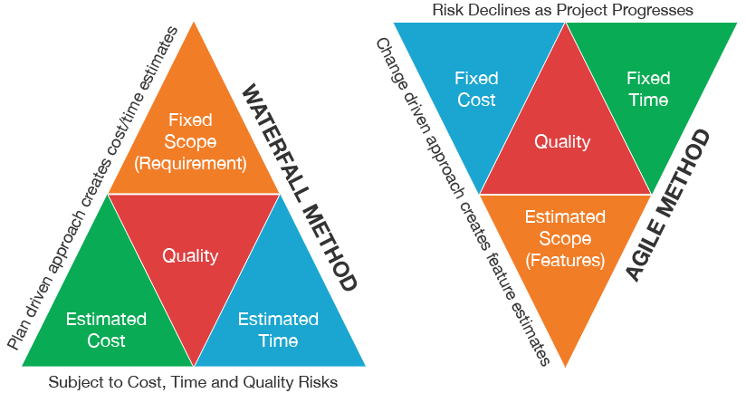
What? Deliver on time
Upends the traditional approach to project scope

Slide 23
What? MoSCoW prioritisation
All projects and requirements are classified as:
MUST have (business/project fails if not delivered)
SHOULD have (painful if not delivered, but workarounds are possible)
COULD have (will add significant business value if delivered)
WON’T have this time (potentially valuable, but agreed out of scope for now)
}
MUST have
Minimum Viable Product (MVP)
}
WON’T
have
SHOULD
have
Potential future development options
Project contingency
COULD
have

Slide 24
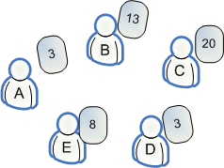
What? Collaborative estimating
Estimating is most accurate and transparent as a group activity
Planning poker
Developers participate in estimating – business colleagues answer questions
Harnesses the “wisdom of crowds”
Process is visible to business
Works best with stable teams doing similar work
Estimates worked out at the feature (user story) level

Slide 25
What? The Agile project portfolio
Project roadmap
Full senior management team workshop
One-page business cases prepared in advance
Projects prioritised by business value
One project per team at a time
Planning poker used to agree initial view of project size
Fixed project end dates (but reviewed during pre-project work)
Outputs captured with post-its on brown paper wall

Slide 26
What? Agile requirements
Project planning
Facilitated workshop with business and IT representatives
Start with key business objectives (around 10)
Use MoSCoW to capture relative importance
Carry out user research (with end users) throughout!
Develop list of “user stories” (30-40)
“As a _____ I want _____ so that ______”
Eg. “As a customer I want to see my order history so that I know whether the work has been completed”
Use MoSCoW to agree relative priority
Use planning poker to estimate relative size
Capture outcomes as a “prioritised requirements list”
Review budgeted time and resources
Intention is to deliver all MUST have, SHOULD have and COULD have requirements
MUST be able to GUARANTEE delivering the minimum viable product (MVP) – ie all MUSTs

Slide 27
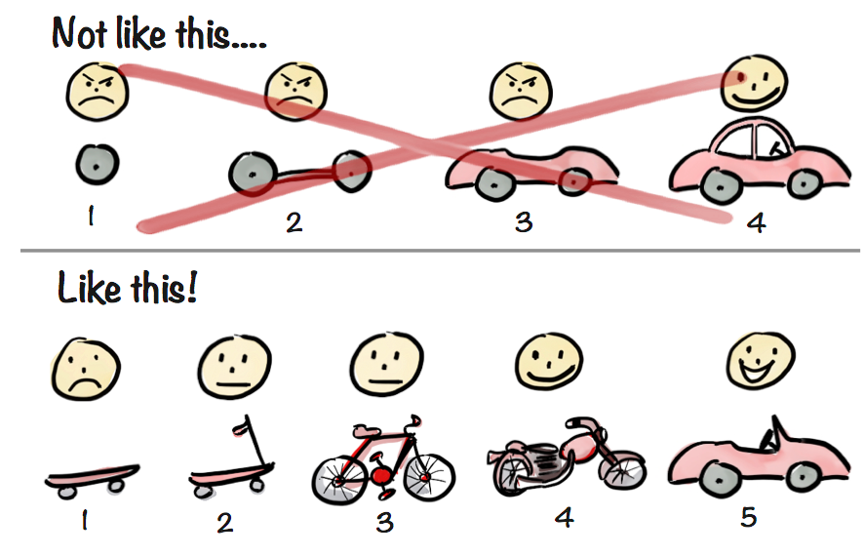
What? Agile delivery
Delivery planning
Break the available time into “sprints” of equal size (2-4 weeks)
Order the user stories in a way that delivers business value as early as possible, eg
Sprint 1: Website captures new orders – no amendments or history
Sprint 2: Website shows history of orders
Sprint 3: Website allows orders to be amended
Sprint 4: Website allows multiple items to be ordered together in a basket
Each sprint produces fully tested, production-ready outcomes –live if possible

Slide 28
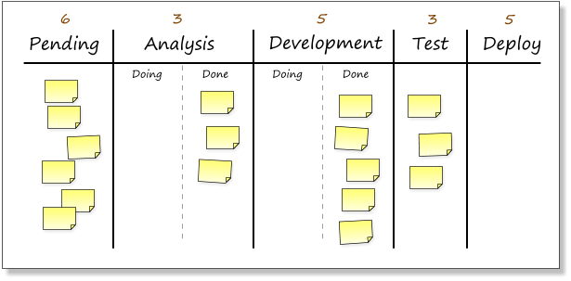
What? Visualise
Kanban boards

Slide 29
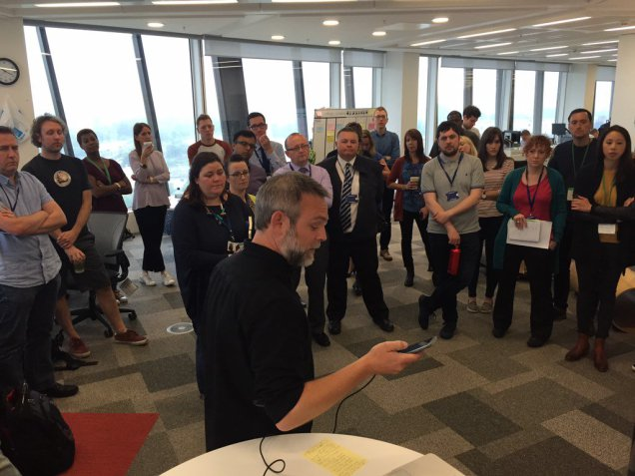
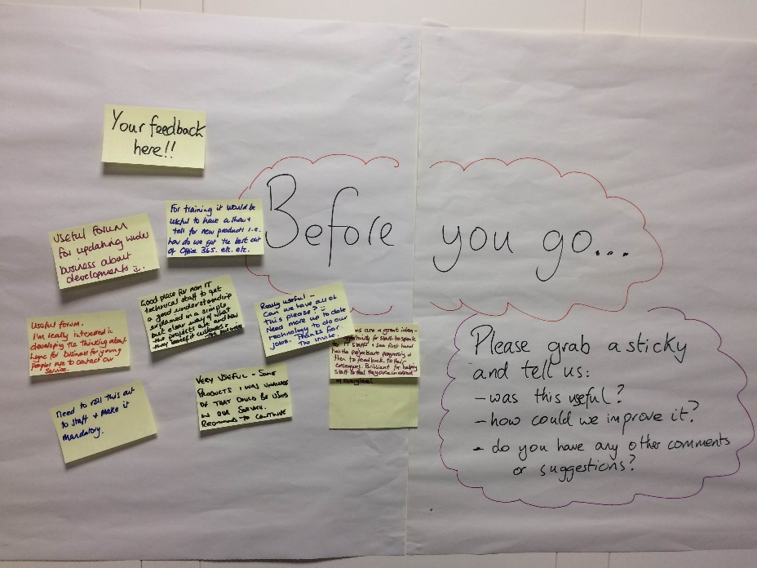
What? Visualise
Show & Tells

Slide 30
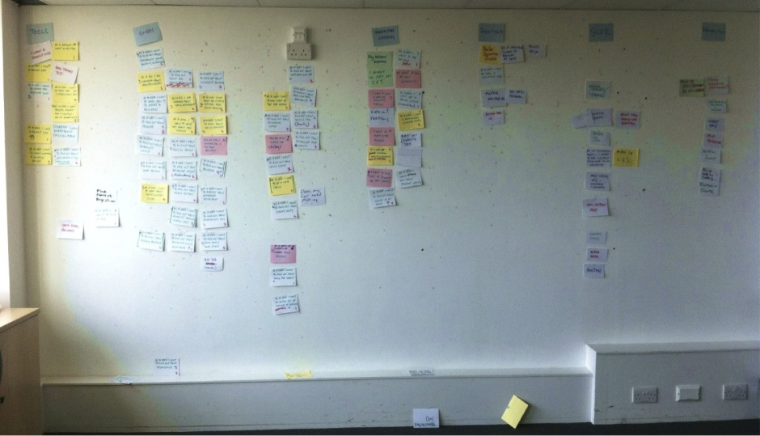
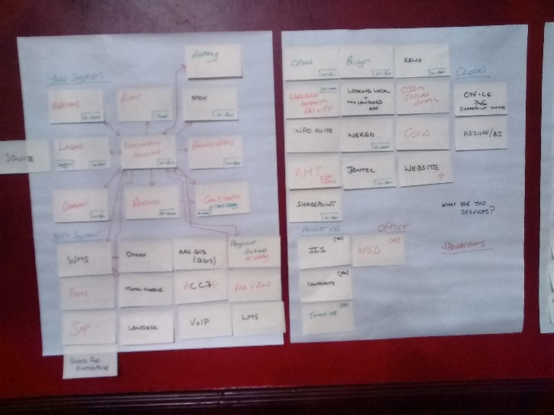
What? Visualise
“Just enough” documentation

Slide 31
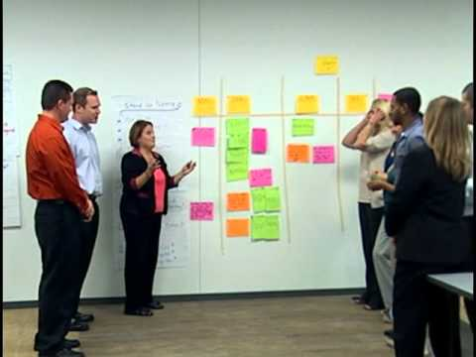
What? Self-organised teams
The delivery team includes both IT developers and business colleagues – ideally co-located
All decisions within the sprint are delegated to the delivery team (so the business rep must have decision making power!)
Hold daily stand-ups to review progress
Hold a retrospective at the end of each sprint to look for improvements

Slide 32
Well? Measuring the impact
For us
Greater variety of work
Better team spirit
Less single-person dependency
In numbers
85% - better understanding of vision and purpose
80% - better measurement of outcomes
80% - better short-term planning
80% - improved value delivery
65% - improved responsiveness to change
60% - improved quality

Slide 33
Well? Measuring the impact
For colleagues
Better visibility of progress
Ability to discuss and affect prioritisation with colleagues
Better on-time delivery
In numbers – which new practices have helped you get better outcomes?
75% - facilitated workshops
75% - MoSCoW prioritisation
75% - story point estimation
And…
Kanban boards are being adopted outside IT for work planning and delivery
MoSCoW is widely used across YHN as a prioritisation tool
There are post-it notes on the walls everywhere!

Slide 34
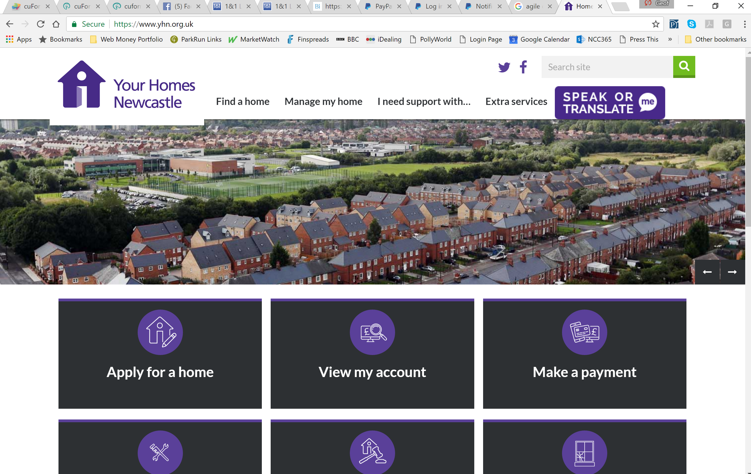
Well? Measuring the impact
For customers
Faster delivery and better usability – eg new website delivered in 8 weeks
On average, projects delivered about 25%-40% more quickly

Slide 35
Well? Challenges
Jargon
Some of the terminology we adopted was unnecessarily complex
“Agile” was viewed with some suspicion, so for the first 12 months we only referred to “our new ways of working”
Business representative availability and empowerment
Agile requires more input from the business – we didn’t always get it
Some managers failed to empower their reps to make decisions – this slows things
Senior-level buy-in is needed to tackle these issues
Traditional hierarchical job roles don’t fit the new model
Junior staff may complain that they’re doing the same job as more senior staff
We changed all our job titles and descriptions to create a new multi-grade generic IT career path – “IT Business Partner”

Slide 36
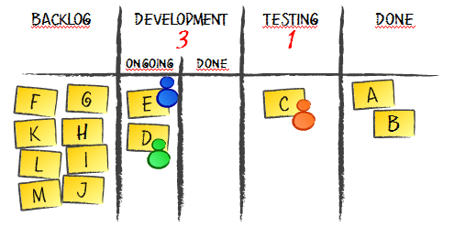
When are we there? Evolution
“Pure” Kanban – continuous flow
Moved away from sprints to “continuous flow” for non-project work
Work In Progress (WIP) limits to improve lead times
Negotiated “policies” to further empower teams
When pulling from backlog, pull cards in strict order, except when it’s necessary to start a fixed-date card
Once in development, pull cards in any appropriate order

Slide 37
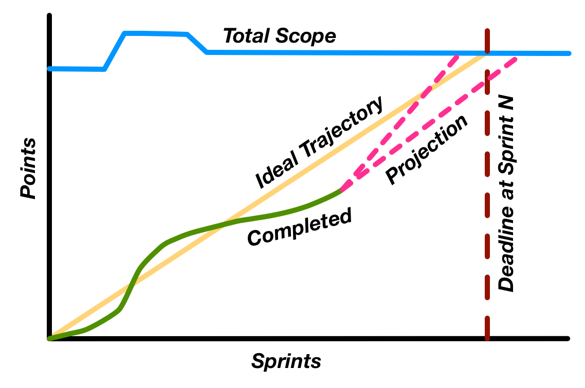
When are we there? Evolution
Velocity, burn-down charts and burn-up charts
Established teams can measure velocity in “story points per sprint”
Allows visual measure of progress within a sprint
Allows accurate prediction of delivery date for future work
Velocity = 25 story points per 2-week sprint
Feature No | Story Points | Days | Estimated Deliery
1 | 5 | 2 | 10-Mar
2 | 8 | 4 | 16-Mar
3 | 5 | 2 | 20-Mar
4 | 13 | 6 | 28-Mar
5 | 2 | 1 | 29-Mar
6 | 3 | 2 | 31-Mar
7 | 13 | 6 | 10-Apr
8 | 21 | 9 | 21-Apr
9 | 5 | 2 | 25-Apr
10 | 13 | 6 | 03-May
11 | 8 | 4 | 09-May
12 | 5 | 2 | 11-May
13 | 8 | 4 | 17-May

Slide 38
Questions?

Slide 39
Contact Information
geof@agilebusiness.org
+44 (0) 7990 574667
@geofellingham
linkedin.com/in/geofellingham
http://www.agilebusiness.org

