Slide 1



So what is the internet of things ?

Slide 2
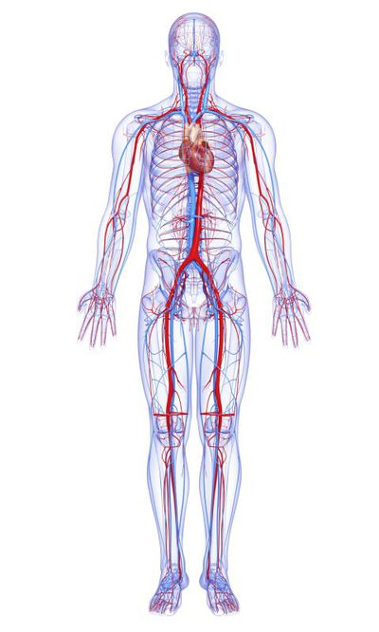



What are the building blocks of IOT?
Analytics
Connectivity
Sensors

Slide 3


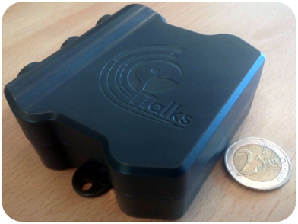
And why is it taking off now ?
Over the last ten years….
1/60
COST OF PROCESSING down to
1/40
COST OF BANDWIDTH down to
$5.00
LOW COST SENSORS around

Slide 4
So what are the components of the Internet of Things…

Slide 5
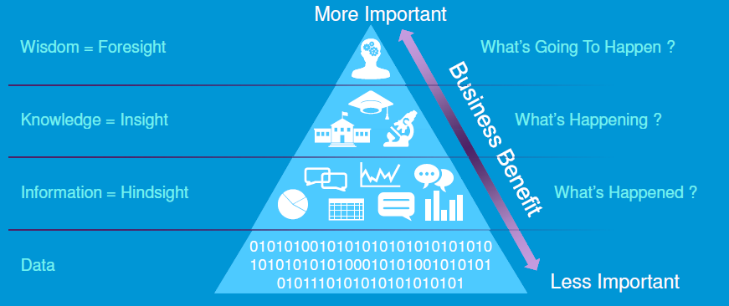
….and why is important ?

Slide 6

Smart Cities – and why the industry is looking in the wrong direction

Slide 7

The standard approach to smart cities focuses on operational verticals….
Glasgow example
Social Smart City focus
Healthcare
£1.13Bn*
Education
£476M
Social services
£390M
Parking
(receipts)
Waste management
Electricity
(inc. street lights)
£3.3M
£17.9M
£67M
Glasgow City Council expenditure (FY16/17 budget)
Standard Smart City focus
*NHS Scotland spend in Glasgow area (est): Average spend on healthcare in Scotland is £1.89K; population of Glasgow c598,830

Slide 8

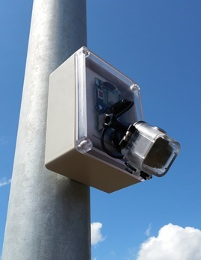
Why focus on lighting / parking / bins ?
Clear business case
Funding available (Horizon 2020)
All within the control of one department
(relatively) straightforward

Slide 9

Smart Social Housing should be the real target but…
Business cases are complex and ‘multi-sided’
No clear lead case
Falls across multiple departments and third parties (like HA’s)

Slide 10
But we think its much more than that…..

Slide 11
We believe that total connectivity is the right way forward for social housing
Inclusive Broadband
Pervasive IOT
Not everyone wants broadband (elderly are a high proportion of Digitally Excluded)
But IOT networks can penetrate the whole building allowing ‘things’ to be connected even where there is no broadband

Slide 12






And we are using Innovate UK to put the idea to the test
Ageing challenges & assisted living
Long term health conditions
Academia
Local Government
Out-patient
Incubators & SME’s
Private sector partners
NHS Trust
Connected tenant
Smart building

Slide 13

Thank you !

