Slide 1
Out with the Old and in with the New Business transformation with Castleton’s complete solution.

Slide 2
Introductions
Jimmy Rogers
Commercial Sales Director
Castleton Technology plc
Ronnie Maher
IT Director
Cluid Housing

Slide 3
Castleton
Market leading point solutions
Complete integrated solution
Continue to collaborate with the Customers
Customer needs are at the heart of what we do

Slide 4
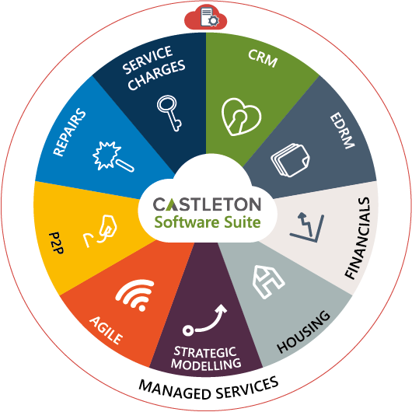
Complete Solution
Integrated products
One stop shop
Cloud based solutions
Digital Engagement with Customers
Mobilisation of all modules
Less complex application landscape

Slide 5
Hosting & Managed Services
Managed IT Services
Hosted Services; IaaS, DaaS, Baas & DRaaS
Infrastructure Solutions & Support
Virtual & Server Infrastructure
Networking & Security
Application Delivery
Infrastructure Consultancy
IT reviews
Project Management

Slide 6
Hosted Services Benefits
Future-proofed services using leading edge technology
Dynamic Scalability and Flexibility
Manageable investment & reduced TCO; Opex to Capex
Enriched IT expertise
Improved Resilience, Security and control
Enhanced Business Continuity and Disaster Recovery

Slide 7
Ronnie Maher IT Director Cluid Housing

Slide 8
Cluid’s Business Transformation Project
Project Aims
IT to enable our business strategy
Building Our Capacity
Improved Customer Service

Slide 9
Cluid’s Business Transformation Project
Why Castleton
We need a Business Applications infrastructure
- integrated, flexible, scalable, mobile
We had already procured best of breed individual solutions
-Financial modelling, Repairs, EDRM, Agile
Acquisition of Housing and Finance applications
Complete integrated solution from a single vendor

Slide 10
Cluid’s Business Transformation Project
Expectations
Removal of manual/clumsy integration processes
Less fragmentation, less duplication ( “waste work” )
Comprehensive integrated reporting solution - Data Warehouse
New additional channels for our customers
Real-time access for our housing staff- true mobility
Any data, from any device, from any location
Facilitate new business models (DLO Repairs)
True integration across Housing, Finance, Repairs, CRM, EDRM

Slide 11
Financial
Planning
Repairs
EDRM
Castleton Products
Currently using Financial Planning, Repairs, EDRM
Currently rolling out Agile, P2P and Customer Application
Next 12 months we will implement CRM, Housing and Financials
Agile
P2P
Customer App
Housing
Financials
CRM

Slide 12
Jimmy Rogers Commercial Sales Director Castleton

Slide 13
Complete Solution
Best of breed products
Fully integrated solution
Central data source
Desktop or mobile
Flexible and future proof

Slide 14
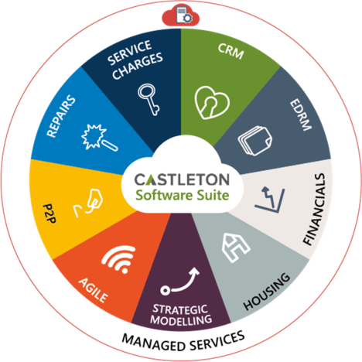
Recap
Best of breed solutions
One complete solution
Cloud based offering

