Slide 1
Welcome to Engage Property Technology
Housing Technology
February 2017

Slide 2


Peter Watson

Slide 3


Slide 4
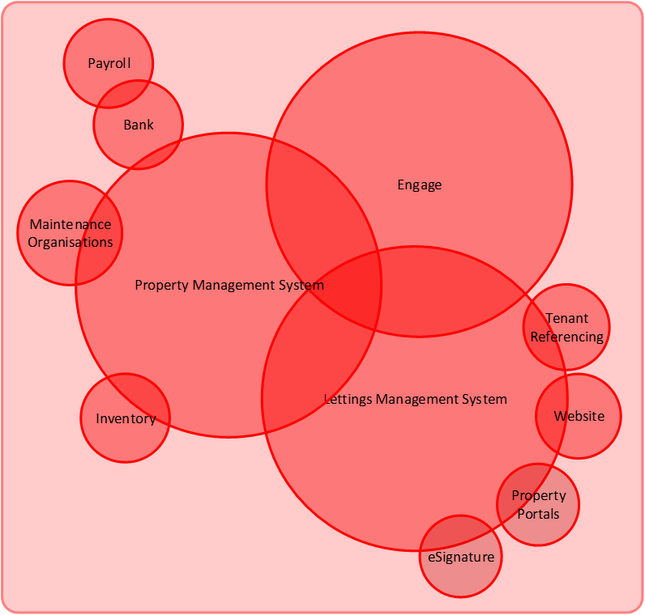
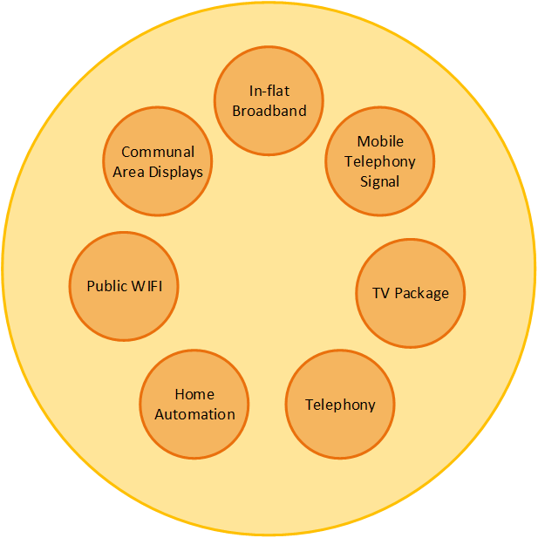
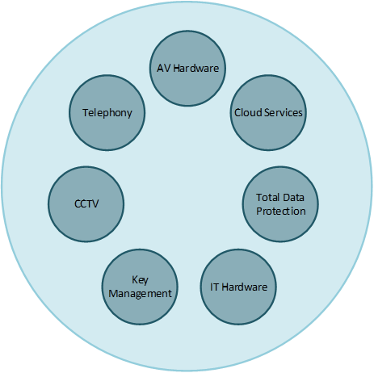

Slide 5
Targets for East Village
Anandh Owen of Delancey: “I have never encountered an IT provider that has demonstrated such a commercial focus for and on behalf of a client…. I would not describe them as a consultancy, or even as an IT partner. They have been a true business partner. “
Reduce the time to let √
Reduce the cost of letting √
Put everything online for customers √
Improve the maintenance process √
Reduce Housing Management costs √
Support the creation of a new community √
Improve communications with customers √
Help create the Get Living London brand √

Slide 6
The world is changing and so are the expectations of the growing number of people who rent

Slide 7
“A generation of
private renters has
emerged and this will
increasingly be the
norm for the 20-39
age group”
PwC, UK housing market outlook 2015

Slide 8
Some Government research…….
Notes:
.

Slide 9
An LSL Survey found…….
64% want to participate in community activities
72% would report issues online
Poor comms drives discontent
70% would like to receive offers from local businesses
46% consider the quality of the landlord before renting
25% would pay more to have a pet

Slide 10
The traditional role of the landlord:
To carry out repairs
Gas and electrical safety
Put fire safety measures in place

Slide 11
What has to happen?
Throw away the rulebook on landlord/resident relations
Don’t accept that working practices can’t change
Only accept a can-do attitude from both staff and suppliers
Look at the new world companies for inspiration on how to engage with customers

Slide 12
Successful companies are driven by technology
The Housing Sector needs to do be the same
As technologists, we need to show the way

Slide 13
What’s being done in PRS?
Big focus on Customer relationship
Automation – Customers should kick processes off and close them
Everything online – payments, statements, documents, comms
Systems being pushed to do more and integration is King
Value added services…….

Slide 14
The bad news…..
Self service usually fails
Systems can be inflexible
Integration does not come as a standard
There is resistance to new thinking

Slide 15
Get it right and…….
Substantially reduce the time to let for build to let
Reduce the calls into your Service centre by 40%
Automate your processes
Improve Customer satisfaction
Engage with your customers and the wider community

Slide 16

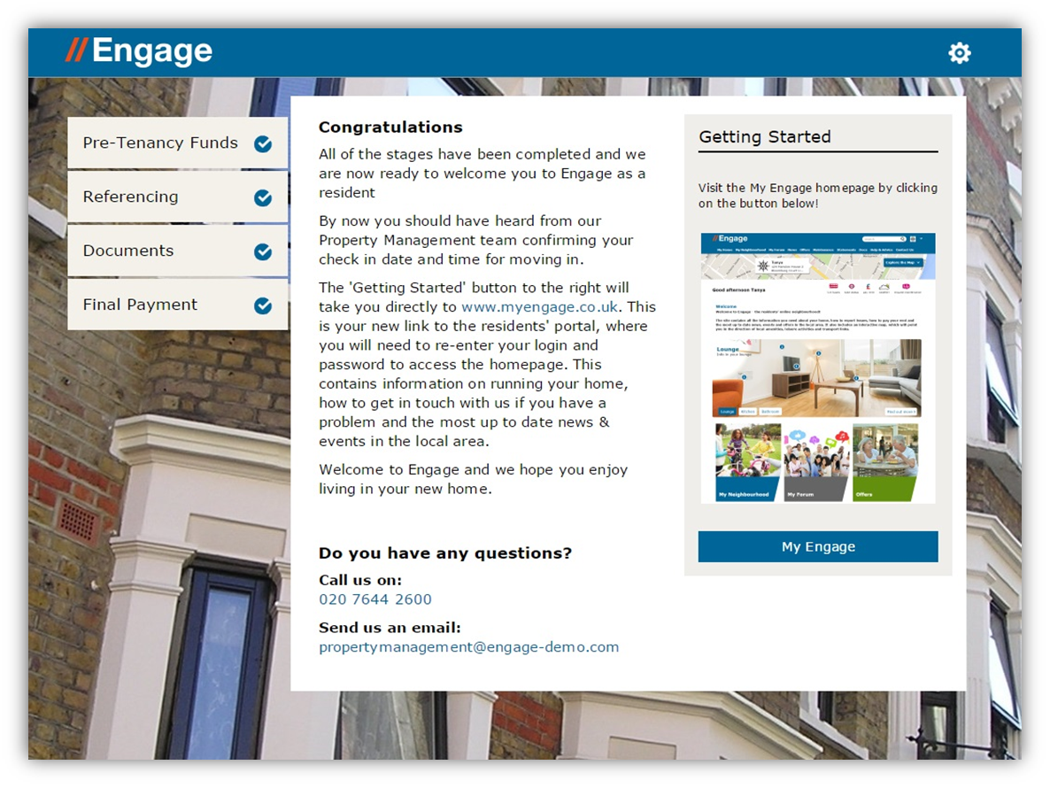

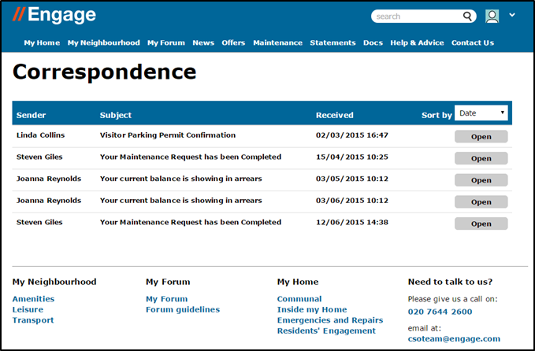
Talk to Engage to see how we can help.

Slide 17
Contacts:
Peter Watson p.watson@engageproptech.com
020 3882 1423
Mitesh Patel m.patel@engageproptech.com
020 7644 2611

