Slide 1
HEARTS, MINDS AND DEVICES
The ‘FIRST WESSEX 2020’
Business Transformation Programme
Patrick Symington and Neil Charlton
Housing Technology 2017
8 March 2017

Slide 2
Takeaway #1
Employee Engagement starts at the top!

Slide 3
What is FW2020 all about?
The Vision
A modernised Business
Industry Leader
Great Customer Service
Cutting Edge
Technology
Excellent
Efficient
Digital
Cloud
Great to be part of – Great to work for!

Slide 4
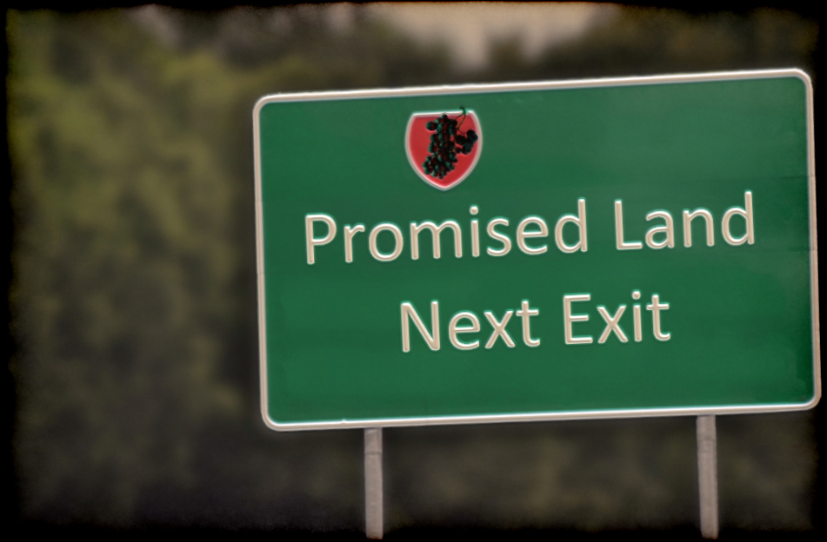
Takeaway #2
The vision has got to be worth striving for

Slide 6
Takeaway #3a
Business transformation can improve service and reduce cost!

Slide 8
Takeaway #3b
Business transformation can improve service, reduce cost
and engage employees!

Slide 9
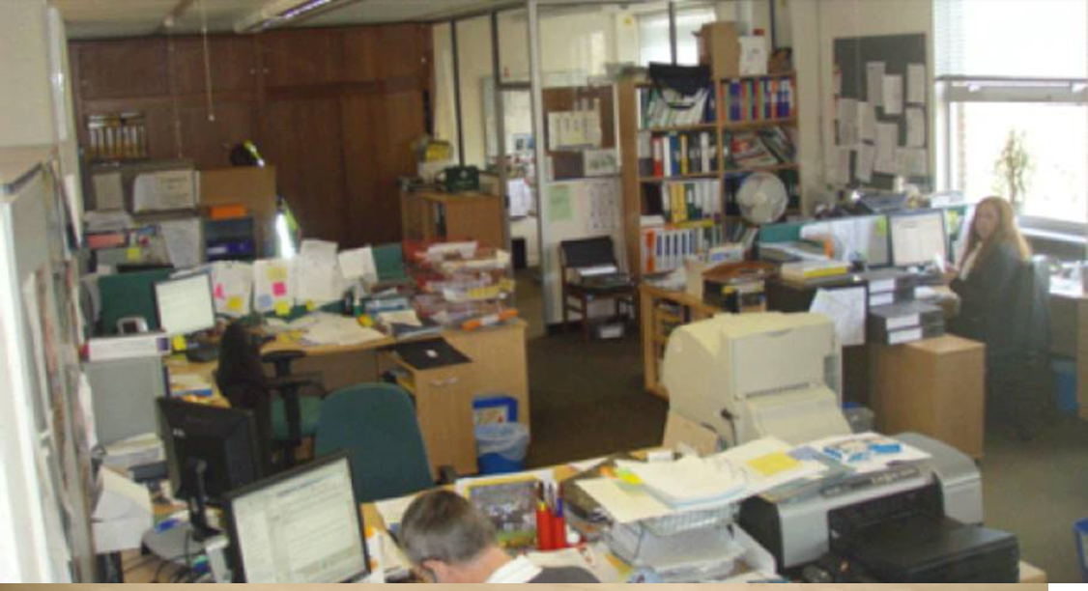

Slide 10
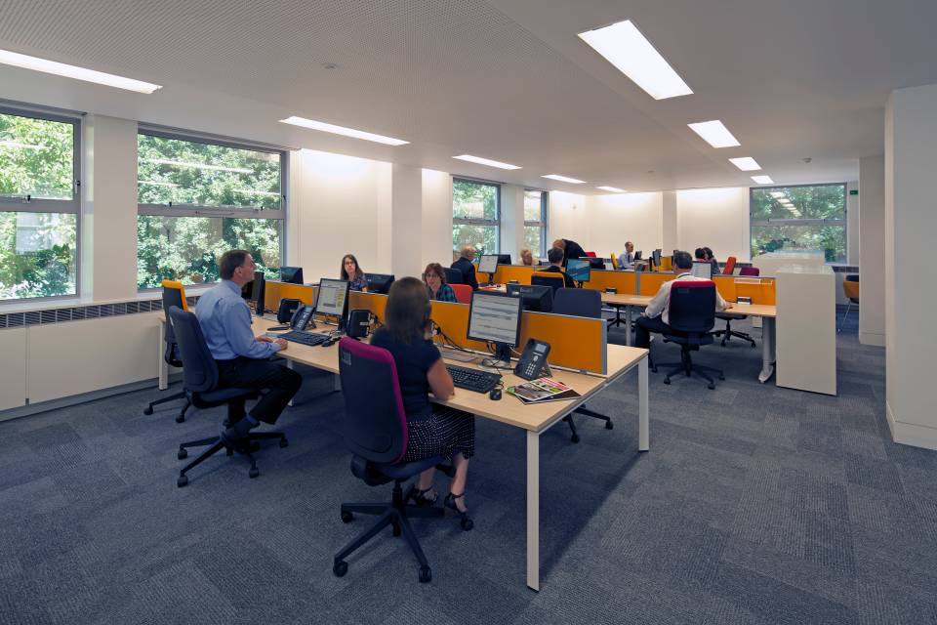
Havant (After)

Slide 11
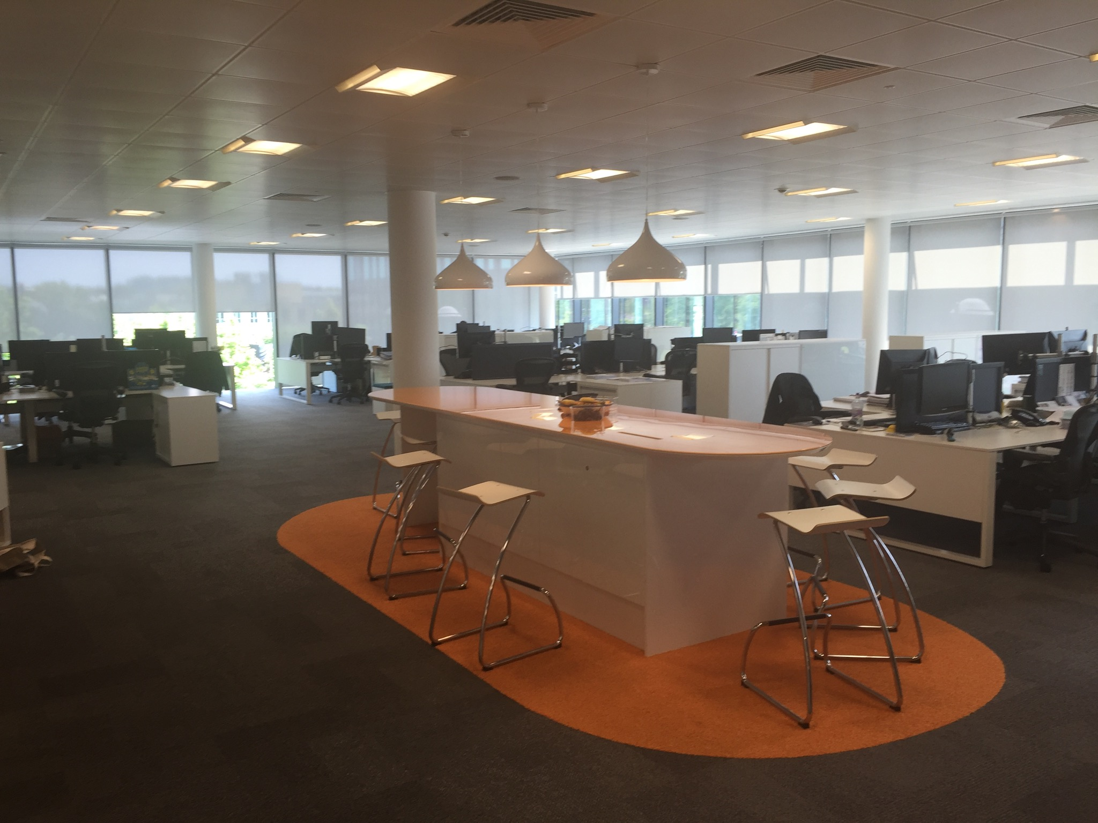
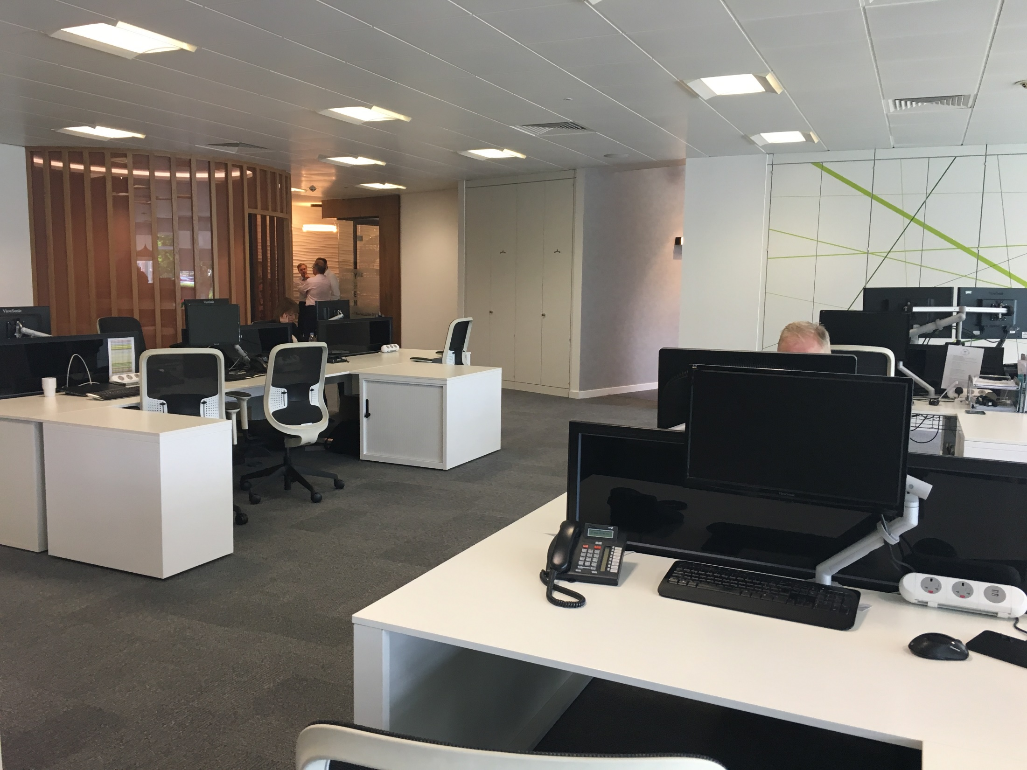

Slide 12
Some BWoW Principles
Flexible working
No ‘ownership’ of workspaces

Slide 13
Dealing with People’s Fears
“They did that in my husband’s office and it didn’t work’’

Slide 15
Some BWoW Principles
Flexible working
No ‘ownership’ of workspaces
But retain team ‘communities’
Variety of environments – to suit the work
‘Paper-lite’ processes
Use mobile technology
Migration to the cloud
Management culture (avoid ‘presenteeism’)

Slide 16
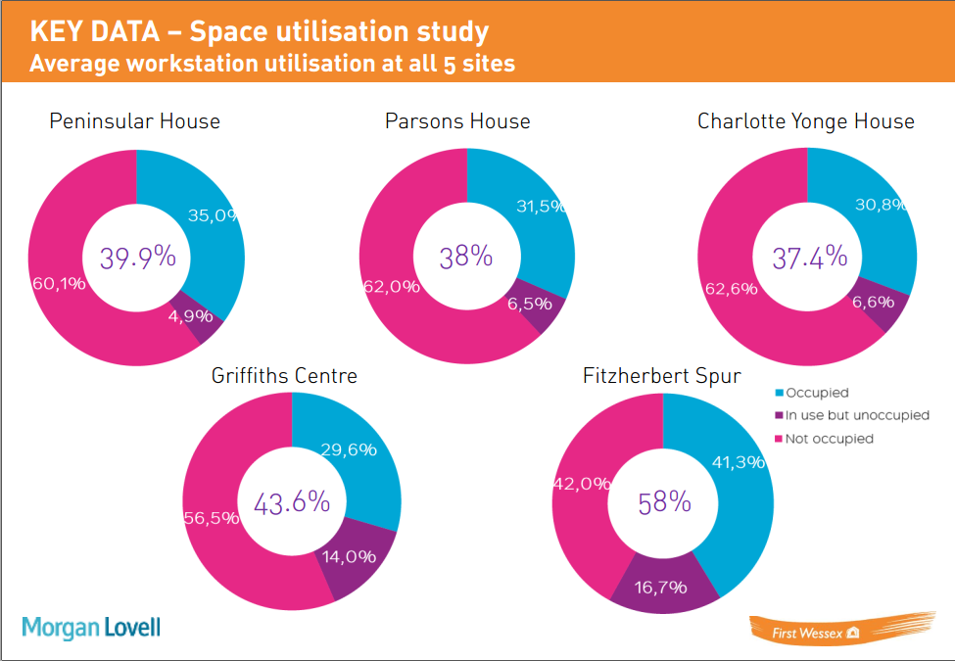
Engagement
Vodafone BWoW Tour:
Executive & Heads of Service
Project Team
Young Leaders
External Consultancy:
Space Utilisation Study
Online Survey
Interviews

Slide 17
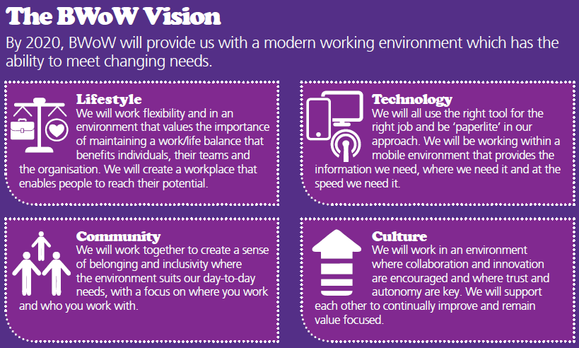
Engagement

Slide 18
Digital
Digital
Automated Payment Line
Resident’s Self Service Portal
Text Messaging
Email Routing
‘Paper-lite’

Slide 19
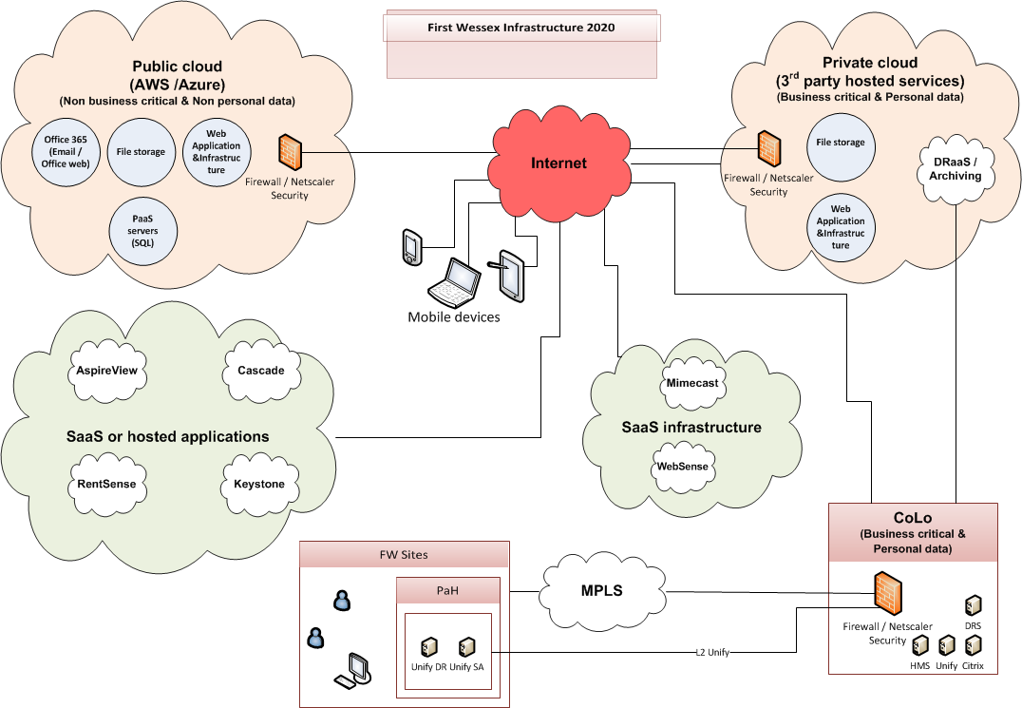
Cloud
Cloud
DR
SaaS
O365
Backups
‘Cloud First’

Slide 20
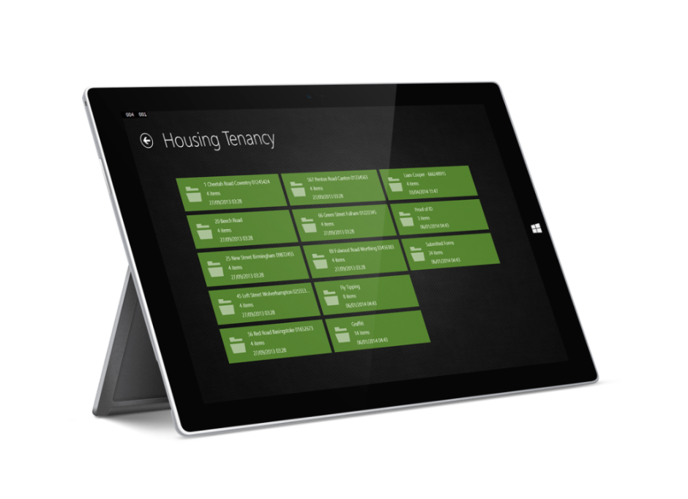
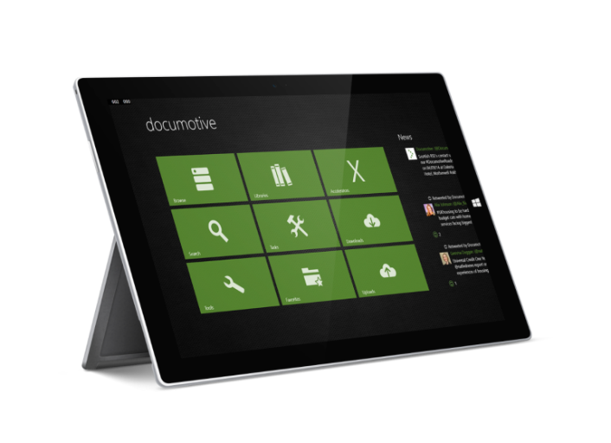
Mobile
Mobile
Maintenance & Servicing
Tenancy Management & Income
App & Form Development
Mobile Apps
BYOD
MDM
WiFi and WAN Upgrades

Slide 21
Takeaway #4
Who are your ambassadors? Your influencers? Your ‘Young Leaders’? Tap into the ‘millennials’.

