Slide 1
IoT Internet of Things
Ian Pritchard
IT Service Delivery Manager
unITe solutions

Slide 2
Central Shropshire and South Staffordshire
12000 properties
581 staff
South and North Shropshire
5000 properties
288 staff

Slide 3
A brand for IT
--
Internally recognised
--
External Sales
Collaborate to Deliver
www.deliverIT.org.uk

Slide 4
5 year old IT partnership
New IT partnership
Then and Now
Key Statistics
11
from 460 to 518
from 42 to 47
from £3660 to £3420
from 60% to 90%
from 85% to 95%
from 95% to 99%
IT Staff members
Total staff supported
Staff supported per IT member
IT cost per employee
KPI Call Performance
Service Satisfaction
System Availability
17
869
51
£3038
94%
98%
99.8%
Notes:
For 5 years Severnside Housing and Shropshire Housing Group have worked in partnership on IT, with a joint IT strategy to support differing business objectives and to provide VFM. With Severnside’s merger with Housing Plus to create the new Housing Plus Group and the challenge of rent cuts, we will review how the IT Strategy and partnership working have been further developed to enable business transformation and deliver operational efficiencies through greater levels of collaboration.

Slide 5
IoT - 21st Century Trojan Horse or Possible Data Revolution
But what does that mean??
Tech being welcomed into our homes and workplaces
Do we know what it is doing?
Data sources more common and widespread than ever before – truly more data from more sources everywhere
But do we know what to do with it?

Slide 6
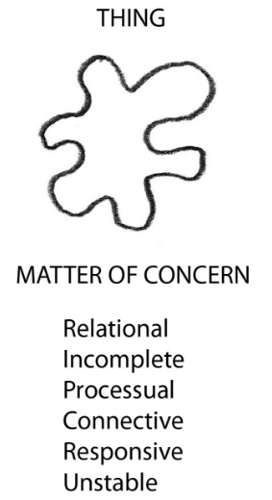
Definition: ‘thing’
some entity, object, or creature that is not or cannot be specifically designated or precisely described
IoT doesn’t really exist…… well not on its own…
There is no single IoT industry
It is a process… a way of linking together separate entities and using triggers to instigate and perform actions
(Martin Heidegger, German philosopher, 1889)

Slide 7
Obligatory statistics
According to Gartner Research, in 2015 there will be connected things
4.9 billion
And by 2020 there will be
20.8 billion
Quocirca’s 2016 research showed the average European business expects
to be dealing with
7,000
IoT devices over the coming 18 months.

Slide 8
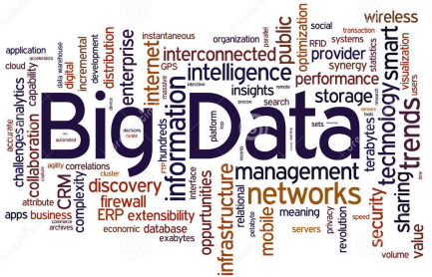
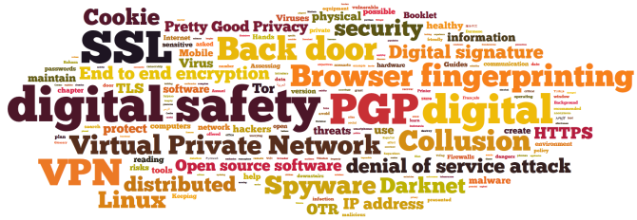
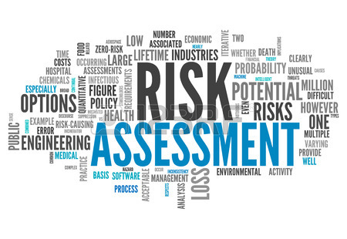
So… Let’s take a look at…..

Slide 10
Big Data - CityVerve - Manchester…….
Launched in July by Manchester City Council
To connect the city's health, transport, environment and services with 20 kinds of sensors.
Intended to make city planning more responsive
Smart Bus Stops which will be able to let drivers know when people are waiting
Smart lighting that comes on when needed, so it is more efficient with using energy.

Slide 11
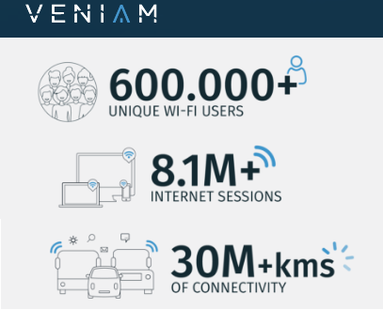
Big Data – Vehicles - Portugal…….
Portuguese company Veniam wants to turn all vehicles into wi-fi hotspots using mesh networks.
Porto is the first city to trial this "internet of moving things“
Proposed for Bin lorries and buses to be broadcasting Wi-Fi.

Slide 12
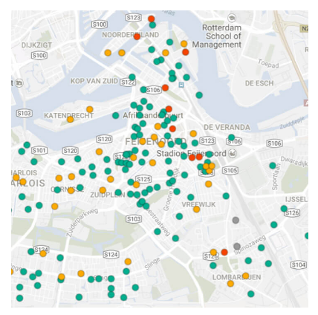
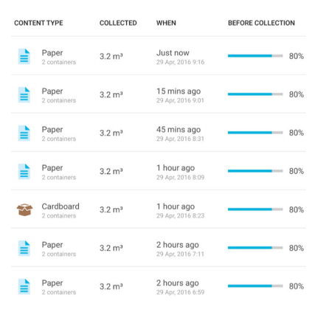
Big Data – Waste - Finland…….
Helping waste and recycling companies operate more efficiently
Finnish startup Enevo’s sensors can tell when a bin is full and then plan a route for the collection lorries that takes traffic into account.

Slide 13
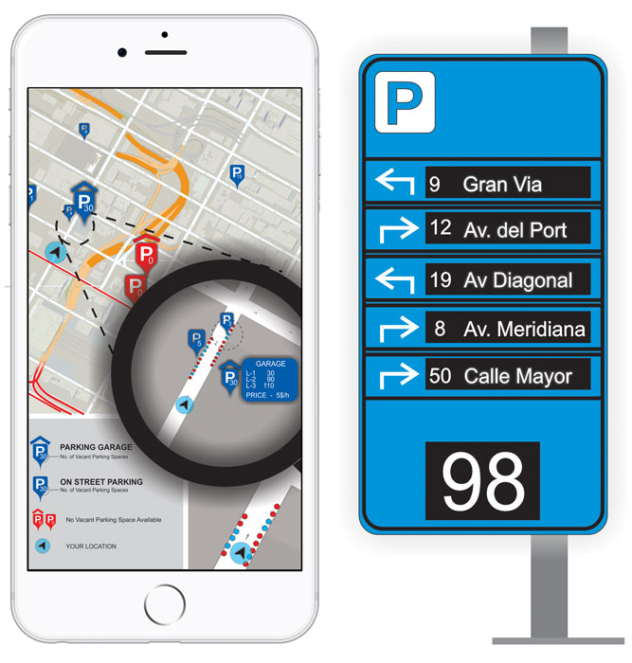
Big Data – Parking - Barcelona…….
Barcelona-based Urbiotica is using sensors to change cities' parking.
Wireless sensors provide real-time data on traffic
Measures traffic, air quality, noise pollution, humidity and temperature
Smartphone App available to see free parking spaces, etc
Helped reduce congestion by ten per cent in Nice, France

Slide 14
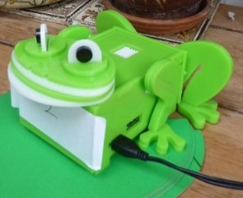
Big Data – Bristol – Citizen Sensing…….
Bristol Approach is a community driven guide to delivering projects that use sensor technologies.
Tracking footfall on run-down streets to help shops tailor their services.
Monitor radiation levels in the environment
Using applications that augment a mobile phone
The ‘Dampbusters’ project

Slide 15
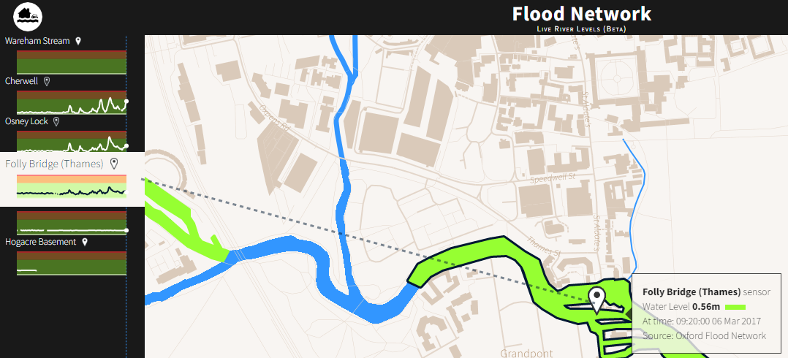
Big Data – Oxford – Water Levels…….
Flood Network has developed sensors in Oxford to collect real-time data on water levels.
Works with Environment Agency data to map where there is a risk of flooding
Rolling out across the UK.

Slide 16
Big Data - Business…….
Benefits – trending, bigger picture, cross agency
Concerns – security, access, data storage/transfer
Risks – who do you trust? What do you trust?
Selling the concept to customers – too much bad press?
Do we have the systems to adequately process and analyse?

Slide 18
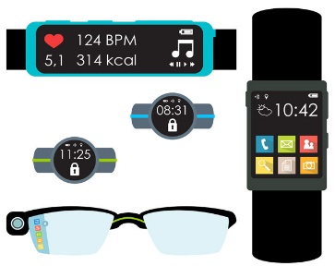
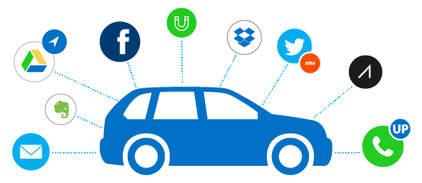
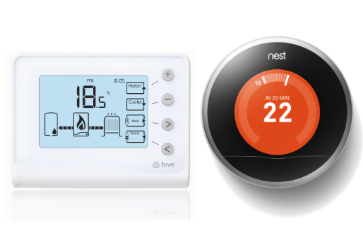
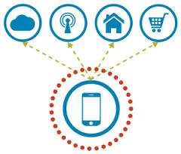
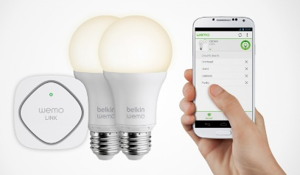
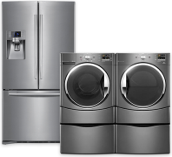
Big Data - Personal…….
Smart cars
Wearables
Health monitoring
But how much data are you creating? And at what cost?
Links with Phishing, home targeting by thieves, identity theft, online banking abuse
Smart heating
Mobile devices
Social media
Smart Appliances
Smart lighting

Slide 19
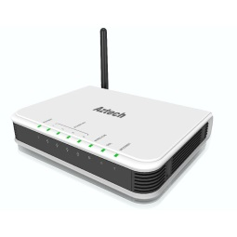
Big Data - Personal…….
Where you go
When you go there
Heartrate, links to doctors
Stress, voice patterns
Internet history
Email history
Wi-fi details
Device history
As below
Location, age
Status, workplace,
Family, address
Calling history
What you eat, when
You shop
What you watch
When you’re in, out
Power usage

Slide 20
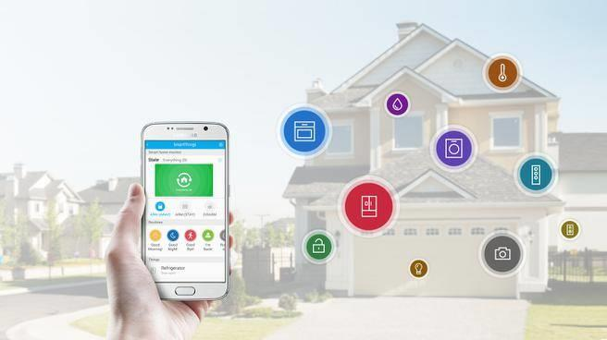
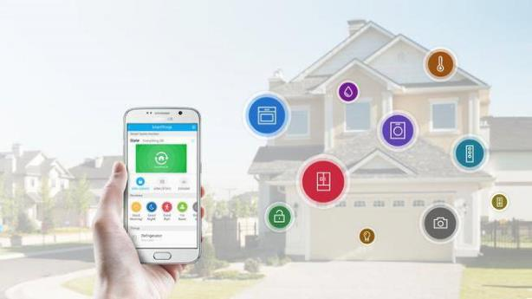
The automated home…..
Is it practical? How far do you take it?
Gimmick vs reality? Alexa?
Adapted homes – beneficial?
Care, vulnerable people
Social Housing? Can this be embedded?
What cost, what risk?

Slide 21
When things go well………….
Microsoft
Logistics

Slide 22
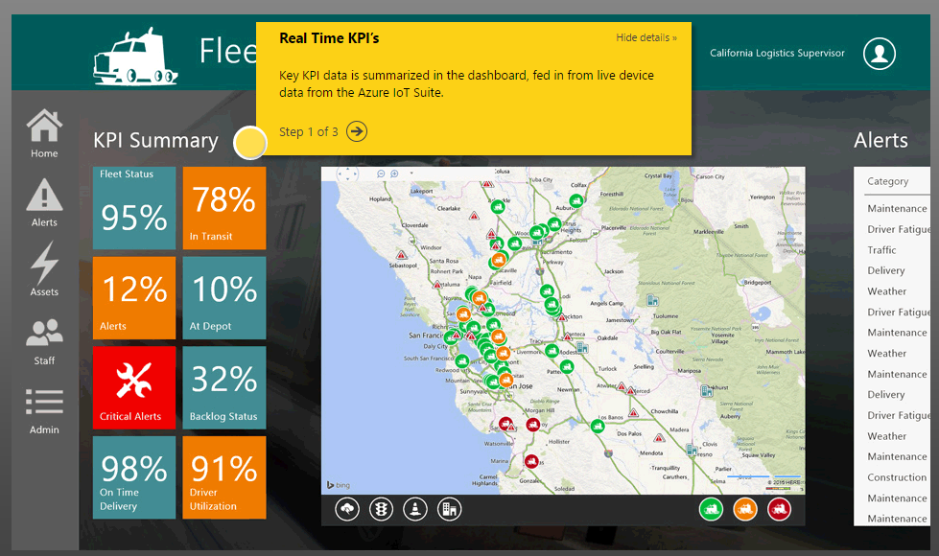

Slide 23
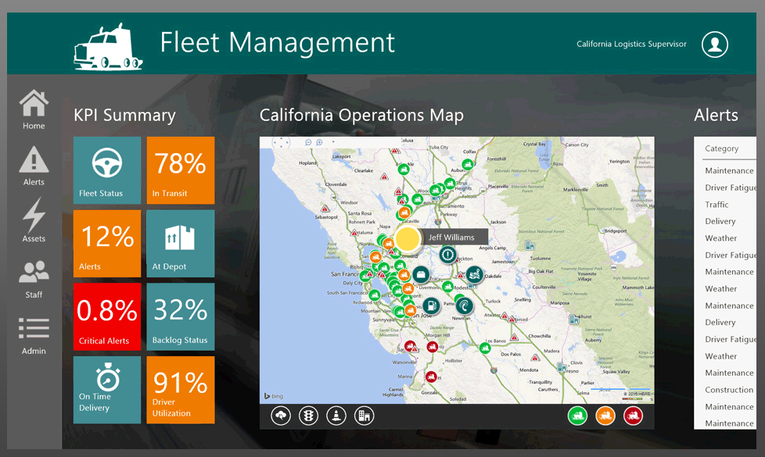

Slide 24
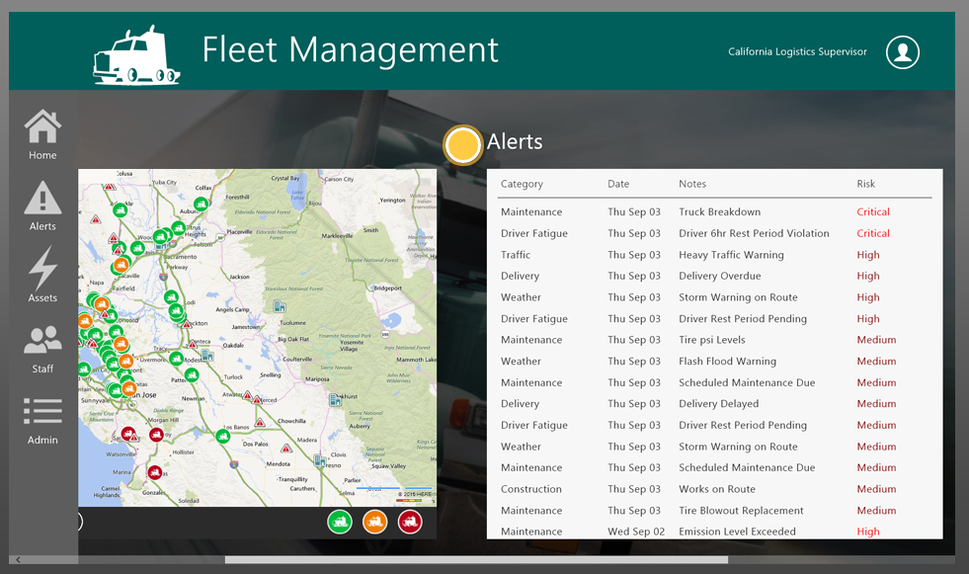

Slide 25
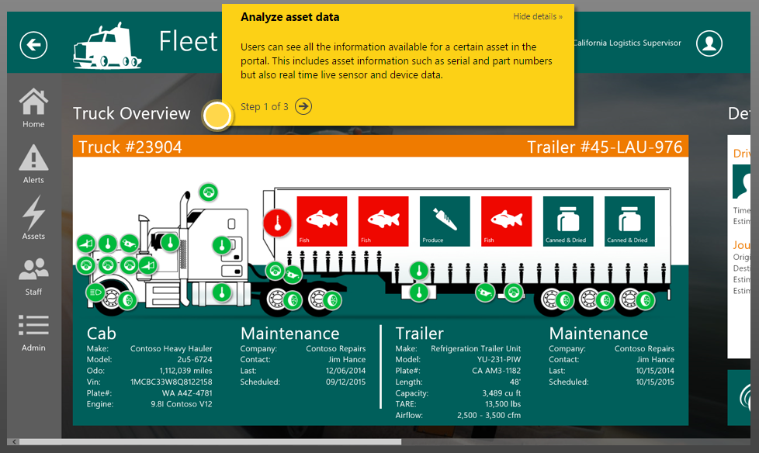

Slide 26
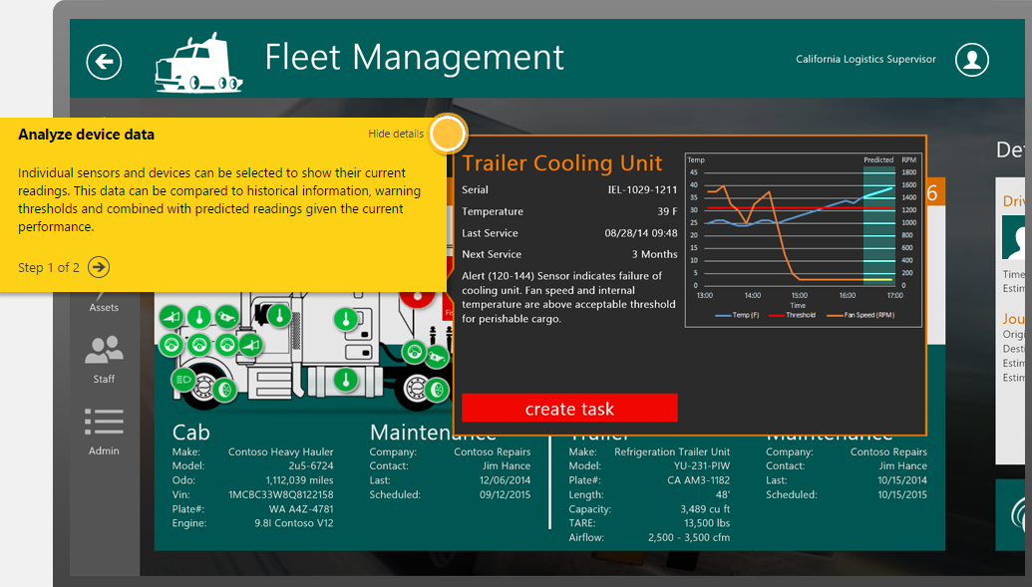

Slide 27
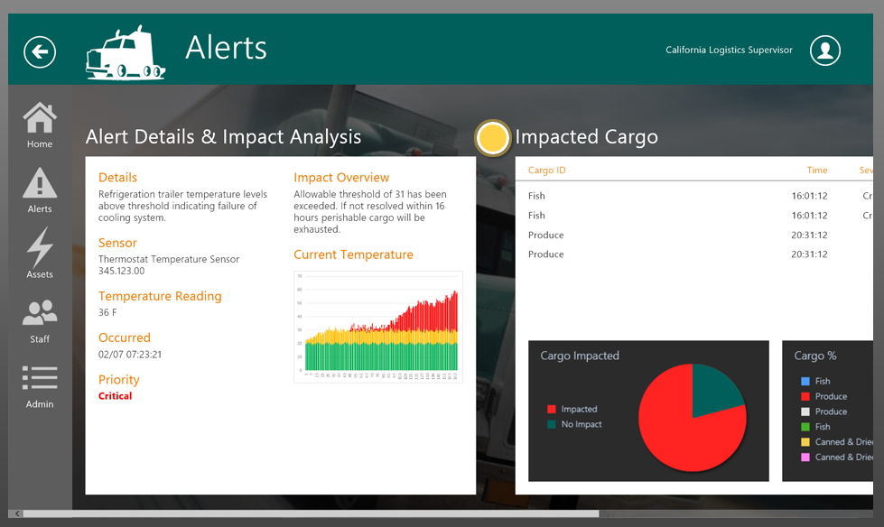

Slide 28
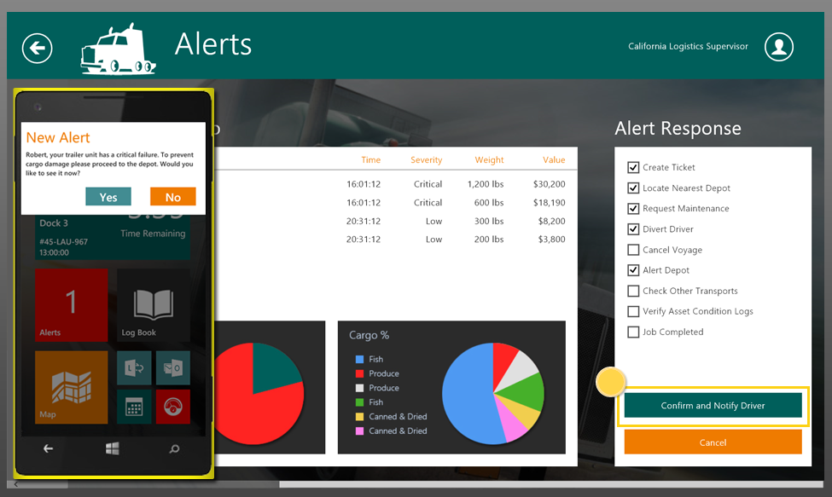

Slide 29
And when things don’t go quite so well………….
Jeep – wi-fi attack – 1.4 million vehicles recalled – radio, wipers, air-con, pictures appear on cars digital display (also TESLA)
Hangzhou Xiongmai Technology IP cameras – sites like gov.uk brought down – DDoS attack
Foscam IP camera – baby monitors – attacker can talk to child
Vizio – US company – legal case – TV’s capturing viewing details and selling data for targeted advertising

Slide 30
And when things don’t go quite so well………….
Satis toilet - Android app Bluetooth PIN hard-coded - cause the toilet to repeatedly flush, raising the water usage and therefore utility cost to its owner
Spiral Toys, - the CloudPets range of Bluetooth-enabled "smart toys” - exposing 821,000 user records online and 2.2 million parent and child voice recordings that had been captured
Just in case………former U.S. Vice President Dick Cheney, had the remote connectivity of a defibrillator implanted in his chest disabled….

Slide 31
Jeff Goldblum – JURASSIC PARK
“Yeah, yeah, but your scientists were so preoccupied with whether or not they could, that they didn't stop to think if they should”
developers
executives

Slide 32
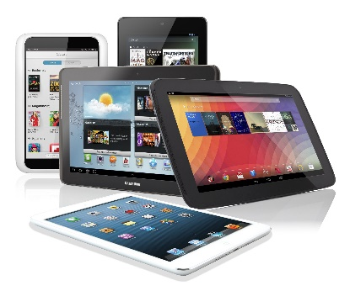
Comparison – iPad ‘revolution’
“Driven by Exec/Board” vs “R&D sign off”
Speed to market affecting quality and control
Standardisation – Where is it?
Do we have a governing body?
Is there a single communication language?
Open Source devices tend to be available at low cost but do they bring additional risk?
The impact of consumerisation

Slide 33
Current applications………….
Voice controls – Amazon Echo/Alexa
Does anyone really need to make a coffee from their seat in front of the TV?
Are they just toys or are there some serious usages?
Now seeing development training being offered – AWS to Alexa
Adapted homes?
Scada / ICS – larger scale usage, better controls, pressure to improve
ICS systems already deployed can be ‘woefully insecure’
Can retro-fitting resolve these issues? At what cost?

Slide 34
Current applications………….
Wearables – great for personal fitness – but what else?
Worker wellness schemes…..
Tesco – goods tracking as staff move through aisles and shelves
Fatigue monitors – transport, maintenance workers
EEG Headbands – monitor your cognitive outputs
Humanyze – people analytics – voice patterns and tone – not recorded – physiology, stress levels, sleep patterns
“According to a study by Rackspace, The Human Cloud at Work, employees wearing wearables at work became 8.5 percent more productive and 3.5 percent more satisfied with their jobs”…….

Slide 35
Barriers to success…………..
Board/Exec not engaged in technology to see benefits
Or driving an agenda they don’t understand?
Security – internet littered with issues
Privacy – how do we we assure it?
Infrastructure – can we support it?
Customer buy-in – incentives? Breaking the ‘big brother’ view

Slide 36
Risk
Very much dependent on your corporate ‘risk appetite’
Data loss – corporate, personal

Slide 37
Security & Privacy
Data protection
Many devices gather sensitive data, the transmission, storage and processing of which needs to be secure for both business and regulatory reasons.
Expanded attack surface.
There will be more devices on networks for attackers to probe as possible entry points to broader IT infrastructure.
Many IoT devices are permanently on and connected, making them prime targets.
DDoS risks

Slide 38
Security & Privacy
IoT security = climate change: we know we need to act now to avoid a long-term disaster, but we don't know how to go about it.
IoT ‘things’ are small, often invisible, and have not-so-powerful processors and little memory; there are a lot of them and they'll be left unchecked by humans for years.
Bot net recruitment? Would we ever know?
Mirai – Brian Krebs DDoS, 2016 - CCTV, DVR’s and routers

Slide 39
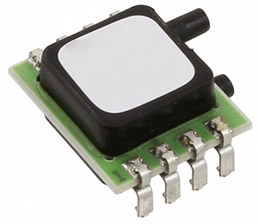
Security - IoT devices typically:
Transmit very little information
Data packets have become so short that some of our most fundamental crypto algorithms wouldn't fit any more
Do not have enough memory to accommodate large antivirus software packages

Slide 40
Infrastructure
Corporate – do we have skills in-house?
Standards – will we ever be able to apply one?
Worldwide – how do we control the spread of IoT devices?
How do we manage updates?
How do we shutdown if needed?
How do we keep track?

Slide 41
Customer ‘buy-in’
How do we assure our customers of:
Data Protection
Privacy
Security
Big brother mentality
Do we incentivize?
How? Can we?
What risks do we open ourselves up to?

Slide 42
Our experiences……..
8 different ‘import’ devices – 5 found to contain Malware
‘Off the shelf’ IoT – communicating with non-euro sites over web
1 interactive smart board – communicating with ‘home’ – is this another Vizio?
IDS / IPS / DNS protection – improved and heightened security required

Slide 43
But let’s look at Housing…..

Slide 44
In Housing…..
Saving money vs. improving customer experiences / lives
Can you do both? Don’t get lost in the financials
Gas servicing – service without a visit?
Smart boilers – alerts and condition statuses
Access issues for Gas servicing removed – no need to attend
ASB – noise levels monitored ‘live’ - cases acted upon faster
Damp/mould problems – building issue or tenancy issue?

Slide 45
In Housing…..
Predictive repairs
Appliances – alerting - vulnerable people not using them
Smart lighting that changes when you move between rooms
‘Smart homes’ where a combination of actions happens dependent on who you are i.e. lighting, heating, music, TV – facial, voice recognition
General property condition monitoring

Slide 46
In Housing…..
Communal areas / Blocks of flats – monitored for footfall after dark
Lifts and stairwells monitored for safety and outages
Employee wellness programmes
Lets focus on staff
Sickness absence – can this be affected?
Remember - “According to a study by Rackspace, The Human Cloud at Work, employees wearing wearables at work became 8.5 percent more productive and 3.5 percent more satisfied with their jobs”…….

Slide 47
In Housing….. The way forward?
Partnership – working with IoT developers gets you ahead of the game, working with internal teams creates understanding of possibilities
Challenge internal processes – but don’t try and fix what isn’t broken
Do it with care – Plan it, Test it, Promote it
Cost saving is a given.. But it may take time to see it
Look beyond the consumer product but embrace the possibilities it brings
The underlying concept may be the important thing

Slide 48
In Housing….. The way forward?
Implement a strategy
Will be influenced by:
IT strategy
IT security policies
Asset management strategy
Customer service strategy
Digital strategy… maybe more
Get people on board
Remember that ROI isn’t just financial

Slide 49
And one final quote…….
……”the question should not be whether the IoT should be used to transform social housing, but how quickly.”………
Sovereign plc.

Slide 50
Thank you for your time Any questions

Slide 51
Credits…..
Wired magazine, May 2016
“The internet of things will turn our machines against us”, Marc Goodman
The Bristol Approach - http://kwmc.org.uk/projects/bristolapproach/
Sovereign plc – how IoT could transform social housing

