Slide 1
Don't throw the baby out
(With the Housing System)
John Sammons
Assistant Director: Information & Technical Services
John.sammons@isoshousing.co.uk

Slide 2
A brief history of Isos Housing
Based in North East England
Amalgamation of
Milecastle Housing, Castle Morpeth Housing, Enterprise 5, Nomad Housing
Joined by Cestria Community Housing
Currently 550 employee's, 17,000 properties
Large geographic area with rural challenges
Ambitious growth plans
23,000 properties and 800 employee's April 17
In discussions with other HA's about partnership

Slide 3
Selecting between two systems
Capita Open Housing
Long term Capita users but also migrated from SX3 and Simdel
Majority of users / properties on this system
Northgate Housing
Used by Cestria Community Housing
Used by YHN (previous service provider to Byker Community Trust)

Slide 4
Why not CRM or ERP?
We did try…
Microsoft Dynamics
Project did not deliver what we expected and we found it difficult to match a sales oriented system to our customer service environment.
We needed to move quickly
Logical to retain skills investment in Housing System / Progress SQL
One supplier focused on Dynamics as add on other had own CRM

Slide 5
The decision process
Develop specification document
Independent consultant
Interviewed key stake holders and developed key requirements
ICT Technical requirements and integration to the stack documented
Workshops over 3-4 day period
With 100+ staff split into voting groups by functional area
Specification responses marked by same groups ahead of demo's
Demo questions prepared in advance
Decision taken 13 out of 15 workgroups
Capita Housing

Slide 6
OT1S was born
One Team 1 System

Slide 7
The crazy decision
Throw out the evolution
Decided to review every process
Full data integrity and cleanse process
Change reference numbers to make more consistent
Tenancy, Property, patches etc
15 years of evolution had left constraints
Felt it was time for a fresh start and re-implementation
Capita thought we were mad!

Slide 8
Creating a project team
Needed staff who were keen to make a difference
Were not frightened to start from scratch
LEAN trained
From key areas of the business
Housing
Trades
Management Information
Both organisations represented from the start
Project Board from wider stakeholders
No Assistant or Executive Directors, all managers & staff representatives

Slide 9
Strong project management
Extensive experience of migrations through acquisitions
Prince 2 Qualified
OGC Programme Mgt Qualified
Excellent People Skills

Slide 10
We have always done it that way?
Ground up needs radical thinkers
Resistance is Futile!
Hearts & Minds need winning
Politics get in the way
Get the project on your Exec agenda

Slide 11
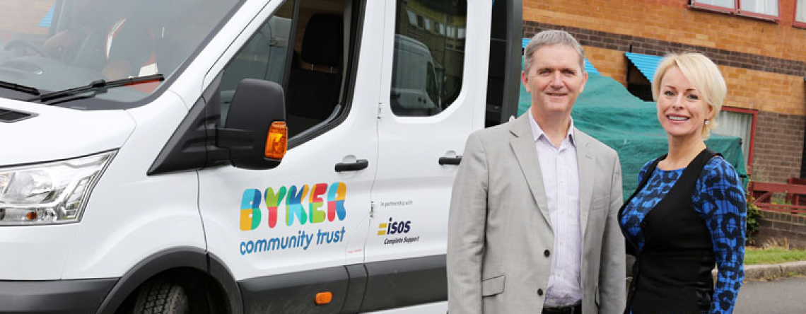
The 'Byker' factor
Six months into our project along comes an opportunity
Cost Sharing ICT services for BCT
Migration from Northgate
October 16 deadline

Slide 12
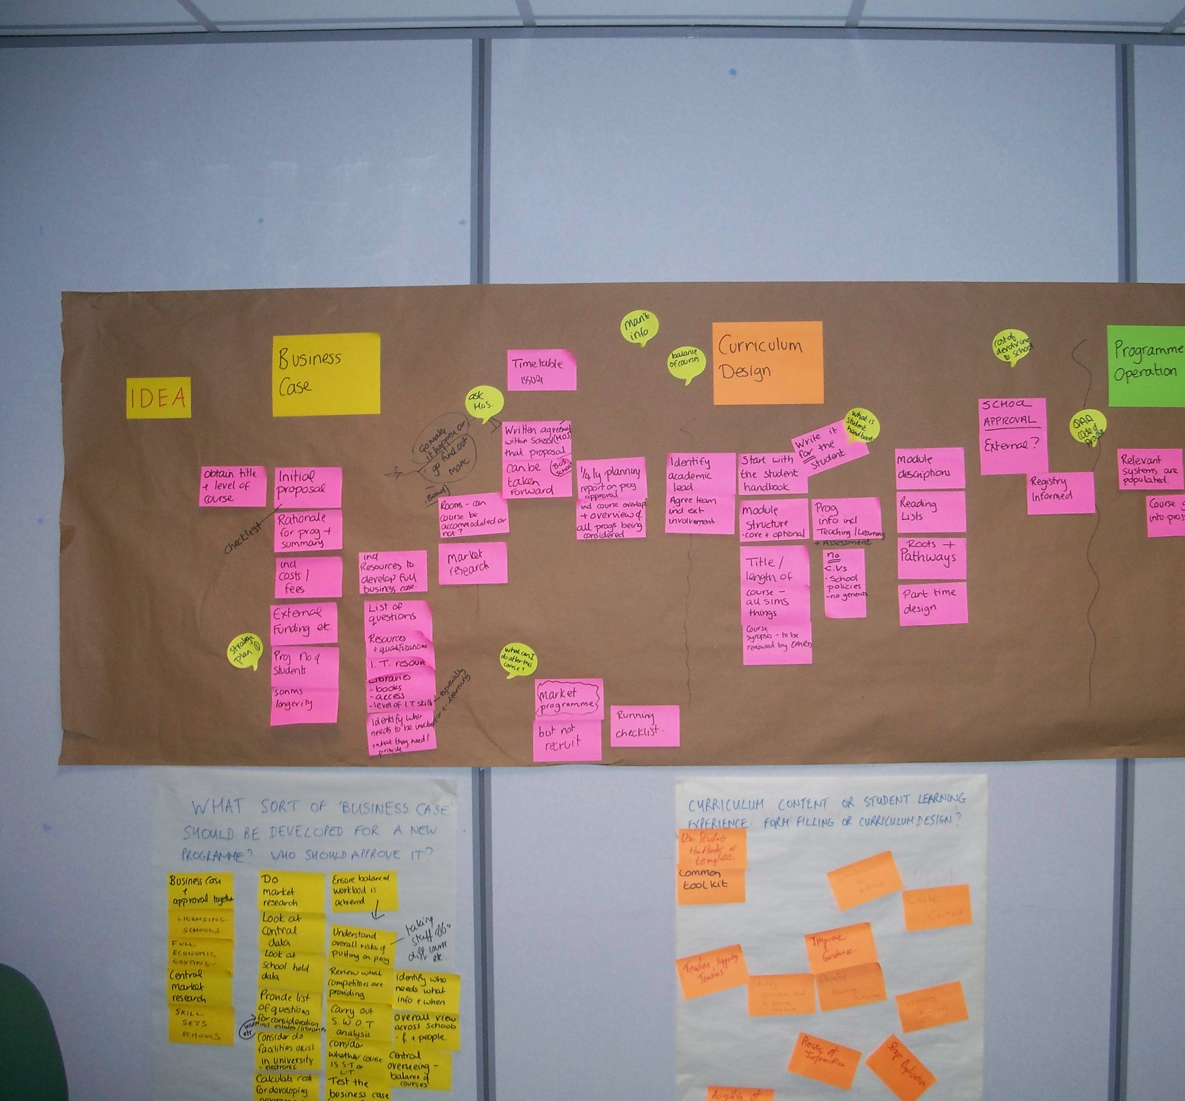
Lean and Leaner

Slide 13
While you are not busy!
Desktop Infrastructure
6 years old needs a refresh
Use VDI architecture with thin clients
Build new desktop to support more advance features of Housing System
Needs to work with both Housing Systems
Prepare for future growth

Slide 14
What went well
Show & Tell Sessions
External Facilitator got buy-in
Spot the differences gave head start
Clear Business Case
Dedicated Project room
Solid Test Scripts
Extensive Training plan
Don't underestimate this!
Bite Sized chunk training
Clear ED/AD message
Everything is up for change

Slide 15
What went well
Data Integrity Lead
Solid Change Control Process
Regular communications
Demo's along the way
Strong Go-Live Plan checklist
Concise and clear about responsibilities
Communicated clearly to business at least 3 times
Pizza, Cake, KFC, Coffee, Tea, Sweets!

Slide 16
Marketing the Aardvark
Used the Aardvark as the face of the project
Gave away Aardvark toys, mugs, pens, mouse mats
OT1S is the new name for the Capita system
Made clear to all staff we are doing something new
The OT1S character will be used in future internal marketing of enhancements and new features

Slide 17
You can never communicate enough
Posters
Briefings
Demo Sessions
Road Shows
Intranet

Slide 18
What tripped us up
Our Project Management System was not easily accessible by external partners
Now use O365 based solution
Timescales for product selection were long and drawn out due to tender process
Ran out of test/train/reconciliation environments
Minimal User Acceptance Testing due to Byker implementation
Final training was rushed to meet timescales
Impacted on go-live support
Key staff were single points of competence and therefore a risk

Slide 19
What tripped us up
Underestimated the amount of technical support required
Transferred large volume of incomplete jobs under pressure from DLO
Delayed go-live and resulted in 2 months of mop up
Data load was slow as Technical work not completed
Change of network card driver next day gave 20 fold performance improvement!
Technical work still being completed during go-live week
Too much change in too tight a window
Finance system was a pain and support not so good
Go-Live just before Christmas impacted on post go-live support

Slide 20
SharePoint
Working with Capita we have developed a 360 degree SharePoint Document Interface
Any document created by Open Housing HAS to be saved to SharePoint
Automatically tagged and Info Mgt Policy applied
Docs can be scanned and tagged by Barcodes
On Disposal Capita link removed automatically

Slide 21
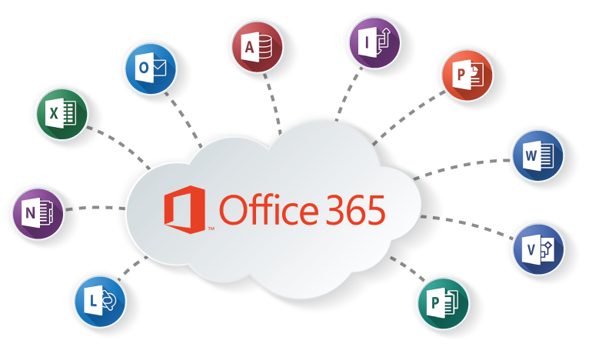
Designed for Office 365
Our Document Management solution is designed for O365 from the ground up
Documents can be added by Capita or directly into a SharePoint document library
Build to leverage the power of mobile solutions with O365 security

Slide 22
Built for GDPR
Compliance
Information Management Policies
Digital Rights Management
eDiscovery
Foundation for all files to be stored, managed and disposed of

Slide 23
Key Benefits of retaining the Housing System
We retained existing skills and knowledge
Did find out how little some of our staff knew!
Starting from a position of understanding
We clearly knew which bits worked and what didn't
Staff could concentrate of function as they understood the basics
Every lean session started with demo from Capita of what was possible
Most staff were surprised at what they 'could' do
Faster project kick off and migration due to existing knowledge

Slide 24
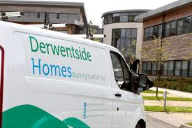
Let's do it all again!
April 3rd 2017 we Amalgamate with Derwentside Homes …..

