Slide 1
Customised Web Mapping
Steve Litchfield
Senior GIS Analyst
steve.litchfield@orbit.org.uk
orbit.org.uk

Slide 2
Customised Web Mapping
About Orbit
Orbit’s GIS Background
Orbit’s Customised Web Mapping Journey
Next Steps
Conclusions

Slide 3
About Orbit
2017 Celebrating our 50th year
12th largest Housing Association
Group Structure
2nd largest developing Housing Association
2020 Vision
12,000 new homes
Achieve Minimum EPC Band C for all properties
£30m Investment into our Communities

Slide 4
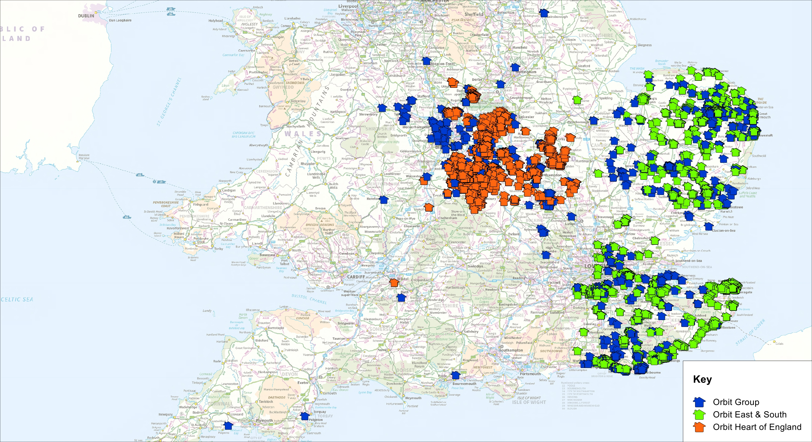
About Orbit
40,000 Homes
81,000 Customers
1,300 Staff

Slide 5
Orbit’s GIS Background
Desktop GIS Introduced 2010-11
To make efficiencies
Improve service to customers
Two Desktop GIS Licences
Previously handled all mapping requests
Produced static maps
Paper or electronic

Slide 6
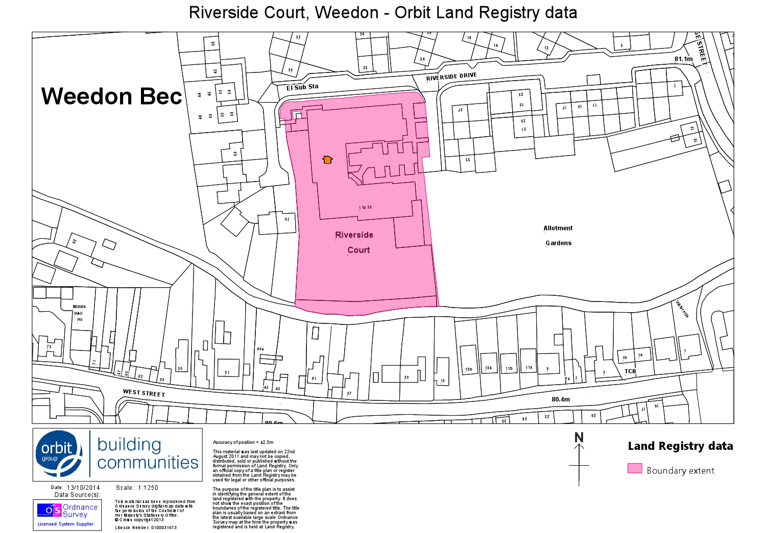
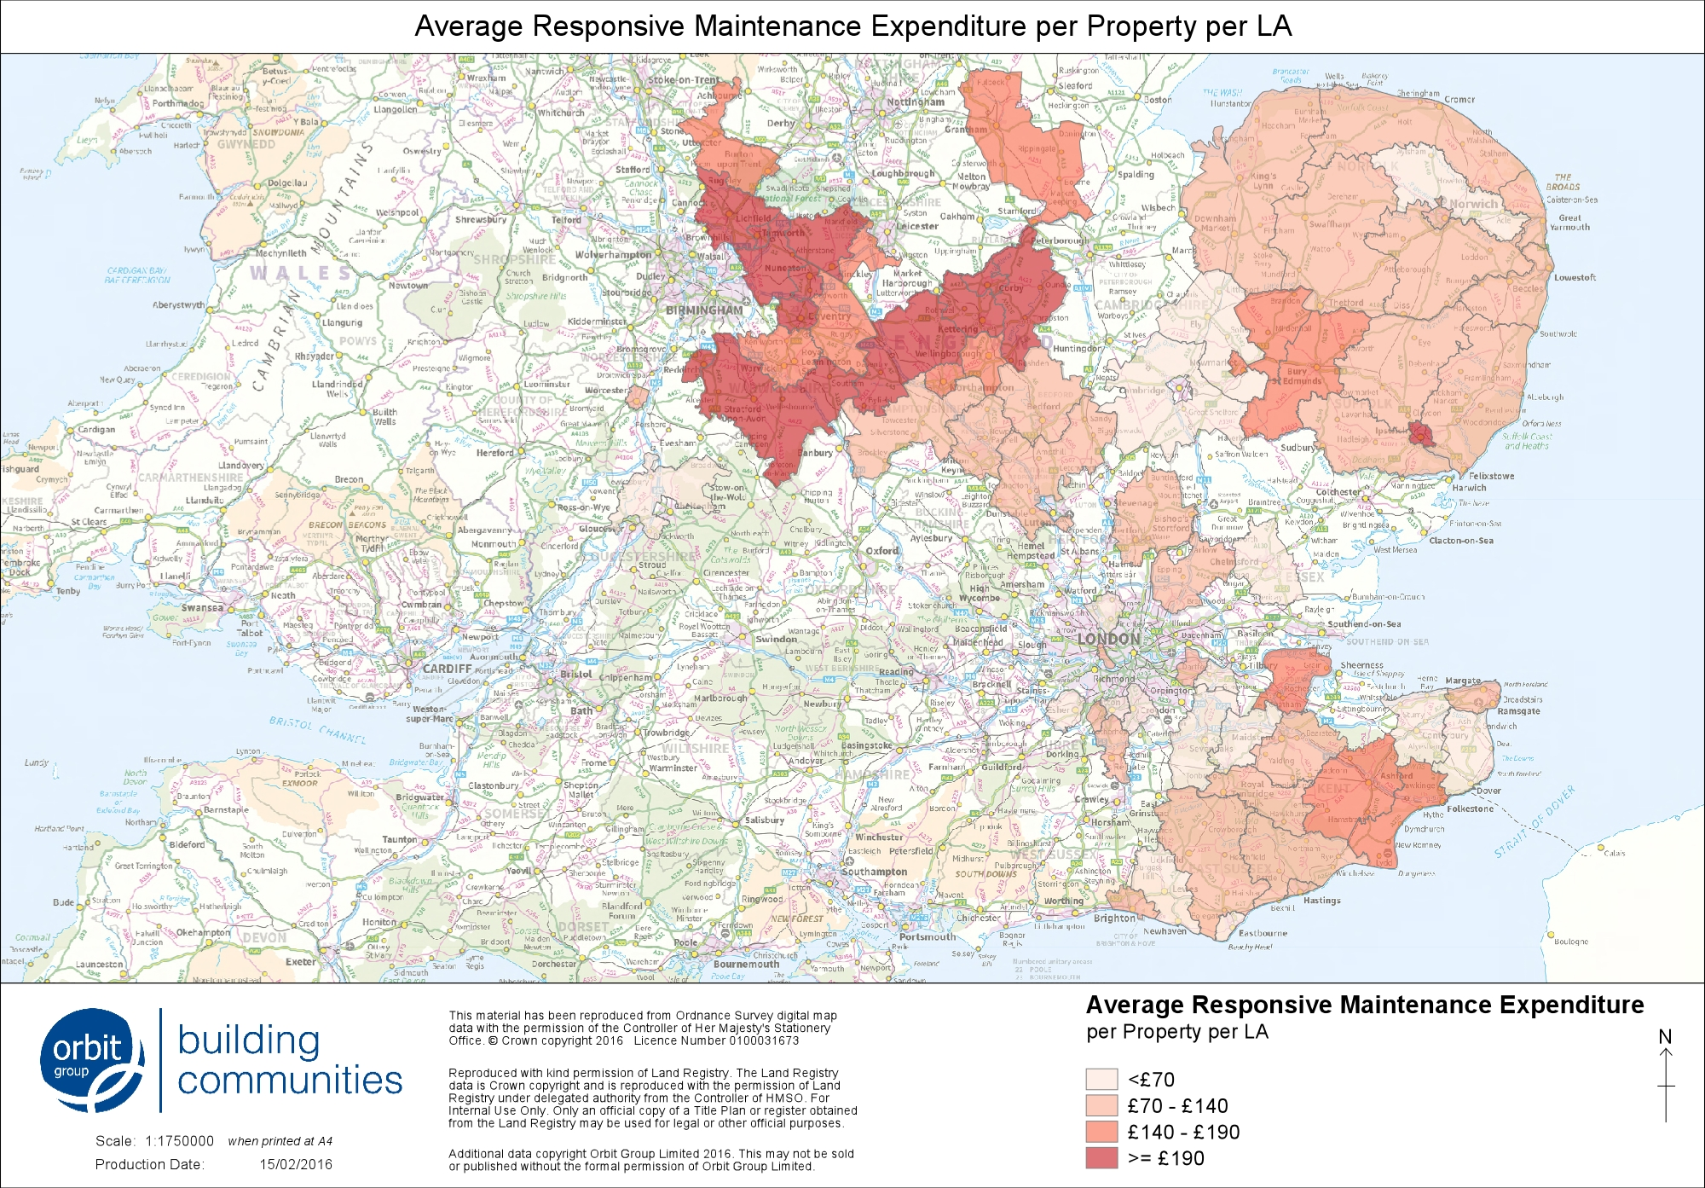
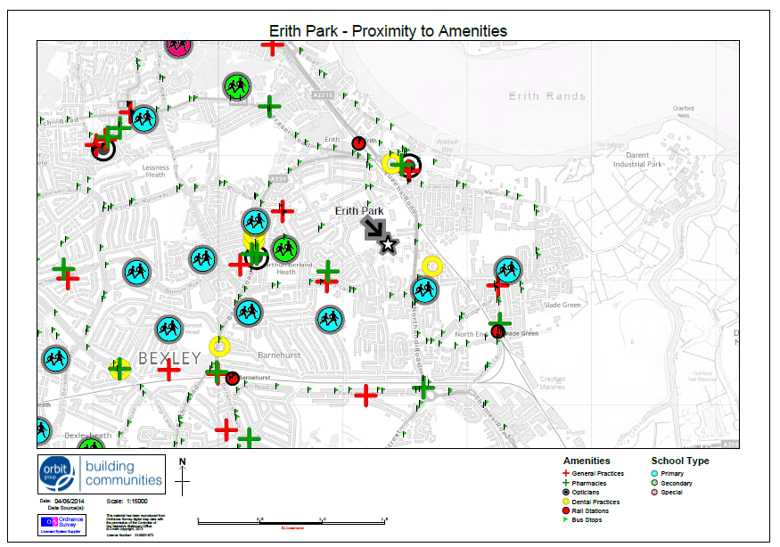
Orbit’s GIS Background

Slide 7
Orbit’s GIS Background
Targeted benefits and savings began to be realised
Momentum for GIS requests increased
Web based GIS therefore seen as a natural progression
Allow users to ‘self serve’
Provide a solution which meets all customers requirements
Build on initial desktop GIS investment
Allow specialists to further develop GIS

Slide 8
Pre-Implementation
Built business case
Assembled project team & initial user group
Design

Slide 9
Orbit’s GIS & Spatial Data
GIS Flowchart
Dedicated Desktop GIS & Database Server
Internal Data
Property Portfolio Daily Extract
Bespoke Requests
Analysis
One off projects
Desktop GIS
(2 x licences for GIS specialists)
PostGIS Database
External Data
OS
Land Reg
Amenities
etc
GIS Data Layers
(Stored on global network drive)
Dedicated Web GIS Server
myM@ps (User Interface)
via Intranet (Desktop & Mobile)
Web GIS Admin
User Interface setup
Geocached Map Data
Background Mapping
GIS Web Service Manager
Handles web requests from users

Slide 10
Pre-Implementation
Software installation
Spatial Database link with Housing Management system
User Guides/Help pages

Slide 11
Implementation
Delivery to Pilot team (Estates) - Feb 2015
Testing, Review and refine
from a users perspective
from a delivery perspective
Decided delivery format for rest of business
Created ‘template’ myM@ps roadshows
Could be delivered by non GIS specialists
Tailored to engage staff as well as to train

Slide 12
Implementation
Estates Services

Slide 13
Implementation
Housing services

Slide 14
Implementation
Planned repairs

Slide 15
Implementation
Development

Slide 16
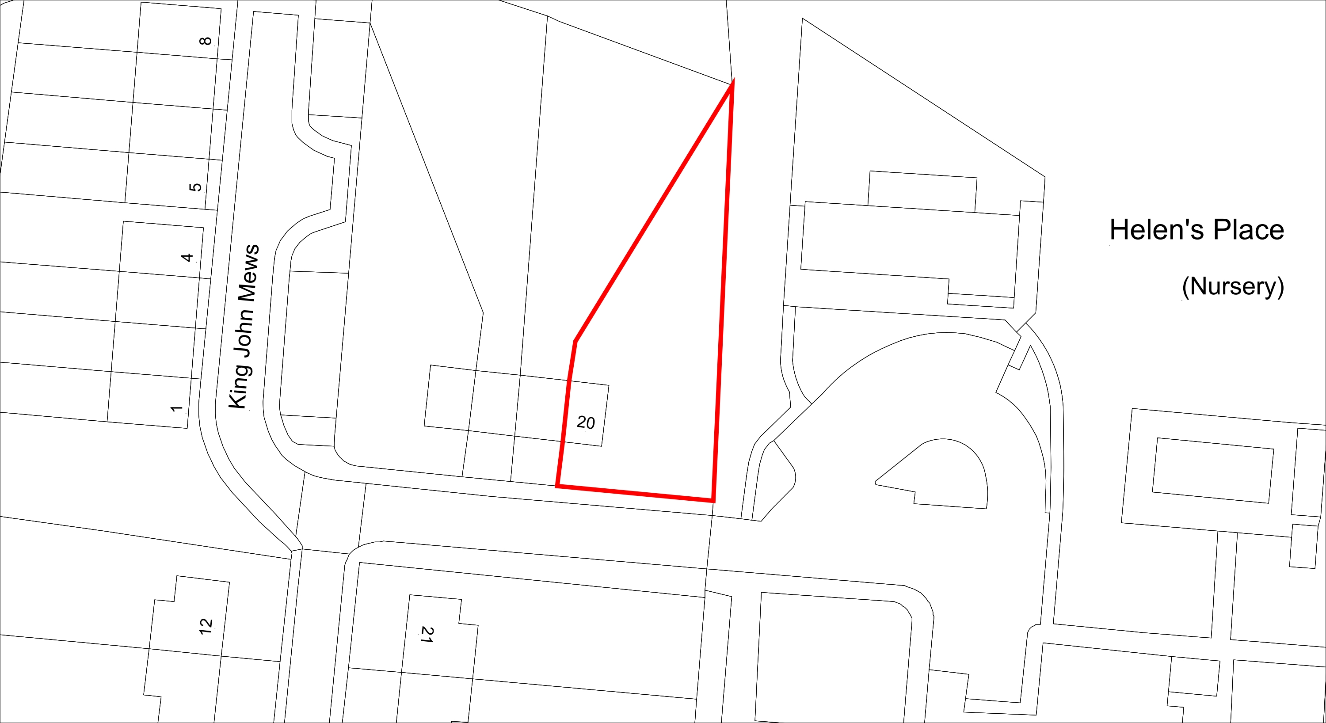
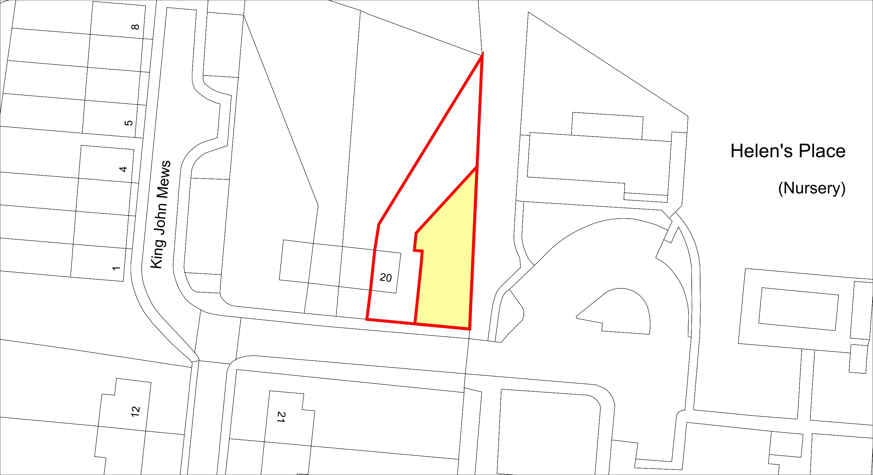
Implementation - Commercial
Case Study
£150k
+£78k
£175k
=£53k profit

Slide 17
Post Implementation
Uptake & Usage
Staff Surveys
Case studies
73% staff have used myM@ps since launch
87% say useful in their role
86% say easy to use

Slide 18
Post Implementation
Uptake & Usage
Google Analytics
25k sessions from July 2015 to 20nd Feb 2017
Currently an average of 75 sessions per day

Slide 19
Post Implementation
Uptake & Usage
£ savings difficult to quantify exactly
Conservative estimate approx. £100k per annum (minimum)
Based on savings in
Costs (queries and associated time to complete)
Travel time
Expenses

Slide 20
Next Steps
Editing functionality for mymaps users
External customer facing version

Slide 21
Customised Web Mapping
Conclusions
Already heralded a success
User Perspective
Value for money
Quicker resolution of queries
Challenges:
Logistics for rollout
Managing expectations

Slide 22
Customised Web Mapping
Thank you
You are welcome to attend the next
in Camden Lock, London on Thursday 27th April.
Please enquire or see the Linkedin group page for details on how to enrol.
GI
4
Housing
event

