Slide 1
Achieving business integration through Service Management
John Sykes
Head of Service Design & Transition

Slide 2
Agenda
Business Context
Aims and Objectives
Approach
Key Focus Areas
Cultural Change

Slide 3
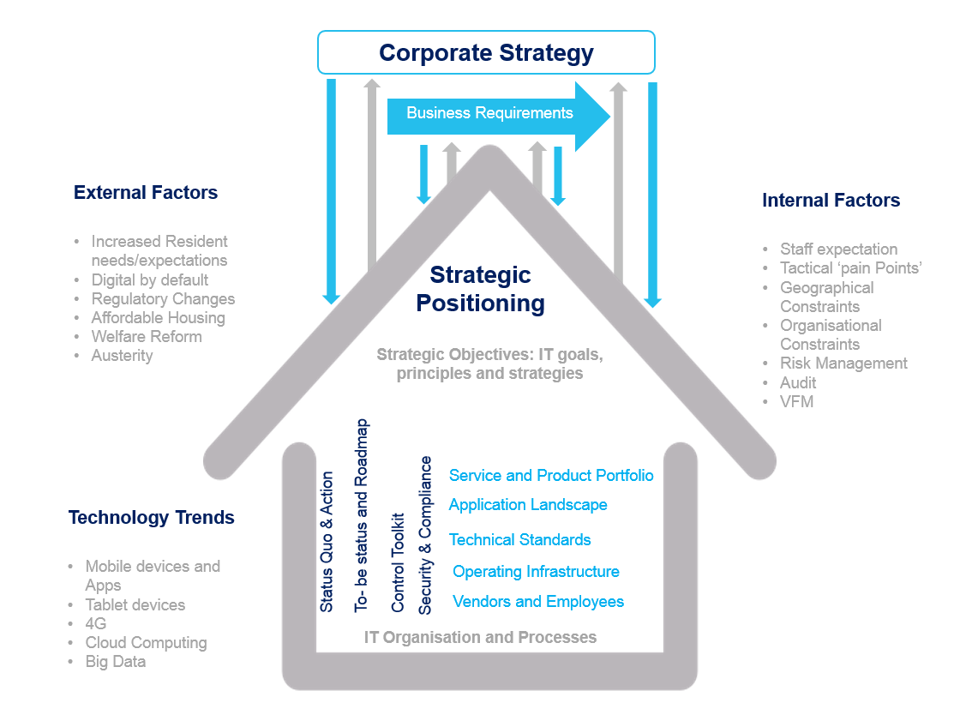
Business Context

Slide 4
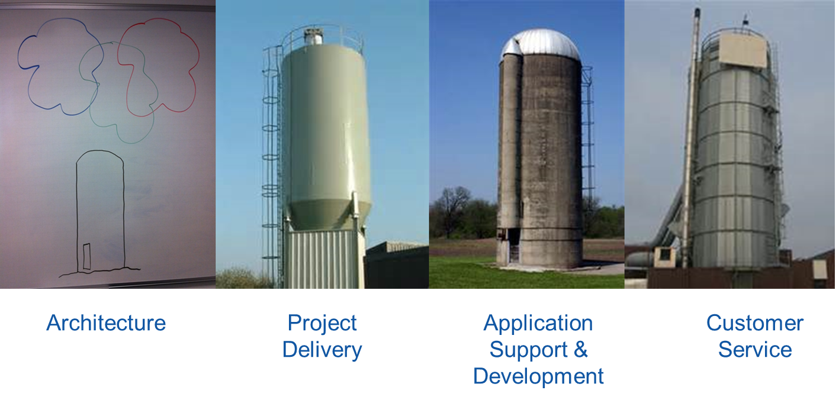
Business Context

Slide 5
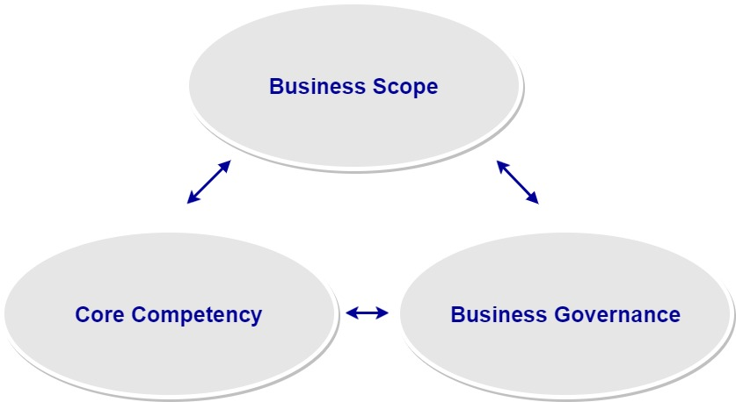
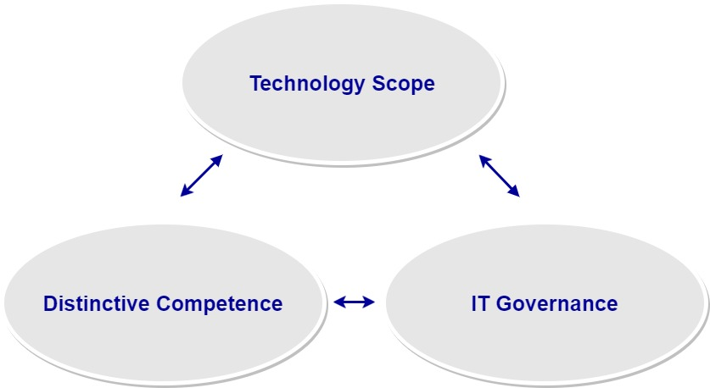
Business Context
Business Strategy
Information Technology Strategy

Slide 6
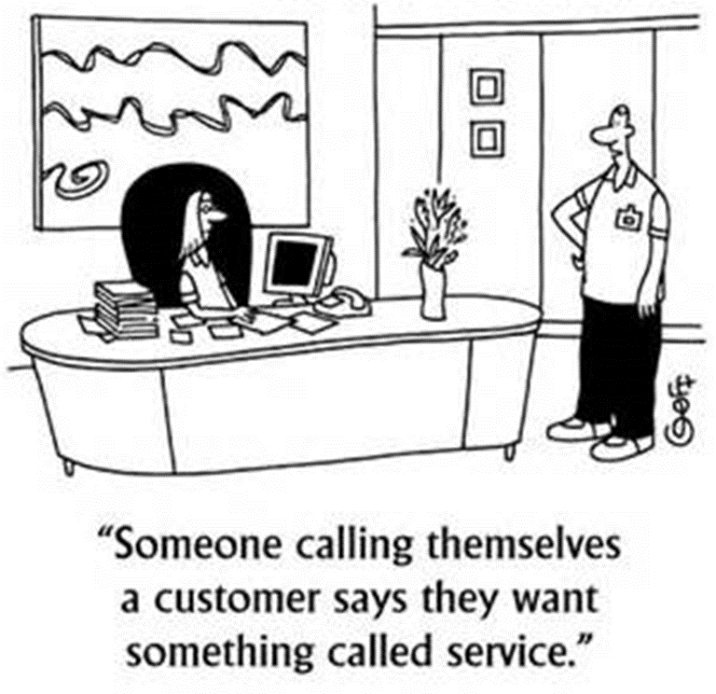
Business Context

Slide 7
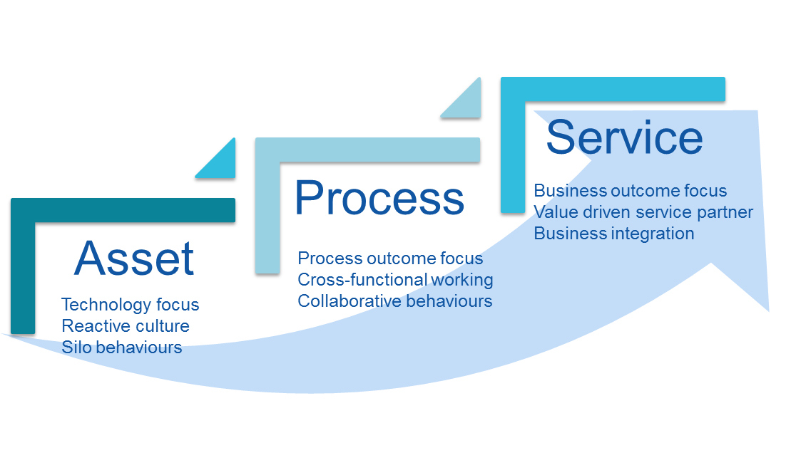
Aims and Objectives

Slide 8
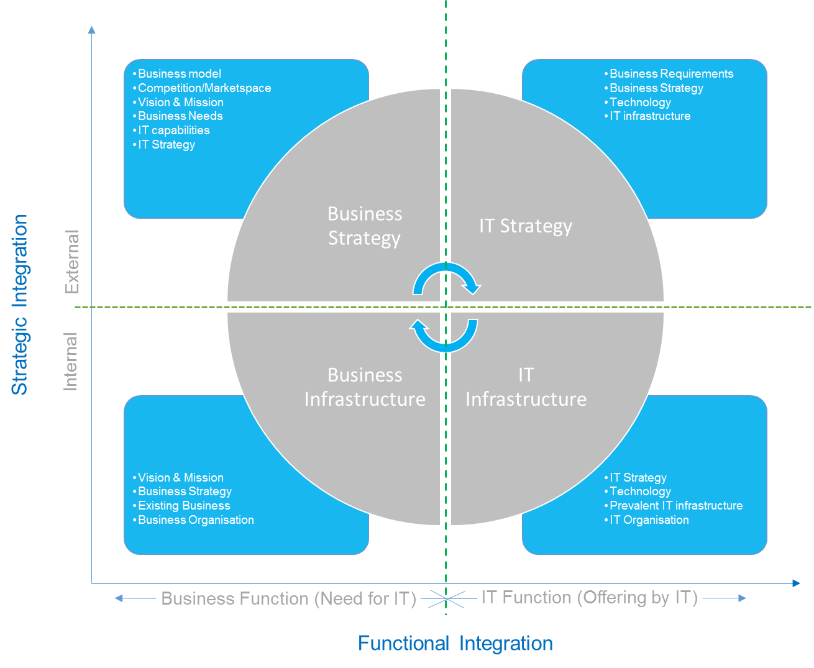
Aims and Objectives

Slide 9
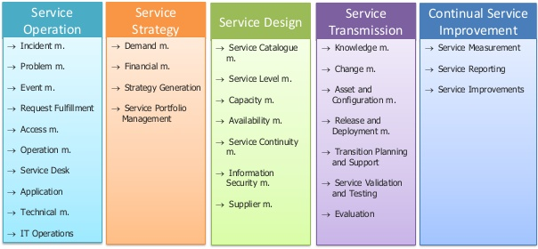
Aims and Objectives
Frameworks & Standards
  Service Management (ITIL)
  Prince ll, Agile, BI Modal
  TOGAF
  ISO 27000
  COBIT
  Gartner
  ‘Fit for Purpose’

Slide 10
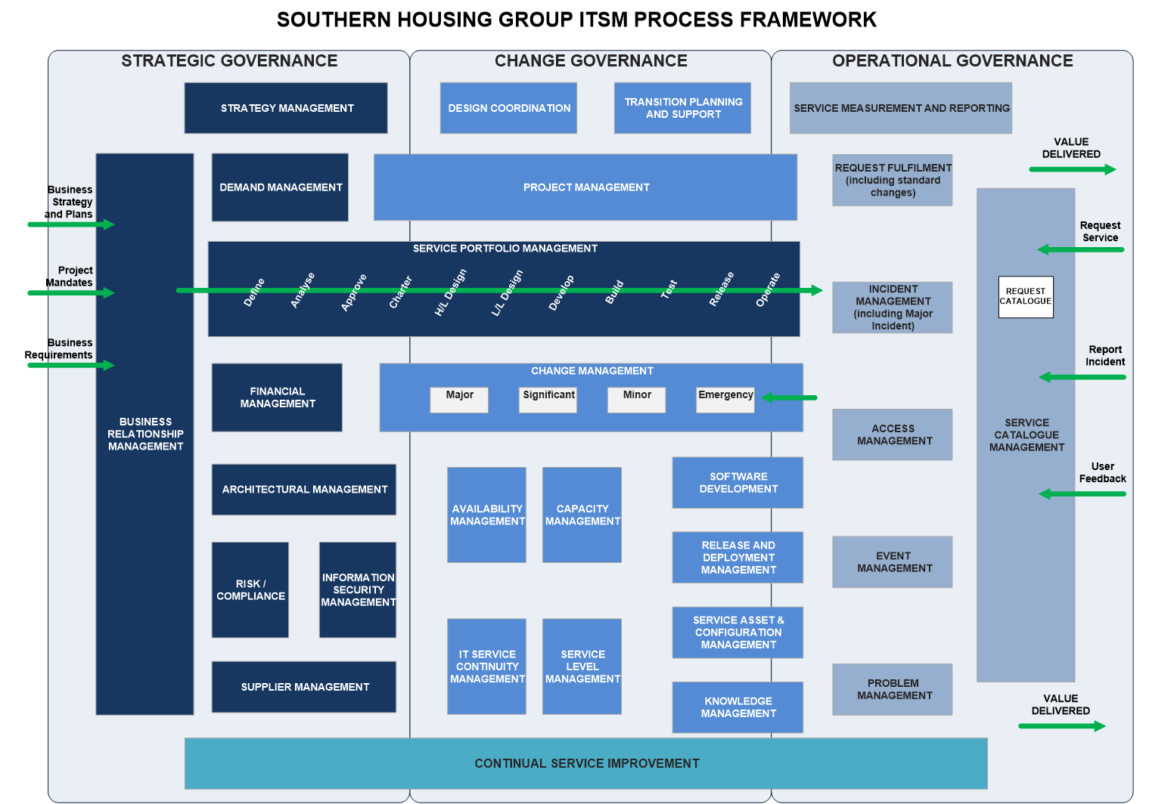
Aims and Objectives

Slide 11
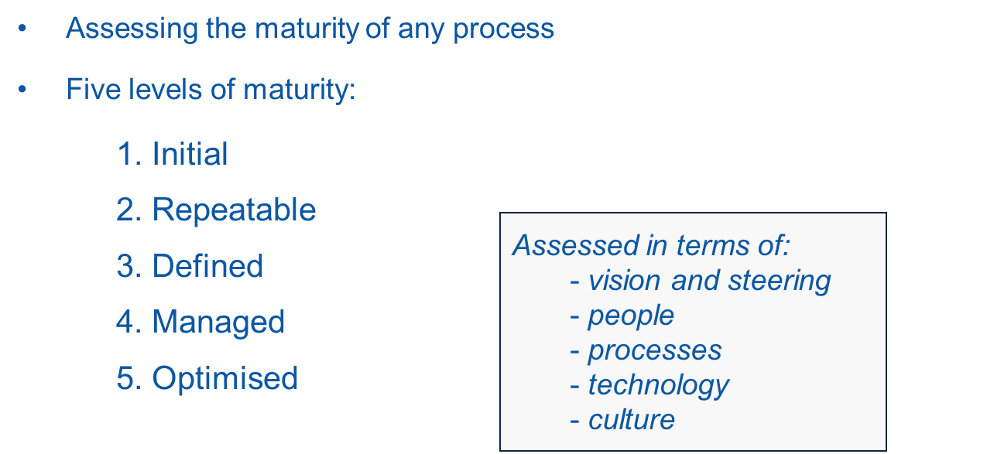
Aims and Objectives

Slide 12
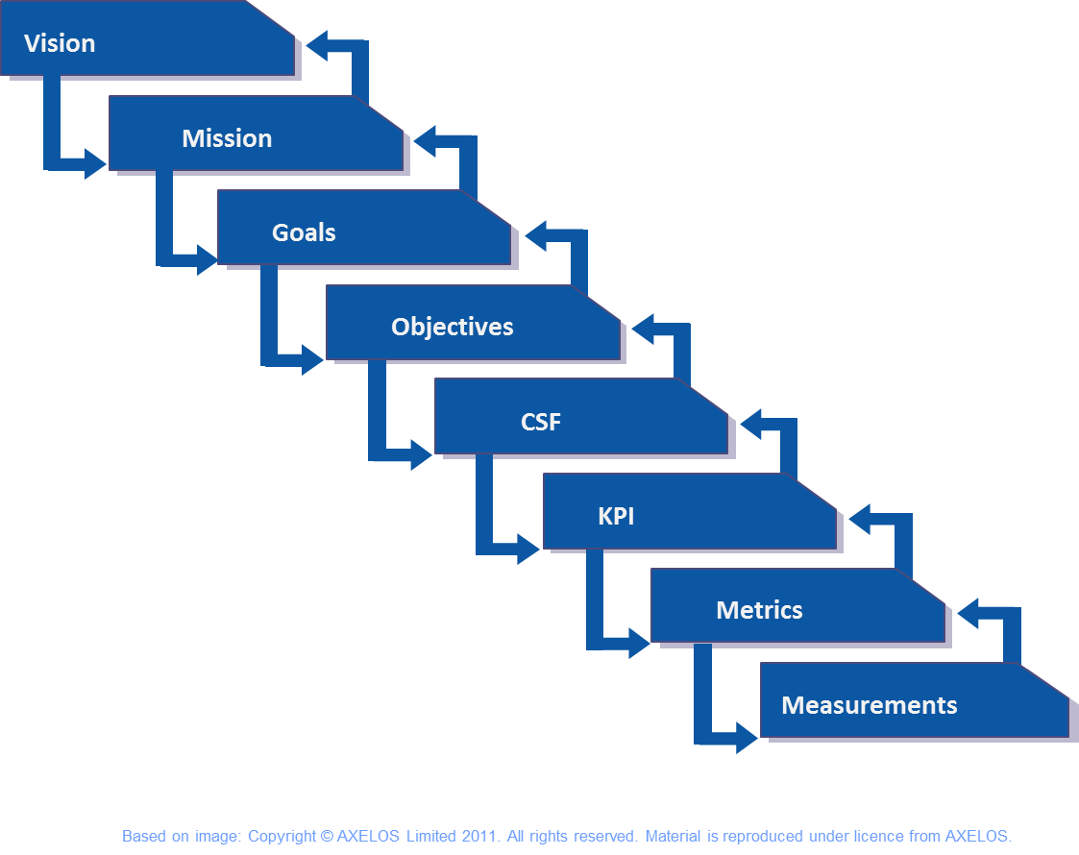

Aims and Objectives

Slide 13
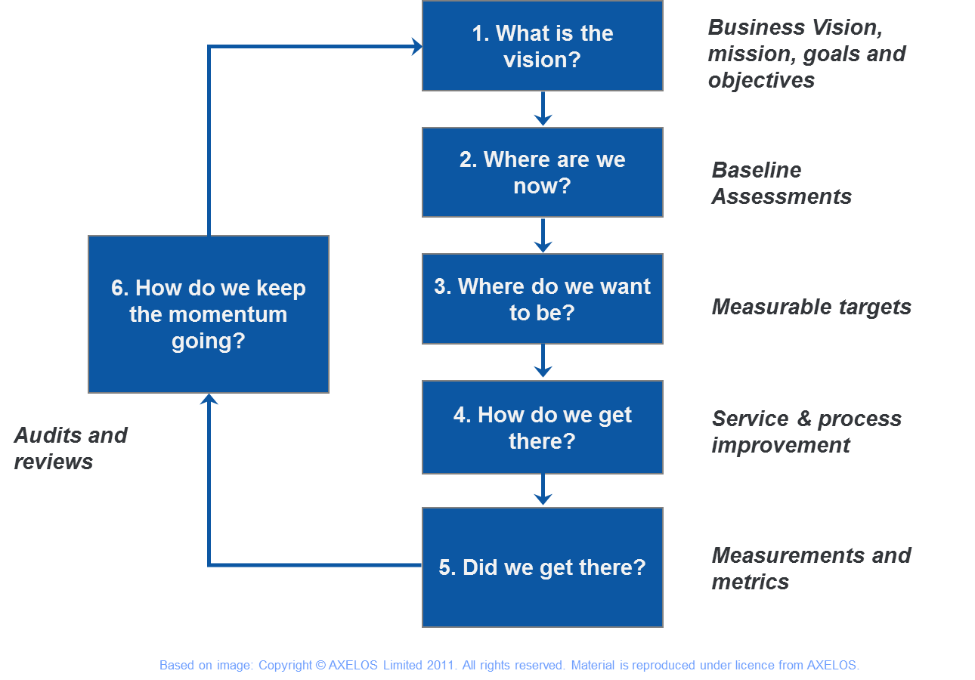
Approach

Slide 14
Approach

Slide 15
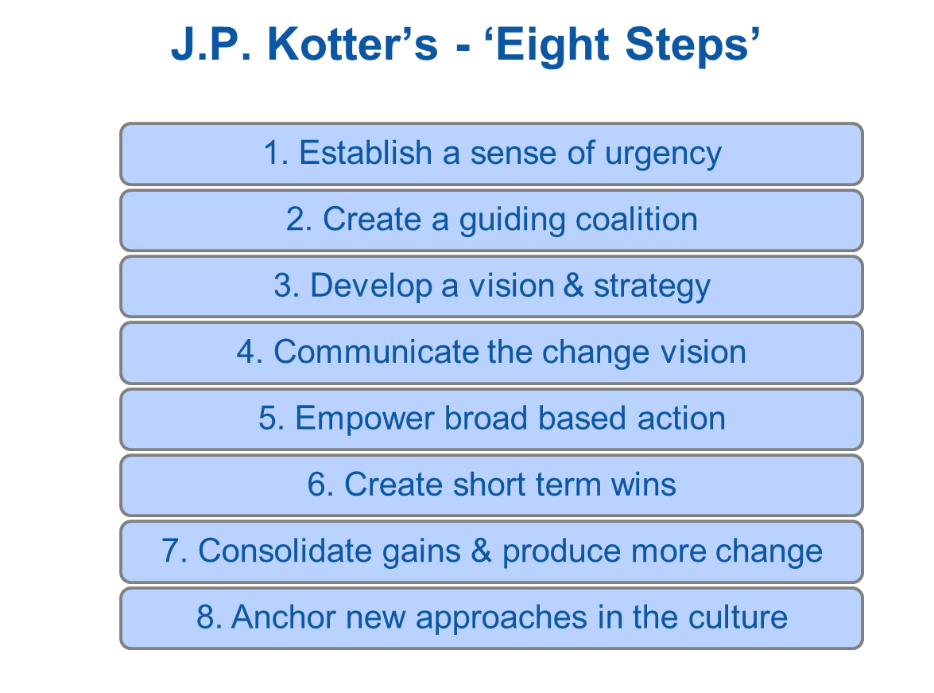
Approach
Based on image: Copyright © AXELOS Limited 2011. All rights reserved. Material is reproduced under licence from AXELOS.

Slide 16
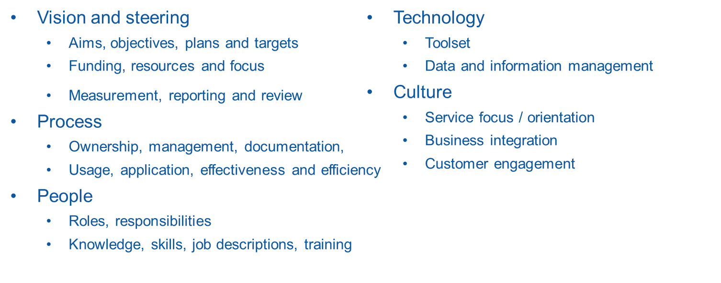
Approach

Slide 17
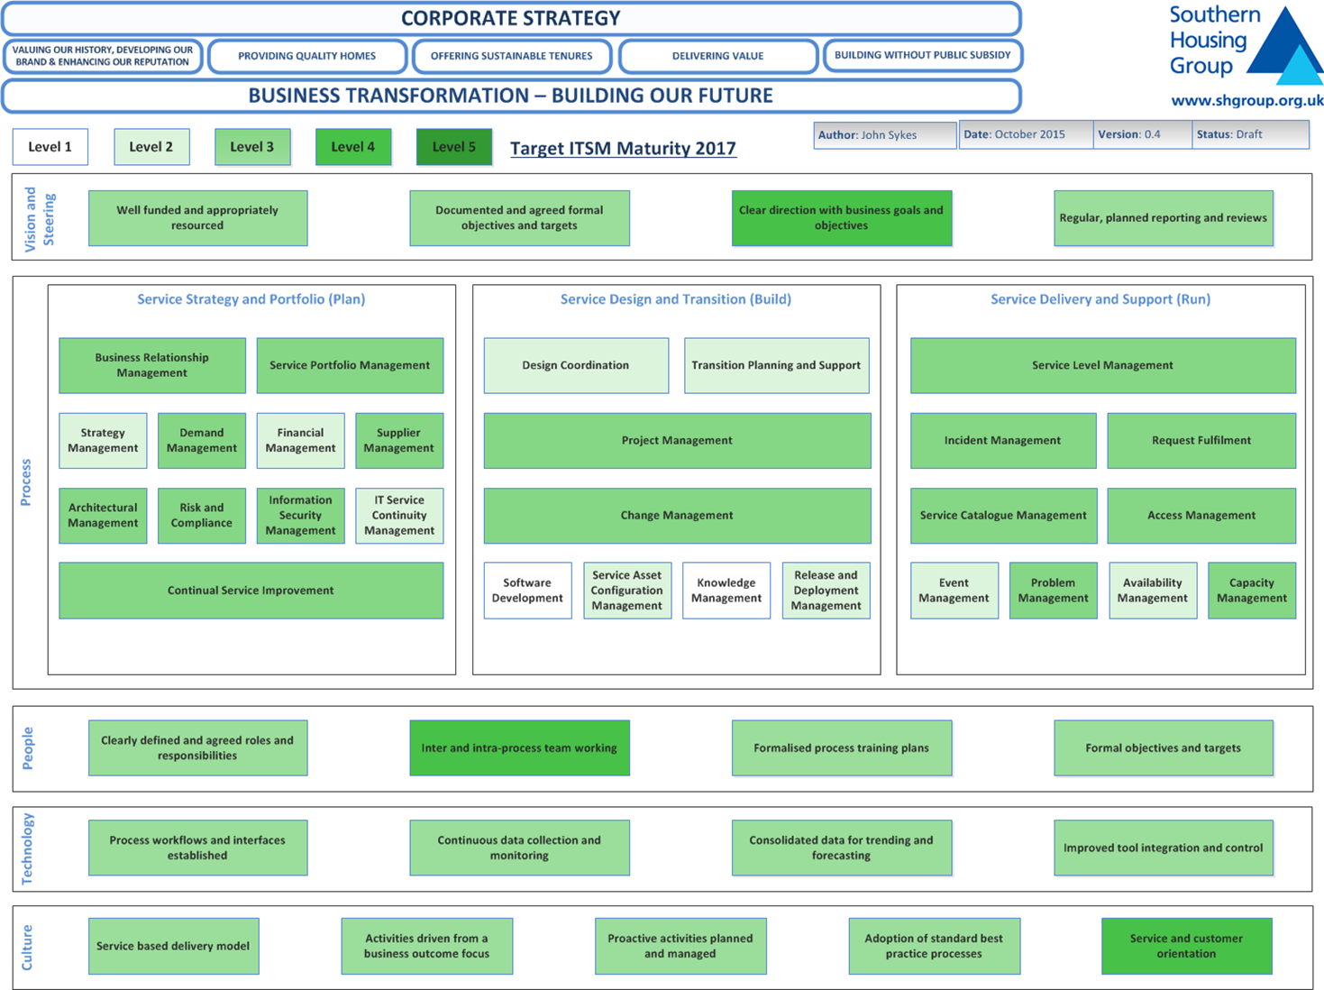
Approach

Slide 18
Key Focus Areas

Slide 19
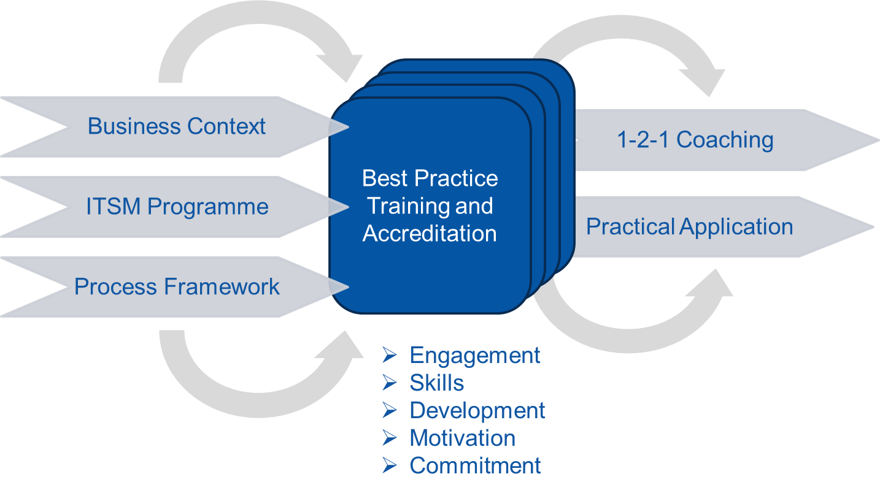
Key Focus Areas

Slide 20
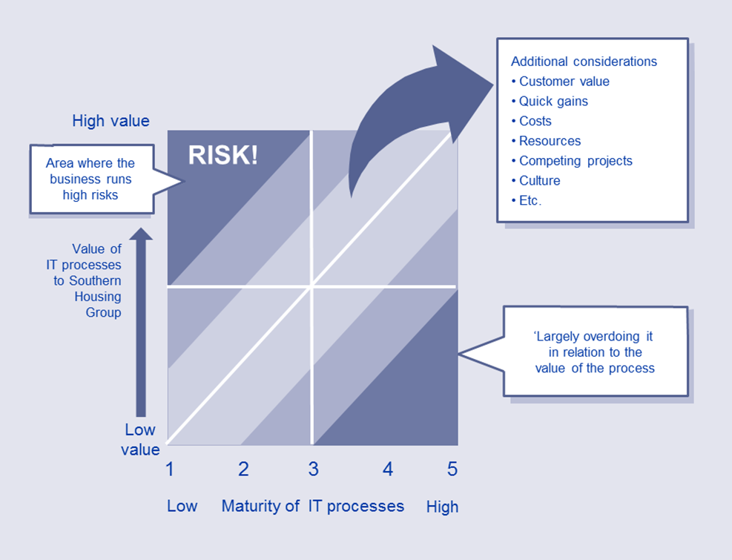
Key Focus Areas
Based on image: Copyright © AXELOS Limited 2011. All rights reserved. Material is reproduced under licence from AXELOS.

Slide 21
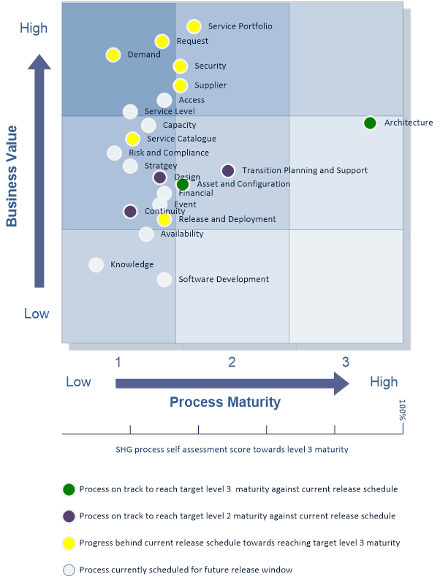
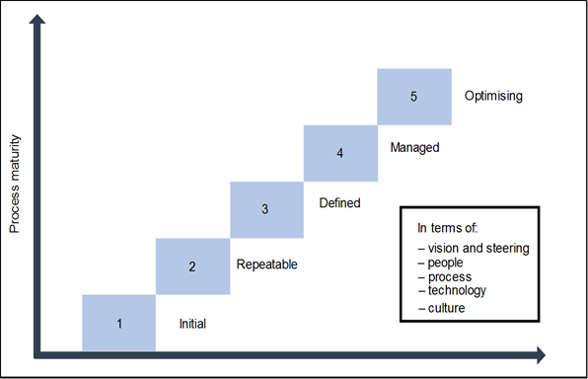
Key Focus Areas

Slide 22
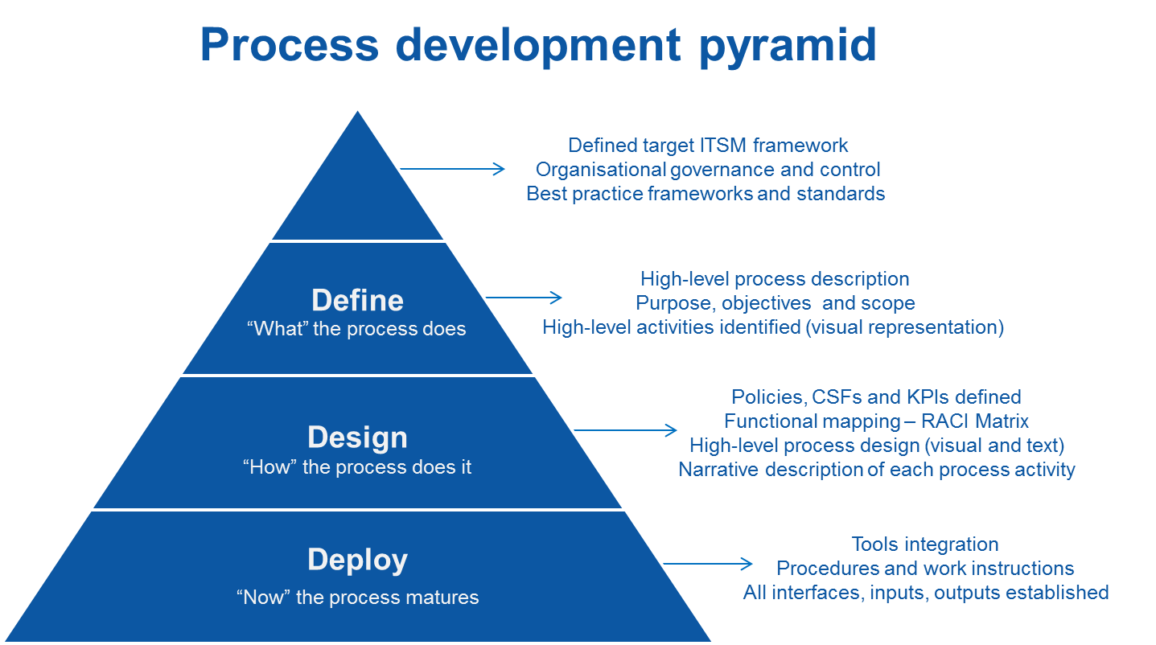
Key Focus Areas

Slide 23
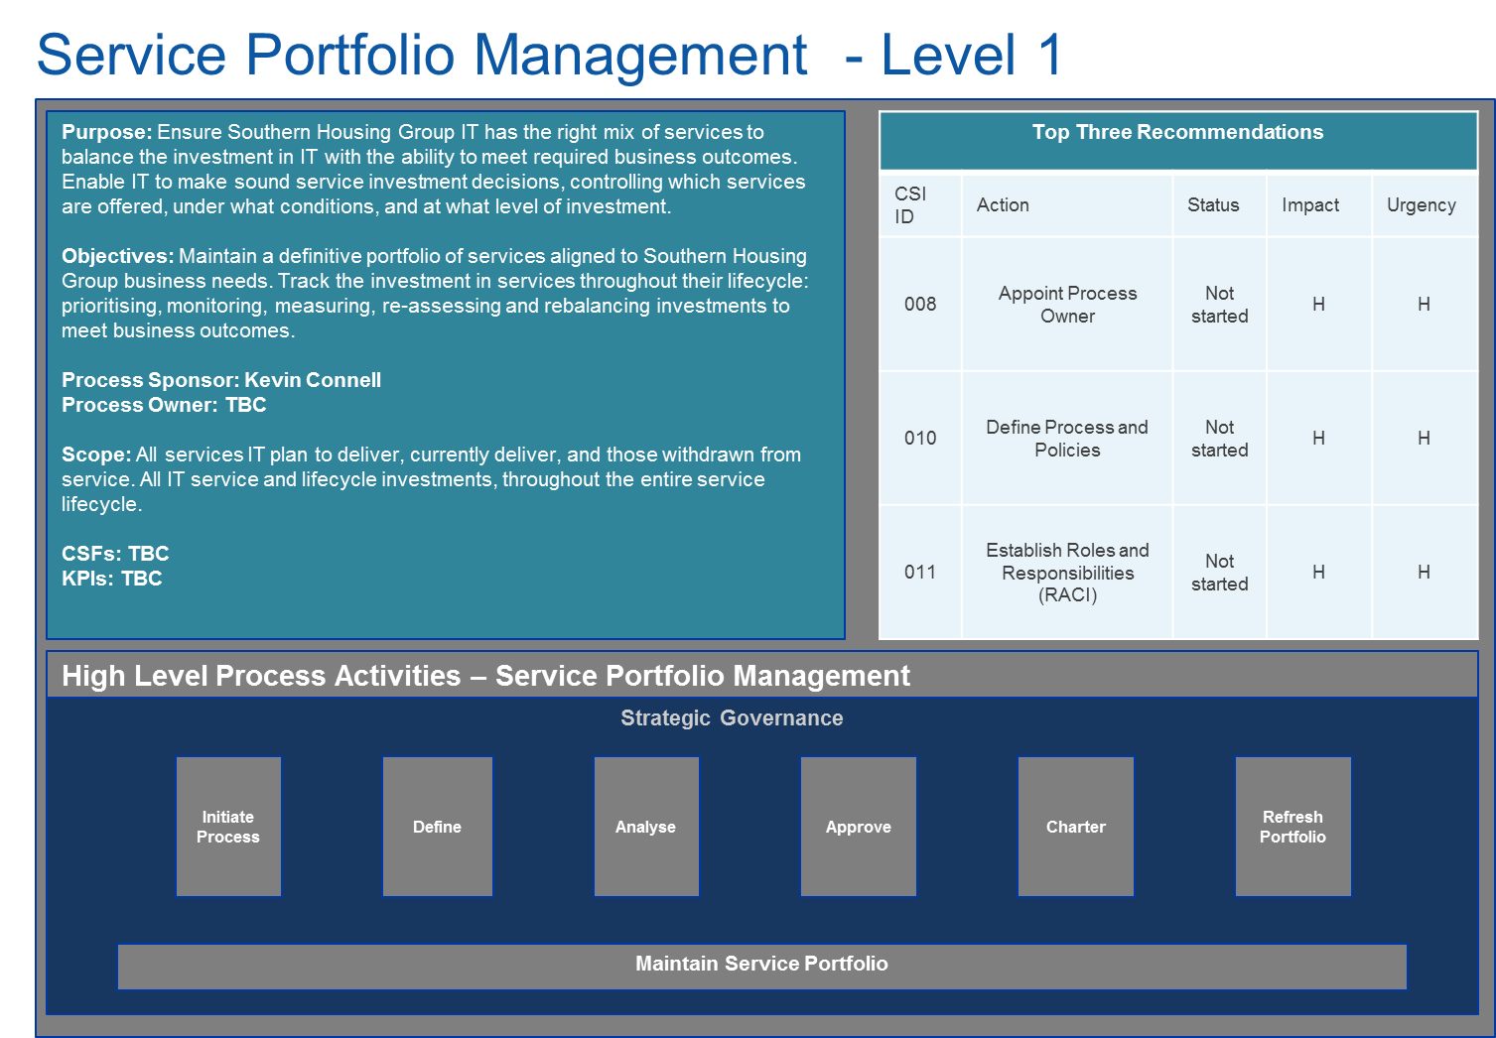
Key Focus Areas

Slide 24
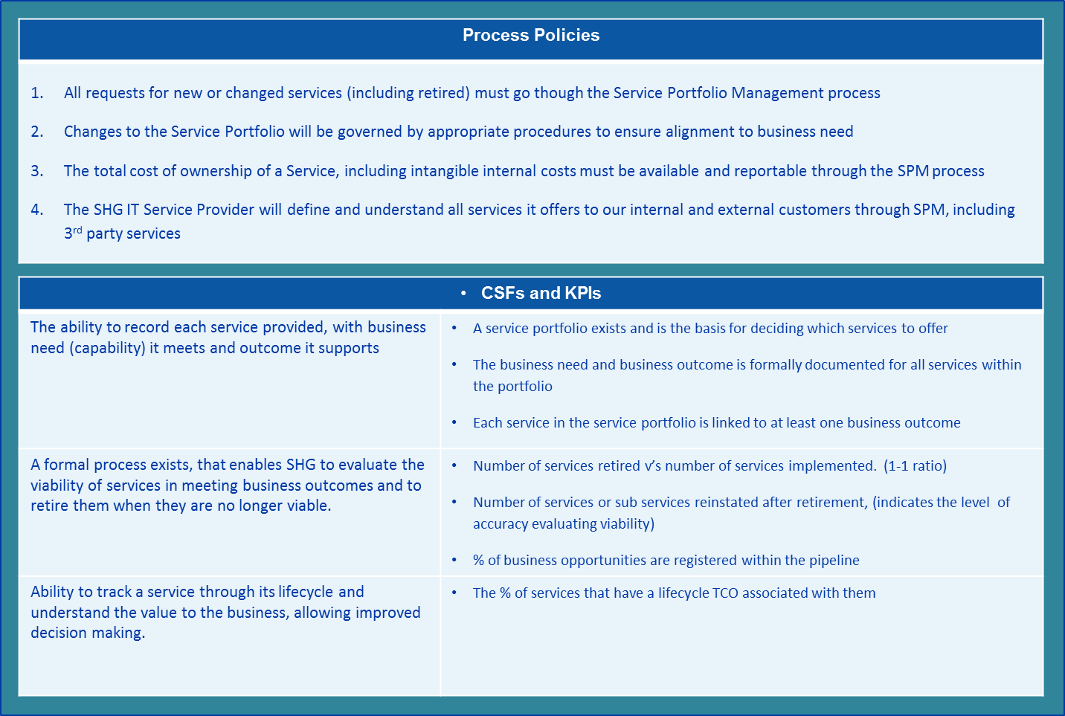
Key Focus Areas

Slide 25
Key Focus Areas

Slide 26
Key Focus Areas

Slide 27
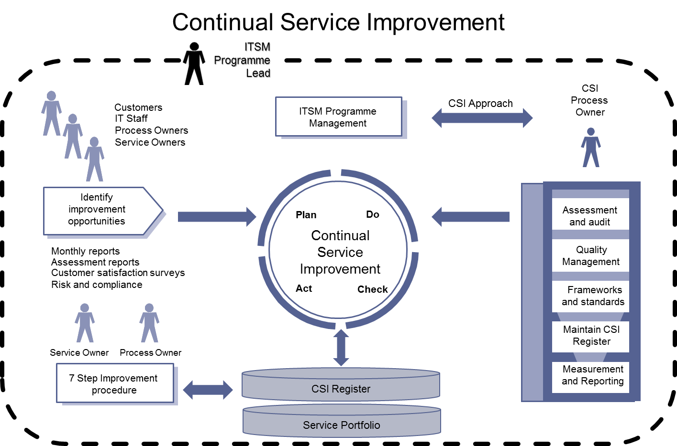
Key Focus Areas

Slide 28
Key Focus Areas

Slide 29
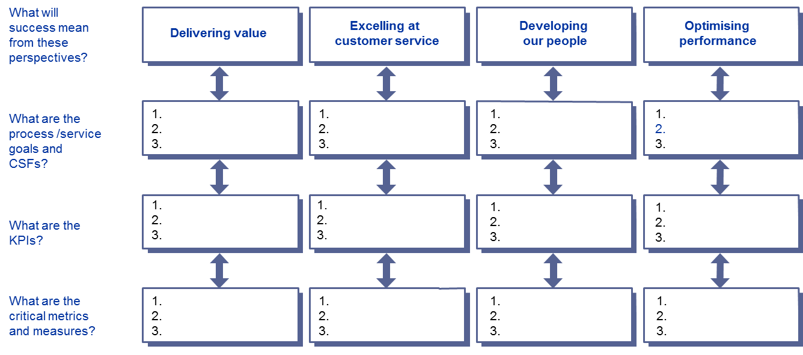
Key Focus Areas

Slide 30
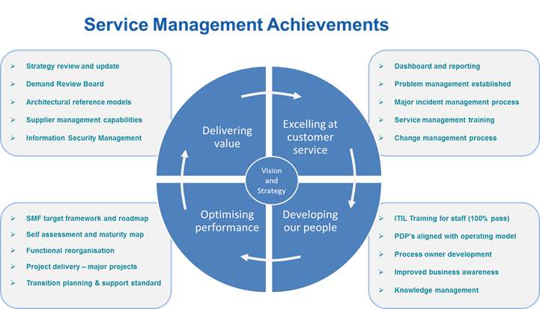
Cultural Change

Slide 31
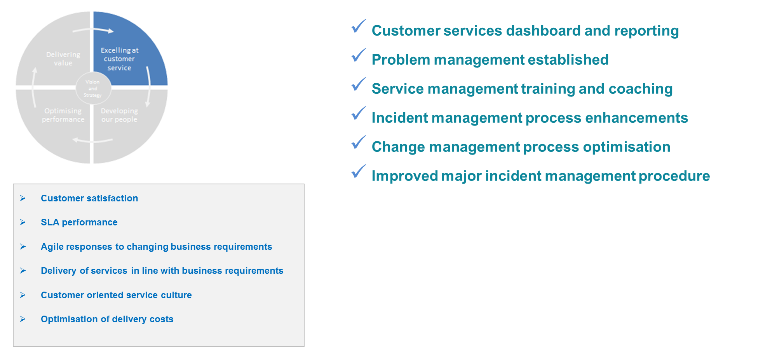
Cultural Change
Excelling at customer service- Achievements

Slide 32
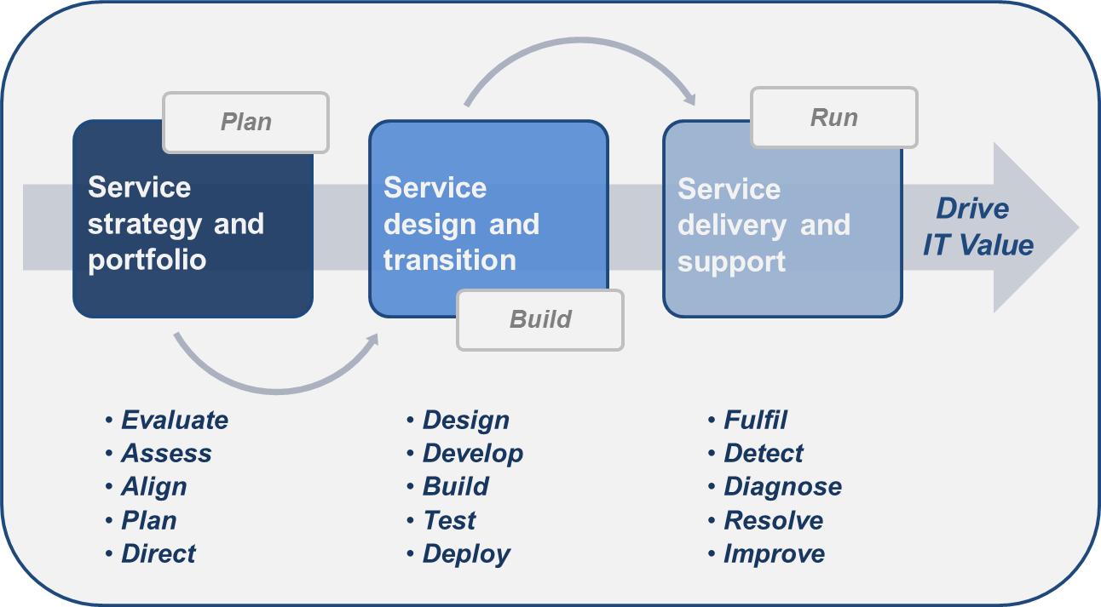
Cultural Change

Slide 33
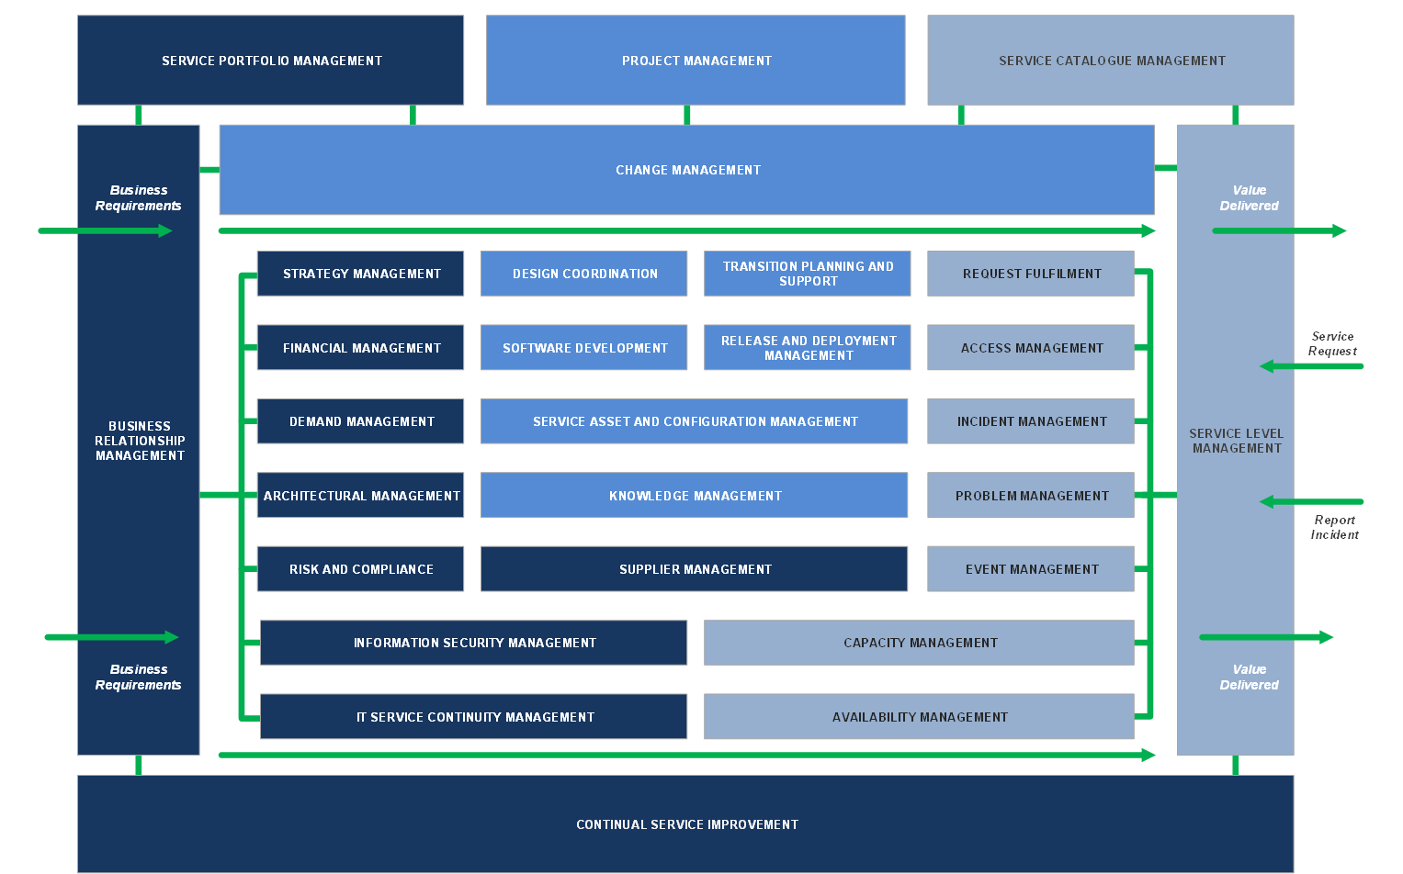
Cultural Change
Service Management Process Framework

Slide 34
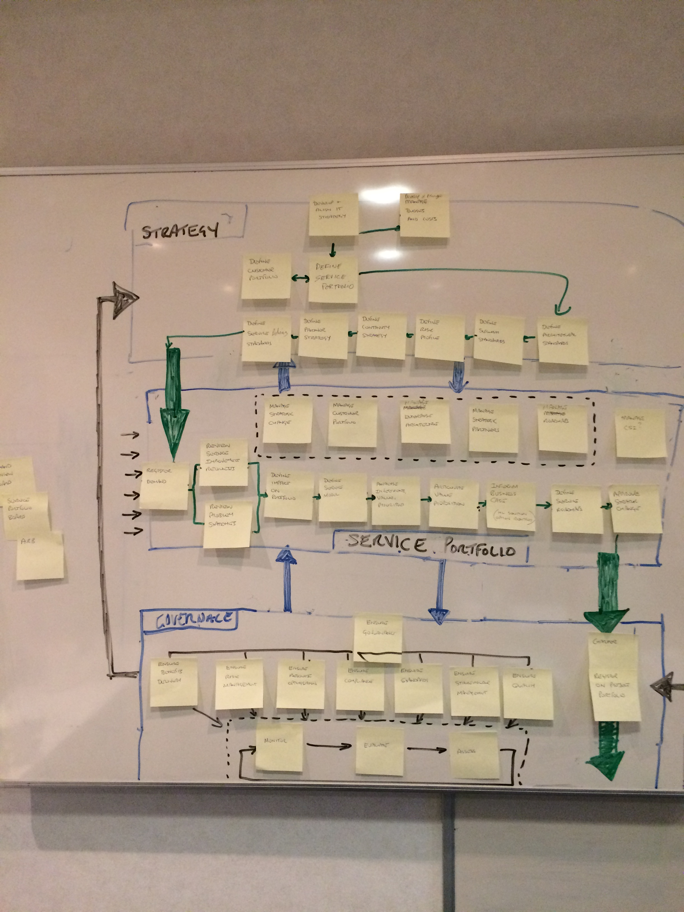
Cultural Change

Slide 35
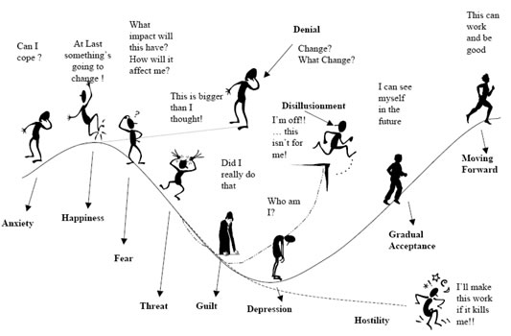
Cultural Change

Slide 36
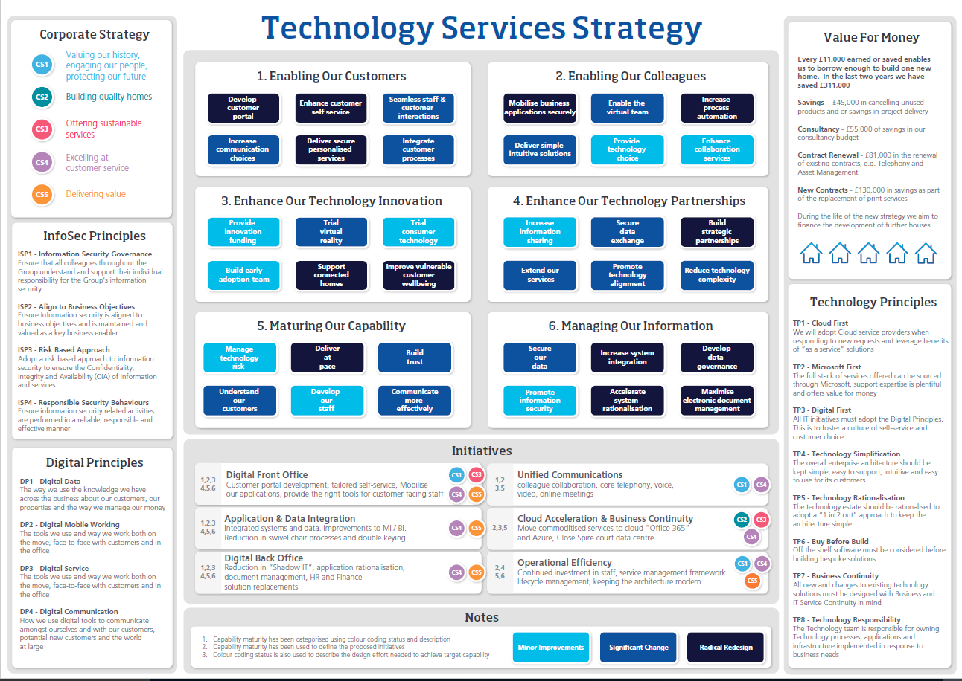
Cultural Change

Slide 37
Questions?

