Slide 1
Managing performance with voice analytics
Oxford Housing Technology Conference 8 - 9 March 2017
Maureen Adams,
Director of Customer Services and Operations
Lee Hayward
Asst Director, Customer Services

Slide 2
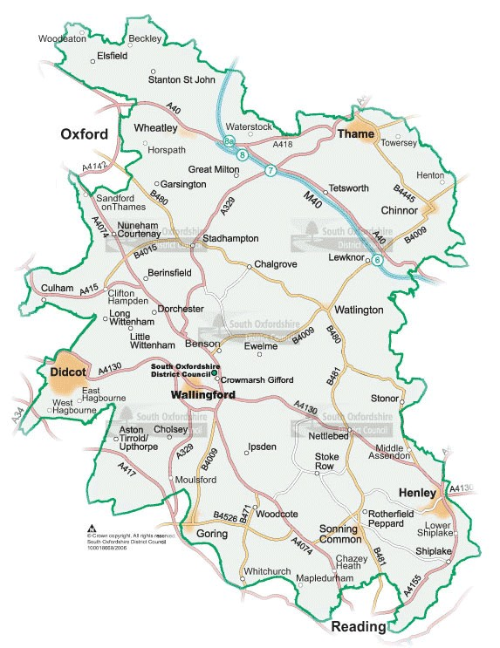
6,500 properties circa South Oxfordshire
Developed 278 homes 15/16
V1 and G1
Co–regulation USP

Slide 3
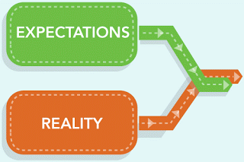

Slide 4
Voice Analytics - AudioFinder
A speech engine converting 35,000 calls into data
Indexing – to make the speech searchable
Query and search any issue, any time – appts, lettings, ASB, welfare reform
Real time tenant insight and feedback
Searches thousands of calls in seconds by key phrases, timings, call duration
Tracks trends and performance
Moves problems upstream

Slide 5
Getting the best from the system
Calls loaded overnight
Searches – new or pre-set with customer phrase
Pinpoint phrase within a longer call
Source immediate best % fit
Tag calls

Slide 6
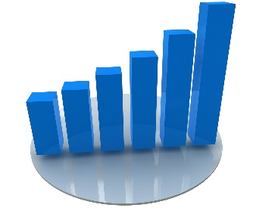
Long Term Improvements
Contract Management
Customer
Touchpoints
ss
Coaching
Voice Analytics – how it has been used?

Slide 7
Nexidia Interaction Analytics
Unbounded Search
Unlimited categories, unlimited reprocessing
Neural phonetic speech engine improves accuracy
MultiChannel
Combined text and speech business apps
True integrated speech and text, including social media
Improved Scale
Search Grid is expandable and distributable. Supports 110,000 hours of audio per day per server
Supports 100% transcription
Workflow
Easy drag and drop workflow for review and remediation
Supports Quality, Compliance, Complaint management
Managed
Analytic Services
MAST ensures customers are successful over time. Outcomes-driven for business insights
Hosting
Private cloud that is fully PCI-compliant for data privacy and protection
Fast Language
Model Creation
Build Language Model using machine learning against a wide variety of textual sources (vs. transcribing audio)
Very fast to develop and comprehensive
Complete Customer Sentiment Analysis
Sentiment model uses words and phrases, pitch, tone, cross-talk, laughter
Low Total Cost
of Ownership
Efficiencies in neural processing provide a greatly reduced hardware footprint
ROBUST ENTERPRISE REPORTING
Fully embedded Multi-dimensional analysis, correlation reporting, OOTB templates, user-defined reports,
customer dashboards, online visual rescaling, multichannel

Slide 8
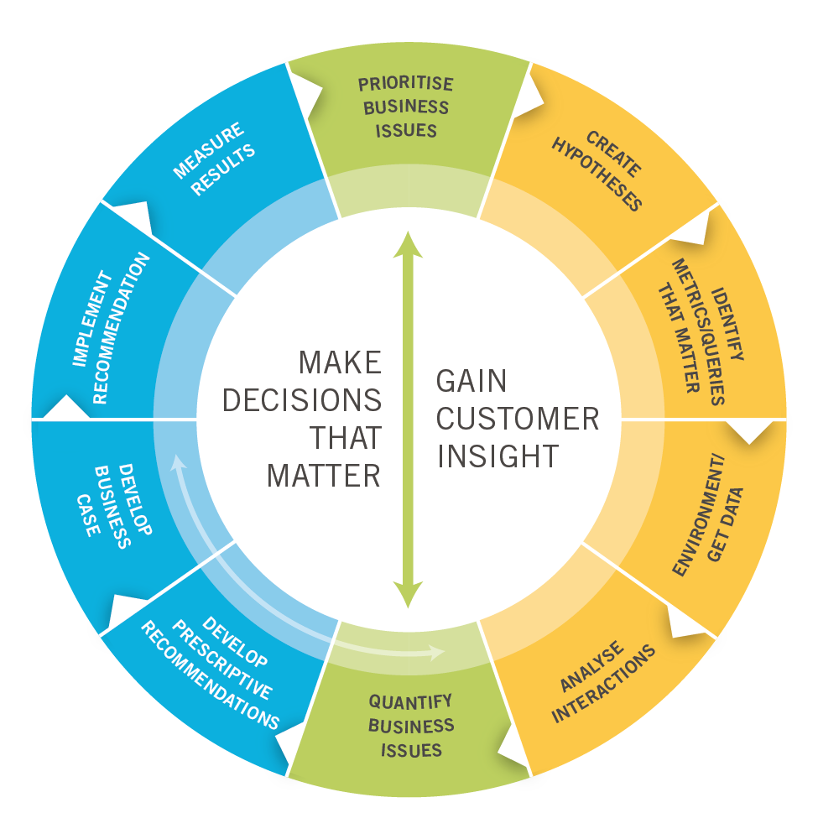
The Process of Transformational Change
Best Practices
Start with a business objective and question
Connect issues with data – and make recommendations based on the data
Know your options for action plans that can operationalise your findings
Make changes (regardless of size) – every win counts!
Spend time and energy to measure results -fragmentary analysis disconnected from business priorities is a cost.

Slide 9










Customer Interaction Analytics for Business Transformation
outcomes for:
Sales Effectiveness
Churn/Retention
Cost Management
Compliance
Customer Satisfaction
        Convert your customer interactions into data
        Convert your data into insight
        Use the insight to deliver business outcomes

Slide 10
Repairs and Maintenance
10,000 calls p/m initaially
18,000 repairs per year
350 empty homes
350 disabled adaptations
320 Grounds maintenance sites
Cleaning at 240 sites

Slide 11






You’re collecting all this customer interaction data…
So how can you benefit from it?

Slide 12
Voice analytics - The Functionality
Root cause analysis: understanding the reason for the call
Trend analysis: Identifying volume trends of calls
Emotion detection: recognising callers’ emotions
Talk analysis: understanding talk periods, silences, holds, talking over and call duration
Script adherence
Quality assurance

Slide 13
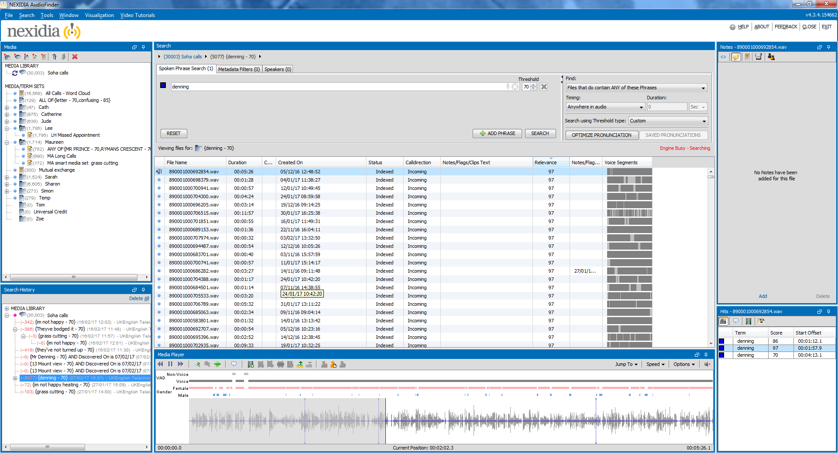

Slide 15
Added value
Improving:
First call resolution, reduces call volume and average handling times
Quality monitoring
The customer experience
Reduce customer attrition
Reduce operating expenses

Slide 16
Summary
Focus on business issues and outcomes
Insight without action is just information
Incremental improvements
Maintain momentum and deliver results
Just Do It - start with a pilot, then expand

Slide 17
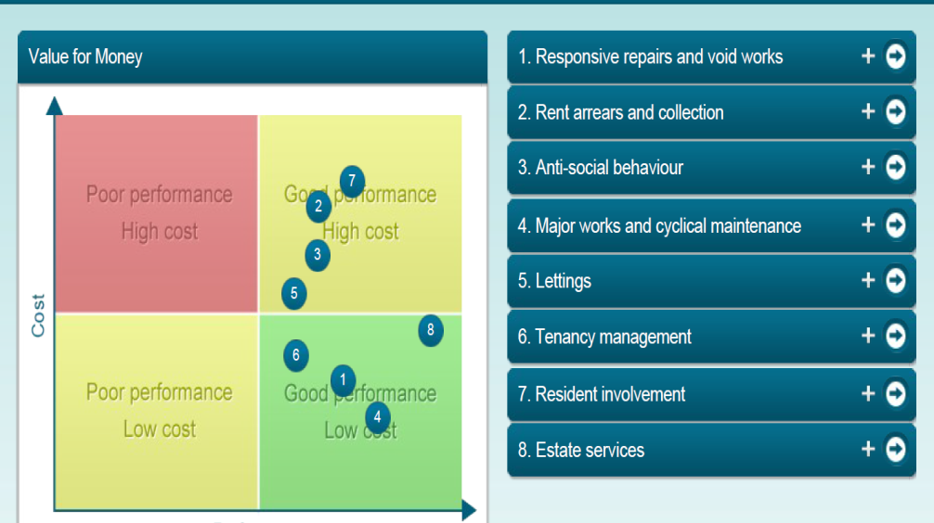
Outcomes
Housemark 2015/16
Formal complaints
 | Soha complaints | Repair complaints
2013-14 | 111 | 61
2014-15 | 60 | 23
2015-16 | 65 | 22
16-17 YTD | 43 | 16
Phone calls into Soha
Customer calls | 2015 calls YTD | 2016 calls YTD
Nov | 70,227 | 65,060
Dec | 76,051 | 70,674

Slide 18
madams@soha.co.uk
lhayward@soha.co.uk
www.soha.co.uk
01235 515900

