Slide 1
The benefits of an enterprise GIS
Housing Technology
9th March 2017

Slide 2
Overview
Sovereign Housing overview
Our GIS journey
Benefits, use cases and demonstrations
Operational
Strategic

Slide 3
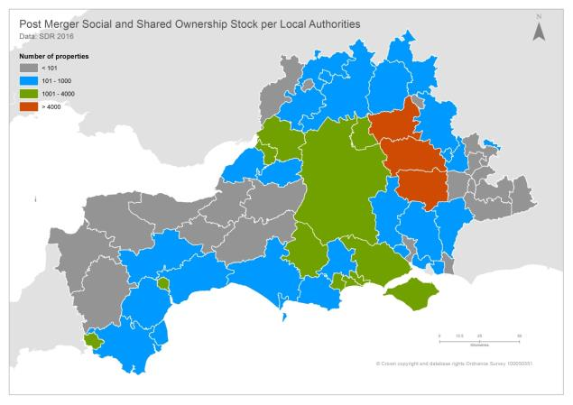
Sovereign Housing Association
New Sovereign, 5th Largest Housing Association
Around 56,000 homes
Over 130,000 residents
Over 2,000 staff

Slide 4
GIS Journey
2013
Handful of desktop GIS users
2014
2015
Web GIS
2016
80 users per day
Very basic system
Enterprise Web GIS SEMS 1
SEMS 2
30 -> 100 users
Land, Property & Grounds Maintenance
Tenancy data & detailed property attributes
250 users per week
Created a GIS Vision & Strategy
GIS Analysis
Focus on data capture
Beta Web GIS
Build confidence in GIS across the organisation
500 users trained
GIS became a core business system
Analysis tools for the organisation
2017
Strategic Decision Tool
SEMS 2.1
Supporting the merger of Sovereign and Spectrum
SEMS 3
Mobile & New HMS

Slide 5
What is SEMS? - Video

Slide 6
What is SEMS?
Browser
Desktop
Device
Apps
Access / Identity Manage Content
Data Storage
Services
Content
. . . delivering web GIS
Server
Online/Cloud
Open systems

Slide 7
Benefits, use cases and demonstrations of an enterprise GIS - Operational

Slide 8
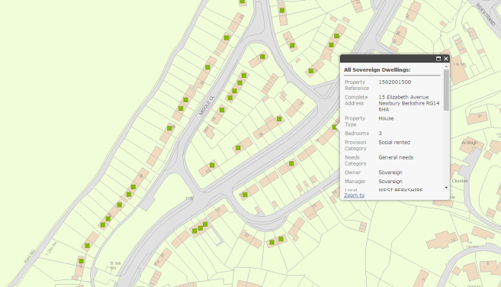
Properties
56,000 homes
7,000 garages
Mapped to sub meter accuracy

Slide 9
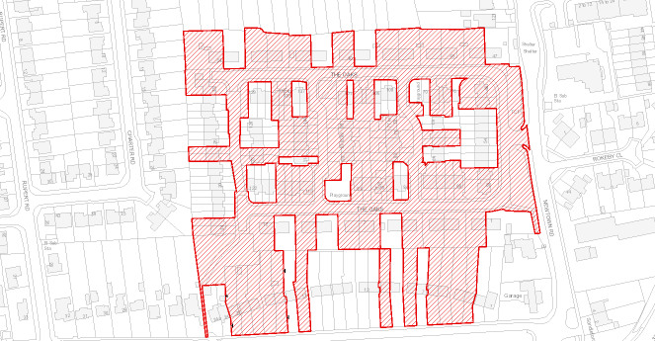
Land Ownership
10,404 titles of land
17,204 polygons of data
Quarterly updates from land registry

Slide 10
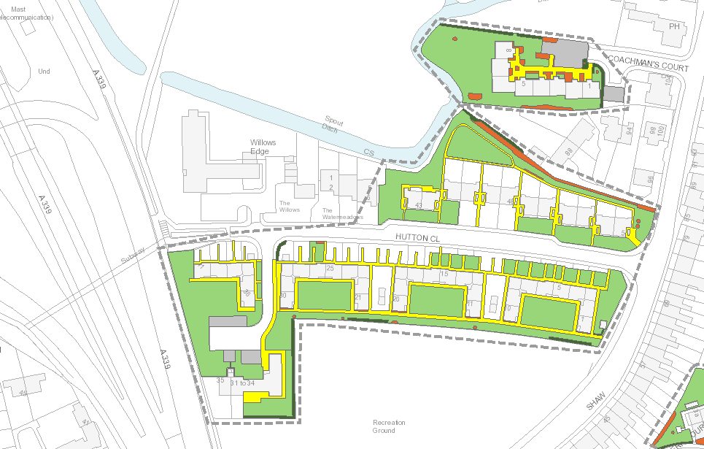
Grounds Maintenance Contract
£1.3m + grounds maintenance contract
28,505 contract polygons
1,359 sites
*pre merger

Slide 11
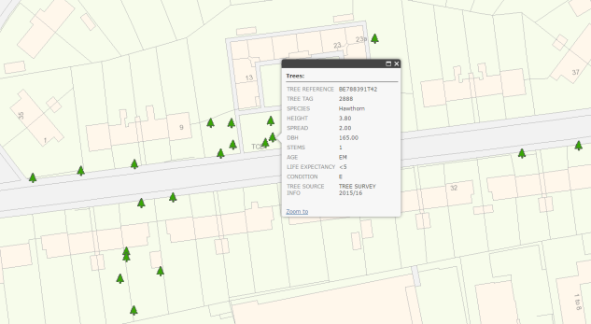
Tree Survey
14,801 individual trees & 1,713 tree groups
Drawn to sub meter accuracy
Working with 3rd Party surveyors
Used GIS to plan the survey

Slide 12
Tenancies & Residents
56,000 tenancies
120,000 residents
Daily extracts via SQL*

Slide 13
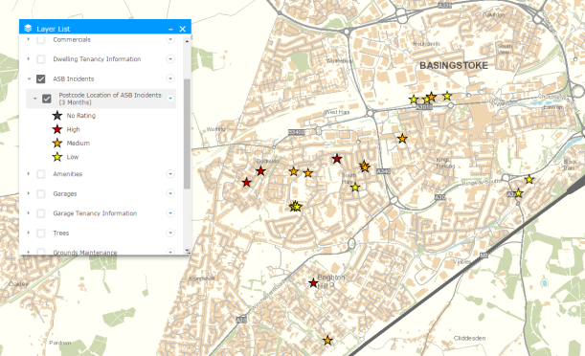
ASB
Daily extracts of ASB data for in house system
Monthly extracts of police data

Slide 14
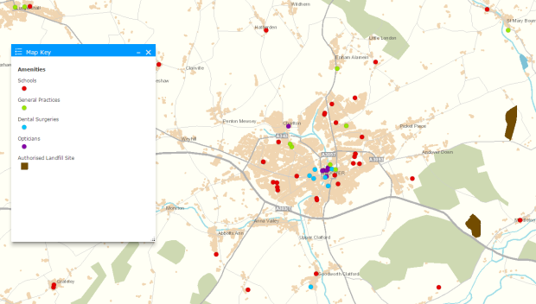
Amenities
Schools
GP Surgeries
Dentists
Opticians

Slide 15
External Datasets

Slide 16
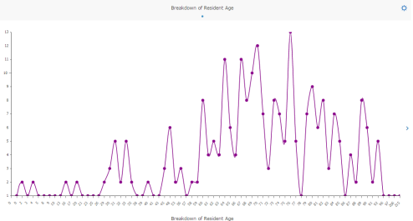
Analysis - not just viewing
SEMS users can
Interact with the data
Identify patterns and trends
Export maps and some data
Advanced users can
Record own GIS data

Slide 17
Demo

Slide 18
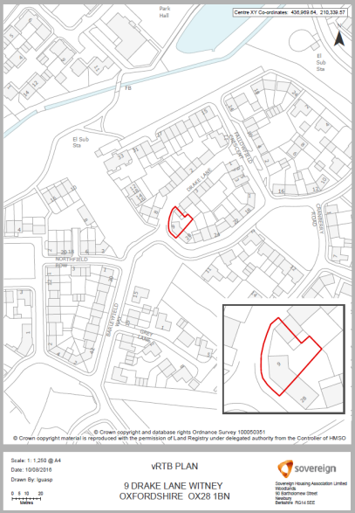
Plan Production
Maps for Legal conveyancing
Voluntary Right to Buy
Maps for Court cases
Site Plans
Insurance Claims

Slide 19
Flood Mapping
Severe flooding in Basingstoke, 2014

Slide 20
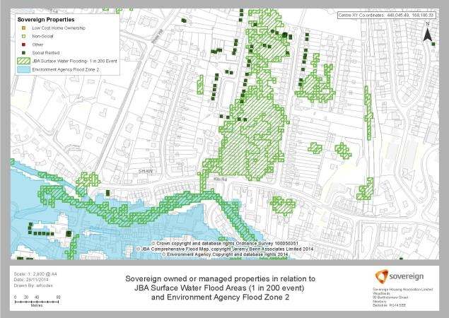
Flood Mapping

Slide 21
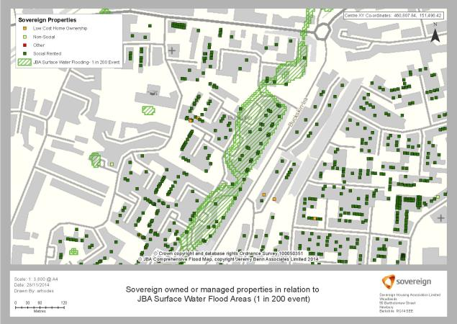
Flood Mapping

Slide 22
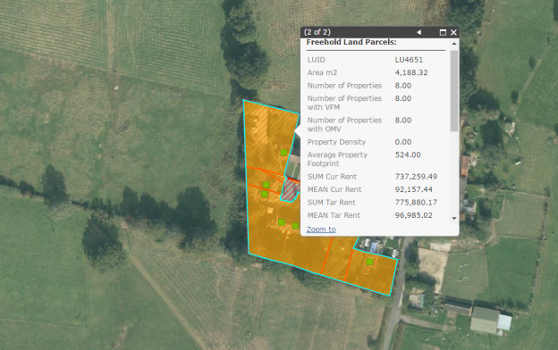
Land Utilisation
Identifying assets for redevelopment
Data driven approach

Slide 23
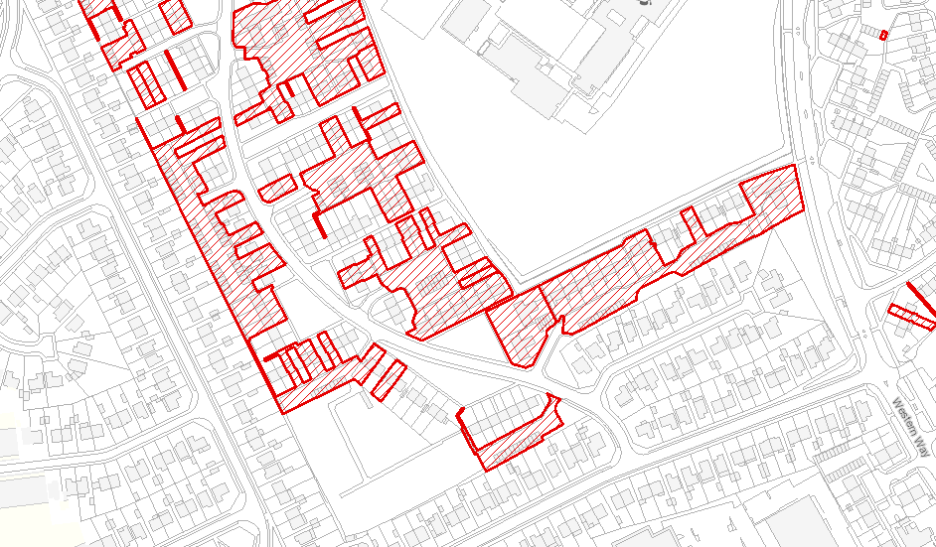
Local Authority Relationships

Slide 24
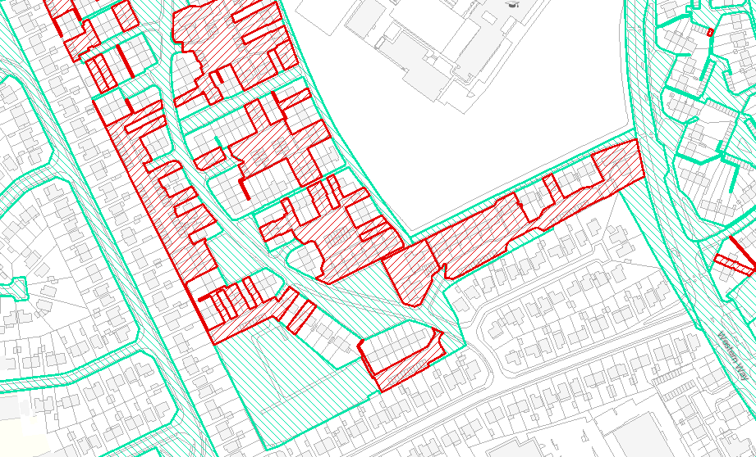
Local Authority Relationships

Slide 25
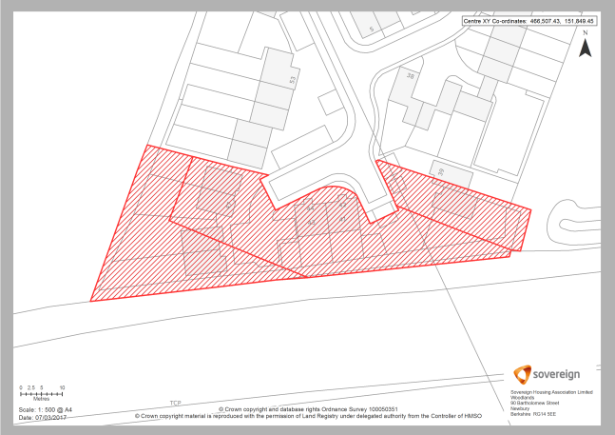
Assets and Liabilities
Checking land that isn't correctly registered

Slide 26
Can we map anything?
Case Study (from a few weeks ago)
Head of Customer Experience:
We discussed mapping our complaints at some points today and I’d like to ask if it was something we could pick up please?
The driver is to demonstrate that we’re getting high levels of complaints from specific areas on specific issues – really I’m interested in mould in Basingstoke.
It’d be really helpful for me to demonstrate the reputational risk in this area, but also for property and development to consider their response

Slide 27
Demo
Complaint mapping demo

Slide 28
Benefits – Operational
Better management of land assets
£19,600 per annum in GM contract
25 potential development / redevelopment sites
Assets and liabilities register
Better understand of our customers
Direct cost savings & income generation
£207,000 income from pylons
£187,000 mobile mast contracts
Efficiency savings through efficient use of staff time
80 + staff per day, 250 + per week
Less reliance on local knowledge
Supports agile working practices
Ideal for central services
Great for new starters
Notes:
How much time do we save using SEMS? Who knows? Its certainly very significant, we count all the minutes its being used by people and it’s currently at the equivalent of 2 people full time using SEMS 37 hours a week

Slide 29
Benefits, use cases and demonstrations of an enterprise GIS - Strategic

Slide 30
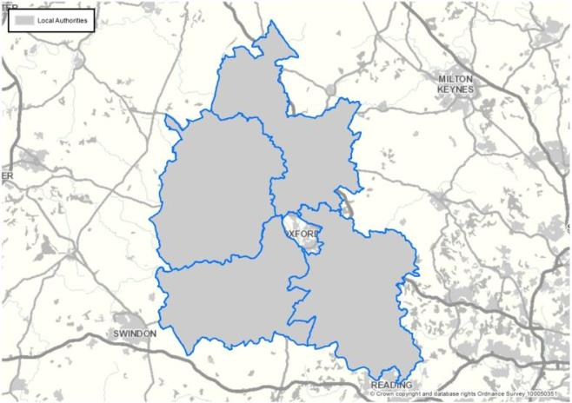
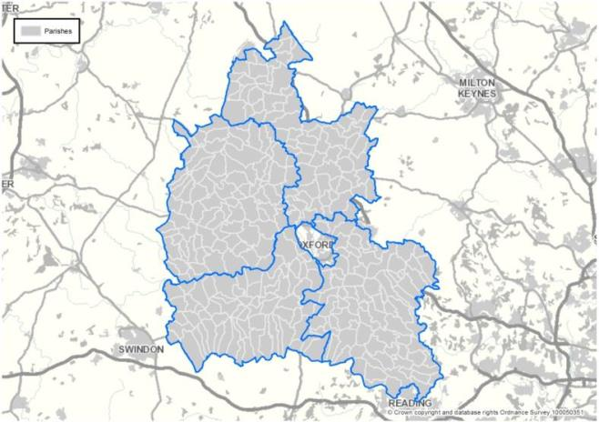
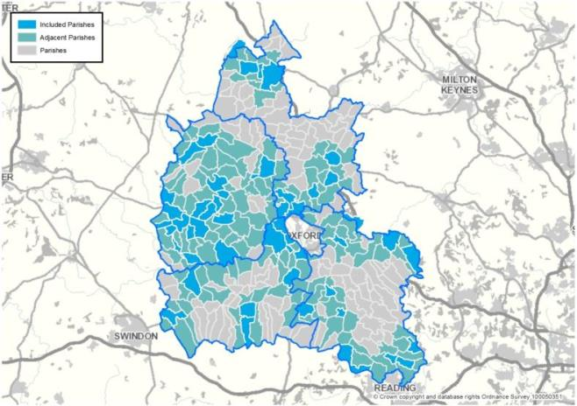
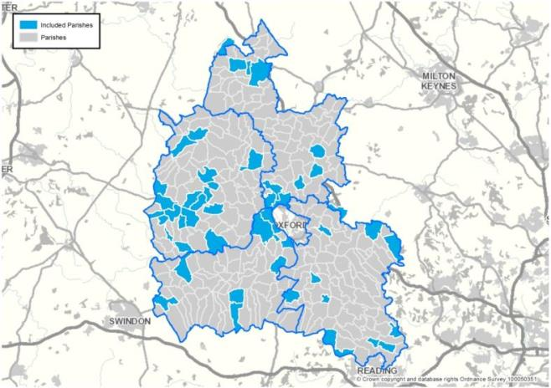
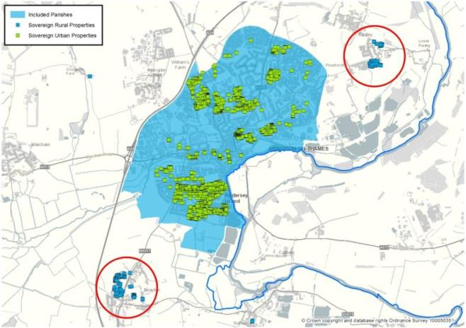
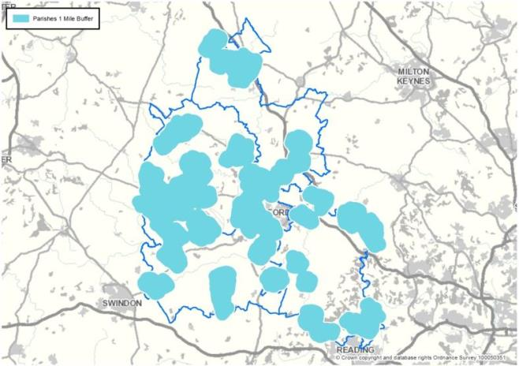
Voluntary Right to buy

Slide 31
Voluntary Right to buy

Slide 32
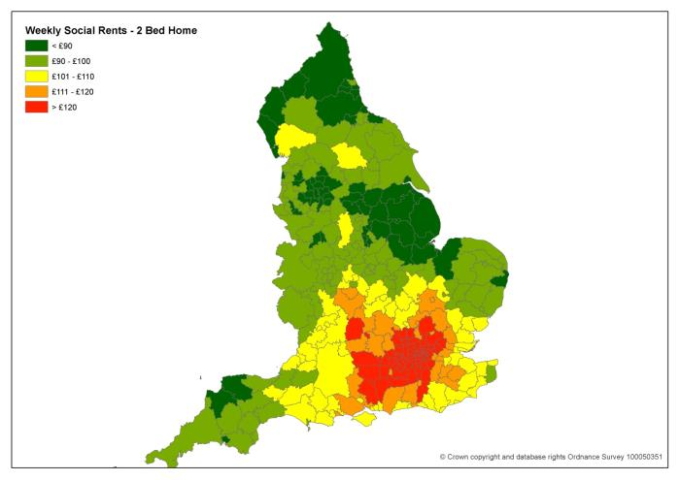
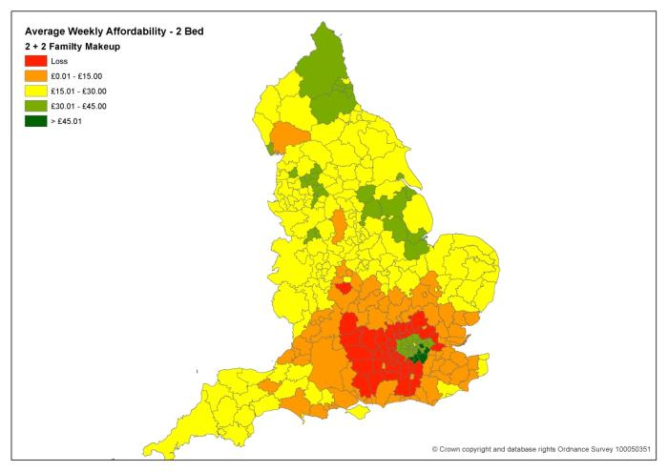
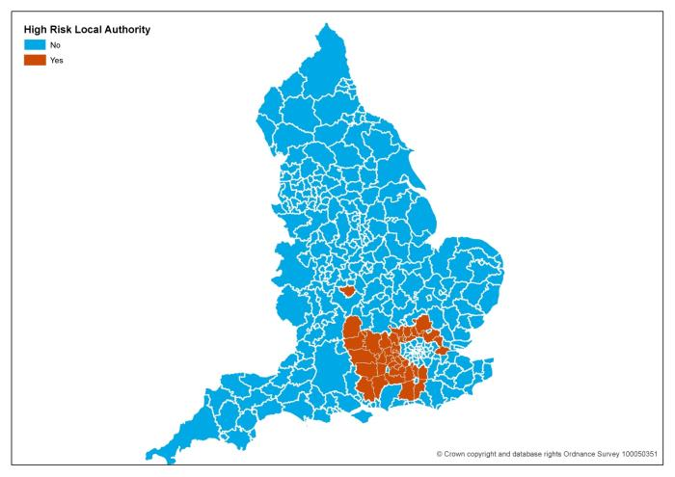
Benefit Cap
Benefit Cap Modelling

Slide 33
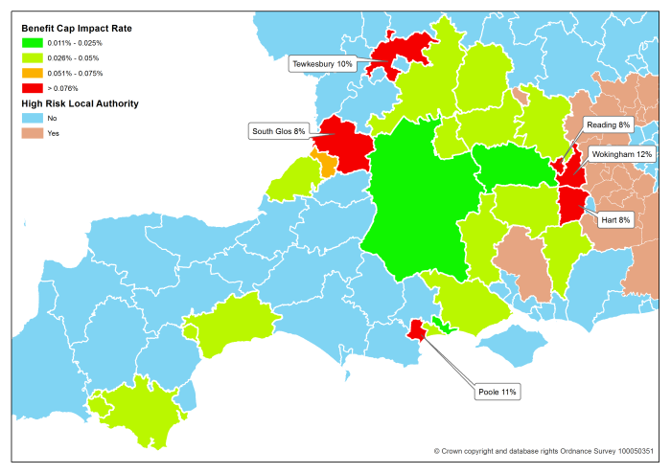
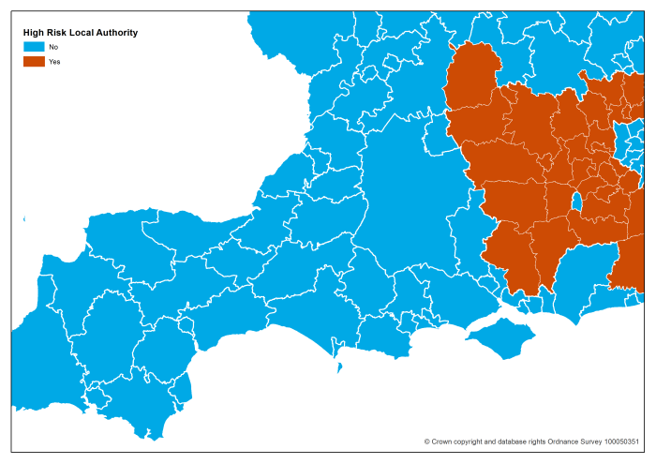
Benefit Cap
Benefit Cap Actual

Slide 34
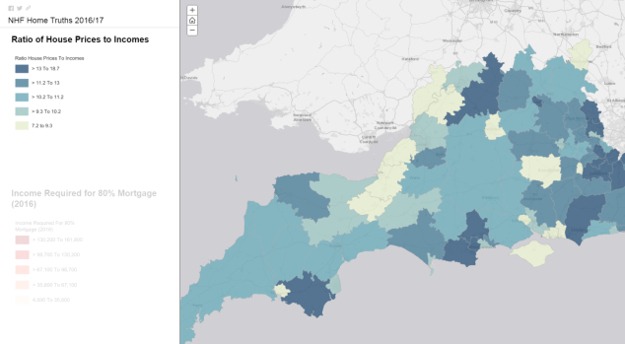
NHF ‘Home Truths’

Slide 35
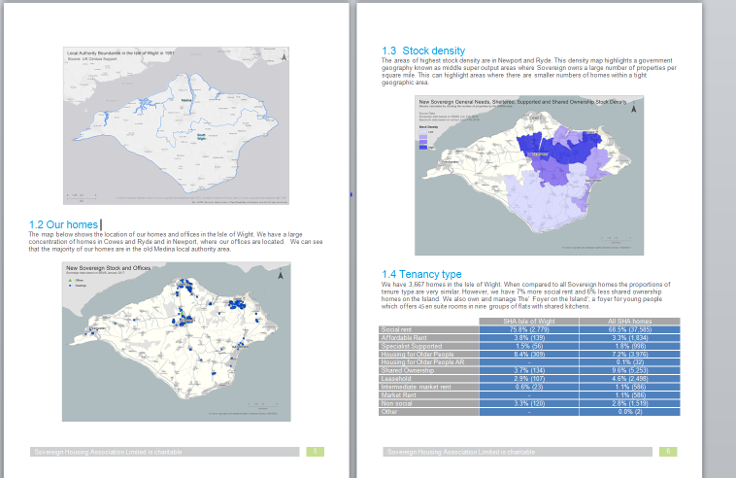
Local authority packs

Slide 36
Merger

Slide 37
Merger

Slide 38
Merger

Slide 39
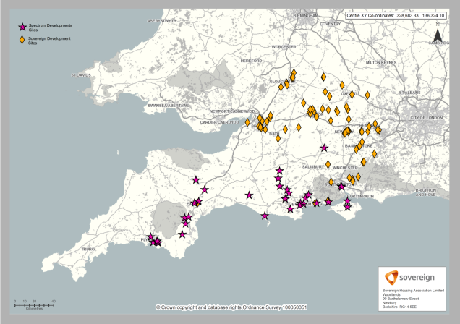
Merger
Supporting the planning phase

Slide 40
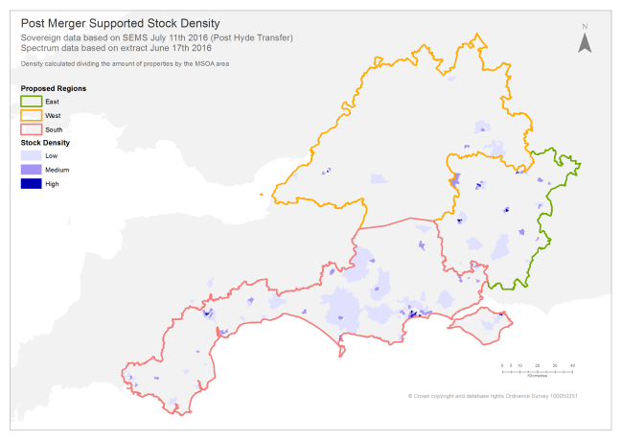
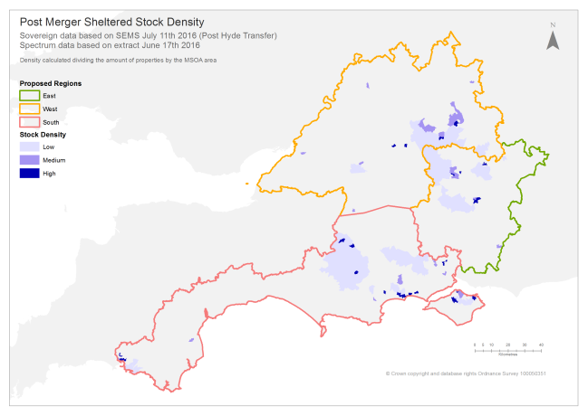
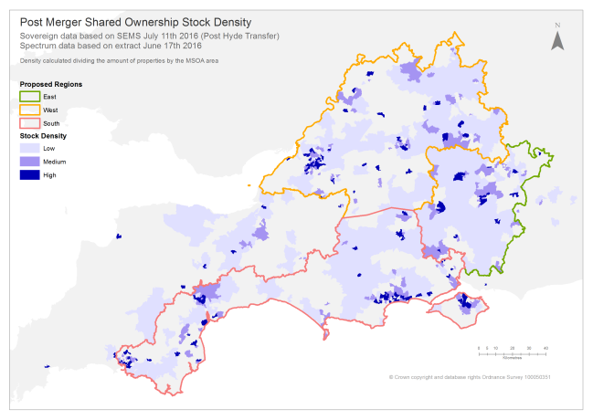
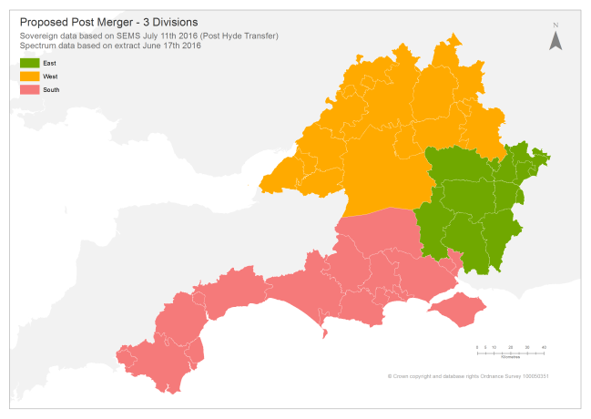
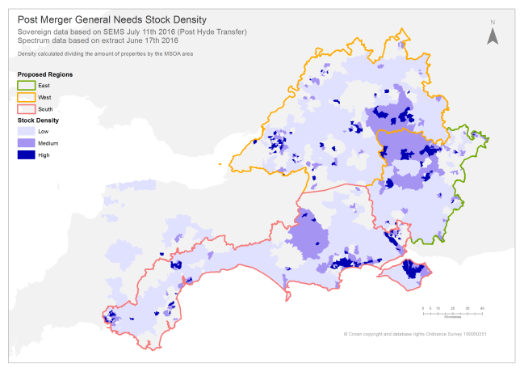
Merger
Supporting the planning phase

Slide 41
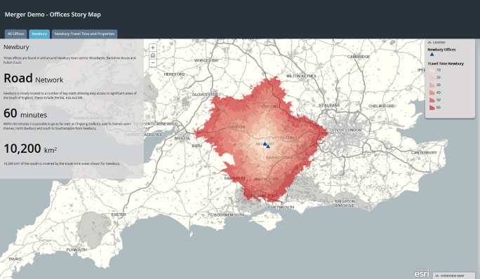
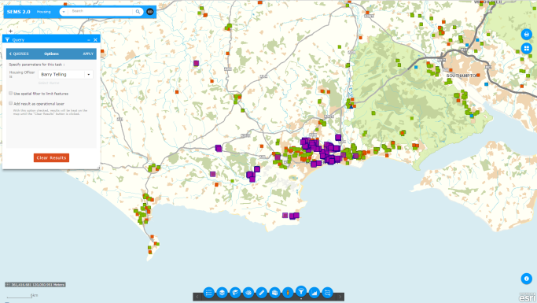
Merger
Supporting Day 1

Slide 42
Enterprise GIS is an enabler
“SEMS is a powerful tool that is valued by our frontline teams and supports them in delivering a great service to our residents, and increasingly it is supporting our strategic business planning and decision making”
Heather Bowman,
Chief Operating Officer

Slide 43
GI4Housing
LinkedIn group
Platform independent
6 monthly meetings
Discussion forum
Next meeting 27th April, Camden Lock, London

Slide 44
In Summary
Benefits of an enterprise GIS
It can save money & generate income
Better management of information
Efficient use of staff time & support better customer service
Reveal development & asset management opportunities
Enabler for strategic insight
Plan strategically for future growth

