Slide 1
Digital adventures at Viridian Housing: How innovation and an agile digital approach is helping to transform ways of delivering services
Ed Wallace, Research & Innovation Manager & Alice Granville, Research & Innovation Lead
Housing Technology Conference 2017
9 March 2017
www.viridianhousing.org.uk

Slide 2
IT’S NOT ABOUT IDEAS.
IT’S ABOUT MAKING IDEAS HAPPEN.
www.viridianhousing.org.uk

Slide 3

www.viridianhousing.org.uk

Slide 4
A dedicated resource…
Research & Innovation Manager
Research & Innovation Lead
(Quant Specialist)
Research & Innovation Lead
Research & Innovation Lead
Research & Innovation Lead
www.viridianhousing.org.uk

Slide 5
With a clear remit…
User Involvement – Involving customers to develop and inform our approach
Customer Insight
Embedding data driven approaches & the use of evidence & insight
Digital
Supporting channel shift, digital service delivery & transformation
  Service Improvement
  Improving existing services & developing new ones
Skills – Supporting others to adopt & use innovative approaches
www.viridianhousing.org.uk

Slide 6
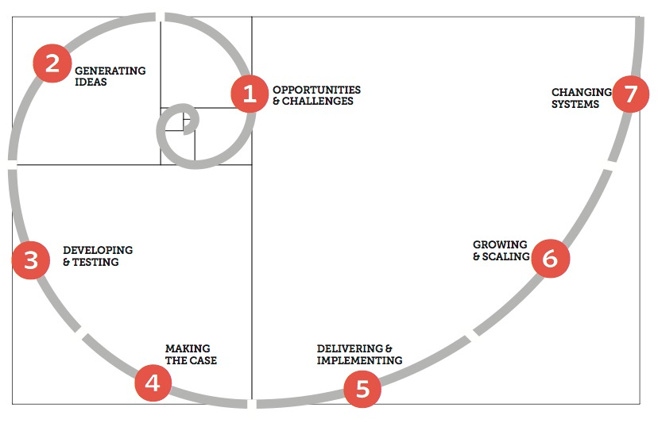
And clear way of working…
www.viridianhousing.org.uk

Slide 7

Creativity
Be bold & give creativity the space to flourish
www.viridianhousing.org.uk

Slide 8
We’ve tackled a lot…Digital Inclusion Community Development Data Ageing Arrears Welfare Reform Domestic Abuse Affordability Assessment Ageing Warm Homes Affordable Tuition Creative Play Mutual Exchanges Voids Shared Ownership Early Tenancy Support Internet of Things Customer Satisfaction Customer Segmentation Challenge Prize Digital First Living Rent Reinvestment…and our ambition has grown over time.
www.viridianhousing.org.uk

Slide 9
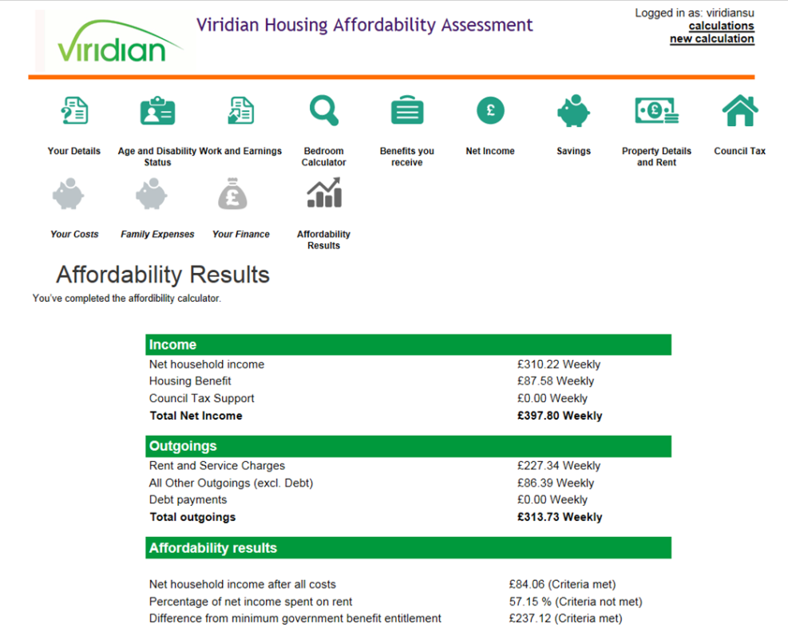
Viridian Affordability Assessment
Developed and tested internally with input from the wider business
Now used across all new Viridian tenancies and is a key part of lettings process
Since October 2013 over 1,600 assessments have been completed
Identified over £75,000 in additional benefits that could be claimed
Helps housing officers & tenants make more informed decisions – and widely used across the sector
www.viridianhousing.org.uk

Slide 10
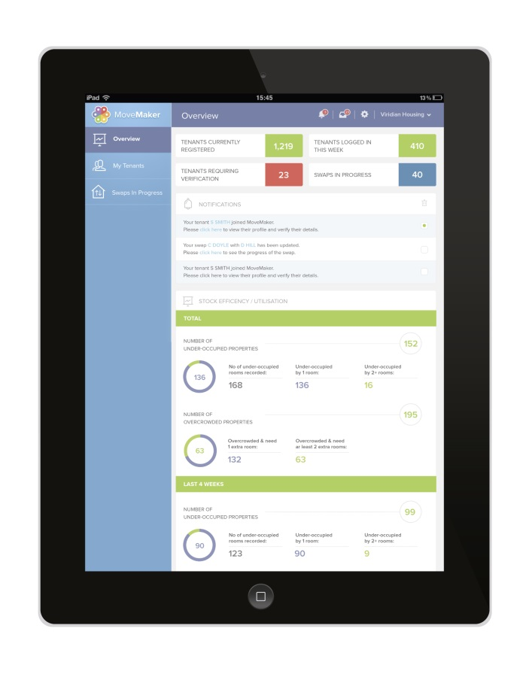

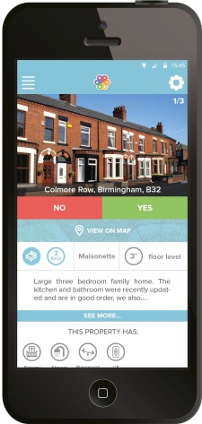
MoveMaker - The really easy way to swap homes
Natively coded digital home swap service – designed for mobile & bought to market within 6 months
Idea originated from a ‘Get Moving’ pilot – and internet dating
Free for tenants and landlords – for 12 months
UK wide offer & used by 16 landlords and over 3,000 residents
Strong focus on the user experience and minimising bureaucracy
www.viridianhousing.org.uk

Slide 11

Feel comfortable about being different
www.viridianhousing.org.uk

Slide 12
It’s not business as usual...
CORE BUSINESS
INNOVATION
Accustomed to relative certainty
Managing risk is an inherent part of the process
Under pressure to be as efficient as possible
A focus on long term impact and value for money
Staff often held accountable to a plan
How we measure and evaluate success is different
www.viridianhousing.org.uk

Slide 13
And learnt some wider important lessons
If activities are not aligned with core business priorities, it is extremely unlikely they will succeed.
Colleagues will struggle to find the time to contribute to innovation activities, unless they are given the opportunity away from their daily roles to do so.
Speed and momentum can be hard to generate and sustain.
The transition to BAU is challenging as people and needs to be planned for as early as possible with key stakeholders and future process owners.
KPIs and wider performance measures often hinder innovation initiatives.
www.viridianhousing.org.uk
Notes:
Innovation is still something that’s very new in the social housing sector – and where it is being referred to it typically focuses on the role of technology
I appreciate technology is broader that social media, mobility, big data or the cloud – but I think it’s important to think about this for a moment because the way the debate is currently being presented overlooks the wider contribution innovation has to offer
So I say this because you may be aware of a small number of housing associations that are gaining a reputation for being innovative, because of their focus on technology –
A lot of the media reports on this – at least the ones I have seen – have tended to focus on things like Google Glass or drones…or as we look to the role robots might play in the future – and overall this has been met by a mixed reaction
Now I’ve a couple of observations to offer on this…
Firstly it’s very positive that a number of HAs are working in this way…and are prepared to speak openly about this and stimulate a wider debate within the sector
As a sector we face some significant challenges, particularly when Universal Credit is rolled out to a significant number of people, because our current ways of working are going to have to change.
Technology is going to have an important role to play in helping us meet these challenges – so the fact there are housing associations out there who are experimenting with technology and trying to understand how it could help us meet these challenges I think is a good think.
However, I also wonder if they are perhaps missing a trick…because their approach, or at least the way it’s being presented in the housing press…reinforces the idea that innovation is something bizarre and off the wall…

Slide 14

Make friends and influence people
www.viridianhousing.org.uk

Slide 15
Digital innovation that is enabled by IT…
…Not digital innovation that is led by IT.
www.viridianhousing.org.uk
Notes:
Innovation is still something that’s very new in the social housing sector – and where it is being referred to it typically focuses on the role of technology
I appreciate technology is broader that social media, mobility, big data or the cloud – but I think it’s important to think about this for a moment because the way the debate is currently being presented overlooks the wider contribution innovation has to offer
So I say this because you may be aware of a small number of housing associations that are gaining a reputation for being innovative, because of their focus on technology –
A lot of the media reports on this – at least the ones I have seen – have tended to focus on things like Google Glass or drones…or as we look to the role robots might play in the future – and overall this has been met by a mixed reaction
Now I’ve a couple of observations to offer on this…
Firstly it’s very positive that a number of HAs are working in this way…and are prepared to speak openly about this and stimulate a wider debate within the sector
As a sector we face some significant challenges, particularly when Universal Credit is rolled out to a significant number of people, because our current ways of working are going to have to change.
Technology is going to have an important role to play in helping us meet these challenges – so the fact there are housing associations out there who are experimenting with technology and trying to understand how it could help us meet these challenges I think is a good think.
However, I also wonder if they are perhaps missing a trick…because their approach, or at least the way it’s being presented in the housing press…reinforces the idea that innovation is something bizarre and off the wall…

Slide 16
Digital First at Viridian
A clearly defined vision for how digital can be used across all aspects of the business.
Designed and planned around wider interdependencies - includes our merger.
A defined delivery plan and project management framework that actively involves the wider business.
An approach that is aligned with our corporate priorities and focused on delivering better services.
www.viridianhousing.org.uk

Slide 17





Digital First at Viridian
This is not just about adding a digital layer to what we do.
The needs of the customer and their home sit at the heart of everything we do.
This is not change that will happen in isolation.
Some people will need help to make this change & we will also continue to offer telephone and face to face support.
Design is important and processes must be intuitive and easy to use.
www.viridianhousing.org.uk

Slide 18

Recognise the need to evolve…
www.viridianhousing.org.uk
Notes:
Innovation is still something that’s very new in the social housing sector – and where it is being referred to it typically focuses on the role of technology
I appreciate technology is broader that social media, mobility, big data or the cloud – but I think it’s important to think about this for a moment because the way the debate is currently being presented overlooks the wider contribution innovation has to offer
So I say this because you may be aware of a small number of housing associations that are gaining a reputation for being innovative, because of their focus on technology –
A lot of the media reports on this – at least the ones I have seen – have tended to focus on things like Google Glass or drones…or as we look to the role robots might play in the future – and overall this has been met by a mixed reaction
Now I’ve a couple of observations to offer on this…
Firstly it’s very positive that a number of HAs are working in this way…and are prepared to speak openly about this and stimulate a wider debate within the sector
As a sector we face some significant challenges, particularly when Universal Credit is rolled out to a significant number of people, because our current ways of working are going to have to change.
Technology is going to have an important role to play in helping us meet these challenges – so the fact there are housing associations out there who are experimenting with technology and trying to understand how it could help us meet these challenges I think is a good think.
However, I also wonder if they are perhaps missing a trick…because their approach, or at least the way it’s being presented in the housing press…reinforces the idea that innovation is something bizarre and off the wall…

Slide 19
An enhanced innovation function
Research & Innovation Manager
Research & Innovation Lead
(Quant Specialist)
Research & Innovation Lead
Research & Innovation Lead
Research & Innovation Lead
Research & Innovation Lead
(Digital)
  Resident Involvement Lead
User Involvement Lead
MoveMaker Lead
Service Design Officer
www.viridianhousing.org.uk

Slide 20
A more collaborative, agile approach
Business
Sponsor
Business
Lead
Business
Advisor
Subject
Matter
Experts
Project
Sponsor
Project
Manager
Team
Leader
Business
Team
Technical
Sponsor
Technical
Lead
Technical
Advisor
Project Level
Delivery Level
Supporting
www.viridianhousing.org.uk
Notes:
Innovation is still something that’s very new in the social housing sector – and where it is being referred to it typically focuses on the role of technology
I appreciate technology is broader that social media, mobility, big data or the cloud – but I think it’s important to think about this for a moment because the way the debate is currently being presented overlooks the wider contribution innovation has to offer
So I say this because you may be aware of a small number of housing associations that are gaining a reputation for being innovative, because of their focus on technology –
A lot of the media reports on this – at least the ones I have seen – have tended to focus on things like Google Glass or drones…or as we look to the role robots might play in the future – and overall this has been met by a mixed reaction
Now I’ve a couple of observations to offer on this…
Firstly it’s very positive that a number of HAs are working in this way…and are prepared to speak openly about this and stimulate a wider debate within the sector
As a sector we face some significant challenges, particularly when Universal Credit is rolled out to a significant number of people, because our current ways of working are going to have to change.
Technology is going to have an important role to play in helping us meet these challenges – so the fact there are housing associations out there who are experimenting with technology and trying to understand how it could help us meet these challenges I think is a good think.
However, I also wonder if they are perhaps missing a trick…because their approach, or at least the way it’s being presented in the housing press…reinforces the idea that innovation is something bizarre and off the wall…

Slide 21
A tighter methodology
Business
Proof of concept
Alpha
Beta
Customer
Discover
Define
Develop
Deploy
Deliver
www.viridianhousing.org.uk

Slide 22
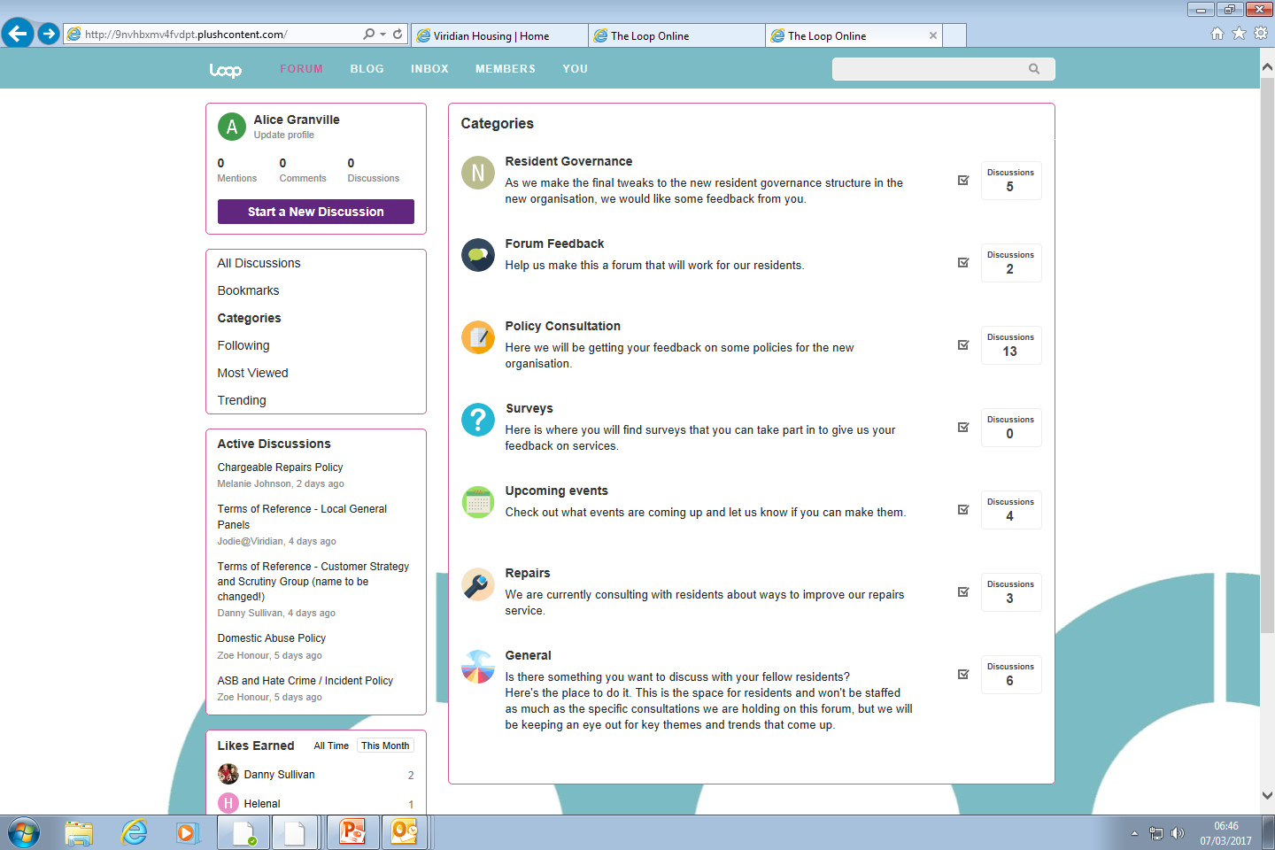
And an even stronger focus on the customer…
Over 350 informally engaged customers.
Workshops and testing can be arranged at short notice.
Online presence.
www.viridianhousing.org.uk

Slide 23



One size doesn’t fit all…
Using Software as a Service
Building something new
Using ‘low code’ platforms
www.viridianhousing.org.uk
Notes:
we have agreed to the following high level priorities:
By 2020 we will deliver 1,500 new homes a year
Residents at the heart
Great customer services
People focused
Maximising social impact

Slide 24
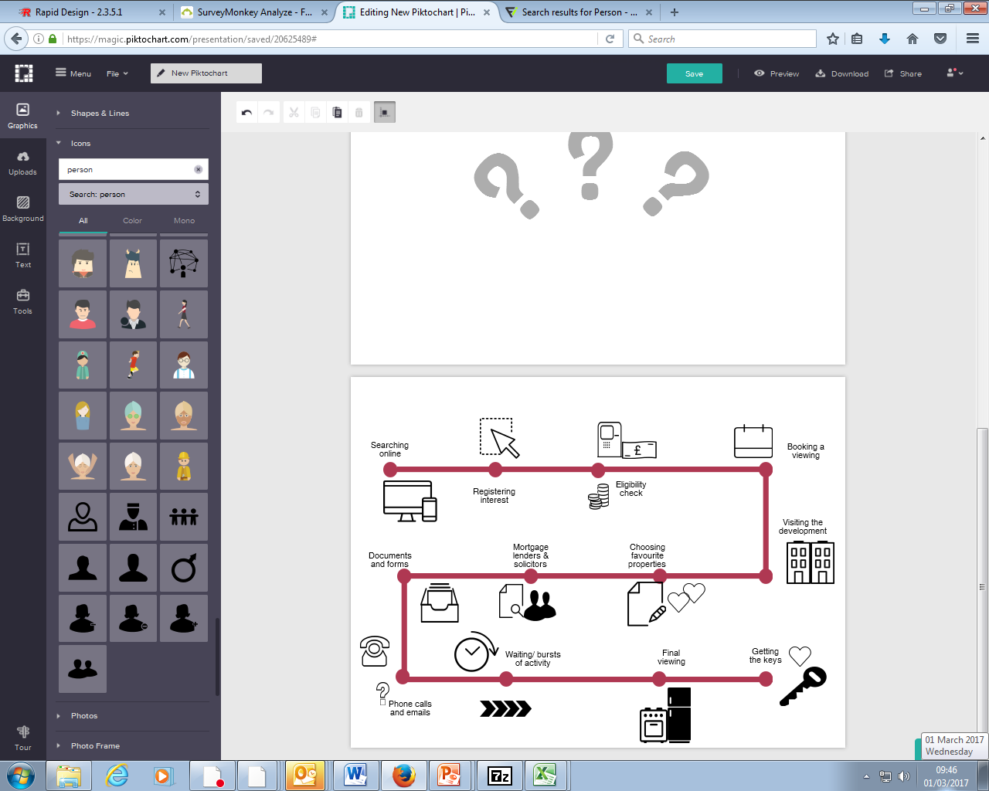
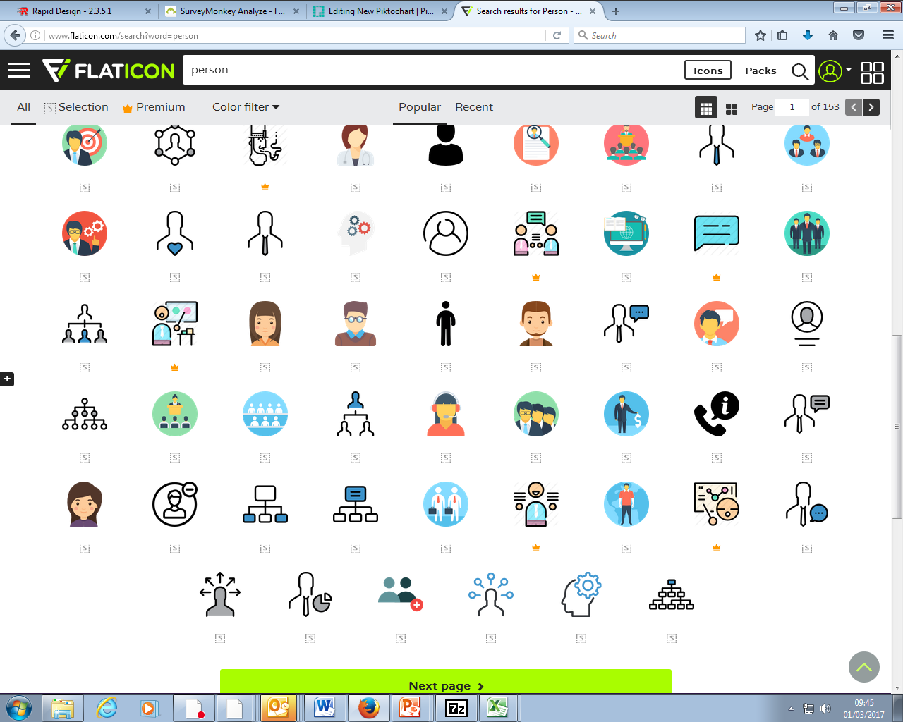
The sales process from a customer perspective…
www.viridianhousing.org.uk
Notes:
we have agreed to the following high level priorities:
By 2020 we will deliver 1,500 new homes a year
Residents at the heart
Great customer services
People focused
Maximising social impact

Slide 25
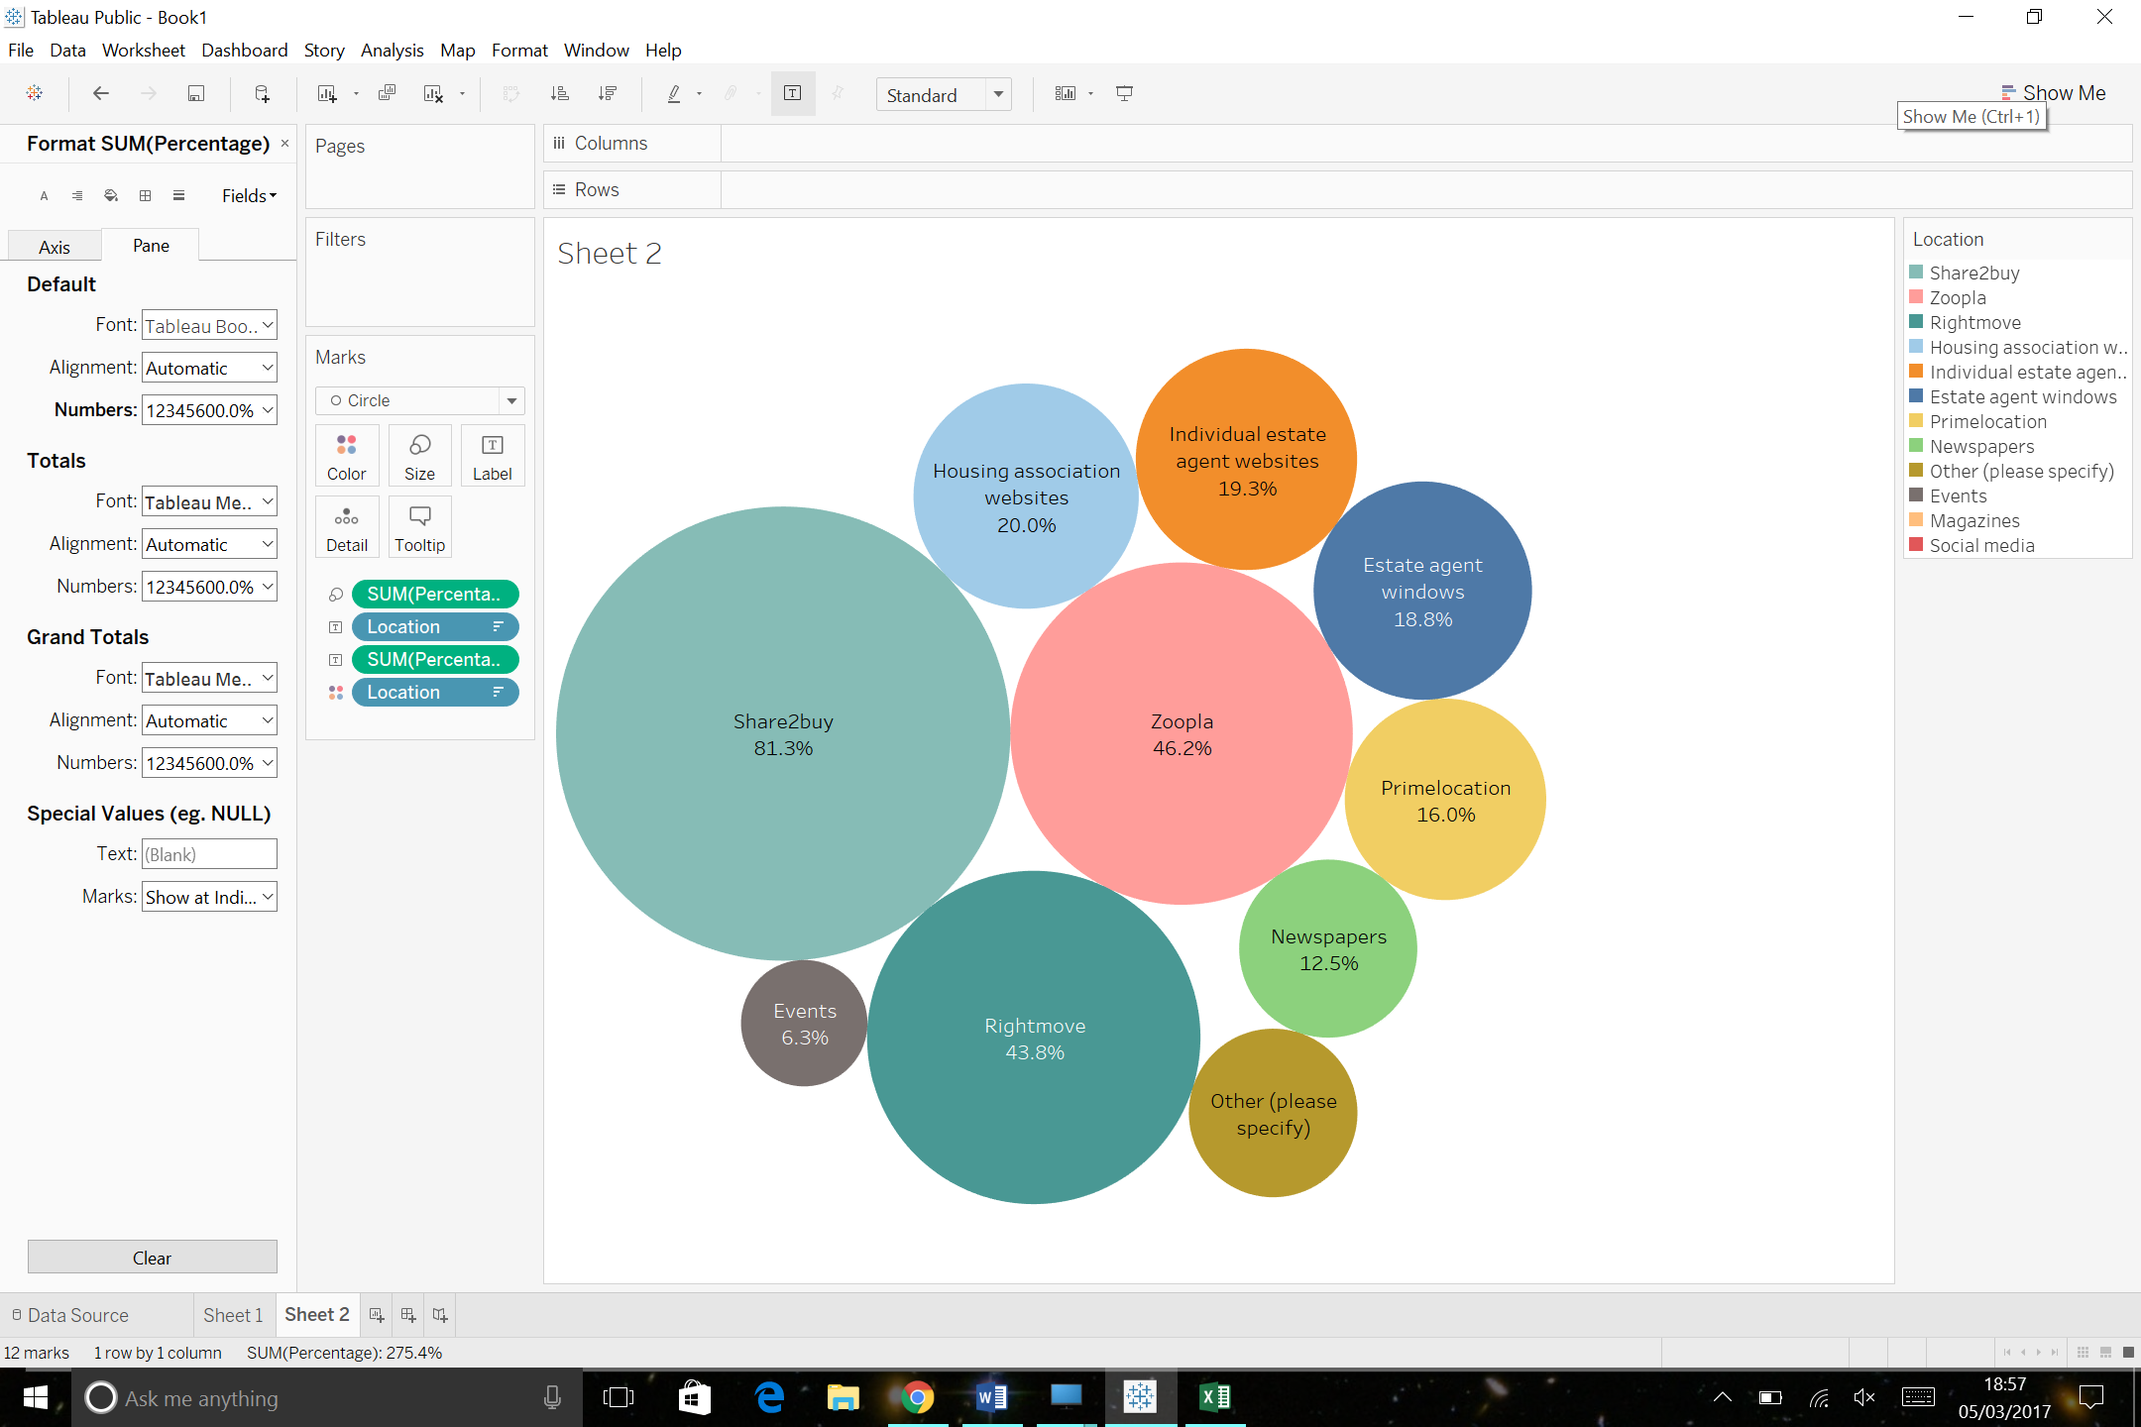
Understanding what our sales customers actually need…
Appointments booking
Selecting properties off plan
Affordability checker
Details about development facilities and service charges
Information about selling the property
www.viridianhousing.org.uk
Notes:
we have agreed to the following high level priorities:
By 2020 we will deliver 1,500 new homes a year
Residents at the heart
Great customer services
People focused
Maximising social impact

Slide 26
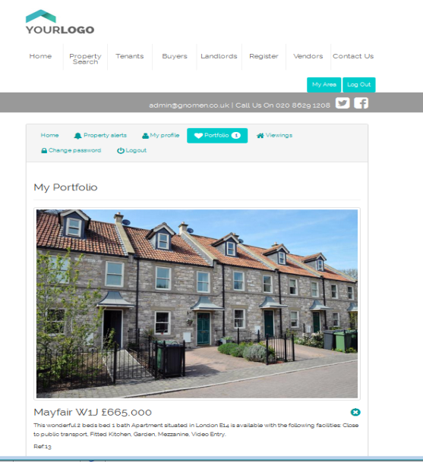


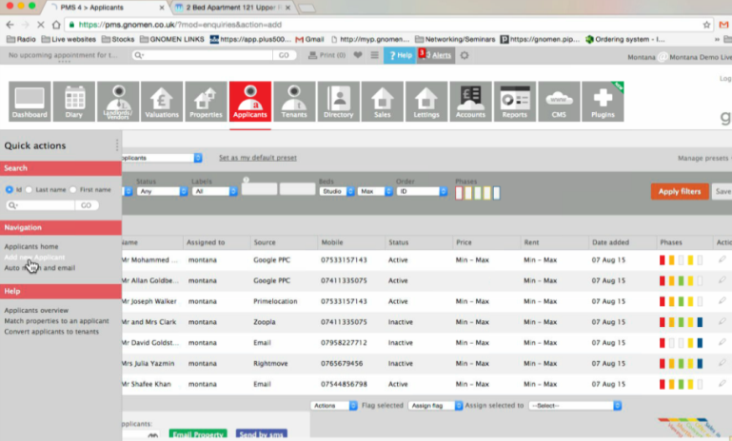
Using a proof of concept to understand requirements
www.viridianhousing.org.uk
Notes:
we have agreed to the following high level priorities:
By 2020 we will deliver 1,500 new homes a year
Residents at the heart
Great customer services
People focused
Maximising social impact

Slide 27

Designing with and for our customers…
Started as an idea in our home-grown innovation challenge.
Built an understanding of customer and business needs.
Built a fully functioning proof of concept within two days.
Customer feedback incorporated at every stage of development.
www.viridianhousing.org.uk
Notes:
we have agreed to the following high level priorities:
By 2020 we will deliver 1,500 new homes a year
Residents at the heart
Great customer services
People focused
Maximising social impact

Slide 28
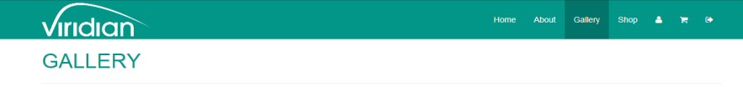
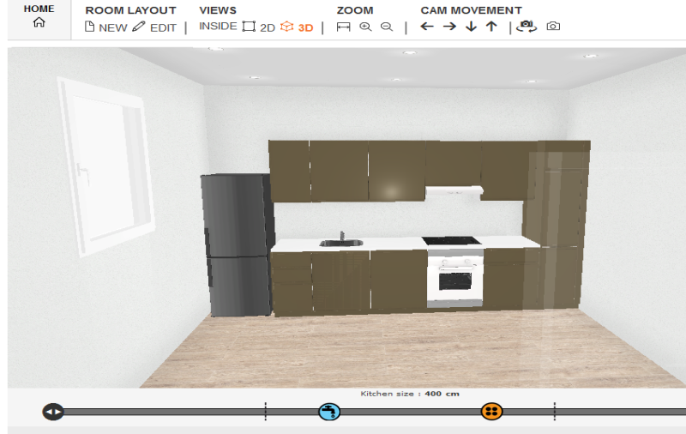
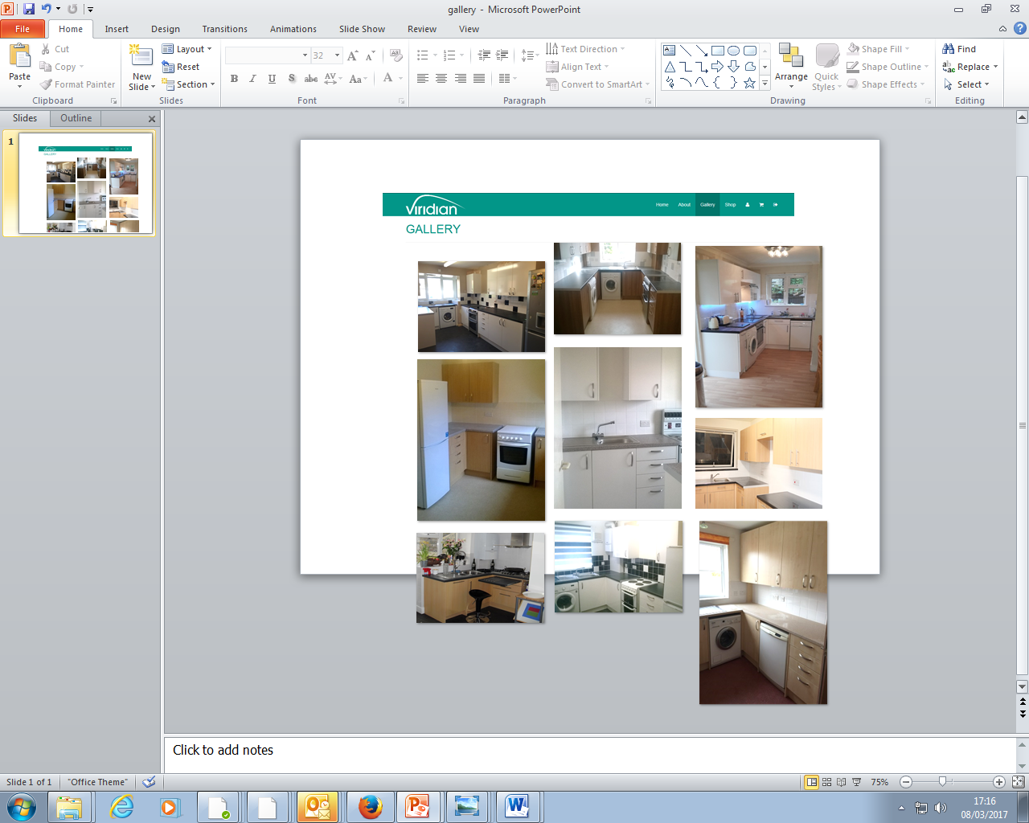
But questioning their wish list…
What our customers asked for….
…and what we actually developed.
www.viridianhousing.org.uk
Notes:
we have agreed to the following high level priorities:
By 2020 we will deliver 1,500 new homes a year
Residents at the heart
Great customer services
People focused
Maximising social impact

Slide 29

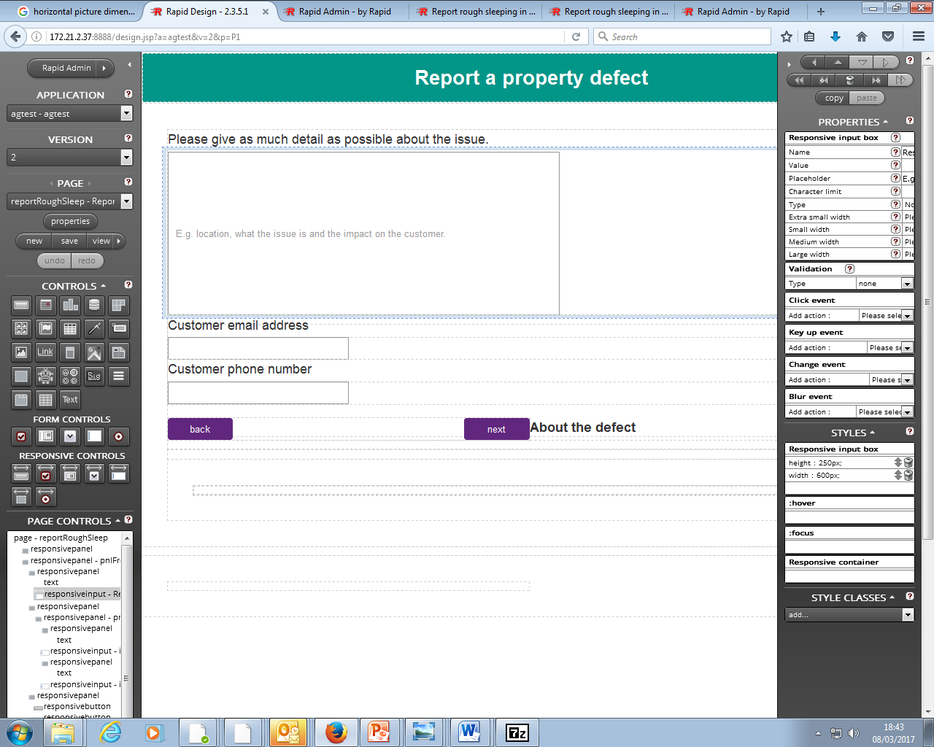




Involving colleagues in development
Mapping out the process and where we could improve.
Sketching out requirements and an initial design.
Building , testing and iterating.
Building , testing and iterating.
Close to a working application. :)
www.viridianhousing.org.uk
Notes:
we have agreed to the following high level priorities:
By 2020 we will deliver 1,500 new homes a year
Residents at the heart
Great customer services
People focused
Maximising social impact

Slide 30




Looking ahead
An organisation that:
Is going places and makes a difference
Does things differently and challenge the norm
Is confident in what we do and is unafraid to lead by example
Harnesses technology and innovation to support our offer
A scalable innovative approach that adds value for residents
www.viridianhousing.org.uk
Notes:
we have agreed to the following high level priorities:
By 2020 we will deliver 1,500 new homes a year
Residents at the heart
Great customer services
People focused
Maximising social impact

Slide 31

www.viridianhousing.org.uk

Slide 32
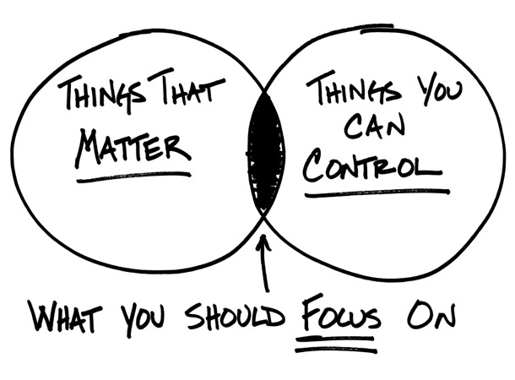
www.viridianhousing.org.uk

Slide 33

www.viridianhousing.org.uk

Slide 34

Thank You
Ed Wallace
Research & Innovation Manager
ed.wallace@viridianhousing.org.uk
@ed_wallace
Alice Granville
Research & Innovation Lead
alice.granville@viridianhousing.org.uk
@alice_granville
www.viridianhousing.org.uk

