Slide 1

Mobilisation,Transformation
& Change Management
Loreen Herzig & Maureen Hopcroft
8th March 2017

Slide 2

Our Journey
  > Then and Now
  > Our People
  > Our IT
  > Mobilisation Approach
  > By Staff for Staff
  > The Feedback
  > The Stats
  > Our Learning
  > Frontline Staff Benefits
  > Our Transformation Journey
  > What our Customers Want
  > What our Business Needs
  > Our Challenges and Opportunities

Slide 3
Wellingborough Homes
Then..
Now
Created in 2007
Located in East Midlands
LSVT to own and manage
Wellingborough Council stock
Original portfolio 4,484 units
Delivered its promises
What Next?
New Corporate Plan 2015-19
Developing 500 homes by 2019
Awarded £3.22M by HCA
G1/V1 rating
26th in 2016 24housing magazine's Top 50 RSLs
Invigorated and on a transformational journey

Slide 4
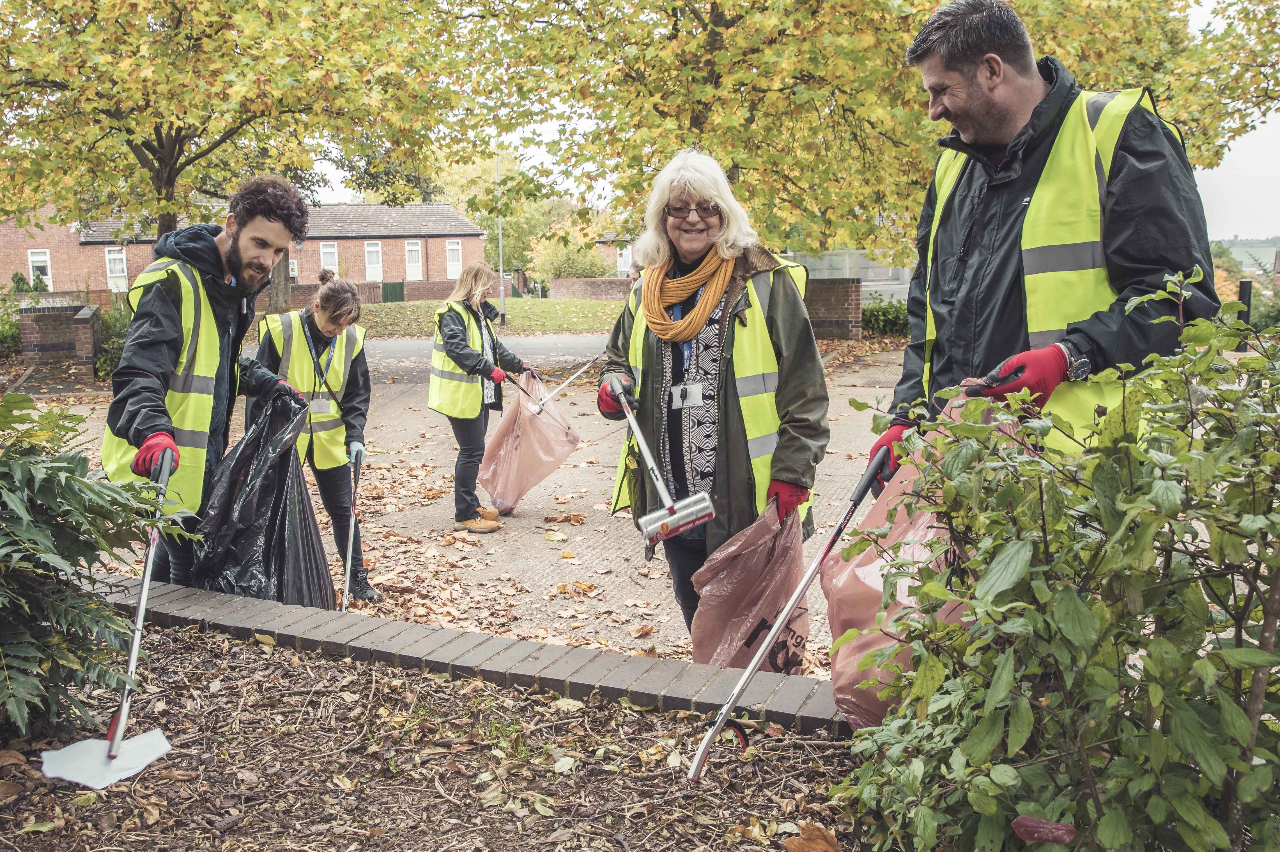
Our People
New All Female Executive Team ‘Can do, Will do’
99 staff, 35% frontline
Organisational Values
Refreshed branding
Raising the Roof staff awards
Restructured Housing Services
& Supported Living
Changing the Culture

Slide 5
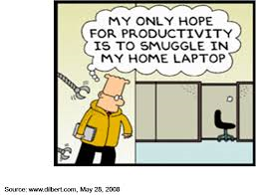
Our IT
Years of underinvestment
External IT Review Feb 2016
IT Restructured mid 2016
BI Team Dec 2016
Project Management training Oct 2016
IT Strategy approved Feb 17
The only way is UP!

Slide 6
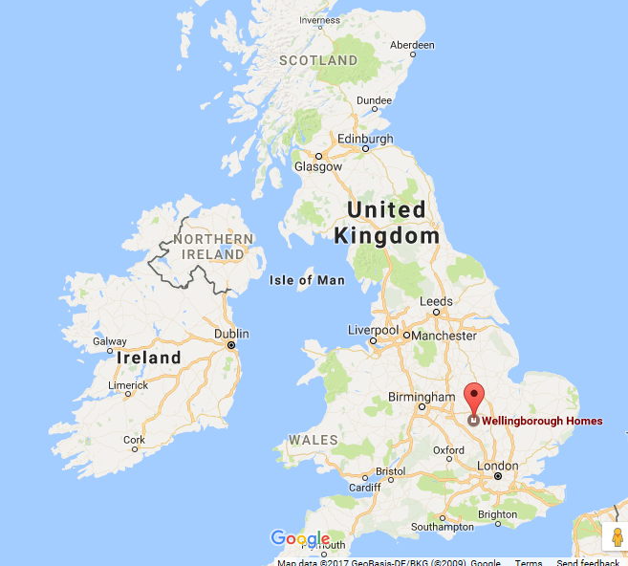
Mobilisation Approach
Led by front line staff
  Designed ‘by staff for staff’
Rural locations
  Typical patch size 1100 units
Low cost option
  Housing Insight’s Pan Connect

Slide 7
What Front Line Staff Wanted

Slide 8
Project Timeline
Initial Workshops
Forms
Design & Iterate
SCS
Form
Final
Signoff
Supplier
PID
Orchard Write backs
UAT
Testing
Partial
Signoff
SCS
Form
Jan 2016
Front line led
20+ business users
Supplier
presence
Mar 2016
Supplier led
Director signoff
No agreed benefits
To June 2016
Front line led
No Formal Process
Labour intensive
Aug 2016
IT led
Dependant on Orchard
No previous IT experience
To Aug 2016
IT Steered
Formal
Process
Both forms & devices tested
Sept 2016
Business signoff
Signoff of 14 forms
To Nov 2016
Outstanding Stock Condition Survey form
Form very lengthy
Nov 2016
Business signoff
All agreed requirements
delivered

Slide 9
The Ball’s in your Court…

Slide 10
UAT

Slide 11
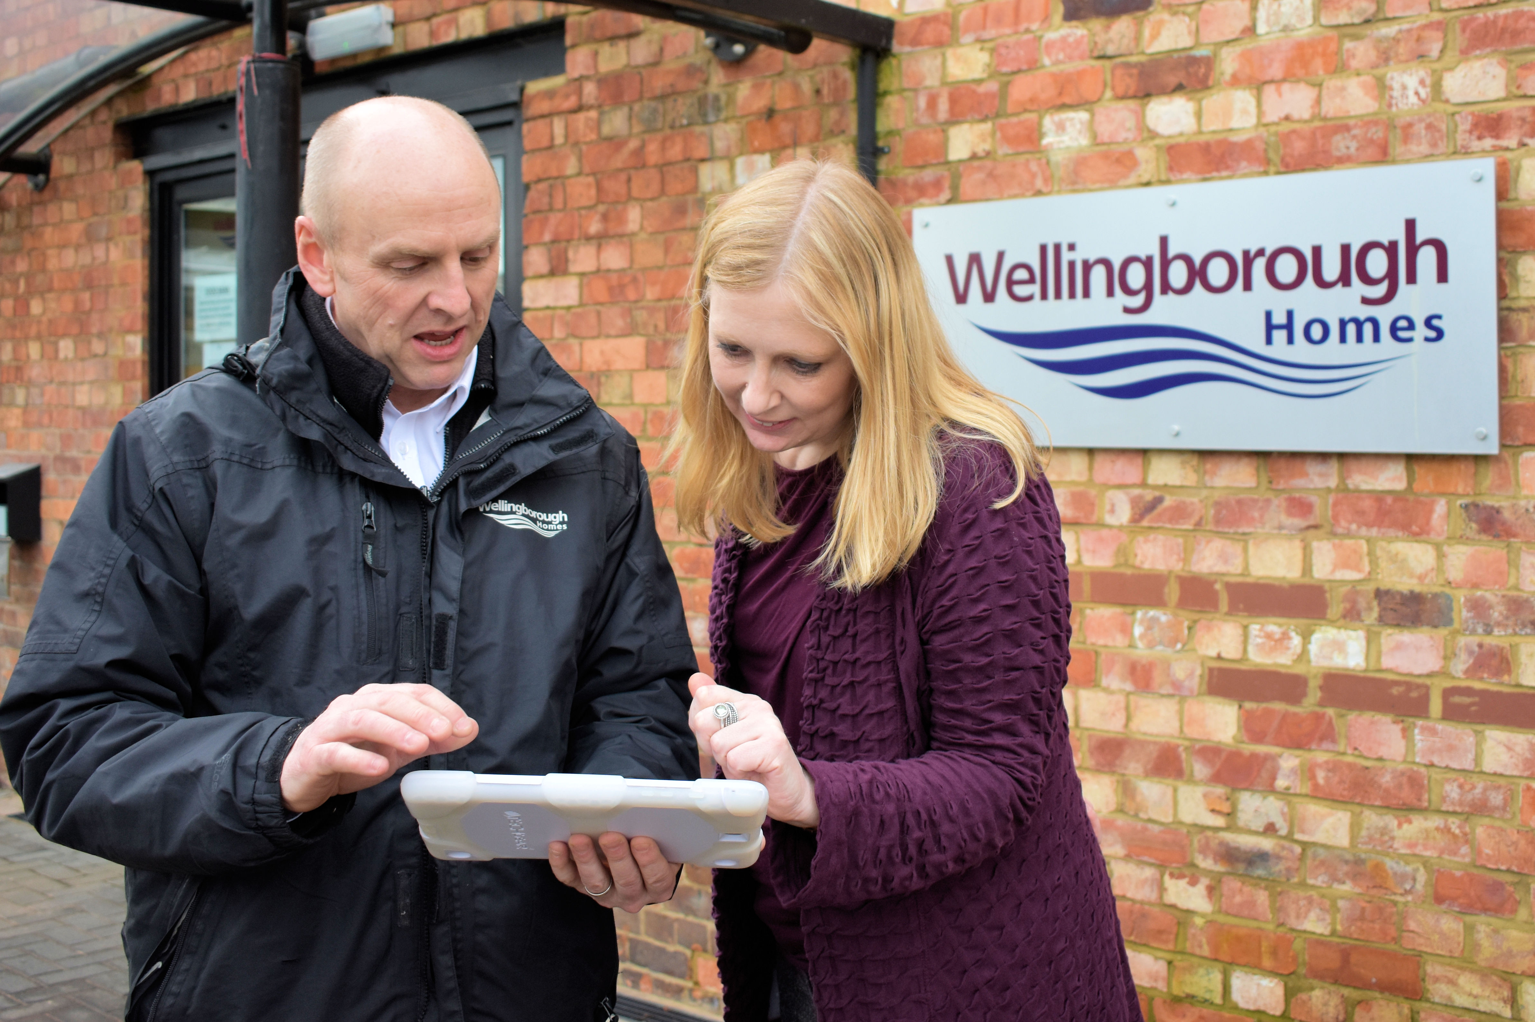
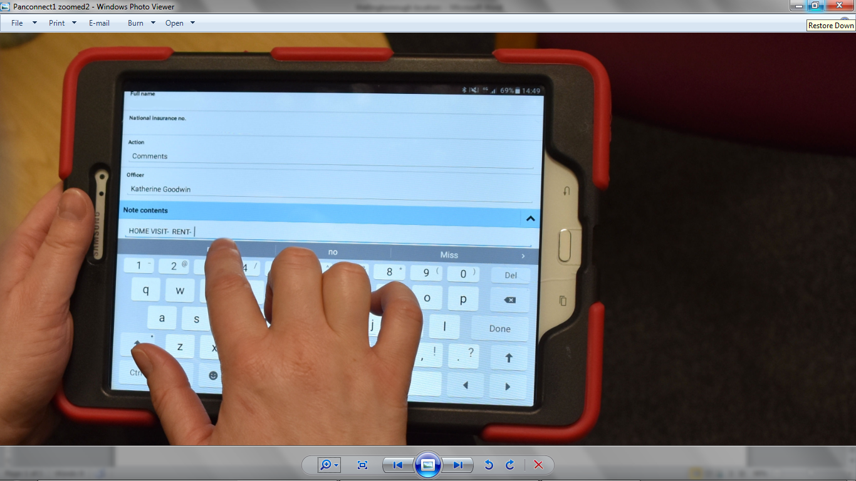
Forms Designed ‘By Staff for Staff’

Slide 12
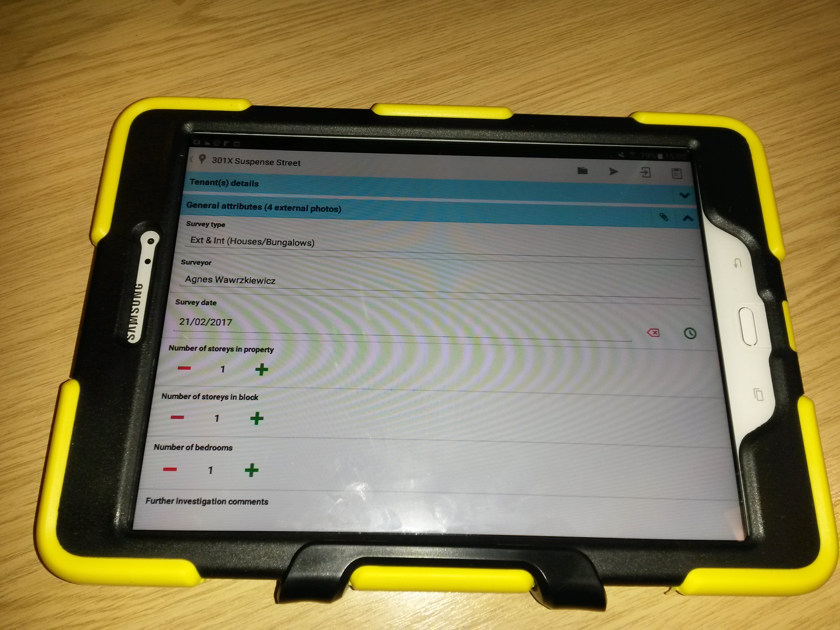
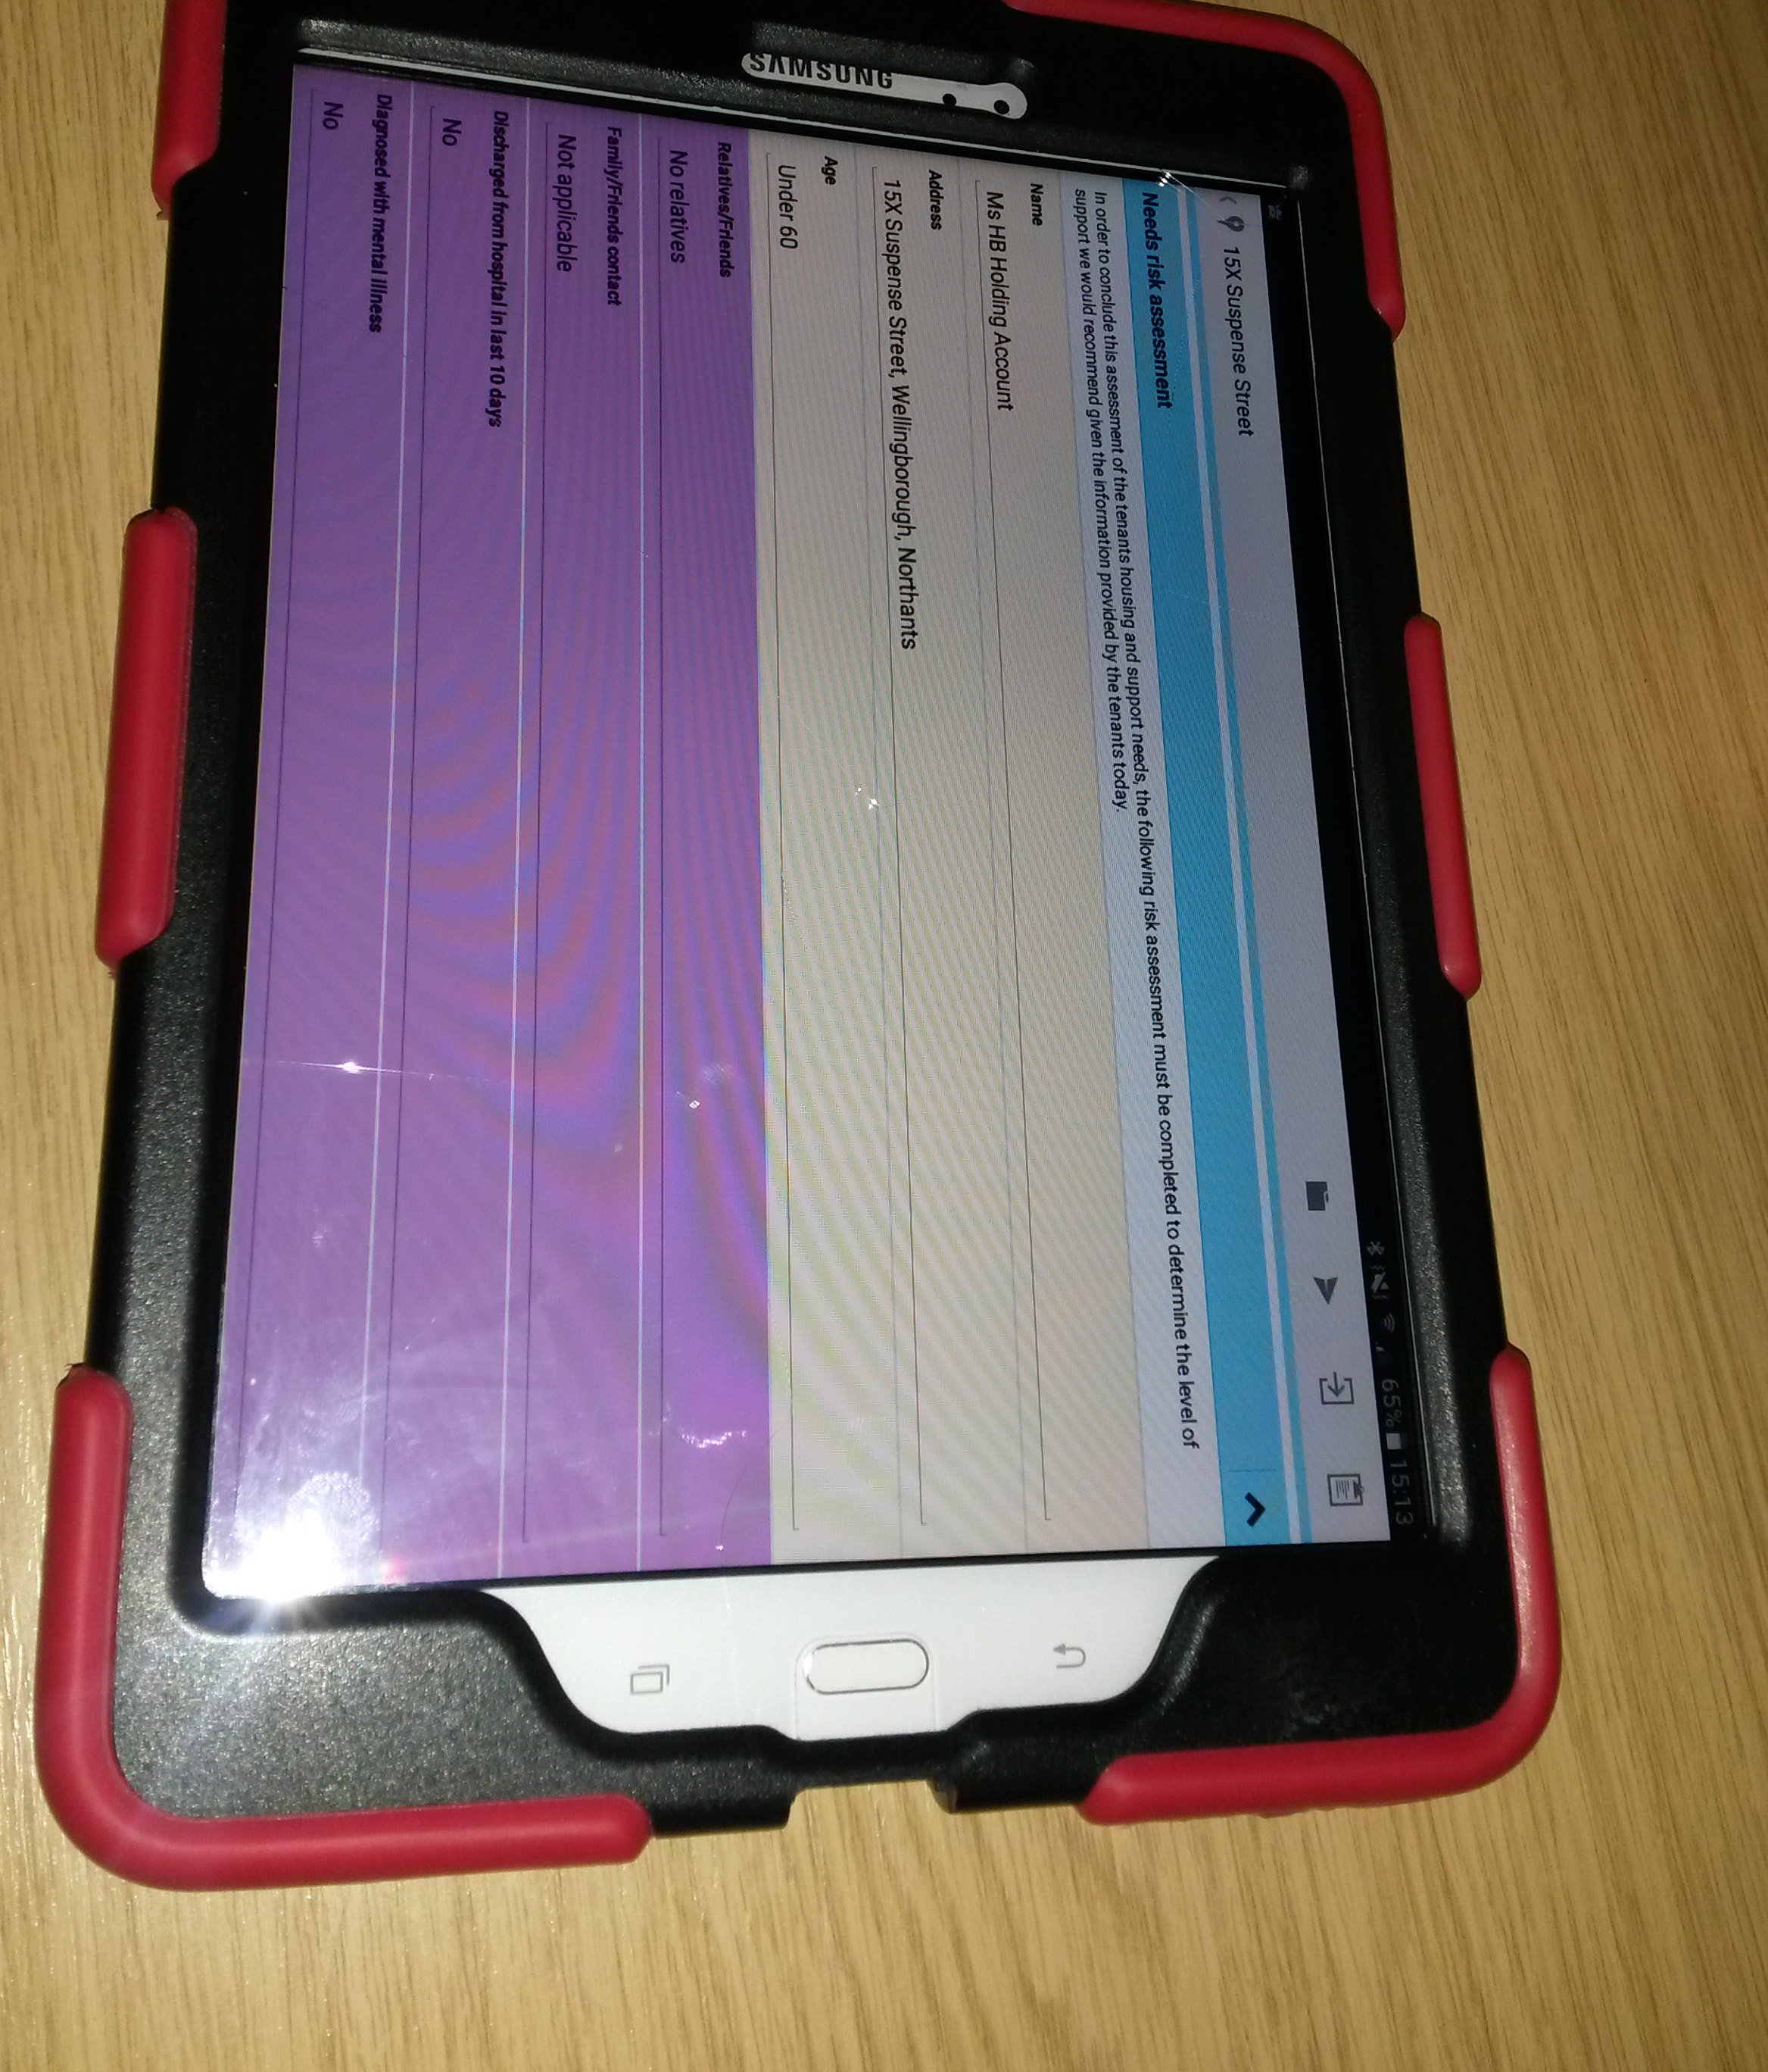
Forms in situ

Slide 13
The Feedback
It’s so easy to use
Making us paper free
It’s absolutely brilliant!
I’m updating rent account with customers
Really good!
When will I get a tablet?
It updates notes straight away
Much more time efficient
I’m uploading photographs!
I can choose the colour of my device
High level of customer satisfaction
I discussed a repair with a customer
Good connectivity, works offline

Slide 14
The Stats
currently 25 users, 72% frontline staff
    Income 100%
    Housing 100%
    Independent Living 100%
    Repairs and Development 71%
    Estate Services 20%
to 35 frontline staff
Income Recovery most prolific users
450 SCS forms loaded, time saving of 27 days
Uploaded 1000 photos
45% organisation are tablet users

Slide 15

Our Learning
Supplier PID
Management buy-in (and sign-off)
Frontline Project Manager (PM), very committed
Multiple iterations x 15 forms
Formal device comparison
Formal UAT Testing
Formal sign off, post project review
No SMART benefits
Required management steer/challenge
PM – no previous experience
No requirements prioritisation
Formal process introduced well into project
Formal process delayed Go Live

Slide 16
Frontline Staff Benefits
Minimises prep time prior to visit
Current information to hand
Significant benefit in customer conversations
Allows response to wider queries
More time spent with customers less on admin
Uploading photos of property and components
Staff are empowered
More flexible working
Audit trail

Slide 17

Our Transformation Journey
Leveraging successful mobilisation
Business focussed IT strategy
Providing excellent customer service
Balancing solid foundation with innovation
Skilling up IT
Embedding Business Improvement
Introducing best practice
Changing the culture

Slide 18
What Our Customers Want
We engaged extensively
  3 workshops, Executive, Senior Management, Operational
  IT Survey 73% response
Resident engagement on specific projects

Slide 19
What Our Business Needs
Holistic Approach to Business Improvement and IT
Re-position IT from ‘keeping the lights on’ to transforming the business
Drive Service Reviews & BPR through customer and business requirements
Consolidate dated infrastructure and 40+ applications
Build on successful staff mobilisation
Underpin with best practice
Monitor and measure success
Review & Consolidate Applications , Infrastructure
Business Process
Reengineering
Workforce Mobilisation
Customer, External & Business Requirements
Organisation Service Reviews

Slide 20
CHANGE
&
CHALLENGES
OPP0RTUNITIES
Continuous Innovation and Change
Resistance to change
Customer & Staff Satisfaction, our USP
Balancing BAU & Innovation
Establishing framework
Growing and Retaining Skills, Empowering Our People
Competing in our Sector
Change what we do and how we learn
Organisational Change support
Include Customers and Staff, stakeholders
Prioritise and Plan
Measurable Benefits
Support Productivity, Creativity Innovation and Retention
USP and recognisable brand, looking outside our sector

Slide 21

And before we go…Any Questions?

