Slide 1
Winner, 2014 Connect ICT Awards- Connected Citizens
Runner up, 2016 o2 Next Gen awards- innovative applications
Winner CIH Scotland Excellence Awards 2016 - developing skills and capacity
Connecting the Unconnected
- looking back, looking forward
Graeme Hamilton Innovation Manager
9 March 2017

Slide 2
Our context in Scotland, especially Glasgow
Strategic link between connectivity, economic growth and citizen participation
Free public wifi in city centre and other key sites
Over 100 community venues with free wifi, access to PCs and digital skills training
Increasing internet usage in most deprived communities
Reliance on mobile phones for broadband connectivity
2

Slide 3
Our 2012 Strategy

Slide 4
Our Digital vision
Affordable internet access in every rented home
All staff and customers digitally enabled
Digitally accessible services for all - customers, suppliers, partners
Provision of mature, easy to use online services defined and driven by and with our customers
4

Slide 5
Digital demonstrator

Slide 6
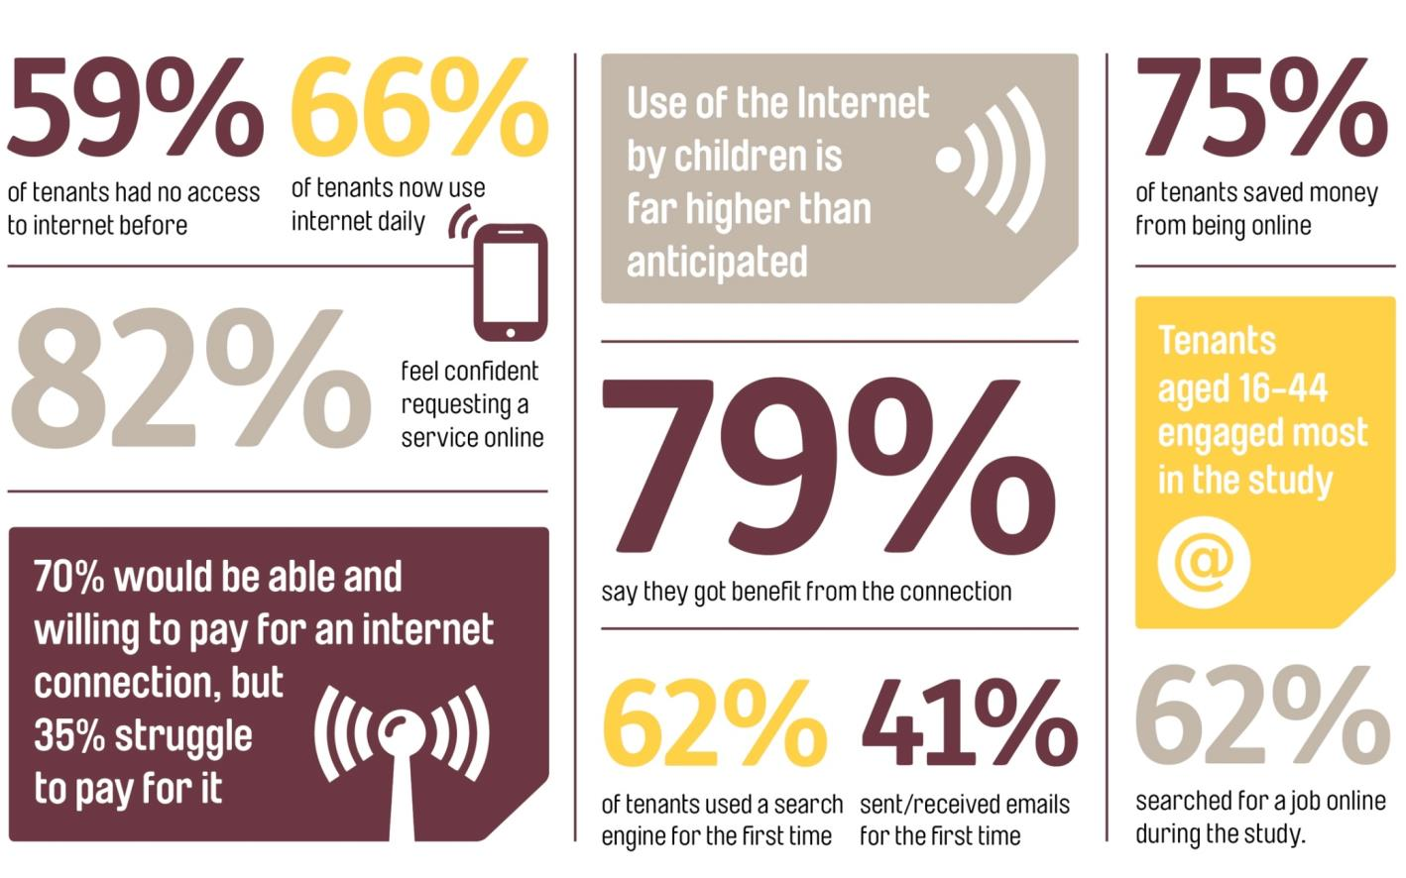
Digital Demonstrator outcomes

Slide 7
Click & Connect

Slide 8
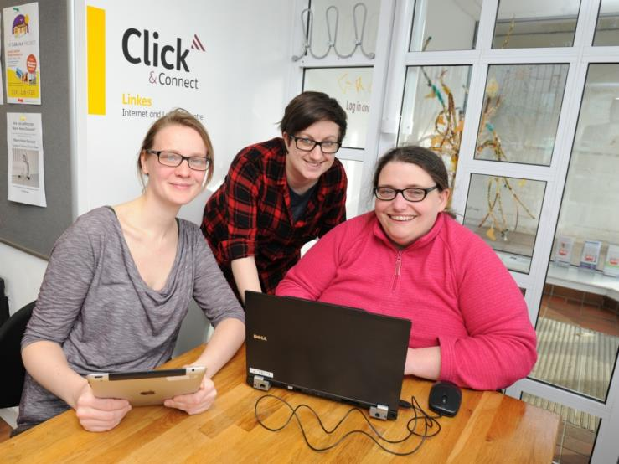
Click & Connect
38 community learning centres
Wifi and PC access
Informal and formal digital skills training
Gateway to job seeking support, volunteering, social inclusion; prisoner rehabilitation
Digital access for hardest to reach groups
8

Slide 9
Measures of Our Success

Slide 10
Digital Volunteering

Slide 11
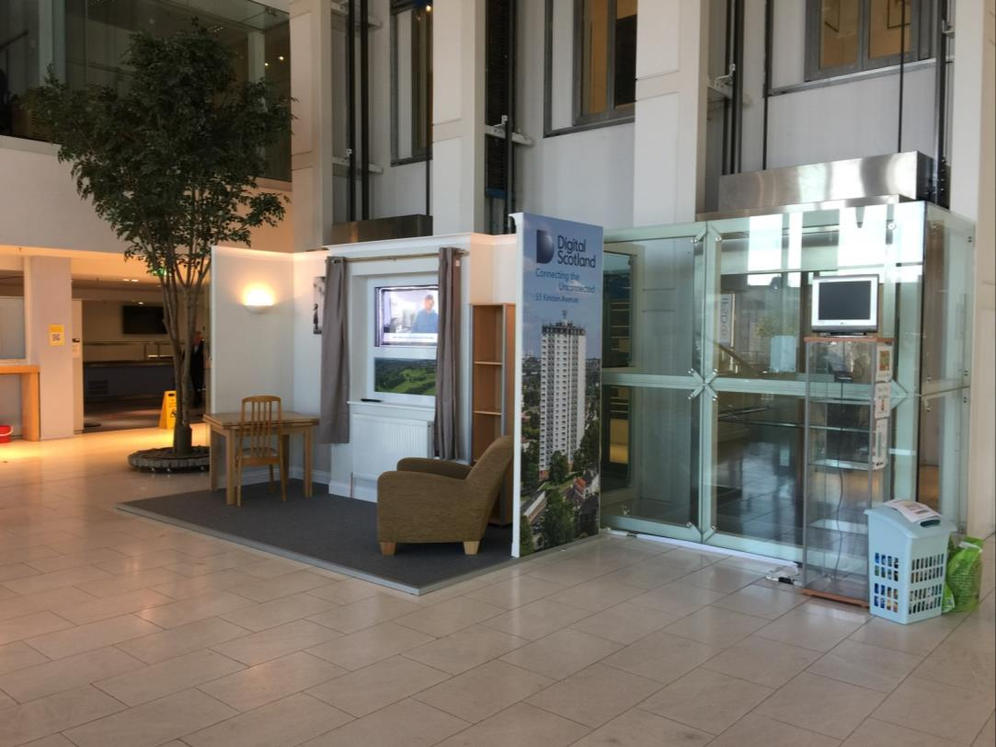
Partnerships

Slide 12
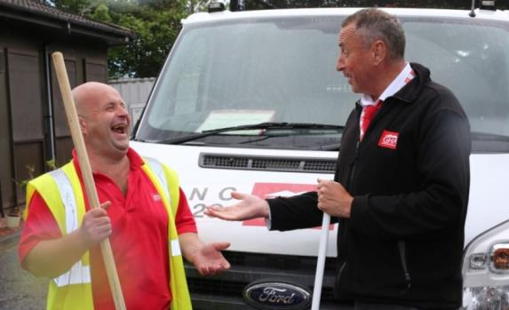
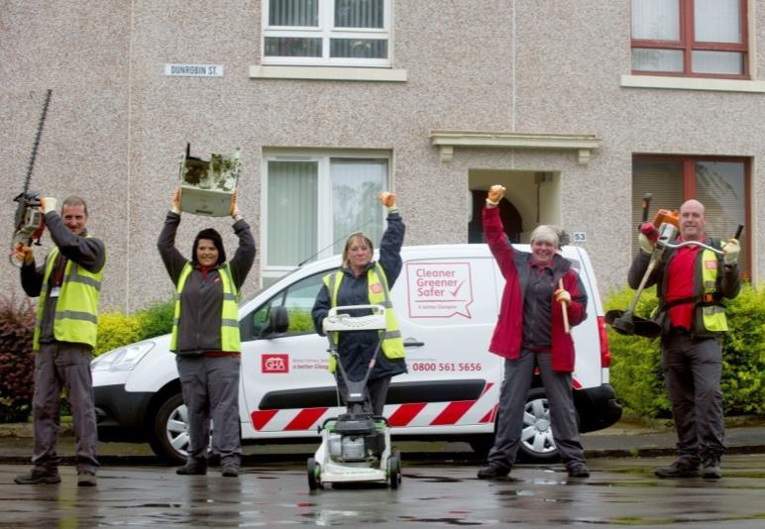
Digital Skills with SQA
Community Janitors- employability programme, now extended to all environmental operatives
Benefits to individual and to all communities in which we work across Scotland
12

Slide 13
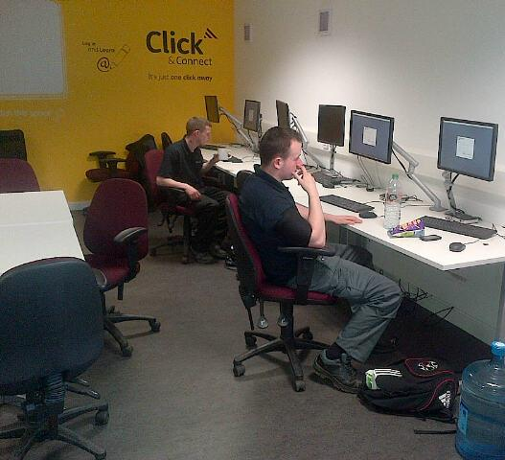
How it works
Digital Participation
Charter collaboration with SQA
121 or small group coaching
Working where it suits the pairing
Developing those skills gaps identified in survey at start of employability programme
Focus on SQA digital learning guides/videos
13

Slide 14
Our 2017 Strategy

Slide 15
Digi- Know

Slide 16
Improving personal digital skills
Digi Connect
Digi Work
Digi Mobile
Tech 4 Execs
Digi Fit
Digi Care
Digi Home
Digi Chat
Digi Protect
Digi Save

Slide 17
Game of Homes

Slide 18
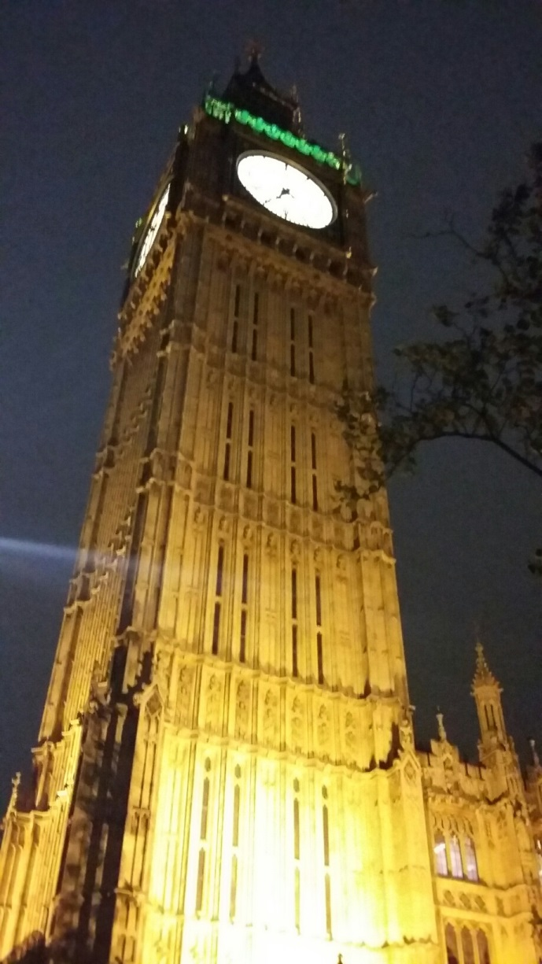
Games and gamification

Slide 19
Digital Service

Slide 20
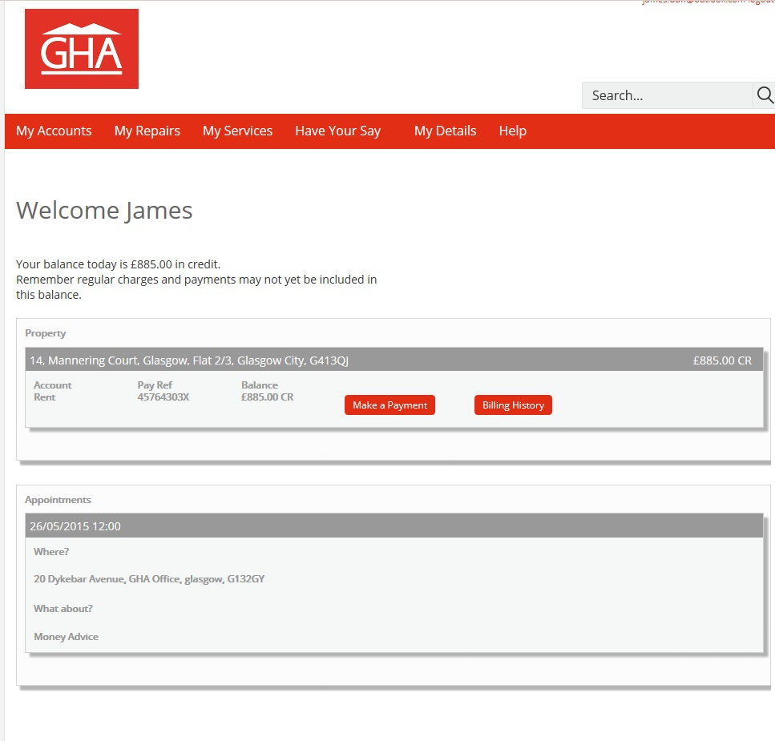
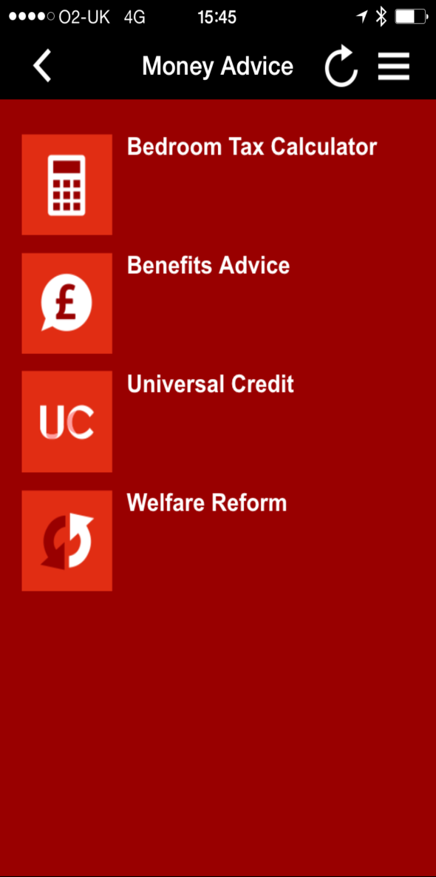
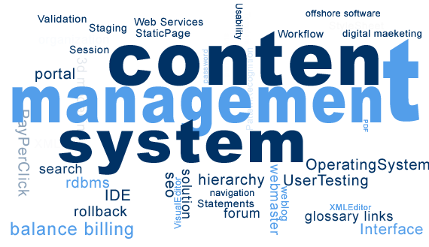
Apps, Websites and things
20

Slide 21
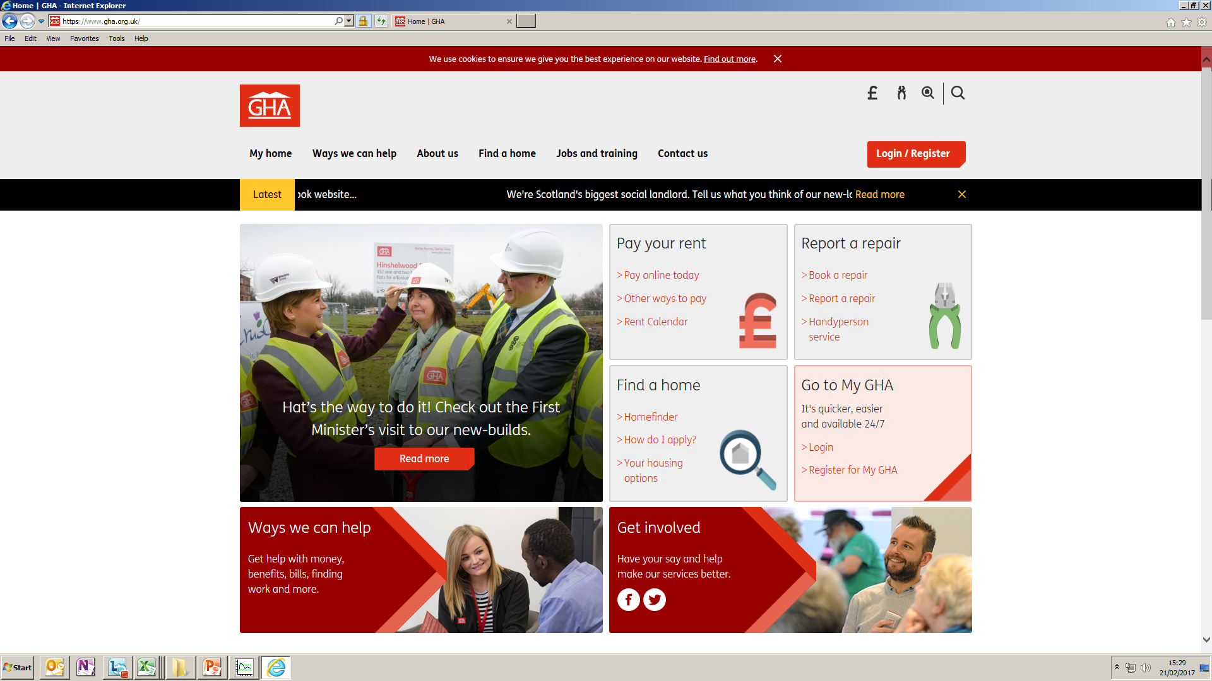
First of nine new websites launched February 2017

Slide 22
Our digital future

Slide 23
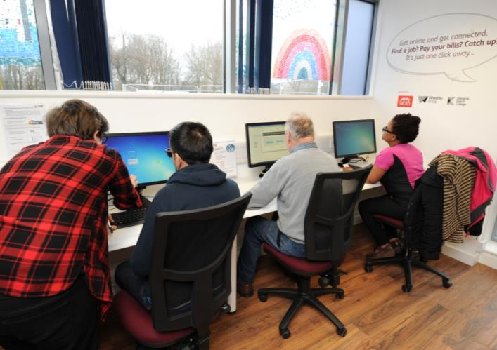
Our strategy for the next five years
Continuing focus on staff and partner development
Opportunities for customer engagement through varied media
Further development of games and gamification including Scottish Social Services Council (SSSC)
Creation of way-leaves for more direct customer/contractor relationships
Improved digital specification for our new build properties
23

Slide 24
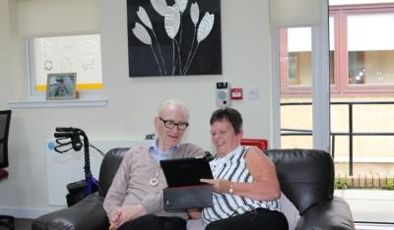
Challenges ahead
Reaching the last 10%
Addressing low level of usage of public service online channels
Over-reliance on mobile devices / smart phones
Overcoming pricing, bundling and affordability for people on low incomes
Meeting outcomes of our Care strategy
24

