Slide 1
We are..
Lawrence Gardner
Head of ICT
Paul Dudley
Business Systems Manager
What we have done
skills
Notes:
A fancy way of saying keep it simple at the sharp end
Organisations who imagine all sort of complexity on the mobile – raising orders – NO,NO,NO
Throw away preconceptions, take expert guidance

Slide 2
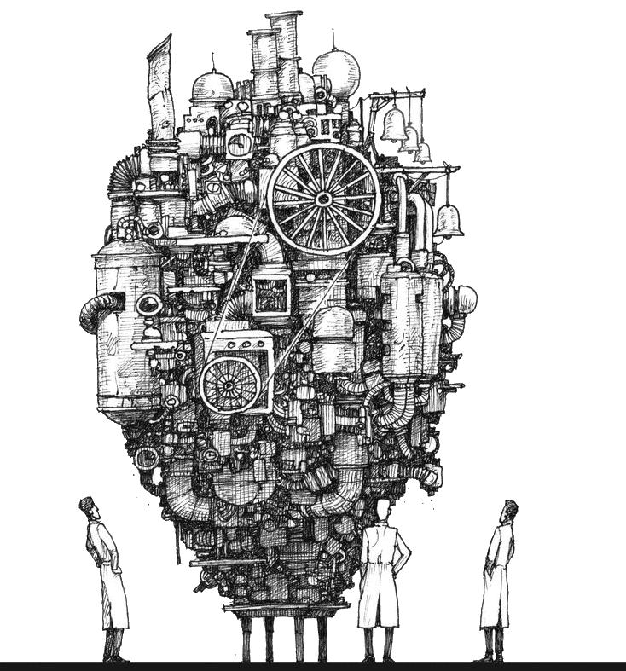
What we have done..
Created from scratch a complete replacement housing solution, covering all business needs ….
Tenancy Management
Workflow (BPM)
Voids and Lettings
Repairs Allocation & Costing
iPad Forms
Development
Asset Management
Repairs Materials e-trading
Arrears
Van stock management
Mobile Repairs
Rents & Service Charges
Vulnerable Tenant Safeguarding
Web Lettings Applications
And to share
Notes:
A fancy way of saying keep it simple at the sharp end
Organisations who imagine all sort of complexity on the mobile – raising orders – NO,NO,NO
Throw away preconceptions, take expert guidance

Slide 3
And to share …
How?
Why?
Success?
Better?
Failure?
Worse?
Advantages?
Disadvantages?
What do the users think!
What started thinking
Notes:
A fancy way of saying keep it simple at the sharp end
Organisations who imagine all sort of complexity on the mobile – raising orders – NO,NO,NO
Throw away preconceptions, take expert guidance

Slide 4
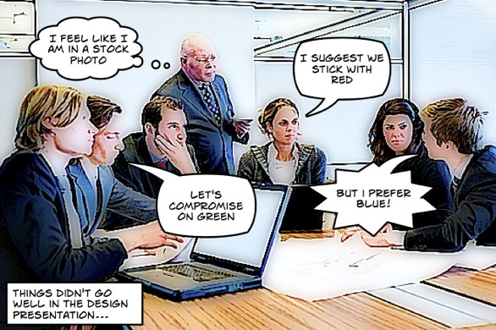
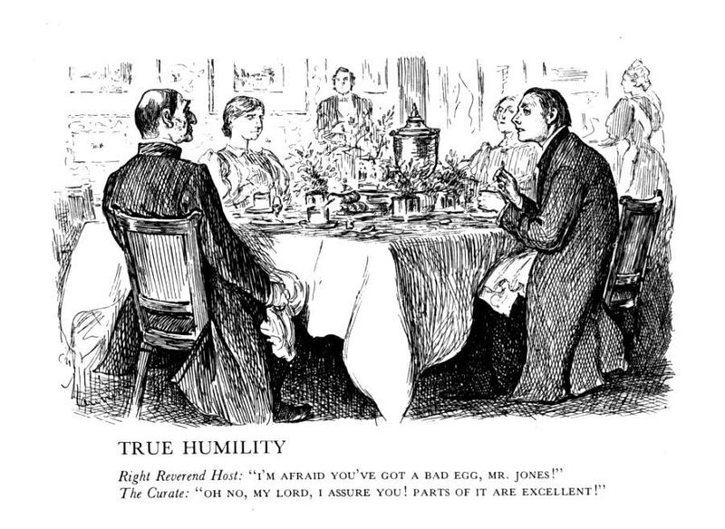
What started us thinking about change?…
Long in the tooth 3rd party system….
designed by committee, evolved by committee:
“Curates Egg”
Switching providers unappealing – severe limitations of choice, Ingrained monopolistic attitudes, expensive round trip!:
Shown our metal, providing solutions ahead of them (never) becoming available from our supplier - beating them at their own game
Captures not captivates:
Expensively obsolete:
Packages, good bad ugly
Notes:
A fancy way of saying keep it simple at the sharp end
Organisations who imagine all sort of complexity on the mobile – raising orders – NO,NO,NO
Throw away preconceptions, take expert guidance

Slide 5
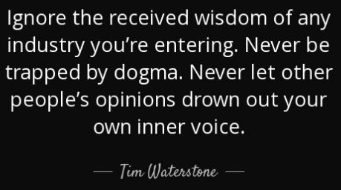
Packages: Good, Bad, Ugly?…
Off the peg …
more likely best available fit rather than exact fit
Enshrine conventional/Received Wisdom
Open Architecture
averse
Always Expensive!
Why write?
skills
Notes:
A fancy way of saying keep it simple at the sharp end
Organisations who imagine all sort of complexity on the mobile – raising orders – NO,NO,NO
Throw away preconceptions, take expert guidance

Slide 6
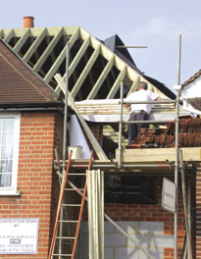
Write your own – why?
100% the way you want it
No one else to win over to have it your way
The only limit is your imagination
BUT!
Change it to suit yourself, in the ways that suit you, when it suits you!
…. Not for the faint-hearted!
Why not write!
skills
Notes:
A fancy way of saying keep it simple at the sharp end
Organisations who imagine all sort of complexity on the mobile – raising orders – NO,NO,NO
Throw away preconceptions, take expert guidance

Slide 7
Write your own – why you might not!
Finding the creative talent,
keeping the creative talent
Mastery of a very particular science!
Containing wild Ideas!
Still ain’t cheap!
Why not write2!
skills
Notes:
A fancy way of saying keep it simple at the sharp end
Organisations who imagine all sort of complexity on the mobile – raising orders – NO,NO,NO
Throw away preconceptions, take expert guidance

Slide 8
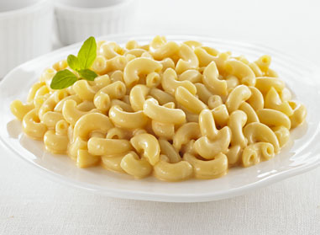
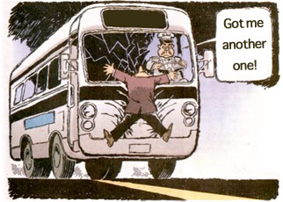
Write your own – why you might not! (Pt II)
All alone on a wide, wide Sea
Risk Appetite – Staid but also SAFE!
Risk Appetite – elevated exposure to ‘run over by a bus theory’
Are your design team trend setters or dedicated followers of fashion?!
Our credentials
skills
Notes:
A fancy way of saying keep it simple at the sharp end
Organisations who imagine all sort of complexity on the mobile – raising orders – NO,NO,NO
Throw away preconceptions, take expert guidance

Slide 9
Write your own – our credentials!
Own development capability since 2002 …
… part of strong in-house ICT team with strong reputation, confidence
Up to Board level
Large, home grown software portfolio: Mobile, e-trading, Contractor, Lettings, Website, etc.
Successes in commercial exploitation of IP
Cart horse
skills
Notes:
A fancy way of saying keep it simple at the sharp end
Organisations who imagine all sort of complexity on the mobile – raising orders – NO,NO,NO
Throw away preconceptions, take expert guidance

Slide 10
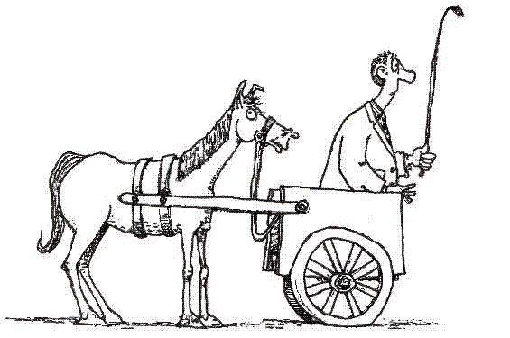
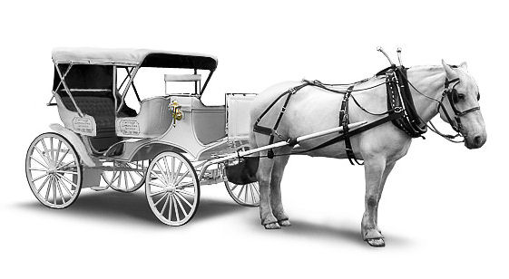
A once in a lifetime opportunity!
Goodbye to the system driving the process due to ….
… Ill-fitting dated solutions …
… over which we have little influence
Hello to the system that follows the process
Scary blank
skills
Notes:
A fancy way of saying keep it simple at the sharp end
Organisations who imagine all sort of complexity on the mobile – raising orders – NO,NO,NO
Throw away preconceptions, take expert guidance

Slide 11
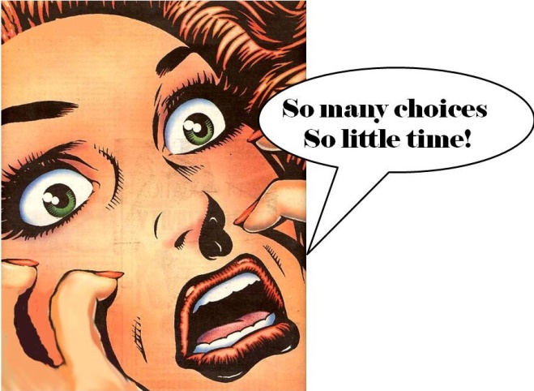
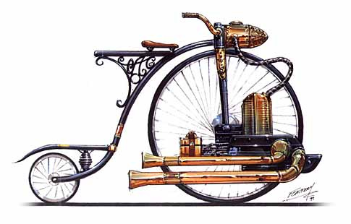
What is the scariest thing when designing something new?
The blank piece of paper!
The dangers of using the old system as a guide for the new, creating a souped-up anachronism
Old car IBS
skills
Notes:
A fancy way of saying keep it simple at the sharp end
Organisations who imagine all sort of complexity on the mobile – raising orders – NO,NO,NO
Throw away preconceptions, take expert guidance

Slide 12
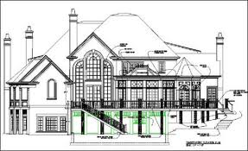
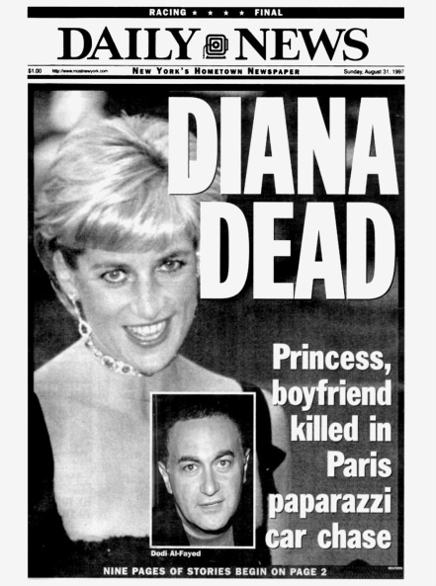
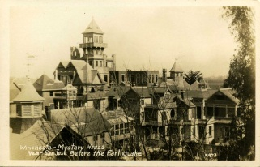
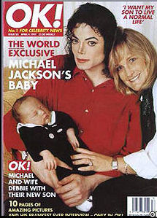
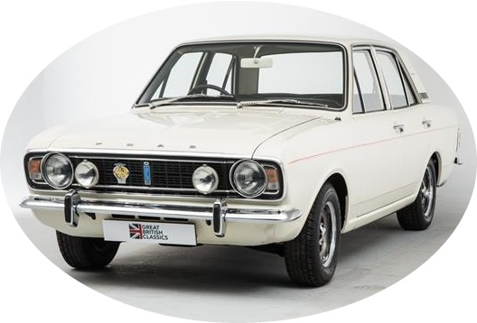
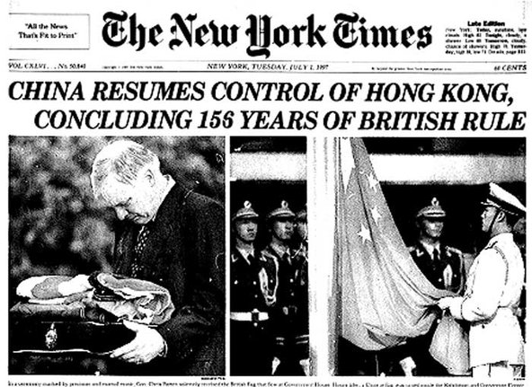
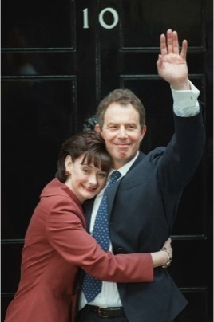
Outgoing bought-in solution- evolution or mutation?
Started as a clean design; 1997
20 years of user led modification …..
Winchester Mystery House
The original sprawling mansion
Started out as an 8 room house
38 years of continuous building works
Ended up a 7 storey, 160 room mansion covering 6 acres
and 1997 was a very long time ago,
In IT design and technology advancement terms……
it’s eons ago …
CADRE arrived
skills
Notes:
A fancy way of saying keep it simple at the sharp end
Organisations who imagine all sort of complexity on the mobile – raising orders – NO,NO,NO
Throw away preconceptions, take expert guidance

Slide 13
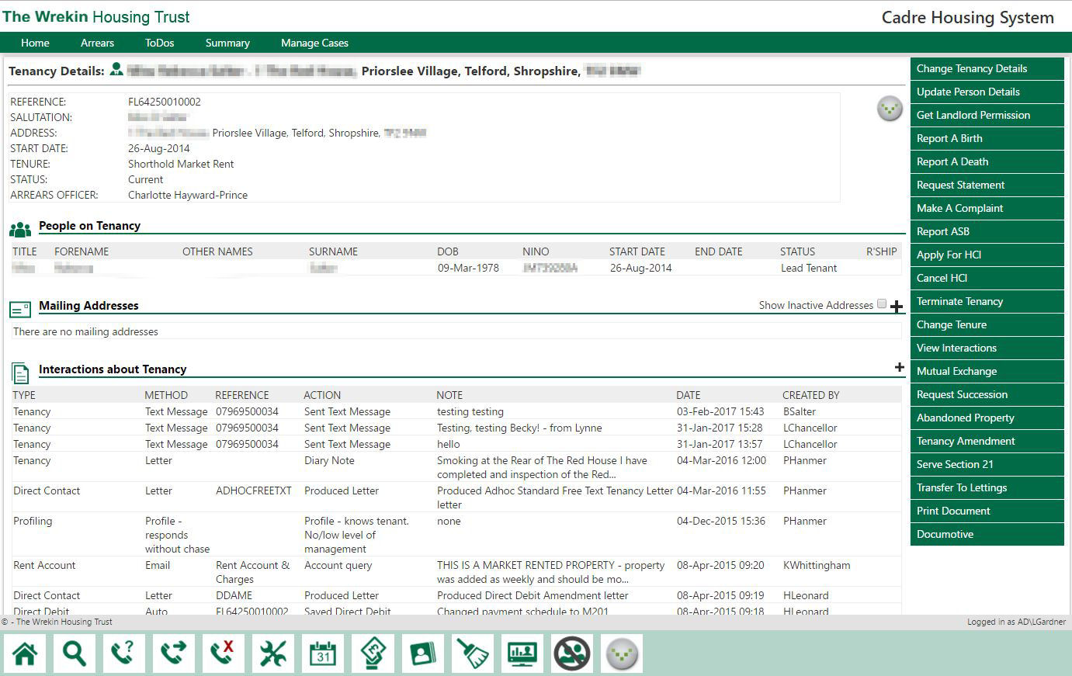
CADRE Housing has arrived!
So 21st Century!
Created in the 21st Century, for the 21st Century
User video
skills
Notes:
A fancy way of saying keep it simple at the sharp end
Organisations who imagine all sort of complexity on the mobile – raising orders – NO,NO,NO
Throw away preconceptions, take expert guidance

Slide 14
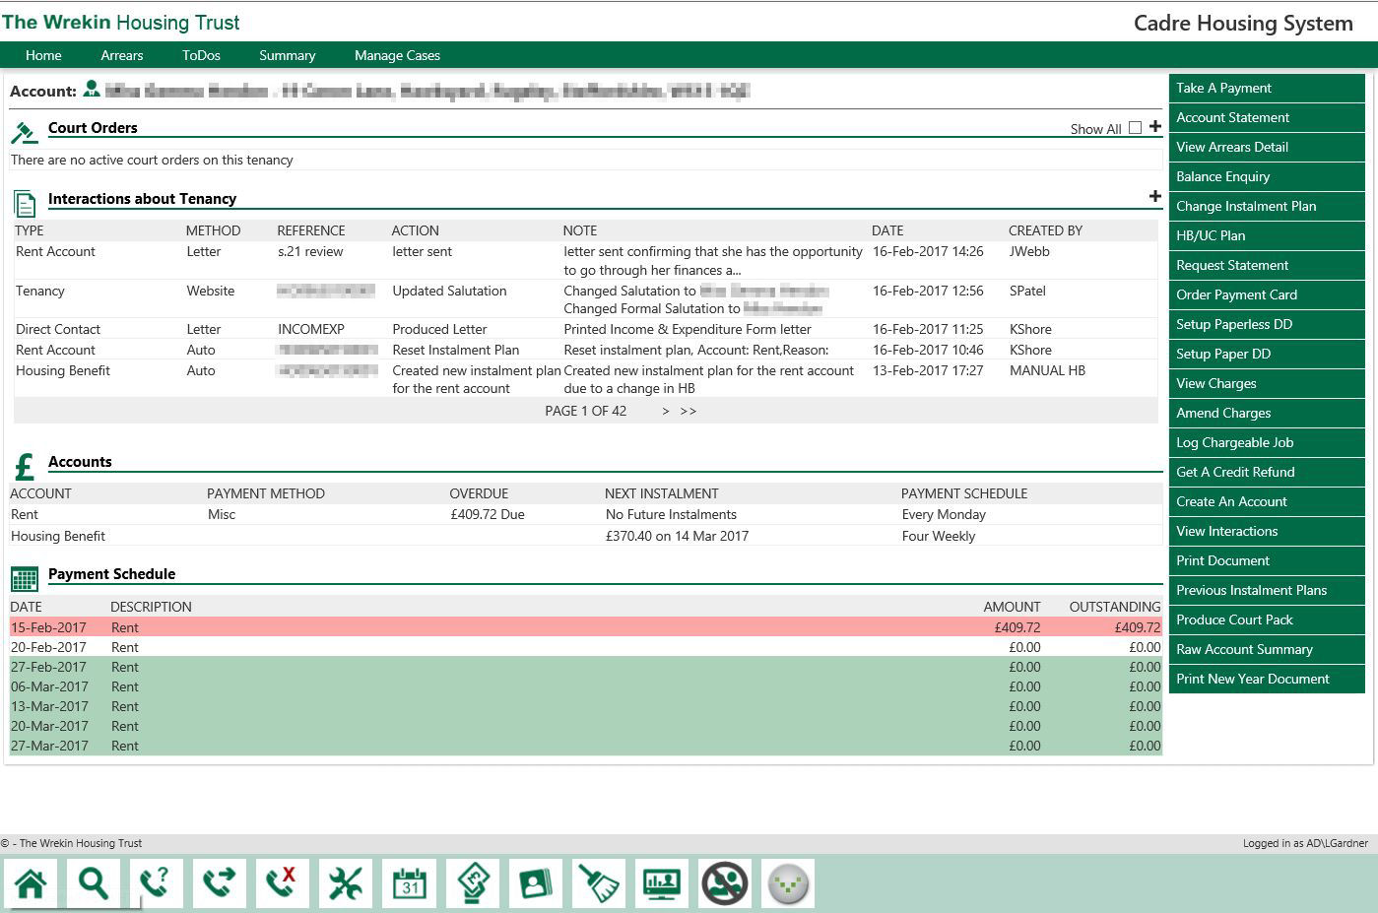
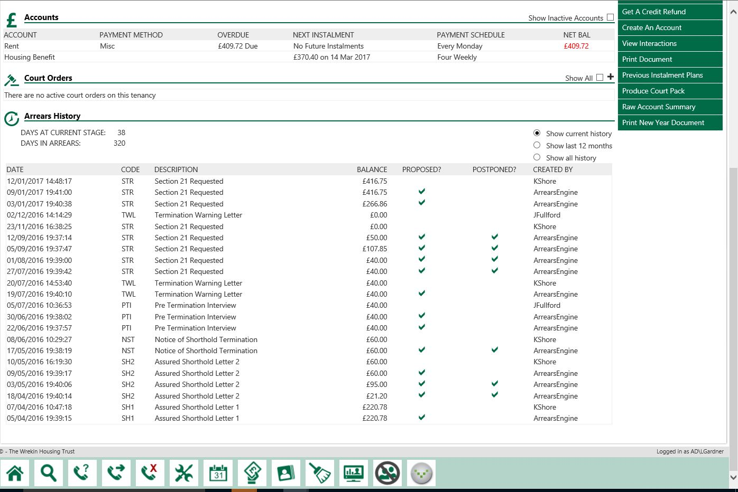
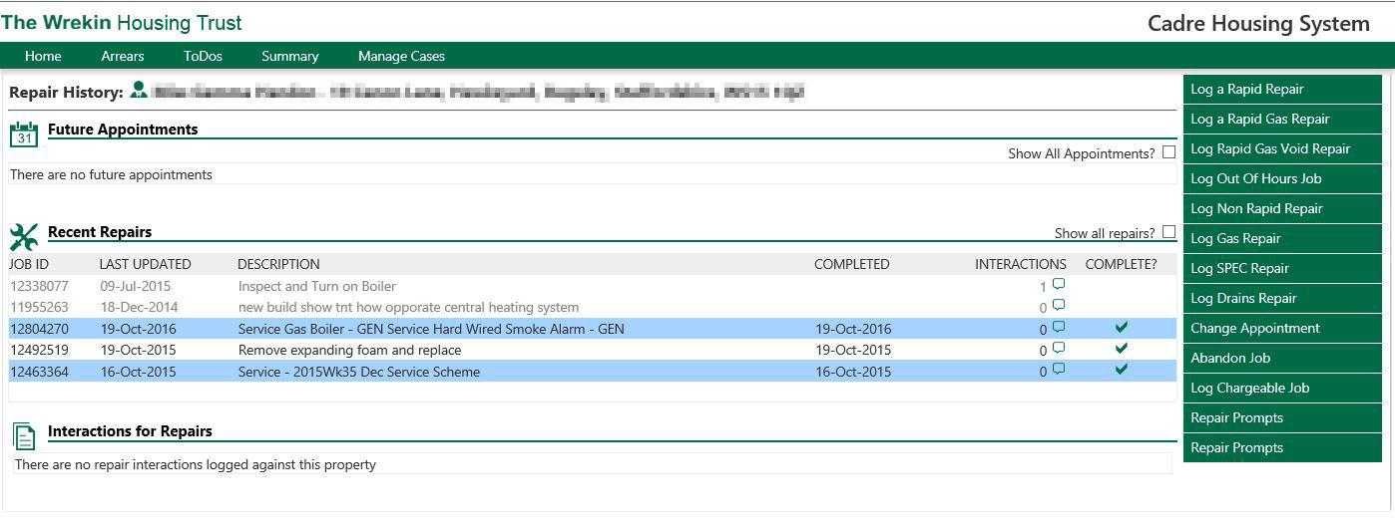
Design led by users
But how ?!?
Systems thinking
skills
Notes:
A fancy way of saying keep it simple at the sharp end
Organisations who imagine all sort of complexity on the mobile – raising orders – NO,NO,NO
Throw away preconceptions, take expert guidance

Slide 15
Systems Thinking!
Introducing ……
Why do customers call in from their point of view? What is our capability in responding to customer demands? How much of our work is, in truth, waste - and how much of this is created by the way the organisation works? www.systemsthinking.co.uk
Design team
Notes:
A fancy way of saying keep it simple at the sharp end
Organisations who imagine all sort of complexity on the mobile – raising orders – NO,NO,NO
Throw away preconceptions, take expert guidance

Slide 16
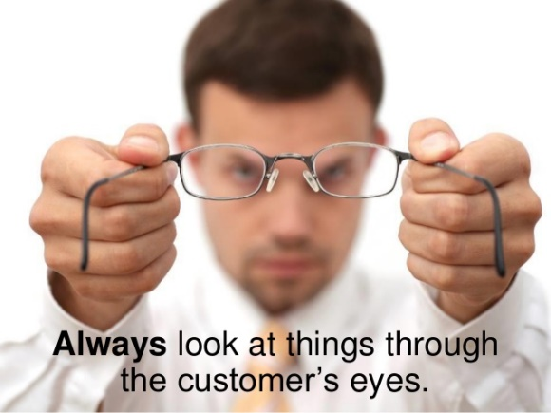
Systems Thinking!
Introducing ……
Each module led by a group of front line practitioners ….
Thinking outside the box, analysing demand, looking at the service through customers eyes….
Cadre sample screens
skills
Notes:
A fancy way of saying keep it simple at the sharp end
Organisations who imagine all sort of complexity on the mobile – raising orders – NO,NO,NO
Throw away preconceptions, take expert guidance

Slide 17
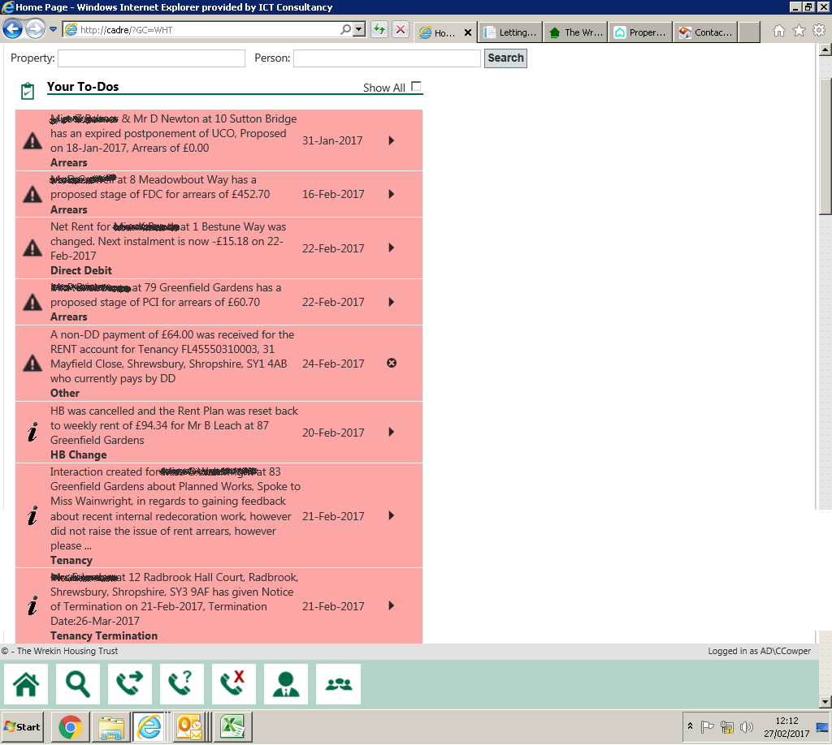
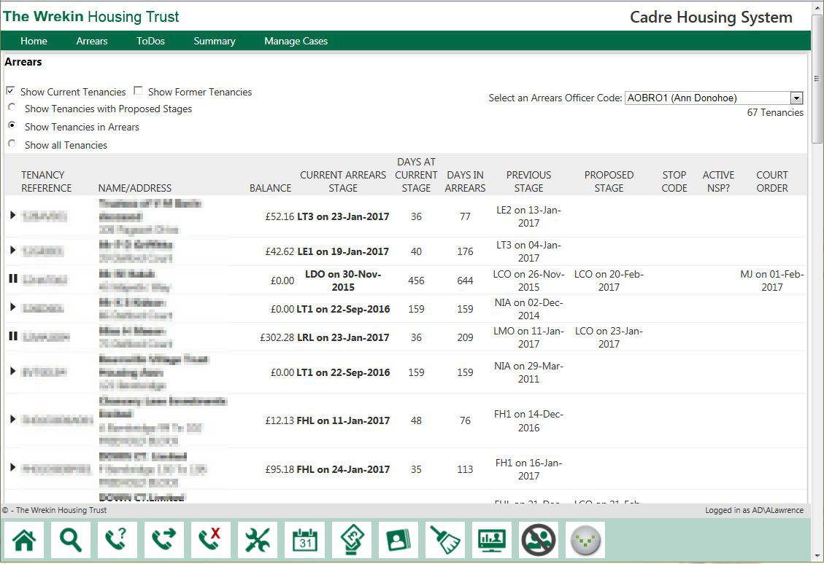
Systems Thinking!
Introducing ……
Fresh thinking, fresh ideas, new approaches….
Cadre accrosstix
skills
Notes:
A fancy way of saying keep it simple at the sharp end
Organisations who imagine all sort of complexity on the mobile – raising orders – NO,NO,NO
Throw away preconceptions, take expert guidance

Slide 18
Innovative design and technically up to date
21st Century ready
C
A
D
R
E
urrent
daptable
ependable
elevant
OPEN!
nabling
21st century ready
skills
Notes:
A fancy way of saying keep it simple at the sharp end
Organisations who imagine all sort of complexity on the mobile – raising orders – NO,NO,NO
Throw away preconceptions, take expert guidance

Slide 19
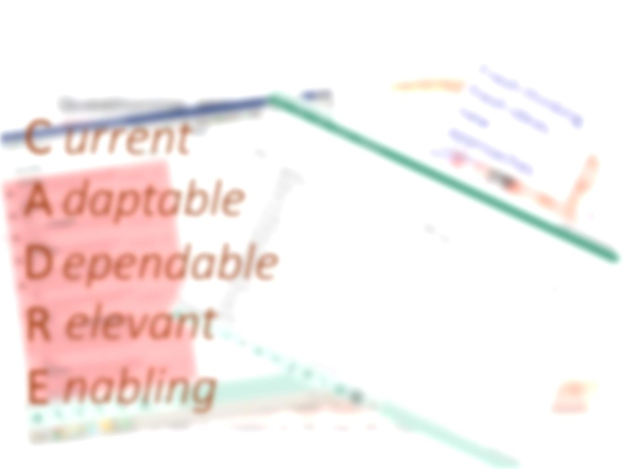
Innovative design and technically up to date
21st Century ready
Microsoft .Net Framework
Microsoft SQL
Browser Based, Cloud/SaaS ready
External Integration
MySQL database support
Disaster resilience, hot failover
MARKET LAUNCH !!!
OPEN!
21st century ready plain
skills
Notes:
A fancy way of saying keep it simple at the sharp end
Organisations who imagine all sort of complexity on the mobile – raising orders – NO,NO,NO
Throw away preconceptions, take expert guidance

Slide 20
Innovative design and technically up to date
21st Century ready
plain English! ……
No more processor stretching, fingers-crossed, Weekly/Fortnightly Debit Raise!
Arrears now!
Flexible instalment plans – personalised to fit paydays
OPEN!
anyone with a browser, on any device can access!
Change for the better
skills
Notes:
A fancy way of saying keep it simple at the sharp end
Organisations who imagine all sort of complexity on the mobile – raising orders – NO,NO,NO
Throw away preconceptions, take expert guidance

Slide 21
Before and After!
Change for the better ?
Product of its age!
Rambling
Costly
Supplier dictated level & pace of change
Before
Refreshed and current
Usable and intuitive
Investing in our future
Unfettered freedom to evolve
OPEN!
After!
Questions
skills
Notes:
A fancy way of saying keep it simple at the sharp end
Organisations who imagine all sort of complexity on the mobile – raising orders – NO,NO,NO
Throw away preconceptions, take expert guidance

Slide 22
Change for the better ?
Questions?
skills
Notes:
A fancy way of saying keep it simple at the sharp end
Organisations who imagine all sort of complexity on the mobile – raising orders – NO,NO,NO
Throw away preconceptions, take expert guidance

