Slide 1
Creating bespoke software
Richard Troote, Head of ICT
Sue Dickinson: Systems Thinking Facilitator
Notes:
Creating bespoke software is always a challenge; working with the business, the in-house IT department and a external IT supplier can be time consuming and frustrating. At Wales and West, the business wanted a unique solution to monitor resident’s needs and outcomes. Although based on a standard model, its requirements meant that an off-the-shelf application wasn’t suitable. They also wanted it integrated into Microsoft Dynamics. Join us and find out how we got on...
Wednesday 8th March 12:15 Exeter

Slide 2
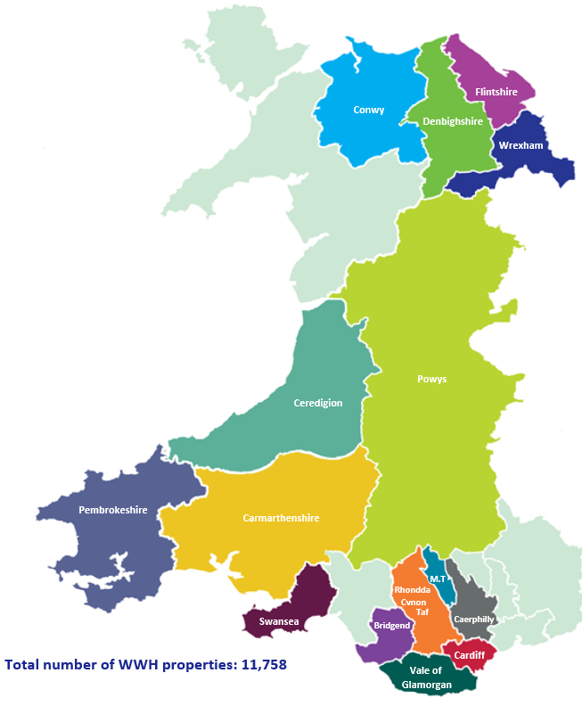
Area of Operation
Founded 1965
11, 758 Properties in Wales
300 New Properties on site
650 Staff

Slide 3
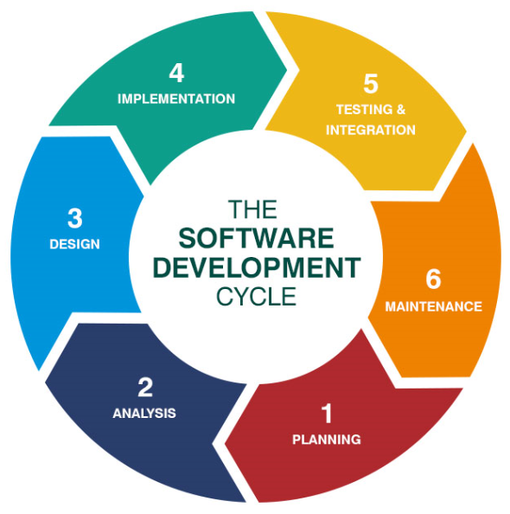
Bespoke Software Development
Notes:
Best practice tells us there are 6 stages to the software development cycle, they are all painful!
How many in the room have commissioned a third party to right bespoke software?

Slide 4
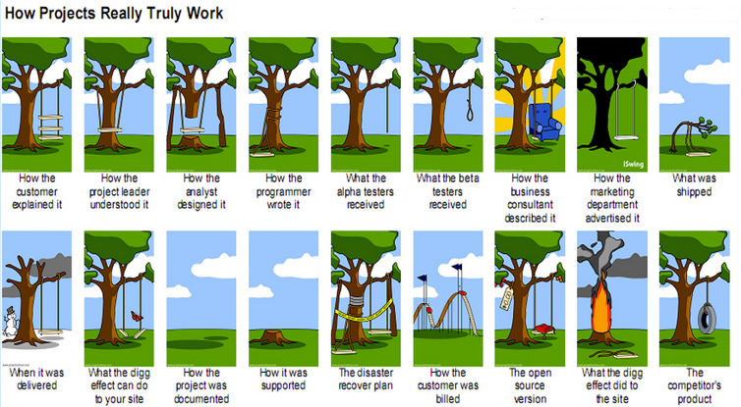
This can be the reality……
Notes:
It doesn’t always go to plan

Slide 5
Stage 1 – Planning
What does the business want?
Why does it have to be different?
Notes:
Who better to tell you the requirements than the business, so here is Sue

Slide 6
Systems Thinking (Vanguard)
2 rules
Don’t break the law
Improve first, then pull I.T

Slide 7
Our Tenancy Sustainability Journey
Started with the customer

Slide 8
We had to understand from the customer perspective
What are we here to do?
What are our applicants/Residents asking for (demand)
What Matters?
What is the right problem to fix?

Slide 9
We decided to follow some customer journeys to see what our system looked like from their perspective

Slide 10
We weren’t so good at meeting the person …
Set procedures – whatever the circumstances
Standard forms
Lengthy Support plans (everyone over 55 needs support …)!!
Packs of unwanted information
External influences and barriers
Everyone got treated the same!

Slide 11
We worked in silo’s – we didn’t always share information

Slide 12
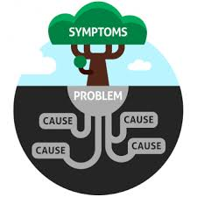
By following customer journeys, we found that we were often not fixing the right problem
So we experimented and tried something radical!

Slide 13
We tried having a conversation
We tried some different questions
and even started listening ..

Slide 14
No forms no unnecessary paperwork!

Slide 15
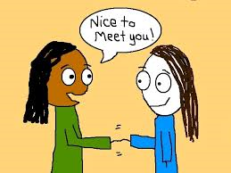
And guess what ...

Slide 16
Measures
Pyramid
Outcome Star

Slide 17
Pyramid
I’m in Chaos
I need some help
I’m ok

Slide 18
I can’t pay my rent (I have a drink problem, I need help to stop)
Can I have a transfer? (I don’t feel safe, everyone is out to get me)
Can you come and talk to me? (I am lonely)
I want to complain about the repairs again (No one is listening to what I really want)
Can I apply for a property with you? (I would prefer to stay where I am but I am having problems with the neighbours)

Slide 19
Presenting demand is often a 'symptom' of something else; to categorise it could have resulted in fixing the wrong problem

Slide 20
After trialling the outcome star on paper, we went to our IT department and asked them if they could help us make it work better …

Slide 21
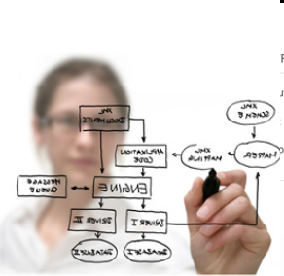
Step 2 - Analysis
Understand what the business needs
Create wireframes
Select resources to deliver solution

Slide 22
Step 3 - Design
Specification document (Including hardware requirements)
Agreed design
Quotation/negotiation
Agreed specification
Notes:
Discuss specification including hardware requirements (always a laugh), agree design

Slide 23
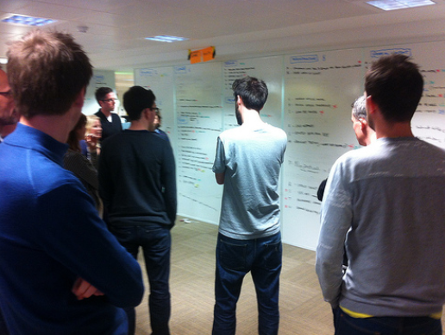
Step 4 – Implementation
Code application
System Testing
(does the software look like the specification document)
Build hardware environment
Install beta version for UAT
So…… Back to Step 3
Notes:
Supplier started work and got quite far until…
Business had a change of heart so back to design and specification,
So this made some of the work obsolete and increased costs within the project as supplier already had a contract, so variations were expensive

Slide 24
Step 3 - Design
Specification document (Including hardware requirements)
Agreed design
Quotation/negotiation
Agreed specification
Notes:
Repeat steps
Much more difficult negotiation this time on cost

Slide 25
Step 4 – Implementation
Try again….
Code application
System Testing
(does the software look like the specification document)
Build hardware environment
Install beta version for UAT
Notes:
Code made
System tested by supplier (hopefully)
New server environment built to supplier specification
Application installed, second attempt as forgot to bring the right USB stick the first time! Grrrrrrrrrrrrrrrrr

Slide 26
Step 5 – Testing and Integration
Integration testing
UAT - Pilot
Expand UAT
Feedback to Supplier
Recode
Agree remedial actions
Notes:
Integration Testing – Does it work in our environment – Not compatible with IE11, Doesn’t render correctly on tablets etc etc
UAT – Pilot
Expand UAT
Feedback to supplier
Agree remedial actions

Slide 27
Step 6 – Maintenance/Change
Ensure you have agreed procedures for maintenance
Try and anticipate requirements changes
Agree a fixed rate or discount rate for enhancements
Notes:
Don’t assume the supplier will come to site – they would rather work remotely
Try and build in easy upgrades to functionality by anticipating future business requirements
Look to discount future work, often companies will do this when trying to sign a contract

Slide 28
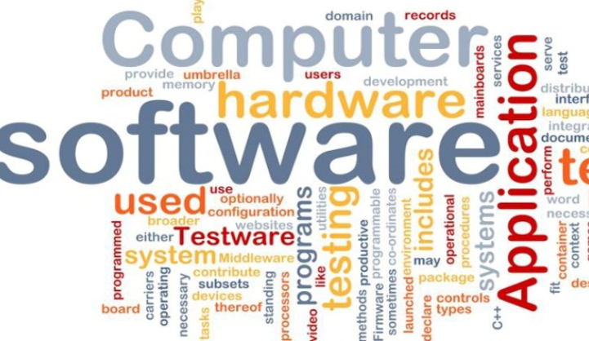
What it looks like
A web App embedded into MS Dynamics
Fully integrated with Resident/Property information
Flexible to deliver future requires, we hope

Slide 29
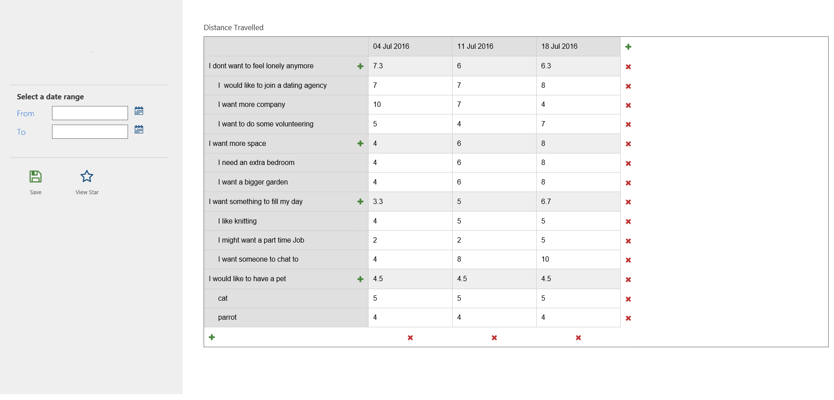
Resident Name
Property Address
Notes:
Data Grid for input

Slide 30
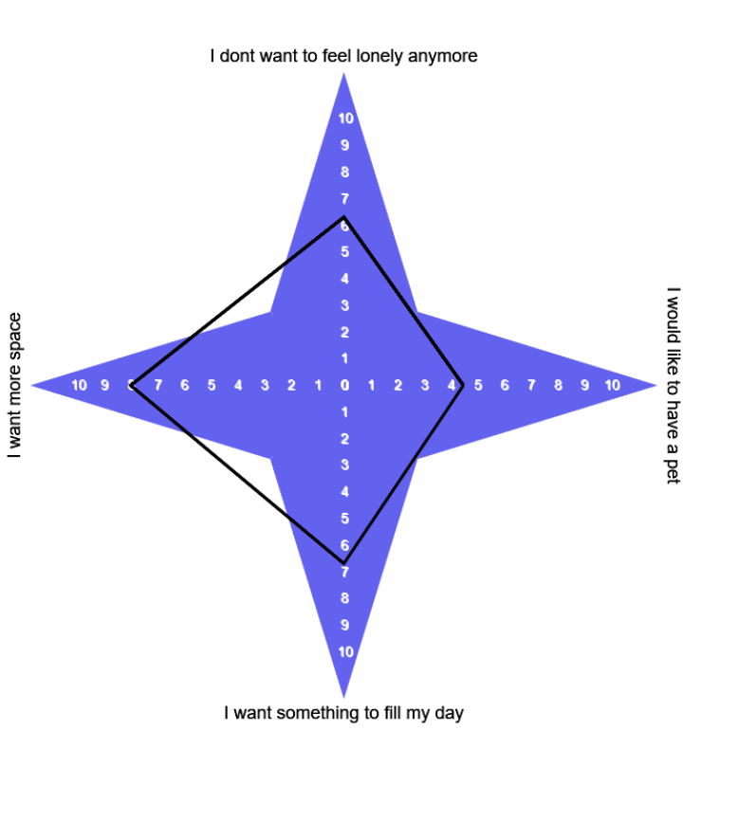
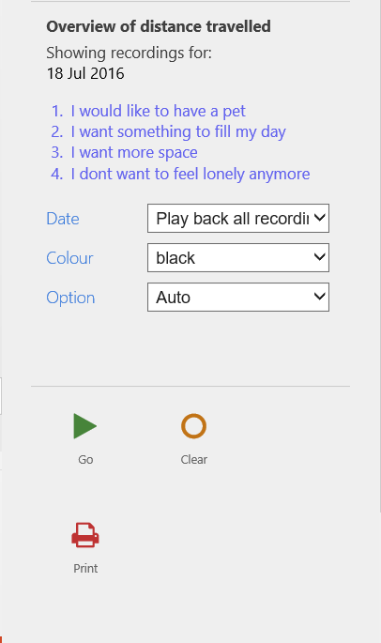
Notes:
Outcome Star

Slide 31
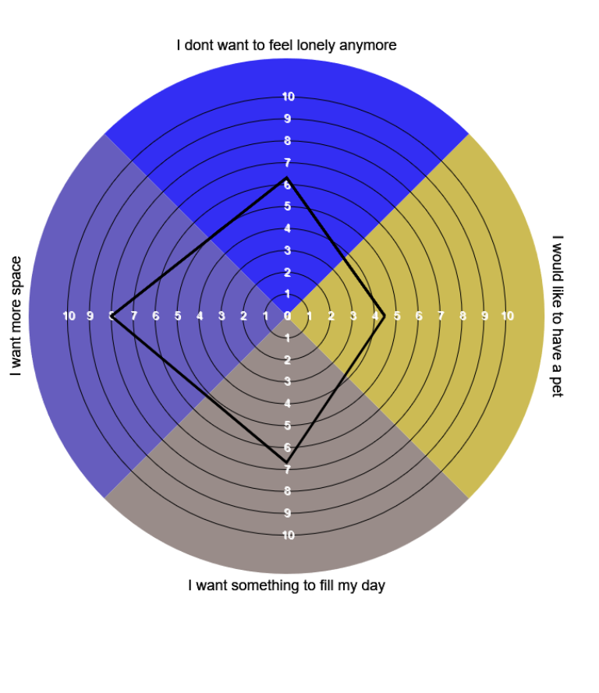
Notes:
Alternative grpah

Slide 32
Lessons Learned
Make sure the business signs off on the requirements
Have a robust specification document
Agree firm milestones to check progress
Agree implementation process in advance
Expect problems and cost over runs

