Slide 1
Crawl, Walk…then Run Like the Wind: Leveraging All Things Data.
Norma Dove-Edwin
Chief Data and Information Officer
Lifeblood:
Data Management in Housing
September 2018

Slide 2
Crawl, Walk…then Run Like the Wind: Leveraging All Things Data.
Places for People – Who We Are
The Mission
Goals and Challenges
The Mission
Tackling the Mission
A View of Success
Making it Real
Our Enablers
Notes:
Why are we doing this? What are our challenges? What’s the problem we are trying to solve?
What are we going to do? How are we going to solve it?
What does our journey look like?
What will success look like?

Slide 3
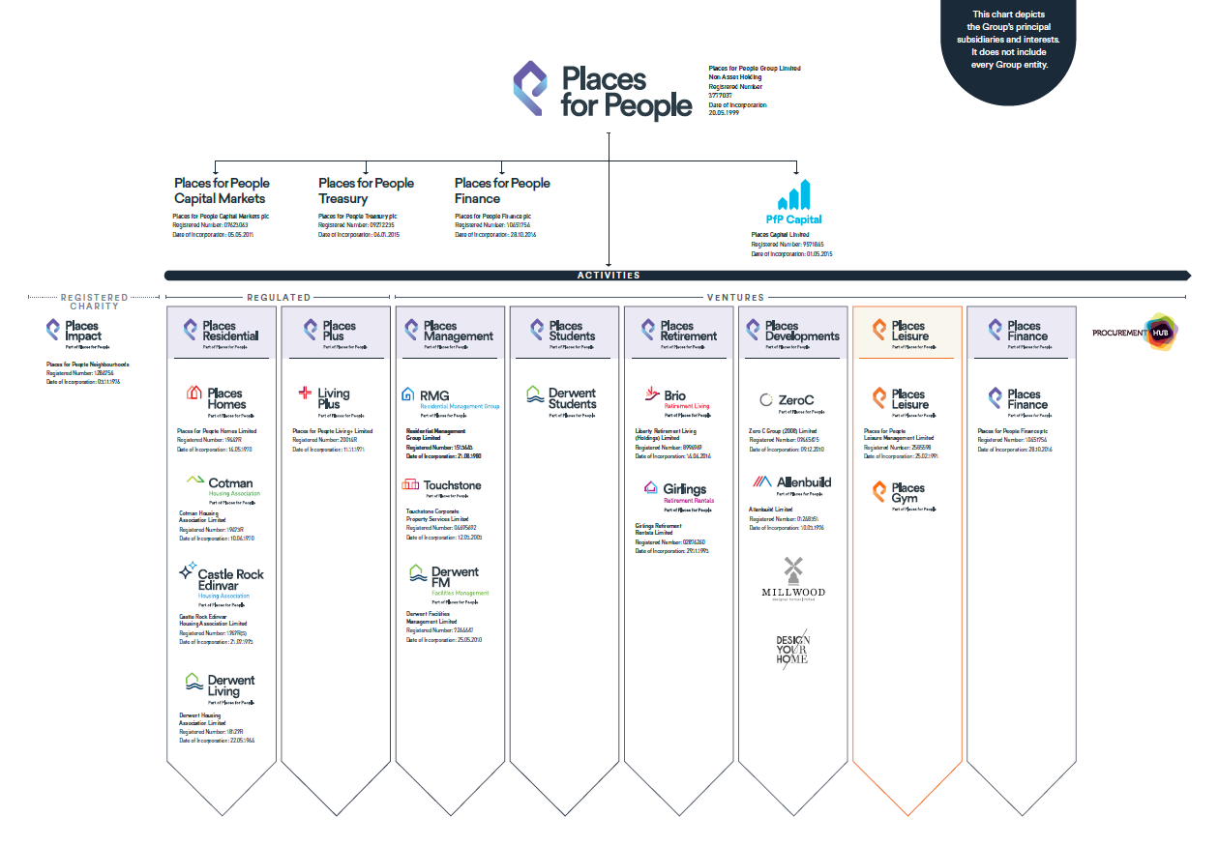
Who We Are
We are a placemaker.
It’s our mission to build sustainable communities that are for everyone.
East Wick & Sweetwater, London; Smith’s Dock, North Tyneside
Over 50 years’ experience.
Commercial approach to delivering social outcomes - 100% of our profits go back into our work in the business.
Own or manage over 190,000 properties
Turnover c.£800m
Employees 12,500

Slide 4
The Mission

Slide 5
Key Goals and Challenges
Key Goals
Improve the Customer (Client) Experience by delivering excellent products and services.
Grow and proactively manage our asset base.
Exceed our social value delivery targets.
Key Challenges
Rapid growth through M&A activity
Made up of over 20 specialist companies
Federated organisational structure with varying degrees of autonomy.
Complex and diverse technology and application landscape, with a high level of functional duplication.
Disparate data formats, standards and nomenclature.
Siloed ways of working

Slide 6
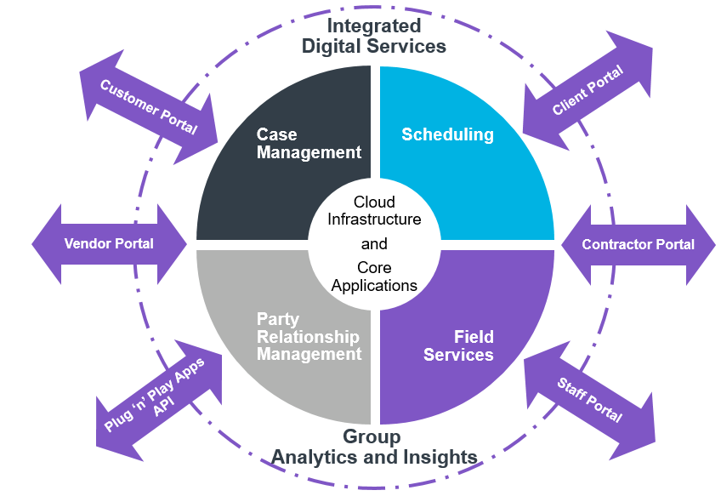
Our Digital Mission
Our digital strategy is synonymous with our business strategy
Build for the future…be ready for continuous improvement (change)
Notes:
Digital Strategy embedded in the business strategy – data management/strategy is not a single aim or goal
Cloud infrastructure
Technology
Data Platform

Slide 7
The Information Brief
What We Said…
We’re going to take data to the next level to deliver analytics and insights.
Why?
To becoming a digital business and improve the Customer’s experience:
Using facts and insights to drive actions and continuously improve products and services.
Using technology to:
Improve the way we work so
that we can focus on value-add Customer driven activities.
Improve the way our Customers interact with us.
How?
By defining the purpose of data: asking questions, what do we want to/need to know?
The Impact
Data will be managed as a Group asset through the Group’s data governance structure.
Subsidiaries and business functions map to local data to the single Group data design that will create a common language.
Notes:
Analytics and insights to drive better products and services
Driven by our internal ways of working: digitisation of the workforce ways of working

Slide 8
Tackling the Mission
We became part of the conversation!
BUSINESS PARTNERING: to truly partner with the other business functions:
Gaining a seat at the table to understand and shape the business strategy and operating model – how we work and want to work.
Starting with the problem – what questions are we trying to answer (not technology!).
Engaging in lots and lots of conversations…innovation usually happens through conversation and idea swapping.
Finding sponsors and supporters to secure budget (and knowing who the indifferents are!)

Slide 9
Delivering our Mission
Analytics and Insights
The berry on the cake!
Fact-based point of view, predictions and scenario planning driving actions.
The Engine Room and Foundations
Data platform to provide a single source for analytics, machine learning and mining
Cloud approach to refresh our infrastructure to be agile, plug and play, future ready to support innovation and improvement (change)
Digital Layer to provide apps and API for our internal and external Customers – the heterogeneous edge
Technology to continuously improve the way we work and engage with our Customers
Data Governance and Management
The base to good quality data.

Slide 10
What Will Success Look Like?

Slide 11
Knowing Our Customers
Analysis on our Customer demographics and property requirements
Analysis on the Customer behaviours, experiences and requirements.
Rent Mid-Market
Retirement
Rent Affordable
Buy Affordable
Buy Mid-Market
Student
Downsize
Supported Living
Analysis to inform the type off units required and the location.
Analysis on payment methods.
Analysis on Customer satisfaction and service delivery.
Analysis on debt management.
Analysis on Customer contact and digital inclusion.
Analysis to provide targeted Customer services
Knowing our Customers: keeping the conversation going to improve their experience

Slide 12
Our Homes
Data on units types:
own
manage
own and manage
Analysis on income collection, debt recovery and customer financial support.
Manage
Repairs
Own
Voids
Yield
Location
Major Works
Disposal
Invest
Predictive analysis to facilitate major works and assets repairs
Analysis on voids to maximise occupancy.
Analysis on workforce planning, demand vs supply, time on job
Analysis on property yield for a balanced portfolio.
Analysis on location of properties: Flood risk? Competitors? Infrastructure?
Analysis on unit portfolio management: Invest? Dispose? Location?
Proactively managing our homes to continuously improve our Customer’s experience

Slide 13
Making It Real

Slide 14
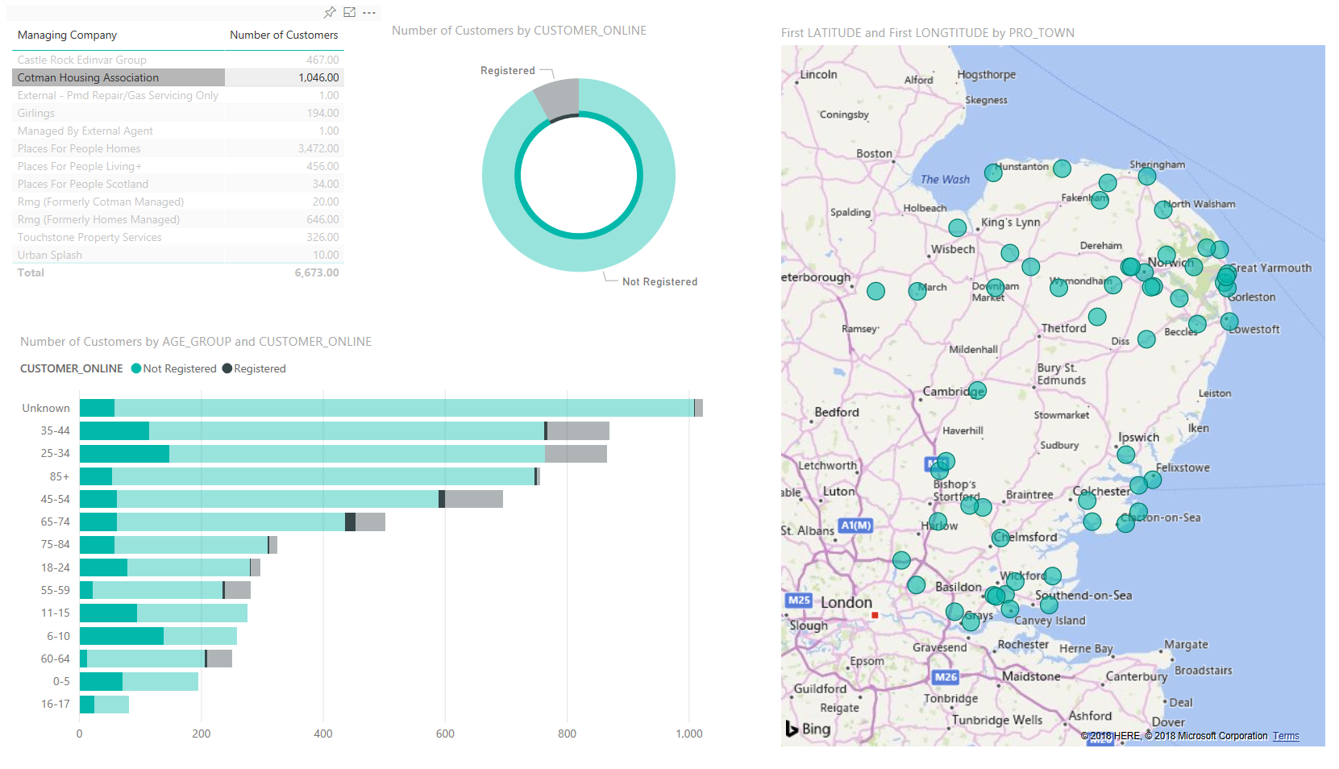
Making it Real
Demographic data to know our customer and deliver insights

Slide 15
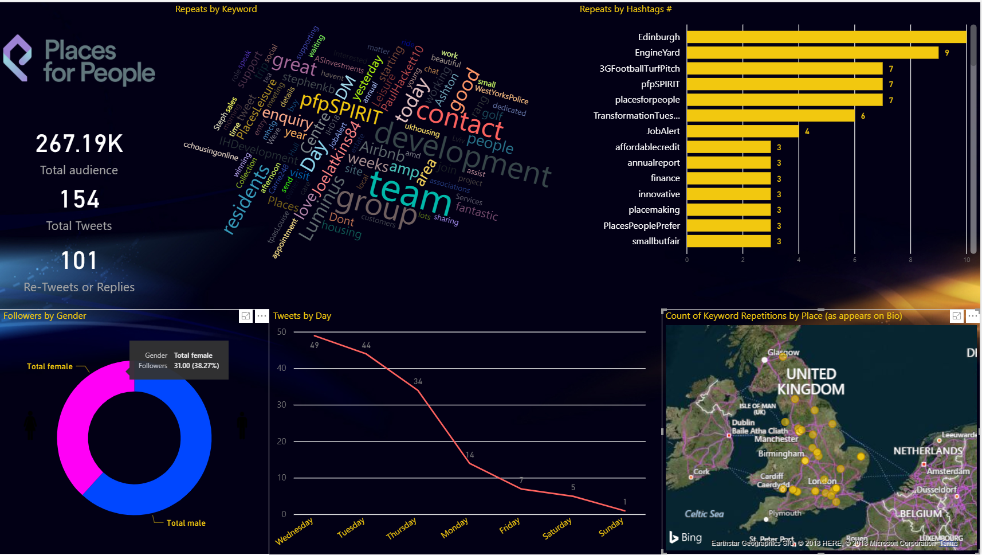
Making it Real
Integrating social media data to understand sentiment and improve communications

Slide 16
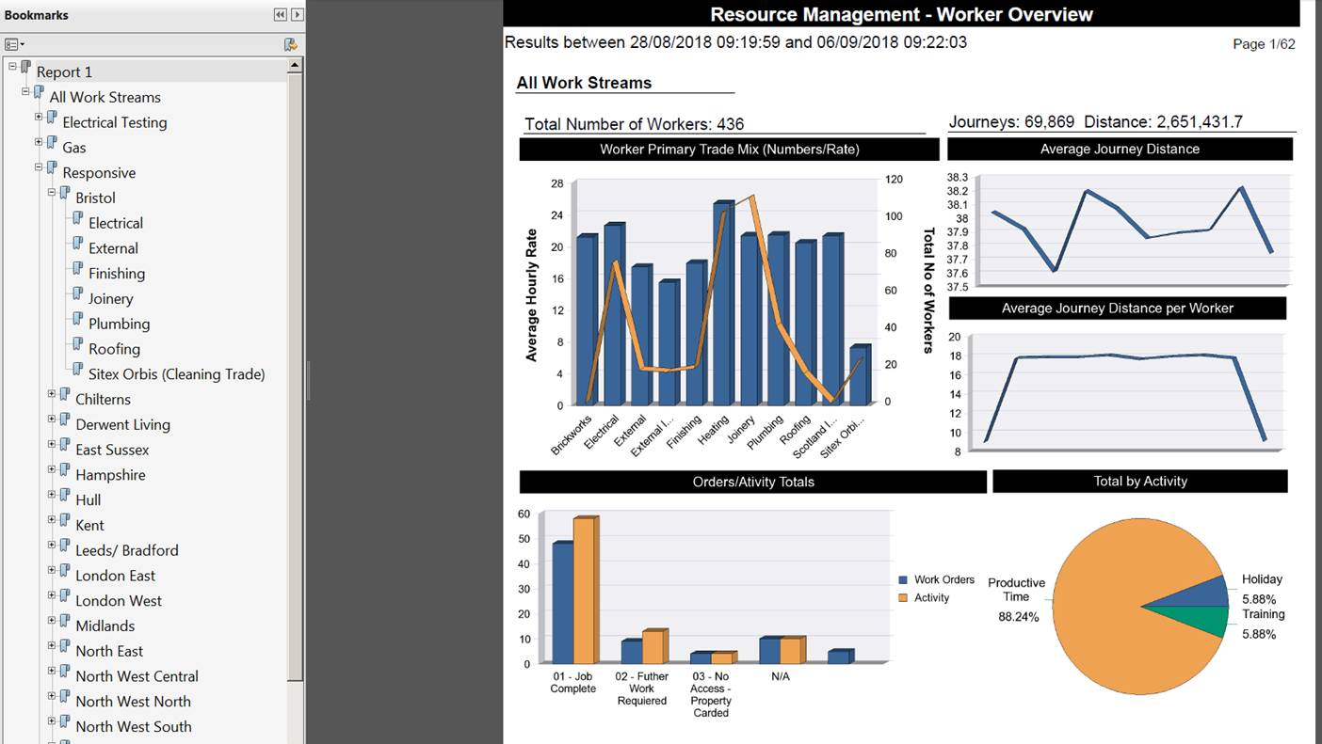
Making it Real
Workforce Planning to maximise productivity via demand vs supply

Slide 17
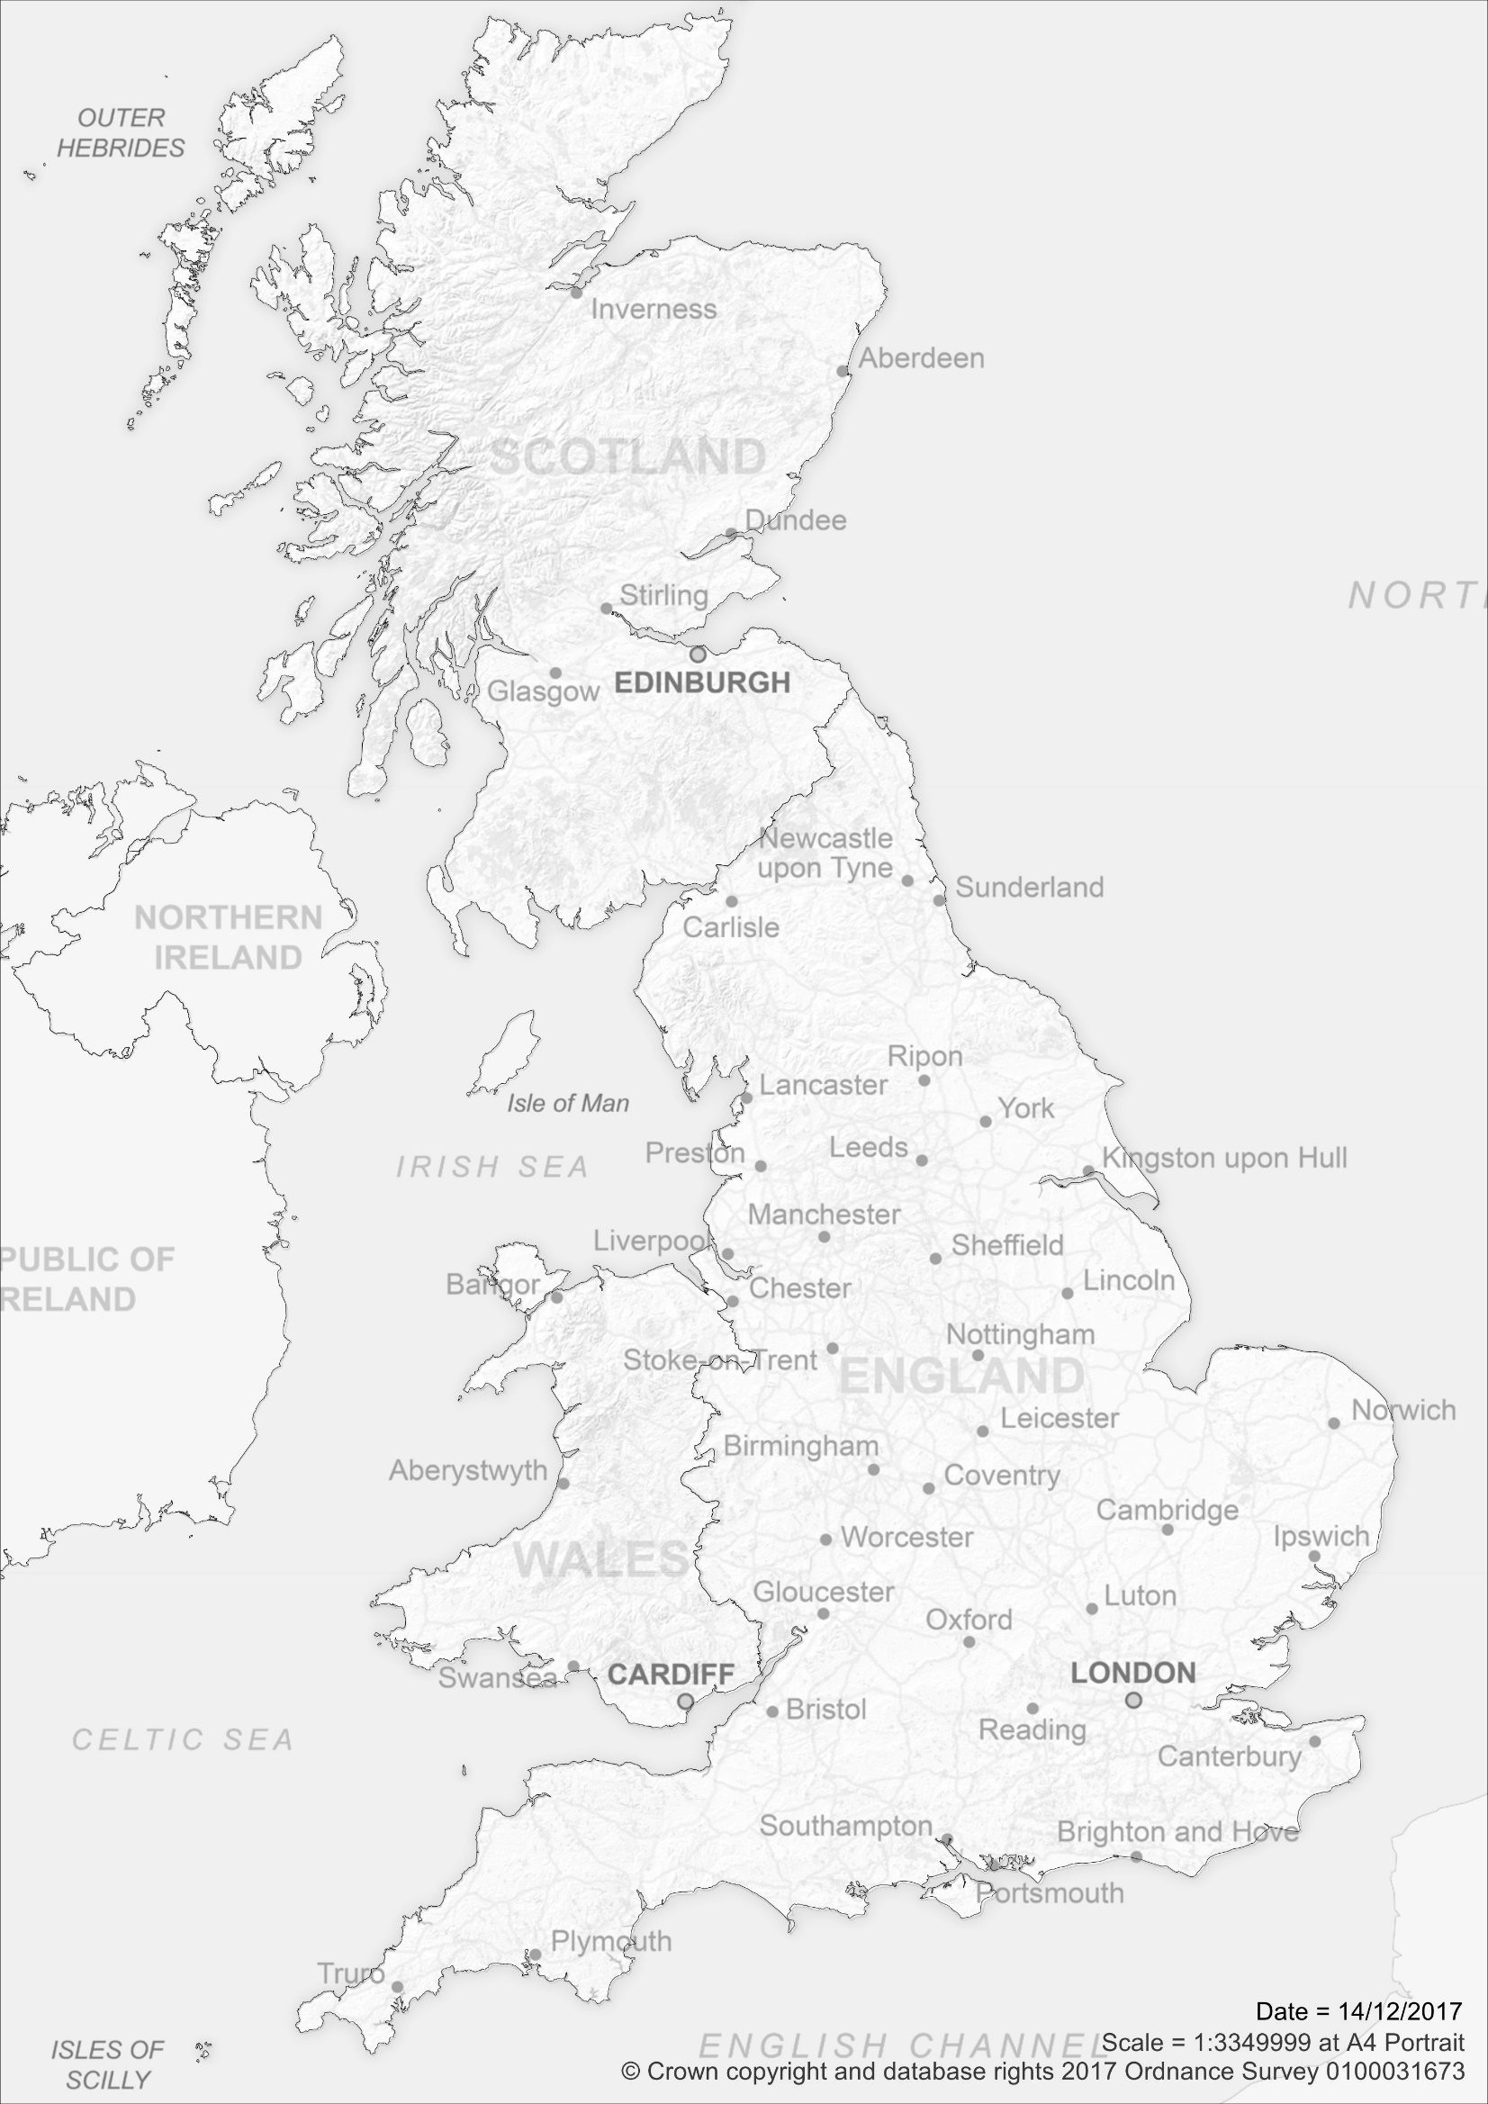
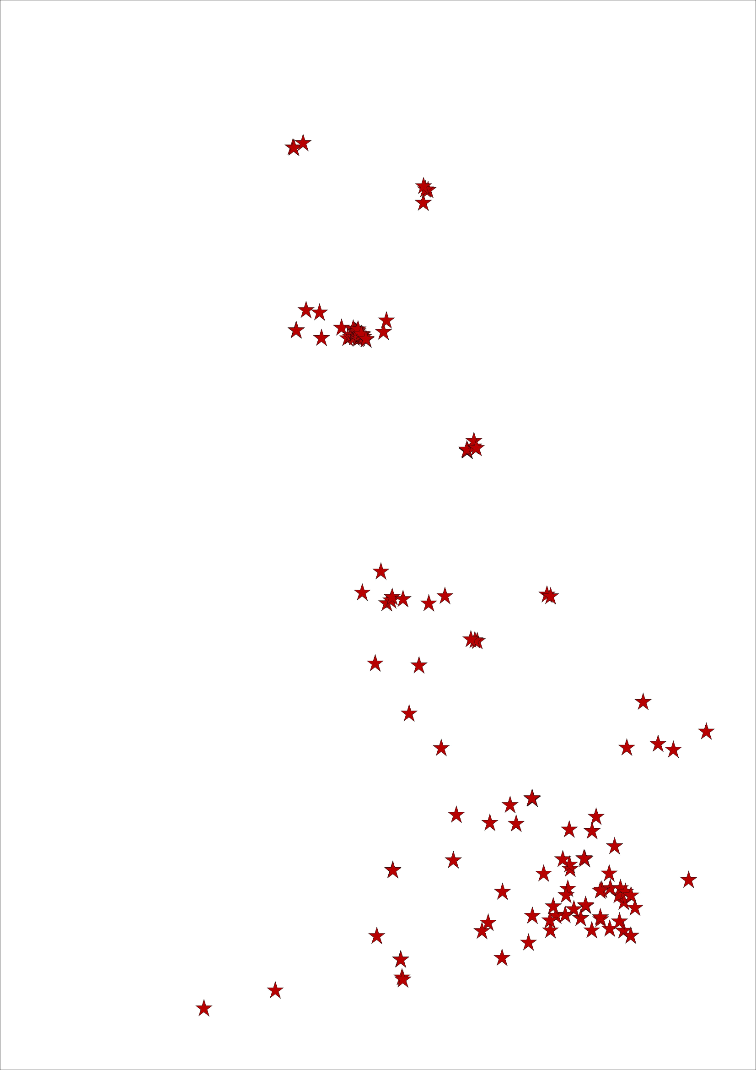
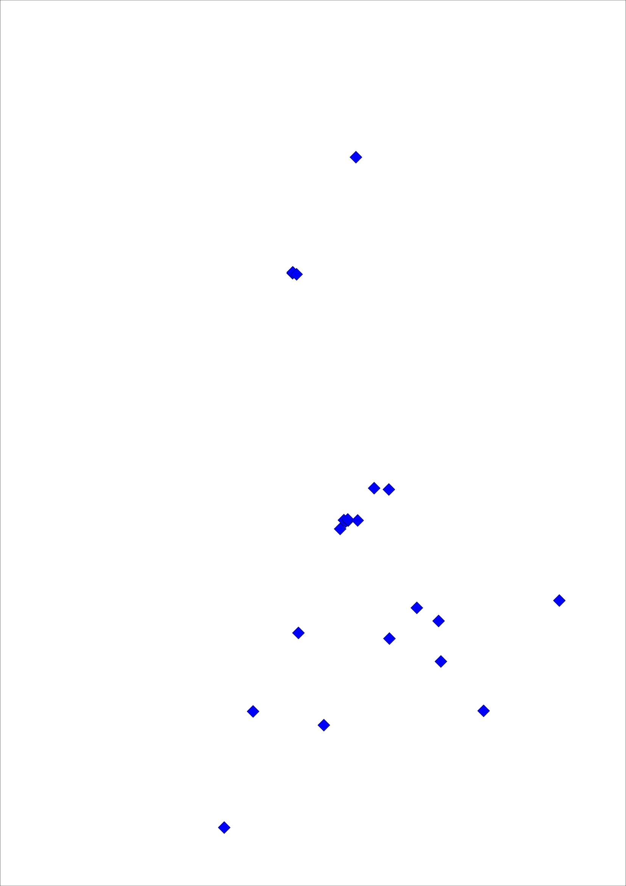
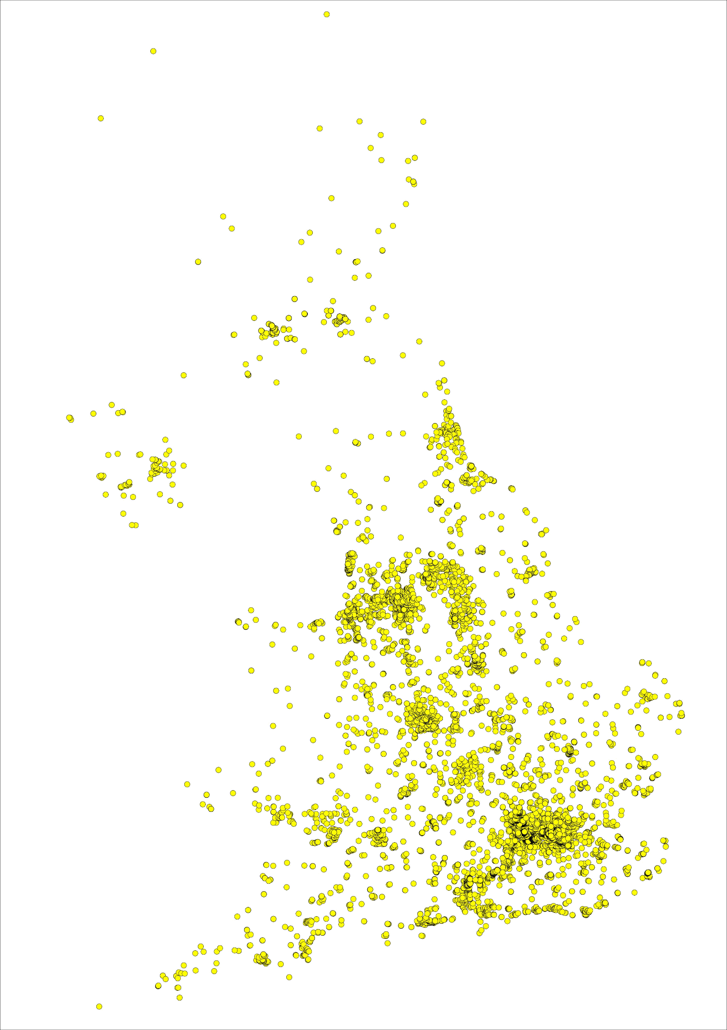
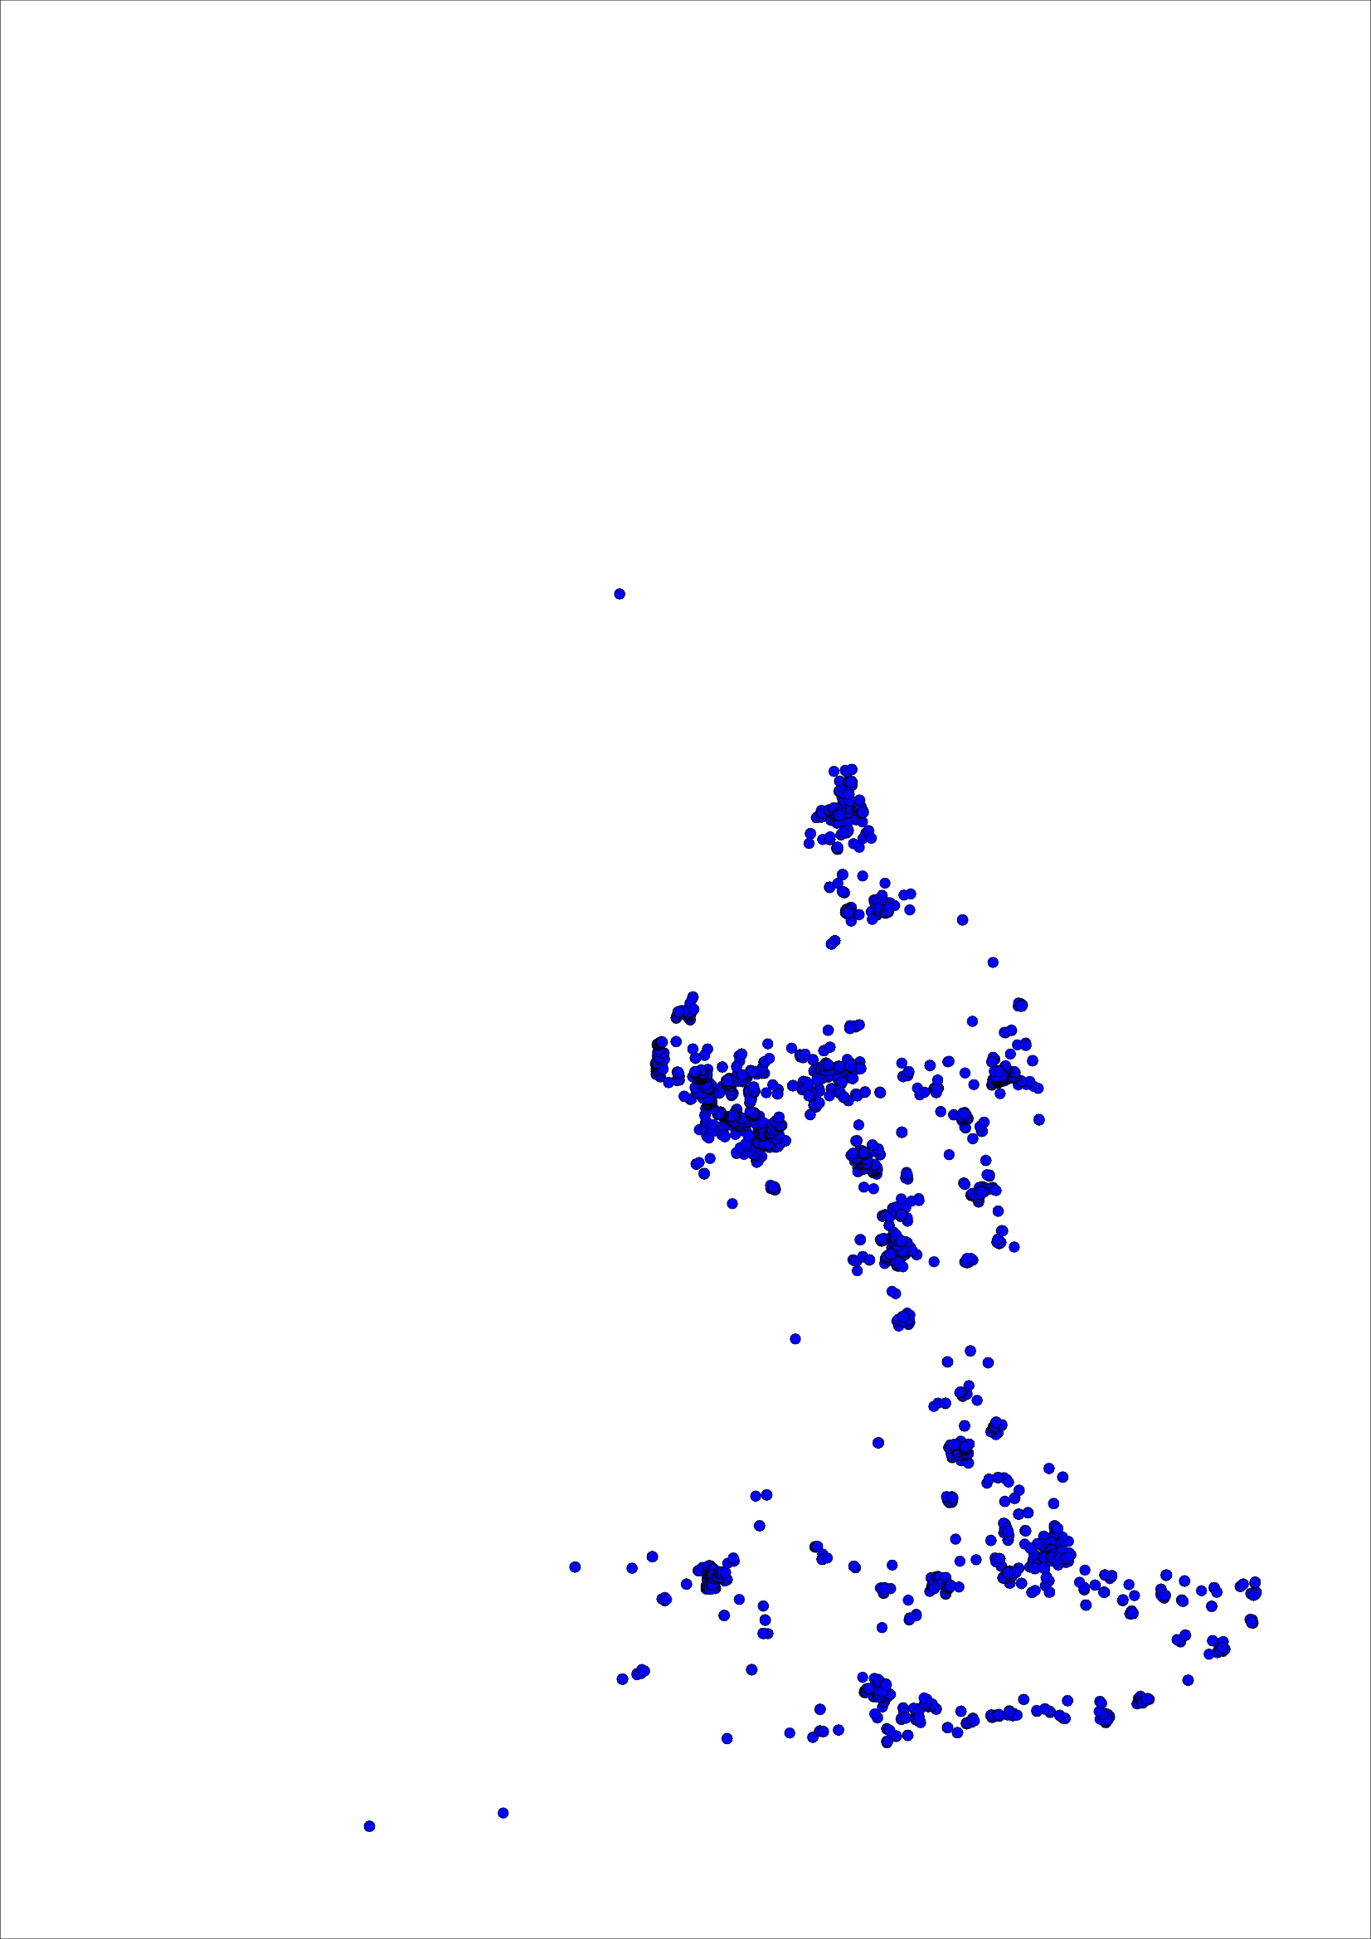
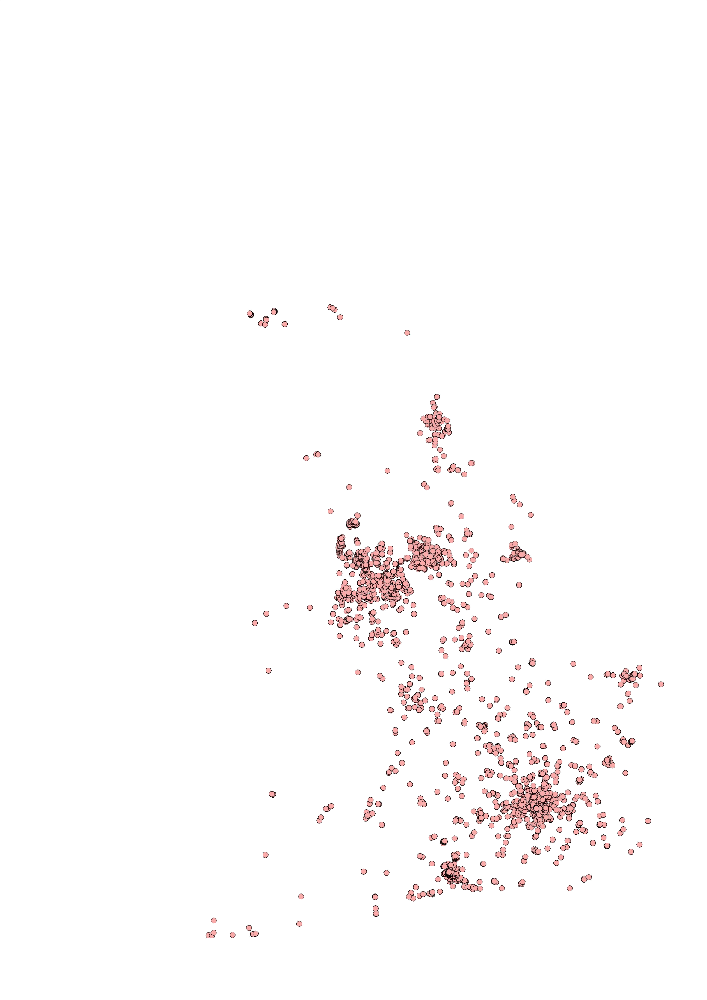
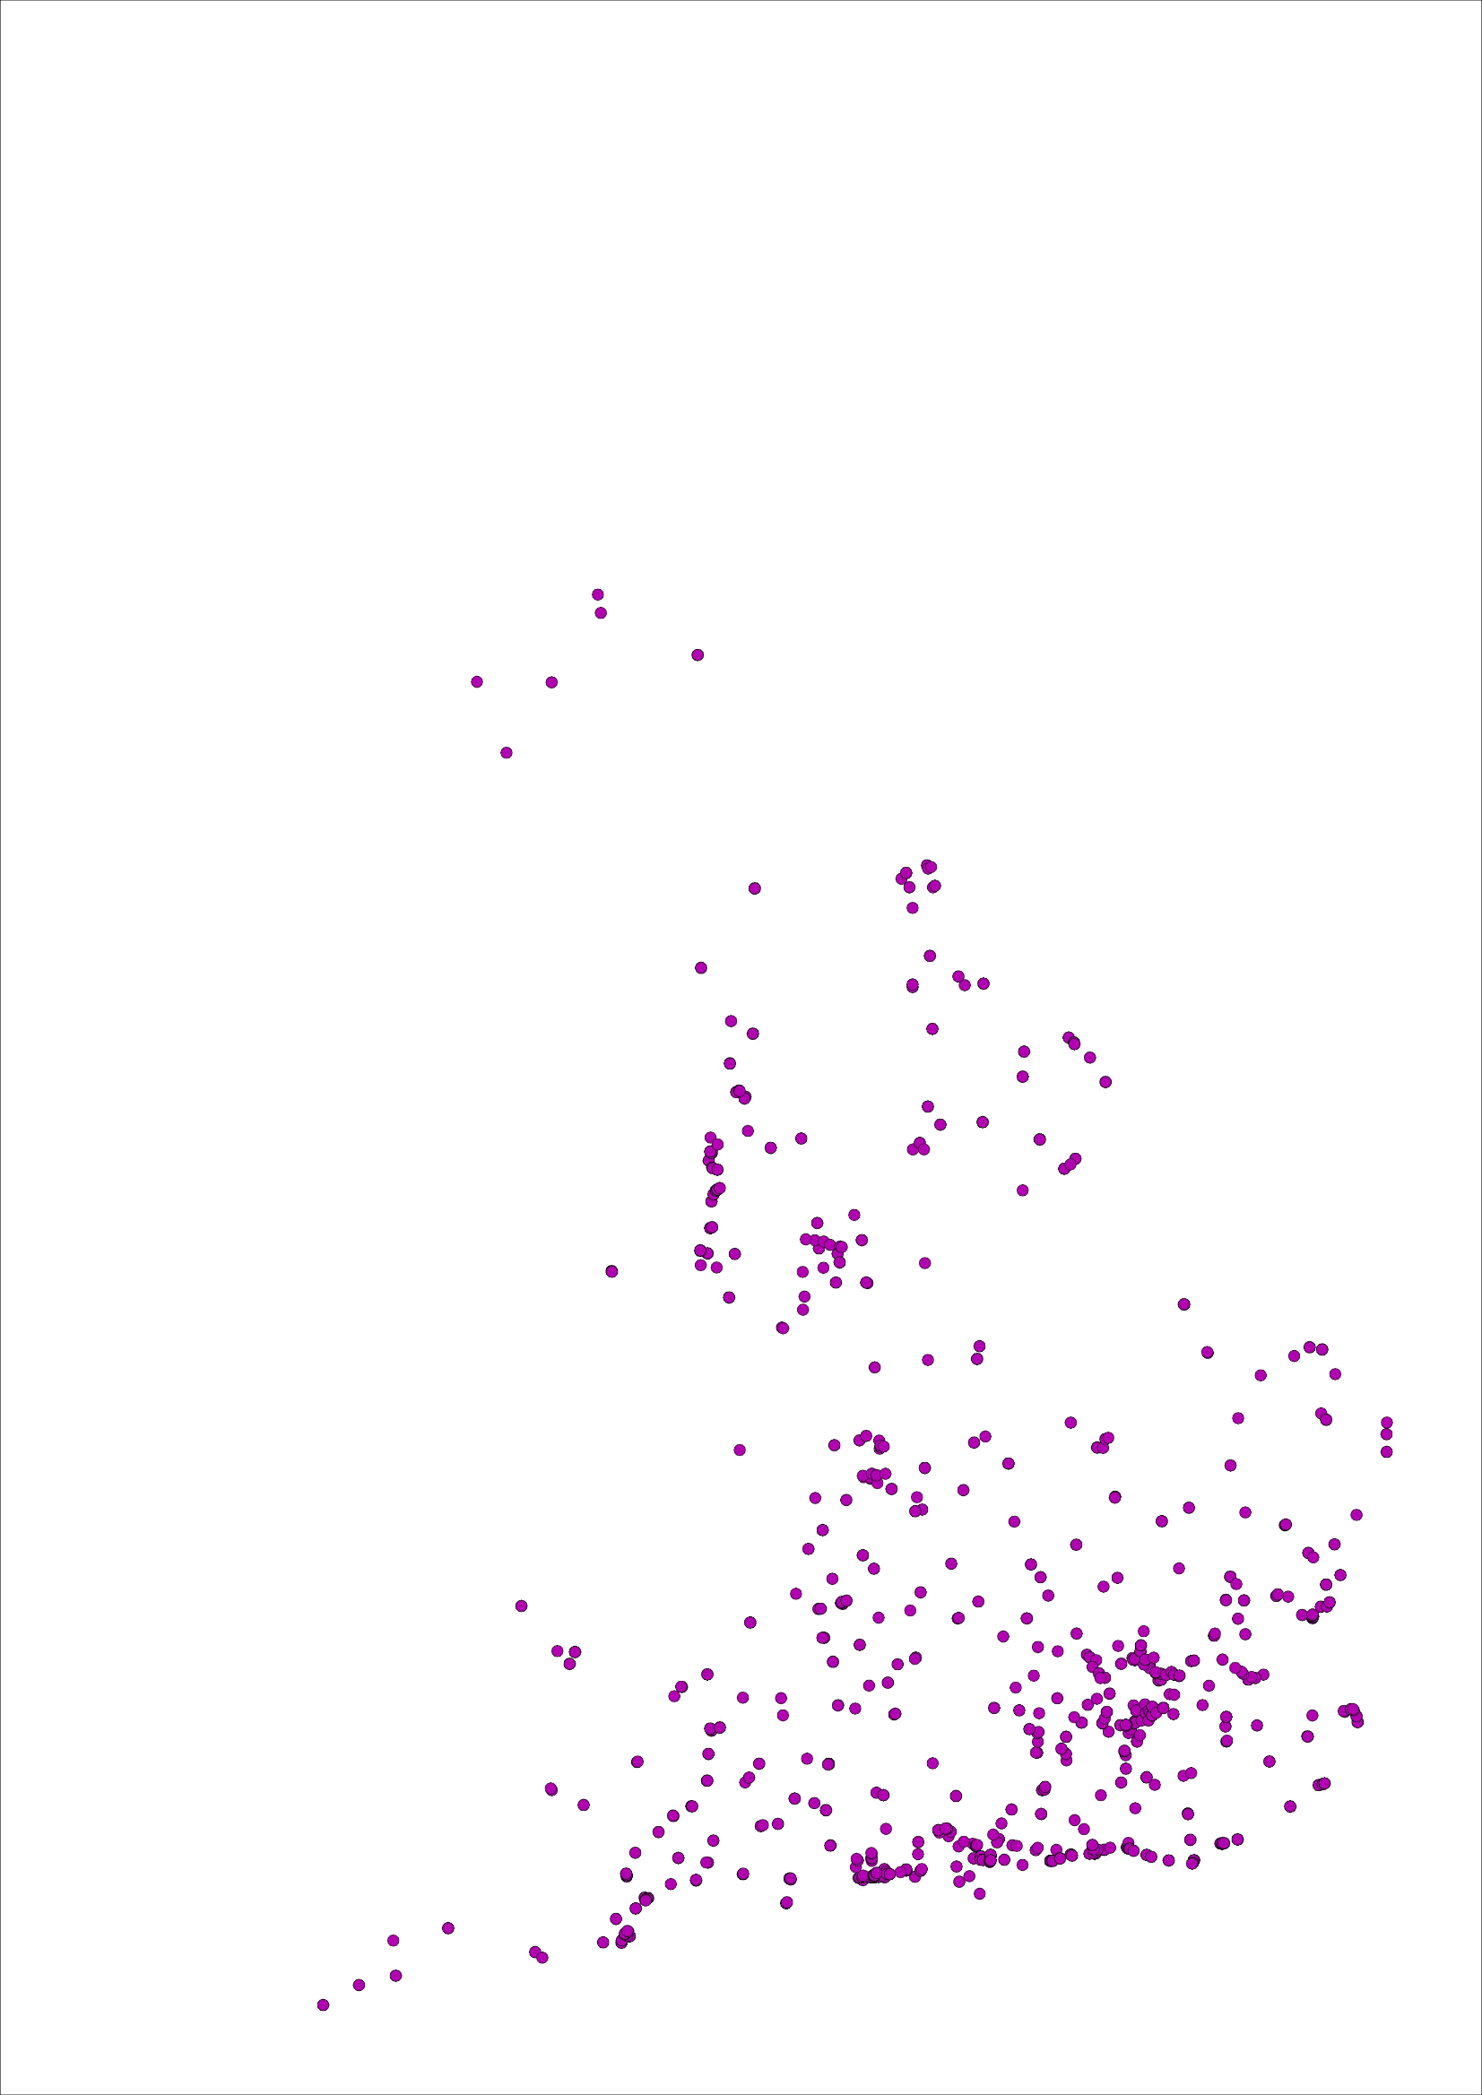
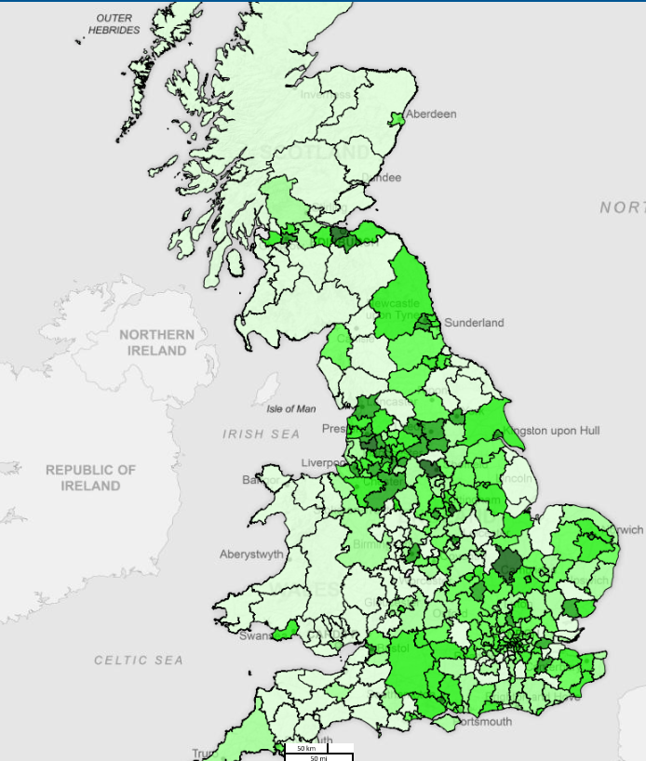
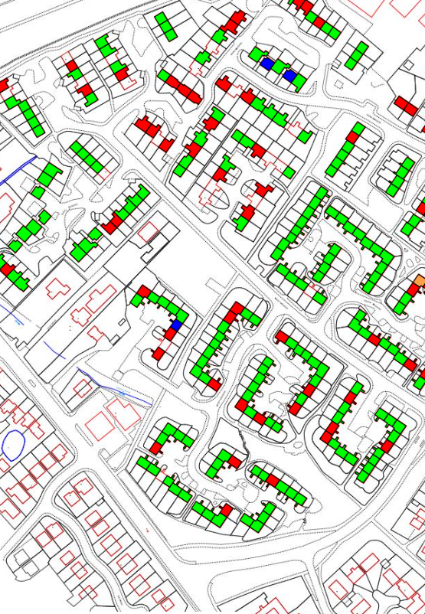
Making It Real
Strategic Planning: asset opportunities and management
17

Slide 18
Enablers and Summary

Slide 19
Summary
VISON AND STRATEGY
Establish a common, shared vision and strategy and set out how the digital and/or data strategy is clearly part of the company vision and strategy.
BUSINESS PARTNERING
Create a programme to formally partner and collaborate with the business functions – start the conversations early and help shape them, facilitates adoption.
WHAT’S THE PROBLEM
Focus on the problem, the business process and the operating model – stay away from technology, technology is the enabler.
PARALLEL DELIVERY
Adopt a flexible delivery approach to deliver analytics and infrastructure with minimum time lag.
MULTIPLE DATA SETS
Valuable insights, patterns and trends come from integrated data sets
Sponsorship
Top down to support the drive and change culture and behaviours, early adopters.
Resource
Analytics and insights is a multi team effort. Built cross-functional collaborations and partnerships to generate adoption: observe, orient, decide and act.
Strategic contractor hires to build the foundations and pass on knowledge

Slide 20
Q&A

Slide 21
Additional Slides

Slide 22
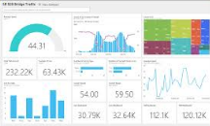
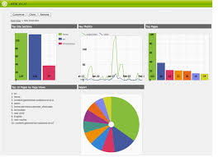
Architecture Overview
How Information Technology Services will enable our goals.
Management Board
GROUP OBJECTIVES AND KPIs
Group Analytics and Insights
Data Dictionary
Enforce Policies
Customer
Insights
?
Data Governance and Management
(Principles, Rules, Standards, Policies)
Asset
Management
Bids and Opportunity
!
Predictive
Maintenance
Property Management
£
Performance
Margin
Map
Transform
Quality Control Cleanse
Sources
Business Unit KPI and Insights
Business Unit KPI and Insights
Business Unit KPI and Insights
Analytics
Insights
Group Language
UNIT
Information and Insights Committee
Data Platform
Harmonised, accurate single data source
Property
Flat
Stock
House
Information Workstream
Leisure Centre
Data Model
Data Workstream
External Data

Slide 23
Our Journey
Data Platform Value
Predictive Analytics Reports
AWS Data Platform
Data Model Extension
Advanced Analytic Reports
AWS Data Platform
Data Model Extension and Group KPIs
Production AWS Data Platform
Basic Analytic Reports
Data Model Extension and Group KPIs
Data Model Extension and Group KPIs
Basic Analytic Reports
Prototype AWS Data Platform
Core Data Model
Infrastructure
Data Management and Governance Set Up
Existing Data Warehouse
Begin Decommission Existing Data Warehouse
Engagement and Communication
Function Pioneer
1st Adopter
Additional Functions
Time

