Slide 1
Unleash your secret weapons
#YSW

Slide 2
Welcome – please get involved!
www.slido.com
#YSW

Slide 3
Hello!
Jo Martin
Deputy Chief Executive
SHAL
Duncan Brown
Director of Finance & Technology
VIVID
#YSW

Slide 4
Some facts and figures
 | A | B
Operating margin | 41% | 45%
Interest cover (EBITDA MRI) | 210% | 221%
Gearing (loan/total assets) | 39% | 50%
Operating cost per unit | £2,977 | £2,816
Homes per FTE | 40 | 37
#YSW

Slide 5
The big reveal…
 | A - SHAL | B - VIVID
Operating margin | 41% | 45%
Interest cover (EBITDA MRI) | 210% | 221%
Gearing (loan/total assets) | 39% | 50%
Operating cost per unit | £2,977 | £2,816
Homes per FTE | 40 | 37
#YSW
#UYSW

Slide 6
The big reveal…
 | A - SHAL | B - VIVID
Operating margin | 41% | 45%
Interest cover (EBITDA MRI) | 210% | 221%
Gearing (loan/total assets) | 39% | 50%
Operating cost per unit | £2,977 | £2,816
Homes per FTE | 40 | 37
Homes in management | 700 | 30,000
#UYSW
#YSW

Slide 7
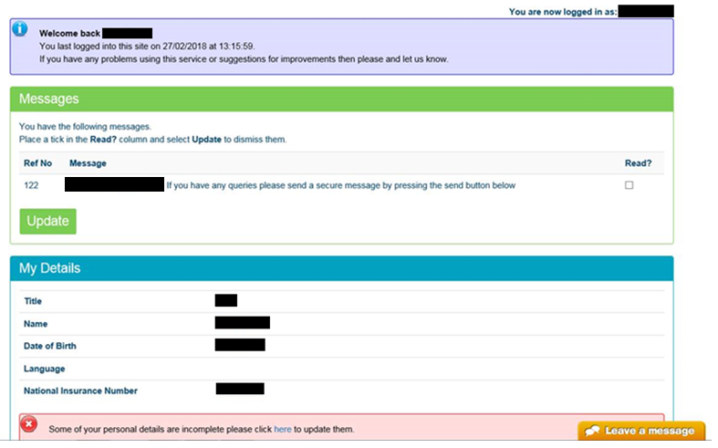
What do our customers see?
#UYSW
#YSW

Slide 8
What do our customers see?
#UYSW
#YSW

Slide 9
How our customers contact us?
#UYSW
#YSW

Slide 10
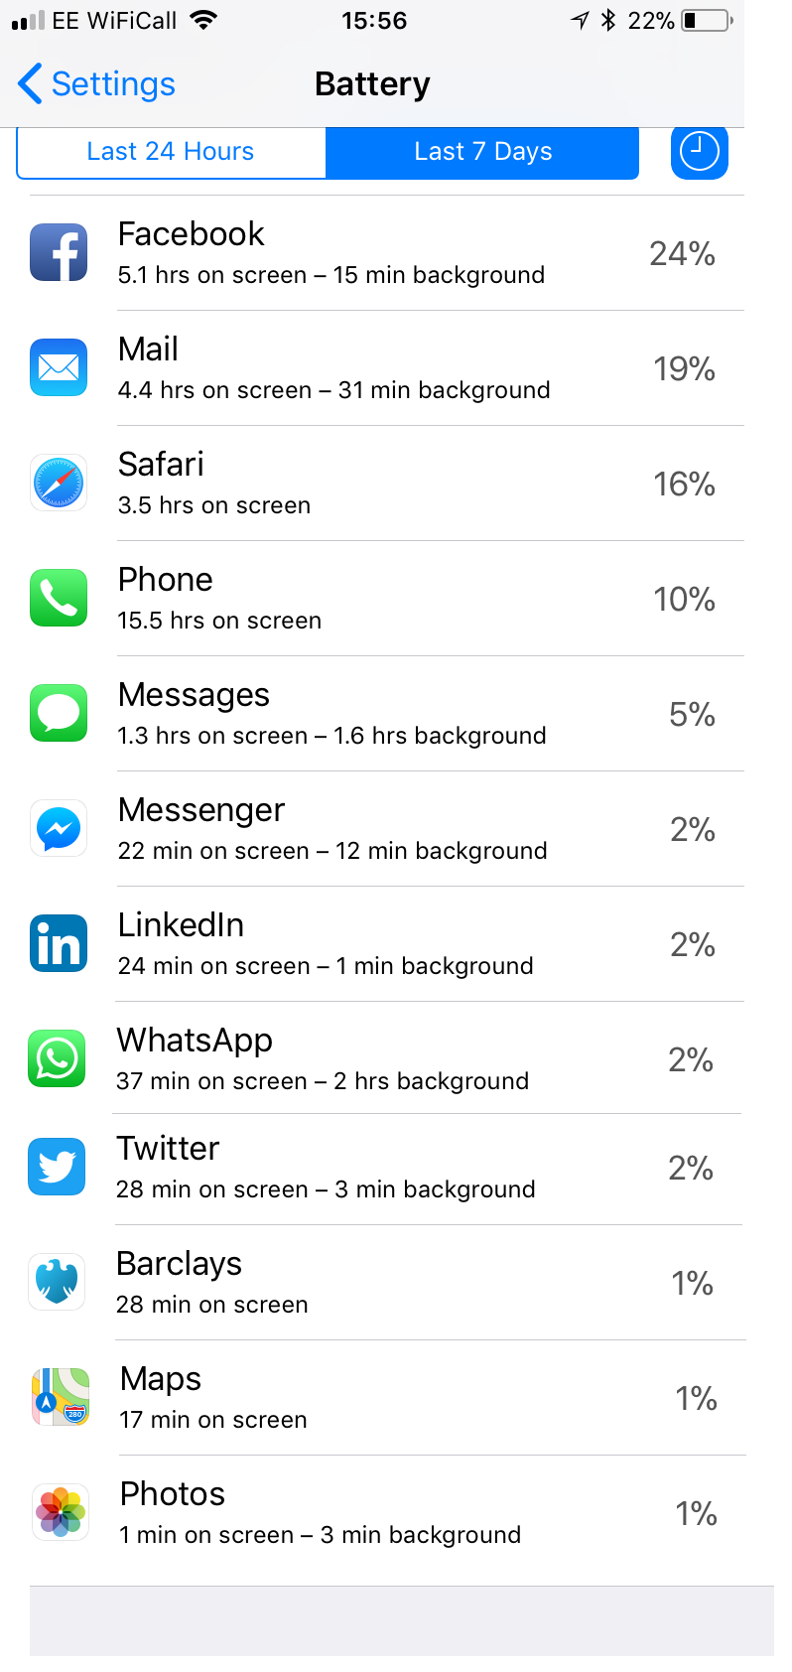
What do we use our mobiles for?
#UYSW
#YSW

Slide 11
Year | Launch | 1964 | 1980 | 1996
1971 | @ | 7 | - | -
1985 | .com | 21 | 5 | -
1991 | www | 27 | 11 | -
1992 | txt | 28 | 12 | -
1995 | Amazon/Ebay | 31 | 15 | -
1996 | Twitter | 32 | 16 | 0
1998 | Google | 34 | 18 | 2
2003 | Skype | 39 | 23 | 7
2004 | Facebook | 40 | 24 | 8
2007 | I-Phone | 43 | 27 | 11
2010 | WhatsApp/Instagram | 46 | 30 | 14
2011 | Snapchat | 47 | 31 | 15
2015 | Periscope | 51 | 35 | 19
2020 | Voice Recognition | 56 | 40 | 24

Slide 13
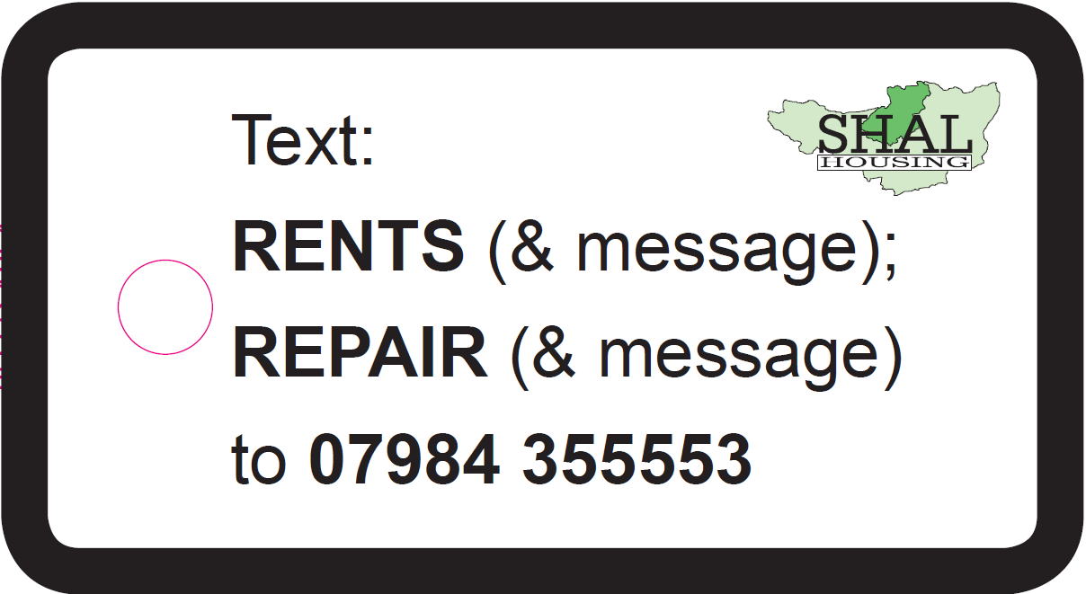
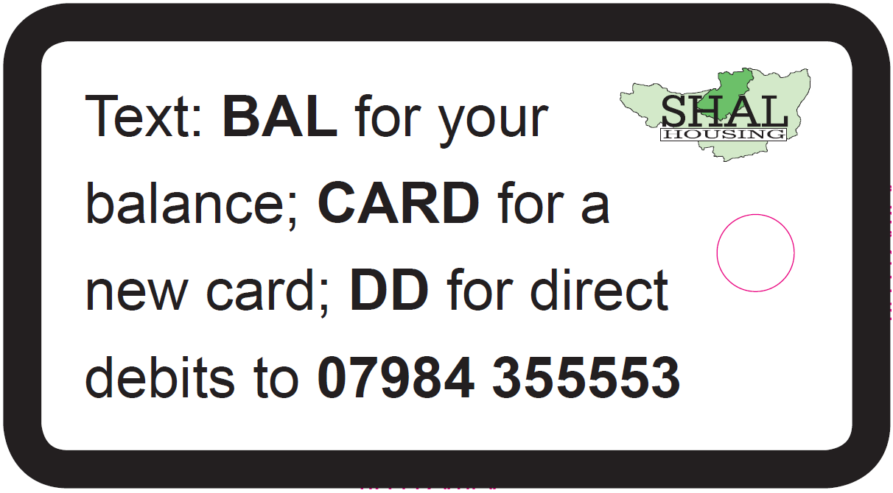
Our text services
#UYSW
#YSW

Slide 14
Working patterns
#UYSW
#YSW

Slide 15
Working patterns
#UYSW
#YSW

Slide 16
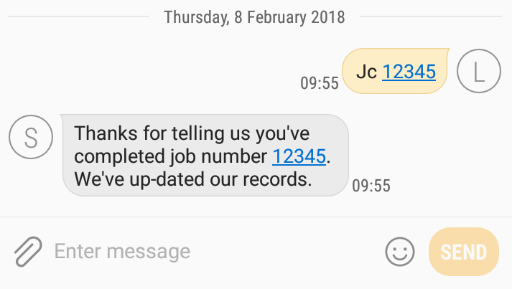
our suppliers are working with us
#UYSW
#YSW

Slide 17
Unleash your secret weapons
Secret weapons
People
Data
Time
#UYSW
#YSW

Slide 18
What did you think?
#YSW
If you could sum up the session in one word what would it be?
#UYSW
#YSW

